Slide 1
Agency Costs, Risk Management, and Capital Structure
HAYNE E. LELAND
報告人:傅祥恩

Slide 2
Introduction

Slide 3
1. Introduction
Financial economics has a rich literature analyzing the capital structure decision in qualitative terms. But it has provided relatively little specific guidance.
Two insights have profoundly shaped the development of capital structure theory.
Modigliani and Miller (M-M) (1958, 1963)
The optimal amount of debt balances the tax deductions provided by interest payments against the external costs of potential default.
Jensen and Meckling (J-M) (1976)
The "asset substitution" problem creates agency costs that the choice of capital structure must recognize and control .

Slide 4
1. Introduction
Past research falls short in two critical dimensions:
The two approaches have not been fully integrated. Although higher risk may transfer value from bondholders, it may also limit the ability of the firm to reduce taxes through leverage.
The pricing of risky debt.
Kim, Ramaswamy, and Sundaresan (1993) and Longstaff and Schwartz (1995) provide bond pricing with credit risk.
Leland (1994a, 1994b) and Leland and Toft (1996) consider optimal static capital structure.
Goldstein, Ju, and Leland (1997) develop closed-form solutions for debt value when debt can be dynamically restructured .

Slide 5
1. Introduction
This paper seeks to encompass elements of both the M-M and J-M approaches to optimal capital structure in a unified framework.
The model reflects the interaction of financing decisions and investment risk strategies.
When investment policies are chosen to maximize equity value after (i.e., ex post) debt is in place, stockholder-bondholder conflicts will lead to agency costs as in J-M. The initial capital structure choice, made ex ante, will balance agency costs with the tax benefits of debt less default costs.

Slide 6
1. Introduction
The paper focuses on two interrelated sets of questions:
How does ex post flexibility in choosing risk affect optimal capital structure? In particular, how do leverage, debt maturity, and yield spreads depend on risk flexibility?
How does the presence of debt distort a firm's ex post choice of risk? At the optimal capital structure and risk choices, how large are agency costs?

Slide 7
2. The Model

Slide 8
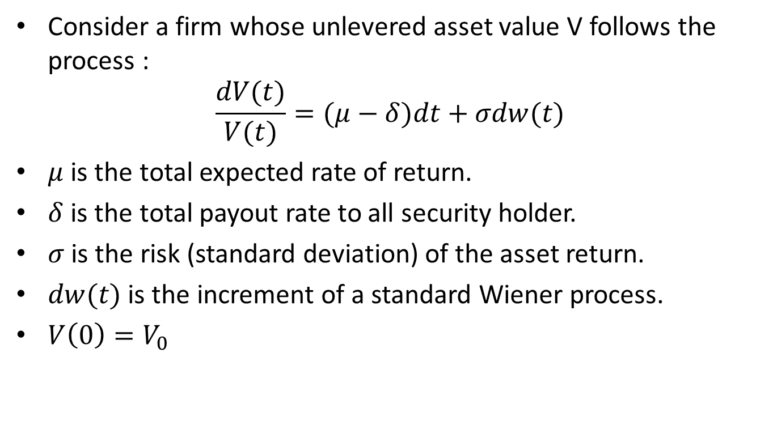
Asset Value
Consider a firm whose unlevered asset value V follows the process :
$$\frac{dV(t)}{V(t)}=(μ−δ)dt+σdw(t)$$
$μ$ is the total expected rate of return.
$δ$ is the total payout rate to all security holder.
$σ$ is the risk (standard deviation) of the asset return.
$dw(t)$ is the increment of a standard Wiener process.
$V\left(0\right)=V_{0}$
Notes:
The value V represents the value of the net cash flows generated by the firm's activities. It is assumed that these cash flows are spanned by the cash flows of marketed securities.
A risk-free asset exists that pays a constant continuously compounded rate of interest r.

Slide 9
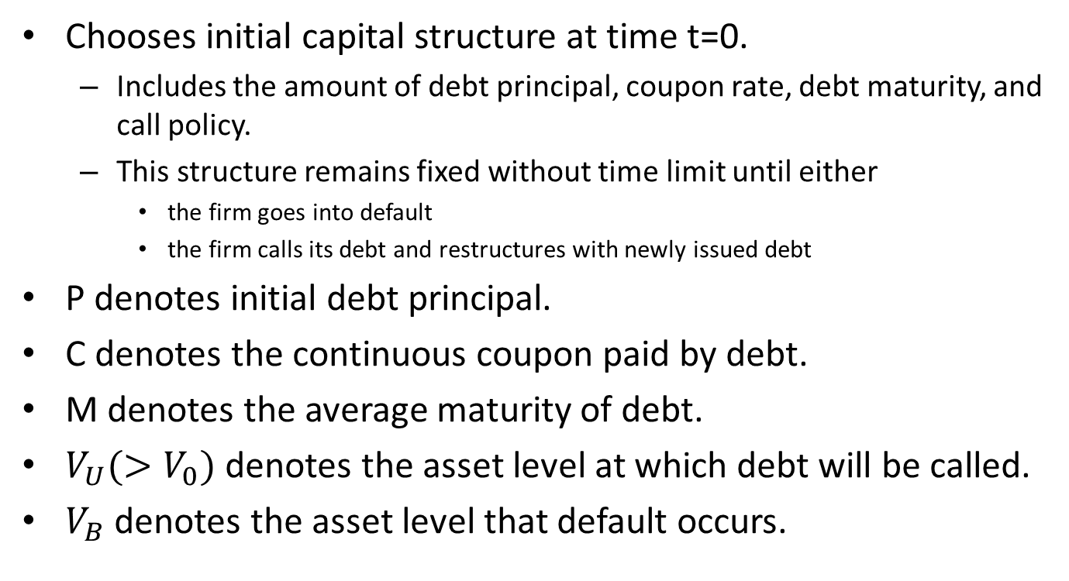
Initial Debt Structure
Chooses initial capital structure at time t=0.
Includes the amount of debt principal, coupon rate, debt maturity, and call policy.
This structure remains fixed without time limit until either
the firm goes into default
the firm calls its debt and restructures with newly issued debt
P denotes initial debt principal.
C denotes the continuous coupon paid by debt.
M denotes the average maturity of debt.
$V_{U}(>V_{0})$ denotes the asset level at which debt will be called.
$V_{B}$ denotes the asset level that default occurs.

Slide 10
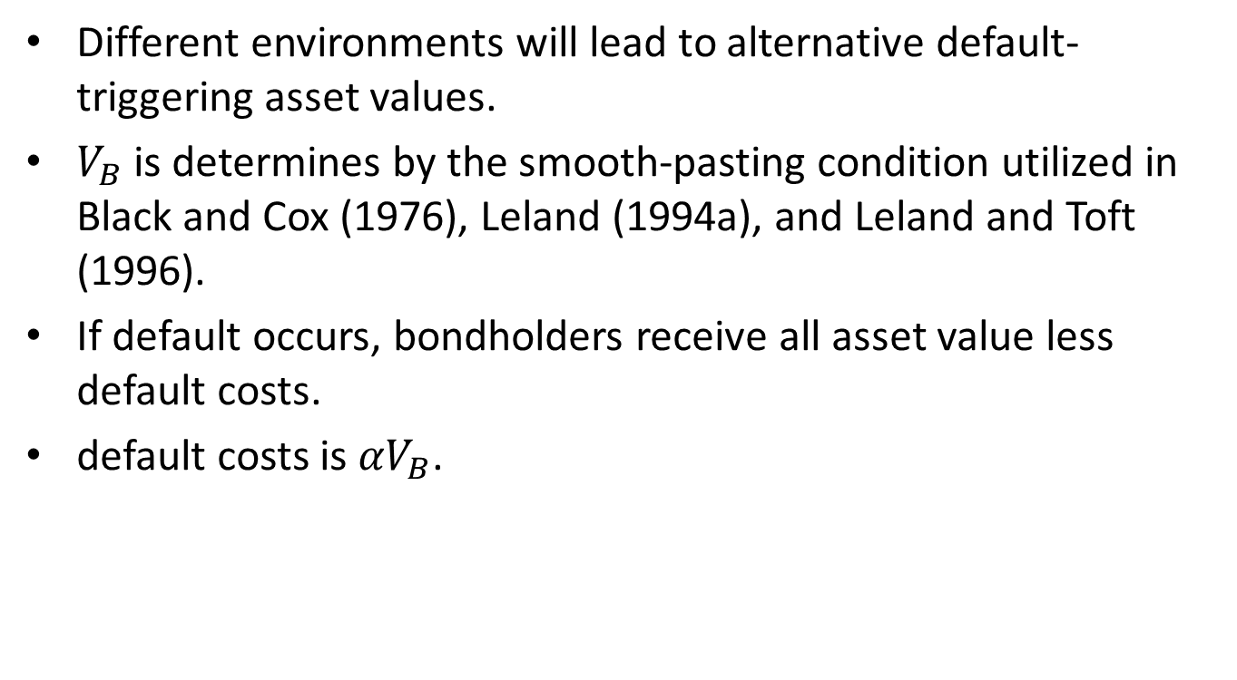
Initial Debt Structure
Different environments will lead to alternative default-triggering asset values.
$V_{B}$ is determines by the smooth-pasting condition utilized in Black and Cox (1976), Leland (1994a), and Leland and Toft (1996).
If default occurs, bondholders receive all asset value less default costs.
default costs is ${αV}_{B}$.

Slide 11
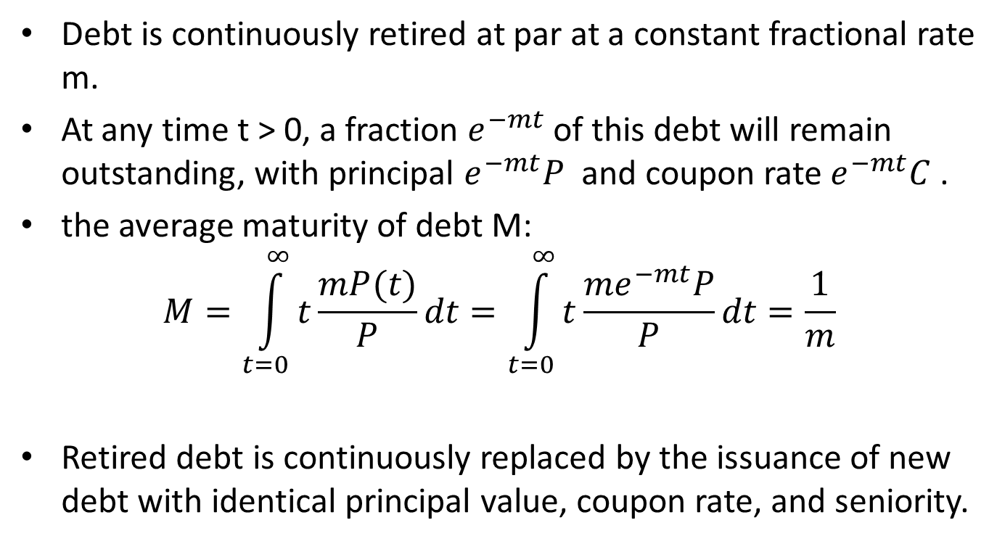
Initial Debt Structure
Debt is continuously retired at par at a constant fractional rate m.
At any time t > 0, a fraction $e^{−mt}$ of this debt will remain outstanding, with principal $e^{−mt}P$ and coupon rate $e^{−mt}C$ .
the average maturity of debt M:
$$M=\int_{t=0}^{∞}{t\frac{mP(t)}{P}dt}=\int_{t=0}^{∞}{t\frac{{me}^{−mt}P}{P}dt}=\frac{1}{m}$$
Retired debt is continuously replaced by the issuance of new debt with identical principal value, coupon rate, and seniority.

Slide 12

Capital Restructuring
When V(t) reaches $V_{U}$ without prior default, debt will be retired at par value and a new debt will be issued as in Goldstein et al. (1997).
P, C, $V_{B}$, and $V_{U}$ will be scaled up by the same proportion $ρ$, where $ρ$ = $V_{U}$/ $V_{0}$

Slide 13
3. Ex Post Selection of Risk and Agency Costs

Slide 14
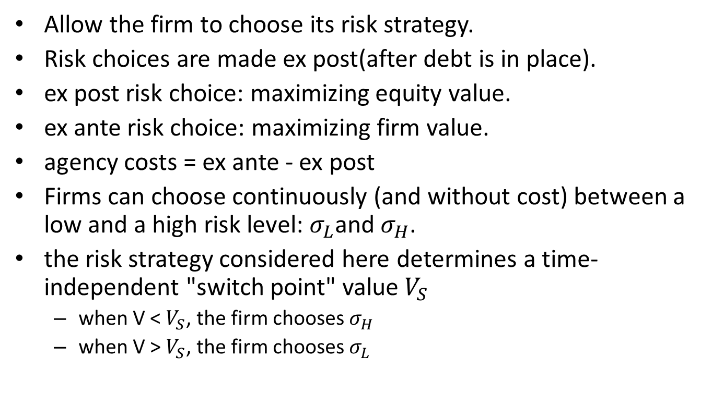
3. Ex Post Selection of Risk and Agency Costs
Allow the firm to choose its risk strategy.
Risk choices are made ex post(after debt is in place).
ex post risk choice: maximizing equity value.
ex ante risk choice: maximizing firm value.
agency costs = ex ante - ex post
Firms can choose continuously (and without cost) between a low and a high risk level: $σ_{L}$and $σ_{H}$.
the risk strategy considered here determines a time-independent "switch point" value $V_{S}$
when V < $V_{S}$, the firm chooses $σ_{H}$
when V > $V_{S}$, the firm chooses $σ_{L}$

Slide 15

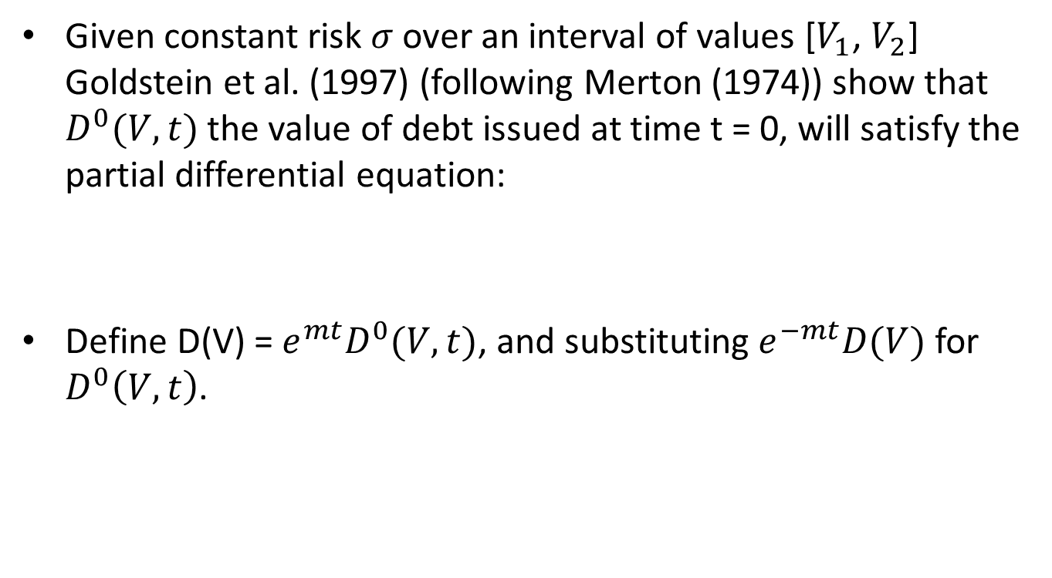
A. Debt Value D
Given constant risk $σ$ over an interval of values [$V_{1}$, $V_{2}$] Goldstein et al. (1997) (following Merton (1974)) show that $D^{0}(V,t)$ the value of debt issued at time t = 0, will satisfy the partial differential equation:
Define D(V) = $e^{mt}D^{0}(V,t)$, and substituting $e^{−mt}D(V)$ for $D^{0}\left(V,t\right)$.

Slide 16

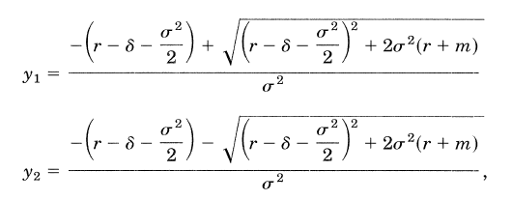

A. Debt Value D
With general solution:
where
$a(a_{1},a_{2})$is determined by the boundary conditions at ${V=V}_{1}$and ${V=V}_{2}$.

Slide 17
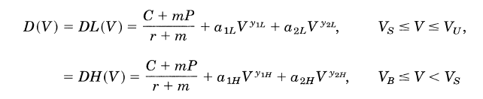

A. Debt Value D
The risk strategy characterized by $V_{s}$ specifies
$σ=σ_{L}$ when $V_{S}≤V≤V_{U}$,
$σ=σ_{H}$ when$V_{B}≤V<V_{S}$

Slide 18




A. Debt Value D
At restructuring, debt is called at par.
At default, debt receives asset value less the default costs.
Value matching and smoothness conditions at ${V=V}_{S}$

Slide 19



A. Debt Value D

Slide 20
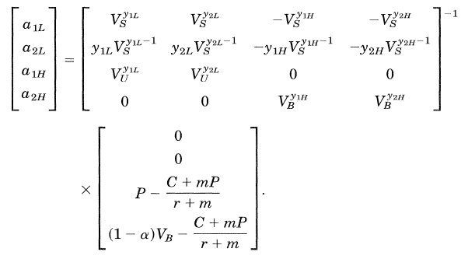
A. Debt Value D

Slide 21


B. Firm Value, Equity Value, and Endogenous Bankruptcy
Firm value $v$ is:
TB is tax benefits from debt.
BC is potential default cost.
TC is costs of debt issuance.

Slide 22

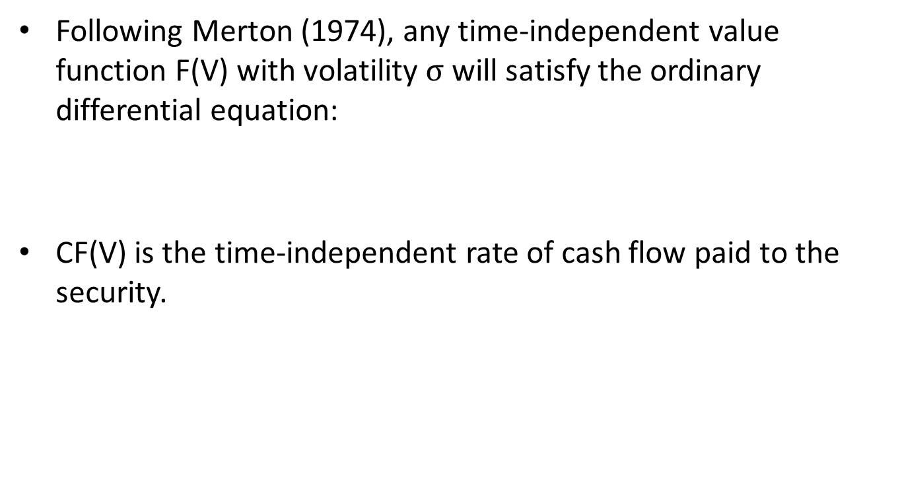
B. Firm Value, Equity Value, and Endogenous Bankruptcy
Following Merton (1974), any time-independent value function F(V) with volatility $σ$ will satisfy the ordinary differential equation:
CF(V) is the time-independent rate of cash flow paid to the security.

Slide 23


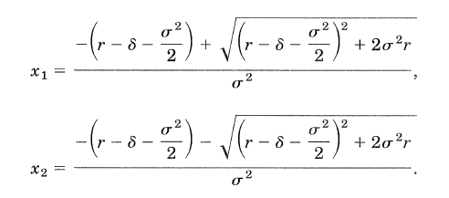
B. Firm Value, Equity Value, and Endogenous Bankruptcy
The solution:
Where

Slide 24




B.1. The Value of Tax Benefits TB
$τ$ is tax rate
C is interest payment
$λ$ is cash flow rate
$λV$ is EBIT
$V_{T}=C/λ$
Assume

Slide 25
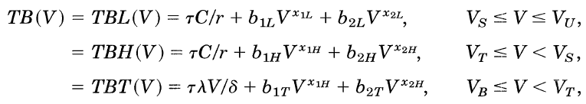





B.1. The Value of Tax Benefits TB
Boundary conditions:

Slide 26




B.2. The Value of Default Costs BC
There is no continuous cash flow associated with default costs
$CF=0$
Boundary conditions:
${BCL}_{V}\left(V_{S}\right)={BCH}_{V}(V_{S})$
$BCL\left(V_{S}\right)=BCH(V_{S})$

Slide 27
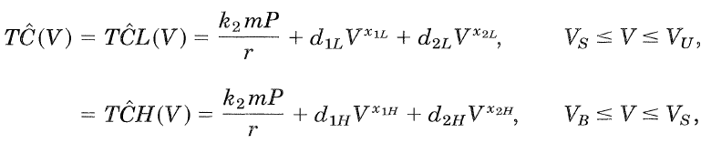



B.3. The Value of Debt Issuance Costs
Boundary conditions:
${T\hat{C}L}_{V}\left(V_{S}\right)= {T\hat{C}H}_{V}(V_{S})$
$T\hat{C}L\left(V_{S}\right)=T\hat{C}H(V_{S})$
$k_{1}$ is restructuring cost
$k_{2}$ is continuous issuance cost

Slide 28
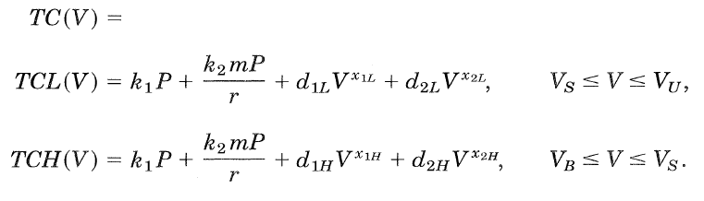
B.3. The Value of Debt Issuance Costs

Slide 29
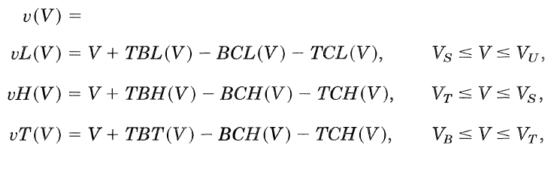
B.4. Firm Value v

Slide 30
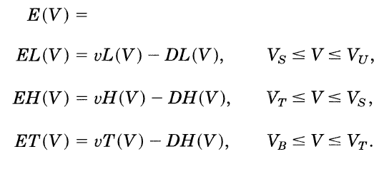
B.5. Equity Value and Endogenous Bankruptcy

Slide 31


B.5. Equity Value and Endogenous Bankruptcy
$V_{B}$is chosen endogenously ex post to maximize the value of equity at ${V=V}_{B}$, given the limited liability of equity and the debt structure $X= (C,P,m,V_{U})$in place. This requires the smooth pasting condition

Slide 32



C. The Choice of the Optimal Risk Switching Value
When the risk switching point can be committed ex ante, the firm will maximize the initial value of the firm:
subject to

Slide 33
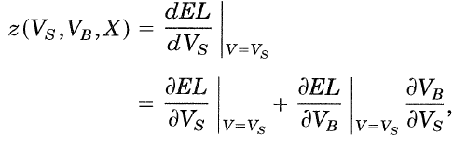

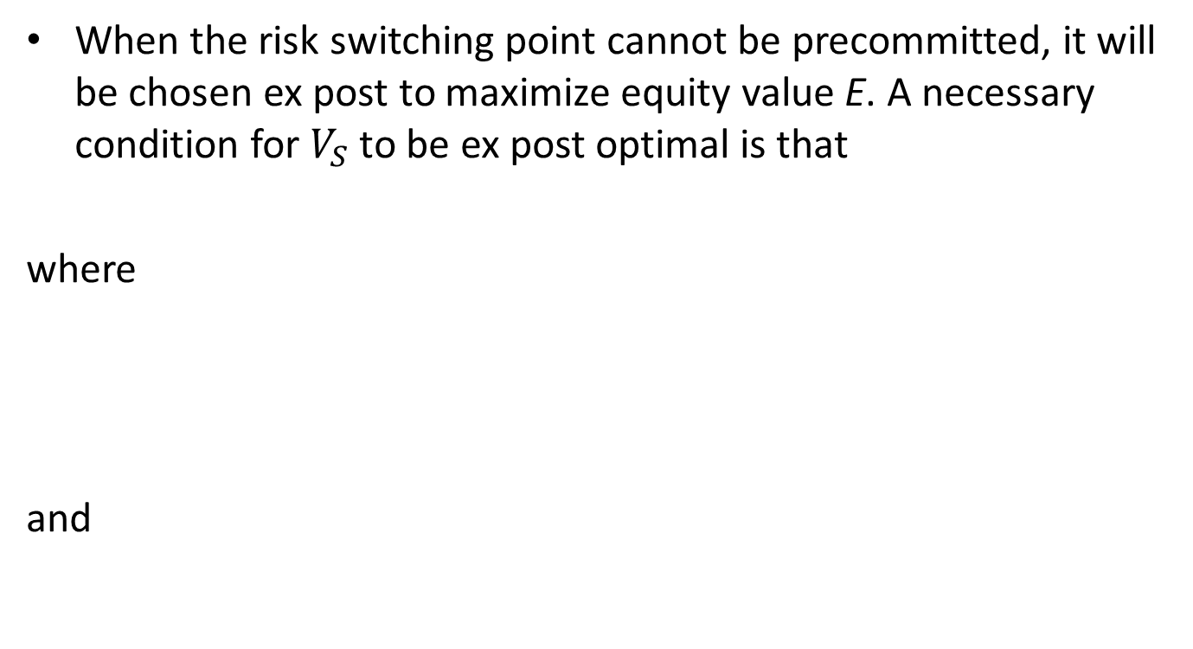
C. The Choice of the Optimal Risk Switching Value
When the risk switching point cannot be precommitted, it will be chosen ex post to maximize equity value E. A necessary condition for $V_{S}$ to be ex post optimal is that
where
and

Slide 34


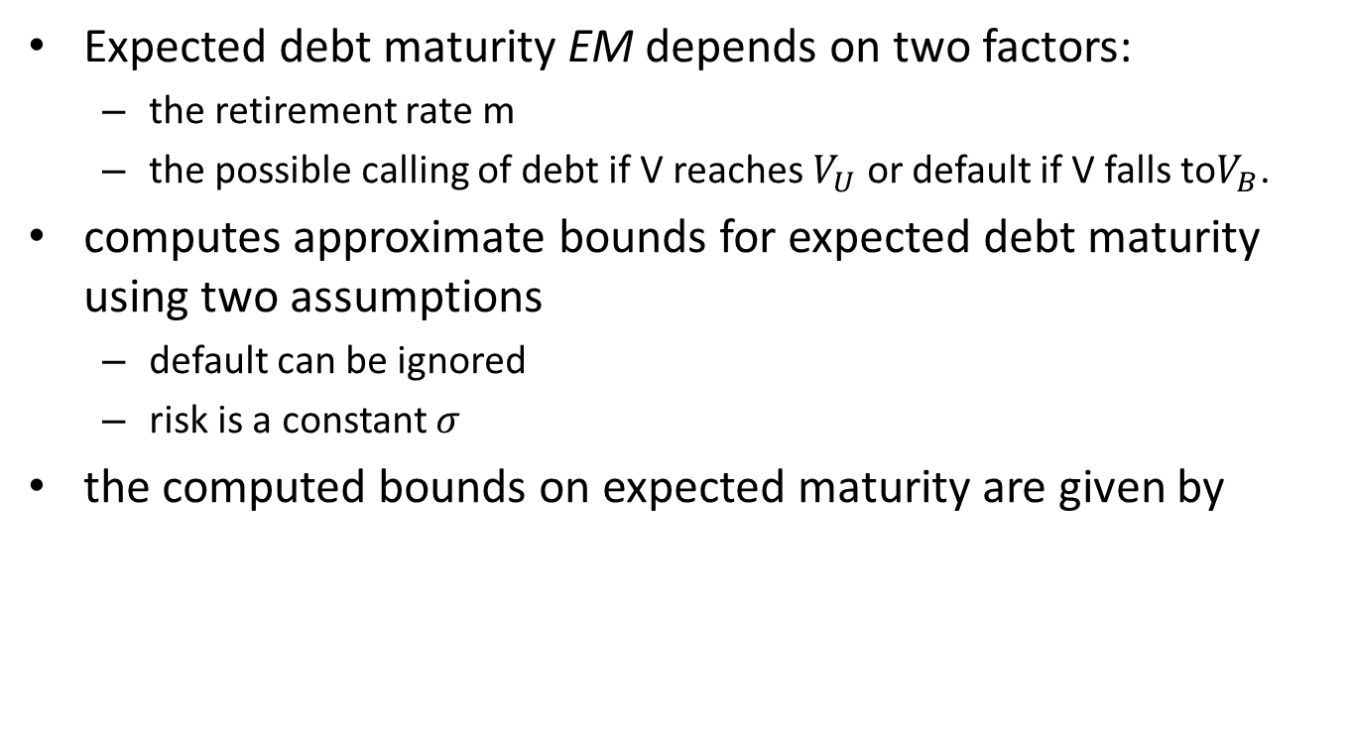
D. The Expected Maturity of Debt
Expected debt maturity EM depends on two factors:
the retirement rate m
the possible calling of debt if V reaches $V_{U}$ or default if V falls to$V_{B}$.
computes approximate bounds for expected debt maturity using two assumptions
default can be ignored
risk is a constant $σ$
the computed bounds on expected maturity are given by
Notes:
the likelihood of restructuring far exceeds the likelihood of default
average risk is bounded above by $σ_{H}$ and below by $σ_{L}$
EM($σ$) is monotonic in risk $σ$ for the range of parameters considered

Slide 35
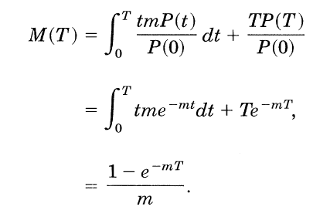
D. The Expected Maturity of Debt
the average maturity of debt M(T), if debt is called at par at time T, is given by

Slide 36


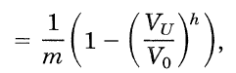


D. The Expected Maturity of Debt
The call time T is given by
where $b=log⁡(V_{U}/V_{0})$
Expected maturity of the debt, therefore, is given by
where

Slide 37
4. The Significance of Agency Costs

Slide 38
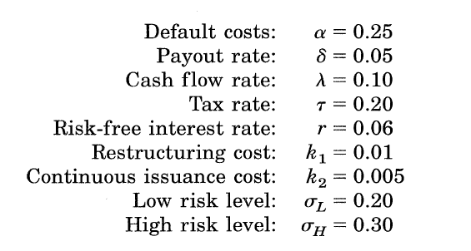
4. The Significance of Agency Costs

Slide 39
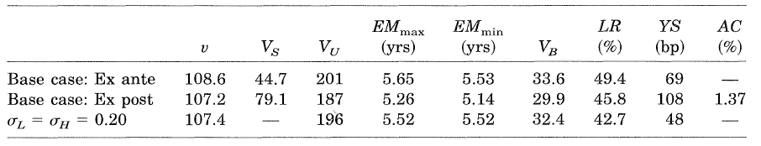
4. The Significance of Agency Costs
LR is optimal leverage
YS is yield spread
AC is agency cost

Slide 40
4. The Significance of Agency Costs
Leverage rises relative to the firm with no risk flexibility.

Slide 41
4. The Significance of Agency Costs
Capital structure shifts in the presence of agency costs.
Leverage, restructure level and expected maturity decrease relative to the ex ante case.

Slide 42
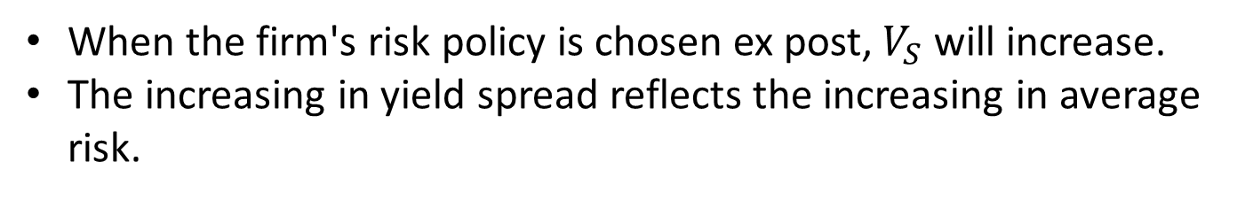
4. The Significance of Agency Costs
When the firm's risk policy is chosen ex post,$V_{S}$ will increase.
The increasing in yield spread reflects the increasing in average risk.

Slide 43
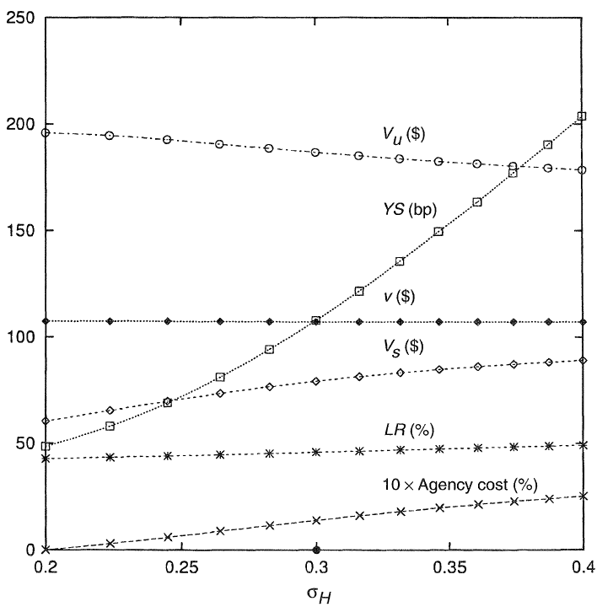

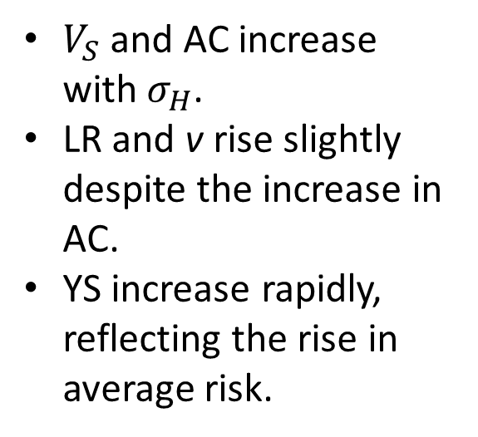
Change $σ_{H}$
$V_{S}$ and AC increase with $σ_{H}$.
LR and v rise slightly despite the increase in AC.
YS increase rapidly, reflecting the rise in average risk.

Slide 44
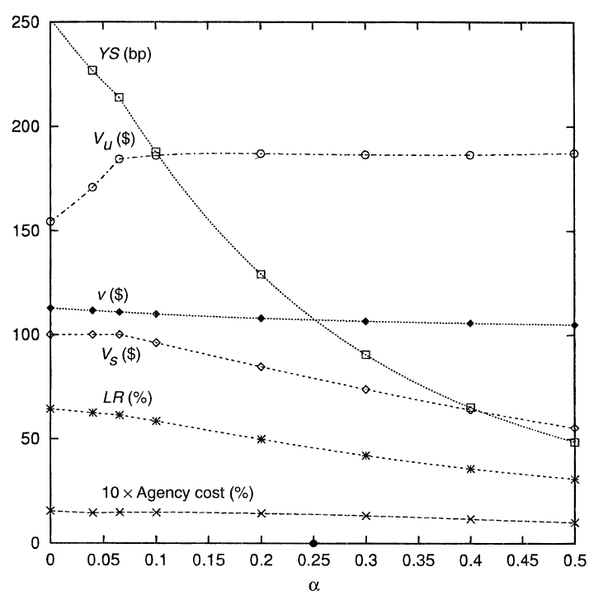

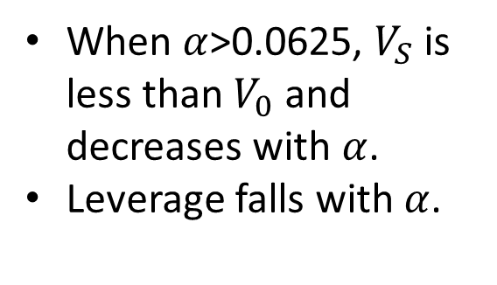
Change $α$
When $α$>0.0625, $V_{S}$ is less than $V_{0}$ and decreases with $α$.
Leverage falls with $α$.
Notes:
Higher default costs imply lower average risk

Slide 45
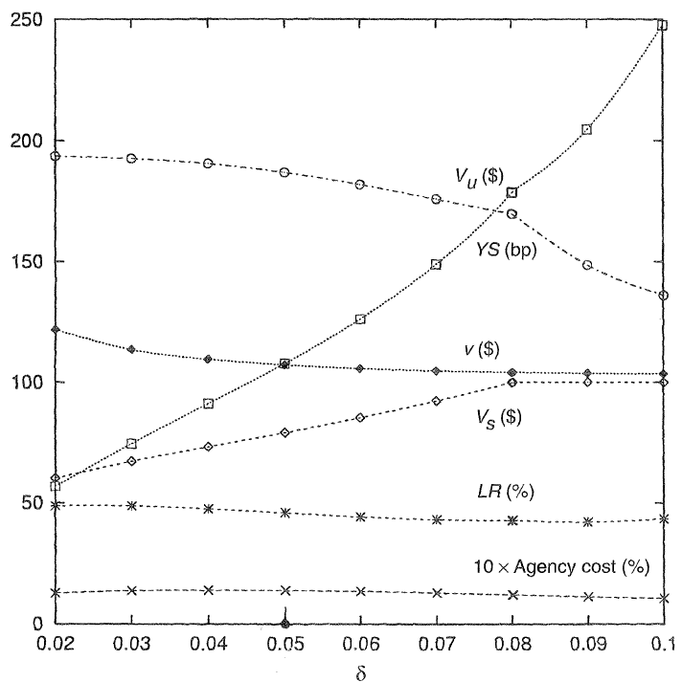
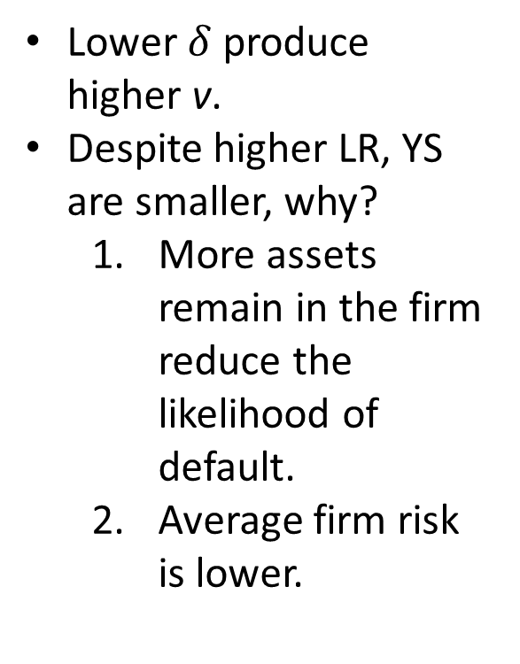

Change $δ$
Lower $δ$ produce higher v.
Despite higher LR, YS are smaller, why?
More assets remain in the firm reduce the likelihood of default.
Average firm risk is lower.

Slide 46
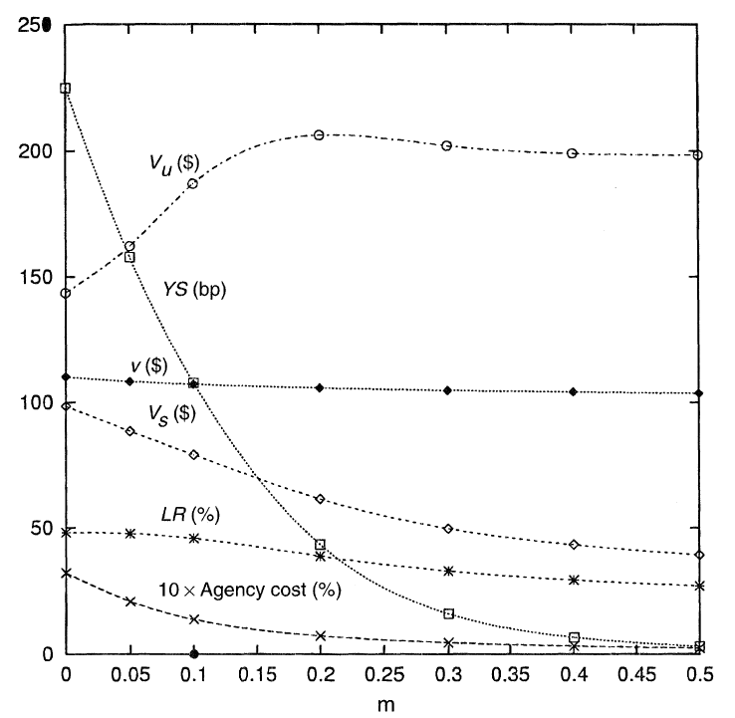
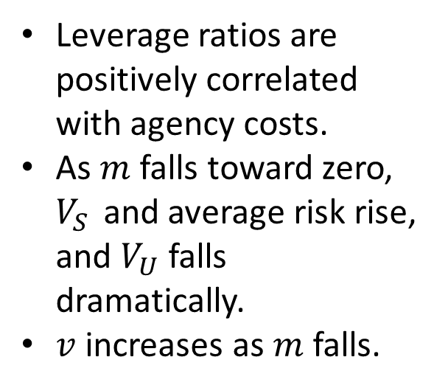

Change $m$
Leverage ratios are positively correlated with agency costs.
As $m$ falls toward zero, $V_{S}$ and average risk rise, and $V_{U}$falls dramatically.
$v$ increases as $m$ falls.

Slide 47
5. Risk Management

Slide 48
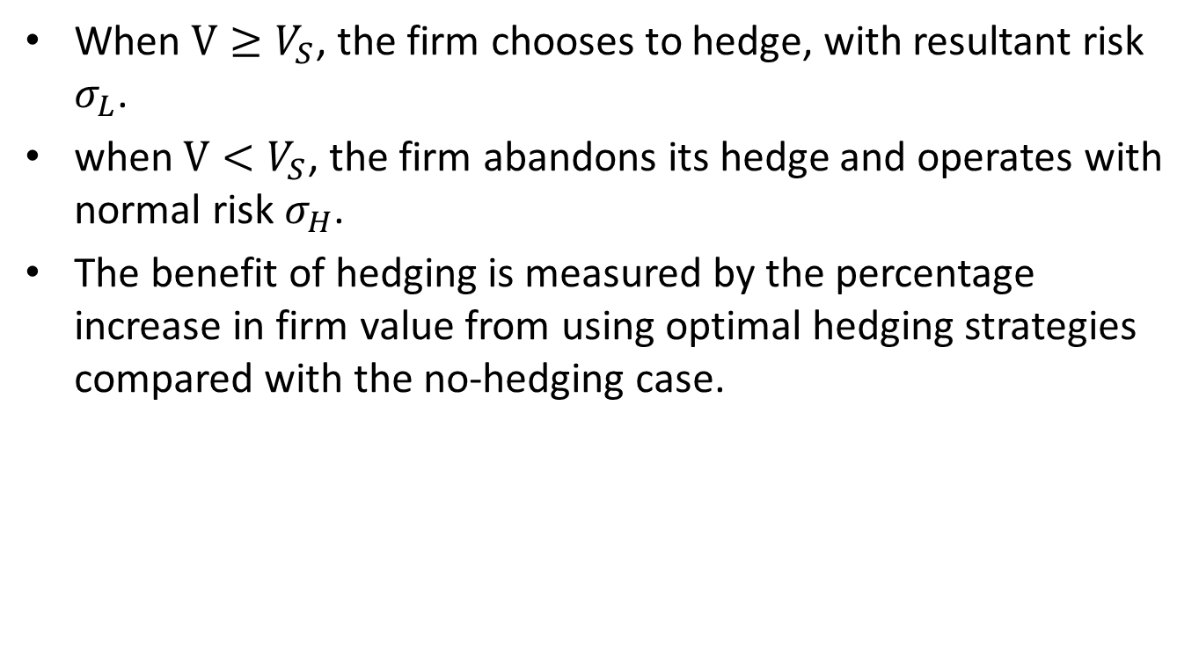
5. Risk Management
When $V≥V_{S}$, the firm chooses to hedge, with resultant risk $σ_{L}$.
when $V<V_{S}$, the firm abandons its hedge and operates with normal risk $σ_{H}$.
The benefit of hedging is measured by the percentage increase in firm value from using optimal hedging strategies compared with the no-hedging case.

Slide 49
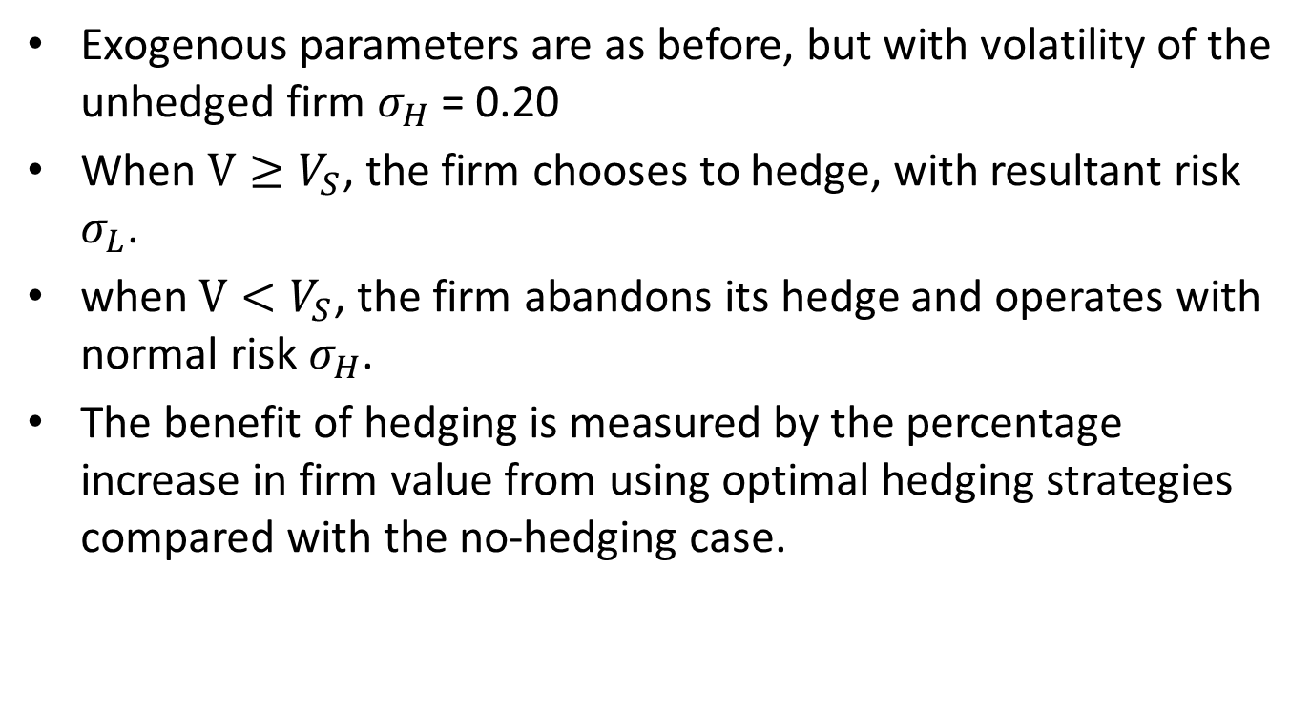
Example
Exogenous parameters are as before, but with volatility of the unhedged firm $σ_{H}$ = 0.20
When $V≥V_{S}$, the firm chooses to hedge, with resultant risk $σ_{L}$.
when $V<V_{S}$, the firm abandons its hedge and operates with normal risk $σ_{H}$.
The benefit of hedging is measured by the percentage increase in firm value from using optimal hedging strategies compared with the no-hedging case.

Slide 50
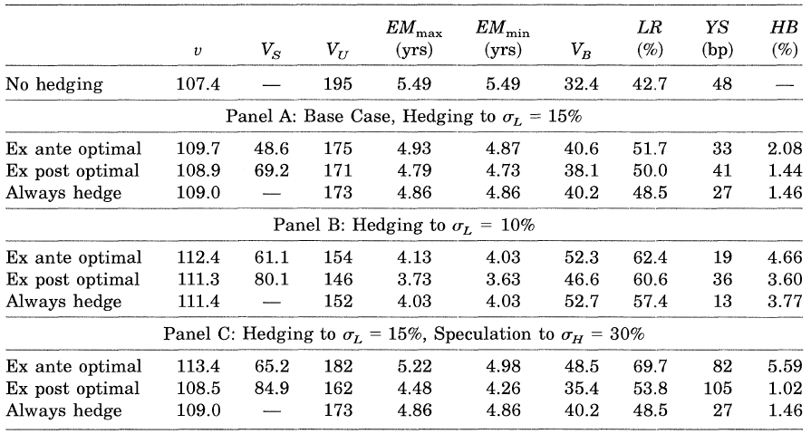
Example

Slide 51
Example
Benefits in Panel B > Benefits in Panel A , these gains result principally from the fact that lower average volatility allows higher leverage.

Slide 52
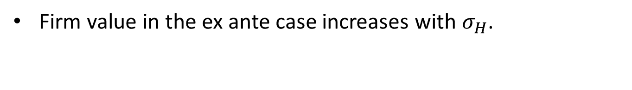
Example
Firm value in the ex ante case increases with $σ_{H}$.

Slide 53
Example
In the ex post case, the net benefits to hedging are substantially reduced because the possibility of incurring higher risk creates greater agency cost.

Slide 54
Example
In comparison with the no-hedging case, leverage increases but expected debt maturity falls.

Slide 55
Example
Ex post optimal strategies have both lower leverage and shorter expected debt maturity, in comparison with the ex ante optimal strategies.
Notes:
This again confirms the contention of Myers (1977) and Barnea et al. (1980) that shorter maturity is used to control agency costs.

Slide 56

Comparative Statics
Next table examines optimal ex post risk strategies and optimal capital structure for a range of parameter values, when $σ_{L}$ = 15%.
The table assumes all exogenous parameters remain at their base case levels except for the parameter heading each row.

Slide 57
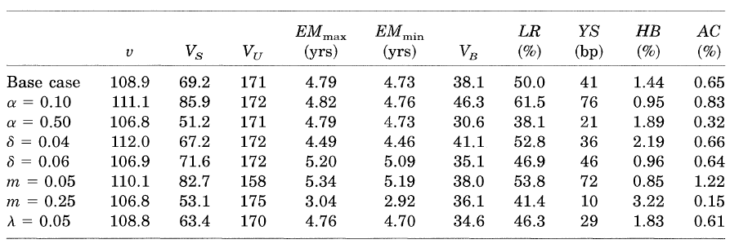
Comparative Statics

Slide 58
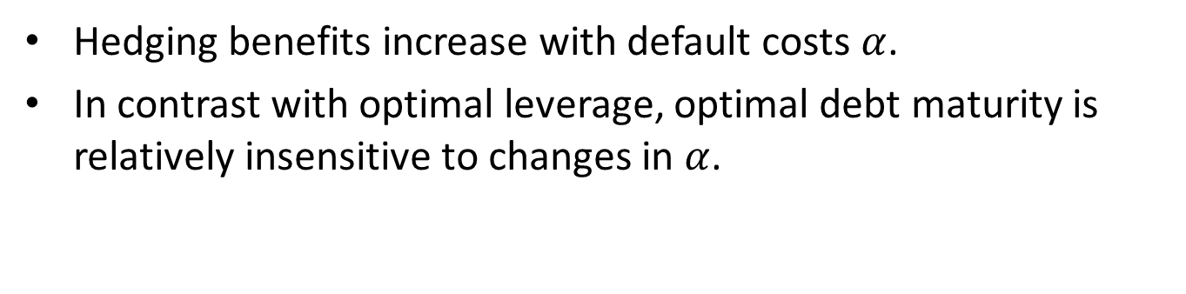
Comparative Statics
Hedging benefits increase with default costs $α$.
In contrast with optimal leverage, optimal debt maturity is relatively insensitive to changes in $α$.

Slide 59
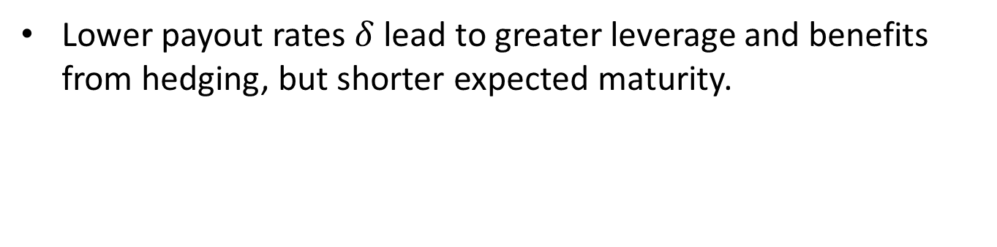
Comparative Statics
Lower payout rates $δ$ lead to greater leverage and benefits from hedging, but shorter expected maturity.

Slide 60

Comparative Statics
Lower retirement rates $m$ lead to greater leverage and expected debt maturity.
Hedging benefits falls dramatically.

Slide 61
Comparative Statics
Smaller EBIT reduces the potential for interest payments to shelter taxable income, and maximal value decreases slightly.
With smaller EBIT, taxes become a more convex function of asset value. Greater convexity means that expected taxes will be reduced more by hedging. Thus the benefits to hedging are larger.

Slide 62
Comparative Statics
Agency costs and the benefits to hedging are inversely related in many cases.
These results challenge the presumption that greater agency costs necessarily imply greater benefits to hedging.

Slide 63
6. Conclusion

Slide 64
6. Conclusion
The model provides quantitative guidance.
In ex post case,
the firm will choose a strategy with higher average risk.
leverage will be lower and debt maturity will be shorter.
yield spreads rise as the potential for asset substitution increases.
Asset substitution will occur even when there are no agency costs.
Agency costs may not be positively associated with optimally chosen levels of leverage.
Notes:
on the amount and maturity of debt, on financial restructuring, and on the firm's optimal risk strategy.
Figure2 p44

Slide 65
6. Conclusion
The model is restrictive in a number of dimensions
Managers are assumed to behave in shareholders' interests.
Dividend policies and investment scale are treated as exogenous.
Information asymmetries are ignored.

