Slide 1
Carpenter_2010_Optimal-exercise-of-executive-stock-options-and-implications-for-firm-cost
教授:戴天時
學生:劉易洲

Slide 2
Introduction
薪水(現金)
股票
選擇權(ESO)

Slide 3
Introduction
(發現問題)
Evidence indicates that both executives and other employees exercise options well before standard theory would predict.
Our paper is the first to provide analytical results on option cost, average life, and the nature of the continuation region for an executive with general concave utility

Slide 4
General framework
In particular, options are explicitly nontransferable and Section 16-c of the Securities Exchange Act prohibits corporate insiders from taking short positions in their company’s stock. However, these constraints on hedging mean that standard American option valuation theory does not apply.
However, evidence that the vast majority of options are exercised well before expiration, even when no dividend is present, suggests that option holders still face significant hedging constraints

Slide 5
General framework
Although we refer to the option holder as an executive, our formulation of the problem could apply equally well to lower-ranked employees. Noninsiders are not subject to Section 16-c short sales restrictions, but they can still find shorting stock to be expensive.

Slide 6
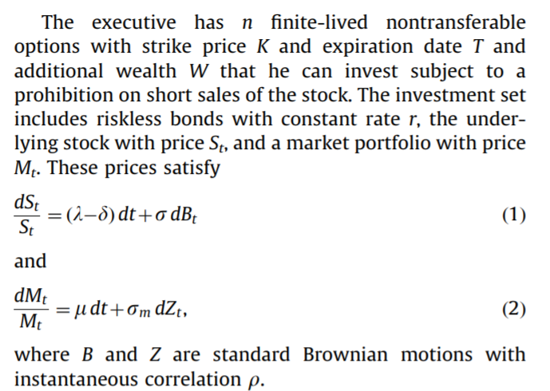
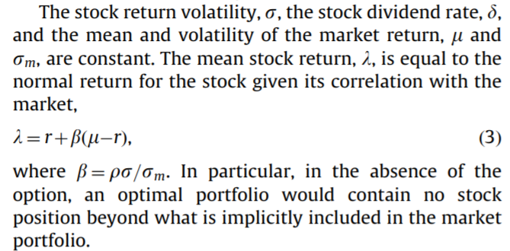
General framework
3.1. Executive’s option exercise and portfolio choice problem

Slide 7
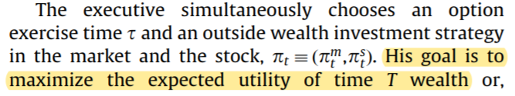
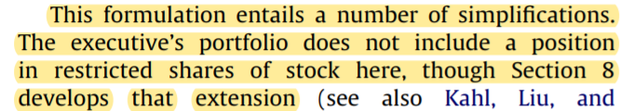
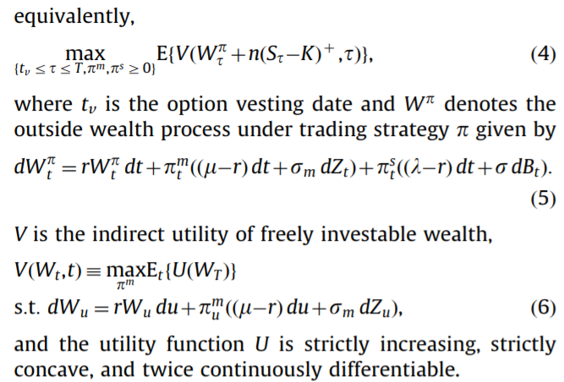
General framework
3.1. Executive’s option exercise and portfolio choice problem

Slide 8

General framework
3.2. Option cost to shareholders and executive’s subjective value
The cost of the option to shareholders who can trade freely is the present value, or replication cost, of that payoff. This can be represented as the risk-neutral expectation of the risklessly discounted option payoff,

Slide 9
General framework
3.2. Option cost to shareholders and executive’s subjective value
Standard theory for tradable options assumes the option holder chooses the exercise policy to maximize the option’s present value, because, when the option is tradable, maximizing present value is consistent with maximizing expected utility.
When the option is nontransferable, these objectives are different, and the utility-maximizing payoff typically has a lower present value.

Slide 10

General framework
3.2. Option cost to shareholders and executive’s subjective value
We define the subjective option value as the amount of freely investable money that would give the executive the same utility as the option, i.e., the value of x such that
where V is the indirect-utility value of freely investable wealth
and f is the value function for the executive’s problem with the options

Slide 11
General framework
3.2. Option cost to shareholders and executive’s subjective value
The discount in the executive’s valuation of the option relative to its cost to shareholders is part of the price shareholders pay for improved performance benefits relative to cash compensation. Section 7 shows how this discount varies with firm characteristics.
Discount = (its cost to shareholders is part of the price shareholders )-(the executive’s valuation of the option) > 0

Slide 12
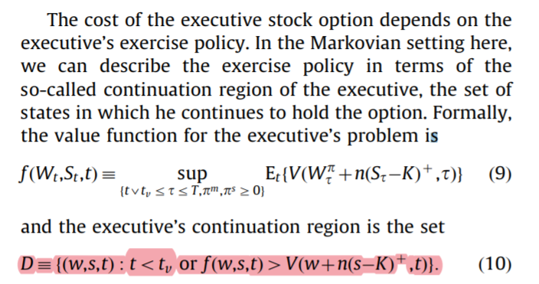
General framework
3.3. Exercise policy and the effect of dividends

Slide 13
General framework
3.3. Exercise policy and the effect of dividends
Proposition 1. The executive’s continuation region is larger the smaller the dividend rate on the stock.

Slide 14
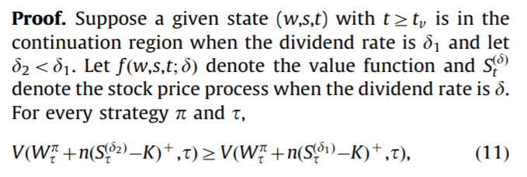
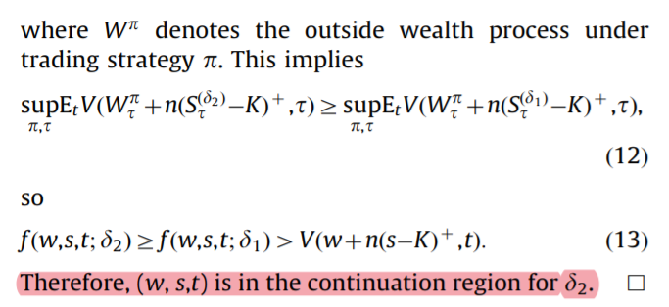
General framework
3.3. Exercise policy and the effect of dividends

Slide 15

General framework
3.3. Exercise policy and the effect of dividends
The inequality also implies Proposition 2.
Proposition 2. The executive’s subjective option value is greater the smaller the dividend rate on the stock.

Slide 16
Special case with no portfolio choice
Setting
Before turning to these, we develop additional analytical results for the special case in which there is no market asset and the executive simply invests outside wealth in riskless bonds
(原因) We also eliminate the risk premium on the stock because otherwise the executive could have a spurious incentive to hold the option to earn the risk premium.

Slide 17
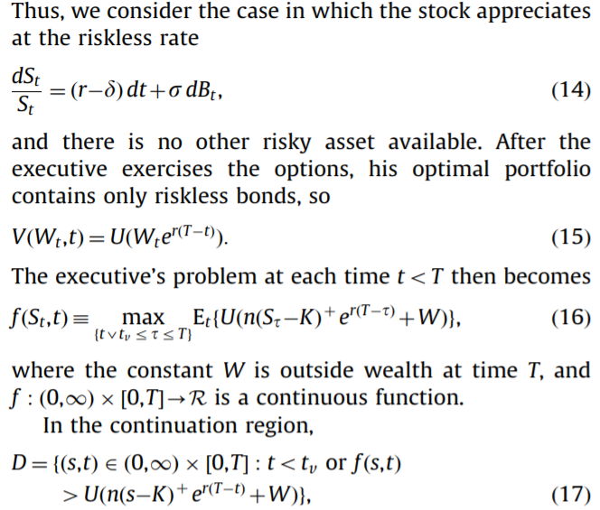
Special case with no portfolio choice

Slide 18
Special case with no portfolio choice
Proposition 4. An executive with less absolute risk aversion has a larger continuation region.

Slide 19
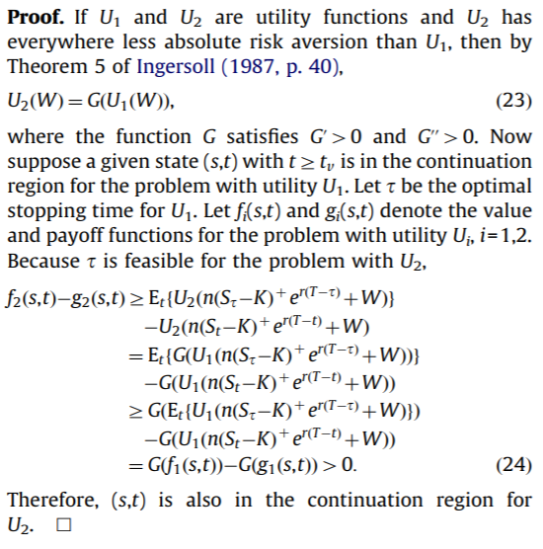
Special case with no portfolio choice

Slide 20
推導: Corollary 1. If the executive has decreasing absolute risk aversion, then the continuation region is larger with greater wealth.
公司股票發股利，勢必影響個人財富，模型是否有考慮進去?

Slide 21


Special case with no portfolio choice
Corollary 1. If the executive has decreasing absolute risk aversion, then the continuation region is larger with greater wealth.
$f_{2}\left(s,t\right)$=max $E_{t}${U[n ${\text{(}S_{τ}\text{−}\text{K}\text{)}}^{+}e^{r(t−τ)}$+w+$W_{2}$-$W_{1}$]}
$f_{1}\left(s,t\right)$=max $E_{t}${U[n ${\text{(}S_{τ}\text{−}\text{K}\text{)}}^{+}e^{r(t−τ)}$+w]}
$g_{2}\left(s,t\right)$=U[n ${\text{(}S_{t}\text{−}\text{K}\text{)}}^{+}e^{r(T−t)}$+w+$W_{2}$-$W_{1}$]
$g_{1}\left(s,t\right)$=U[n ${\text{(}S_{t}\text{−}\text{K}\text{)}}^{+}e^{r(T−t)}$+w]
$f_{2}\left(s,t\right)$-$g_{2}\left(s,t\right)≥E_{t}${U[n ${\text{(}S_{τ}\text{−}\text{K}\text{)}}^{+}e^{r(t−τ)}$+w+$W_{2}$-$W_{1}$]}
-U[n ${\text{(}S_{t}\text{−}\text{K}\text{)}}^{+}e^{r(T−t)}$+w+$W_{2}$-$W_{1}$]
= $E_{t}${G[U[n ${\text{(}S_{τ}\text{−}\text{K}\text{)}}^{+}e^{r(t−τ)}$+w]]}
-G{U[n ${\text{(}S_{t}\text{−}\text{K}\text{)}}^{+}e^{r(T−t)}$+w]}
$≥$ G{$E_{t}${U[n ${\text{(}S_{t}\text{−}\text{K}\text{)}}^{+}e^{r(T−t)}$+w]}}
-G{U[n ${\text{(}S_{t}\text{−}\text{K}\text{)}}^{+}e^{r(T−t)}$+w]}
= G[$f_{1}\left(s,t\right)$]-G[$g_{1}\left(s,t\right)$] > 0
Notes:
II. 遞減型絕對風險厭惡（Decreasing Absolute Risk Aversion, DARA）:隨著資產的增加，對於風險的厭惡程度降低，最高投資數額變大，則可以稱作遞減型絕對風險厭惡。

Slide 22

公司股票發股利，勢必影響個人財富，模型是否有考慮進去?
已知:
$\frac{dS_{t}}{S_{t}}$ = ($λ$-$δ$)dt+$σ$d$B_{t}$ ; $λ$ = r+$β$($μ$-r)
$\frac{dM_{t}}{M_{t}}$ = $μ$dt+$σ_{m}$d$Z_{t}$
(假設市場投資組合中股利小至忽略不計)
d$W_{t}^{π}$ = $π_{t}^{m}\frac{dM_{t}}{M_{t}}$ +$π_{t}^{S}$($\frac{dS_{t}}{S_{t}}$ +$δ$dt)
d$W_{t}^{π}$ = $π_{t}^{m}(μ\text{dt}\text{+}σ_{m}\text{d}Z_{t})$+$π_{t}^{m}\{[$($λ$-$δ$)dt+$σ$d$B_{t}]$+$δ$dt}
d$W_{t}^{π}$ = $π_{t}^{m}(μ\text{dt}\text{+}σ_{m}\text{d}Z_{t})$+$π_{t}^{m}\{[λ$dt+$σ$d$B_{t}]$}
d$W_{t}^{π}$ = r$W_{t}^{π}$dt + $π_{t}^{m}((μ\text{−}\text{r}\text{)}\text{dt}\text{+}σ_{m}\text{d}Z_{t})$+$π_{t}^{m}\{[(λ$-r)dt+$σ$d$B_{t}]$}
Notes:
所以最初的模型是有考慮股利率進去的!

Slide 23
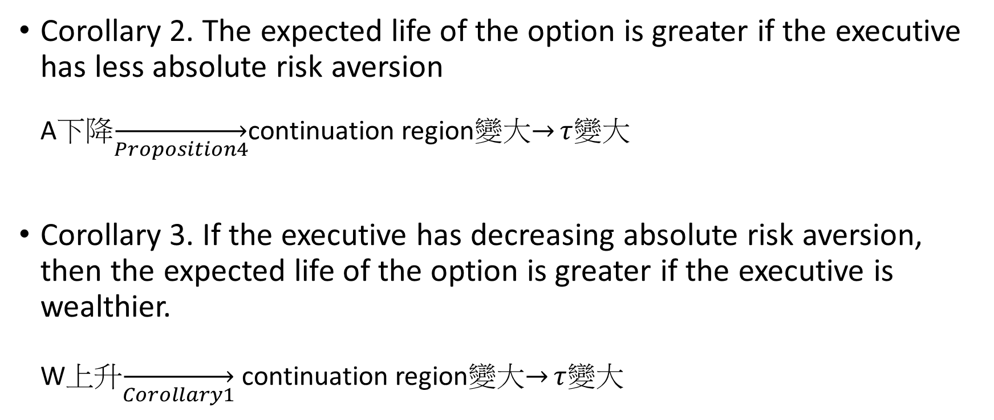
Special case with no portfolio choice
Corollary 2. The expected life of the option is greater if the executive has less absolute risk aversion A下降$\overset{→}{Proposition4}$continuation region變大$\overset{→}{}τ$變大
Corollary 3. If the executive has decreasing absolute risk aversion, then the expected life of the option is greater if the executive is wealthier. W上升$\overset{→}{Corollary1}$ continuation region變大$\overset{→}{}τ$變大

Slide 24
Special case with no portfolio choice
Proposition 5. If the dividend is zero, option cost is greater if the executive has less absolute risk aversion.

Slide 25
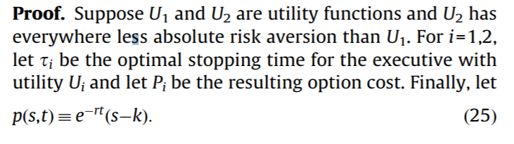
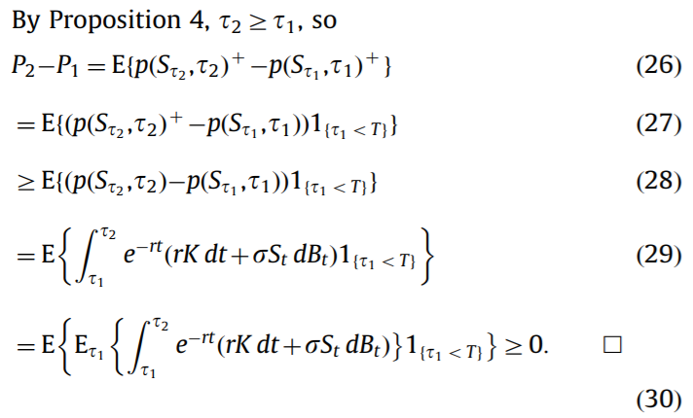
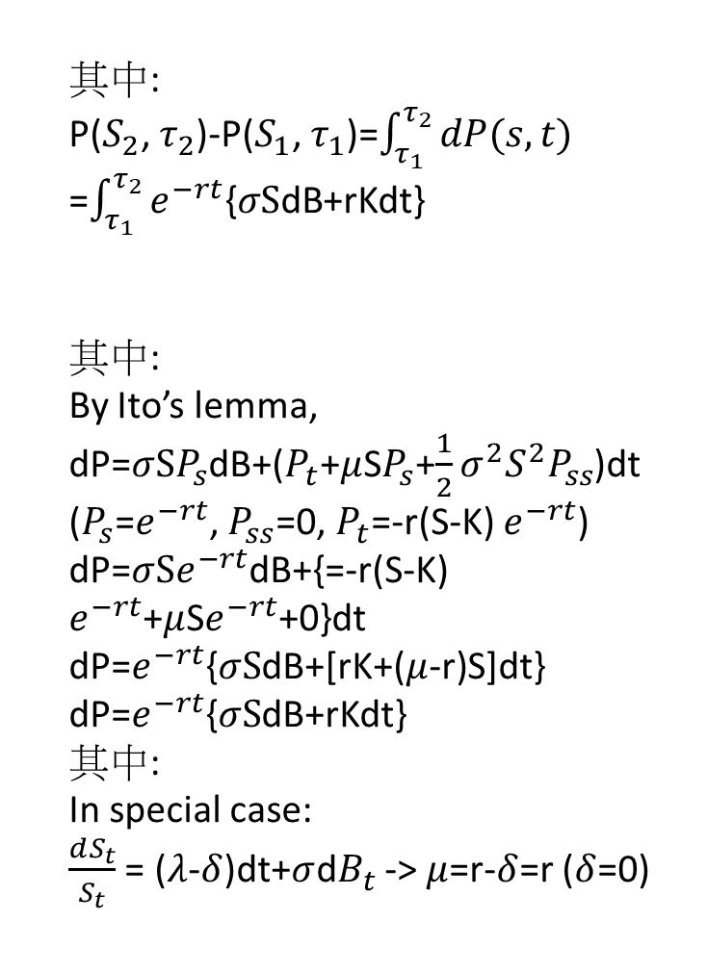
其中:
P($S_{2}$, $τ_{2}$)-P($S_{1}$, $τ_{1}$)=$\int_{τ_{1}}^{τ_{2}}{dP(s,t)}$
=$\int_{τ_{1}}^{τ_{2}}{e^{−rt}\text{\{}σS\text{dB}\text{+}\text{rKdt}\text{\} }}$
其中:
By Ito’s lemma,
dP=$σSP_{s}$dB+($P_{t}$+$μ$S$P_{s}$+$\frac{1}{2}σ^{2}S^{2}P_{ss}$)dt
($P_{s}$=$e^{−rt}$, $P_{ss}$=0, $P_{t}$=-r(S-K) $e^{−rt}$)
dP=$σSe^{−rt}$dB+{=-r(S-K) $e^{−rt}$+$μ$S$e^{−rt}$+0}dt
dP=$e^{−rt}${$σS$dB+[rK+($μ$-r)S]dt}
dP=$e^{−rt}${$σS$dB+rKdt}
其中:
In special case:
$\frac{dS_{t}}{S_{t}}$ = ($λ$-$δ$)dt+$σ$d$B_{t}$ -> $μ$=r-$δ$=r ($δ$=0)

Slide 26
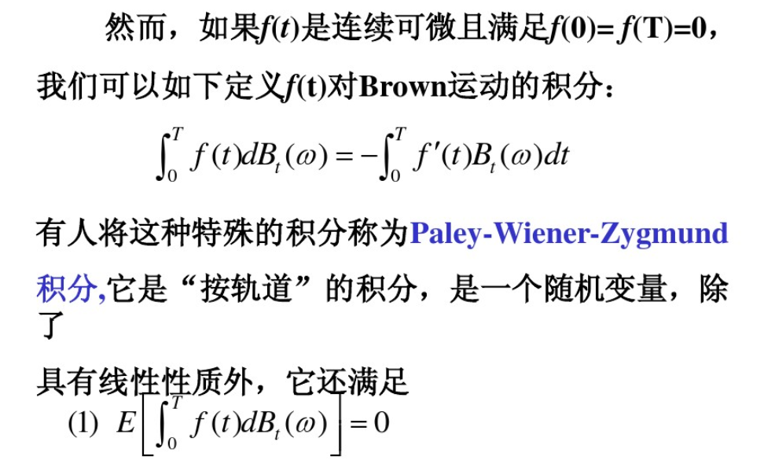

Slide 27
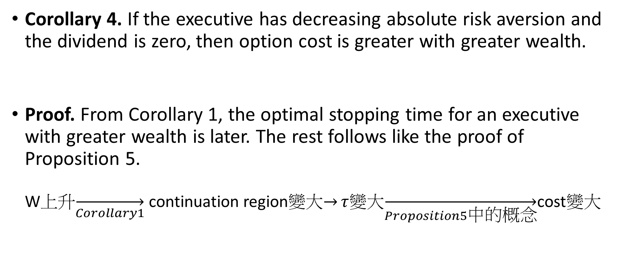
Special case with no portfolio choice
Corollary 4. If the executive has decreasing absolute risk aversion and the dividend is zero, then option cost is greater with greater wealth.
Proof. From Corollary 1, the optimal stopping time for an executive with greater wealth is later. The rest follows like the proof of Proposition 5. W上升$\overset{→}{Corollary1}$ continuation region變大$\overset{→}{}τ$變大$\overset{→}{Proposition5中的概念}$cost變大

Slide 28
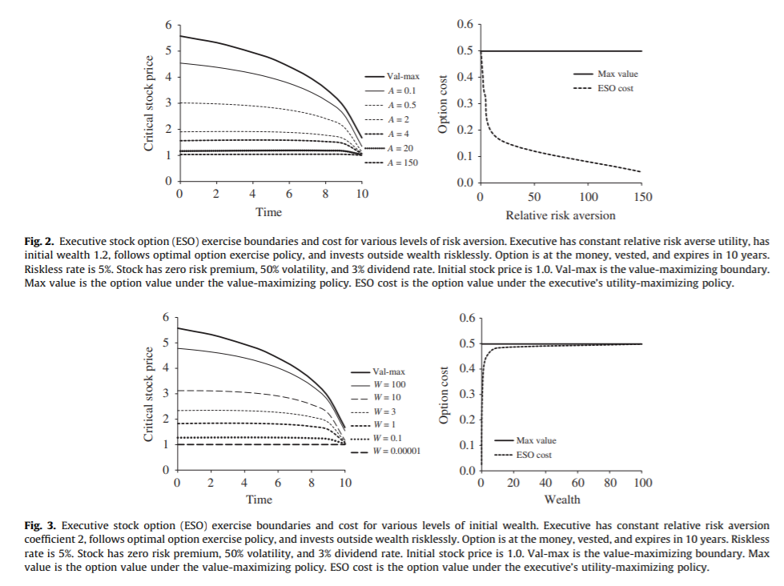
Special case with no portfolio choice

Slide 29
Special case with no portfolio choice
The examples also suggest that as risk aversion grows large, or as outside wealth goes to zero, the boundary falls to S=K and option cost falls to zero (or the value of a European option that expires on the vesting date).
The intuition for this is that as risk aversion grows large, the risk premium required to trade a certain exercise value for a risky continuation value goes to infinity.
However, as risk aversion goes to zero, or as wealth grows large, option cost converges to its maximized value. (Max value is the option value under the value-maximizing policy. ESO cost is the option value under the executive’s utility-maximizing policy.)

Slide 30
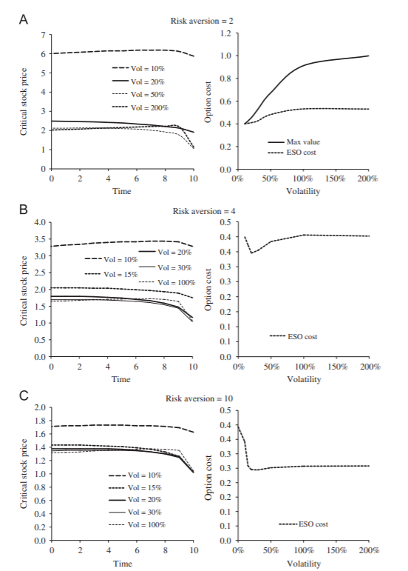

Slide 31
Special case with no portfolio choice
(現象1: increase in volatility ，continuation region先減後增)
The risk-averse utility of the option payoff, as a function of the stock price, has both a convex region and a concave region, so, in principle, an increase in volatility could either lead the executive to continue longer or exercise sooner.

Slide 32

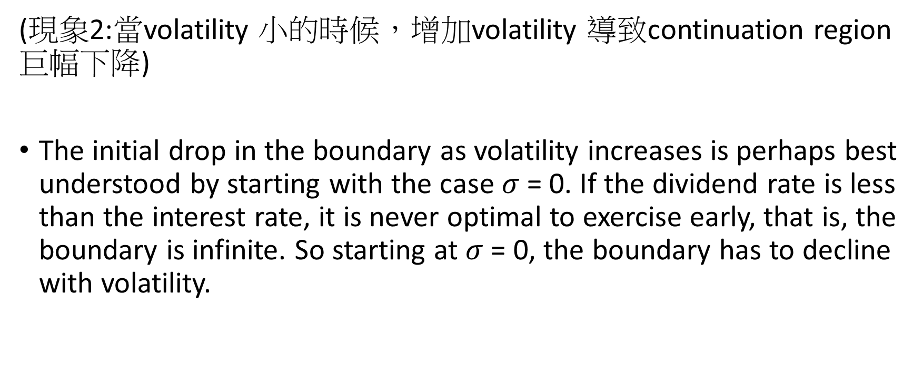
Special case with no portfolio choice
(現象2:當volatility 小的時候，增加volatility 導致continuation region巨幅下降)
The initial drop in the boundary as volatility increases is perhaps best understood by starting with the case $σ$= 0. If the dividend rate is less than the interest rate, it is never optimal to exercise early, that is, the boundary is infinite. So starting at $σ$= 0, the boundary has to decline with volatility.
0
> 0

Slide 33
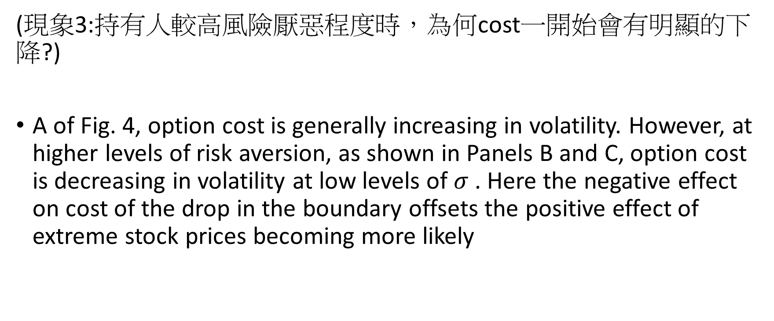
Special case with no portfolio choice
(現象3:持有人較高風險厭惡程度時，為何cost一開始會有明顯的下降?)
A of Fig. 4, option cost is generally increasing in volatility. However, at higher levels of risk aversion, as shown in Panels B and C, option cost is decreasing in volatility at low levels of $σ$. Here the negative effect on cost of the drop in the boundary offsets the positive effect of extreme stock prices becoming more likely

Slide 34
Special case with no portfolio choice
現象4:
Fig. 4 also shows that, in some cases, especially when volatility is high, the utility-maximizing exercise boundary might not decline monotonically in time (by contrast, the value-maximizing boundary always declines as expiration approaches)

Slide 35
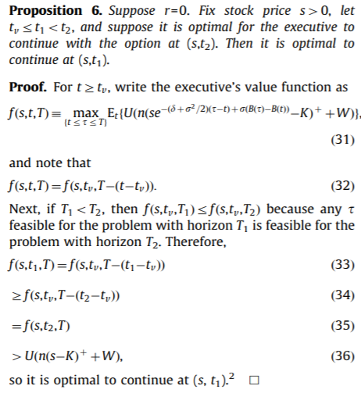

Slide 36
This result indicates that the nonmonotonicity of the boundary in time must stem from the presence of a positive interest rate.

