Slide 1
Why do some firms give stock options to all employees?: An empirical examination of alternative theories
Paul Oyer, Scott Schaefer

Slide 2
outline
簡述之前 incentive 的模型
Incentive的實證結果
Sorting的實證結果
Retention的實證結果

Slide 3
Incentive 模型簡述

Slide 4
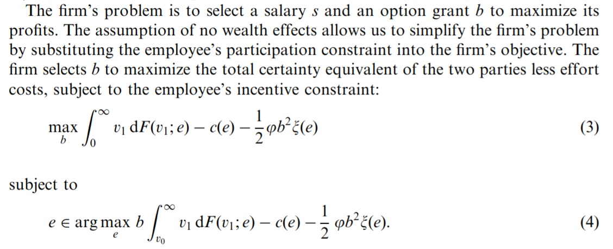
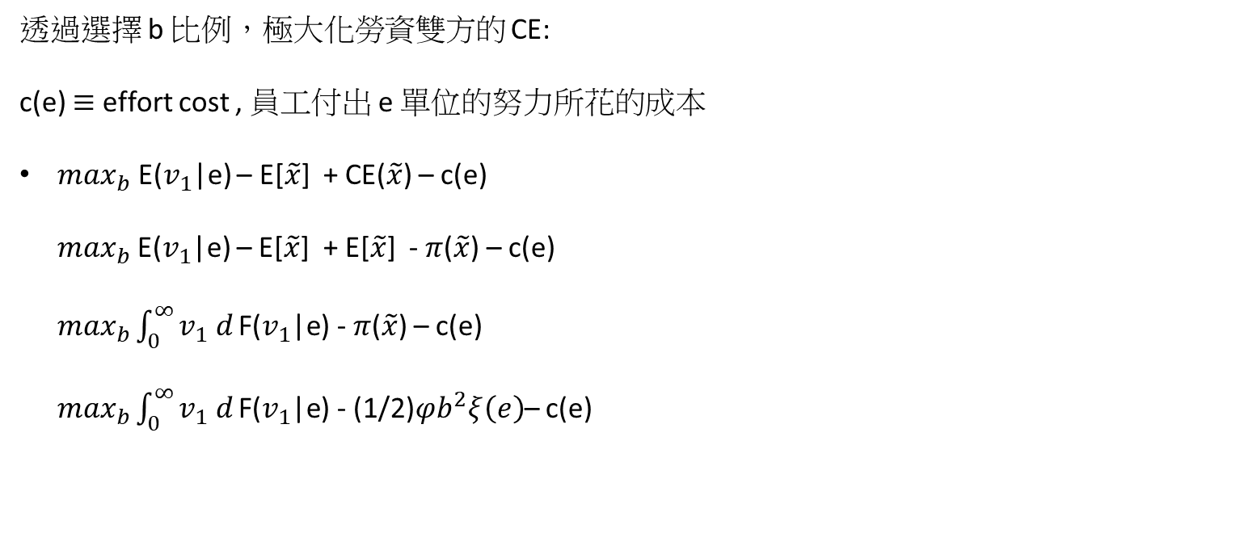
透過選擇 b 比例，極大化勞資雙方的 CE:
c(e) $≡$ effort cost , 員工付出 e 單位的努力所花的成本
$\max_{b}$ E($v_{1}$|e) – E[$\tilde{x}$] + CE($\tilde{x}$) – c(e) $\max_{b}$E($v_{1}$|e) – E[$\tilde{x}$] + E[$\tilde{x}$] - $π$($\tilde{x}$) – c(e) $\max_{b}\int_{0}^{∞}{v_{1} d}\text{F}\text{(}v_{1}\text{|}\text{e}\text{)}$ - $π$($\tilde{x}$) – c(e) $\max_{b}\int_{0}^{∞}{v_{1} d}\text{F}\text{(}v_{1}\text{|}\text{e}\text{)}$ - (1/2)$φb^{2}ξ\left(e\right)$– c(e)

Slide 5
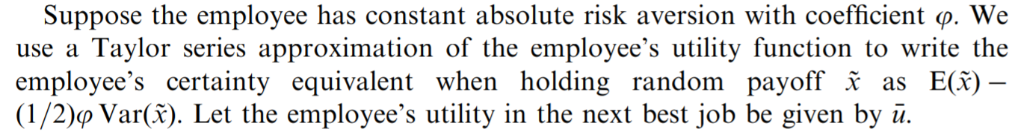

$π$($\tilde{x}$) $≡$ risk premium of employees $U$( E[$\tilde{x}$] ) = U ( CE($\tilde{x}$) + $π$($\tilde{x}$) ) 則 CE($\tilde{x}$) = E[$\tilde{x}$] -$π$($\tilde{x}$)
根據剛剛推得的結果 $π$($\tilde{x}$) = - (1/2)$φ$Var($\tilde{x}$) ，帶入上式 CE($\tilde{x}$) = E[$\tilde{x}$] -$π$($\tilde{x}$) = E[$\tilde{x}$] - (1/2)$φ$Var($\tilde{x}$) = E[$\tilde{x}$] - (1/2)$φb^{2}ξ\left(e\right)$ 其中: $ξ\left(e\right)$ $≡$the variance of max[$v_{1}$ - $v_{0}$ , 0] Var($\tilde{x}$) = Var(max[b($v_{1}$ - $v_{0}$) , 0] = $b^{2}$* Var(max[$v_{1}$ - $v_{0}$ , 0] ) = $b^{2}ξ\left(e\right)$

Slide 6
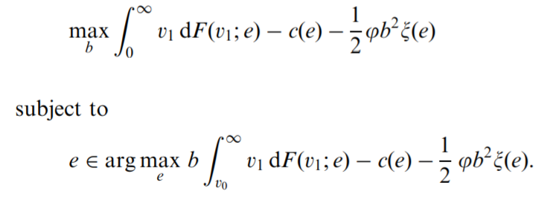
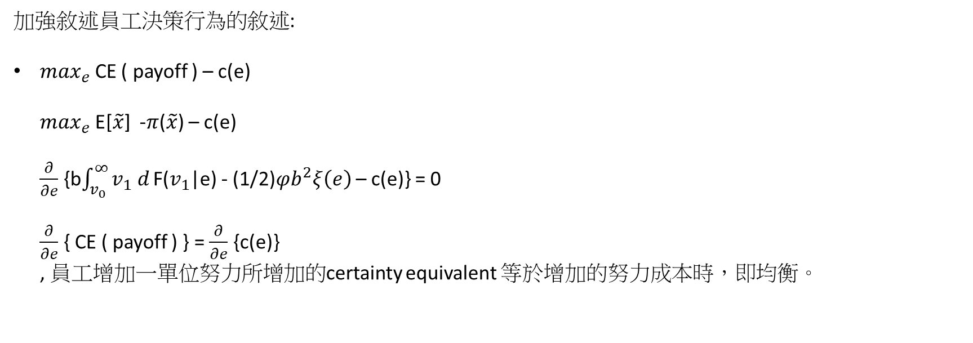
加強敘述員工決策行為的敘述:
$\max_{e}$ CE ( payoff ) – c(e) $\max_{e}$ E[$\tilde{x}$] -$π$($\tilde{x}$) – c(e) $\frac{∂}{∂e}$ {b$\int_{v_{0}}^{∞}{v_{1} d}\text{F}\text{(}v_{1}\text{|}\text{e}\text{)}$ - (1/2)$φb^{2}ξ\left(e\right)$ – c(e)} = 0 $\frac{∂}{∂e}$ { CE ( payoff ) } = $\frac{∂}{∂e}$ {c(e)} , 員工增加一單位努力所增加的certainty equivalent 等於增加的努力成本時，即均衡。

Slide 7
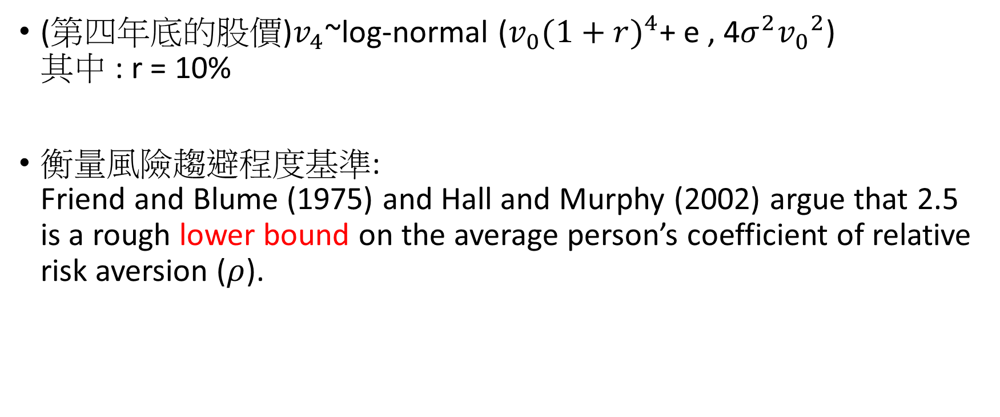
Incentive 實證設定
(第四年底的股價)$v_{4}$~log-normal ($v_{0}{(1+r)}^{4}$+ e , 4$σ^{2}{v_{0}}^{2}$) 其中 : r = 10%
衡量風險趨避程度基準: Friend and Blume (1975) and Hall and Murphy (2002) argue that 2.5 is a rough lower bound on the average person’s coefficient of relative risk aversion ($ρ$).

Slide 8
Incentive 實證設定
絕對風險趨避係數轉換成相對風險係數: We convert this to an Arrow-Pratt measure of absolute risk aversion (as required by our agency model) by dividing by the employee’s wealth level, which we assume to be five times the annual salary paid by the firm to middle managers.

Slide 9
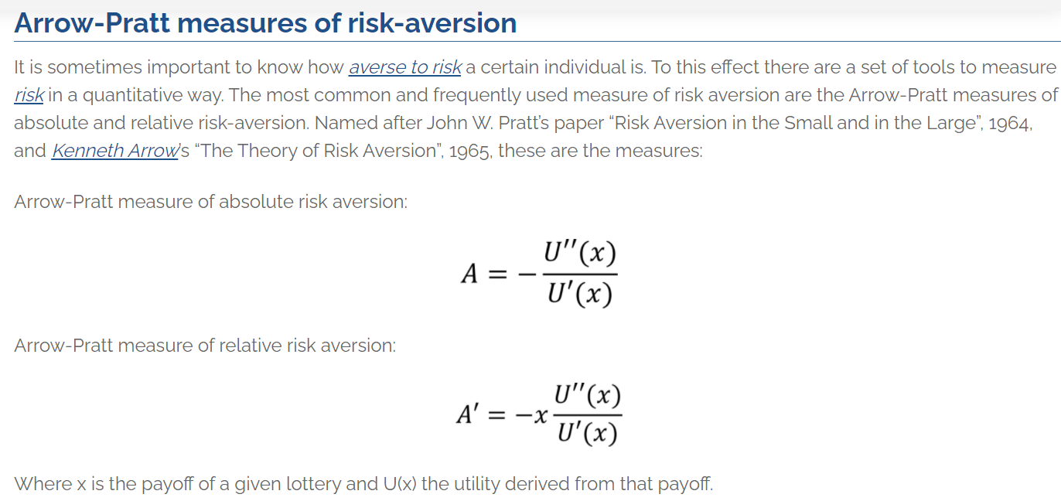

Slide 10


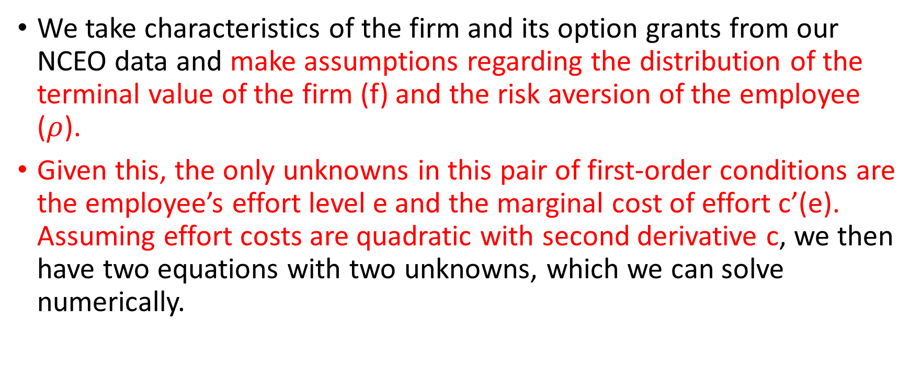
Incentive 實證設定
We take characteristics of the firm and its option grants from our NCEO data and make assumptions regarding the distribution of the terminal value of the firm (f) and the risk aversion of the employee ($ρ$).
Given this, the only unknowns in this pair of first-order conditions are the employee’s effort level e and the marginal cost of effort c’(e). Assuming effort costs are quadratic with second derivative c, we then have two equations with two unknowns, which we can solve numerically.

Slide 11
incentive實證結果

Slide 12
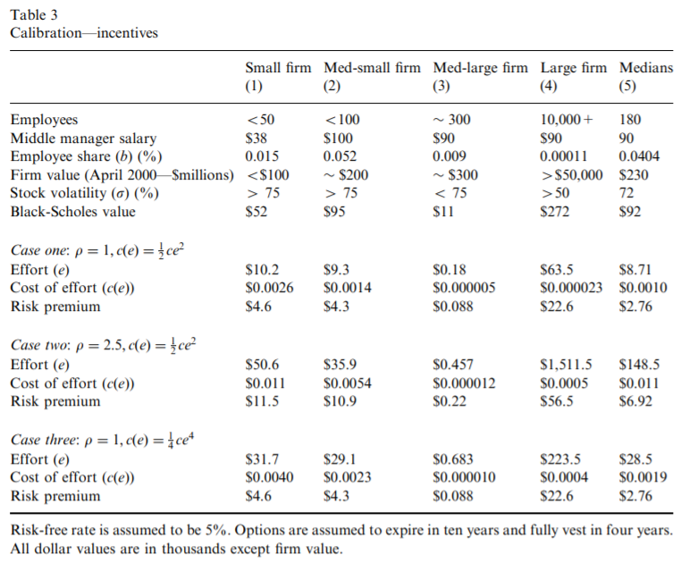

Slide 13
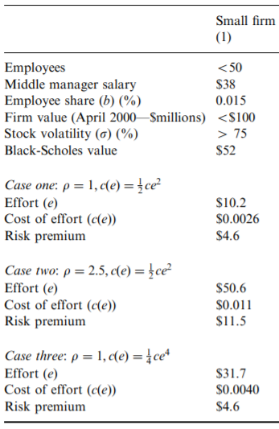
Incentive 實證結論
We focus first on the smallest firm, listed in Column (1). This firm has a small number of employees.
our model computes that the employee’s additional productivity arising as a result of the option grant is $10,200, annually. The risk premium the employee attaches to annual compensation on account of the option grant is $4,600. The annual cost to the employee of exerting this additional effort is $2.60.

Slide 14
Incentive 實證結論
假設員工員更風險趨避，帶入解未知數 e , c
這個結果看起來相當的不合理，更趨避ESO的價值應該對於員工來說更沒價值，為何會付出更多努力呢?
論文中的說法: If employees are more risk averse, then the marginal cost to the firm of using option-based pay is higher. Hence, firms are willing to make the observed grants only if the responsiveness of effort to incentives is higher.
Notes:
第二點:
解那兩條方程式，除了 e 和 c’’(e)=c 都是外升變數。
調整偏好程度，給予ESO數量還是固定(b)，因仍然外生給定，
數值方法解出來，e應該要較大，
因員工風險偏好程度增加，ESO對員工價值較小，若仍然要維持相同的ESO數量(b)，
勢必incentive的效果要更顯著，從報表來看effort較大。
刪掉的部分:
To see the intuition for this, recall that our model solves for effort using the firm’s first-order condition, which states that the marginal benefit and marginal cost associated with additional option grants must be equal.

Slide 15
Incentive 實證結論
其實我們相信這是數學解出來的解即可
論文中，為解釋這個不直觀的結果，給出來的解釋為 : firms are willing to make the observed grants only if the responsiveness of effort to incentives is higher.
那我們分解他模型的數學，觀察何謂 the responsiveness of effort to incentives ?

Slide 16
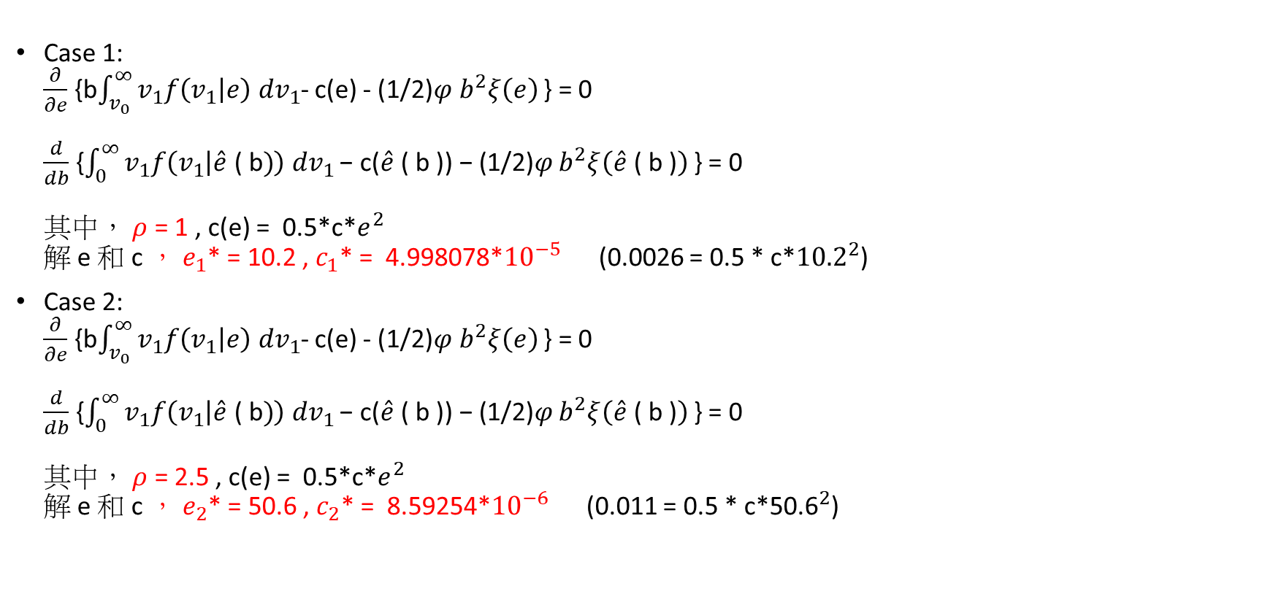
根據報表計算一些必要的數值
Case 1: $\frac{∂}{∂e}$ {b$\int_{v_{0}}^{∞}{v_{1}f\left(v_{1} | e\right) dv_{1}}$- c(e) - (1/2)$φ b^{2}ξ\left(e\right)$ } = 0 $\frac{d}{db}$ {$\int_{0}^{∞}{v_{1}f\left(v_{1} | \hat{e}\text{ ( }\text{b})\right) dv_{1}}\text{− }\text{c}\text{(}\hat{e}\text{ ( }\text{b}\text{ )) − (1/2)}φ b^{2}ξ\left(\hat{e}\text{ ( }\text{b}\text{ )}\right)$ } = 0 其中， $ρ$ = 1 , c(e) = 0.5*c*$e^{2}$ 解 e 和 c ， $e_{1}$* = 10.2 , $c_{1}$* = 4.998078*${10}^{−5}$ (0.0026 = 0.5 * c*${\text{10.2}}^{2}$)
Case 2: $\frac{∂}{∂e}$ {b$\int_{v_{0}}^{∞}{v_{1}f\left(v_{1} | e\right) dv_{1}}$- c(e) - (1/2)$φ b^{2}ξ\left(e\right)$ } = 0 $\frac{d}{db}$ {$\int_{0}^{∞}{v_{1}f\left(v_{1} | \hat{e}\text{ ( }\text{b})\right) dv_{1}}\text{− }\text{c}\text{(}\hat{e}\text{ ( }\text{b}\text{ )) − (1/2)}φ b^{2}ξ\left(\hat{e}\text{ ( }\text{b}\text{ )}\right)$ } = 0 其中， $ρ$ = 2.5 , c(e) = 0.5*c*$e^{2}$ 解 e 和 c ， $e_{2}$* = 50.6 , $c_{2}$* = 8.59254*${10}^{−6}$ (0.011 = 0.5 * c*${\text{50.6}}^{2}$)

Slide 17

Incentive 實證結論
既然文中是 incentive 的影響，那我們著重觀察員工的一階條件式
以下為 case1 的均衡解 $\frac{∂}{∂e}$ {b$\int_{v_{0}}^{∞}{v_{1}f\left(v_{1} | e\right) dv_{1}}$- c(e) - (1/2)$φ b^{2}ξ\left(e\right)$ } = 0 => b$\int_{v_{0}}^{∞}{v_{1}f_{2}\left(v_{1} | e\right) dv_{1}}$ = $c_{1}$’($e_{1}$*) + (1/2)$φ_{1}b^{2}ξ\left(e_{1}\text{∗}\right)$ (MR1=MC1)
(case2) $ρ$ = 1 → 2.5 , c’(e) = $c_{1}$’(e) → $c_{2}$’(e) 且 $c_{1}$’(e) > $c_{1}$’(e) 若 $c_{1}$’($e_{1}$*) + (1/2)$φ_{1}b^{2}ξ\left(e_{1}\text{∗}\right)$ > $c_{2}$’($e_{1}$*) + (1/2)$φ_{2}b^{2}ξ\left(e_{1}\text{∗}\right)$ (MC1>MC2) 也就是說 $c_{2}$’($e_{1}$*) 下降的幅度帶來的影響 大於 $φ_{2}$ 上升帶來的影響。 則，MR1=MC1>MC2，對2號員工多努力一單位的效益大於成本，所以2號員工付出的努力

Slide 18
Incentive 實證結論
話說回來， 仔細觀察，多努力其實是MC下降，導致員工多努力，而論文對此的解釋為 : firms are willing to make the observed grants only if the responsiveness of effort to incentives is higher.
以上的解釋主要的不是要表達員工風險更趨避者更有激勵效果，這些解釋只是要說明兩條決策等式解出來數值的合理性。

Slide 19
Incentive 實證結論
The third calibration also yields higher effort figures than does the first. The cost-of-effort function here is flatter, meaning employees are more responsive to low-powered incentives.
Notes:
flatter的原因是，
c是方程式數值解出來的，
雖 case3 是4次方，由於解出來的c*非常小，
在e*不大的時候，function其實是更flatter的。

Slide 20
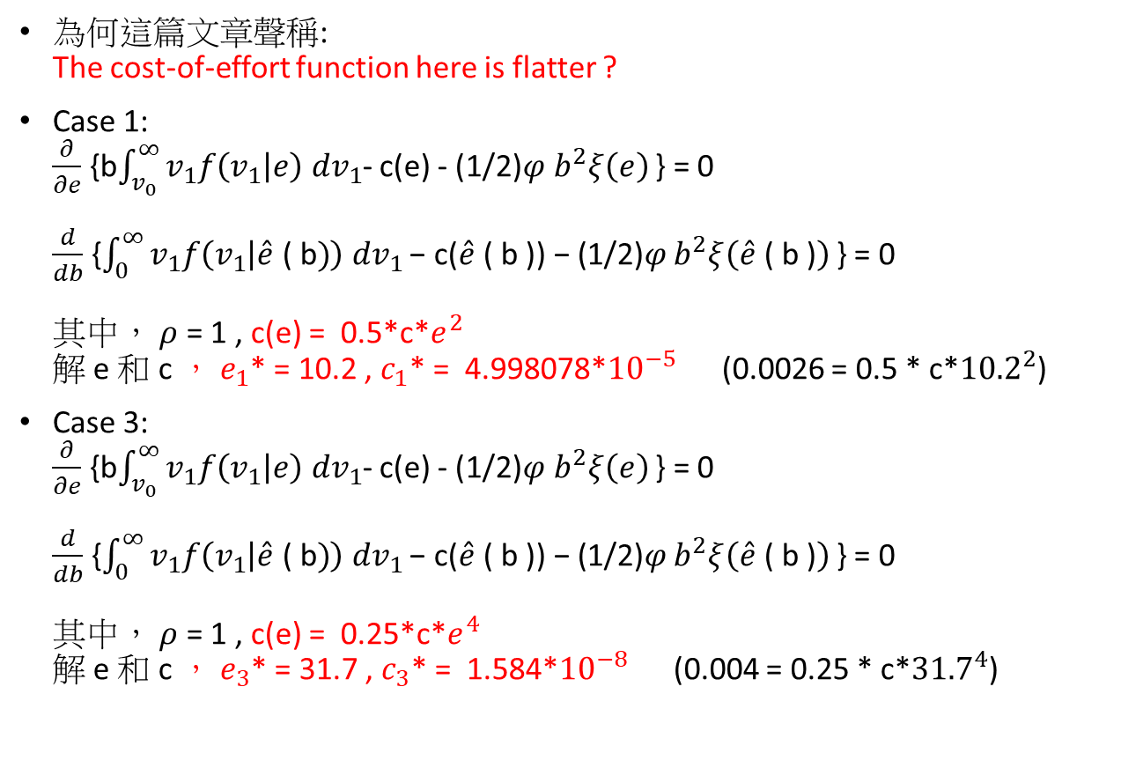
Incentive 實證結論
為何這篇文章聲稱: The cost-of-effort function here is flatter ?
Case 1: $\frac{∂}{∂e}$ {b$\int_{v_{0}}^{∞}{v_{1}f\left(v_{1} | e\right) dv_{1}}$- c(e) - (1/2)$φ b^{2}ξ\left(e\right)$ } = 0 $\frac{d}{db}$ {$\int_{0}^{∞}{v_{1}f\left(v_{1} | \hat{e}\text{ ( }\text{b})\right) dv_{1}}\text{− }\text{c}\text{(}\hat{e}\text{ ( }\text{b}\text{ )) − (1/2)}φ b^{2}ξ\left(\hat{e}\text{ ( }\text{b}\text{ )}\right)$ } = 0 其中， $ρ$ = 1 , c(e) = 0.5*c*$e^{2}$ 解 e 和 c ， $e_{1}$* = 10.2 , $c_{1}$* = 4.998078*${10}^{−5}$ (0.0026 = 0.5 * c*${\text{10.2}}^{2}$)
Case 3: $\frac{∂}{∂e}$ {b$\int_{v_{0}}^{∞}{v_{1}f\left(v_{1} | e\right) dv_{1}}$- c(e) - (1/2)$φ b^{2}ξ\left(e\right)$ } = 0 $\frac{d}{db}$ {$\int_{0}^{∞}{v_{1}f\left(v_{1} | \hat{e}\text{ ( }\text{b})\right) dv_{1}}\text{− }\text{c}\text{(}\hat{e}\text{ ( }\text{b}\text{ )) − (1/2)}φ b^{2}ξ\left(\hat{e}\text{ ( }\text{b}\text{ )}\right)$ } = 0 其中， $ρ$ = 1 , c(e) = 0.25*c*$e^{4}$ 解 e 和 c ， $e_{3}$* = 31.7 , $c_{3}$* = 1.584*${10}^{−8}$ (0.004 = 0.25 * c*${\text{31.7}}^{4}$)
Notes:
flatter的原因是，
c是方程式數值解出來的，
雖 case3 是4次方，由於解出來的c*非常小，
在e*不大的時候，function其實是更flatter的。

Slide 21
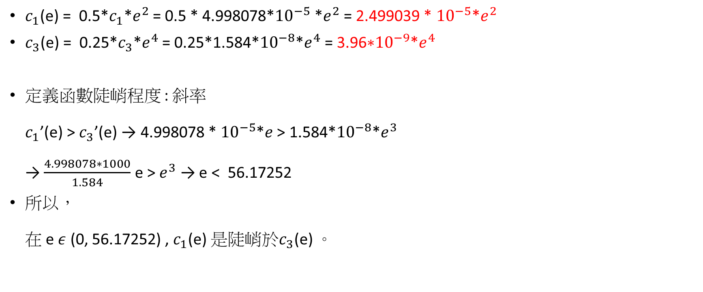
The cost-of-effort function here is flatter ?
$c_{1}$(e) = 0.5*$c_{1}$*$e^{2}$ = 0.5 * 4.998078*${10}^{−5}$ *$e^{2}$ = 2.499039 * ${10}^{−5}$*$e^{2}$
$c_{3}$(e) = 0.25*$c_{3}$*$e^{4}$ = 0.25*$\text{1.584*}{10}^{−8}$*$e^{4}$ = 3.96$\text{∗}{10}^{−9}$*$e^{4}$
定義函數陡峭程度 : 斜率 $c_{1}$’(e) > $c_{3}$’(e) → 4.998078 * ${10}^{−5}$*$e$ > 1.584*${10}^{−8}$*$e^{3}$ → $\frac{4.998078∗1000}{1.584}$ e > $e^{3}$ → e < 56.17252
所以， 在 e $ε$ (0, 56.17252) , $c_{1}$(e) 是陡峭於$c_{3}$(e) 。

Slide 22

Incentive 實證結論
已知 $c_{1}$’(e) > $c_{3}$’(e) , e $ε$ (0, 56.17252)
Notes:
flatter的原因是，
c是方程式數值解出來的，
雖 case3 是4次方，由於解出來的c*非常小，
在e*不大的時候，function其實是更flatter的。

Slide 23
Incentive 實證結論
以上都是簡述不同的外生給定，報表輸出的結果，此處才探究incentive為何不顯著。
We conclude from this exercise that the provision of incentives does not appear very plausible as an explanation for option-based pay.
If this were the case, it seems clear that the parties’ inability to contract on effort is generating a very substantial underprovision of effort.

Slide 24
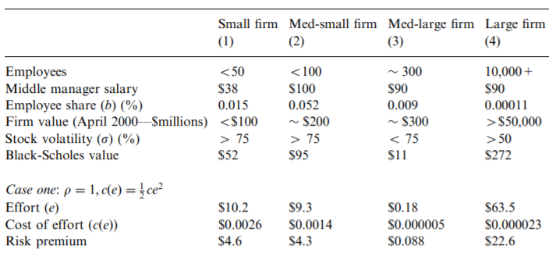
Incentive 實證結論
This difference, which strikes us as implausibly large, is implied by our agency model combined with the assumption that observed option grants reflect optimal incentives.
This comparison is even more dramatic in the case of the large firm, where the additional benefits and costs of options are $63,500 and about two cents, respectively.
Notes:
既然這個model都已經是利用ESO極大化incentive，
結果還會這麼戲劇化，
員工付出那麼少努力，公司可以多賺到這麼多，
直觀來看公司並沒有最佳化incentive，
似乎公司可以多給一些錢使員工更努力，公司能夠賺更多錢才對。

Slide 25
Sorting實證設定

Slide 26
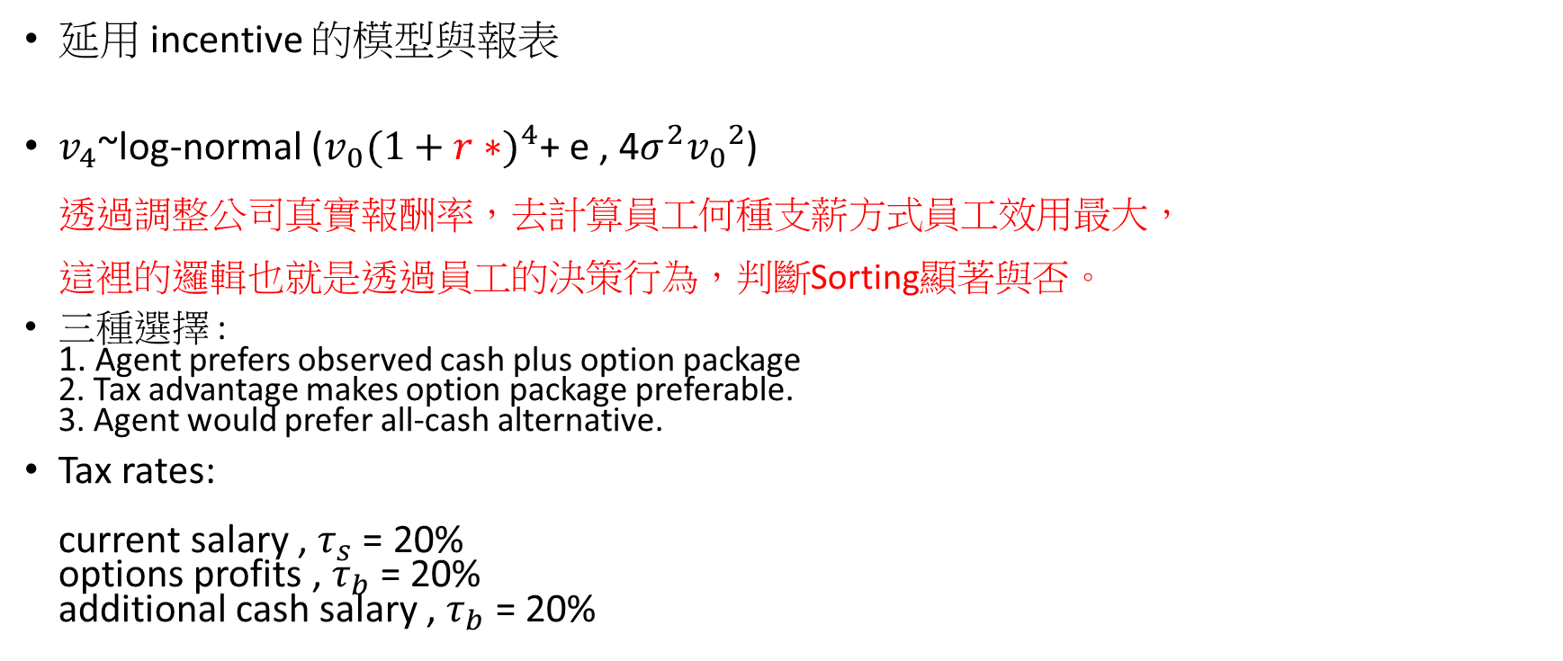
Sorting實證設定
延用 incentive 的模型與報表
$v_{4}$~log-normal ($v_{0}{(1+r∗)}^{4}$+ e , 4$σ^{2}{v_{0}}^{2}$) 透過調整公司真實報酬率，去計算員工何種支薪方式員工效用最大， 這裡的邏輯也就是透過員工的決策行為，判斷Sorting顯著與否。
三種選擇 : 1. Agent prefers observed cash plus option package 2. Tax advantage makes option package preferable. 3. Agent would prefer all-cash alternative.
Tax rates: current salary , $τ_{s}$ = 20% options profits , $τ_{b}$ = 20% additional cash salary , $τ_{b}$ = 20%

Slide 27
Sorting 實證結果
We first consider an employee with coefficient of relative risk aversion 2.5 who expects the firm’s share price to increase by 10% per year.
At our small, medium-small, and large firms (Figs. 1, 2, and 4), such an employee prefers an all-cash package costing the firm the same amount.
These conclusions do not change markedly when the employee is less risk averse.

Slide 28
Sorting 實證結果
(medium-large firm剛好例外)
The medium-large firm makes small option grants, and such an employee would prefer the observed salary plus option package because of the tax advantages.

Slide 29
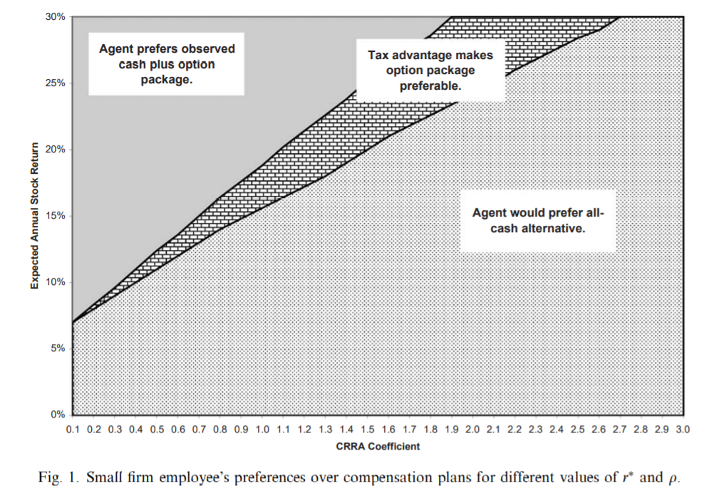
Small firm

Slide 30
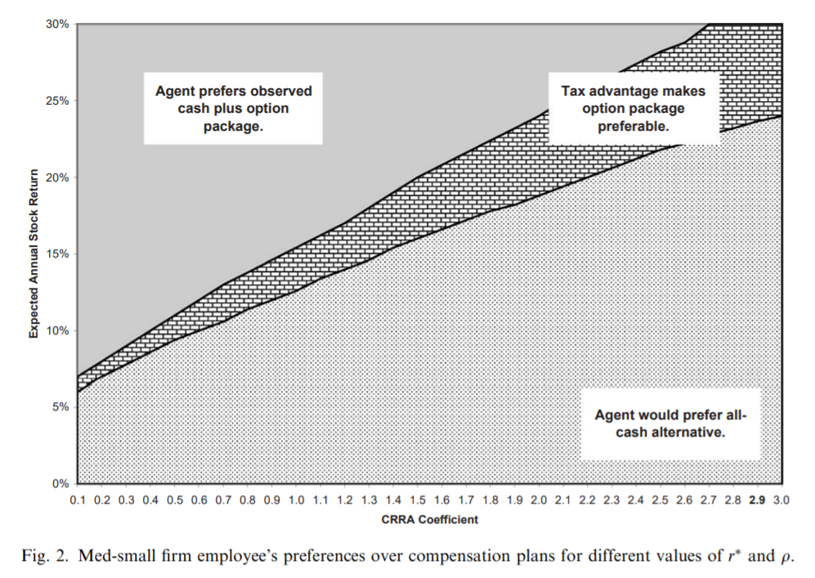
Med-small firm

Slide 31
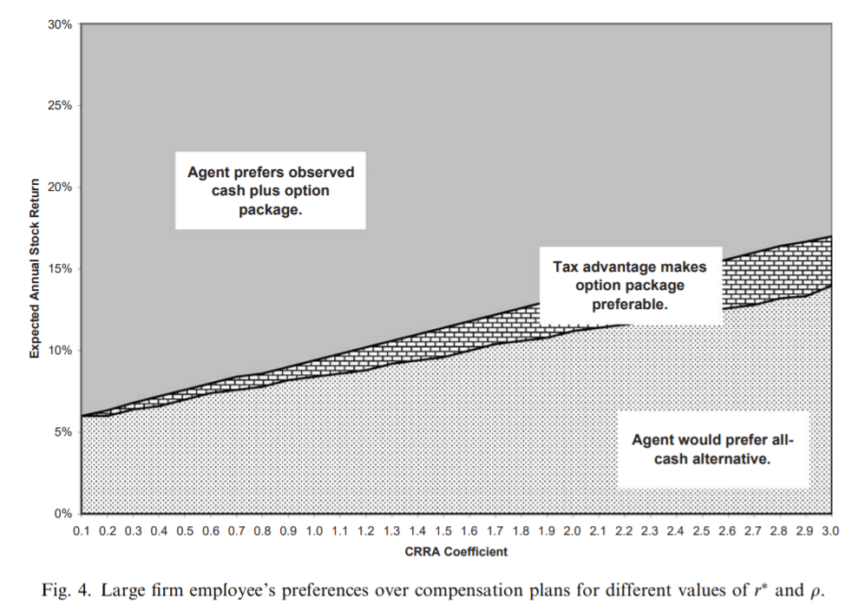
Large firm

Slide 32
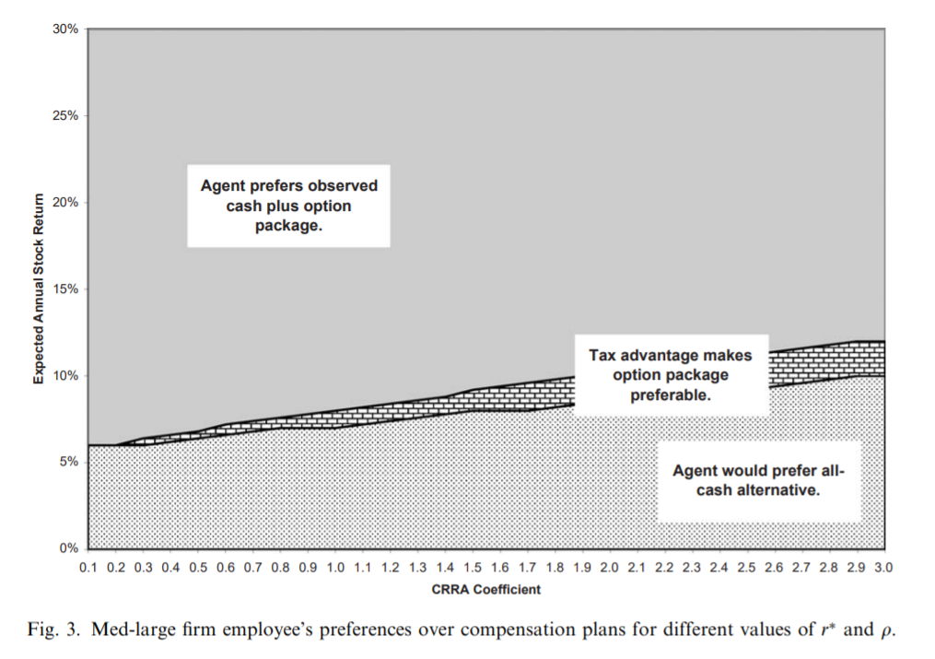
Med-large firm

Slide 33
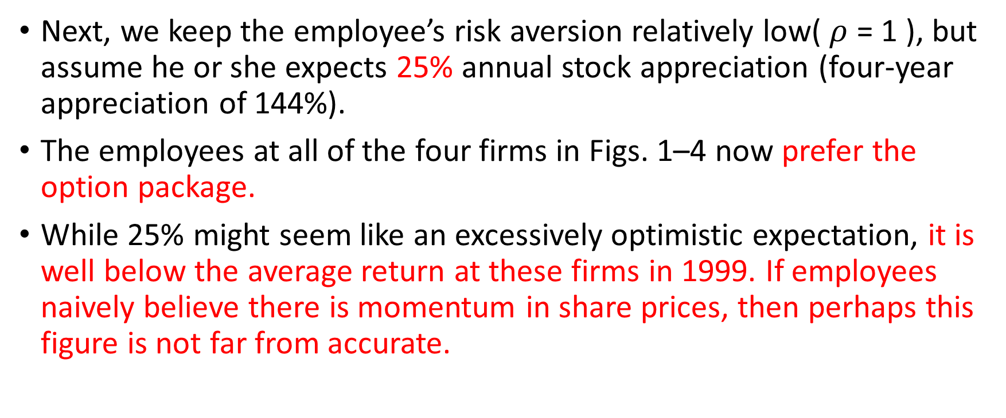
Sorting 實證結果
Next, we keep the employee’s risk aversion relatively low( $ρ$ = 1 ), but assume he or she expects 25% annual stock appreciation (four-year appreciation of 144%).
The employees at all of the four firms in Figs. 1–4 now prefer the option package.
While 25% might seem like an excessively optimistic expectation, it is well below the average return at these firms in 1999. If employees naively believe there is momentum in share prices, then perhaps this figure is not far from accurate.

Slide 34
Small firm

Slide 35
Med-small firm

Slide 36
Med-large firm

Slide 37
Large firm

Slide 38
Sorting 實證結果
As discussed in Section 3.2, one reason why firms might attach options to the employment relation is if optimistic employees are more productive.
Firms would strictly prefer the option package if granting it also attracts a more productive employee.
In this case, we can use our estimates from Table 3 to provide an estimate of the level of the productivity(effort) difference that would justify the options grants in the NCEO data.

Slide 39
Models and empirical implications 3.2. Sorting (其他paper的做法)
Traditional models of sorting(see, for example, Lazear, 2001) suggest that a firm might want to tie some of its employees’ pay to firm performance as a means of attracting able employees to work at the firm.
If optimistic employees are relatively willing to invest in firm-specific human capital, relatively hard working, or otherwise more productive, the firm needs to make options a condition of employment to insure more productive workers self-select into the firm.

Slide 40
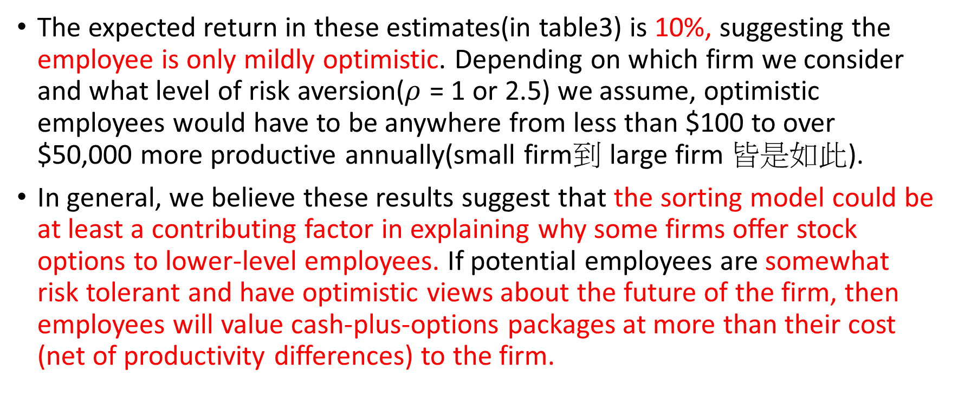
Sorting 實證結果
The expected return in these estimates(in table3) is 10%, suggesting the employee is only mildly optimistic. Depending on which firm we consider and what level of risk aversion($ρ$ = 1 or 2.5) we assume, optimistic employees would have to be anywhere from less than $100 to over $50,000 more productive annually(small firm到 large firm 皆是如此).
In general, we believe these results suggest that the sorting model could be at least a contributing factor in explaining why some firms offer stock options to lower-level employees. If potential employees are somewhat risk tolerant and have optimistic views about the future of the firm, then employees will value cash-plus-options packages at more than their cost (net of productivity differences) to the firm.

Slide 41
Definition of Risk Tolerance
Personal risk tolerance is the amount of risk that an investor is comfortable taking or the degree of uncertainty that an investor is able to handle. Risk tolerance often varies with age, income, and financial goals. It can be determined by many methods, including questionnaires designed to reveal the level at which an investor can invest but still be able to sleep at night.

Slide 42
retention
實證報表的結論

Slide 43
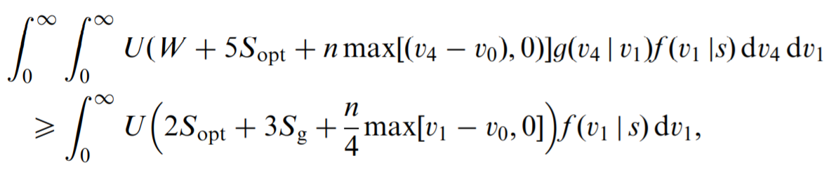

看懂報表的關鍵
These inequalities allow us to compute upper bounds on $S_{g}$, $S_{u}$, and $S_{b}$, and a lower bound on k. We also compute the ‘‘retention value’’—that is, the Black-Scholes dollar value of options forfeited in the event the employee leaves—under the good and bad industry states.

Slide 44
看懂報表的關鍵
雖然很難想像上下界如何求得，但可得知在報表界限內的數字，及滿足下方兩條不等式。
其代表的涵義分別為 1. E[U(retention)] > E[U(resign)] 2. cost(all-cash) > cost(package)

Slide 45
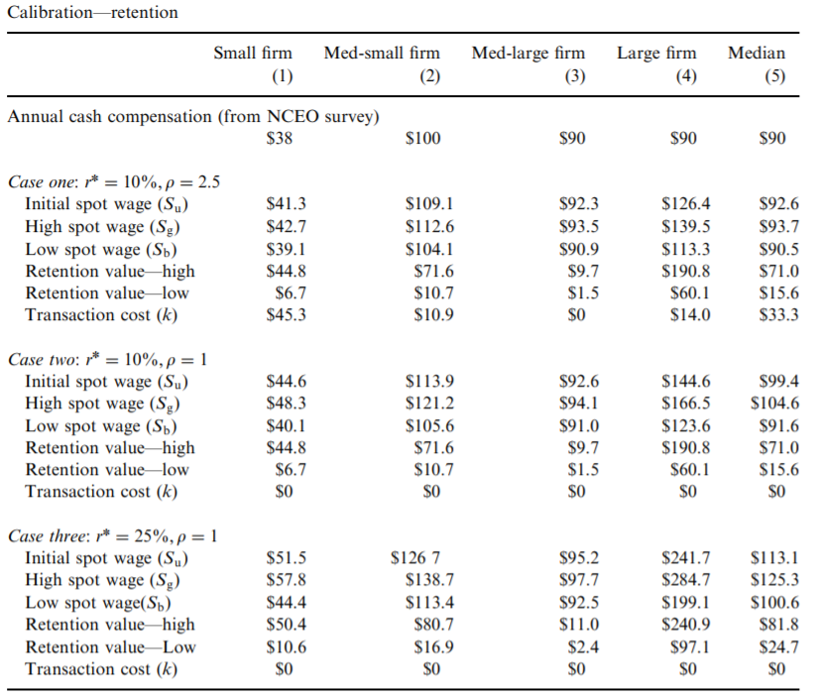
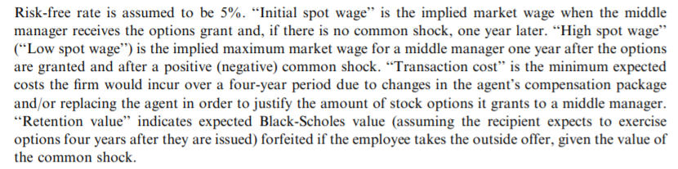

Slide 46

The first case we consider, with r* = 10% and $ρ$ = 2.5; suggest that contracting costs would have to be large at many firms in our sample in order for a retention argument to explain option grants made by firms in Columns 1 and 3

Slide 47
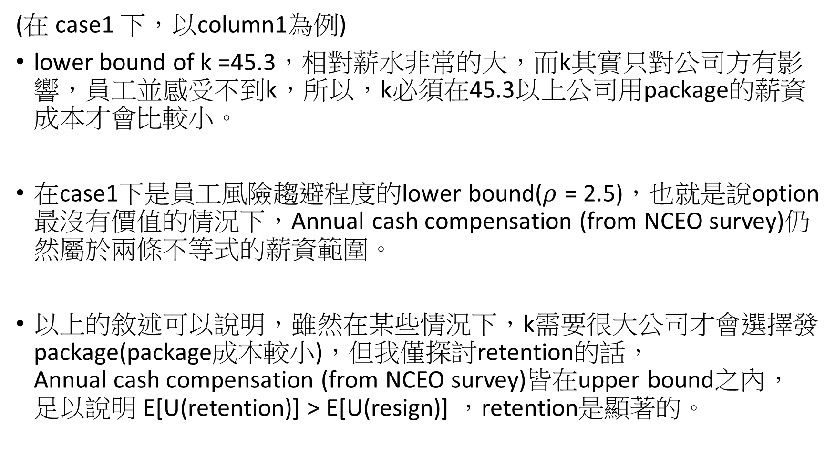
(在 case1 下，以column1為例)
lower bound of k =45.3，相對薪水非常的大，而k其實只對公司方有影響，員工並感受不到k，所以，k必須在45.3以上公司用package的薪資成本才會比較小。
在case1下是員工風險趨避程度的lower bound($ρ$ = 2.5)，也就是說option最沒有價值的情況下，Annual cash compensation (from NCEO survey)仍然屬於兩條不等式的薪資範圍。
以上的敘述可以說明，雖然在某些情況下，k需要很大公司才會選擇發package(package成本較小)，但我僅探討retention的話， Annual cash compensation (from NCEO survey)皆在upper bound之內， 足以說明 E[U(retention)] > E[U(resign)] ，retention是顯著的。

Slide 49
Retention (The second case)
Our estimates suggest that firms benefit from using options even if they do not lower the cost of raising an employee’s wage. That is, the firms in the table can justify the use of options at any positive turnover cost.
In this second set of estimates, the turnover or renegotiation costs are negligible and the amount of unvested option value would have a significant effect on employee retention.
Notes:
(刪掉的論述)
Therefore, the results suggest that the retention model can justify the use of stock options if market wages for managers in this sample really vary by as much as Table 4 suggests.

Slide 51
Retention(The third case)
combines the sorting and retention models, by assuming the employee is optimistic regarding the firm’s share price.
Here, the retention argument can explain option grants even if spot wages vary $5,000 to $40,000 over a short horizon. The retention values grow as employees value their holdings more highly, and the critical values of turnover costs fall even further below zero.
Notes:
第二點，因薪水變動幅度大，員工仍不離職，就可以聲稱員工看到自己手上retention value非常大。

Slide 54
End

Slide 55
不用的頁面

Slide 56
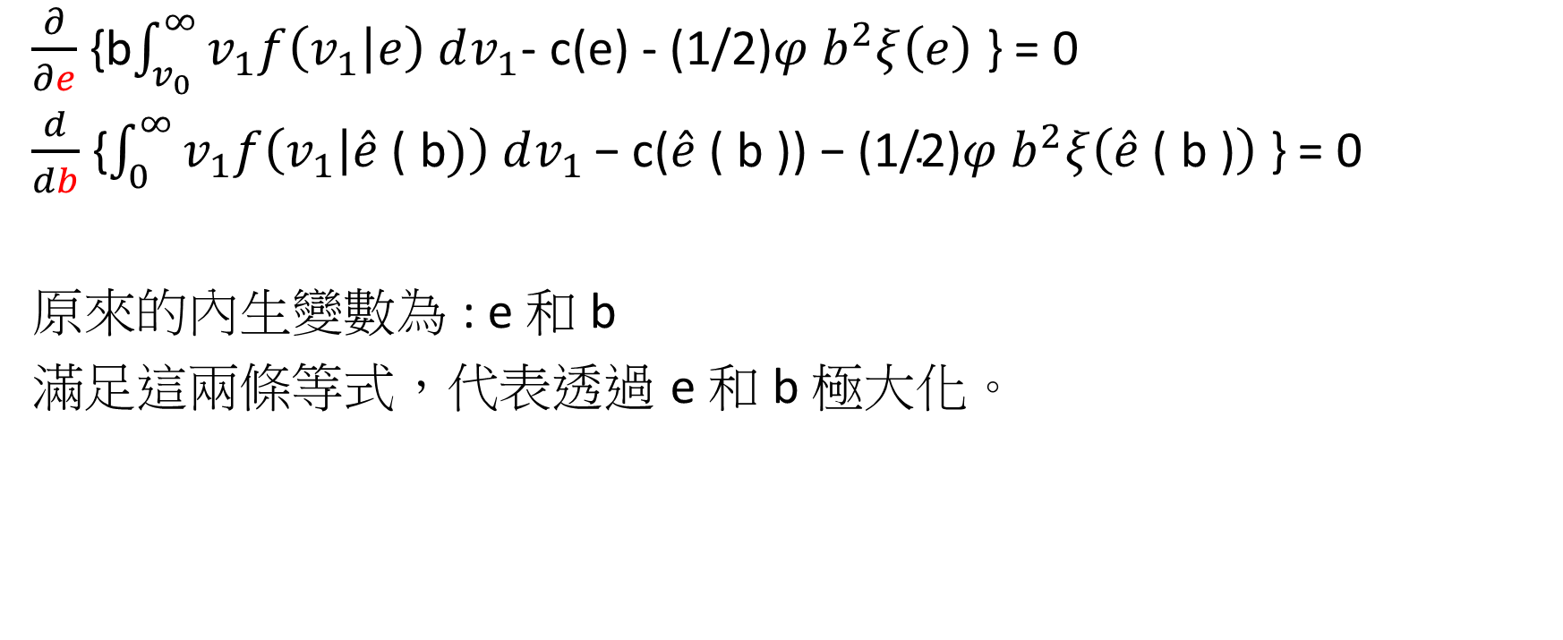
Incentive 實證設定
$\frac{∂}{∂e}$ {b$\int_{v_{0}}^{∞}{v_{1}f\left(v_{1} | e\right) dv_{1}}$- c(e) - (1/2)$φ b^{2}ξ\left(e\right)$ } = 0
$\frac{d}{db}$ {$\int_{0}^{∞}{v_{1}f\left(v_{1} | \hat{e}\text{ ( }\text{b})\right) dv_{1}}\text{− }\text{c}\text{(}\hat{e}\text{ ( }\text{b}\text{ )) − (1/2)}φ b^{2}ξ\left(\hat{e}\text{ ( }\text{b}\text{ )}\right)$ } = 0
原來的內生變數為 : e 和 b
滿足這兩條等式，代表透過 e 和 b 極大化。

Slide 57
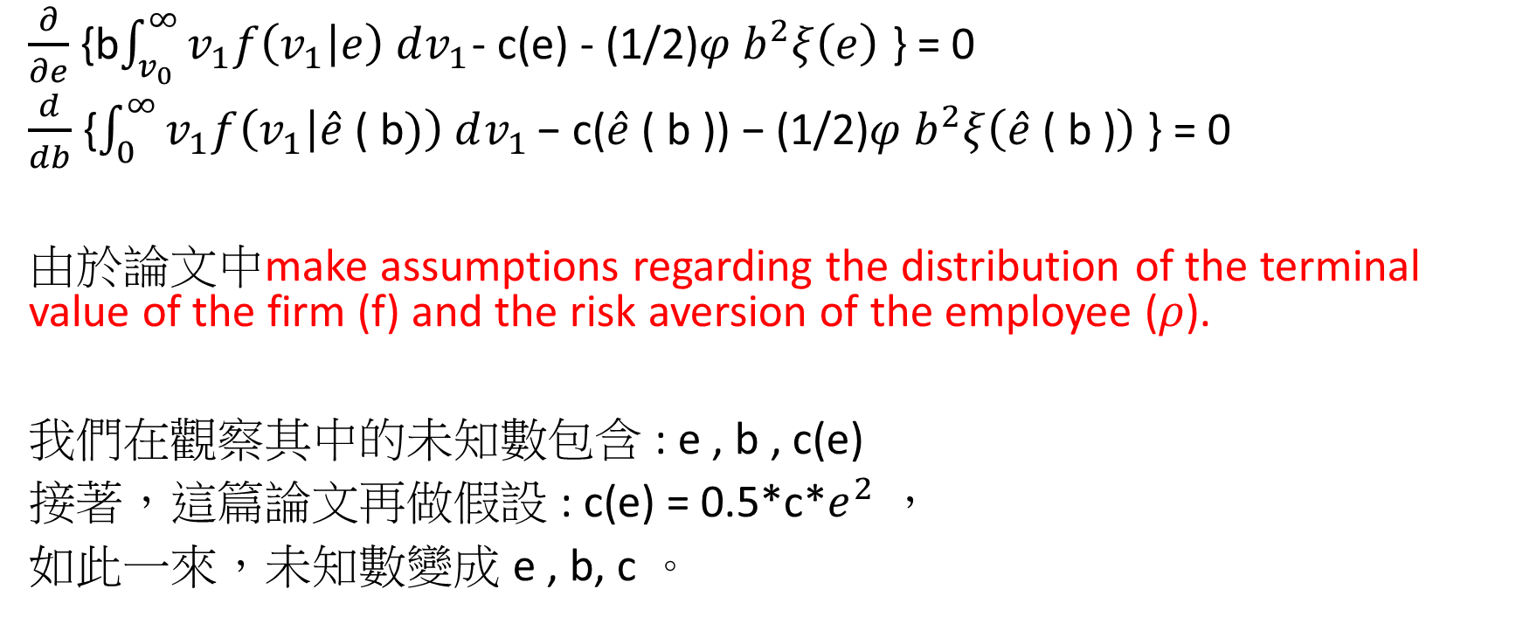
Incentive 實證設定
$\frac{∂}{∂e}$ {b$\int_{v_{0}}^{∞}{v_{1}f\left(v_{1} | e\right) dv_{1}}$- c(e) - (1/2)$φ b^{2}ξ\left(e\right)$ } = 0
$\frac{d}{db}$ {$\int_{0}^{∞}{v_{1}f\left(v_{1} | \hat{e}\text{ ( }\text{b})\right) dv_{1}}\text{− }\text{c}\text{(}\hat{e}\text{ ( }\text{b}\text{ )) − (1/2)}φ b^{2}ξ\left(\hat{e}\text{ ( }\text{b}\text{ )}\right)$ } = 0
由於論文中make assumptions regarding the distribution of the terminal value of the firm (f) and the risk aversion of the employee ($ρ$).
我們在觀察其中的未知數包含 : e , b , c(e)
接著，這篇論文再做假設 : c(e) = 0.5*c*$e^{2}$ ，
如此一來，未知數變成 e , b, c 。

Slide 58
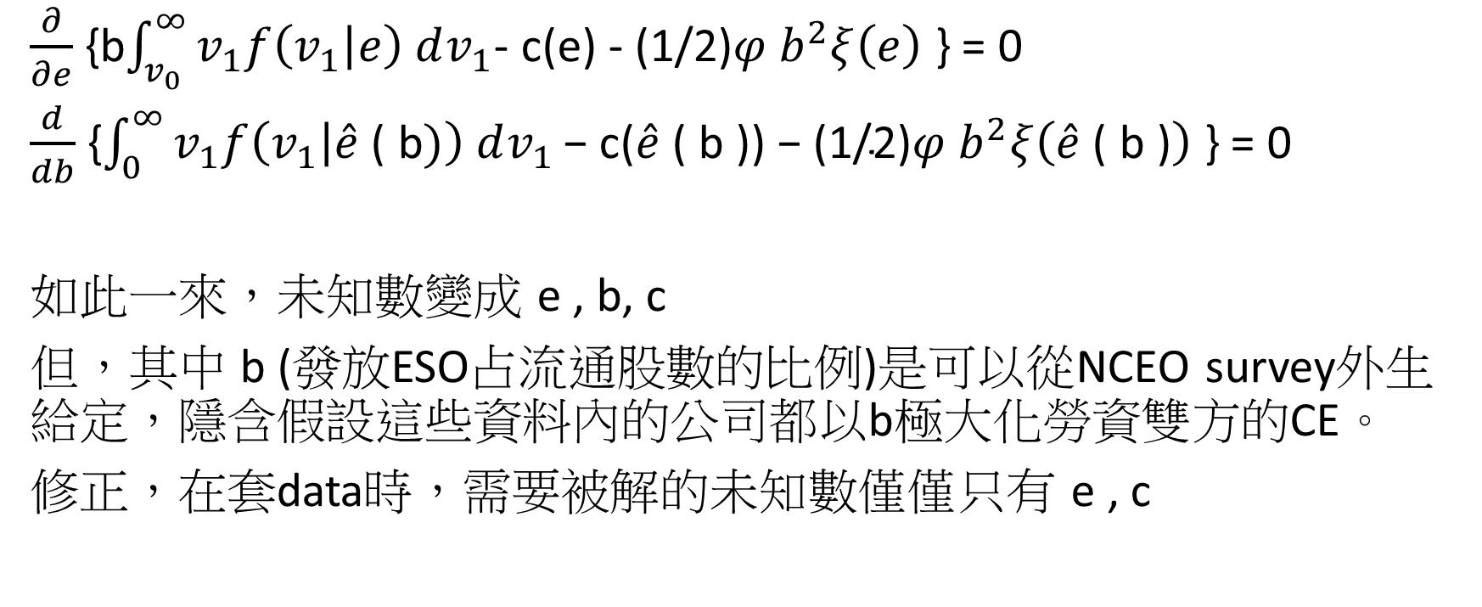
Incentive 實證設定
$\frac{∂}{∂e}$ {b$\int_{v_{0}}^{∞}{v_{1}f\left(v_{1} | e\right) dv_{1}}$- c(e) - (1/2)$φ b^{2}ξ\left(e\right)$ } = 0
$\frac{d}{db}$ {$\int_{0}^{∞}{v_{1}f\left(v_{1} | \hat{e}\text{ ( }\text{b})\right) dv_{1}}\text{− }\text{c}\text{(}\hat{e}\text{ ( }\text{b}\text{ )) − (1/2)}φ b^{2}ξ\left(\hat{e}\text{ ( }\text{b}\text{ )}\right)$ } = 0
如此一來，未知數變成 e , b, c
但，其中 b (發放ESO占流通股數的比例)是可以從NCEO survey外生給定，隱含假設這些資料內的公司都以b極大化勞資雙方的CE。
修正，在套data時，需要被解的未知數僅僅只有 e , c

Slide 59

Incentive 實證設定
Cost of effort 函數假設 1. c(e) = 0.5*c*$e^{2}$ 2. c(e) = 0.25*c*$e^{4}$ 其中: c透過上頁兩個方程式聯立求解

