Slide 1
Why do some firms give stock options to all employees, An empirical examination of theories

Slide 2
retention

Slide 3
The spot wages
If options are intended to help firms index wages to market conditions, then short run variation in the value of option packages must be of the same order of magnitude as short-run variation in spot wages.
Given our detailed NCEO data on option grants, we can compute the short-run variation in the value of option packages, and use this to infer firms’ expectations regarding wage variation.

Slide 4
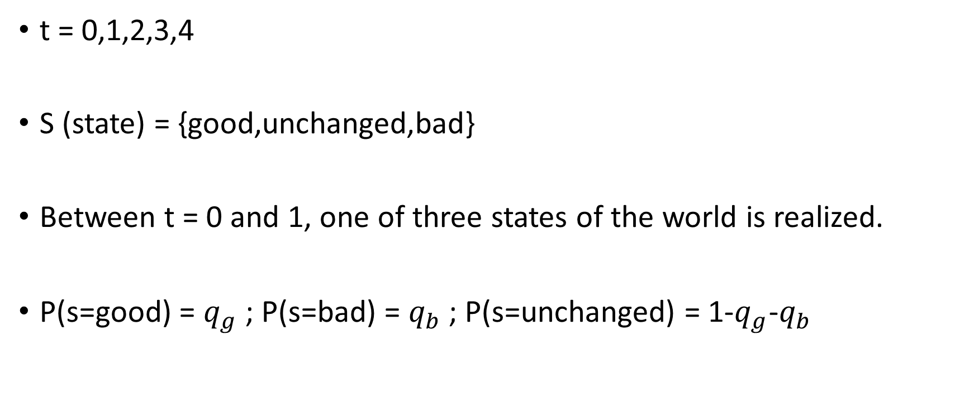
設定
t = 0,1,2,3,4
S (state) = {good,unchanged,bad}
Between t = 0 and 1, one of three states of the world is realized.
P(s=good) = $q_{g}$ ; P(s=bad) = $q_{b}$ ; P(s=unchanged) = 1-$q_{g}$-$q_{b}$

Slide 5
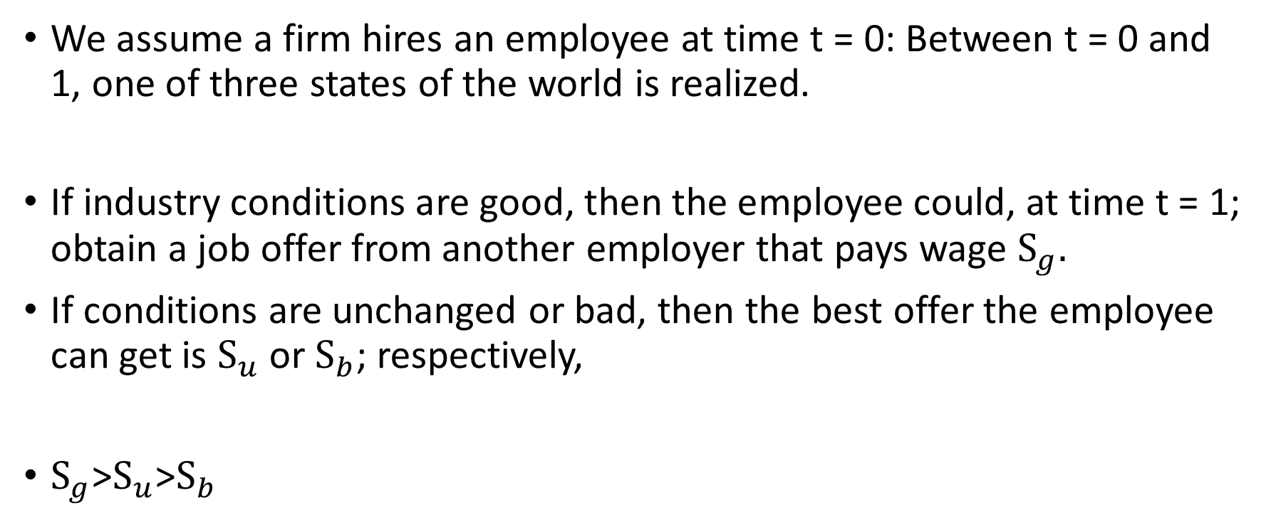
設定
We assume a firm hires an employee at time t = 0: Between t = 0 and 1, one of three states of the world is realized.
If industry conditions are good, then the employee could, at time t = 1; obtain a job offer from another employer that pays wage $S_{g}.$
If conditions are unchanged or bad, then the best offer the employee can get is $S_{u}$ or $S_{b}$; respectively,
$S_{g}$>$S_{u}$>$S_{b}$

Slide 6

設定
$v_{1}$ $≡$ stock price , t=1
E[ $v_{1}$ |good state] = $v_{g}$ E[ $v_{1}$ |unchange state] = $v_{u}$ E[ $v_{1}$ |bad state] = $v_{b}$
E[ $v_{1}$] = $v_{u}$

Slide 7
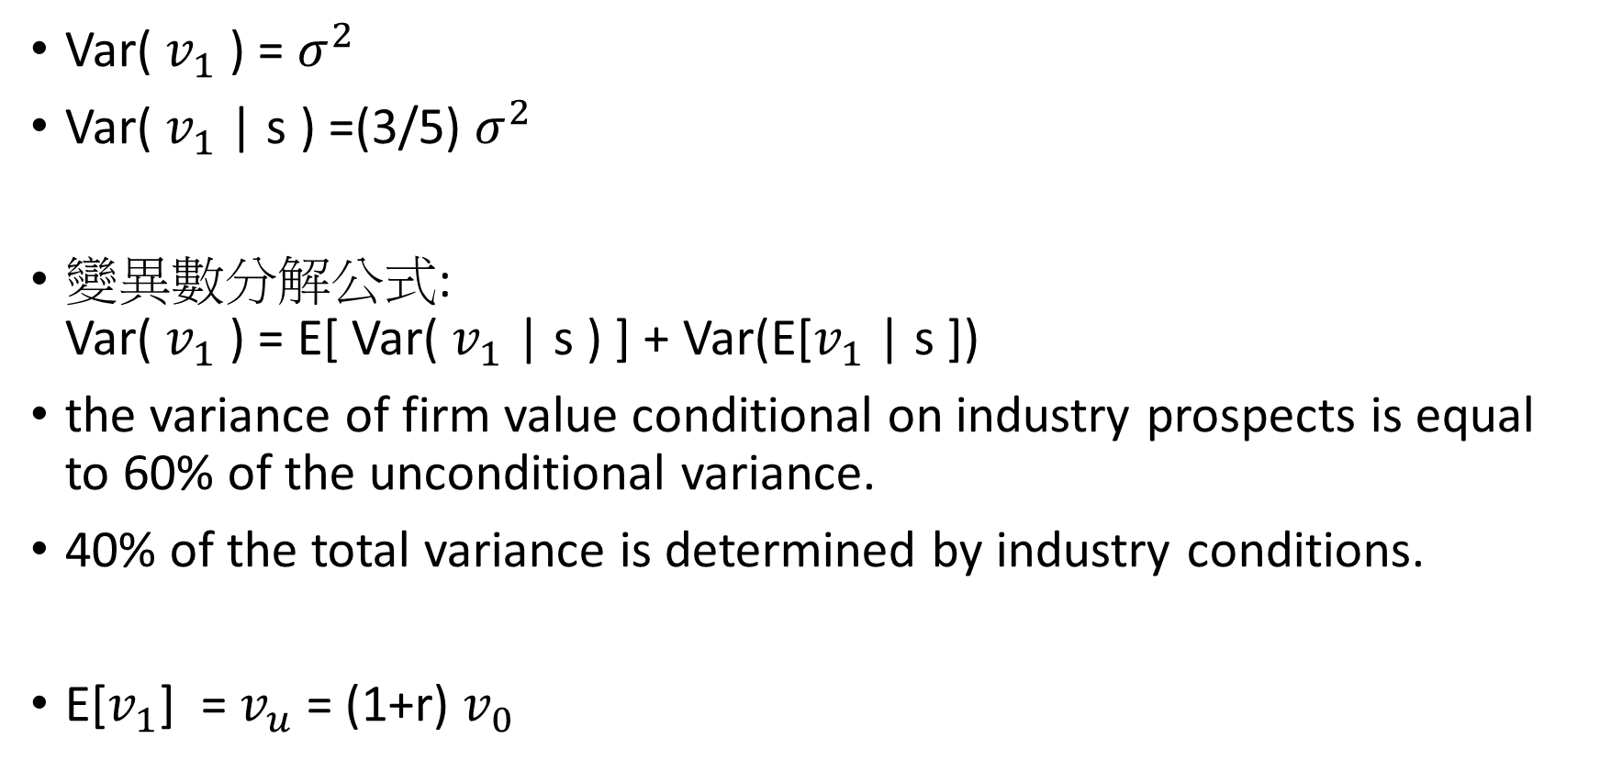
設定
Var( $v_{1}$ ) = $σ^{2}$
Var( $v_{1}$ | s ) =(3/5) $σ^{2}$
變異數分解公式: Var( $v_{1}$ ) = E[ Var( $v_{1}$ | s ) ] + Var(E[$v_{1}$ | s ])
the variance of firm value conditional on industry prospects is equal to 60% of the unconditional variance.
40% of the total variance is determined by industry conditions.
E[$v_{1}$] = $v_{u}$ = (1+r) $v_{0}$

Slide 8
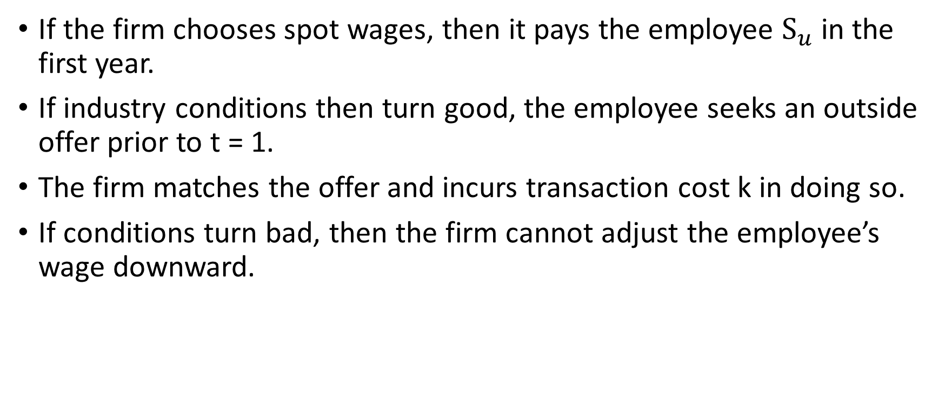
設定
If the firm chooses spot wages, then it pays the employee $S_{u}$ in the first year.
If industry conditions then turn good, the employee seeks an outside offer prior to t = 1.
The firm matches the offer and incurs transaction cost k in doing so.
If conditions turn bad, then the firm cannot adjust the employee’s wage downward.

Slide 9
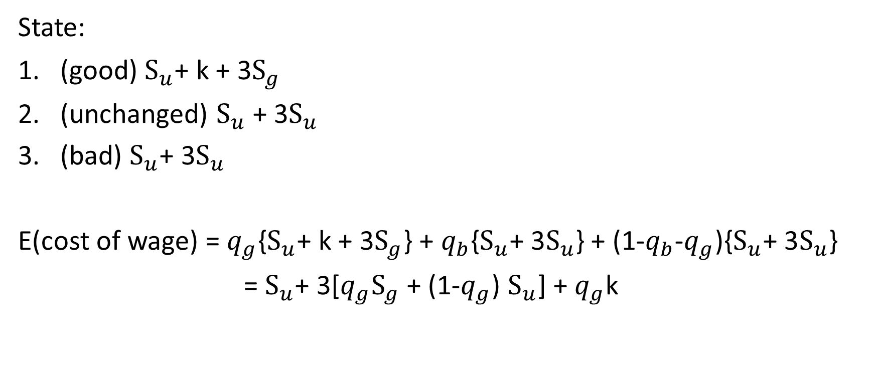
the expected cost to the firm of offering the spot wage job
State:
(good) $S_{u}$+ k + 3$S_{g}$
(unchanged) $S_{u}$ + 3$S_{u}$
(bad) $S_{u}\text{+ 3}S_{u}$
E(cost of wage) = $q_{g}${$S_{u}$+ k + 3$S_{g}$} + $q_{b}${$S_{u}\text{+ 3}S_{u}$} + (1-$q_{b}$-$q_{g}$){$S_{u}\text{+ 3}S_{u}$}
= $S_{u}$+ 3[$q_{g}S_{g}$ + (1-$q_{g}$) $S_{u}$] + $q_{g}$k

Slide 10
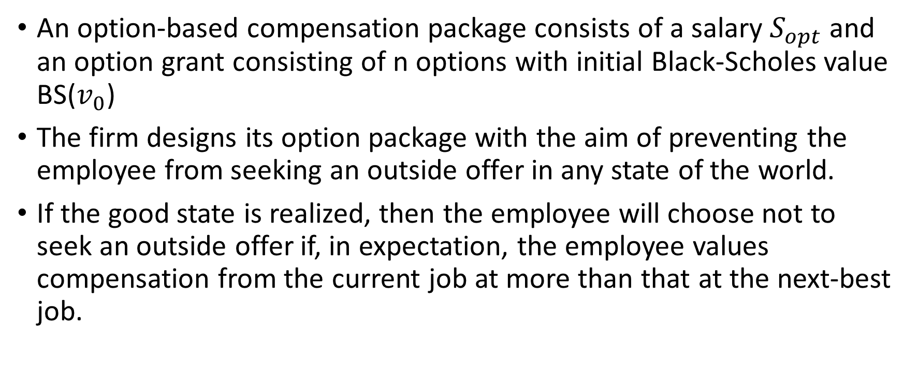
option-based compensation package
An option-based compensation package consists of a salary $S_{opt}$and an option grant consisting of n options with initial Black-Scholes value BS($v_{0}$)
The firm designs its option package with the aim of preventing the employee from seeking an outside offer in any state of the world.
If the good state is realized, then the employee will choose not to seek an outside offer if, in expectation, the employee values compensation from the current job at more than that at the next-best job.

Slide 11
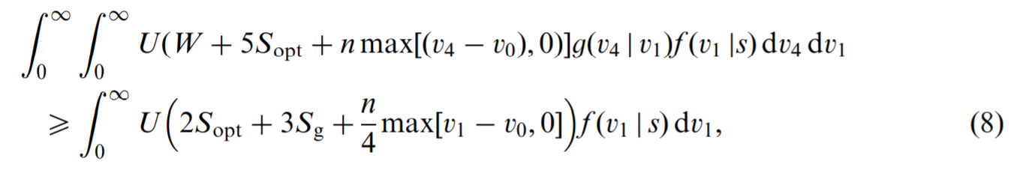
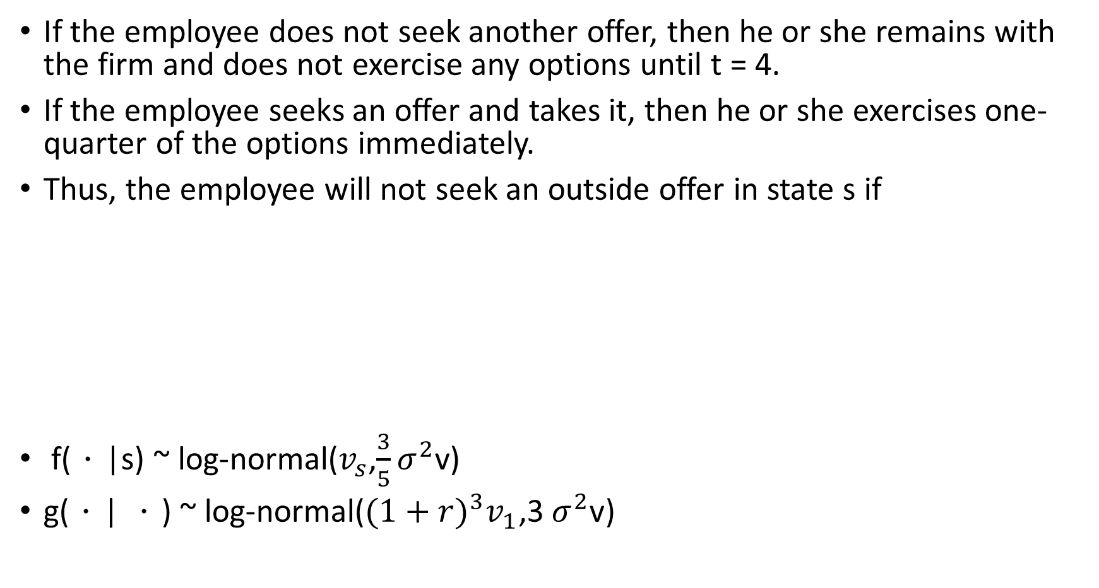
option-based compensation package
If the employee does not seek another offer, then he or she remains with the firm and does not exercise any options until t = 4.
If the employee seeks an offer and takes it, then he or she exercises one-quarter of the options immediately.
Thus, the employee will not seek an outside offer in state s if
f(．|s) ~ log-normal($v_{s}$,$\frac{3}{5}σ^{2}$v)
g(．| ．) ~ log-normal(${(1+r)}^{3}v_{1}$,3$σ^{2}$v)

Slide 12
option-based compensation package(公司角度)
The firm prefers offering the option-based job to the spot wage job if

Slide 13
量化 retention
We also compute the ‘‘retention value’’—that is, the Black-Scholes dollar value of options forfeited in the event the employee leaves—under the good and bad industry states.

Slide 14
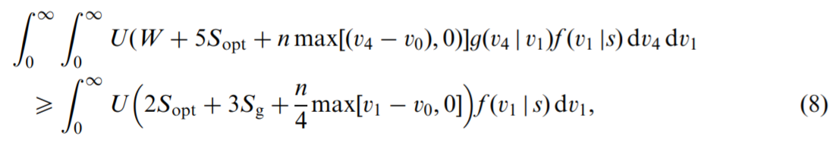

問題
These inequalities allow us to compute upper bounds on $S_{g}$; $S_{u}$; and $S_{b}$; and a lower bound on k.

Slide 15
