Slide 1
Why do some firms give stock options to all employees?: An empirical examination of alternative theories (修正)
Paul Oyer, Scott Schaefer

Slide 2

錯誤驗證
If CE = E[ $\tilde{x}$ ] + (1/2)$φ Var(\tilde{x} \text{)}$ , (1/2)$φ Var(\tilde{x} \text{)}$ >0
E[U( $\tilde{x}$ )] = U(CE) = U(E[ $\tilde{x}$ ] + (1/2)$φ Var(\tilde{x} \text{)}$ ) > U(E[ $\tilde{x}$ ] )
Risk averse : E[U( $\tilde{x}$ )] < U(E[ $\tilde{x}$ ] )
Risk lover : E[U( $\tilde{x}$ )] > U(E[ $\tilde{x}$ ] )

Slide 3
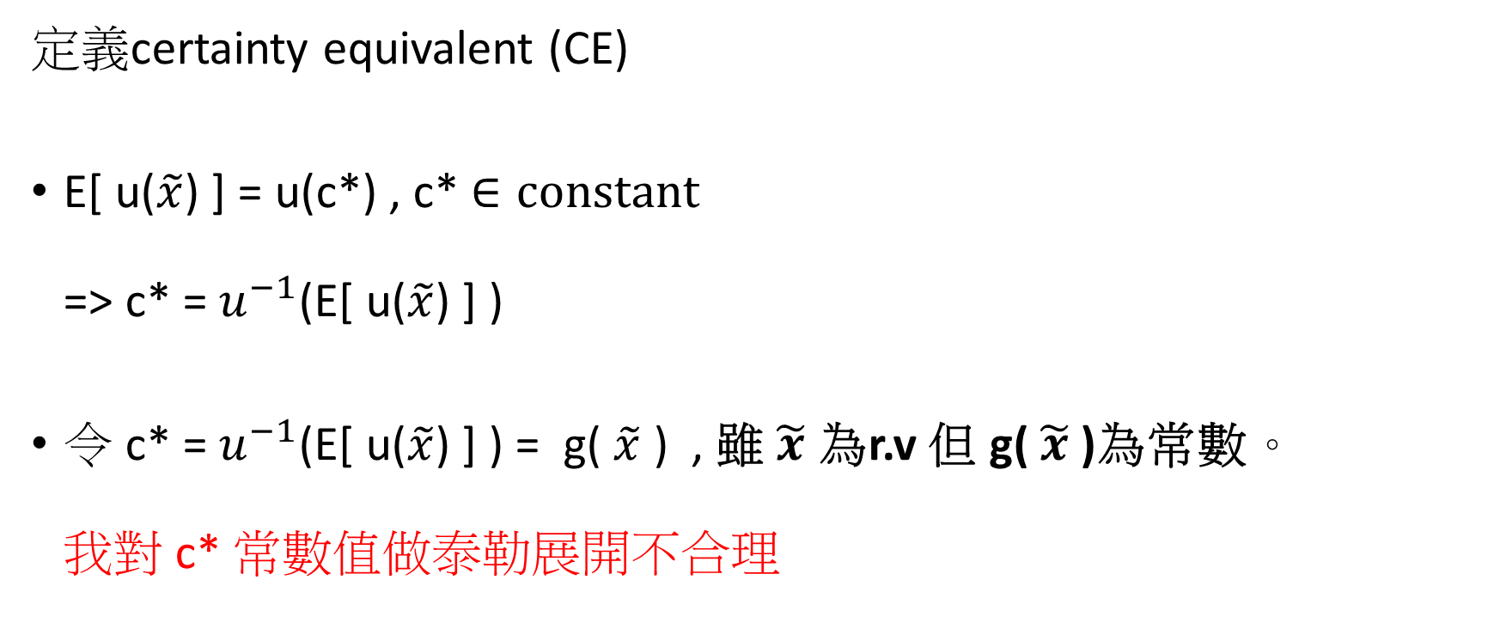
更新上次的作法
定義certainty equivalent (CE)
E[ u($\tilde{x}$) ] = u(c*) , c* $∈constant$ => c* = $u^{−1}$(E[ u($\tilde{x}$) ] )
令 c* = $u^{−1}$(E[ u($\tilde{x}$) ] ) = g( $\tilde{x}$ ) , 雖 $\tilde{x}$ 為r.v 但 g( $\tilde{x}$ )為常數。 我對 c* 常數值做泰勒展開不合理

Slide 4
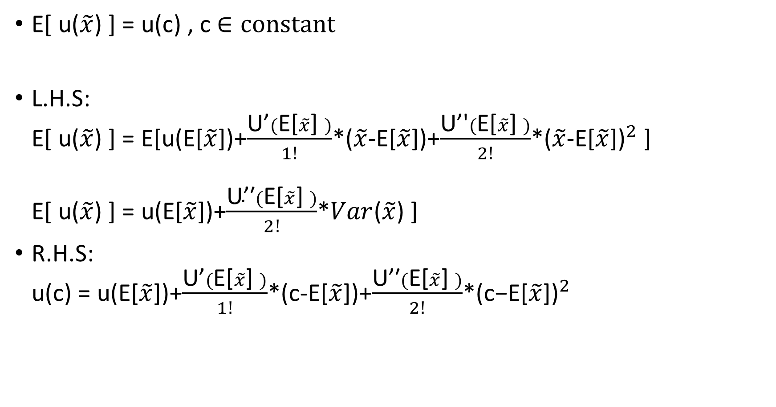
E[ u($\tilde{x}$) ] = u(c) , c $∈constant$
L.H.S: E[ u($\tilde{x}$) ] = E[u(E[$\tilde{x}$])+$\frac{\text{U}\text{’}(\text{E}\text{[}\tilde{x}\text{] })}{1!}$*($\tilde{x}$-E[$\tilde{x}$])+$\frac{\text{U}\text{’′}(\text{E}\text{[}\tilde{x}\text{] })}{2!}$*${\text{(}\tilde{x}\text{−}\text{E}\text{[}\tilde{x}\text{])}}^{2}$ ] E[ u($\tilde{x}$) ] = u(E[$\tilde{x}$])+$\frac{\text{U}\text{’′}(\text{E}\text{[}\tilde{x}\text{] })}{2!}$*$Var$($\tilde{x}$) ]
R.H.S: u(c) = u(E[$\tilde{x}$])+$\frac{\text{U}\text{’}(\text{E}\text{[}\tilde{x}\text{] })}{1!}$*(c-E[$\tilde{x}$])+$\frac{\text{U}\text{’′}(\text{E}\text{[}\tilde{x}\text{] })}{2!}$*${\text{(}\text{c}\text{−}\text{E}\text{[}\tilde{x}\text{])}}^{2}$

Slide 5
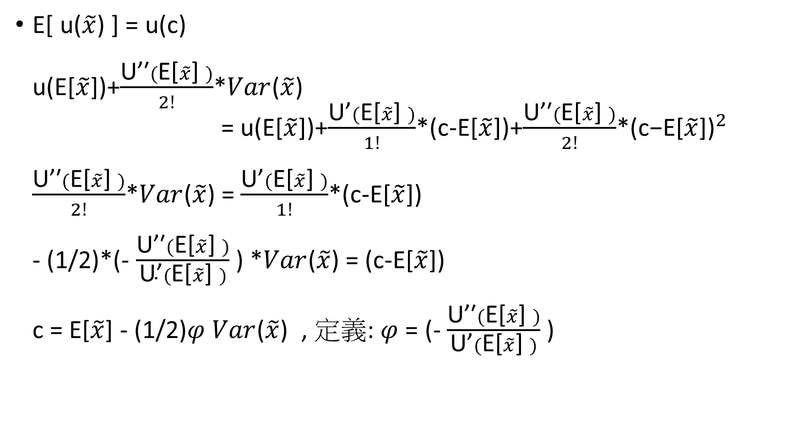
E[ u($\tilde{x}$) ] = u(c) u(E[$\tilde{x}$])+$\frac{\text{U}\text{’′}(\text{E}\text{[}\tilde{x}\text{] })}{2!}$*$Var$($\tilde{x}$) = u(E[$\tilde{x}$])+$\frac{\text{U}\text{’}(\text{E}\text{[}\tilde{x}\text{] })}{1!}$*(c-E[$\tilde{x}$])+$\frac{\text{U}\text{’′}(\text{E}\text{[}\tilde{x}\text{] })}{2!}$*${\text{(}\text{c}\text{−}\text{E}\text{[}\tilde{x}\text{])}}^{2}$ $\frac{\text{U}\text{’′}(\text{E}\text{[}\tilde{x}\text{] })}{2!}$*$Var$($\tilde{x}$) = $\frac{\text{U}\text{’}(\text{E}\text{[}\tilde{x}\text{] })}{1!}$*(c-E[$\tilde{x}$]) - (1/2)*(- $\frac{\text{U}\text{’′}(\text{E}\text{[}\tilde{x}\text{] })}{\text{U}\text{’}(\text{E}\text{[}\tilde{x}\text{] })}$ ) *$Var$($\tilde{x}$) = (c-E[$\tilde{x}$]) c = E[$\tilde{x}$] - (1/2)$φ Var$($\tilde{x}$) , 定義: $φ$= (- $\frac{\text{U}\text{’′}(\text{E}\text{[}\tilde{x}\text{] })}{\text{U}\text{’}(\text{E}\text{[}\tilde{x}\text{] })}$ )
0

Slide 6
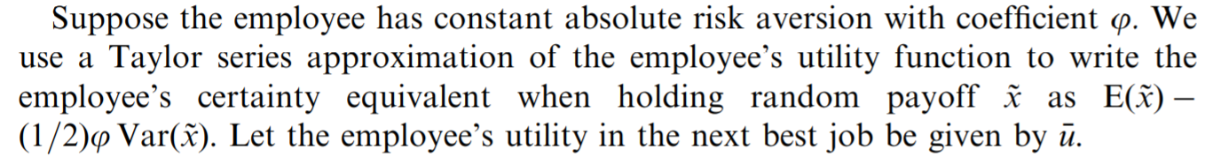

Slide 7
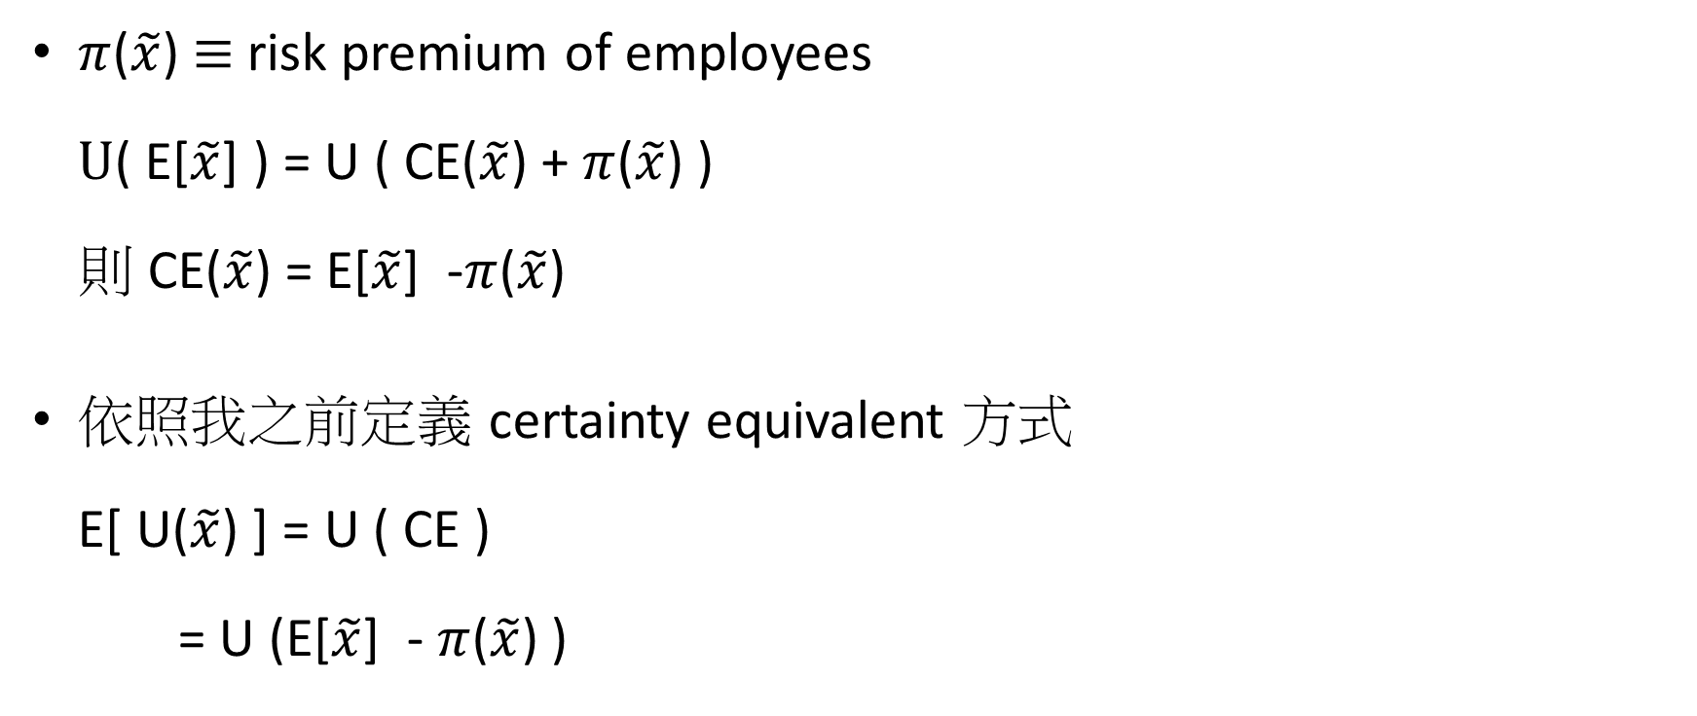
投資學定義方式(更有解釋性)
$π$($\tilde{x}$) $≡$ risk premium of employees $U$( E[$\tilde{x}$] ) = U ( CE($\tilde{x}$) + $π$($\tilde{x}$) ) 則 CE($\tilde{x}$) = E[$\tilde{x}$] -$π$($\tilde{x}$)
依照我之前定義 certainty equivalent 方式 E[ U($\tilde{x}$) ] = U ( CE ) = U (E[$\tilde{x}$] -$π$($\tilde{x}$) )

Slide 8
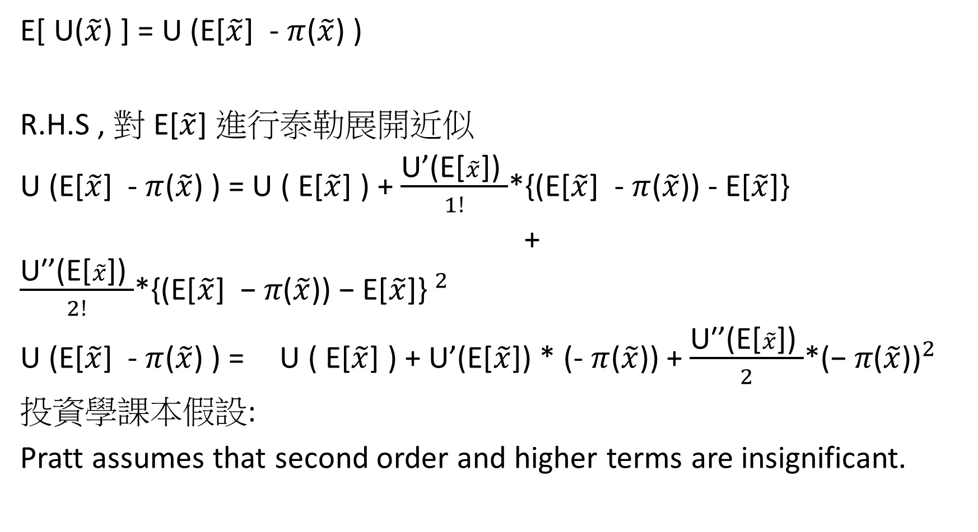
E[ U($\tilde{x}$) ] = U (E[$\tilde{x}$] -$π$($\tilde{x}$) )
R.H.S , 對 E[$\tilde{x}$] 進行泰勒展開近似
U (E[$\tilde{x}$] -$π$($\tilde{x}$) ) = U ( E[$\tilde{x}$] ) + $\frac{\text{U}\text{’(}\text{E}\text{[}\tilde{x}\text{]}\text{)} }{1!}$*{(E[$\tilde{x}$] -$π$($\tilde{x}$)) - E[$\tilde{x}$]}
+ $\frac{\text{U}\text{′}\text{’(}\text{E}\text{[}\tilde{x}\text{]) }}{2!}$*${\text{\{(}\text{E}\text{[}\tilde{x}\text{] −} π\text{(}\tilde{x}\text{)) − }\text{E}\text{[}\tilde{x}\text{]\} }}^{2}$
U (E[$\tilde{x}$] -$π$($\tilde{x}$) ) = U ( E[$\tilde{x}$] ) + $\text{U}\text{’(}\text{E}\text{[}\tilde{x}\text{]) }$* (-$π$($\tilde{x}$)) + $\frac{\text{U}\text{′’(}\text{E}\text{[}\tilde{x}\text{]) }}{2}$*${\text{(−} π\text{(}\tilde{x}\text{))}}^{2}$
投資學課本假設:
Pratt assumes that second order and higher terms are insignificant.
0

Slide 9
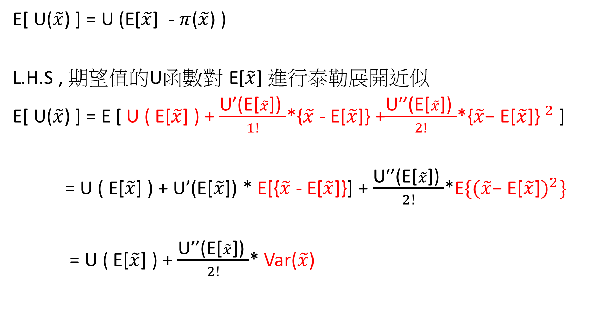
E[ U($\tilde{x}$) ] = U (E[$\tilde{x}$] -$π$($\tilde{x}$) )
L.H.S , 期望值的U函數對 E[$\tilde{x}$] 進行泰勒展開近似
E[ U($\tilde{x}$) ] = E [ U ( E[$\tilde{x}$] ) + $\frac{\text{U}\text{’(}\text{E}\text{[}\tilde{x}\text{]}\text{)} }{1!}$*{$\tilde{x}$ - E[$\tilde{x}$]} +$\frac{\text{U}\text{′’(}\text{E}\text{[}\tilde{x}\text{]) }}{2!}$*${\text{\{}\tilde{x}\text{− }\text{E}\text{[}\tilde{x}\text{]\} }}^{2}$ ]
= U ( E[$\tilde{x}$] ) + $\text{U}\text{’(}\text{E}\text{[}\tilde{x}\text{]}\text{)}$ * E[{$\tilde{x}$ - E[$\tilde{x}$]}] + $\frac{\text{U}\text{′’(}\text{E}\text{[}\tilde{x}\text{]) }}{2!}$*E${\text{\{(}\tilde{x}\text{− }\text{E}\text{[}\tilde{x}\text{]})}^{2}\}$
= U ( E[$\tilde{x}$] ) + $\frac{\text{U}\text{′’(}\text{E}\text{[}\tilde{x}\text{]) }}{2!}$* Var($\tilde{x}$)
0

Slide 10

L.H.S = R.H.S
E[ U($\tilde{x}$) ] = U (E[$\tilde{x}$] -$π$($\tilde{x}$) )
U ( E[$\tilde{x}$] ) + $\frac{\text{U}\text{′’(}\text{E}\text{[}\tilde{x}\text{]) }}{2!}$* Var($\tilde{x}$) = U ( E[$\tilde{x}$] ) - $\text{U}\text{’(}\text{E}\text{[}\tilde{x}\text{]) }$*$π$($\tilde{x}$)
$\frac{\text{U}\text{′’(}\text{E}\text{[}\tilde{x}\text{]) }}{2!}$* Var($\tilde{x}$) = - $\text{U}\text{’(}\text{E}\text{[}\tilde{x}\text{]) }$*$π$($\tilde{x}$)
$π$($\tilde{x}$) = (1/2) (- $\frac{\text{U}\text{′’(}\text{E}\text{[}\tilde{x}\text{]) }}{\text{U}\text{’(}\text{E}\text{[}\tilde{x}\text{])}}$) * Var($\tilde{x}$)
$π$($\tilde{x}$) = (1/2)$φ$Var($\tilde{x}$)

Slide 11

$π$($\tilde{x}$) $≡$ risk premium of employees $U$( E[$\tilde{x}$] ) = U ( CE($\tilde{x}$) + $π$($\tilde{x}$) ) 則 CE($\tilde{x}$) = E[$\tilde{x}$] -$π$($\tilde{x}$)
根據剛剛推得的結果 $π$($\tilde{x}$) = - (1/2)$φ$Var($\tilde{x}$) ，帶入上式 CE($\tilde{x}$) = E[$\tilde{x}$] -$π$($\tilde{x}$) = E[$\tilde{x}$] - (1/2)$φ$Var($\tilde{x}$) = E[$\tilde{x}$] - (1/2)$φb^{2}ξ\left(e\right)$ 其中: $ξ\left(e\right)$ $≡$the variance of max[$v_{1}$ - $v_{0}$ , 0] Var($\tilde{x}$) = Var(max[b($v_{1}$ - $v_{0}$) , 0] = $b^{2}$* Var(max[$v_{1}$ - $v_{0}$ , 0] ) = $b^{2}ξ\left(e\right)$

Slide 12
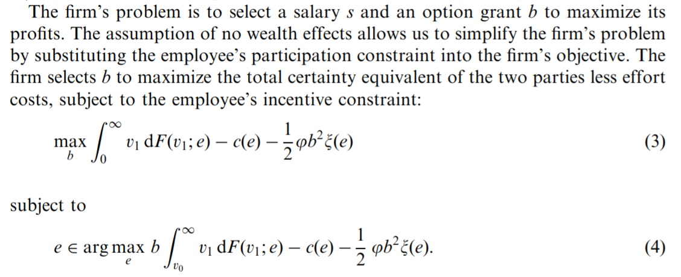
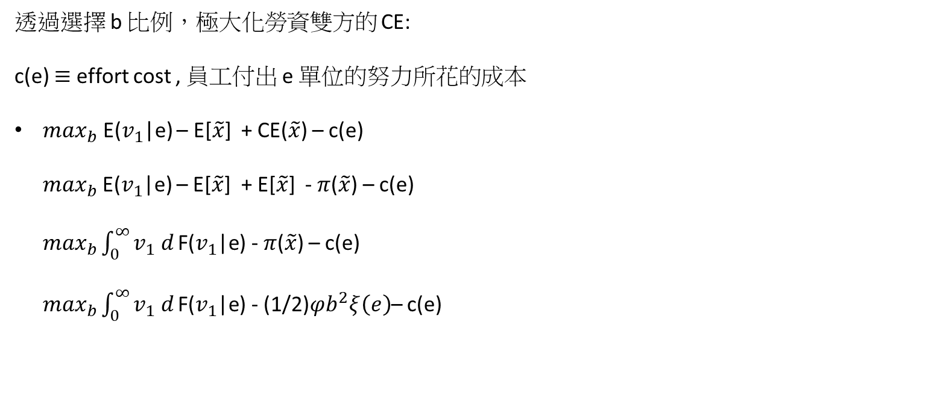
透過選擇 b 比例，極大化勞資雙方的 CE:
c(e) $≡$ effort cost , 員工付出 e 單位的努力所花的成本
$\max_{b}$ E($v_{1}$|e) – E[$\tilde{x}$] + CE($\tilde{x}$) – c(e) $\max_{b}$E($v_{1}$|e) – E[$\tilde{x}$] + E[$\tilde{x}$] - $π$($\tilde{x}$) – c(e) $\max_{b}\int_{0}^{∞}{v_{1} d}\text{F}\text{(}v_{1}\text{|}\text{e}\text{)}$ - $π$($\tilde{x}$) – c(e) $\max_{b}\int_{0}^{∞}{v_{1} d}\text{F}\text{(}v_{1}\text{|}\text{e}\text{)}$ - (1/2)$φb^{2}ξ\left(e\right)$– c(e)

Slide 13
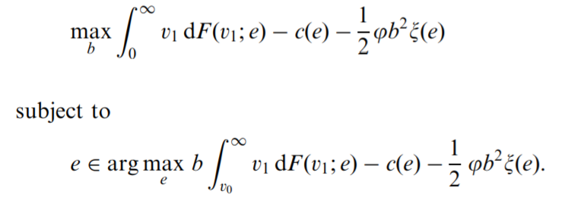
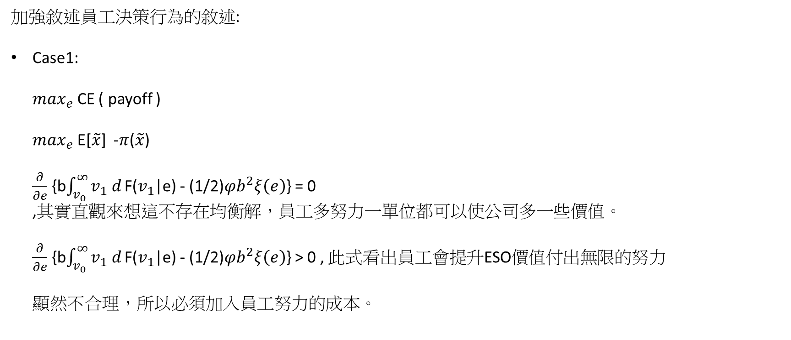
加強敘述員工決策行為的敘述:
Case1: $\max_{e}$ CE ( payoff ) $\max_{e}$ E[$\tilde{x}$] -$π$($\tilde{x}$) $\frac{∂}{∂e}$ {b$\int_{v_{0}}^{∞}{v_{1} d}\text{F}\text{(}v_{1}\text{|}\text{e}\text{)}$ - (1/2)$φb^{2}ξ\left(e\right)$} = 0 ,其實直觀來想這不存在均衡解，員工多努力一單位都可以使公司多一些價值。 $\frac{∂}{∂e}$ {b$\int_{v_{0}}^{∞}{v_{1} d}\text{F}\text{(}v_{1}\text{|}\text{e}\text{)}$ - (1/2)$φb^{2}ξ\left(e\right)$} > 0 , 此式看出員工會提升ESO價值付出無限的努力 顯然不合理，所以必須加入員工努力的成本。

Slide 14

加強敘述員工決策行為的敘述:
Case2: $\max_{e}$ CE ( payoff ) – c(e) $\max_{e}$ E[$\tilde{x}$] -$π$($\tilde{x}$) – c(e) $\frac{∂}{∂e}$ {b$\int_{v_{0}}^{∞}{v_{1} d}\text{F}\text{(}v_{1}\text{|}\text{e}\text{)}$ - (1/2)$φb^{2}ξ\left(e\right)$ – c(e)} = 0 $\frac{∂}{∂e}$ { CE ( payoff ) } = $\frac{∂}{∂e}$ {c(e)} , 員工增加一單位努力所增加的certainty equivalent 等於增加的努力成本時，即均衡。

Slide 15
最終均衡解
This equation has an intuitive interpretation.
The left-hand side is the amount by which the value captured by the firm increases when b increases by a small amount.
The right-hand side is the amount by which the employee’s risk premium increases when the firm increases b

