Slide 1
Interest Rate Derivatives: The Standard Market Models 張歆樺

Slide 2
Outline
Bond options
Interest rate caps and floors
European swap options

Slide 3
Bond options
A bond option is an option to buy or sell a particular bond by a particular date for a particular price. In addition to trading in the over-the-counter market, bond options are frequently embedded in bonds when they are issued to make them more attractive to either the issuer or potential purchasers.

Slide 4
Callable bond
This is a bond that contains provisions allowing the issuing firm to buy back the bond at a predetermined price at certain times in the future. The holder of such a bond has sold a call option to the issuer. The strike price or call price in the option is the predetermined price that must be paid by the issuer to the holder.
Callable bonds cannot usually be called for the first few years of their life. (This is known as the lockout period.) After that, the call price is usually a decreasing function of time.
Bonds with call features generally offer higher yields than bonds with no call features

Slide 5
Puttable bond
This contains provisions that allow the holder to demand early redemption at a predetermined price at certain times in the future. The holder of such a bond has purchased a put option on the bond as well as the bond itself. Because the put option increases the value of the bond to the holder, bonds with put features provide lower yields than bonds with no put features.

Slide 6

European Bond Options
The assumption made in the standard market model for valuing European bond options is that the forward bond price has a volatility $σ_{B}$. This allows Black’s model in Section 28.6 to be used.

Slide 7
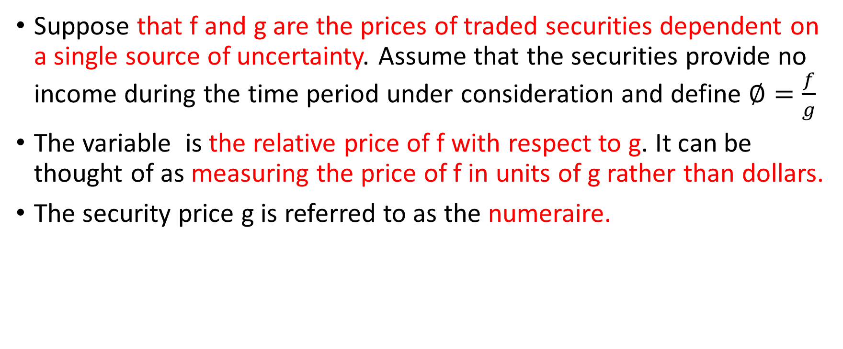
The Equivalent Martingale Measure Result
Suppose that f and g are the prices of traded securities dependent on a single source of uncertainty. Assume that the securities provide no income during the time period under consideration and define $∅=\frac{f}{g}$
The variable is the relative price of f with respect to g. It can be thought of as measuring the price of f in units of g rather than dollars.
The security price g is referred to as the numeraire.

Slide 8
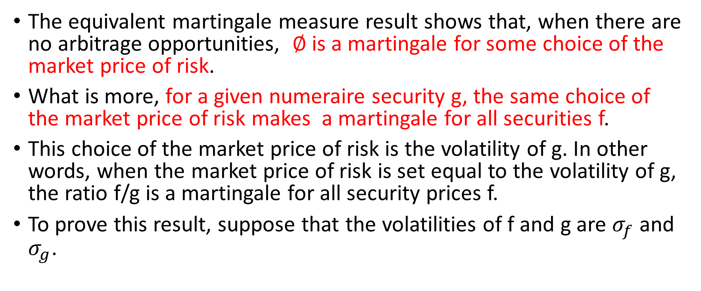
The Equivalent Martingale Measure Result
The equivalent martingale measure result shows that, when there are no arbitrage opportunities, $∅$is a martingale for some choice of the market price of risk.
What is more, for a given numeraire security g, the same choice of the market price of risk makes a martingale for all securities f.
This choice of the market price of risk is the volatility of g. In other words, when the market price of risk is set equal to the volatility of g, the ratio f/g is a martingale for all security prices f.
To prove this result, suppose that the volatilities of f and g are $σ_{f}$ and $σ_{g}$.

Slide 9
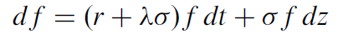
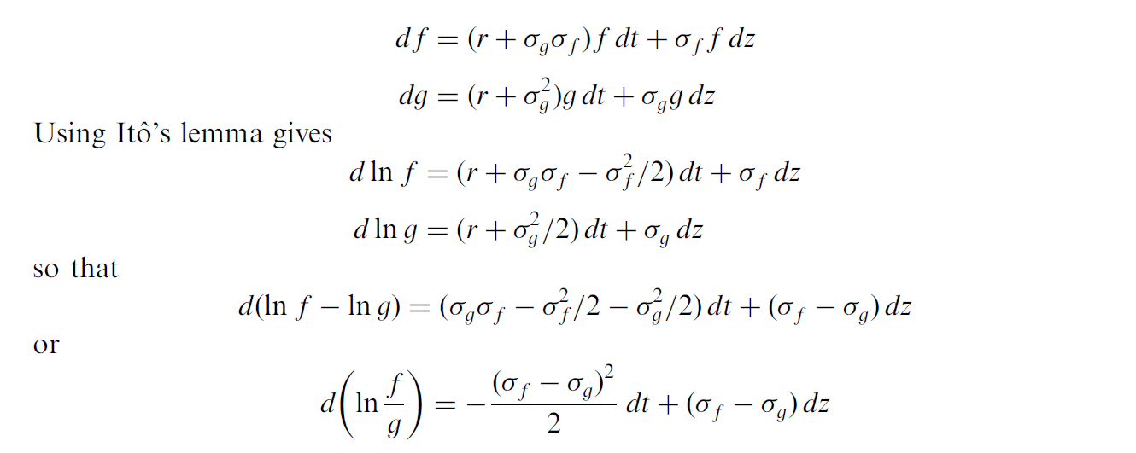

The Equivalent Martingale Measure Result
From equation , the parameter $λ$ is known as the market price of risk. Consider a world where the market price of risk is $σ_{g}.$

Slide 10
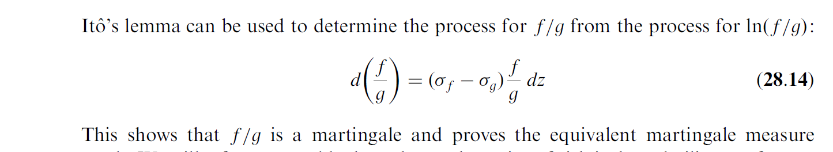
The Equivalent Martingale Measure Result

Slide 11
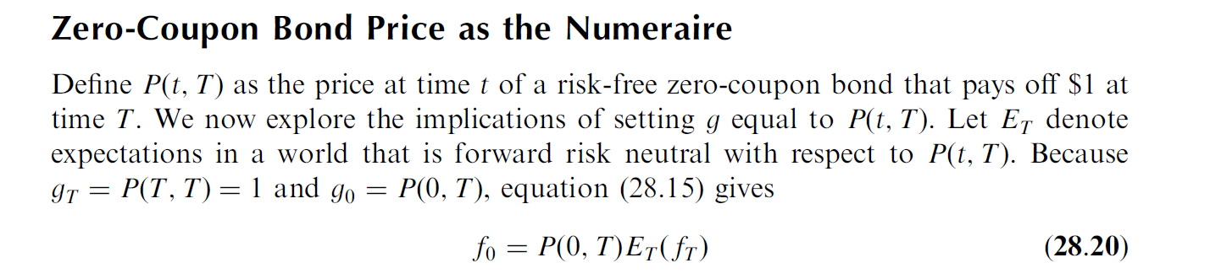
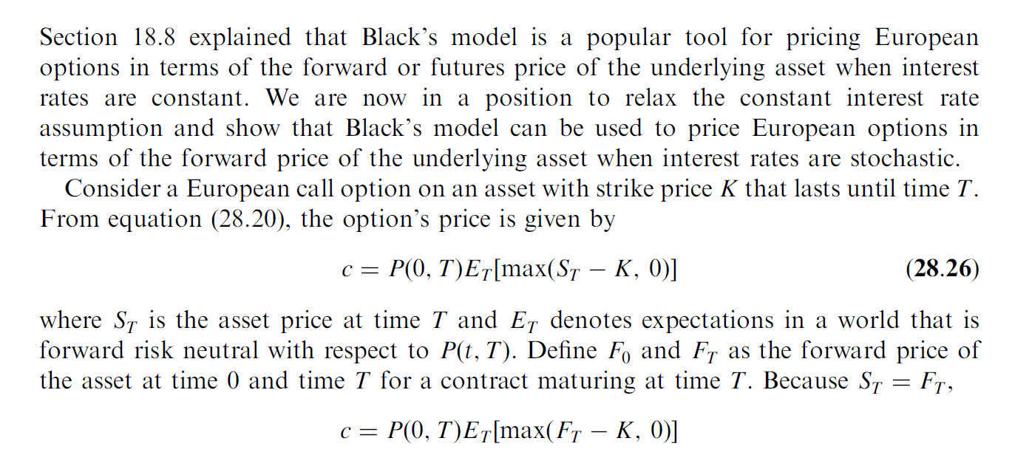
Black’s model revisited

Slide 12
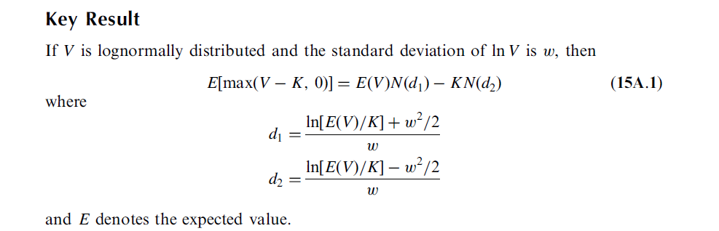
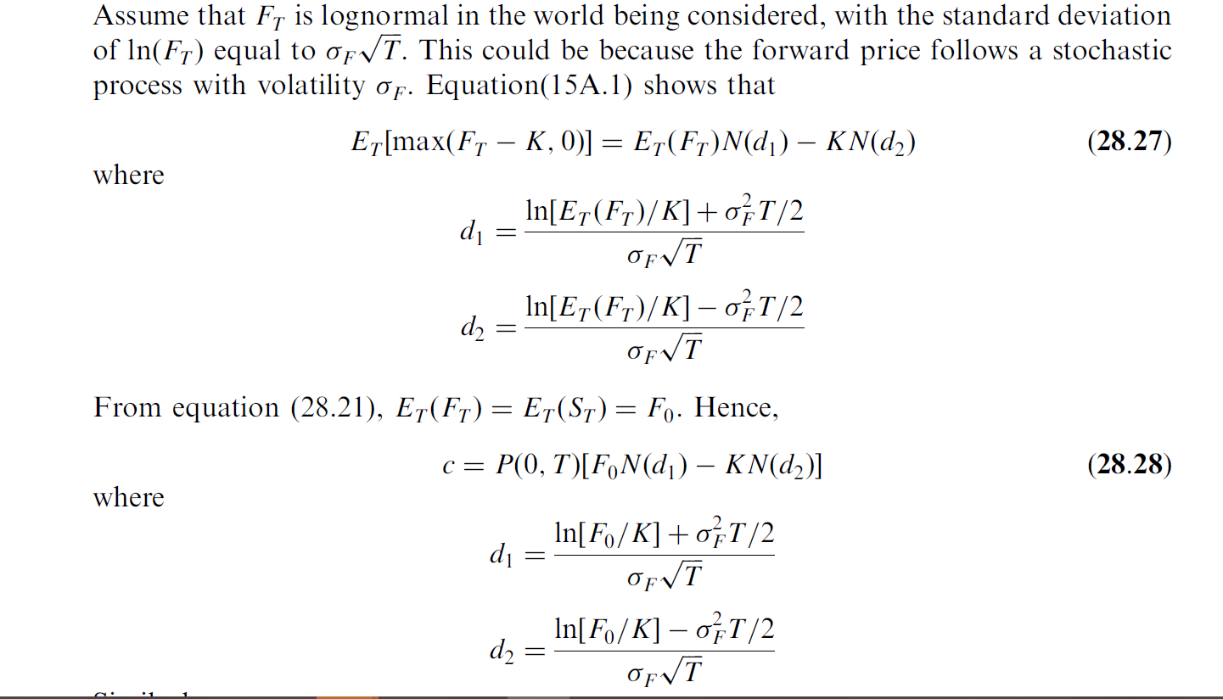
Black’s model revisited

Slide 13
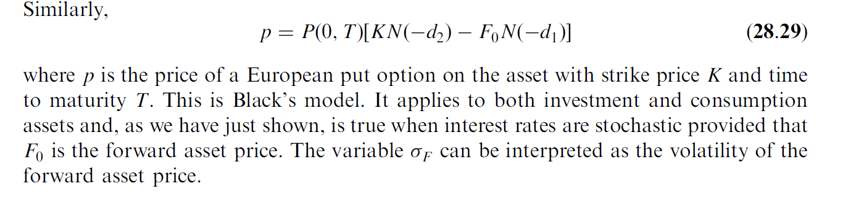
Black’s model revisited

Slide 14
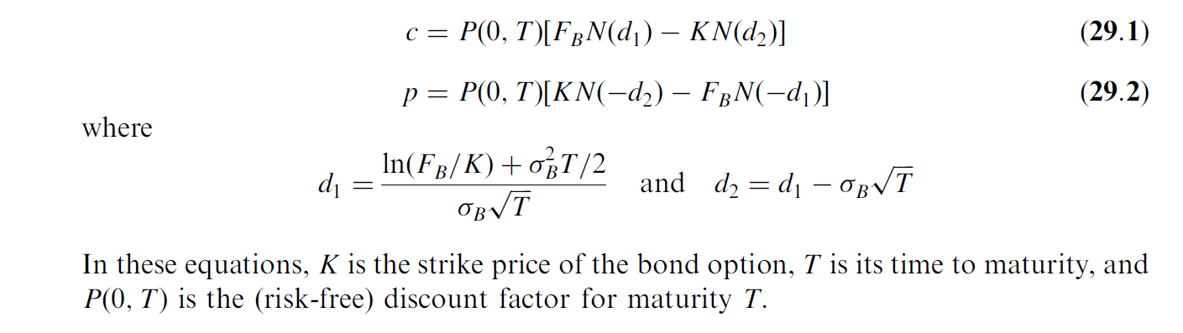

European Bond Options
In equations (28.28) and (28.29), F is set equal to $σ_{B}$ and $F_{0}$ is set equal to the forward bond price $F_{B}$, so that

Slide 15
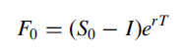
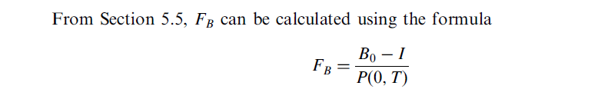

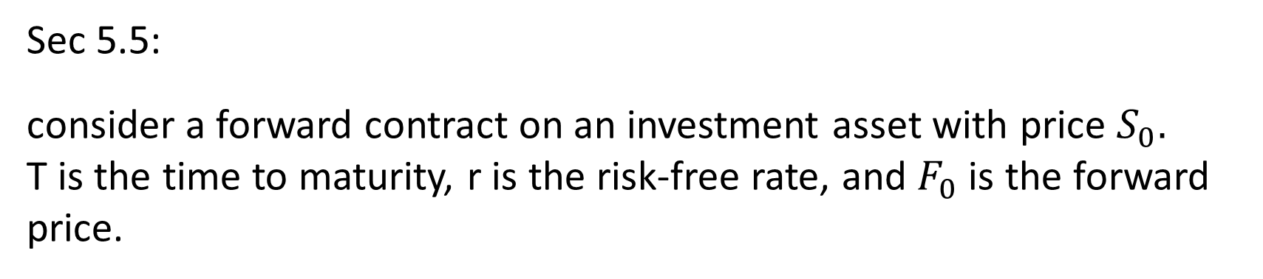
European Bond Options
Sec 5.5:
consider a forward contract on an investment asset with price $S_{0}.$
T is the time to maturity, r is the risk-free rate, and $F_{0}$ is the forward price.
where $B_{0}$ is the bond price at time zero and I is the present value of the coupons that will be paid during the life of the option. In this formula, both the spot bond price and the forward bond price are cash prices rather than quoted prices.

Slide 16
Interest rate caps and floors
Interest rate caps can best be understood by first considering a floating-rate note where the interest rate is reset periodically equal to LIBOR. The time between resets is known as the tenor. Suppose the tenor is 3 months. The interest rate on the note for the first 3 months is the initial 3-month LIBOR rate; the interest rate for the next 3 months is set equal to the 3-month LIBOR rate prevailing in the market at the 3-month point; and so on.
An interest rate cap is designed to provide insurance against the rate of interest on the floating-rate note rising above a certain level. This level is known as the cap rate.

Slide 17
Interest rate caps example
Suppose that the principal amount is $10 million, the tenor is 3 months, the life of the cap is 5 years, and the cap rate is 4%. (Because the payments are made quarterly, this cap rate is expressed with quarterly compounding.) The cap provides insurance against the interest on the floating rate note rising above 4%.
For the moment we ignore day count issues and assume that there is exactly 0.25 year between each payment date.
Suppose that on a particular reset date the 3-month LIBOR interest rate is 5%. The floating rate note would require
of interest to be paid 3 months later.
0.25 x 0.05 x $10,000,000 = $125,000

Slide 18
Interest rate caps
With a 3-month LIBOR rate of 4% the interest payment would be
0.25 x 0.04 x $10,000,000 = $100,000
The cap therefore provides a payoff of $25,000. The payoff does not occur on the reset date when the 5% is observed: it occurs 3 months later. This reflects the usual time lag between an interest rate being observed and the corresponding payment being required.
At each reset date during the life of the cap, LIBOR is observed. If LIBOR is less than 4%, there is no payoff from the cap three months later. If LIBOR is greater than 4%, the payoff is one quarter of the excess applied to the principal of $10 million.

Slide 19
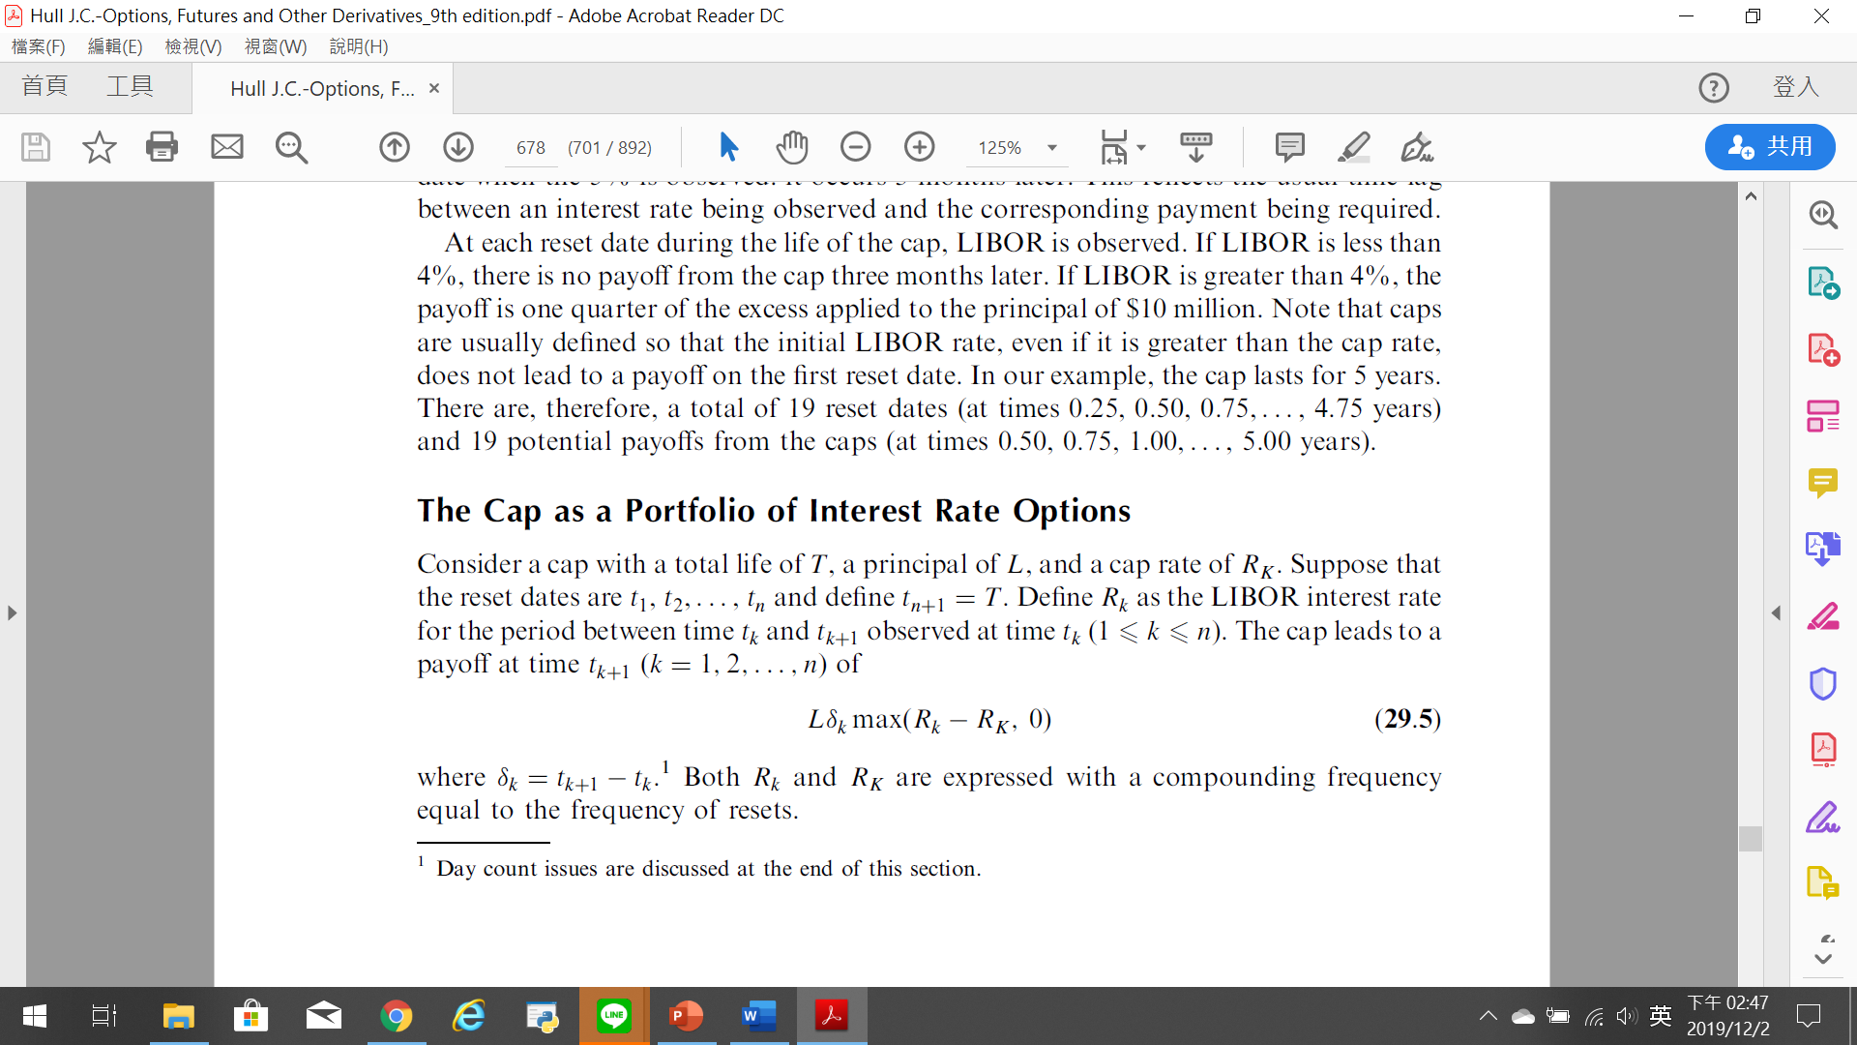
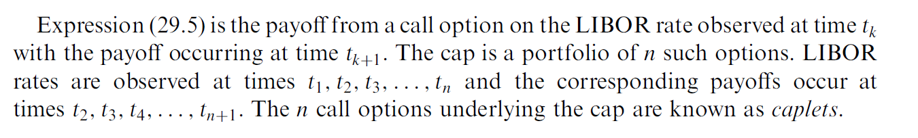
The Cap as a Portfolio of Interest Rate Options

Slide 20
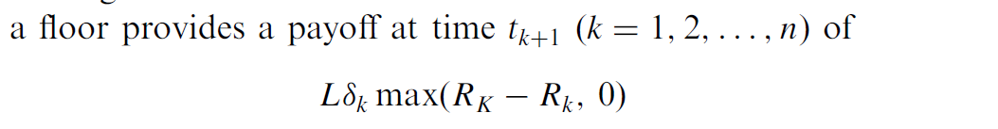
Floors and Collars
Interest rate floors and interest rate collars (sometimes called floor–ceiling agreements) are defined analogously to caps. A floor provides a payoff when the interest rate on the underlying floating-rate note falls below a certain rate. With the notation already introduced,
Analogously to an interest rate cap, an interest rate floor is a portfolio of put options on interest rates. Each of the individual options comprising a floor is known as a floorlet.

Slide 21
Collar
A collar is an instrument designed to guarantee that the interest rate on the underlying LIBOR floating-rate note always lies between two levels. A collar is a combination of a long position in a cap and a short position in a floor. It is usually constructed so that the price of the cap is initially equal to the price of the floor. The cost of entering into the collar is then zero.

Slide 22
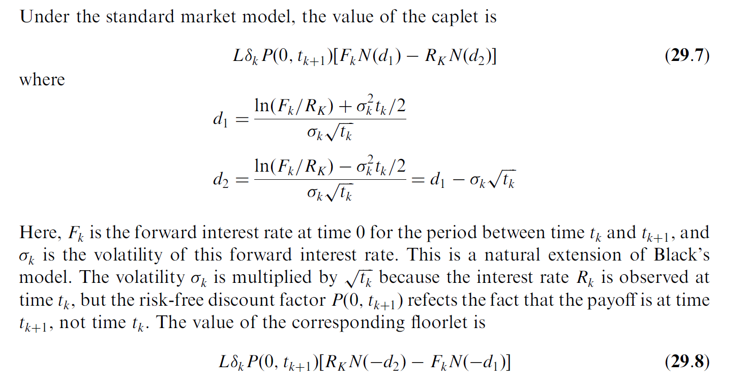
Valuation of Caps and Floors

Slide 23
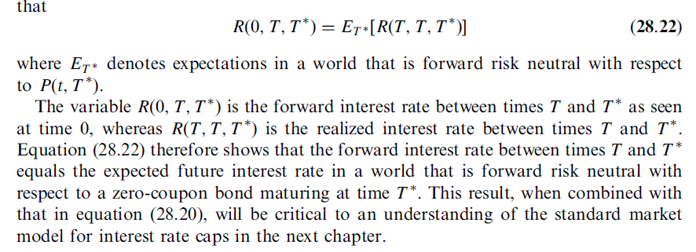
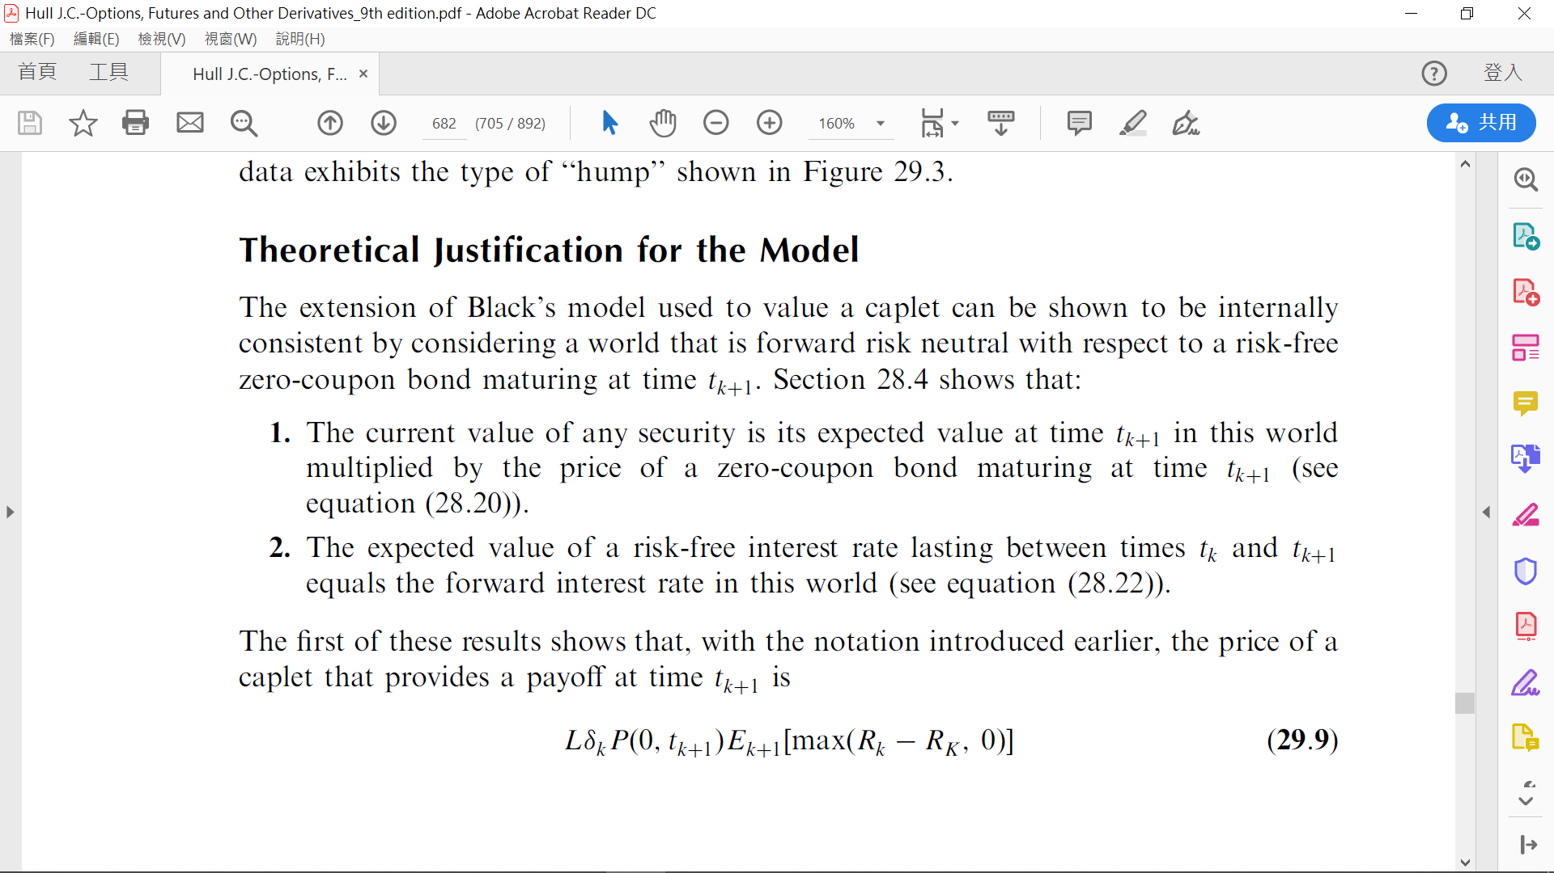
Theoretical Justification for the Model

Slide 24
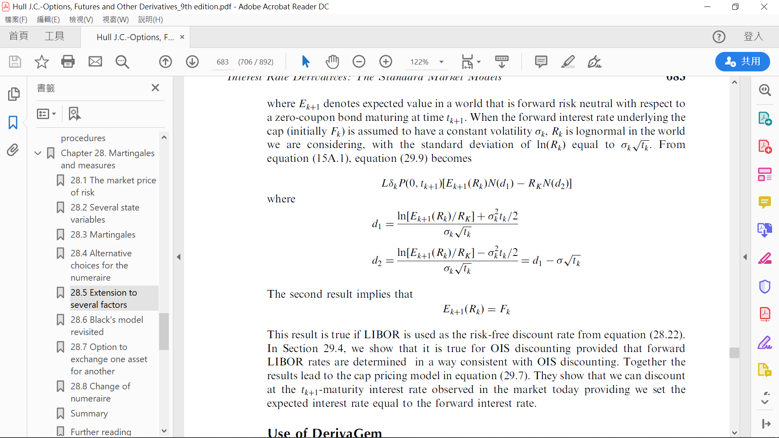
Theoretical Justification for the Model

Slide 25
European Swap Option
Swap options, or swaptions, are options on interest rate swaps and are another popular type of interest rate option. They give the holder the right to enter into a certain interest rate swap at a certain time in the future. (The holder does not, of course, have to exercise this right.)

Slide 26
An example of how a swaption might be used
Consider a company that knows that in 6 months it will enter into a 5-year floating-rate loan agreement and knows that it will wish to swap the floating interest payments for fixed interest payments to convert the loan into a fixed-rate loan.
At a cost, the company could enter into a swaption giving it the right to receive 6-month LIBOR and pay a certain fixed rate of interest, say 3% per annum, for a 5-year period starting in 6 months.
If the fixed rate exchanged for floating on a regular 5-year swap in 6 months turns out to be less than 3% per annum, the company will choose not to exercise the swaption and will enter into a swap agreement in the usual way.
However, if it turns out to be greater than 3% per annum, the company will choose to exercise the swaption and will obtain a swap at more favorable terms than those available in the market.

Slide 27
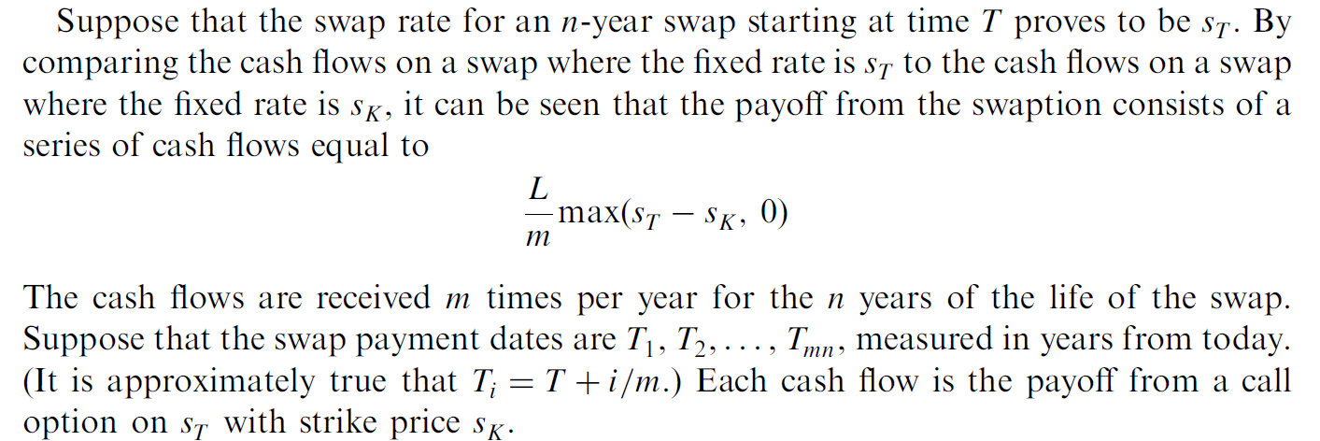

Valuation of European Swaptions
Consider a swaption where the holder has the right to pay a rate $s_{K}$ and receive LIBOR on a swap that will last n years starting in T years. We suppose that there are m payments per year under the swap and that the notional principal is L.
For now we will ignore the effect of day count conventions and assume that each fixed payment on the swap is the fixed rate times L/m.

Slide 28
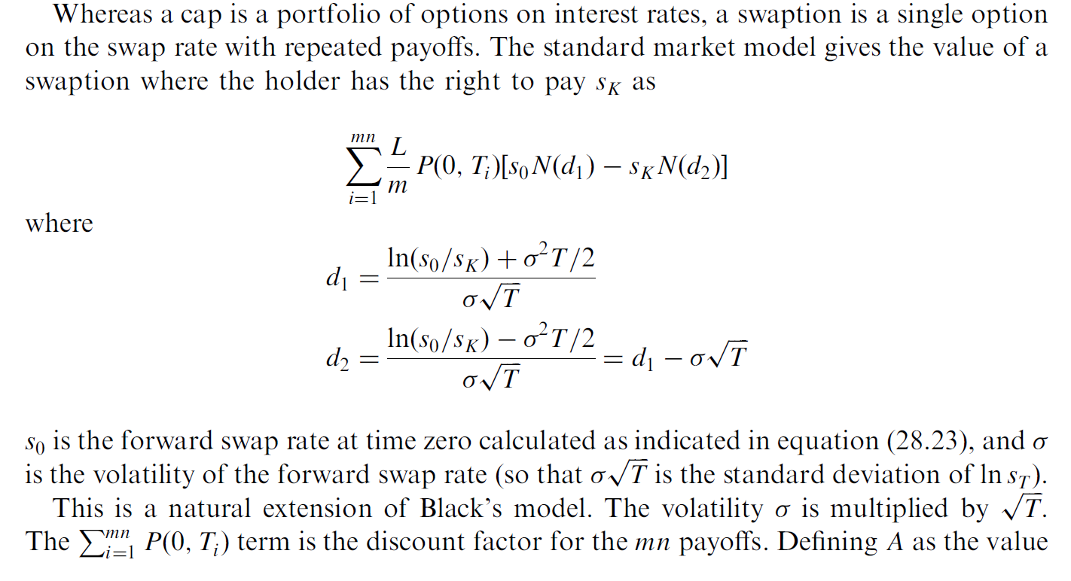
Valuation of European Swaptions

Slide 29
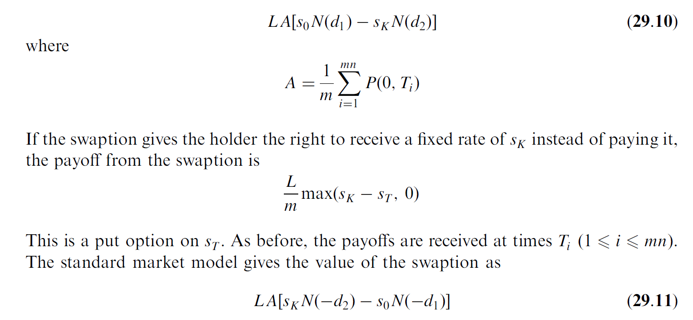

Valuation of European Swaptions
Defining A as the value of a contract that pays 1/m at times Ti (1 $≤$ $i≤$ mn), the value of the swaption becomes

