Slide 1
GMWB 帳戶價值建立和短利的關係

Slide 2
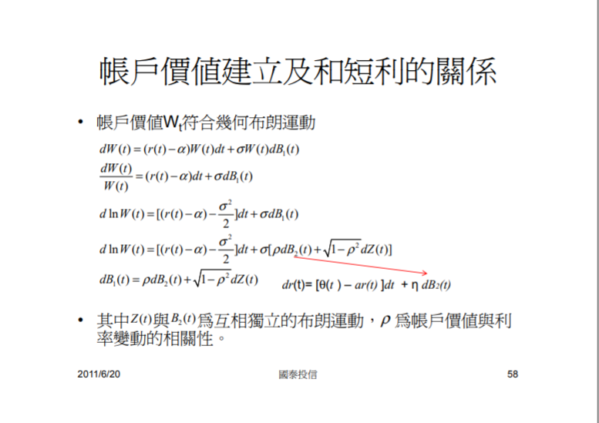

Slide 3
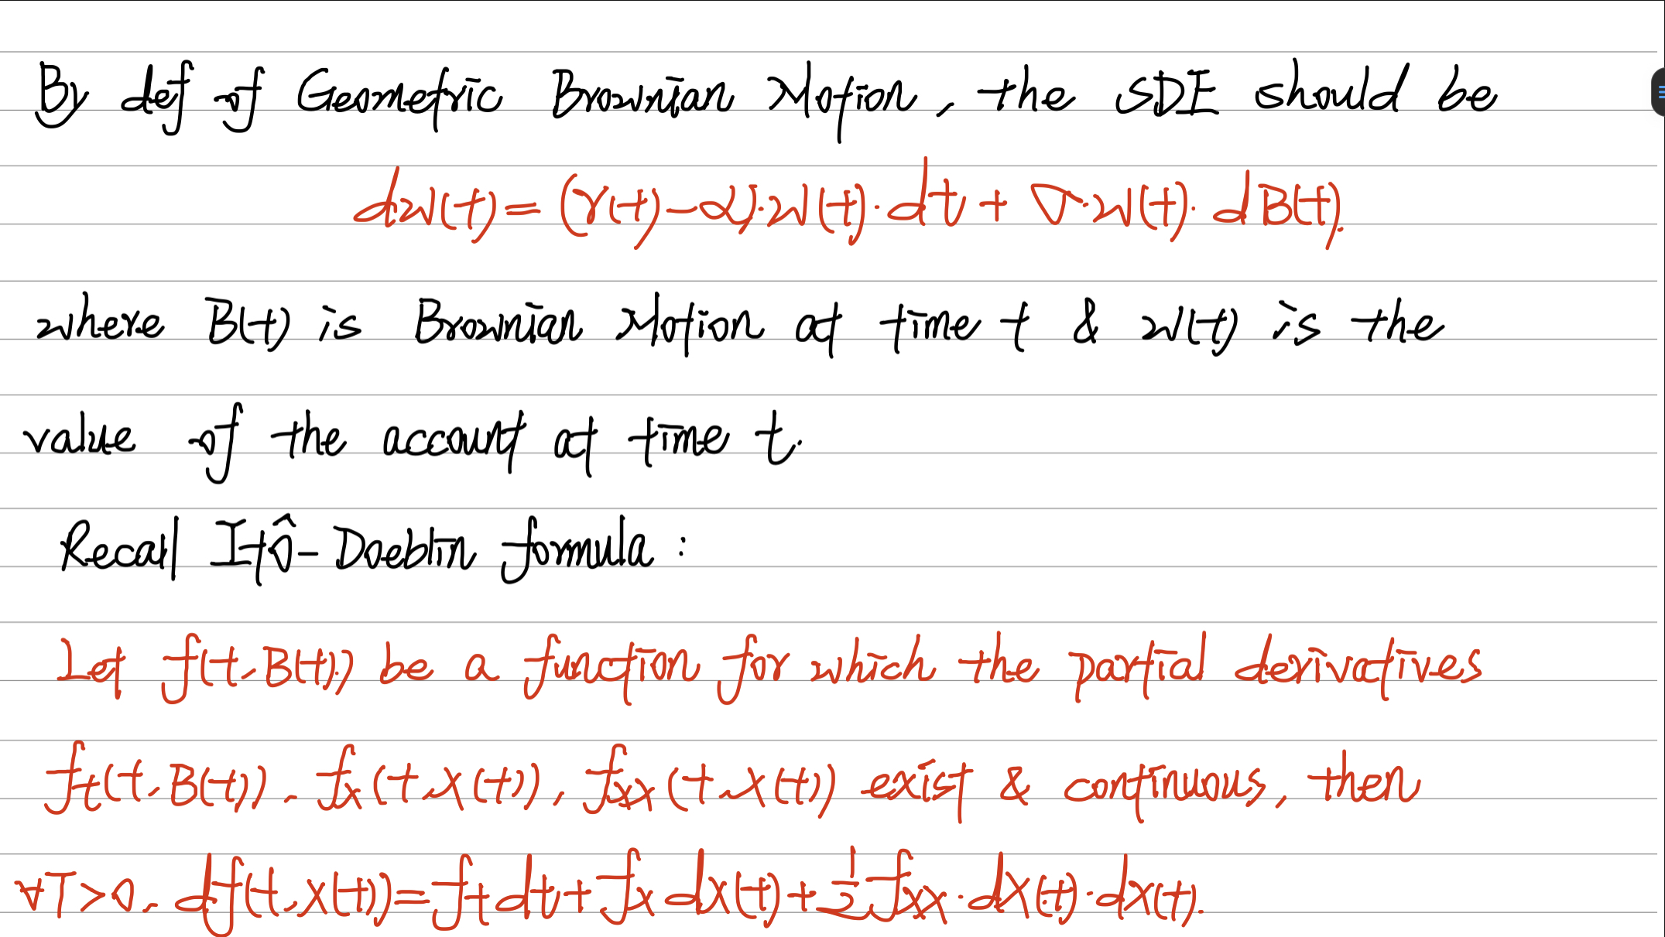

Slide 4
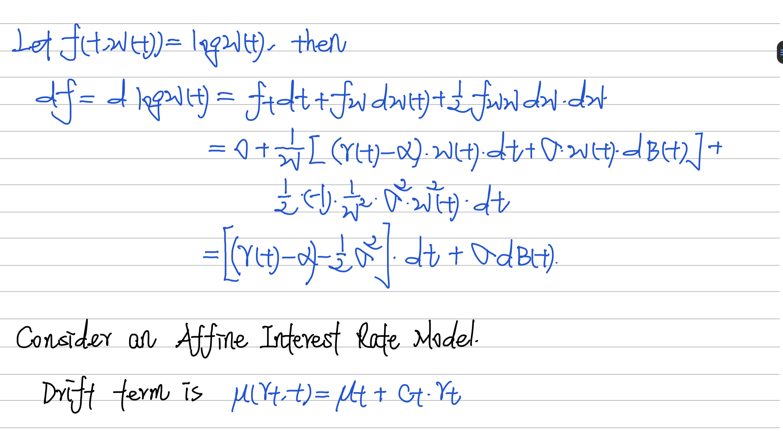

Slide 7
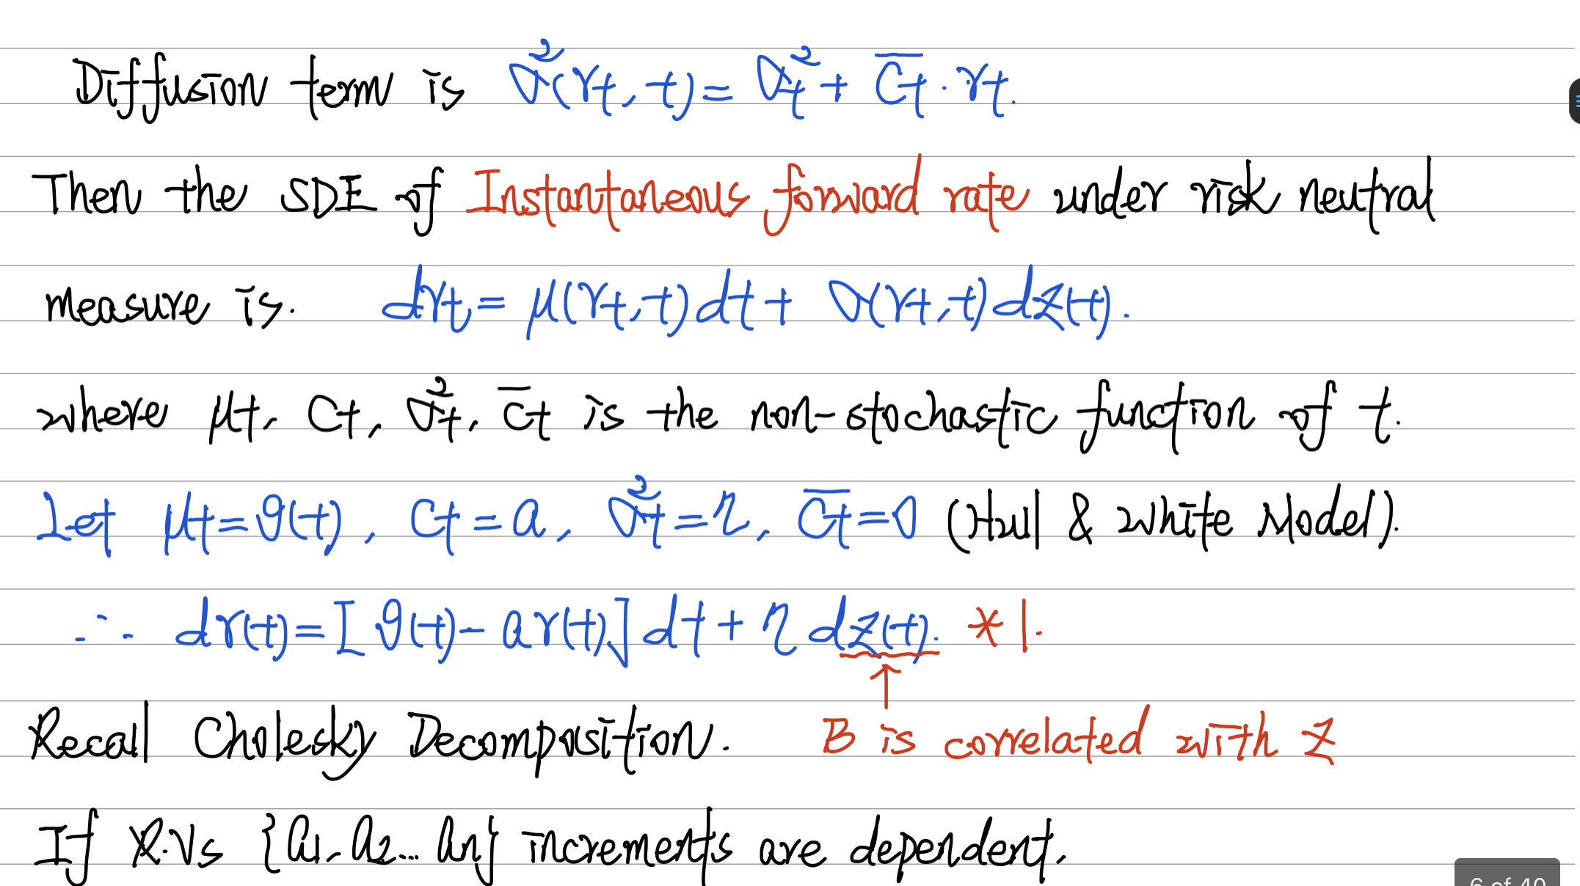

Slide 8
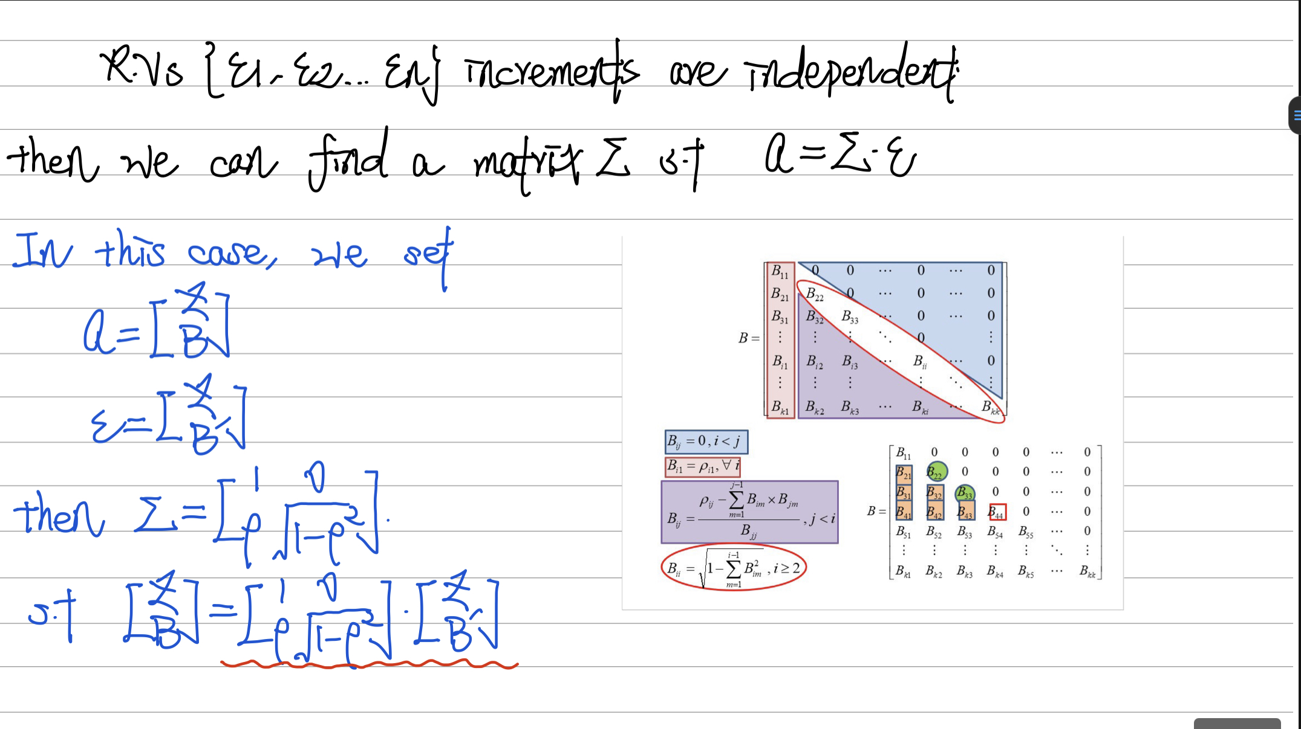

Slide 9
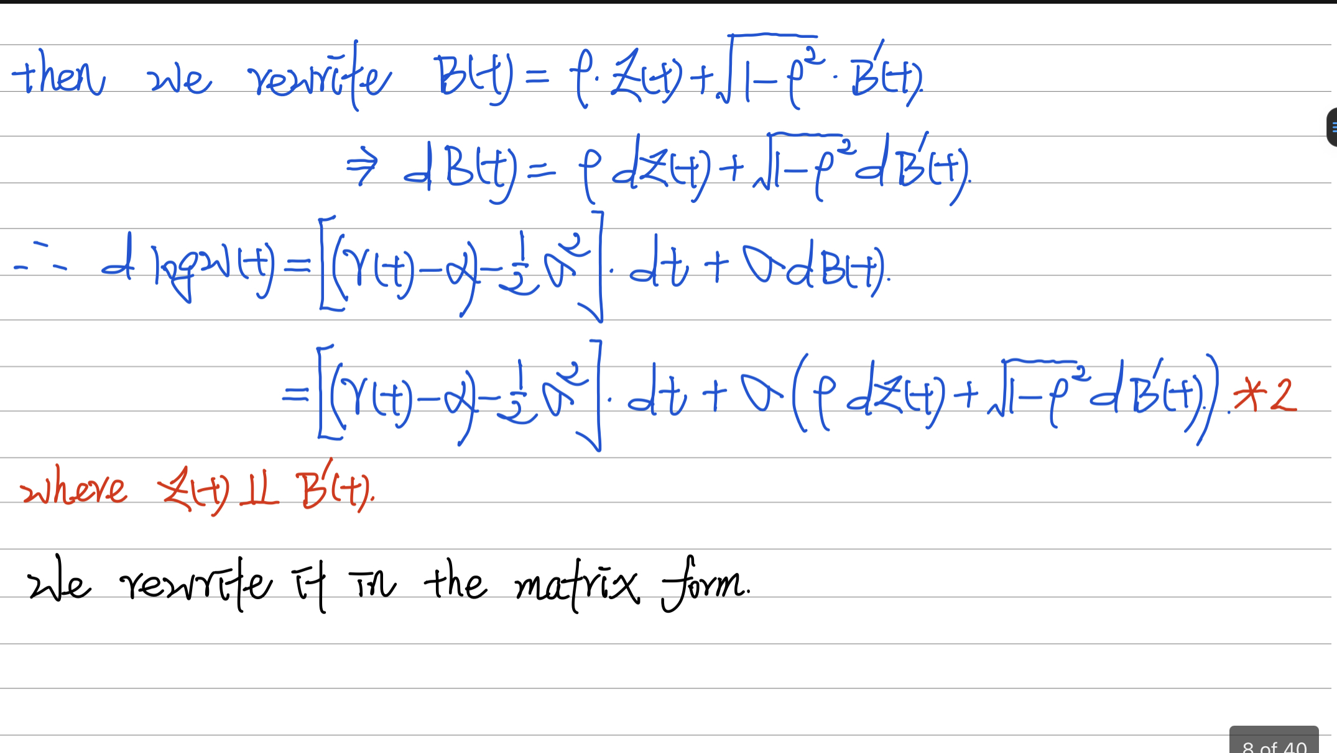

Slide 10
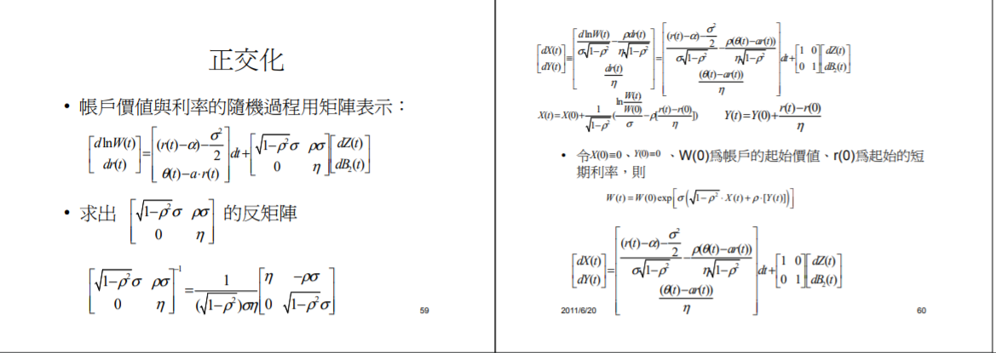

Slide 11
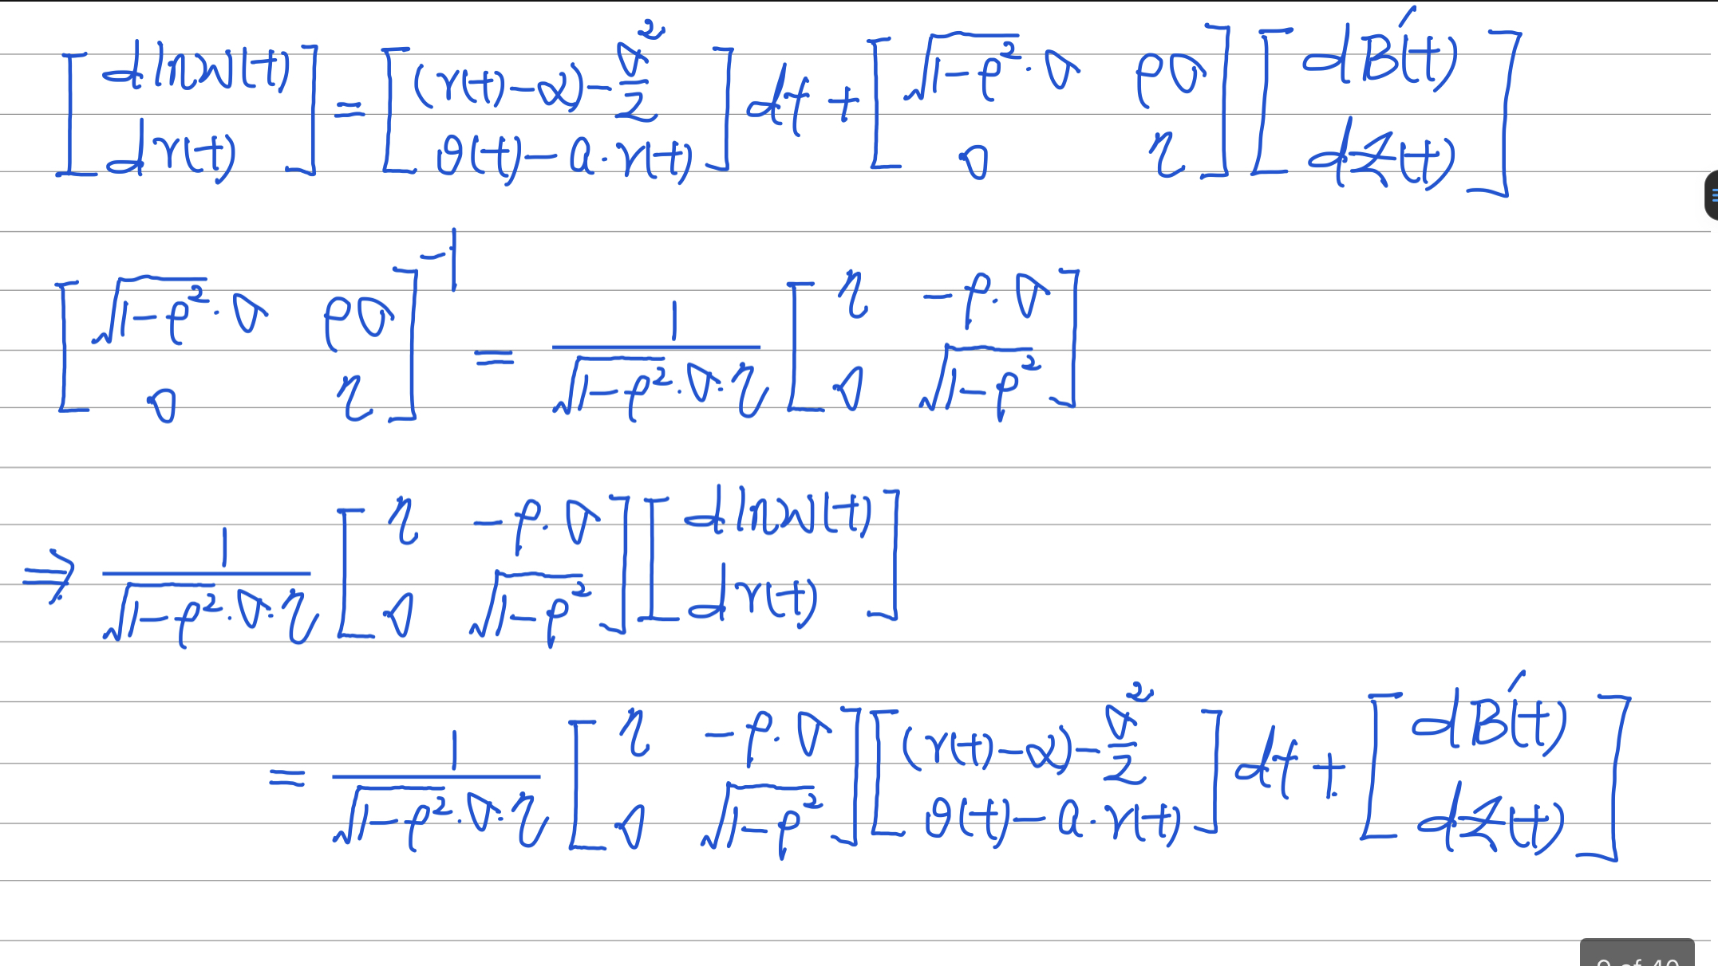

Slide 12
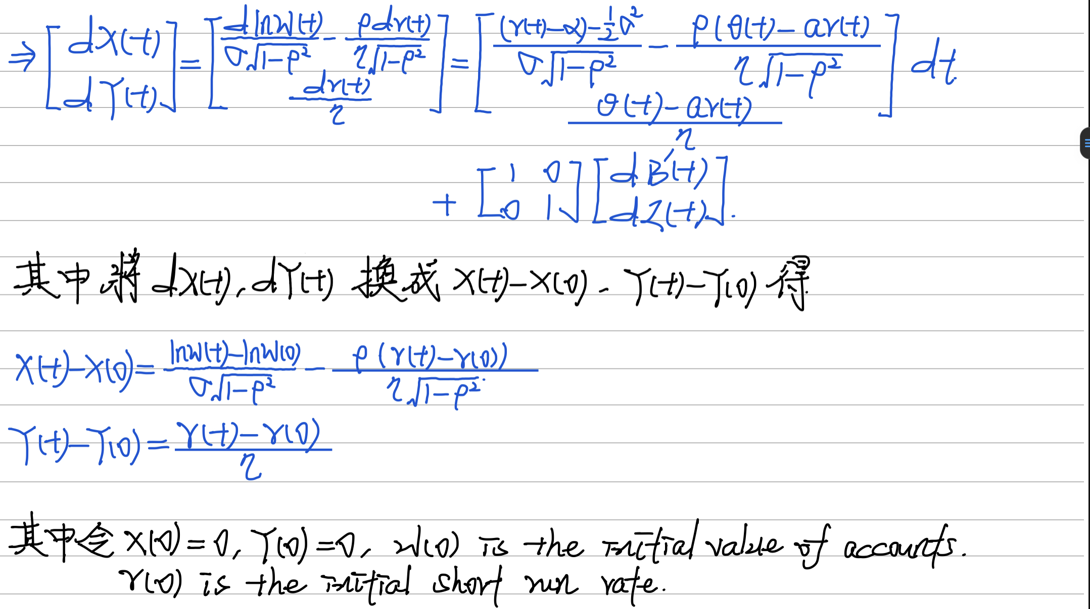

Slide 13
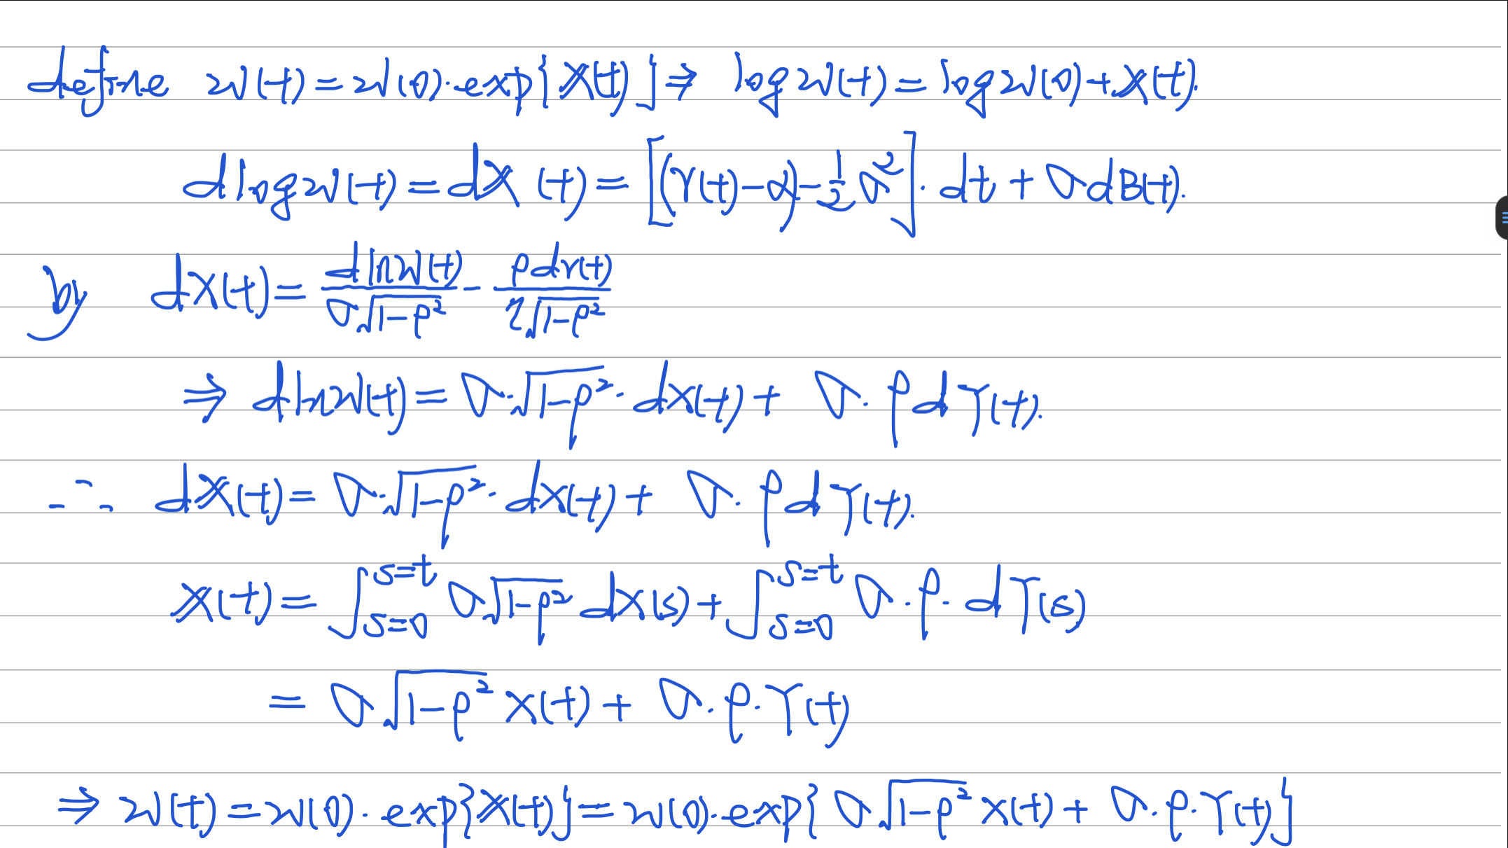

Slide 14
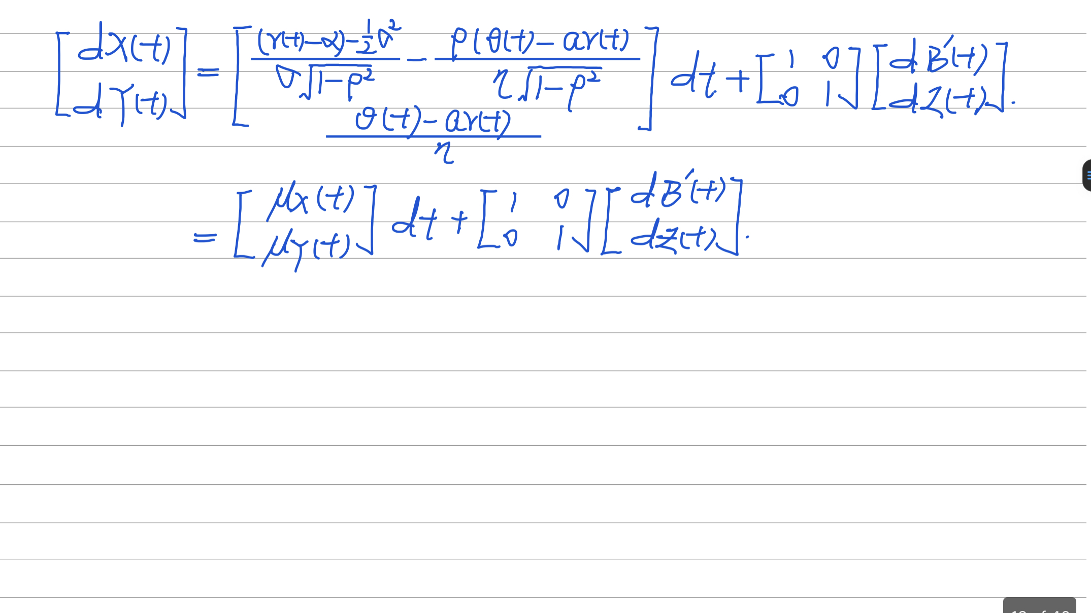

Slide 15
5 . 3 Martingale Representation Theorem

Slide 16
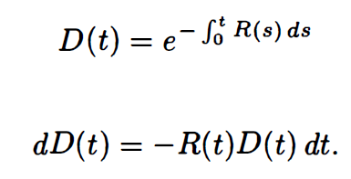


Recall the discount process:
and under the risk-neutral measure, the value of the option can be written as:
The risk-neutral pricing formula for the price (value) at time t of a derivative security paying V(T) at time T was derived under the assumption that if an agent begins with the correct initial capital.

Slide 17

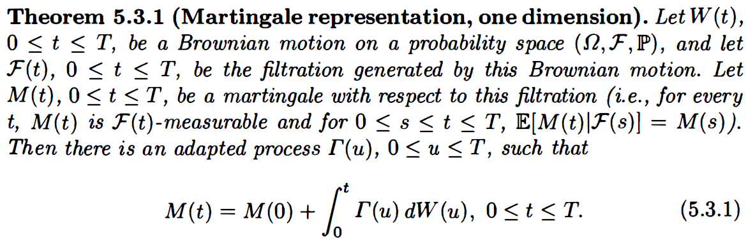
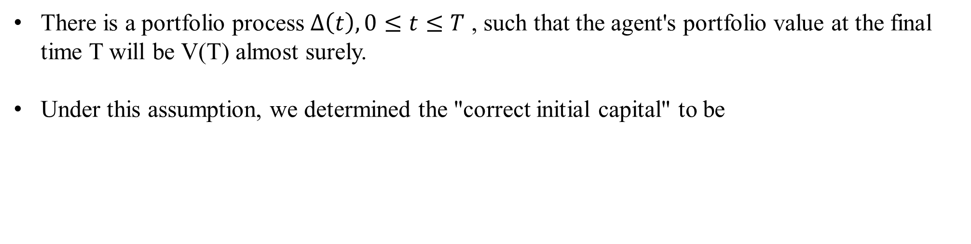
There is a portfolio process $Δ\left(t\right), 0≤t≤T$ , such that the agent's portfolio value at the final time T will be V(T) almost surely.
Under this assumption, we determined the "correct initial capital" to be
Ito Integral with Brownian Motion

Slide 18
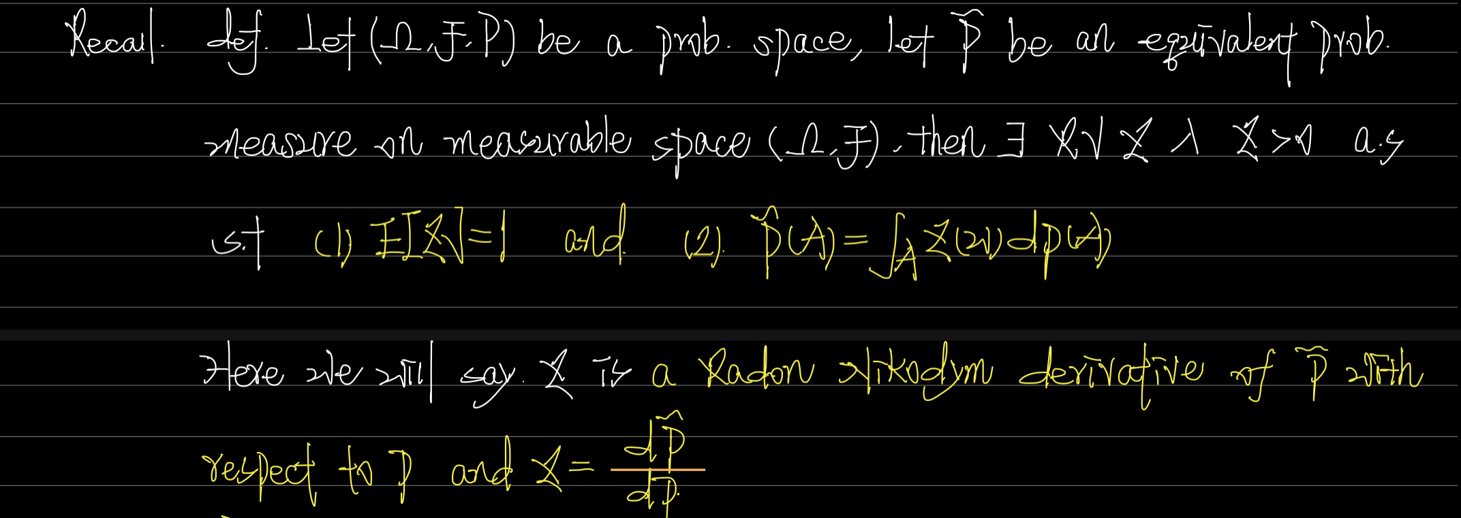

Slide 19
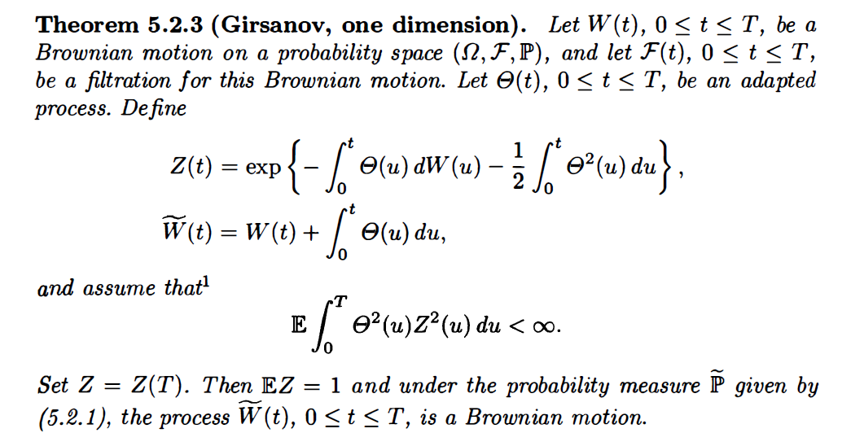

Slide 20
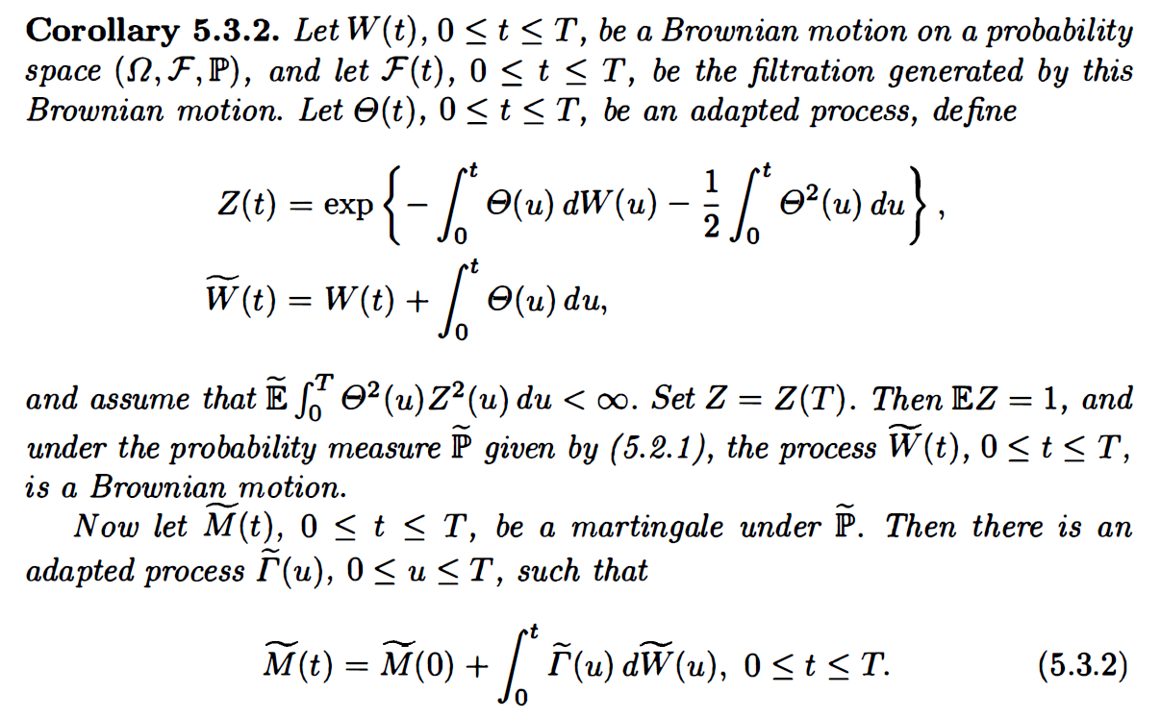
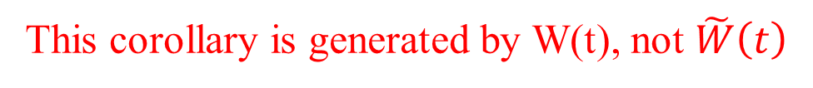
This corollary is generated by W(t), not $\tilde{W}\left(t\right)$

Slide 21
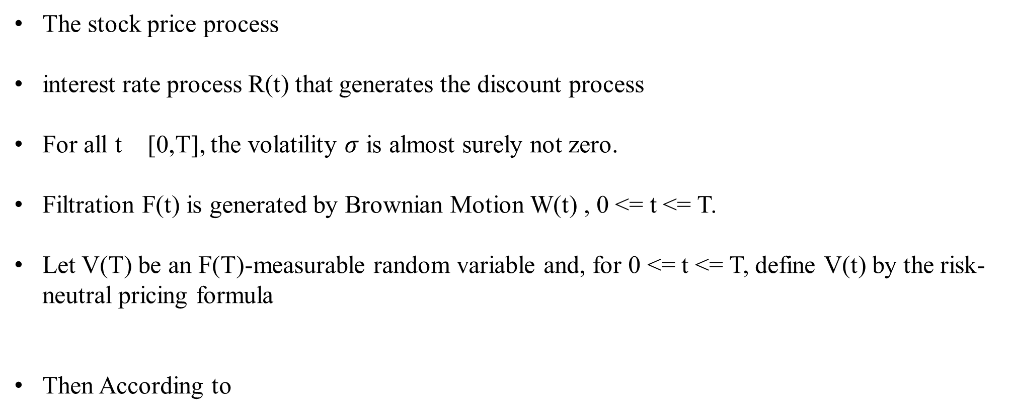
The stock price process
interest rate process R(t) that generates the discount process
For all t [0,T], the volatility $σ$ is almost surely not zero.
Filtration F(t) is generated by Brownian Motion W(t) , 0 <= t <= T.
Let V(T) be an F(T)-measurable random variable and, for 0 <= t <= T, define V(t) by the risk-neutral pricing formula
Then According to

Slide 22
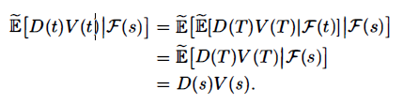
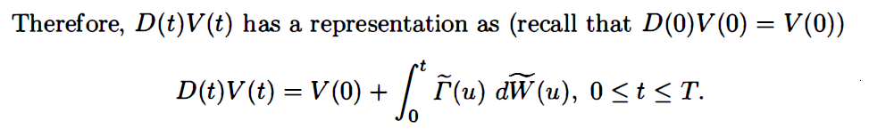
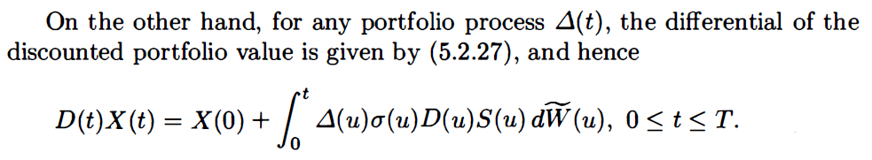


Slide 23
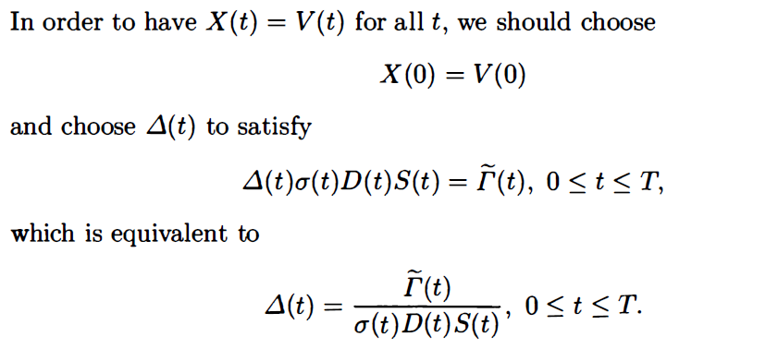

Slide 24

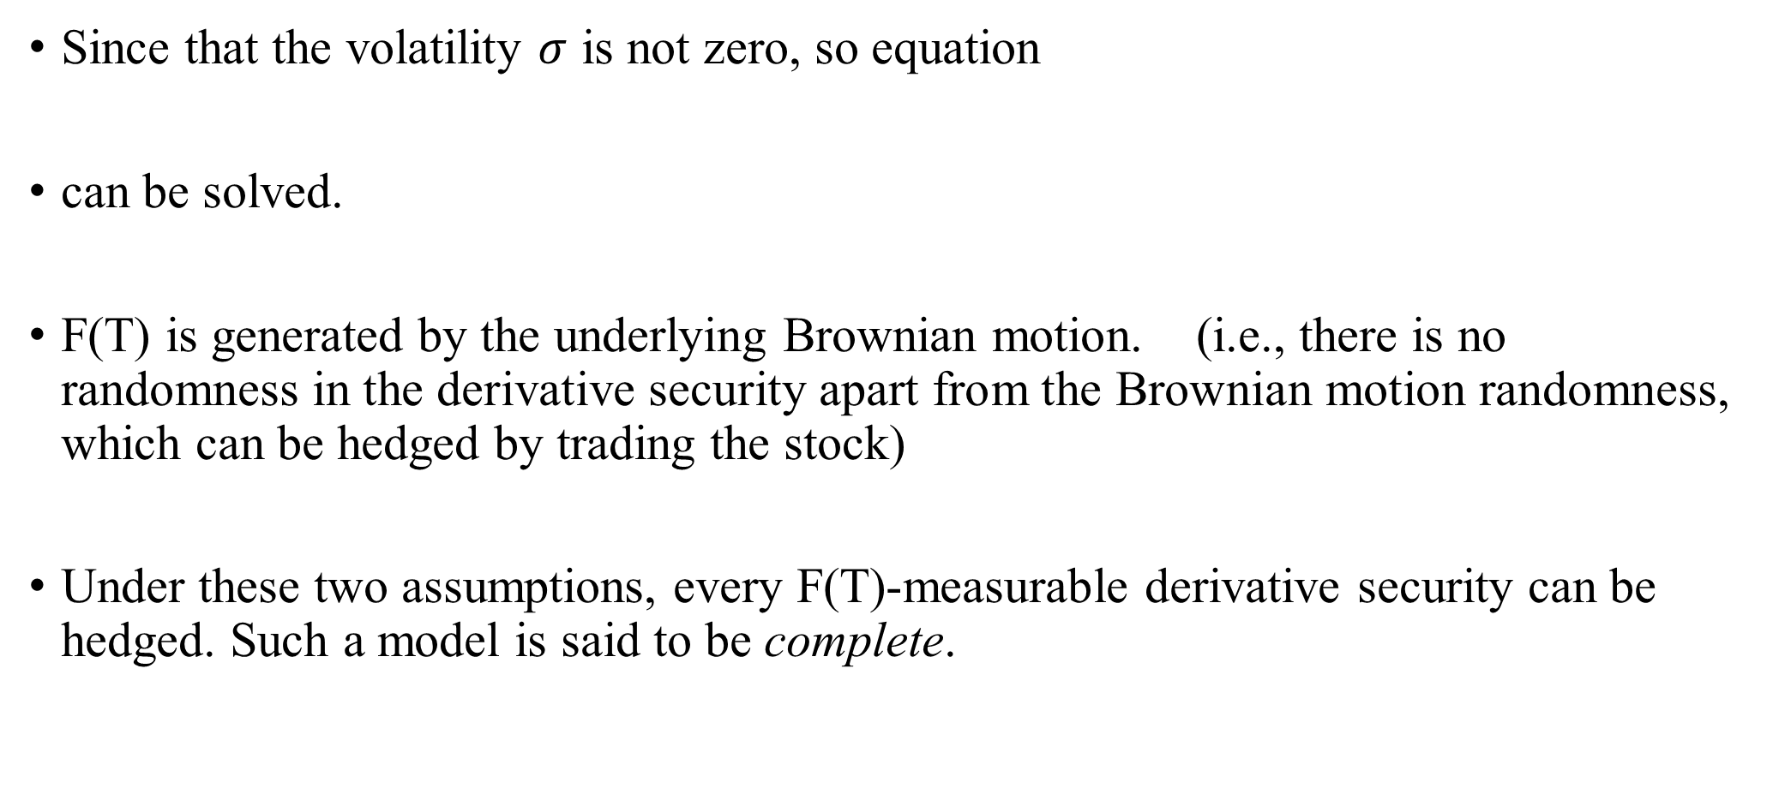
Since that the volatility $σ$ is not zero, so equation
can be solved.
F(T) is generated by the underlying Brownian motion. (i.e., there is no randomness in the derivative security apart from the Brownian motion randomness, which can be hedged by trading the stock)
Under these two assumptions, every F(T)-measurable derivative security can be hedged. Such a model is said to be complete.

