Slide 1
綜前面章節，已有方法可以做機率測度的轉換（真實機率轉換至風險中立機率測度）。
設股價為幾何布朗運動，另外再定義一折現的隨機過程。
結合股價與折現的隨機過程，再轉換至風險中立的測度上，即得到一股價在風險中立測度上的隨機過程。
推廣至衍生品（買權），建構投資組合，並定義出投組的收益隨機過程，由投資組合的現金部位推論衍生品的價格。
最後推導出Black Scholes Formula

Slide 2
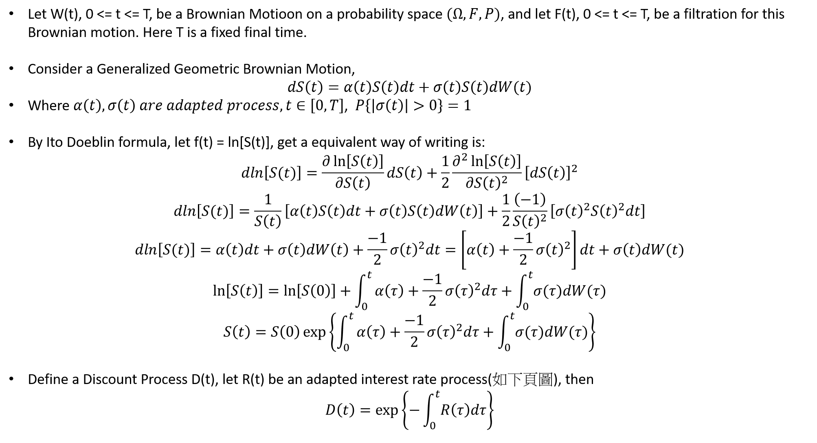

Slide 3
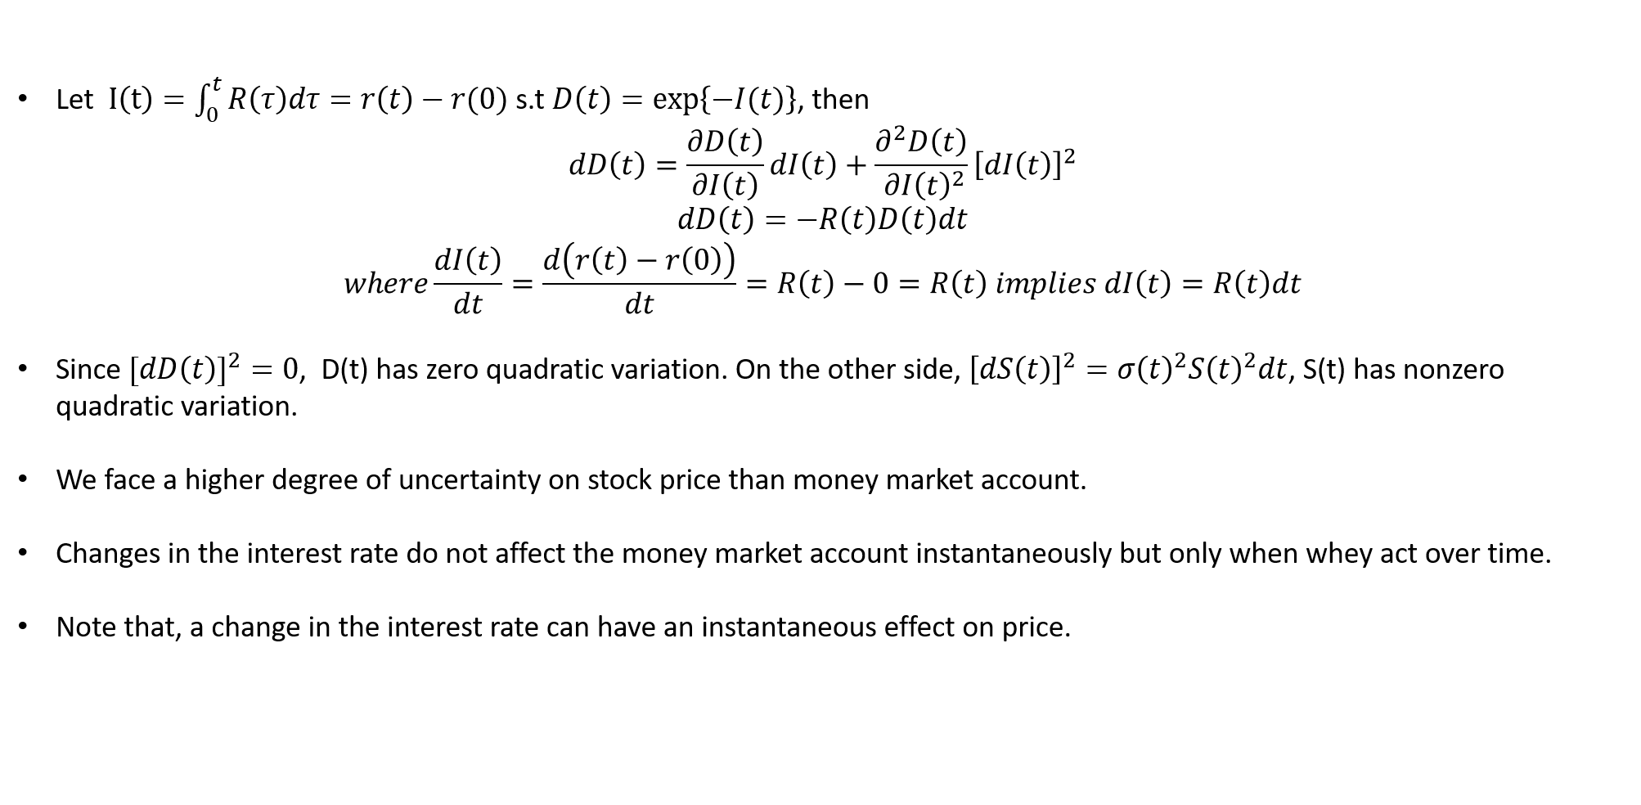
they

Slide 4
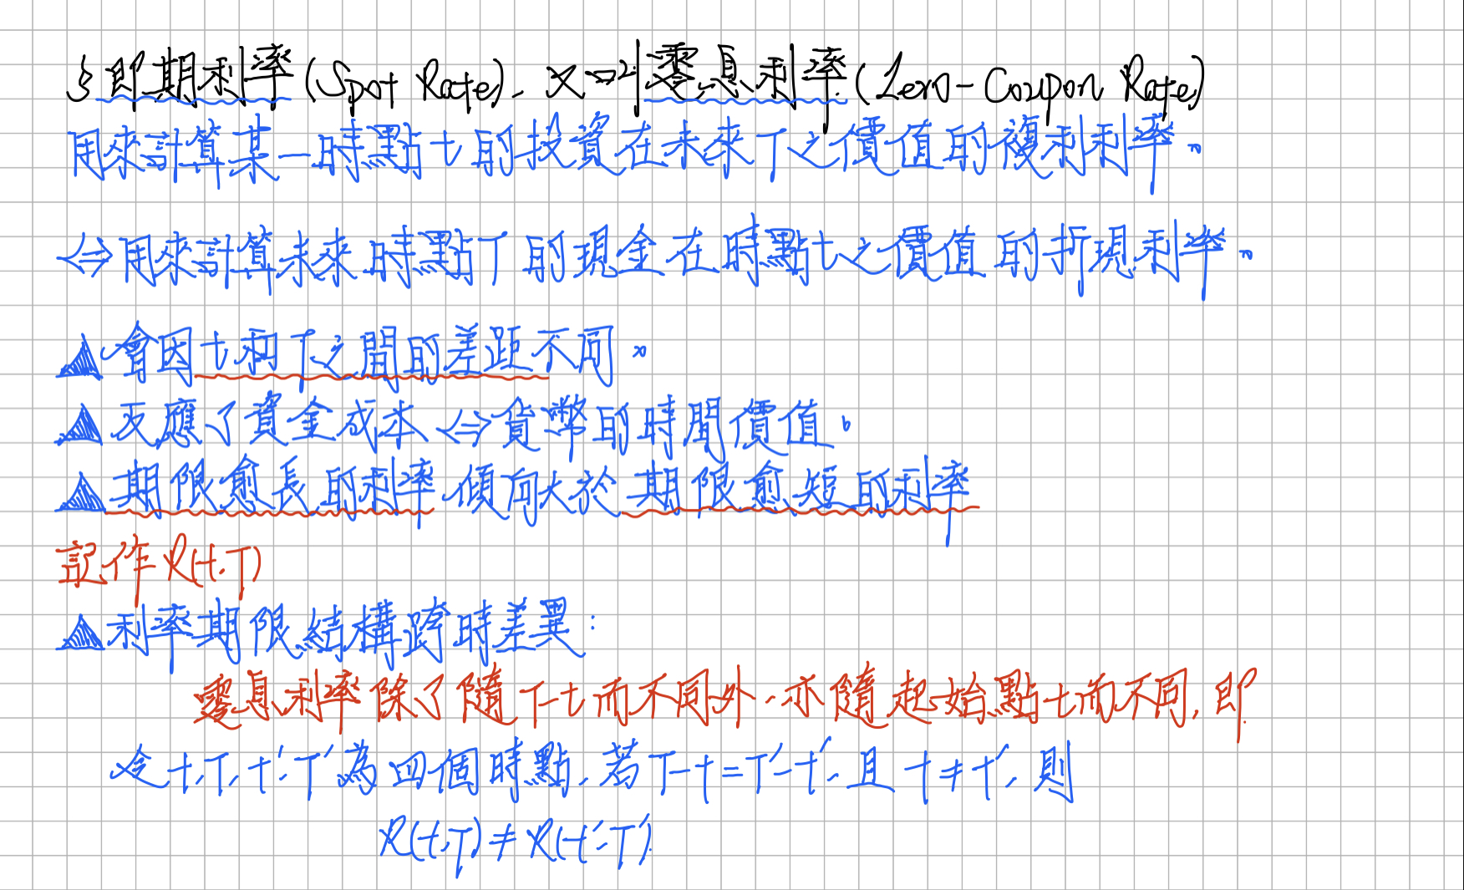

Slide 5
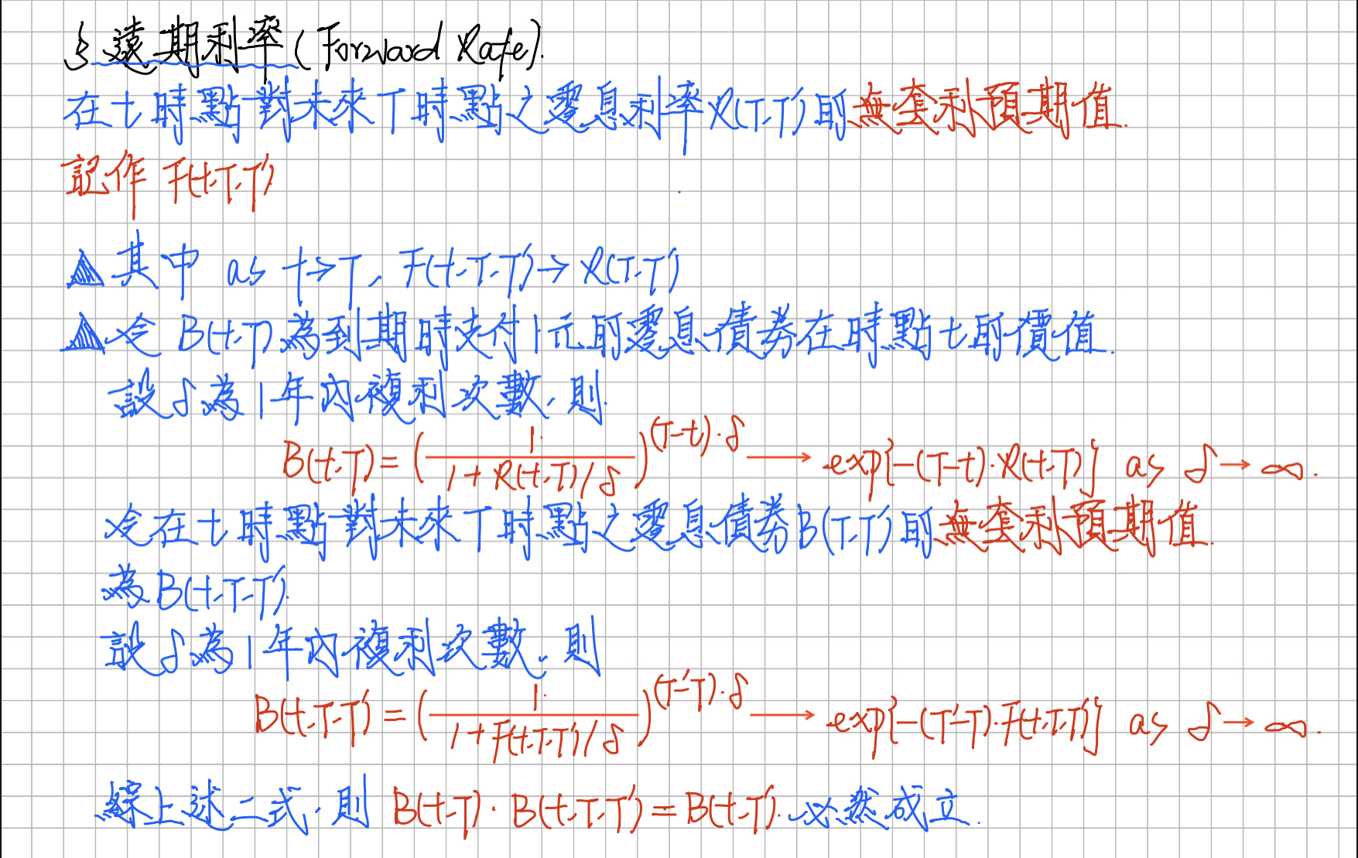

Slide 6
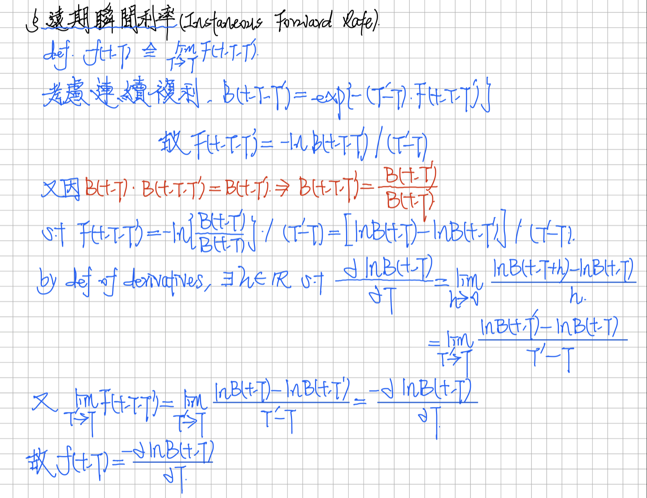

Slide 7
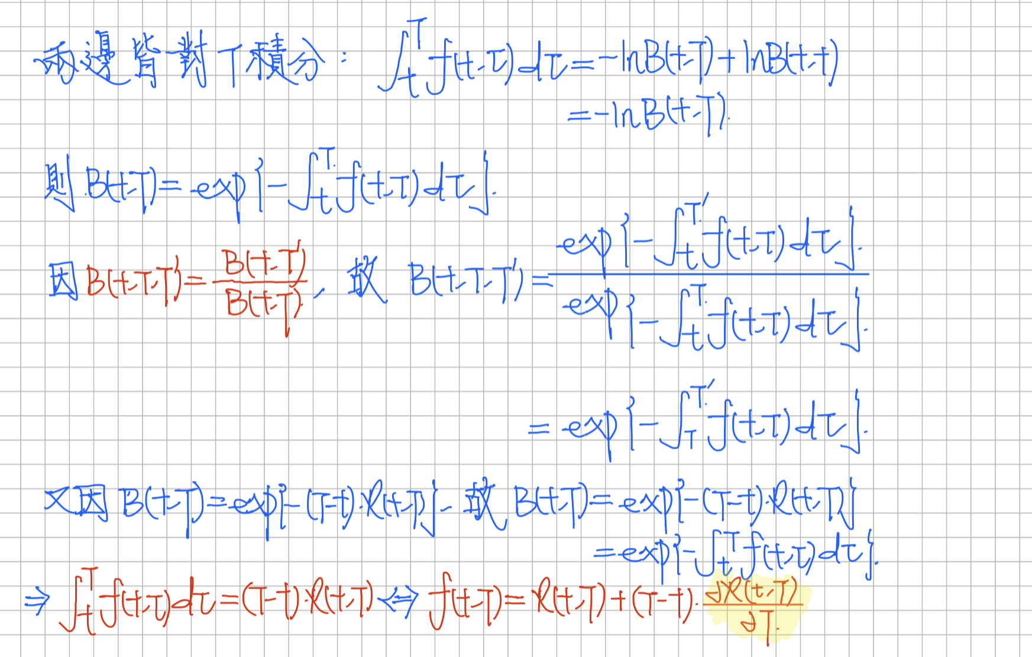
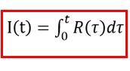

Slide 8
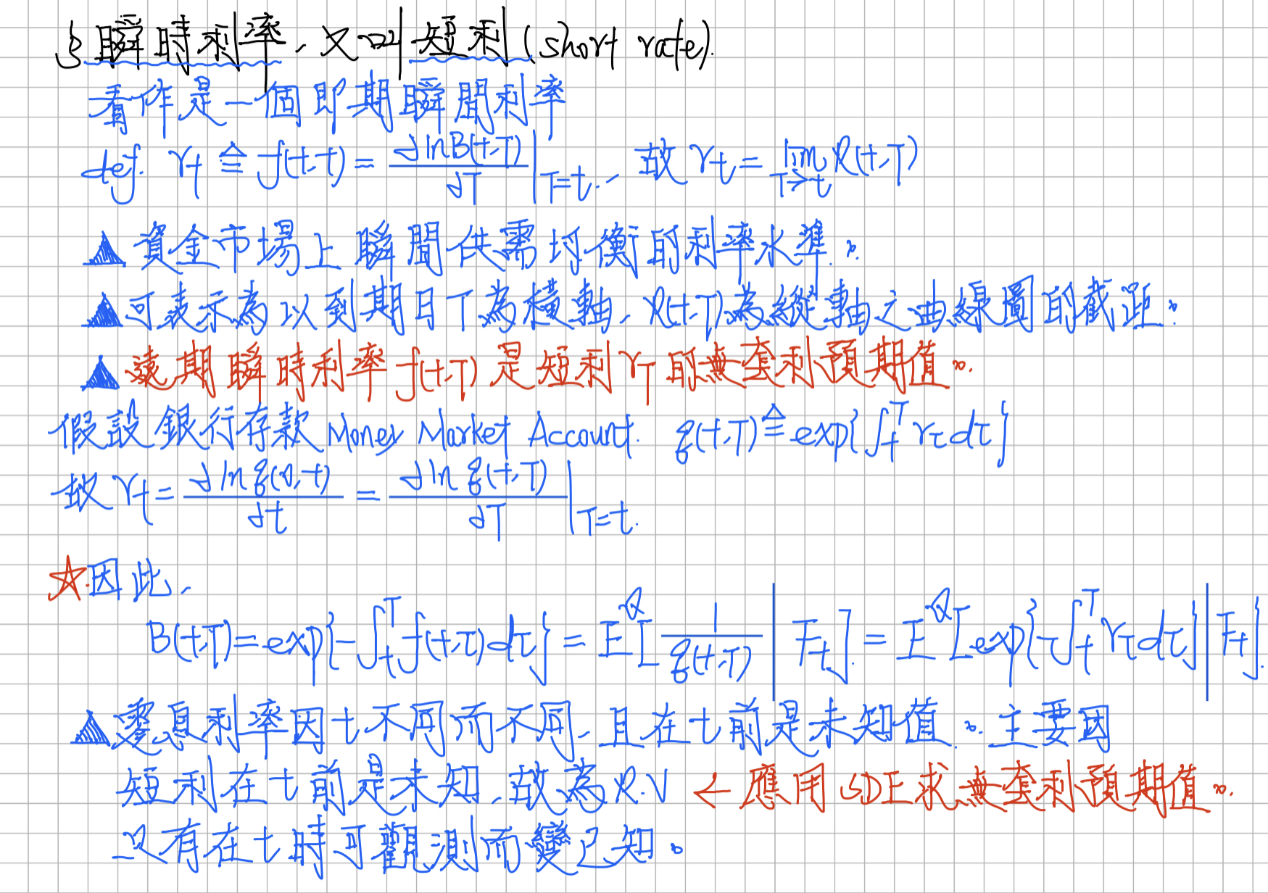

Slide 9
they

Slide 11
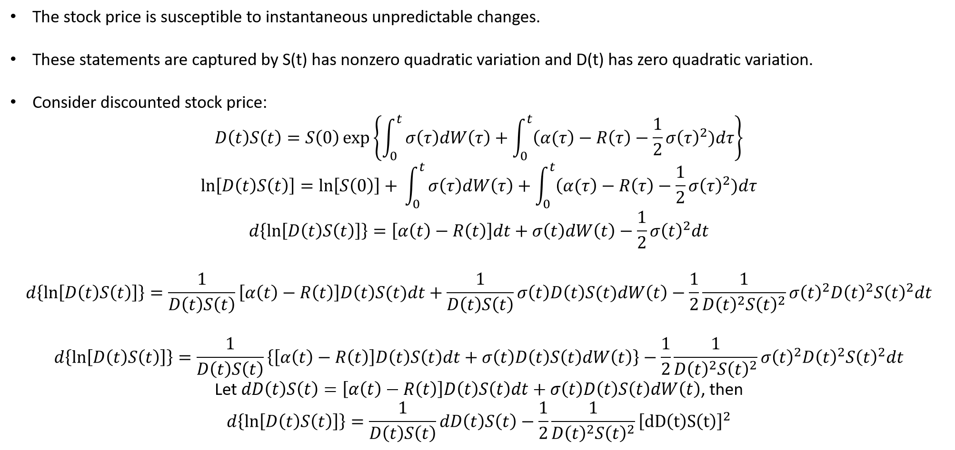

Slide 12
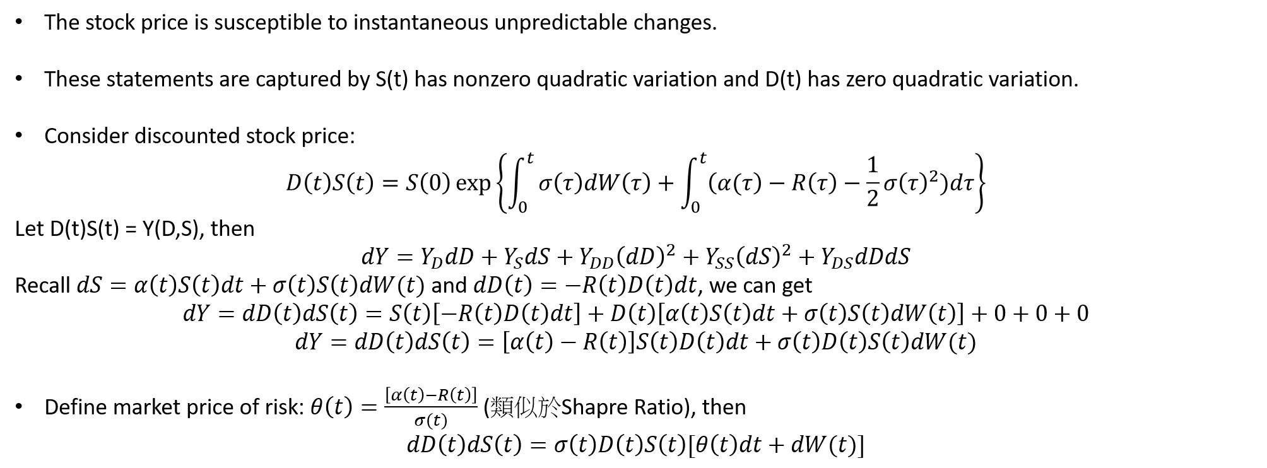
S(t)
S(t)
S(t)

Slide 13
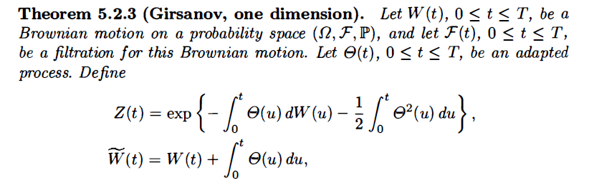
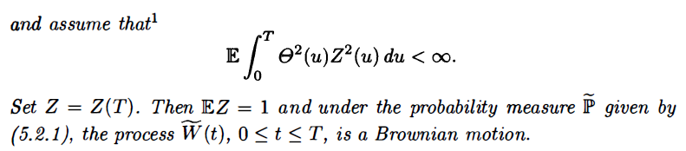


Recall Girsanov’s Theorem
=

Slide 14
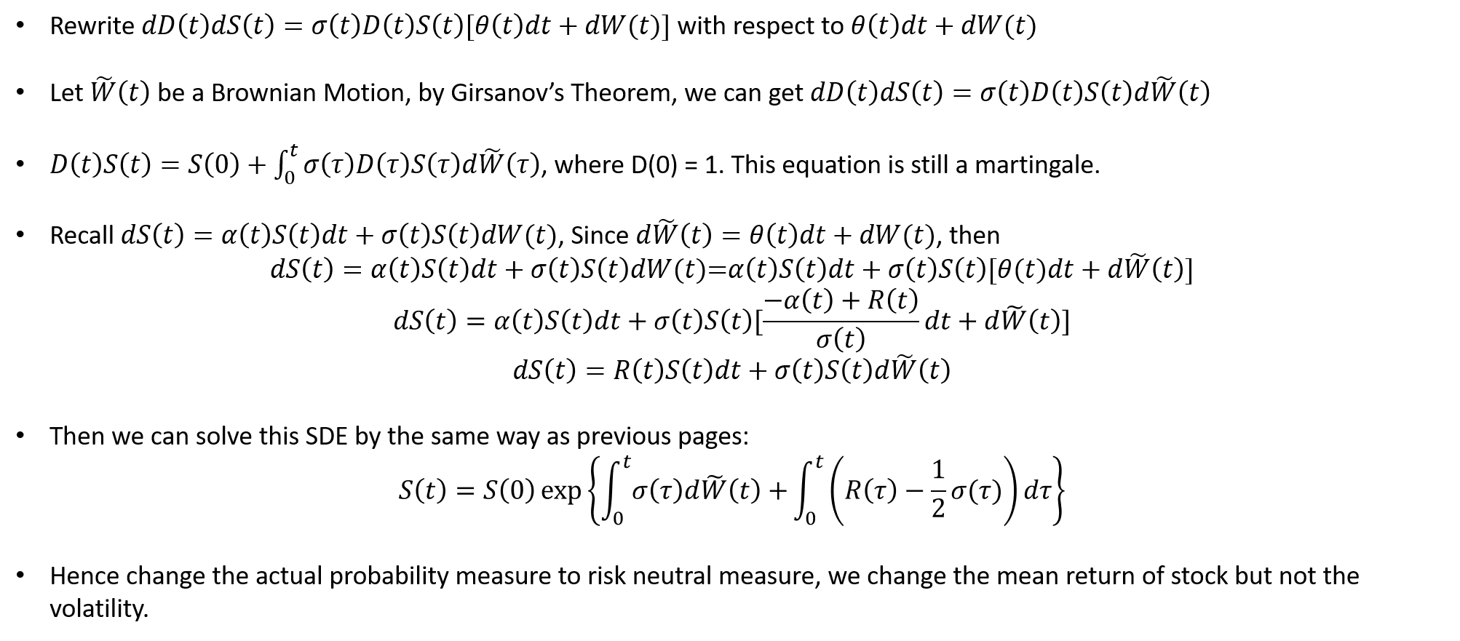
S(t)
S(t)
-

Slide 15
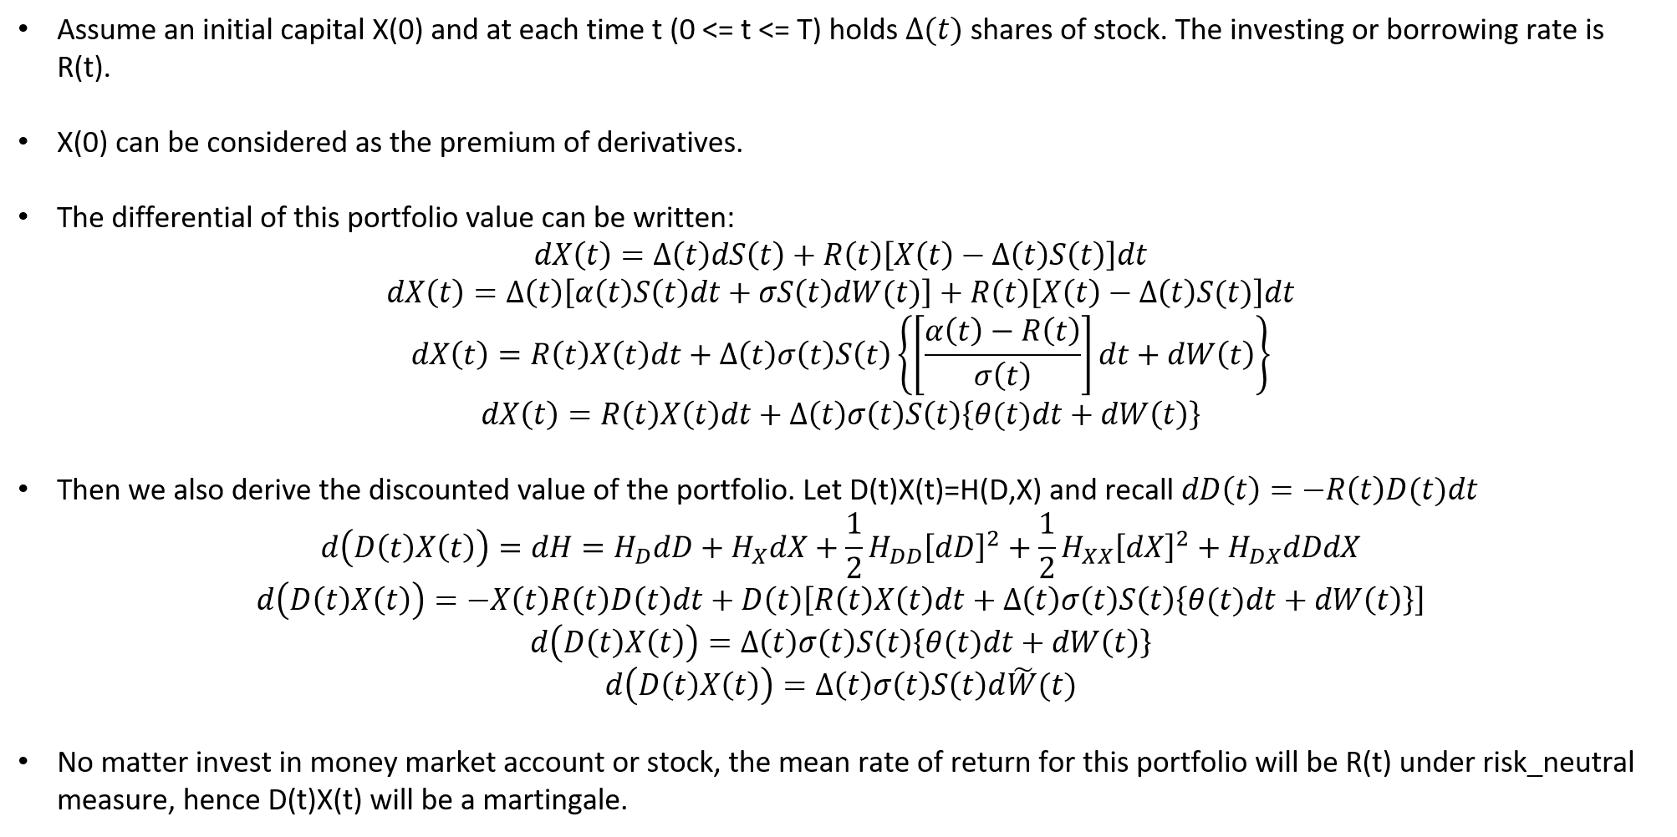

Slide 16
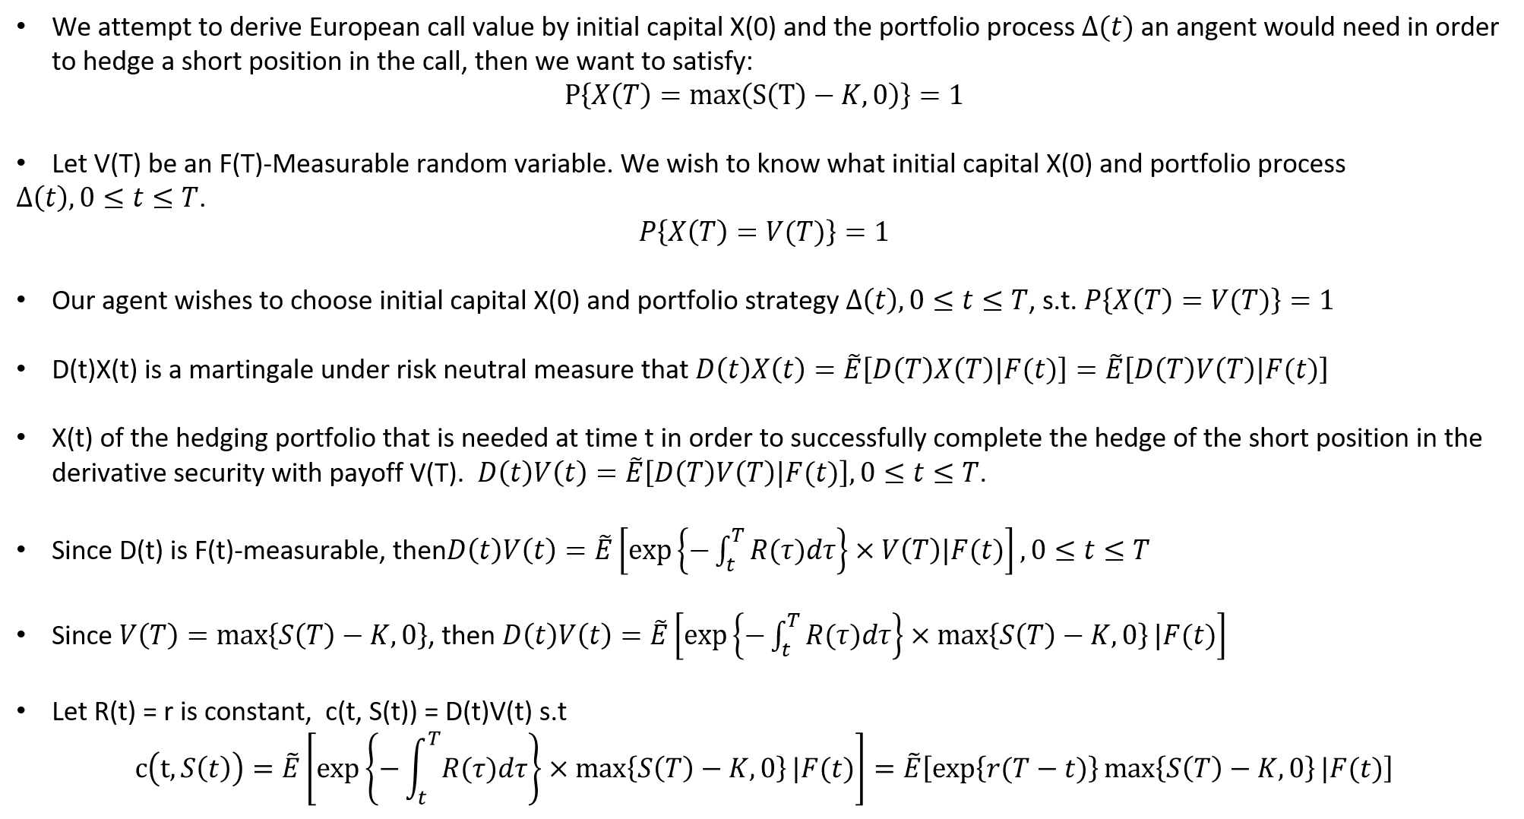

Slide 17
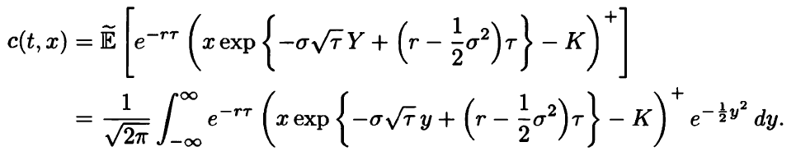



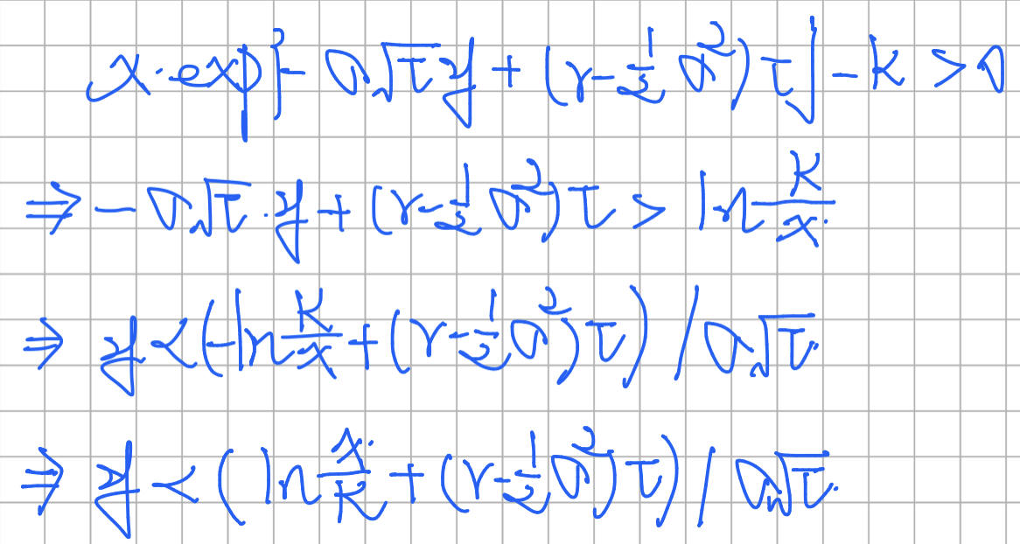

We take $S\left(t\right)=S\left(0\right)\exp\left\{σ\tilde{W}\left(t\right)+\left(r−\frac{1}{2}σ^{2}\right)t\right\}$, and we may thus write:
$$S\left(T\right)=S\left(t\right)\exp\left\{σ\left(\tilde{W}\left(T\right)−\tilde{W}\left(t\right)\right)+\left(r−\frac{1}{2}σ^{2}\right)τ\right\}$$
$$S\left(T\right)=S\left(t\right)\exp\left\{−σ\sqrt{τ}Y+\left(r−\frac{1}{2}σ^{2}\right)τ\right\}$$
Where $Y=−\frac{\tilde{W}\left(T\right)−\tilde{W}\left(t\right)}{\sqrt{T−t}}$.

Slide 18
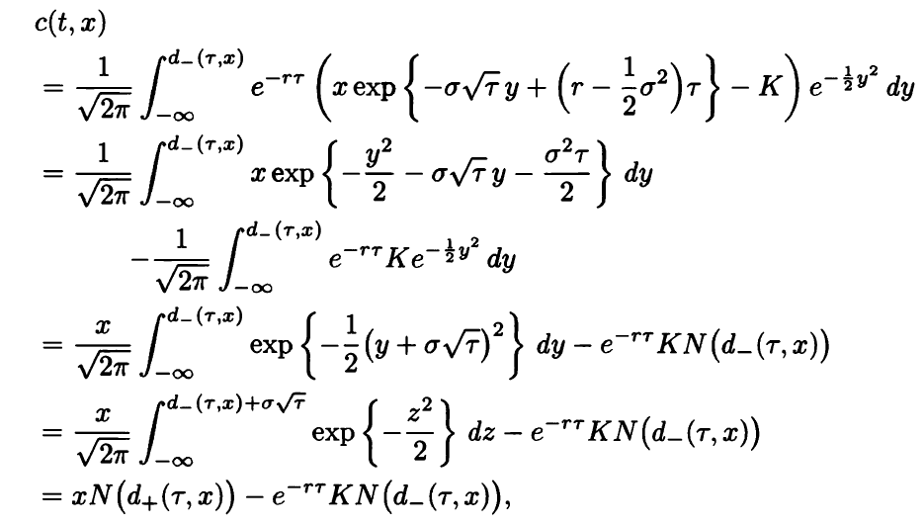

This is the result of Black-Scholes-Merton partial differential equation derived by the device of switching to the risk-neutral measure.

Slide 19
