Slide 1
Kalman Filter and EM Algorithm Approach

Slide 2
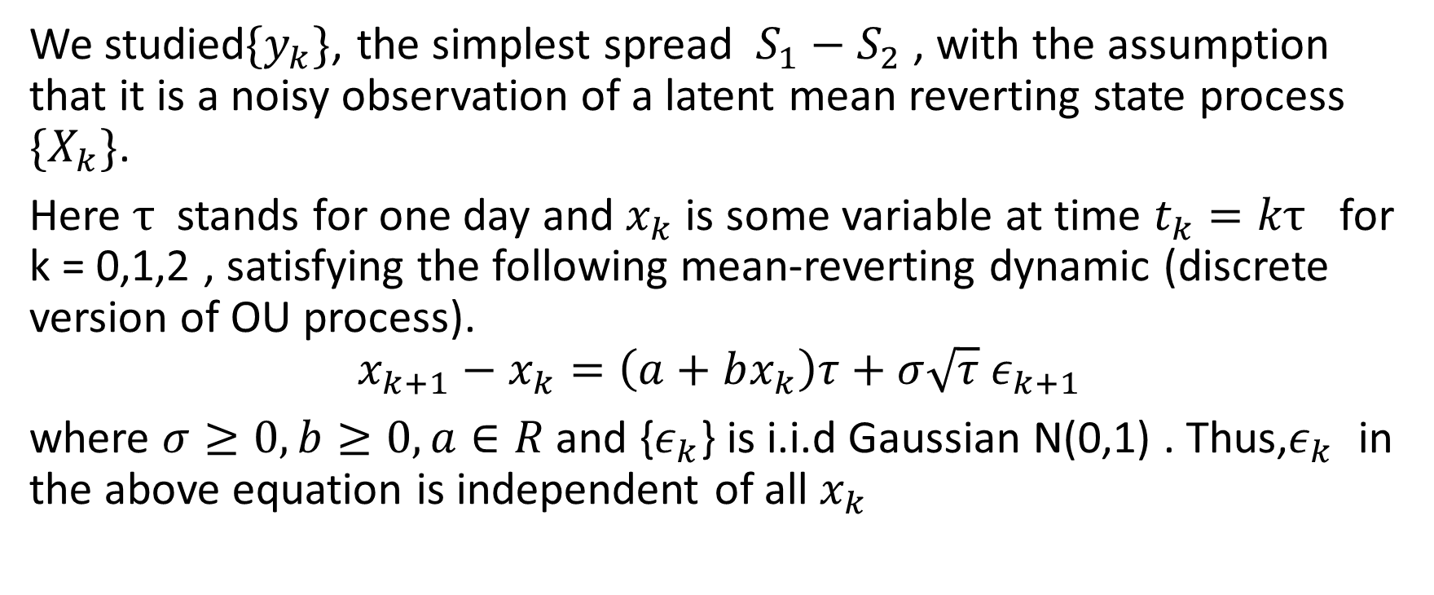
The Spread Model
We studied$\{y_{k}\}$, the simplest spread $S_{1}−S_{2}$ , with the assumption that it is a noisy observation of a latent mean reverting state process $\{X_{k}\}$.
Here $τ$ stands for one day and $x_{k}$ is some variable at time $t_{k}=kτ$ for k = 0,1,2 , satisfying the following mean-reverting dynamic (discrete version of OU process).
$$x_{k+1}−x_{k}=\left(a+bx_{k}\right)τ+σ\sqrt{τ} ε_{k+1}$$
where $σ≥0,b≥0,a∈R$ and {$ε_{k}$} is i.i.d Gaussian N(0,1) . Thus,$ε_{k}$ in the above equation is independent of all $x_{k}$

Slide 3
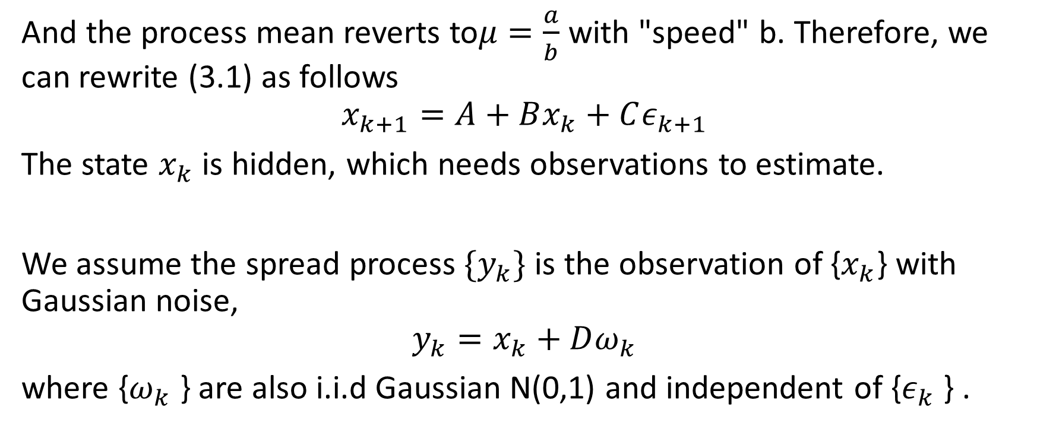
And the process mean reverts to$μ=\frac{a}{b}$ with "speed" b. Therefore, we can rewrite (3.1) as follows
$$x_{k+1}=A+Bx_{k}+Cε_{k+1}$$
The state $x_{k}$ is hidden, which needs observations to estimate.
We assume the spread process ${\{y}_{k}\}$ is the observation of {$x_{k}$} with Gaussian noise,
$$y_{k}=x_{k}+Dω_{k}$$
where {$ω_{k}$ } are also i.i.d Gaussian N(0,1) and independent of {$ε_{k}$ } .

Slide 4
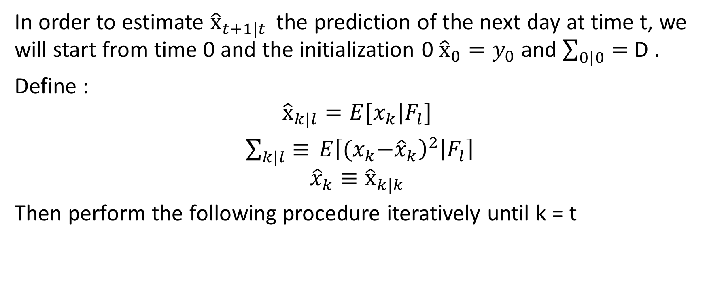
Kalman Filter
In order to estimate ${\hat{x}}_{t+1|t }$ the prediction of the next day at time t, we will start from time 0 and the initialization 0 ${\hat{x}}_{0}=y_{0}$and $\sum_{0|0}{=}$ D .
Define :
$${\hat{x}}_{k|l}=E[x_{k}|F_{l}]$$
$\sum_{k|l}{≡} E{\left[{(x}_{k}−{\hat{x}}_{k}\right)}^{2}\left|F_{l}\right]$
$${\hat{x}}_{k}{≡\hat{x}}_{k|k}$$
Then perform the following procedure iteratively until k = t

Slide 5
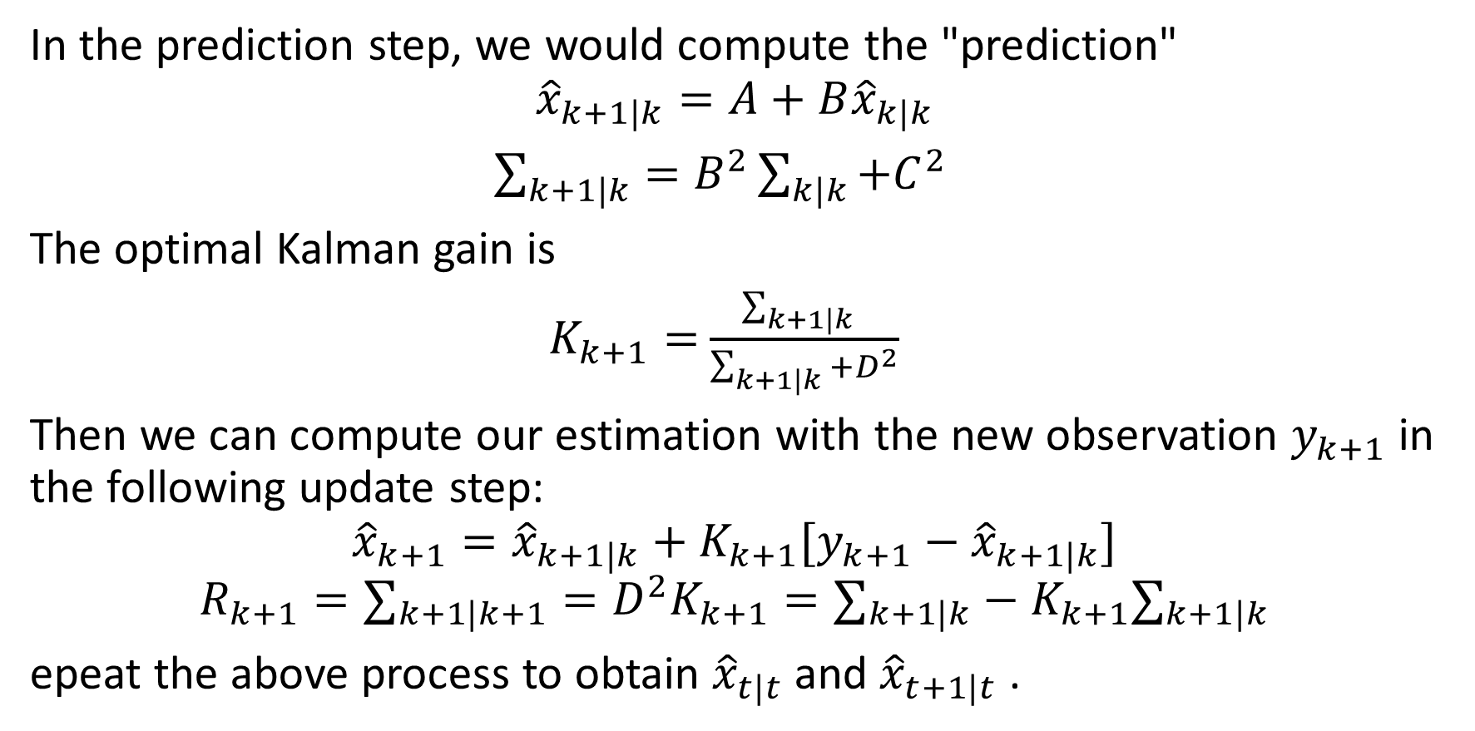
In the prediction step, we would compute the "prediction"
$${\hat{x}}_{k+1|k}=A+B{\hat{x}}_{k|k}$$
$\sum_{k+1|k}{=B^{2}}\sum_{k|k}{+C^{2}}$
The optimal Kalman gain is
$K_{k+1}=$ $\frac{\sum_{k+1|k}{ }}{\sum_{k+1|k}{+D^{2}}}$
Then we can compute our estimation with the new observation $y_{k+1}$ in the following update step:
$${\hat{x}}_{k+1}={\hat{x}}_{k+1|k}+K_{k+1}[y_{k+1}−{\hat{x}}_{k+1|k}]$$
$$R_{k+1}=∑_{k+1|k+1}=D^{2}K_{k+1}=∑_{k+1|k}−K_{k+1}∑_{k+1|k}$$
epeat the above process to obtain ${\hat{x}}_{t|t}$and ${\hat{x}}_{t+1|t}$ .

Slide 6
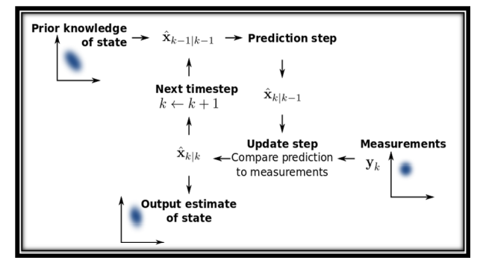
Kalman filter

Slide 7
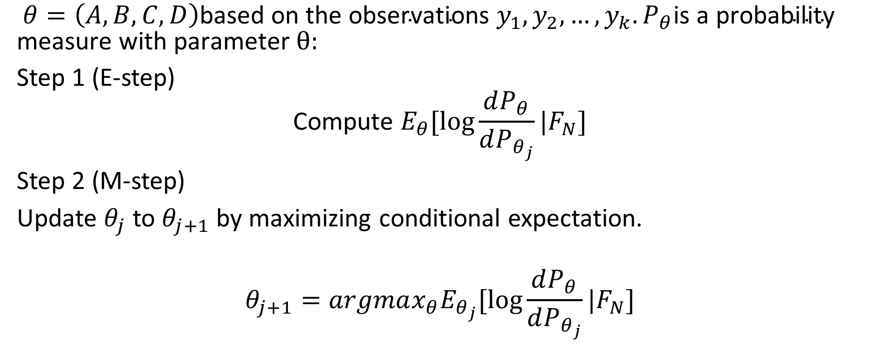
Estimation using EM Algorithm
$θ=\left(A,B,C,D\right)\text{based} \text{on} \text{the} \text{observations} y_{1},y_{2},…,y_{k}.P_{θ}\text{is} \text{a} \text{probability} \text{measure} \text{with} \text{parameter} θ:$
Step 1 (E-step)
$$\text{Compute} E_{θ}[\log{\frac{dP_{θ}}{dP_{θ_{j}}}|F_{N}]}$$
Step 2 (M-step)
Update $θ_{j}$to $θ_{j+1}$by maximizing conditional expectation.
$$θ_{j+1}=argmax_{θ}E_{θ_{j}}[\log{\frac{dP_{θ}}{dP_{θ_{j}}}|F_{N}]}$$

Slide 8
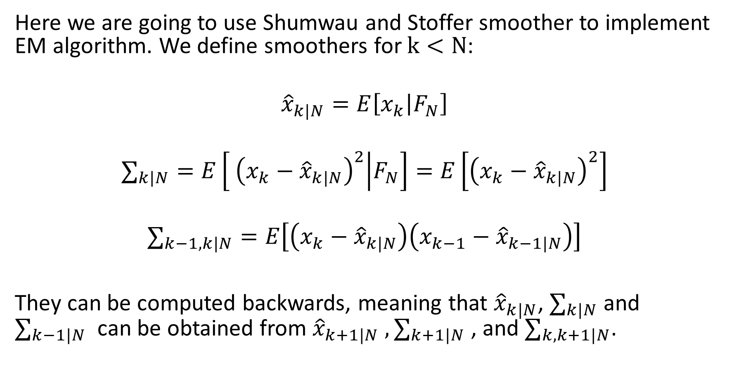
Here we are going to use Shumwau and Stoffer smoother to implement EM algorithm. We define smoothers for $k<N$:
$${\hat{x}}_{k|N}=E\left[x_{k} | F_{N}\right]$$
$$∑_{k|N}=E\left[ {\left(x_{k}−{\hat{x}}_{k|N}\right)}^{2} | F_{N}\right]=E\left[{\left(x_{k}−{\hat{x}}_{k|N}\right)}^{2}\right]$$
$$∑_{k−1,k|N}=E\left[\left(x_{k}−{\hat{x}}_{k|N}\right)\left(x_{k−1}−{\hat{x}}_{k−1|N}\right)\right]$$
They can be computed backwards, meaning that ${\hat{x}}_{k|N}$, $∑_{k|N}$ and $∑_{k−1|N}$ can be obtained from ${\hat{x}}_{k+1|N}$ $,∑_{k+1|N}$ , and $∑_{k,k+1|N}$.

Slide 9
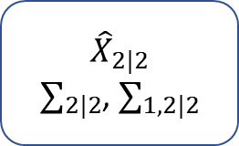
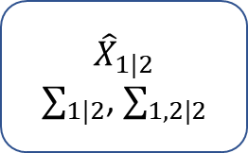
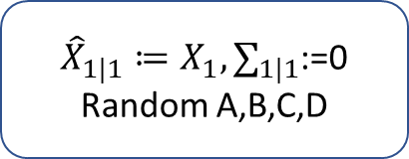



EM algorithm works in the form of Kalman smoother/filter.
${\hat{X}}_{1|1}≔X_{1},∑_{1|1}$:=0
Random A,B,C,D
Kalman
Filter
$${\hat{X}}_{2|2}$$
$∑_{2|2}$, $∑_{1,2|2}$
Kalman
Filter
$${\hat{X}}_{3|3}$$
$∑_{3|3}$, $∑_{2,3|3}$
smoother
smoother
$${\hat{X}}_{1|2}$$
$∑_{1|2}$, $∑_{1,2|2}$
$${\hat{X}}_{2|3}$$
$∑_{2|3}$, $∑_{1,2|3}$
smoother
$${\hat{X}}_{1|3}$$
$∑_{1|3}$, $∑_{1,2|3}$

Slide 10
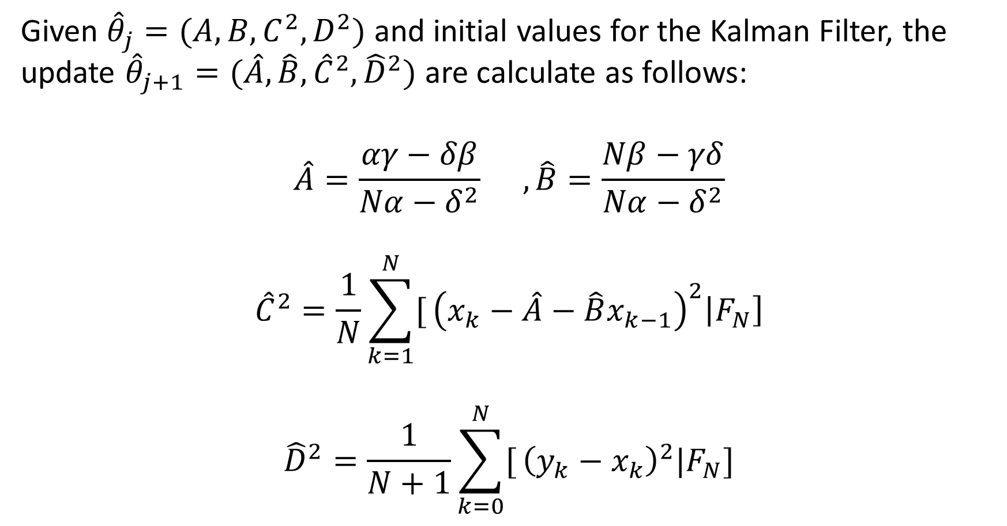
Given ${\hat{θ}}_{j}=(A,B,C^{2},D^{2})$and initial values for the Kalman Filter, the update ${\hat{θ}}_{j+1}=(\hat{A},\hat{B},{\hat{C}}^{2},{\hat{D}}^{2})$are calculate as follows:
$$\hat{A}=\frac{αγ−δβ}{Nα−δ^{2}} ,\hat{B}=\frac{Nβ−γδ}{Nα−δ^{2}}$$
$${\hat{C}}^{2}=\frac{1}{N}\sum_{k=1}^{N}{[}{\left(x_{k}−\hat{A}−\hat{B}x_{k−1}\right)}^{2}\left|F_{N}\right]$$
$${\hat{D}}^{2}=\frac{1}{N+1}\sum_{k=0}^{N}{[}{\left(y_{k}−x_{k}\right)}^{2}|F_{N}]$$

Slide 11
