Slide 1
Forecasting Stock Prices Using a Hybrid Deep Learning Model
IEEE Access
黃敏涓

Slide 2
Outline
Abstract
Knowledge Base
Data construction
Feature extraction
Hybrid Deep Learning Model
MLP
BiLSTM
AM
Evaluation Metrics
Experimental Results

Slide 3
Abstract
提出由MLP(Multi-Layer Perceptron), BiLSTM(Bidirectional LSTM), AM(Attention Mechanism)所構成的Hybrid Deep Learning Model對S&P 500, NASDAQ, Russell 2000, Dow Jones的收盤價做預測。

Slide 4
Outline
Abstract
Knowledge Base
Data construction
Feature extraction
Hybrid Deep Learning Model
MLP
BiLSTM
AM
Evaluation Metrics
Experimental Results

Slide 5
Data Construction- 4 Dataset
透過建立一個 knowledge base蒐集可能影響股價走向的指標，再從中選出對於預測收盤價最有影響的指標
Historical prices of stock:
Derived from the daily opening, highest, lowest, and closing prices of four stock indexes: S&P 500, NASDAQ, Russell 2000, and Dow Jones.
Technical indicators of stock closing prices:
每個股票指數會建立27個technical indicators(SMA, RSI..)，但不是所有都能用來改善股價的預測
Pearson correlation coefficient

Slide 6
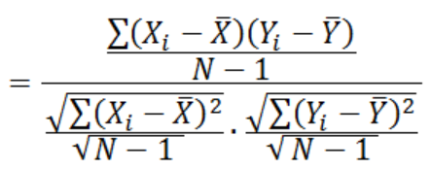
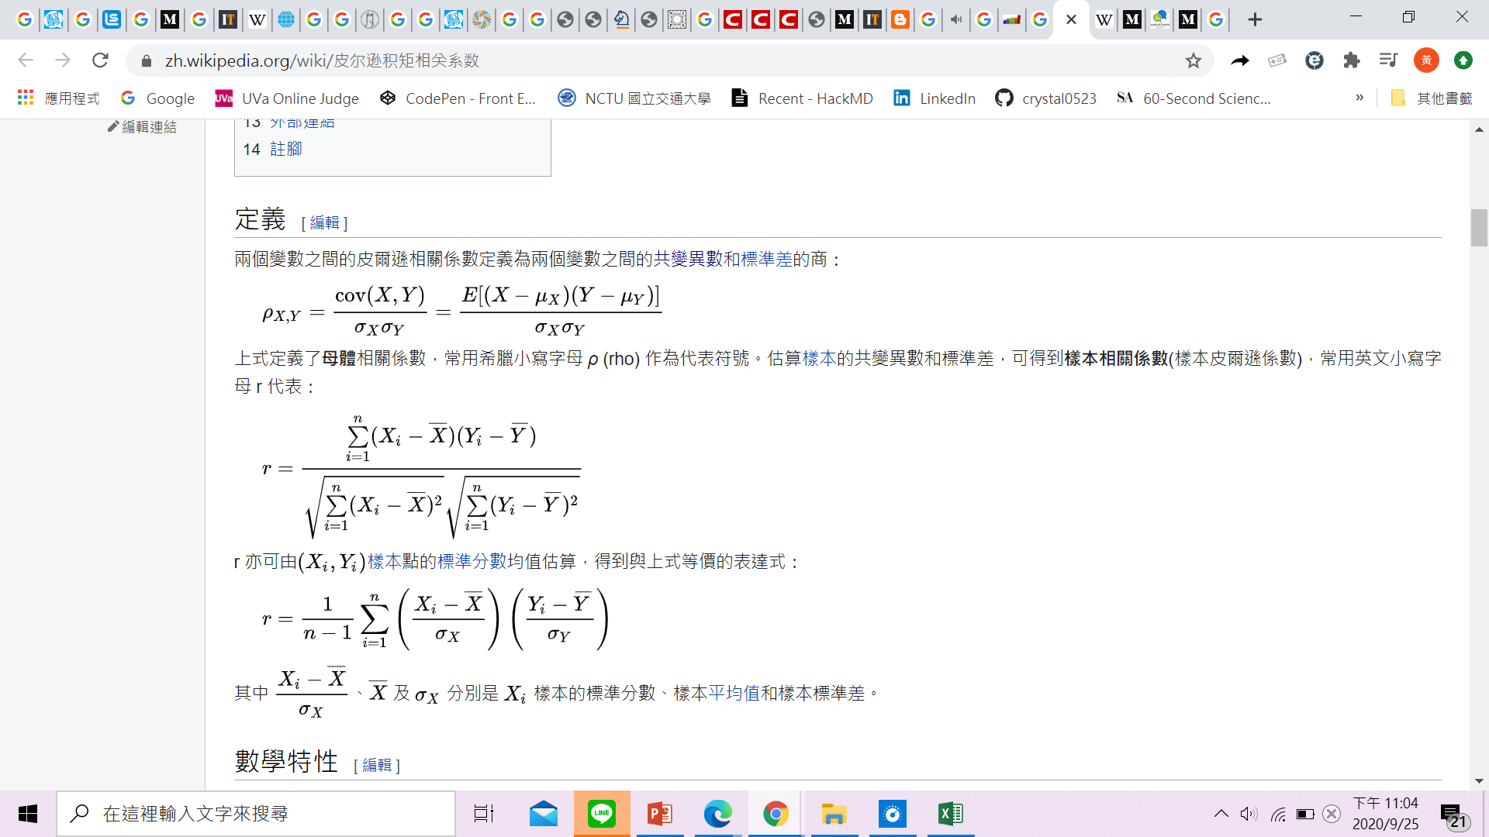
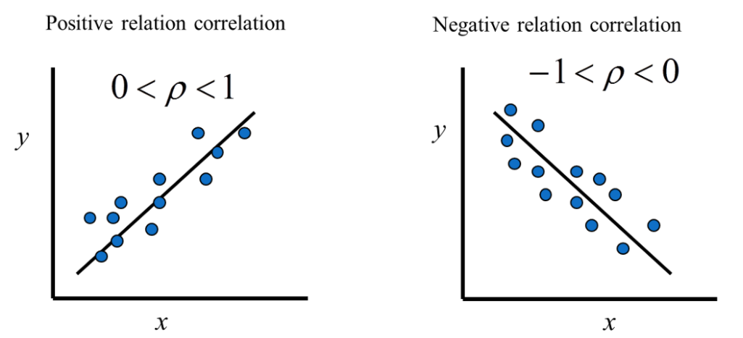
Pearson correlation coefficient
度量變數X: stock index closing prices和Y: technical indicator之間的相關程度，其值介於-1與1之間

Slide 7
Data Construction
Natural resources (gold, silver, and oil) prices:
daily opening, highest, lowest, and closing prices of natural resources (gold, silver, and oil) in dollars
Historical data of the Google index:
股票在Google的每日搜尋次數(反映daily popularity of stock)

Slide 8
Outline
Abstract
Knowledge Base
Data construction
Feature extraction
Hybrid Deep Learning Model
MLP
BiLSTM
AM
Evaluation Metrics
Experimental Results

Slide 9
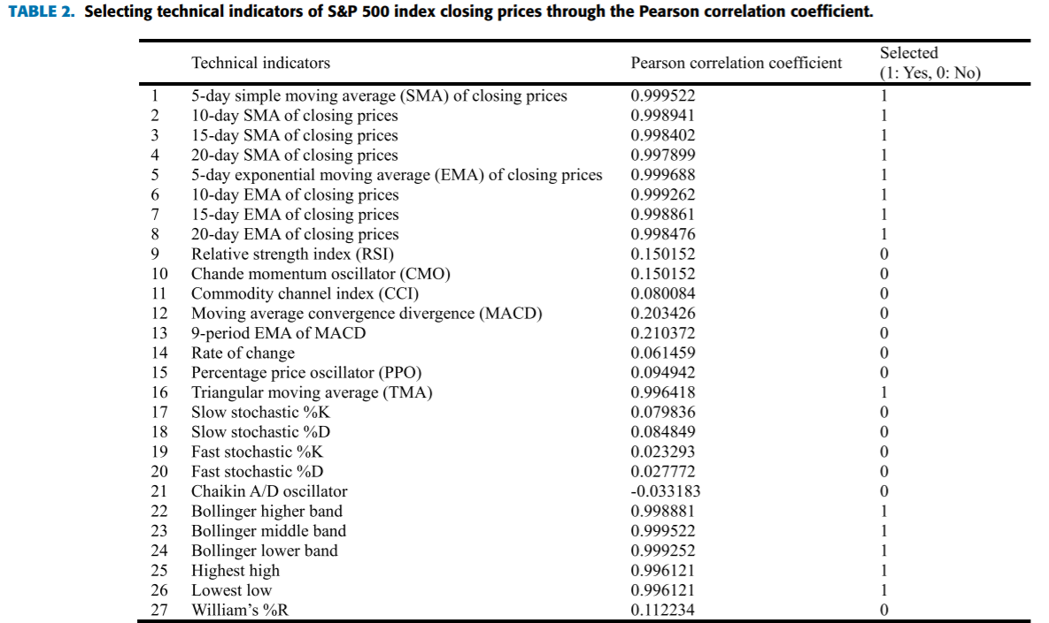
Feature Extraction
correlations between the technical indicators and closing prices
選出14個correlation coefficient > 0.7的
technical indicator為 candidate features

Slide 10
Feature Extraction
標的: S&P 500 index
Historical prices of stock | SP, SP_Open, SP_High, SP_Low, SP_Close | 5
Technical indicators of stock closing prices (Pearson correlation coefficient>0.7) | SP_Close_SMA_5, SP_Close_SMA_10, SP_Close_SMA_15, SP_Close_SMA_20, SP_Close_EMA_5, SP_Close_EMA_10, SP_Close_EMA_15, SP_Close_EMA_20, SP_TRIMA_Close, SP_STOCH_slowk, SP_STOCH_slowd, SP_BBANDS_upperband, SP_BBANDS_middleband, SP_BBANDS_lowerband, | 14
Natural resources (gold, silver, and oil) prices | Gold_Open, Gold_High, Gold_Low, Gold_Close, Silver_Open, Silver_High, Silver_Low, Silver_Close, Oil_Open, Oil_High, Oil_Low, Oil_Close | 12
共31個feature作為預測closing price所需的data

Slide 11
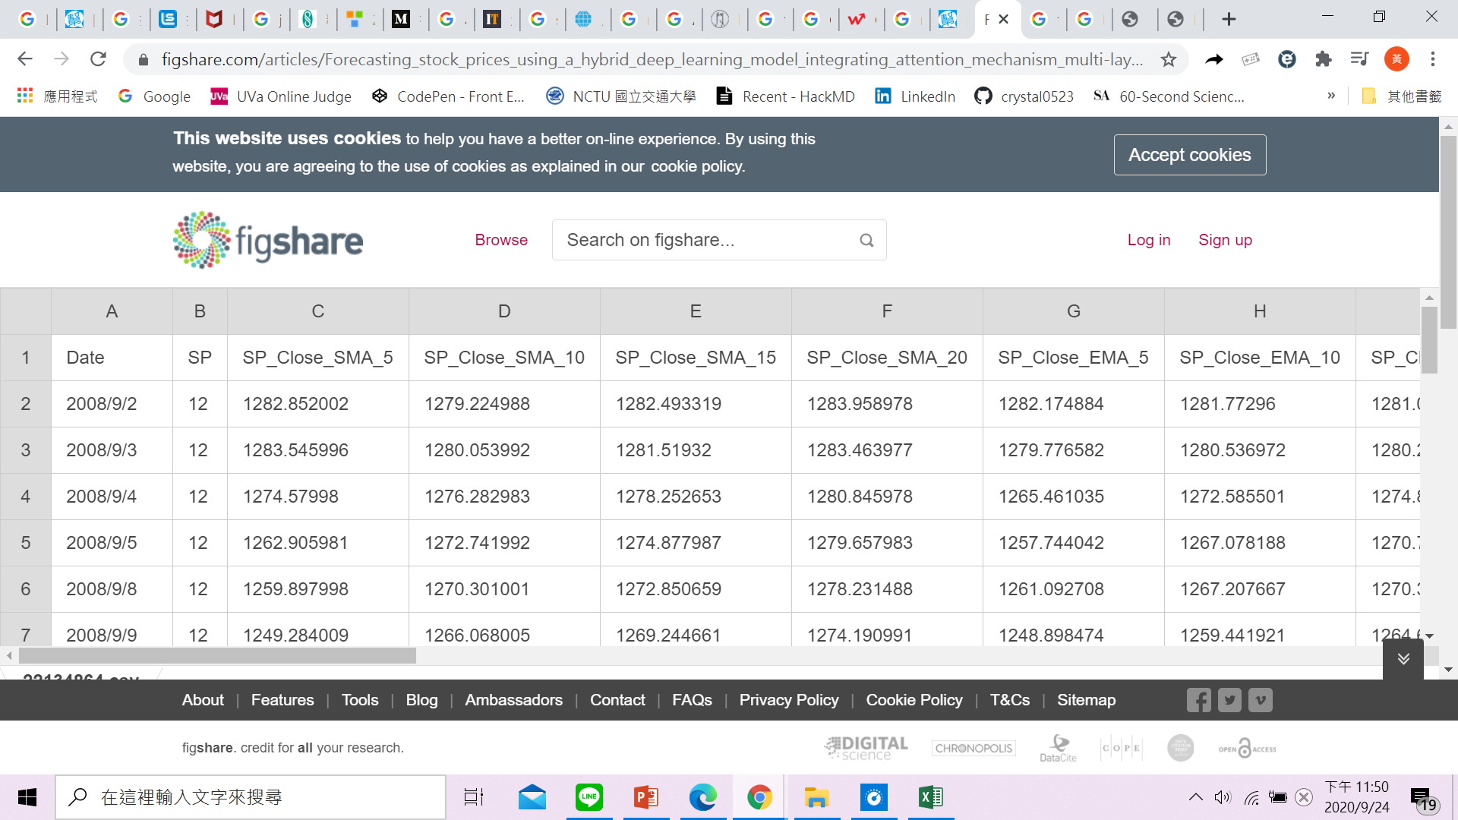
Feature Extraction- S&P 500
total_data_for_SP.csv

Slide 12
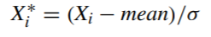


Feature Extraction-PCA
使用PCA對維度很大(31維)的Knowledge Base做降維
Data先做normalization:
$$X$$
$$X_{1}$$

Slide 13
Dataset
Training: 2008/9/2~2018/3/25, 2407 records(in unit of days)
Validation: 2018/3/26~2019/4/16, 267 records
Testing: 2019/4/17~2019/7/12, 60 records
Total: 2008/9/2~2019/7/12 , 2734 records
Data source: Yahoo Finance

Slide 14
Outline
Abstract
Knowledge Base
Data construction
Feature extraction
Hybrid Deep Learning Model
MLP
BiLSTM
AM
Evaluation Metrics
Experimental Results

Slide 15
Hybrid Deep Learning Model
Integrating:
MLP: Achieve faster transformation of feature space(hidden layer的embedded vector) and faster gradient descent because of its good capability in parallel data processing
BiLSTM: Extract features of stock time series data
AM(Attention Mechanism): To make the neural networks focus more on the crucial temporal information by assigning higher weights, thus improving the forecasting accuracy further
Rapid Convergence
Extract feature effectively

Slide 16
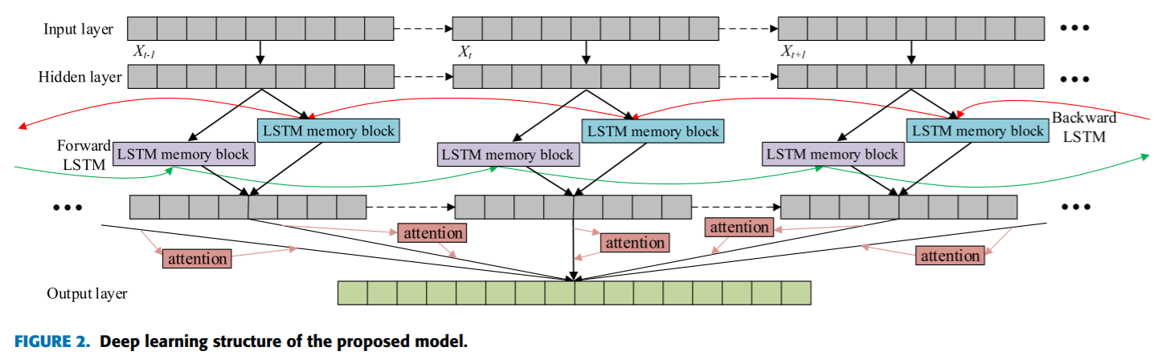
Hybrid Deep Learning Model

Slide 17
Outline
Abstract
Knowledge Base
Data construction
Feature extraction
Hybrid Deep Learning Model
MLP
BiLSTM
AM
Evaluation Metrics
Experimental Results

Slide 18
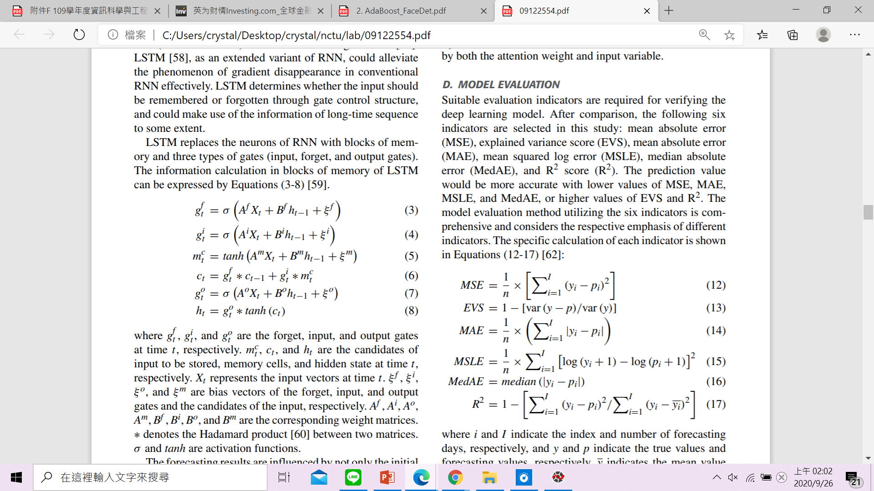
Evaluation Metrics
I: number of forecasting days
y: true value
p: forecasting value
Mean Squared Error
Mean Absolute Error
Error: Smaller the better
Median Absolute Error
Mean Squared Log Error
Explain Variance Score
Larger the better

Slide 19
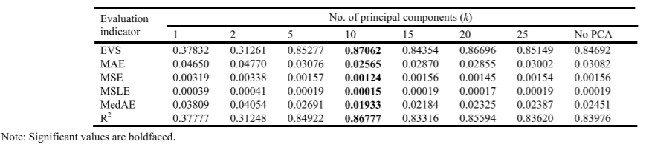
Adjust Dimension-PCA
n=31 to k=?
標的: S&P 500 index
time horizon : 一天
適當的k值可以提升acc，不適當的值反而比沒做PCA來的差

Slide 20
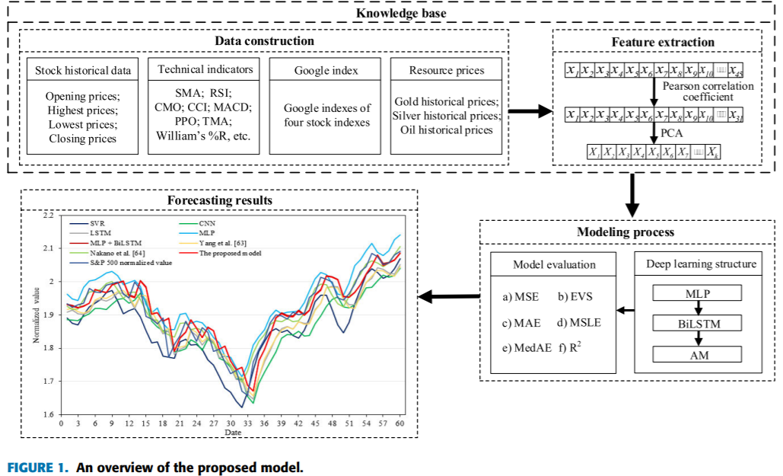

Slide 21
Outline
Abstract
Knowledge Base
Data construction
Feature extraction
Hybrid Deep Learning Model
MLP
BiLSTM
AM
Evaluation Metrics
Experimental Results

Slide 22
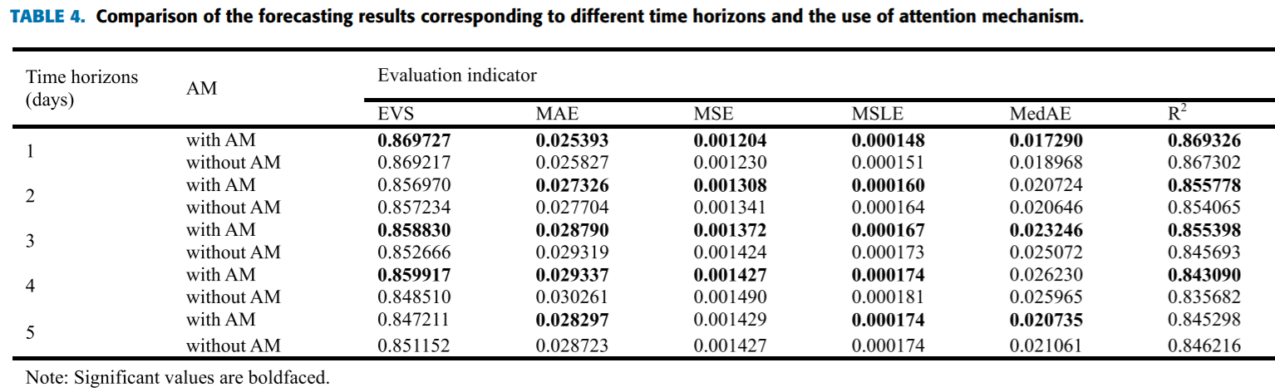
Experimental Results
標的: S&P 500 index

Slide 23
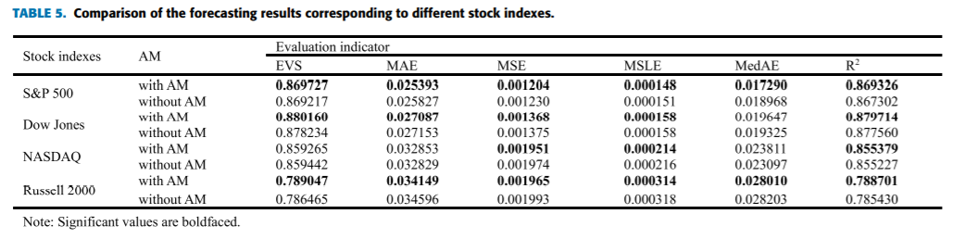
Experimental Results
Time horizon: 1Day

Slide 24
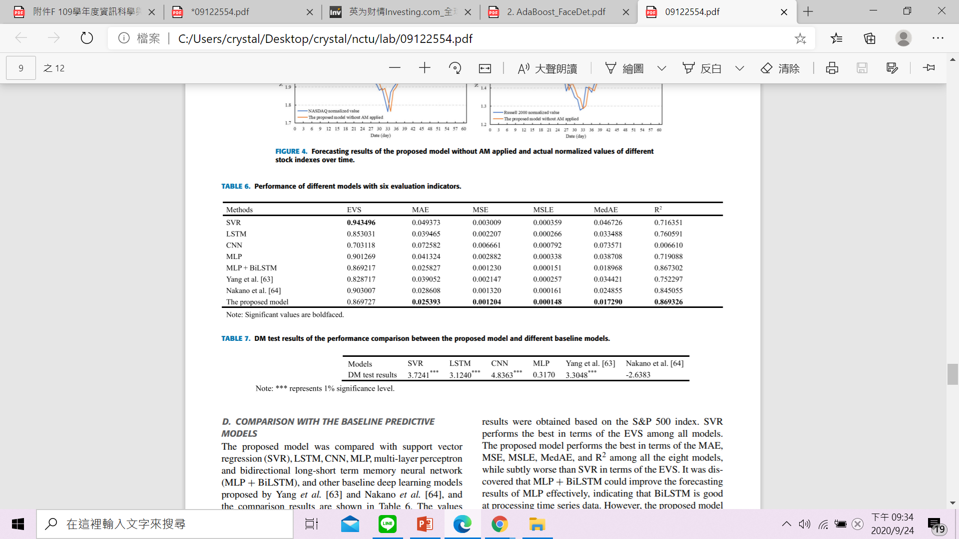
Experimental Results
Performance in comparison of different models
Performance in comparison of different models using Diebold-Mariano test
標的: S&P 500 index
標的: S&P 500 index

