Slide 1
Generative adversarial network based telecom fraud detection at the receiving bank
ELSEVIER 2018

Slide 2
Outline
Abstract
Model Architecture
GAN
GMM
Algorithm
Dataset
Input vector
Experimental Results
Real World Application

Slide 3
Abstract
使用GAN based on a deep denoising autoencoder 的架構來辨識由於電話詐騙所產生的轉帳交易，並真實運用在中國兩家銀行的交易機制中，成功地降低了客戶端和銀行端的損失

Slide 4
Outline
Abstract
Model Architecture
GAN
GMM
Algorithm
Dataset
Input vector
Experimental Results
Real World Application

Slide 5
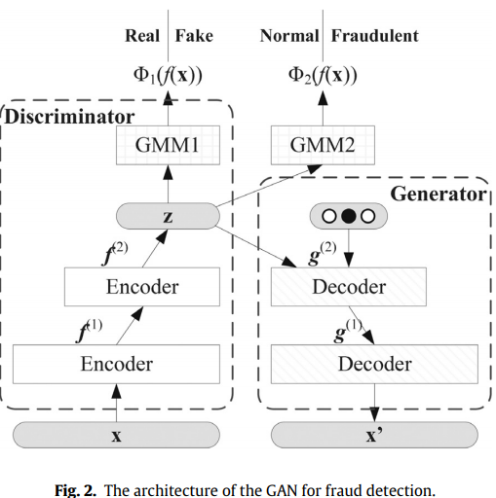
Model architecture

Slide 6
Outline
Abstract
Model Architecture
GAN
GMM
Algorithm
Dataset
Input vector
Experimental Results
Real World Application

Slide 7
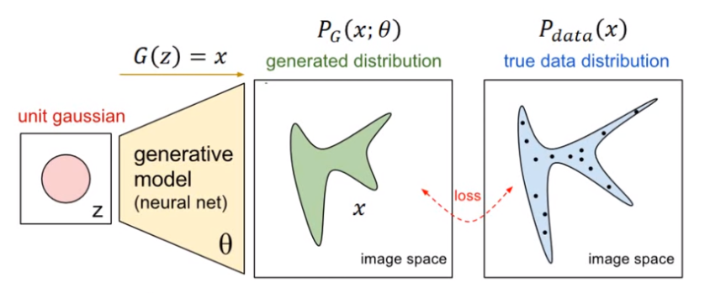

GAN (Generative Adversarial Network)
GAN 的目標:
希望產生資料的distribution $P_{G}$(x;θ)(distribution parameterized by θ)與原始資料的distribution $P_{data}$(x) 相近
透過Discriminator計算$P_{G}$(x;θ)和$P_{data}$(x)的Divergence

Slide 8
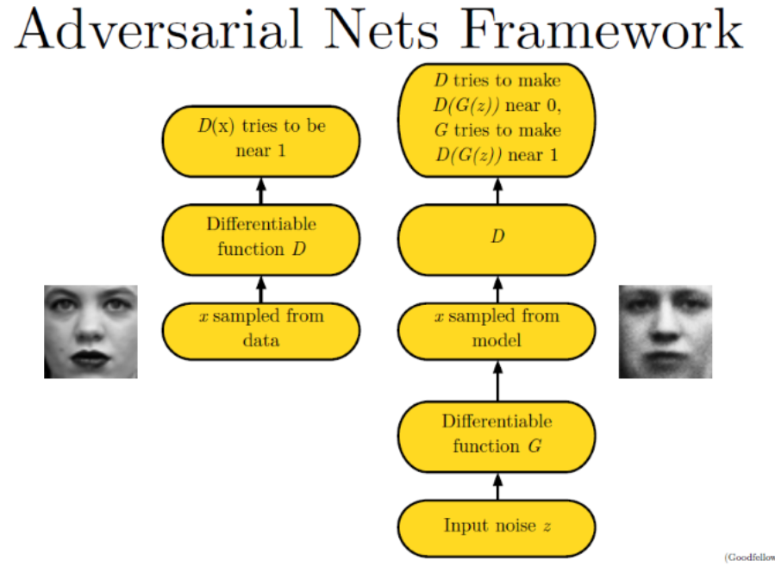
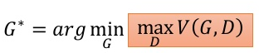
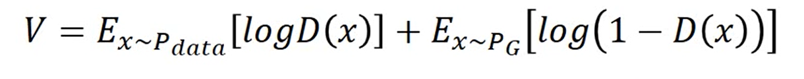
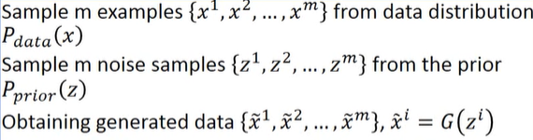
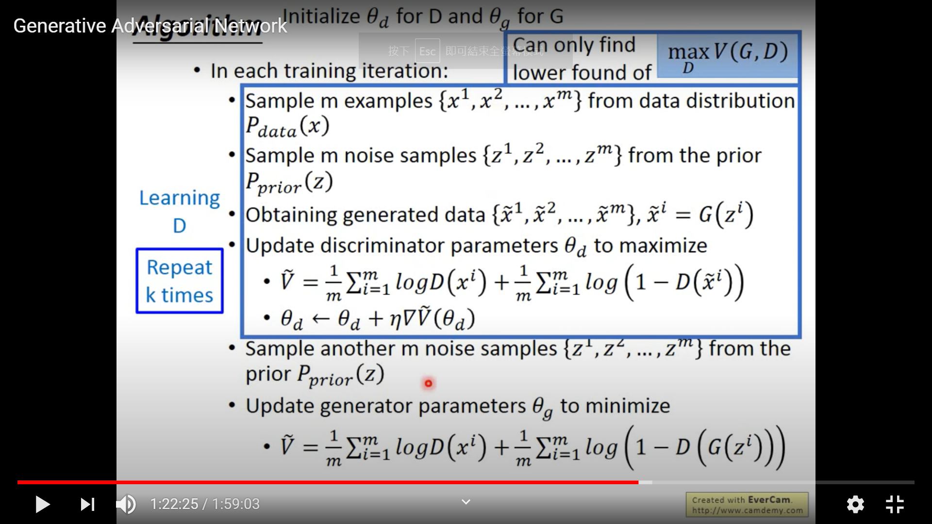
GAN
two-player minimax game:
1: real
0: fake
Objective function:
Discriminator: maximize
Generator: minimize

Slide 9
Outline
Abstract
Model Architecture
GAN
GMM
Algorithm
Dataset
Input vector
Experimental Results
Real World Application

Slide 10
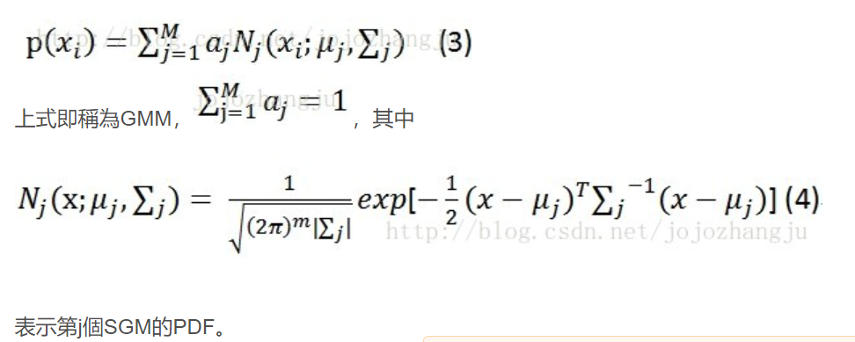
GMM(Gaussian Mixture Model)
高斯混合模型被視爲一種聚類方法，可用在機器學習中對unlabel data進行分類，分類結果由概率表示。
由多個高斯模型來完成較複雜的建模
一批數據X={X1,X2,..Xn}，假設每個點均由一個單高斯分佈生成，而這一批數據共由M個單高斯模型生成，具體某個數據屬於哪個單高斯模型未知，將所有來自不同分佈的數據點混在一起，該分佈稱為高斯混合分佈。
數據的概率分佈密度函數可以通過加權函數表示:
稱為一個component

Slide 11
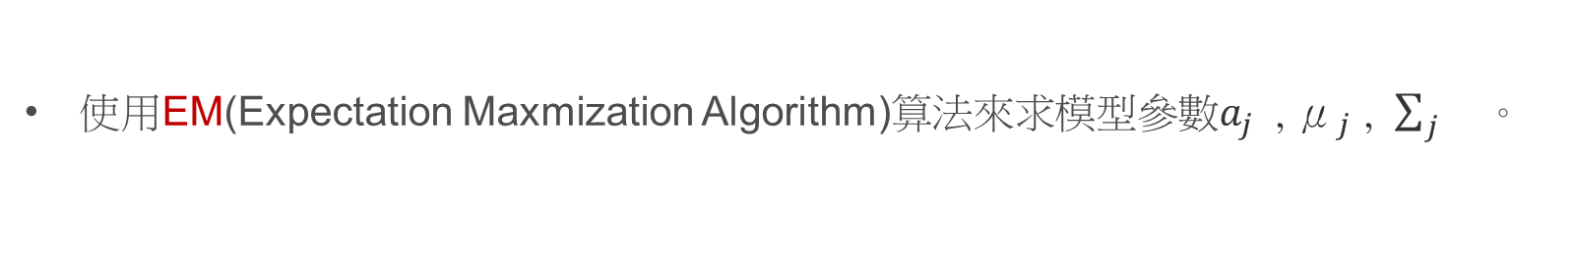
GMM(Gaussian Mixture Model)
GMM是一種聚類算法，每個component就是一個聚類中心。
使用EM(Expectation Maxmization Algorithm)算法來求模型參數$a_{j}$ , ${\text{μ}}_{j}$ , $\sum_{j}{}$。
Step1: 隨機選擇一個component（被選中的概率是$a_{j}$）
Step2: 把樣本代入component，判斷是否屬於這個類別，如果不屬於則回到step1

Slide 12
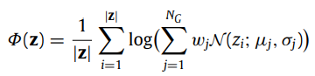
Model architecture
Discriminator: 由Encoder+GMM1構成，將 input vector透過encoder處理得到latent vector
GMM threshold: 0.5
GMM1: input 為latent vector z, output Ф(z) 計算input vector x 是real transfer的probability
Gaussian Mixture Model(GMM):
probability
Deep Denoising Autoencoder: noisy input(data set often contains incomplete and noisy information), 讓模型有去噪的能力

Slide 13
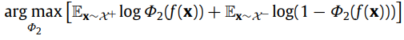
Model architecture
Generator: 由Decoder構成，將latent vector以及額外的one hot label( normal, fraudulent, or unseen)餵進decoder，得到 a set of features (which constitutes a fake transfer)
GMM threshold: 0.5
GMM2: classifier, GMM2 is trained via EM algorithm once D and G are trained , 目標函數:
X+ : distribution of positive samples (normal transfers)
X- : distribution of neagative samples (fraudulent transfers)

Slide 14
Outline
Abstract
Model Architecture
GAN
GMM
Algorithm
Dataset
Input vector
Experimental Results
Real World Application

Slide 15
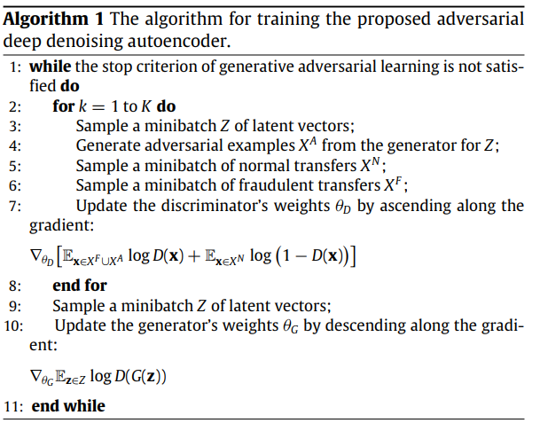
Algorithm
Positive example:
generated example, fraudulent example
Negative example: normal transfer
更新Discriminator
(maximize)
?
1
0
更新
Generator
0

Slide 16
Outline
Abstract
Model Architecture
GAN
GMM
Algorithm
Dataset
Input vector
Experimental Results
Real World Application

Slide 17
Input Vector
type | information
Transfer information | 金額,時間
Sending account information | Sending bank, sending region
Transfer records from sending account to the receiving bank | 轉帳頻率,平均轉帳金額,大筆轉帳易頻率,平均大筆轉帳金額
Transfer records from the sending account to the receiver(該人有多個帳戶, receiving bank是其中一個) | 轉帳頻率,平均轉帳金額,大筆轉帳交易頻率,平均大筆轉帳金額
跟該feature有關的fraudulent transfer數量/the total number of fraudulent cases
over the last year, the last month, the last week(3)
corresponding values of the current recipient account and the other accounts of the same holder over the last year, the last month, and the last week(6)

Slide 18
Input Vector
type | information
Information of the receiving account | 接收區域, 帳戶餘額, 帳戶存在時間, 開戶地點,持有人手機前幾碼(prefix),持有人年紀,持有人性別,持有人出生地,持有人擁有的其他帳戶數量,其他帳戶開戶區域不同的數量,其他帳戶手機號碼不同的數量,其他帳戶存在時間的平均以及標準差
Transactional records of the receiver | 平均餘額, 存款頻率,平均存款金額(大筆) 臨櫃存款頻率,平均臨櫃存款金額(大筆), 提款頻率,平均提款金額(大筆), 臨櫃提款頻率,平均臨櫃提款金額(大筆) 改變提領地區的比例,改變提領大筆金額地區的比例
跟該feature有關的fraudulent transfer數量/the total number of fraudulent cases
over the last year, the last month, the last week(3)
corresponding values of the current recipient account and the other accounts of the same holder over the last year, the last month, and the last week(6)
168維

Slide 19
Dataset
The data set has 330,000 large transfer samples ,including 329,820 normal transfers and 180 real-world fraudulent transfers, all taking from real transactional data of two banks,江西省農村商業銀行 and 上饒銀行。
Train discriminator & generator
Additional 6000 fraudulent transfers
A
B
Data
Test
Use A+B to train Classifier (GMM2)
i.e. 5-fold Cross validation

Slide 20
Outline
Abstract
Model Architecture
GAN
GMM
Algorithm
Dataset
Input vector
Experimental Results
Real World Application

Slide 21
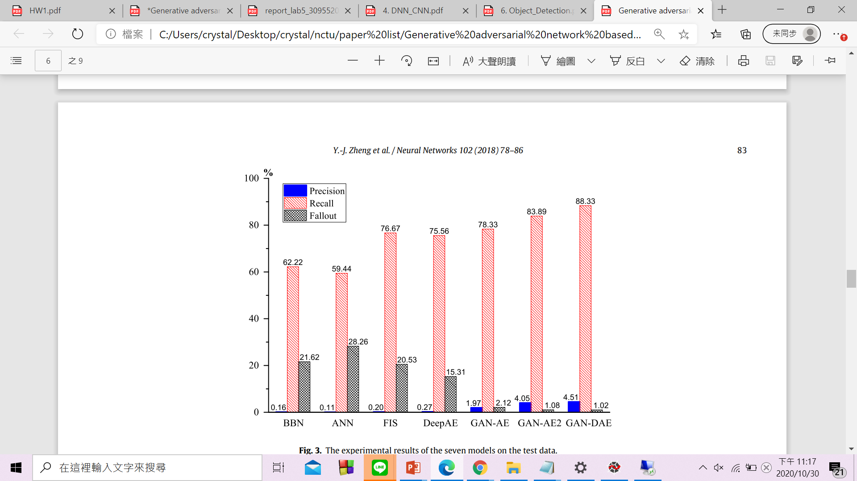
Experimental Results
Precision: percentage of transfers identified as fraudulent
Recall: detection accuracy
Fallout: percentage of normal transfers are misclassified as frauds(misclassification)
High Recall, low fallout

Slide 22
Outline
Abstract
Model Architecture
GAN
GMM
Algorithm
Dataset
Input vector
Experimental Results
Real World Application

Slide 23
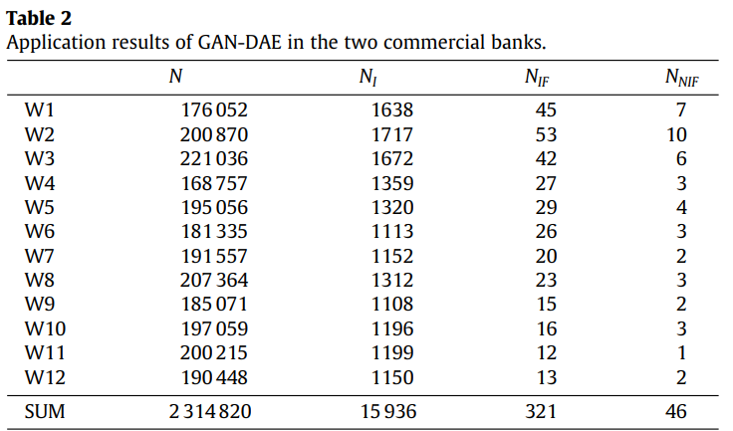
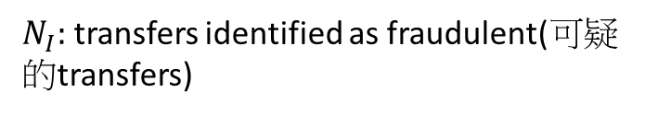


Real World Application
N: Total number of large transfer
During September 5 to November 27 (12 weeks), 2016
(provided by江西省農村商業銀行 and 上饒銀行 )
$N_{I}:$ transfers identified as fraudulent(可疑的transfers)
$N_{IF}$: fraudulent transfers identified
$N_{NIF}$: fraudulent transfers not identified
從w3開始，將前前周為normal transfers和確認為fraudulent transfers的data tuple加入training dataset中重train模型(incremental learning)
detection rate is more than 87%(321/367)

Slide 24
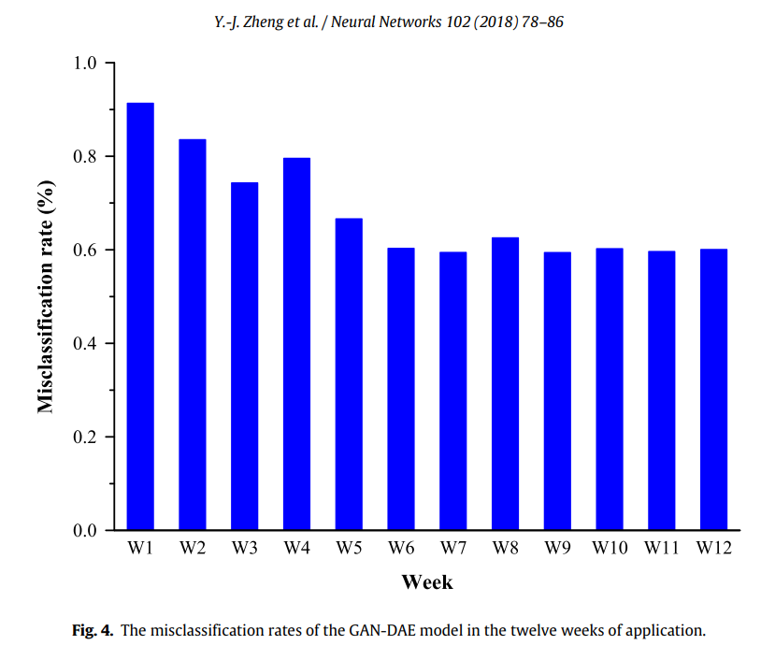
Real World Application
the misclassification rate 在前六周逐漸降低,
在後六周維持在0.6%左右

Slide 25
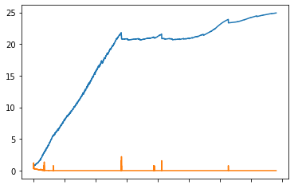
目前implement的問題
G loss
G loss 沒有收斂，D loss迅速收斂到0
(一般而言應該是0.5,0.6)
D loss

Slide 26
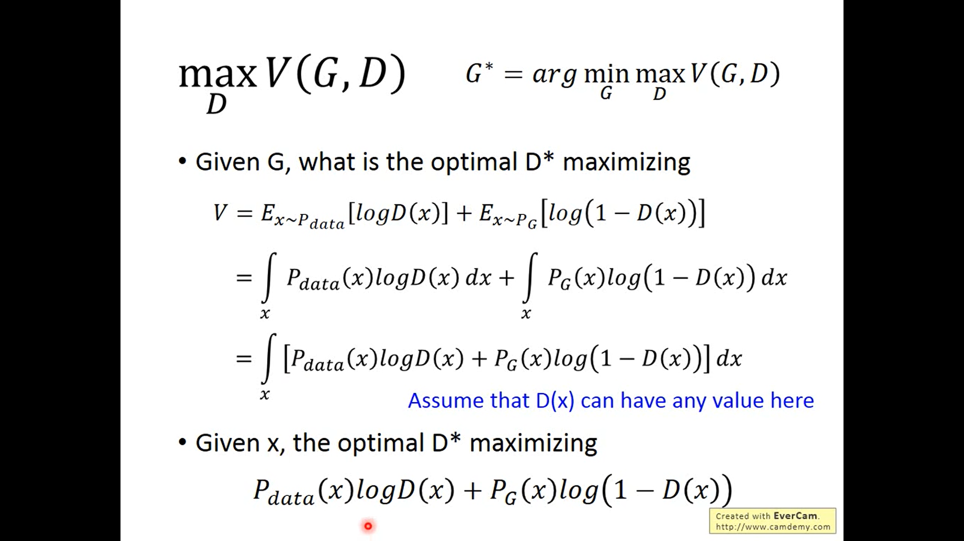
公式推導

Slide 27
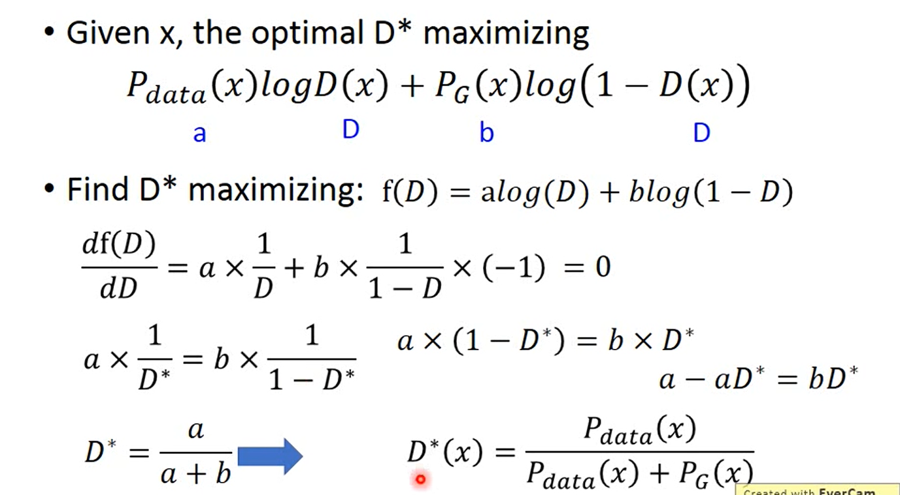
公式推導

Slide 28
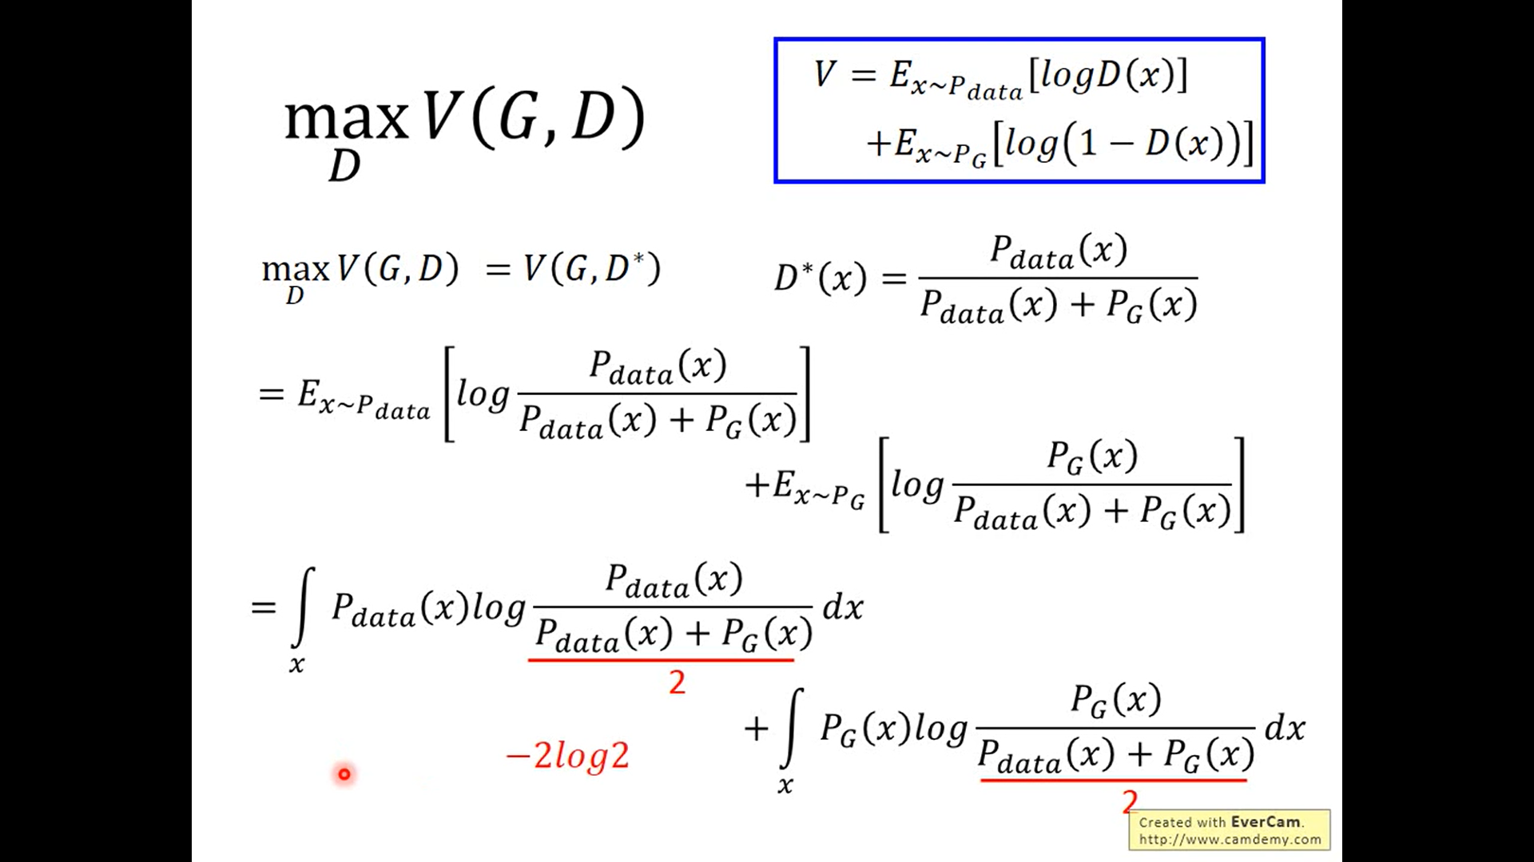
公式推導

Slide 29
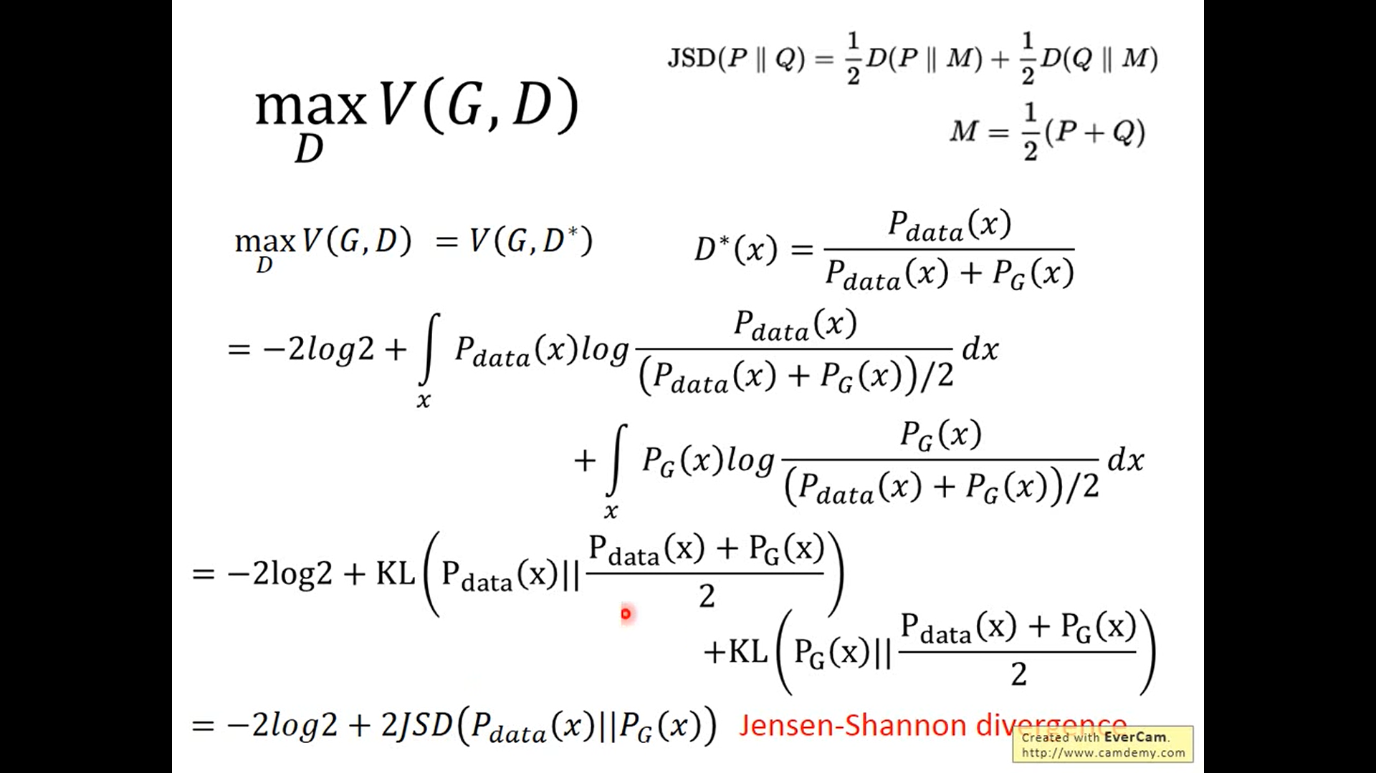
公式推導

