Slide 1
4.5 Black-Scholes-Merton Equation
(4.5.5，4.5.6)

Slide 2






4.5.5 The Greeks
The derivatives of function c( t, x ) of (4.5.19) with respect to various variables are called the Greeks
  Delta
  Theta
  Gamma
  Vega
  Rho
  Psi

Slide 3
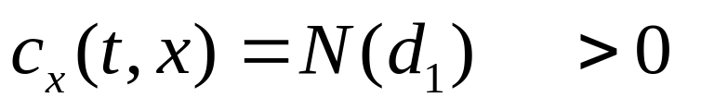
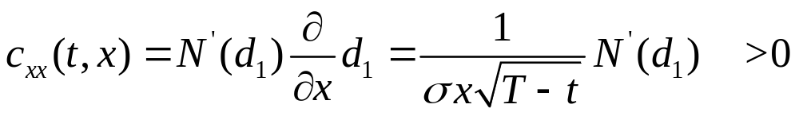
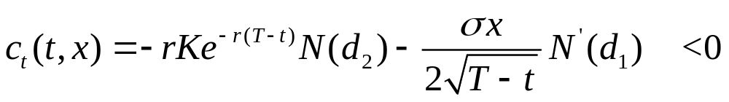
The Greeks
Delta
Gamma
Theta

Slide 4
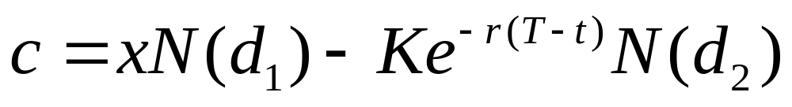
Hedging portfolio
At time t, stock price is x,
Short a call option
The hedging portfolio value is
The amount invested in the money market is

Slide 5

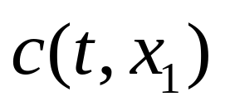
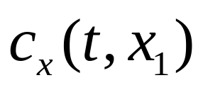


Delta-neutral position
Because delta and gamma are positive, for fixed t , the function c( t,x ) is increasing and convex in the variable x (see Fig 4.5.1)
Consider a portfolio when stock price is we
  Long a call
  Short stock shares
  Invest in money market account

Slide 6
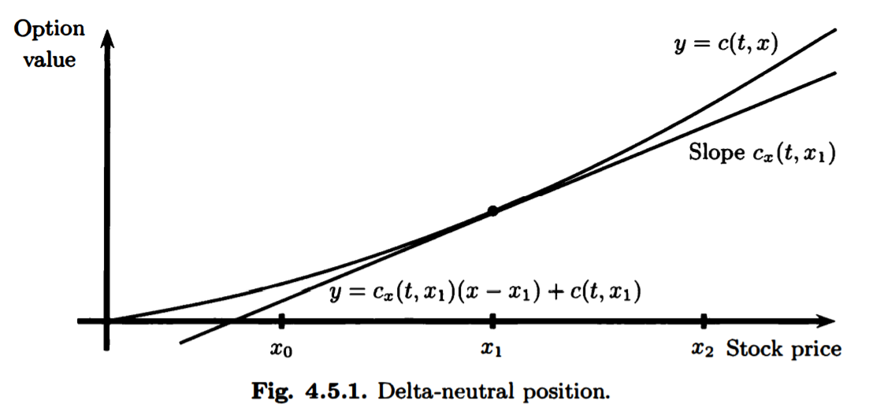

Slide 7
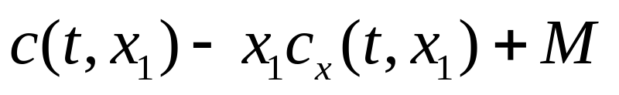

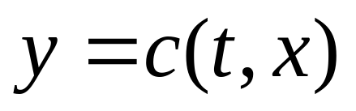
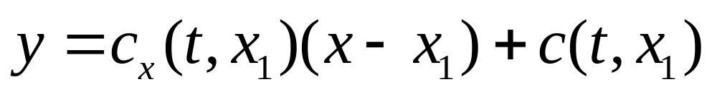
Sensitivity to stock price changes of the portfolio
The initial portfolio value is zero at time t
If the stock price were instantaneously fall to our portfolio value would change to be
This is the difference at between the curve and the straight line

Slide 8

Sensitivity to stock price changes of the portfolio
Because this difference is positive, our portfolio benefits from an instantaneous drop in the stock price
On the other hand, if the stock price were instantaneously rise to
It would result the same phenomenon
Hence, the portfolio we have set up is said to be delta-neutral and long gamma

Slide 9
Long gamma
It benefits from the convexity of c( t,x ) as described above
If there is an instantaneously(瞬間) rise or an instantaneously fall in the stock price, the value of the portfolio increases
A long gamma portfolio is profitable in times of high stock volatility

Slide 10
Delta-neutral
It refers to the fact that the line in Fig 4.5.1 is tangent to the curve
When the stock price makes a small move, the change of portfolio value due to the corresponding change in option price is nearly offset by the change in the value of our short position in the stock
The straight line is a good approximation to the option price for small stock price moves

Slide 11

Arbitrage opportunity
The portfolio described above may at first appear to offer an arbitrage opportunity
When we let time move forward
  both the long gamma position and the positive investment in the money market account offer an opportunity for profit
  the curve is shifts downward because theta is negative
To keep the portfolio delta-neutral, we have to continuously rebalance our portfolio

Slide 12
Vega
The derivative of the option price w.r.t. the volatility is called vega
The more volatile stocks offer more opportunity from the portfolio that hedges a long call position with a short stock position, and hence the call is more expensive so long as the put option

Slide 13
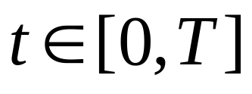
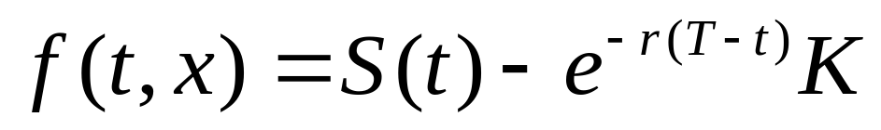
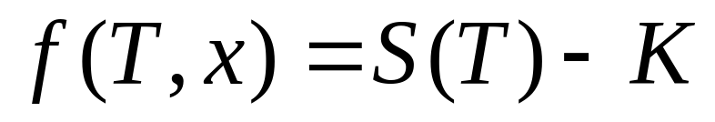
4.5.6 Put-Call parity
A forward contract with delivery price K obligates its holder to buy one share of the stock at the expiration time T in exchange for payment K
Let f( t,x ) denote the value of the forward contract at time t,
The value of the forward contract at expiration time T

Slide 14
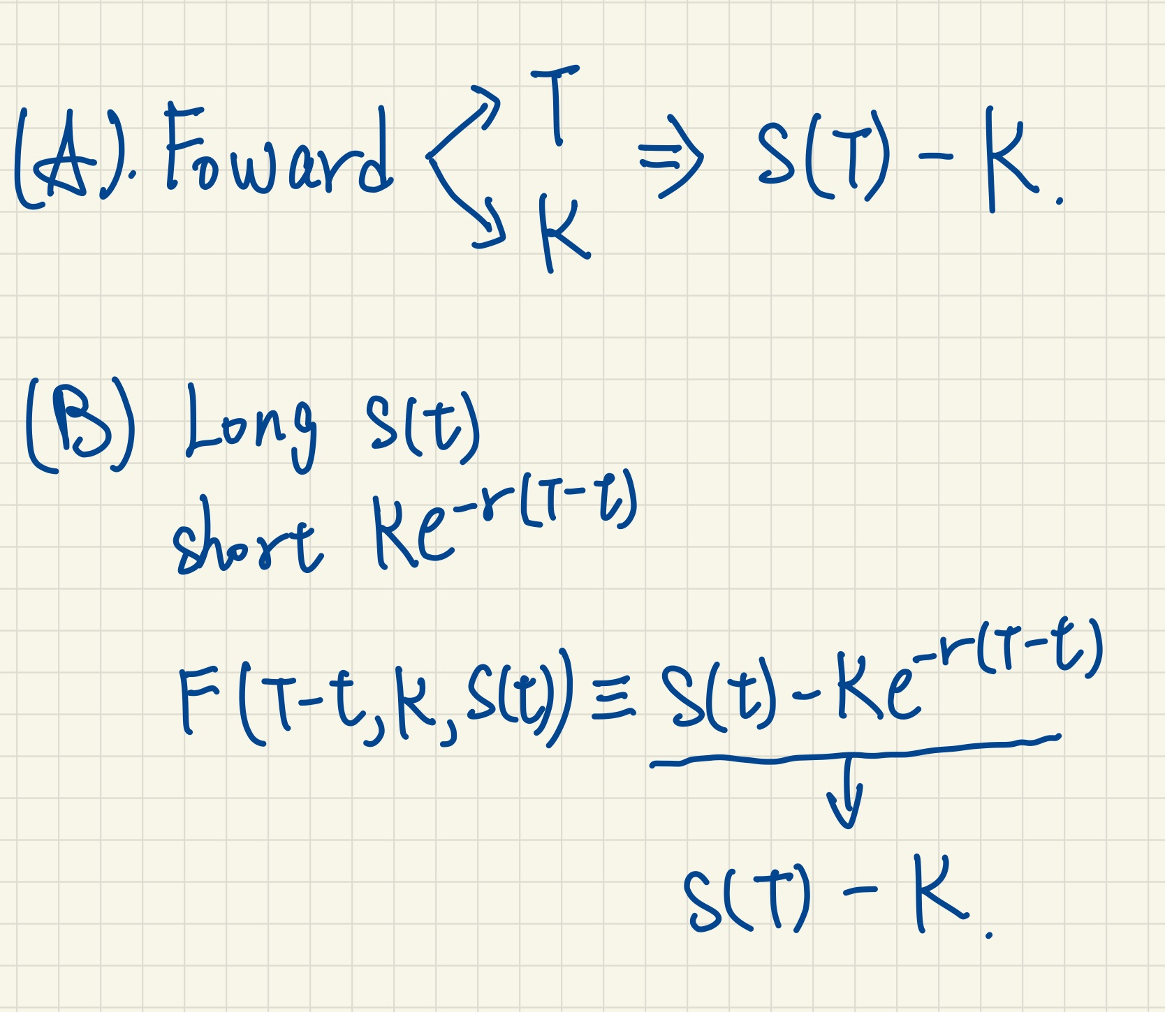

Slide 15
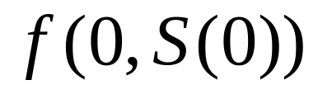
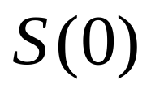
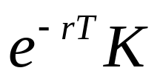
Forward contract
Static hedge
  A hedge that doesn’t trade except at the initial time
Consider a portfolio at time 0
  Short a forward contract
  Long a stock
  Borrow from the money market account

Slide 16
Replicating the payoff of the forward contract
At expiration time T of the forward contract
  Owns a stock S(T)
  Debt to the money market account grown to K
Portfolio value at time T
  S(T)-K
Just replicating the payoff of the forward contract with a portfolio we made at time 0

Slide 17
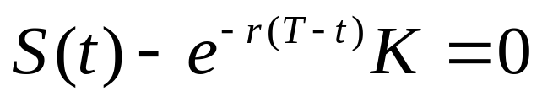
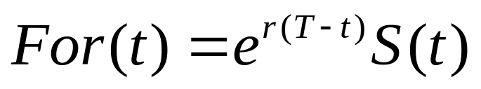
Forward price
The forward price of a stock at time t is defined to be the value of K that cause the forward contract at time t to have value zero
i.e., it is the value of K that satisfies the equation
The forward price at time t is
The forward price isn’t the price of the forward contract

Slide 18
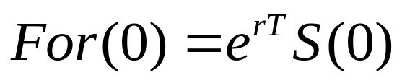
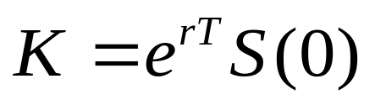
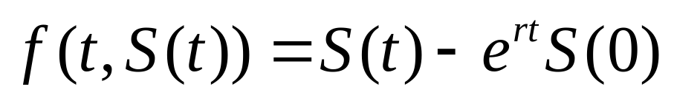
Forward price
The forward price at time t is the price one can lock in at time t for the purchase of one share of stock at time T, paying the price at time T
Consider a situation at time 0, one can lock in a price for buying a stock at time T
Set
The value of the forward contract at time t

Slide 19
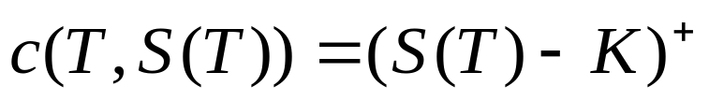
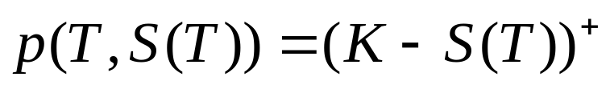
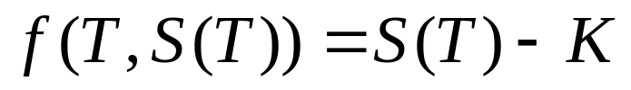
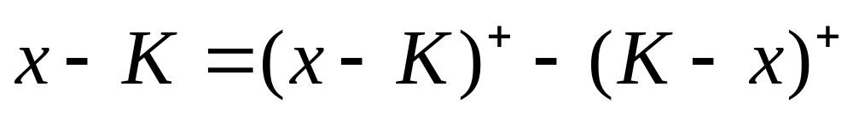
Put-Call Parity
Consider some of the derivatives and their payoff at expiration time T
  European call
  European put
  Forward contract
Observe a equation that will hold for any number x
(4.5.28)

Slide 20
Put-Call Parity
Let x = S(T), the equation (4.5.28) implies
The payoff of the forward contract agrees with the payoff of a portfolio that is long a call and short a put
The value at time T is holding , so long as holding at all previous times
(4.5.29)

Slide 21
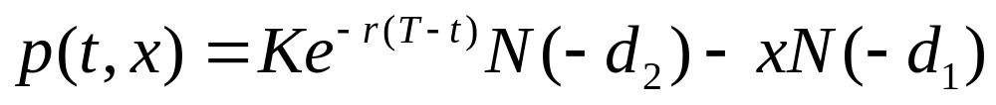
Put-Call Parity
The relationship of equation (4.5.29) is called put-call parity
We can use the put-call parity and the call option formula we derived from the Black-Scholes-Merton formula to obtain the Black-Scholes-Merton put formula

Slide 22
