Slide 1
5.3
Martingale Representation Theorem
黃聖鈞

Slide 2

簡介
在上個章節提到的公式
是在假設我們有一個正確的初始資本，且一個portfolio process
，使得在T時點的投組價值為幾乎確定為V(T)推倒出來的
在上述假設下，我們的正確初始資本會是
且避險投組在時間 t 的價值則為V(t)
In this section, in the model with one stock driven by one Brownian motion, we verify the assumption on which the risk--neutral pricing formula (5.2.31) is based.

Slide 3
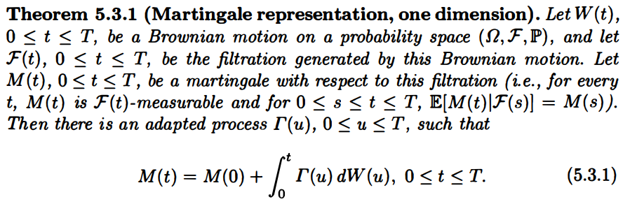

5.3.1 Martingale Representation with One Brownian Motion
Every martingale with respect to this filtration is an initial condition plus an Ito integral with respect to the Brownian motion.

Slide 4
Corollary 5.3.2
The assumption that the filtration in Theorem 5.3.1 is the one generated by the Brownian motion is more restrictive than the assumption of Girsanov‘s Theorem (Theorem 5.2.3)
If we include this extra restriction in Girsanov‘s Theorem, then we obtain the following corollary
The first paragraph of this corollary is just a repeat of Girsanov's Theorem
the second part contains the new assertion

Slide 5
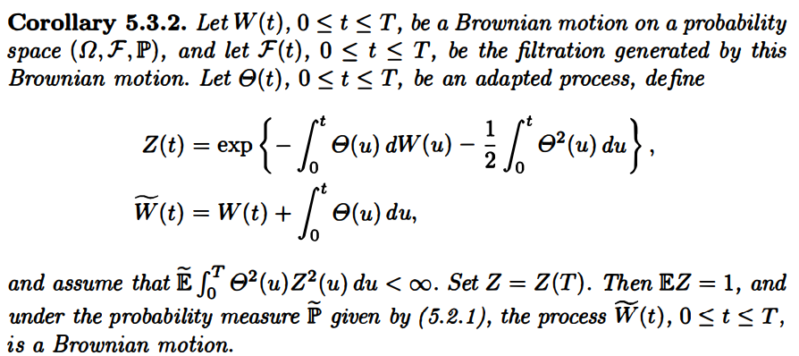
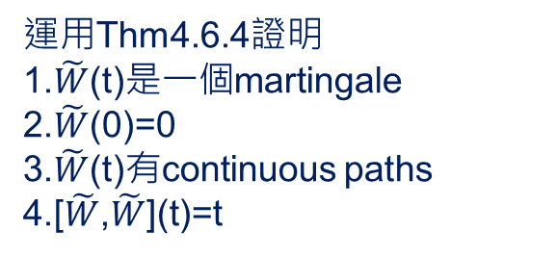

Corollary 5.3.2 - 1
運用Thm4.6.4證明
1.$\tilde{W}$(t)是一個martingale
2.$\tilde{W}$(0)=0
3.$\tilde{W}$(t)有continuous paths
4.[$\tilde{W}$,$\tilde{W}$](t)=t
$\tilde{W}$(t)為Brownian motion

Slide 6
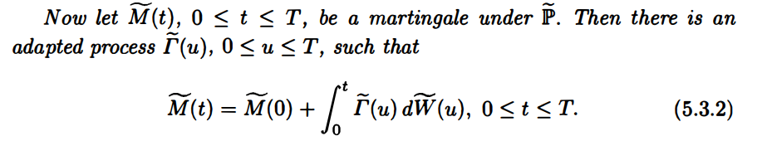
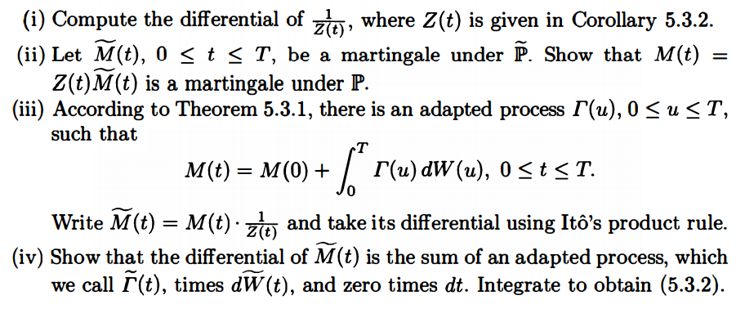
Corollary 5.3.2 - 2
證明

Slide 7
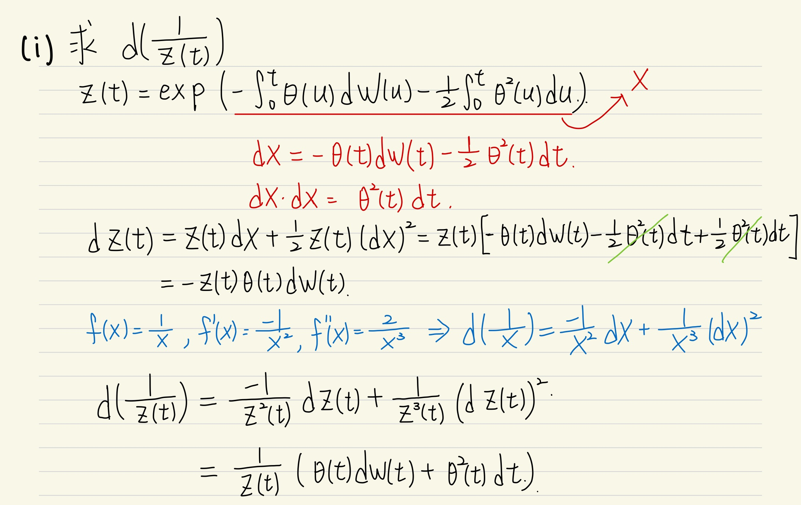
Proof : (i)

Slide 8
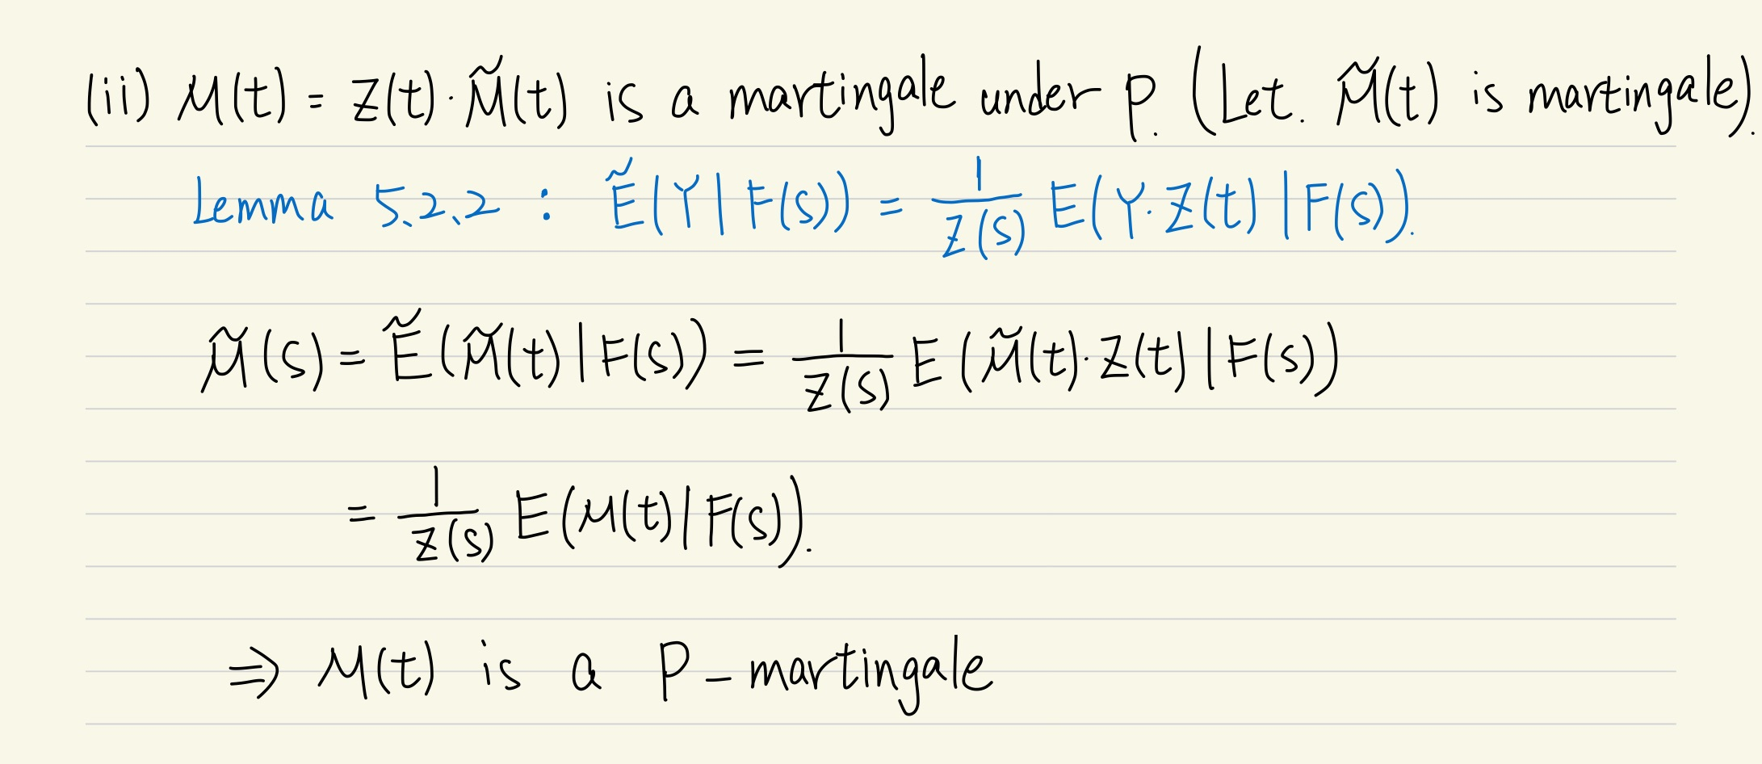
Proof : (ii)

Slide 9
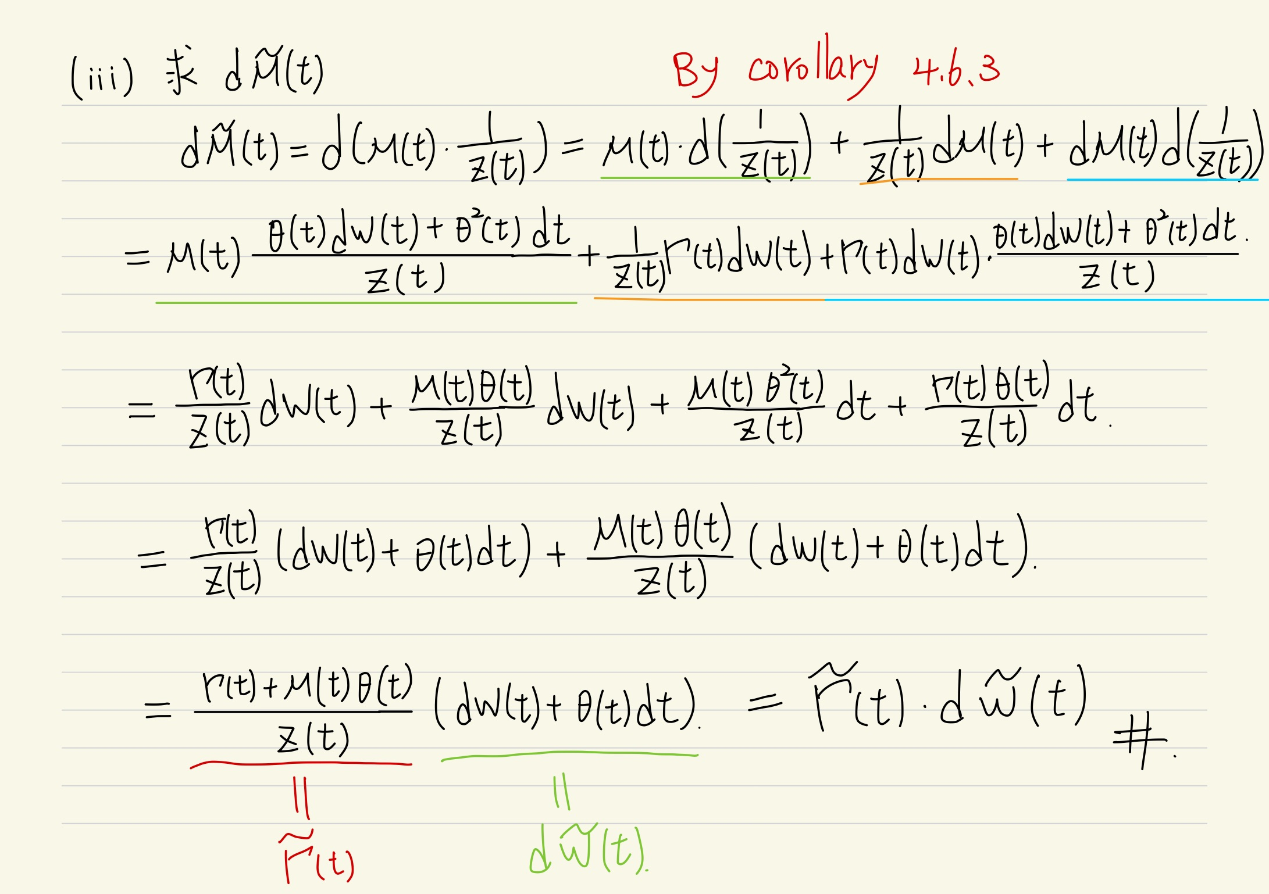
Proof : (iii)

Slide 10

5.3.2 Hedging with One Stock
Now we have the stock price process (5.2.15)
and an interest rate process R(t) that generates the discount process(5.2.17)
Recall the assumption that, for all t ∈ [0,T], the volatility is almost surely not zero.
We make the additional assumption that the filtration F(t), 0 ≤ t ≤ T, is generated by the Brownian motion W(t), 0 ≤ t ≤ T.

Slide 11

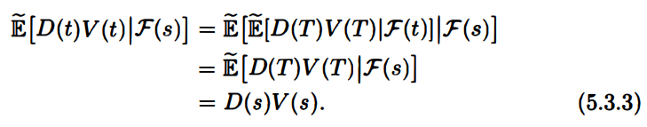
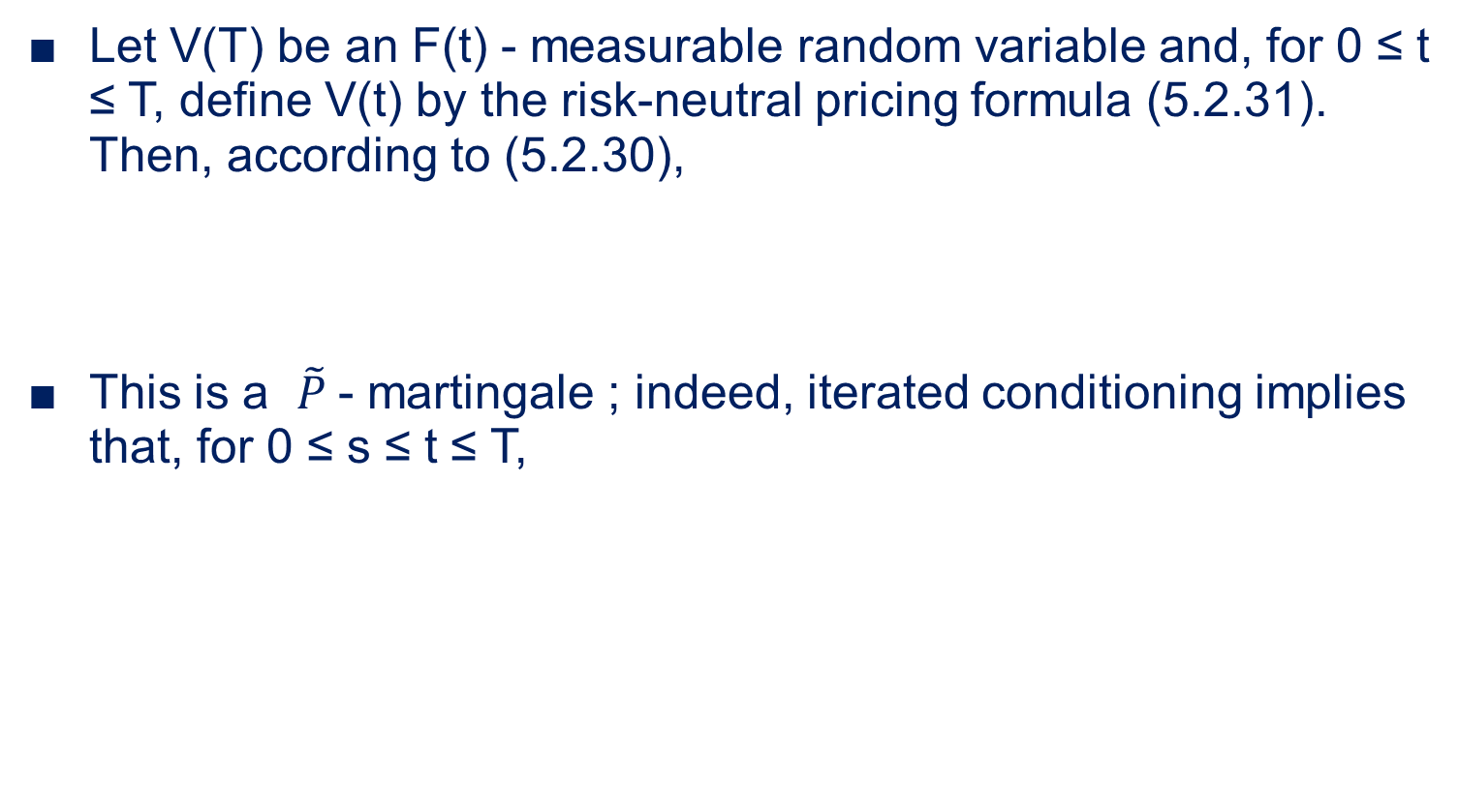
5.3.2 Hedging with One Stock
Let V(T) be an F(t) - measurable random variable and, for 0 ≤ t ≤ T, define V(t) by the risk-neutral pricing formula (5.2.31). Then, according to (5.2.30),
This is a $\tilde{P}$- martingale ; indeed, iterated conditioning implies that, for 0 ≤ s ≤ t ≤ T,

Slide 12

5.3.2 Hedging with One Stock
Therefore, has a representation as (recall that )
For any portfolio process , the differential of the discounted portfolio value is given by
, and hence

Slide 13


5.3.2 Hedging with One Stock
In order to have for all t, we should choose
And choose to satisfy
With these choices, we have a hedge for a short position in the derivative security with payoff V(T) at time T.

Slide 14
5.3.2 Hedging with One Stock
Two key assumptions that make the hedge possible :
the volatility is not zero, so equation (5.3.7) can be solved for
F(T) is generated by the underlying Brownian motion
(i.e., there is no randomness in the derivative security apart from the Brownian motion randomness, which can be hedged by trading the stock).
Under these two assumptions, every F(T)-measurable derivative security can be hedged. Such a model is said to be complete.

Slide 15

結論
The Martingale Representation Theorem證明了風險中性定價公式 (5.2.30) 和 (5.2.31) 的合理性，但它沒有提供找到對避險投資組合 的實用方法
在(5.3.8) 公式中包含了 ，在The Martingale Representation Theorem中保證了 存在，因此 存在，但它亦沒有提供找到 的方法

