Slide 1
4.6 Multivariable Stochastic Calculus
報告人:劉佩佳

Slide 2
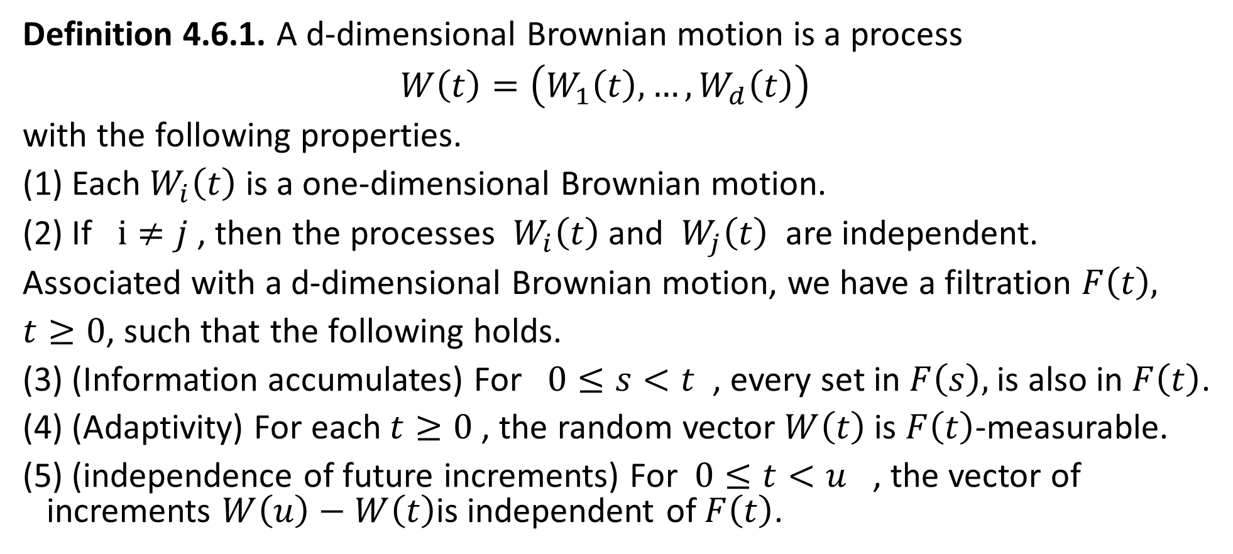
4.6.1 Multiple Brownian Motion
Definition 4.6.1. A d-dimensional Brownian motion is a process
$W\left(t\right)=\left(W_{1}\left(t\right),…,W_{d}\left(t\right)\right)$
with the following properties.
(1) Each $W_{i}\left(t\right)$ is a one-dimensional Brownian motion.
(2) If $i≠j$ , then the processes $W_{i}\left(t\right)$ and $W_{j}\left(t\right)$ are independent.
Associated with a d-dimensional Brownian motion, we have a filtration $F\left(t\right),$
$t≥0$, such that the following holds.
(3) (Information accumulates) For $0≤s<t$ , every set in $F\left(s\right),$is also in $F\left(t\right)$.
(4) (Adaptivity) For each $t≥0$ , the random vector $W\left(t\right)$is $F\left(t\right)$-measurable.
(5) (independence of future increments) For $0≤t<u$ , the vector of increments $W\left(u\right)−W\left(t\right)$is independent of $F\left(t\right)$.

Slide 3
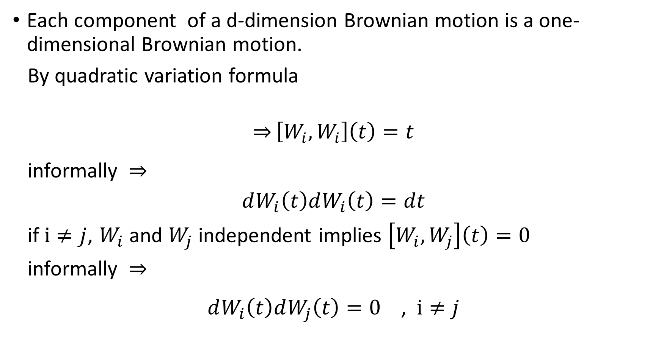
Each component of a d-dimension Brownian motion is a one-dimensional Brownian motion.
By quadratic variation formula
$$\overset{⇒}{}\left[W_{i},W_{i}\right]\left(t\right)=t$$
informally
$$dW_{i}\left(t\right)dW_{i}\left(t\right)=dt$$
if $i≠j$, $W_{i}$ and $W_{j}$ independent implies $\left[W_{i},W_{j}\right]\left(t\right)=0$
informally
$dW_{i}\left(t\right)dW_{j}\left(t\right)=0$ , $i≠j$

Slide 4
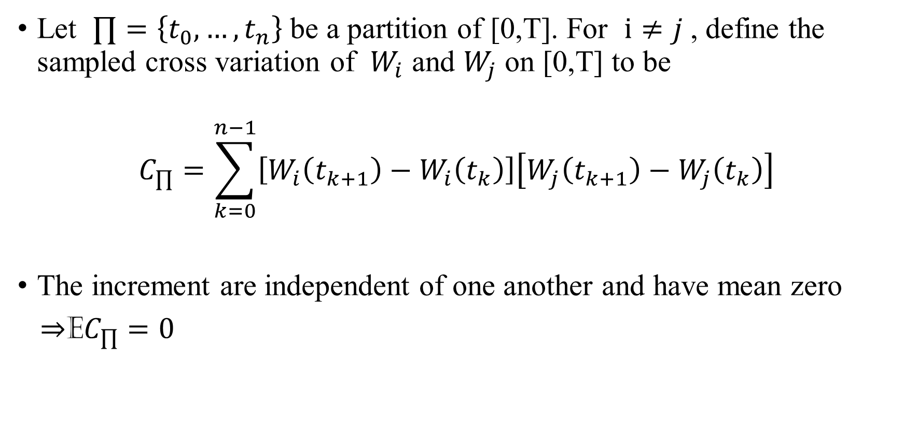
Let $∏=\left\{t_{0},…,t_{n}\right\}$ be a partition of [0,T]. For $i≠j$ , define the sampled cross variation of $W_{i}$ and $W_{j}$ on [0,T] to be
$$C_{∏}=\sum_{k=0}^{n−1}{\left[W_{i}\left(t_{k+1}\right)−W_{i}\left(t_{k}\right)\right]\left[W_{j}\left(t_{k+1}\right)−W_{j}\left(t_{k}\right)\right]}$$
The increment are independent of one another and have mean zero
E$C_{∏}=0$

Slide 5
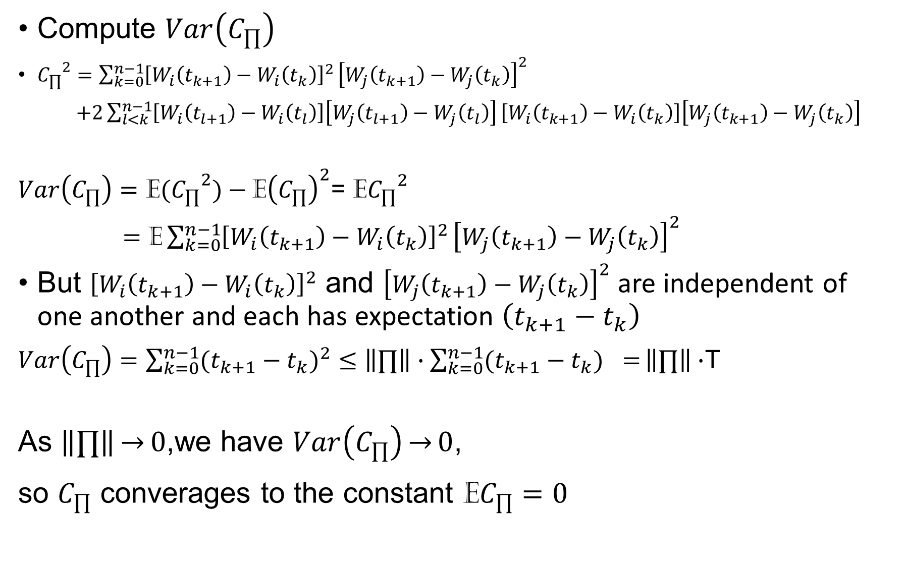
Compute $Var\left(C_{∏}\right)$
${C_{∏}}^{2}=\sum_{k=0}^{n−1}{{\left[W_{i}\left(t_{k+1}\right)−W_{i}\left(t_{k}\right)\right]}^{2}}{\left[W_{j}\left(t_{k+1}\right)−W_{j}\left(t_{k}\right)\right]}^{2}$
$+2\sum_{l<k}^{n−1}{\left[W_{i}\left(t_{l+1}\right)−W_{i}\left(t_{l}\right)\right]\left[W_{j}\left(t_{l+1}\right)−W_{j}\left(t_{l}\right)\right]}\left[W_{i}\left(t_{k+1}\right)−W_{i}\left(t_{k}\right)\right]\left[W_{j}\left(t_{k+1}\right)−W_{j}\left(t_{k}\right)\right]$
$Var\left(C_{∏}\right)=\text{E}{{(C}_{∏}}^{2})−{\text{E}\left(C_{∏}\right)}^{2}$= $\text{E}{C_{∏}}^{2}$
$=$ $\text{E}\sum_{k=0}^{n−1}{{\left[W_{i}\left(t_{k+1}\right)−W_{i}\left(t_{k}\right)\right]}^{2}}{\left[W_{j}\left(t_{k+1}\right)−W_{j}\left(t_{k}\right)\right]}^{2}$
But ${\left[W_{i}\left(t_{k+1}\right)−W_{i}\left(t_{k}\right)\right]}^{2}$ and ${\left[W_{j}\left(t_{k+1}\right)−W_{j}\left(t_{k}\right)\right]}^{2}$ are independent of one another and each has expectation $\left(t_{k+1}−t_{k}\right)$
$Var\left(C_{∏}\right)=\sum_{k=0}^{n−1}{{(t_{k+1}−t_{k})}^{2}}≤\left\|∏\right\|∙\sum_{k=0}^{n−1}{{(t_{k+1}−t_{k})}^{}=}\left\|∏\right\|∙$T
As $\left\|∏\right\|\overset{→}{}0$,we have $Var\left(C_{∏}\right)\overset{→}{}0$,
so $C_{∏}$ converages to the constant E$C_{∏}=0$

Slide 6
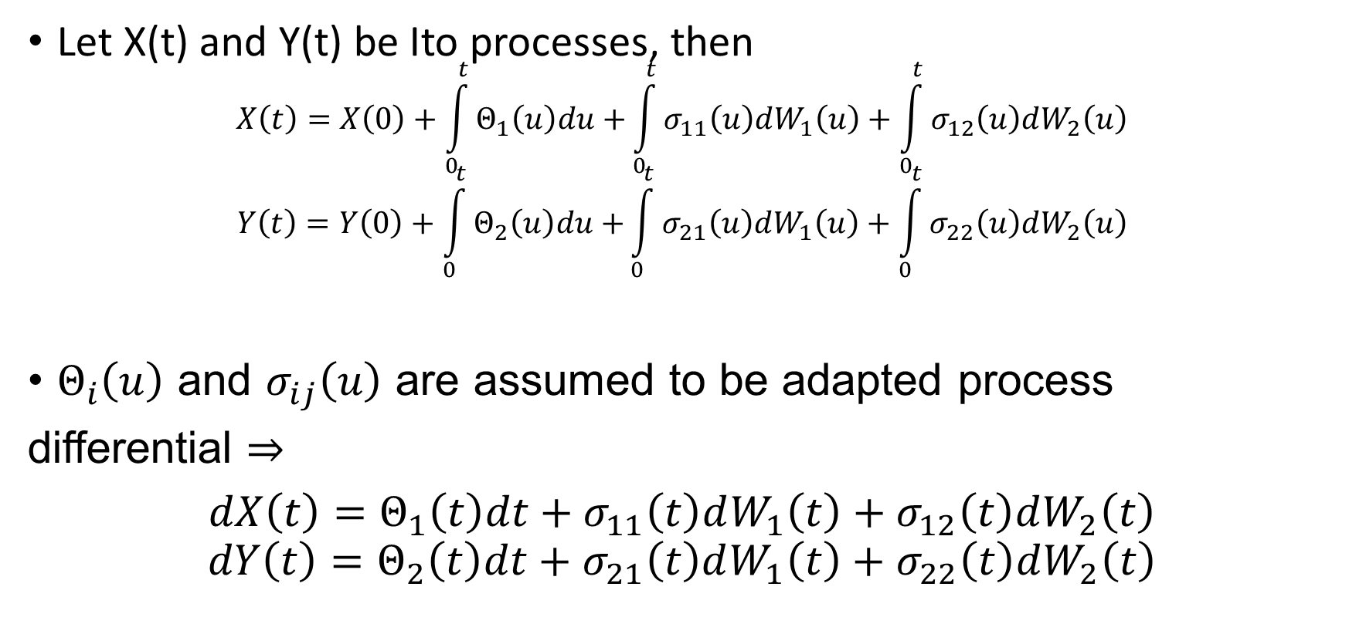
4.6.2 Ito-Doeblin Formula for Multiple Processes
Let X(t) and Y(t) be Ito processes, then
$$X\left(t\right)=X\left(0\right)+\int_{0}^{t}{Θ_{1}\left(u\right)du+}\int_{0}^{t}{σ_{11}\left(u\right)dW_{1}\left(u\right)+\int_{0}^{t}{σ_{12}\left(u\right)dW_{2}\left(u\right)}}$$
$$Y\left(t\right)=Y\left(0\right)+\int_{0}^{t}{Θ_{2}\left(u\right)du+}\int_{0}^{t}{σ_{21}\left(u\right)dW_{1}\left(u\right)+\int_{0}^{t}{σ_{22}\left(u\right)dW_{2}\left(u\right)}}$$
$Θ_{i}\left(u\right)$ and $σ_{ij}\left(u\right)$ are assumed to be adapted process
differential
$$dX\left(t\right)=Θ_{1}\left(t\right)dt+σ_{11}\left(t\right)dW_{1}\left(t\right)+σ_{12}\left(t\right)dW_{2}\left(t\right)$$
$$dY\left(t\right)=Θ_{2}\left(t\right)dt+σ_{21}\left(t\right)dW_{1}\left(t\right)+σ_{22}\left(t\right)dW_{2}\left(t\right)$$
(4.6.1)
(4.6.2)

Slide 7
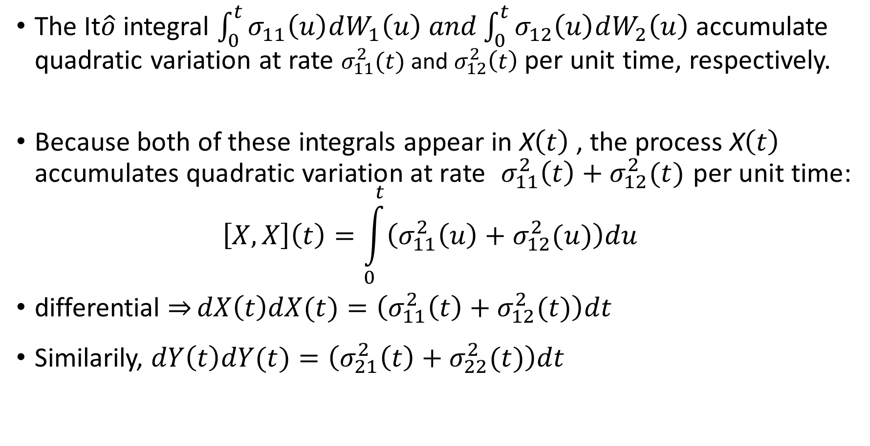
The It$\hat{o}$ integral $\int_{0}^{t}{σ_{11}\left(u\right)dW_{1}\left(u\right) and\int_{0}^{t}{σ_{12}\left(u\right)dW_{2}\left(u\right)}}$ accumulate quadratic variation at rate $σ_{11}^{2}(t)$ and $σ_{12}^{2}\left(t\right)$ per unit time, respectively.
Because both of these integrals appear in X$\left(t\right)$, the process X$\left(t\right)$ accumulates quadratic variation at rate $σ_{11}^{2}\left(t\right)+σ_{12}^{2}(t)$ per unit time:
$$\left[X,X\right]\left(t\right)=\int_{0}^{t}{\left(σ_{11}^{2}\left(u\right)+σ_{12}^{2}(u)\right)du}$$
differential $\overset{⇒}{}dX\left(t\right)dX(t)=\left(σ_{11}^{2}\left(t\right)+σ_{12}^{2}(t)\right)dt$
Similarily, $dY\left(t\right)dY(t)=\left(σ_{21}^{2}\left(t\right)+σ_{22}^{2}(t)\right)dt$
(4.6.3)
(4.6.4)

Slide 8
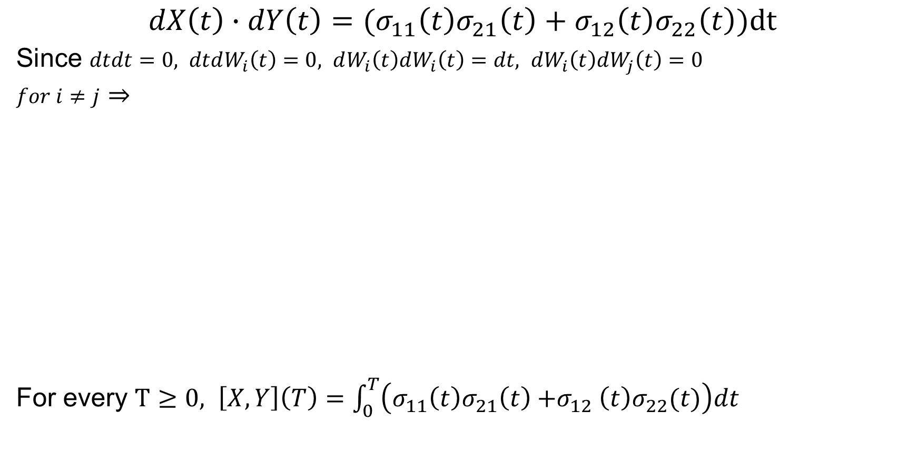
$$dX\left(t\right)∙dY\left(t\right)=(σ_{11}\left(t\right)σ_{21}\left(t\right)+σ_{12}\left(t\right)σ_{22}\left(t\right))dt$$
Since $dtdt=0, dtdW_{i}\left(t\right)=0, dW_{i}\left(t\right)dW_{i}\left(t\right)=dt, dW_{i}\left(t\right)dW_{j}\left(t\right)=0$
$for i≠j$
For every $T≥0, \left[X,Y\right]\left(T\right)=\int_{0}^{T}{\left(σ_{11}^{}\left(t\right){σ_{21}^{}\left(t\right){+σ}_{12}^{}\left(t\right)σ}_{22}^{}(t)\right)dt}$
(4.6.5)
(4.6.6)

Slide 9
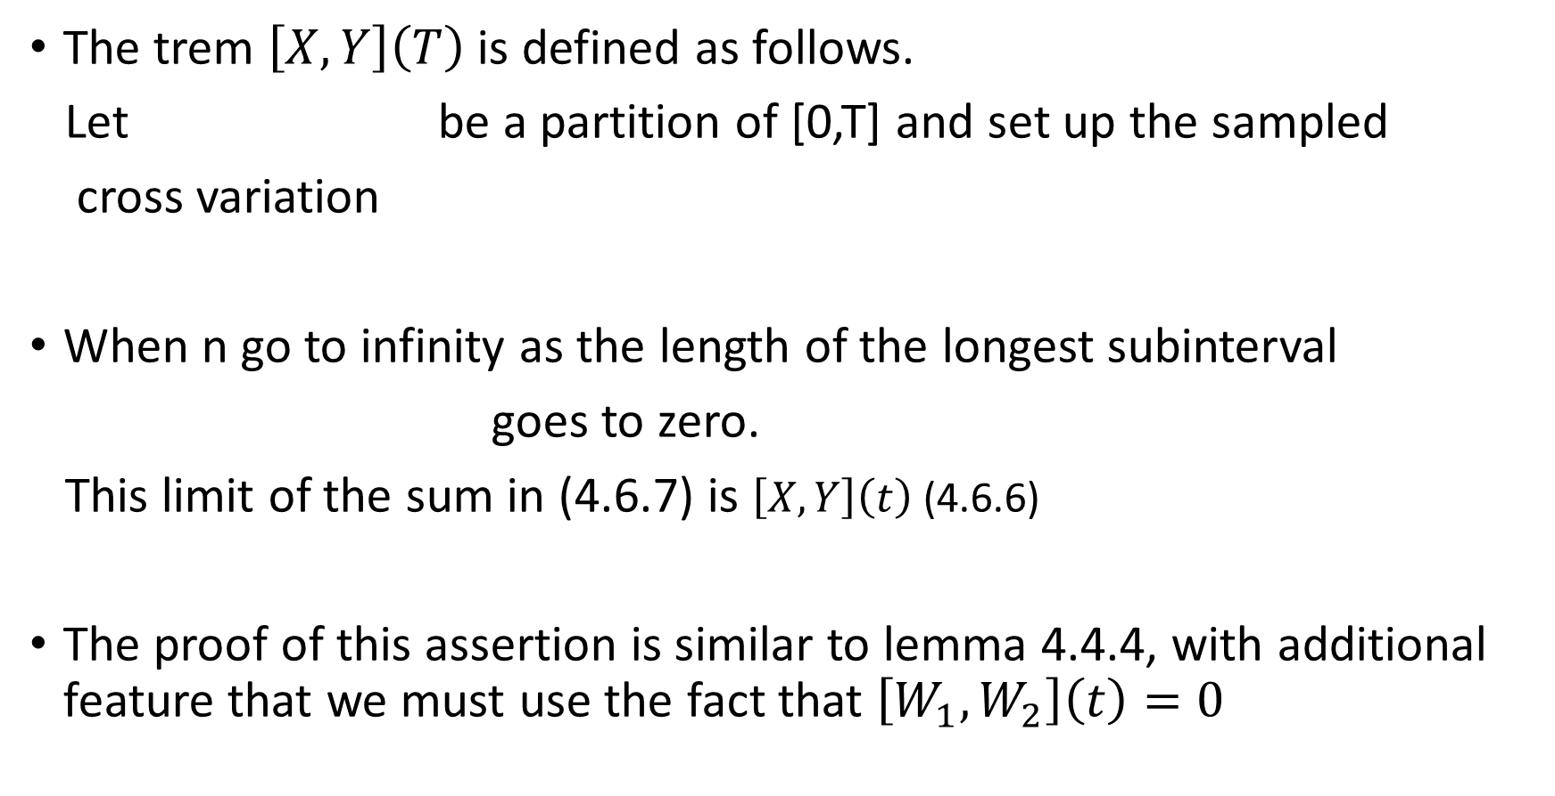
The trem $\left[X,Y\right]\left(T\right)$ is defined as follows.
Let be a partition of [0,T] and set up the sampled
cross variation
When n go to infinity as the length of the longest subinterval
goes to zero.
This limit of the sum in (4.6.7) is $\left[X,Y\right]\left(t\right)$ (4.6.6)
The proof of this assertion is similar to lemma 4.4.4, with additional feature that we must use the fact that $\left[W_{1},W_{2}\right]\left(t\right)=0$
(4.6.7)

Slide 10
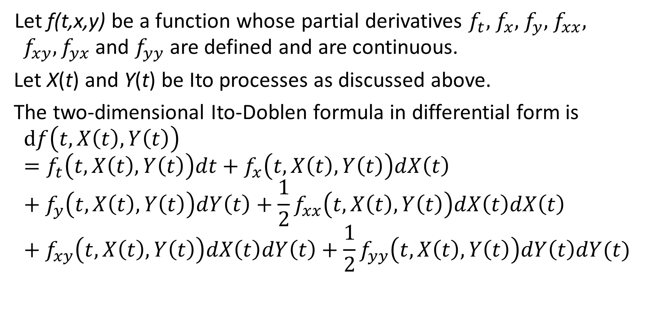
Theorem 4.6.2 (Two-dimensional Ito-Doeblin formula).
Let f(t,x,y) be a function whose partial derivatives $f_{t},$ $f_{x},$ $f_{y},$ $f_{xx},$ $f_{xy},f_{yx}$and $f_{yy}$ are defined and are continuous.
Let X(t) and Y(t) be Ito processes as discussed above.
The two-dimensional Ito-Doblen formula in differential form is
$$df\left(t,X\left(t\right),Y\left(t\right)\right)=f_{t}\left(t,X\left(t\right),Y\left(t\right)\right)dt+f_{x}\left(t,X\left(t\right),Y\left(t\right)\right)dX\left(t\right)+f_{y}\left(t,X\left(t\right),Y\left(t\right)\right)dY\left(t\right)+\frac{1}{2}f_{xx}\left(t,X\left(t\right),Y\left(t\right)\right)dX\left(t\right)dX\left(t\right)+f_{xy}\left(t,X\left(t\right),Y\left(t\right)\right)dX\left(t\right)dY\left(t\right)+\frac{1}{2}f_{yy}\left(t,X\left(t\right),Y\left(t\right)\right)dY\left(t\right)dY(t)$$
(4.6.8)

Slide 11


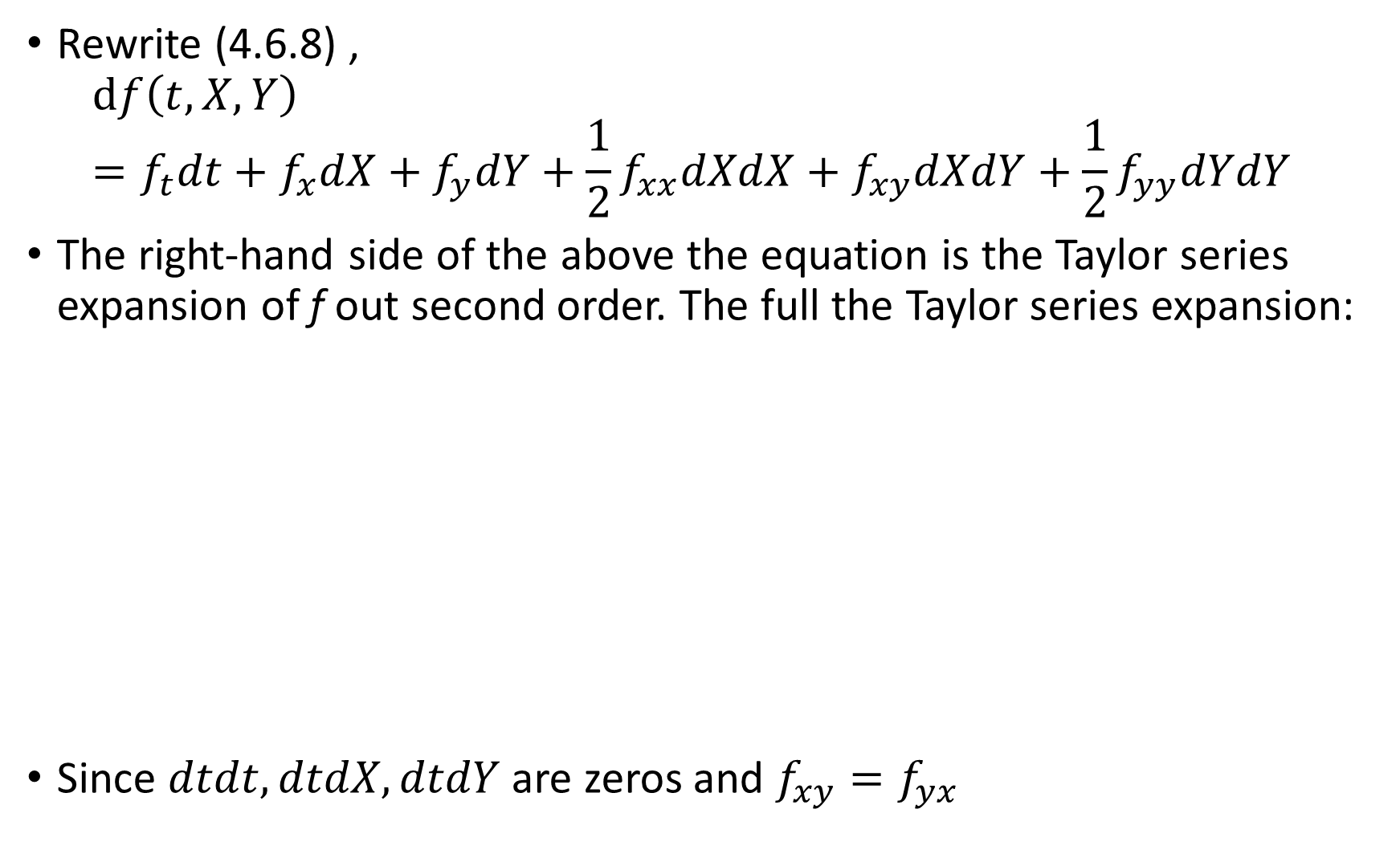
Rewrite (4.6.8) ,
$$df\left(t,X,Y\right)=f_{t}dt+f_{x}dX+f_{y}dY+\frac{1}{2}f_{xx}dXdX+f_{xy}dXdY+\frac{1}{2}f_{yy}dYdY$$
The right-hand side of the above the equation is the Taylor series expansion of f out second order. The full the Taylor series expansion:
Since $dtdt, dtdX, dtdY$ are zeros and $f_{xy}=f_{yx}$
(4.6.9)

Slide 12
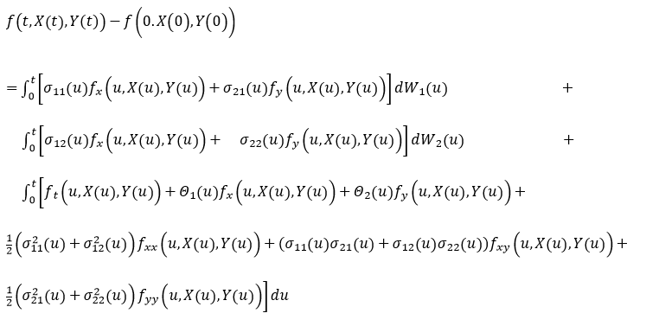
Making (4.6.1) – (4.6.5) substitution and then integrating (4.6.9)
we obtain the Ito-Doeblin formula in integral form :
The right-hand side of this equation has one ordinary (Lebesgue) integral with respect to du and two Ito integrals with respect to dW₁(u) and dW₂(u).
(4.6.10)

Slide 13

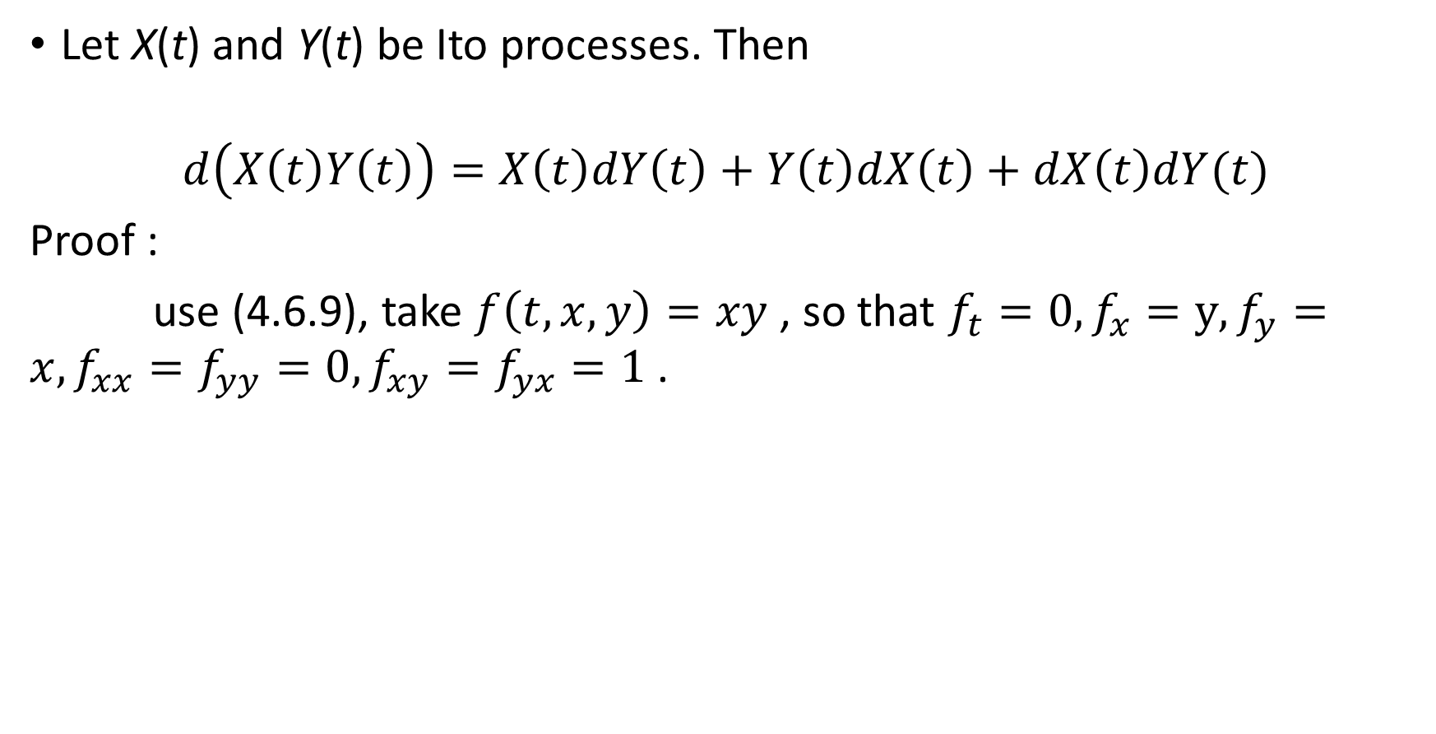
Corollary 4.6.3 (Ito product rule)
Let X(t) and Y(t) be Ito processes. Then
$$d\left(X\left(t\right)Y\left(t\right)\right)=X\left(t\right)dY\left(t\right)+Y\left(t\right)dX\left(t\right)+dX\left(t\right)dY(t)$$
Proof :
use (4.6.9), take $f\left(t,x,y\right)=xy$ , so that $f_{t}=0, f_{x}=y, f_{y}=x, f_{xx}=f_{yy}=0, f_{xy}=f_{yx}=1$ .

Slide 14
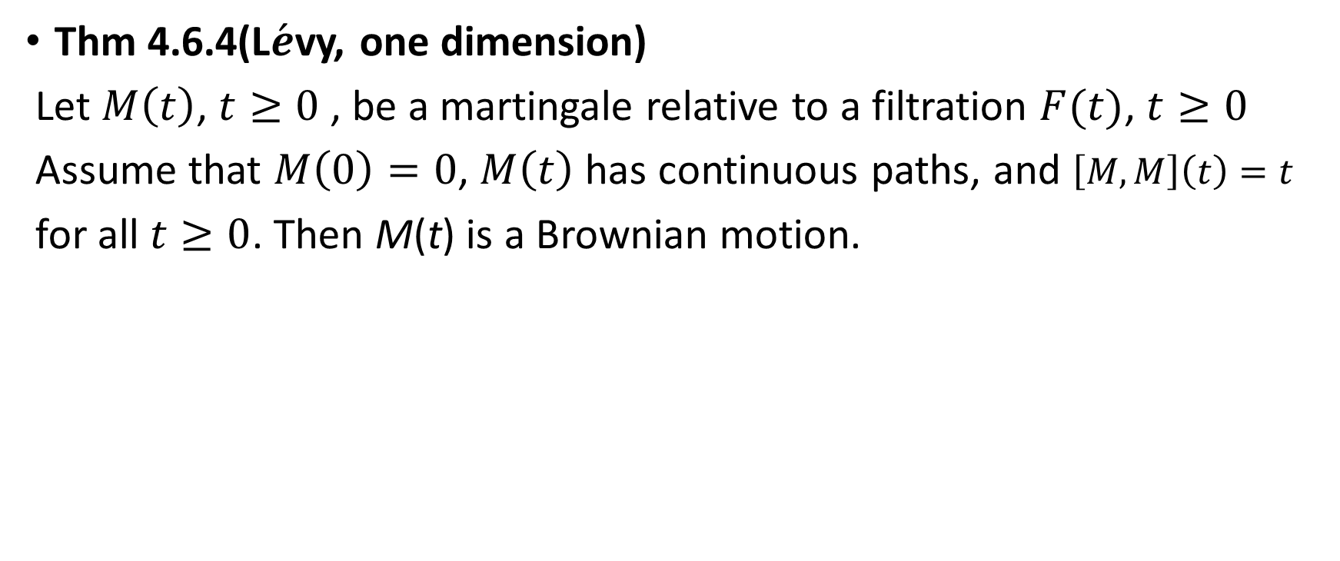
4.6.3 Recognizing a Brownian Motion
Thm 4.6.4(L$\acute{e}$vy, one dimension)
Let $M\left(t\right)$, $t≥0$ , be a martingale relative to a filtration $F(t)$, $t≥0$
Assume that $M\left(0\right)=0$, $M\left(t\right)$ has continuous paths, and $\left[M,M\right]\left(t\right)=t$
for all $t≥0$. Then M(t) is a Brownian motion.

Slide 15

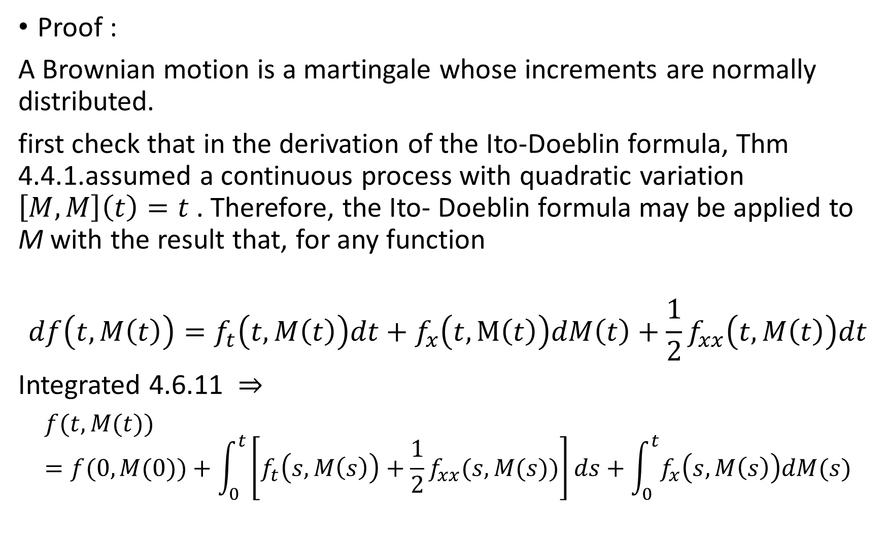
Proof :
A Brownian motion is a martingale whose increments are normally distributed.
first check that in the derivation of the Ito-Doeblin formula, Thm 4.4.1.assumed a continuous process with quadratic variation $\left[M,M\right]\left(t\right)=t$ . Therefore, the Ito- Doeblin formula may be applied to M with the result that, for any function
$$df\left(t,M\left(t\right)\right)=f_{t}\left(t,M\left(t\right)\right)dt+f_{x}\left(t,M\left(t\right)\right)dM\left(t\right)+\frac{1}{2}f_{xx}\left(t,M\left(t\right)\right)dt$$
Integrated 4.6.11
$$f(t,M(t))=f(0,M(0))+\int_{0}^{t}{\left[f_{t}\left(s,M\left(s\right)\right)+\frac{1}{2}f_{xx}(s,M(s))\right]ds+\int_{0}^{t}{f_{x}\left(s,M\left(s\right)\right)dM(s)}}$$
$$( dM\left(t\right)dM\left(t\right)=dt )$$
(4.6.11)
(4.6.12)

Slide 16
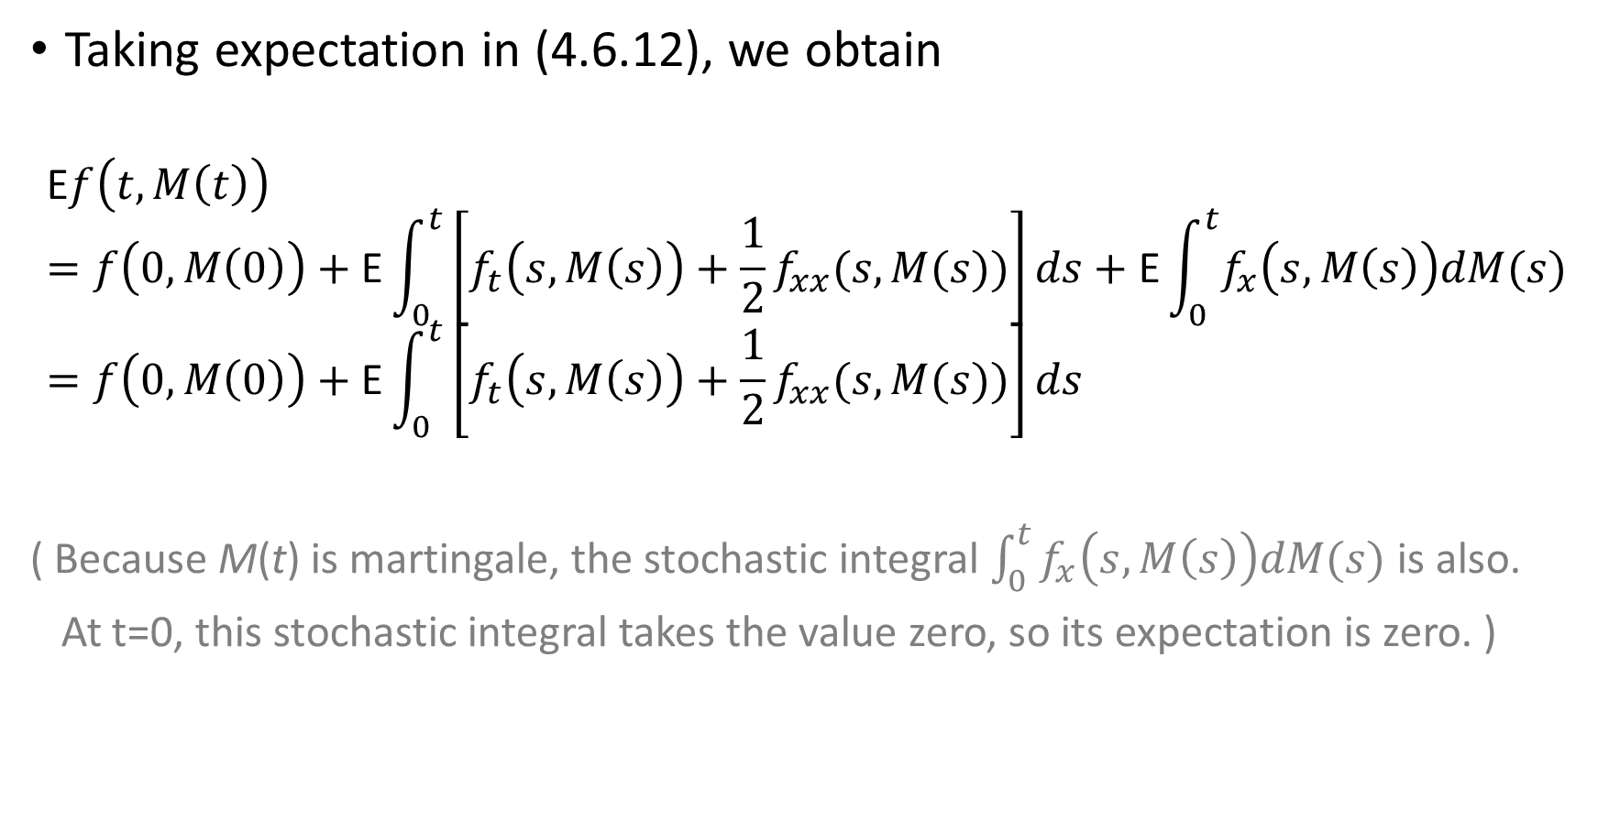
Taking expectation in (4.6.12), we obtain
$$\text{E}f\left(t,M\left(t\right)\right)=f\left(0,M\left(0\right)\right)+\text{E}\int_{0}^{t}{\left[f_{t}\left(s,M\left(s\right)\right)+\frac{1}{2}f_{xx}(s,M(s))\right]ds+\text{E}\int_{0}^{t}{f_{x}\left(s,M\left(s\right)\right)dM(s)}}=f\left(0,M\left(0\right)\right)+\text{E}\int_{0}^{t}{\left[f_{t}\left(s,M\left(s\right)\right)+\frac{1}{2}f_{xx}(s,M(s))\right]ds}$$
( Because M(t) is martingale, the stochastic integral $\int_{0}^{t}{f_{x}\left(s,M\left(s\right)\right)dM(s)}$ is also.
At t=0, this stochastic integral takes the value zero, so its expectation is zero. )
(4.6.13)

Slide 17
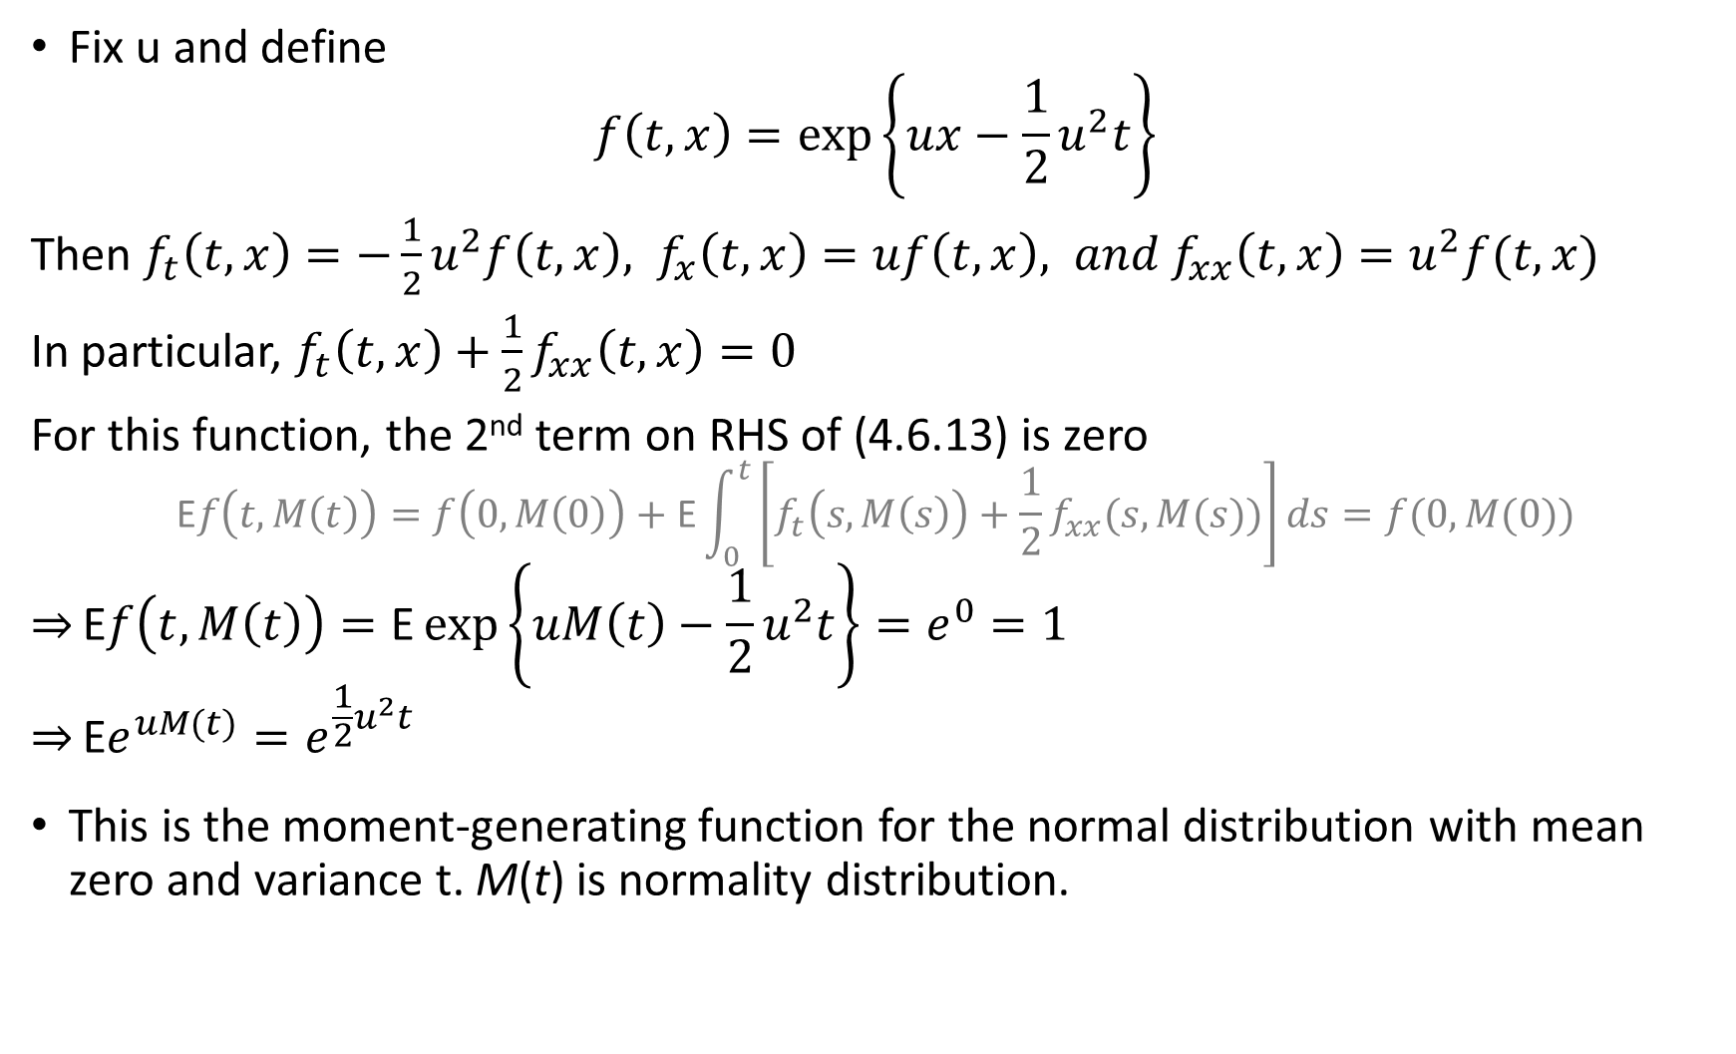
Fix u and define
$$f\left(t,x\right)=\exp\left\{ux−\frac{1}{2}u^{2}t\right\}$$
Then $f_{t}\left(t,x\right)=−\frac{1}{2}u^{2}f\left(t,x\right), f_{x}\left(t,x\right)=uf\left(t,x\right), and f_{xx}\left(t,x\right)=u^{2}f(t,x)$
In particular, $f_{t}\left(t,x\right)+\frac{1}{2}f_{xx}\left(t,x\right)=0$
For this function, the 2nd term on RHS of (4.6.13) is zero
$$\text{E}f\left(t,M\left(t\right)\right)=f\left(0,M\left(0\right)\right)+\text{E}\int_{0}^{t}{\left[f_{t}\left(s,M\left(s\right)\right)+\frac{1}{2}f_{xx}(s,M(s))\right]ds=f(0,M(0))}$$
$$\overset{⇒}{}\text{E}f\left(t,M\left(t\right)\right)=\text{E}\exp\left\{uM\left(t\right)−\frac{1}{2}u^{2}t\right\}=e^{0}=1$$
$$\overset{⇒}{}\text{E}e^{uM(t)}=e^{\frac{1}{2}u^{2}t}$$
This is the moment-generating function for the normal distribution with mean zero and variance t. M(t) is normality distribution.

Slide 18
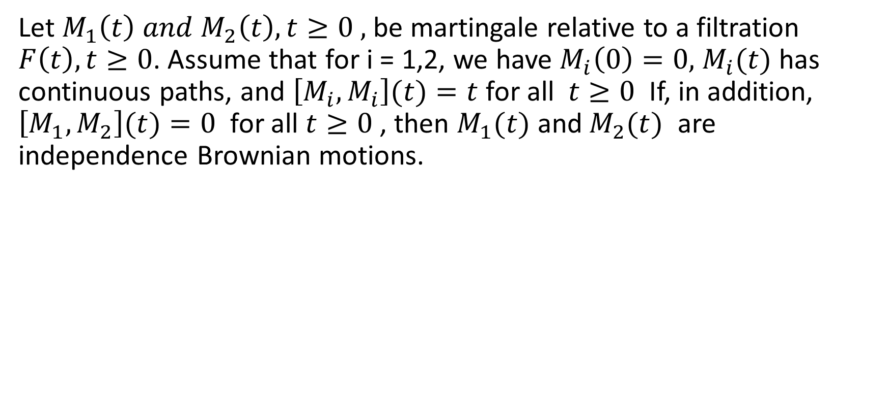
Thm 4.6.5 (L$\acute{e}$vy, two dimension)
Let $M_{1}\left(t\right) and M_{2}\left(t\right),t≥0 ,$ be martingale relative to a filtration $F\left(t\right), t≥0$. Assume that for i = 1,2, we have $M_{i}\left(0\right)=0,$ $M_{i}(t)$ has continuous paths, and $\left[M_{i},M_{i}\right](t)=t$ for all $t≥0$ If, in addition, $\left[M_{1},M_{2}\right](t)=0$ for all $t≥0$ , then $M_{1}(t)$ and${ M}_{2}(t)$ are independence Brownian motions.

Slide 19
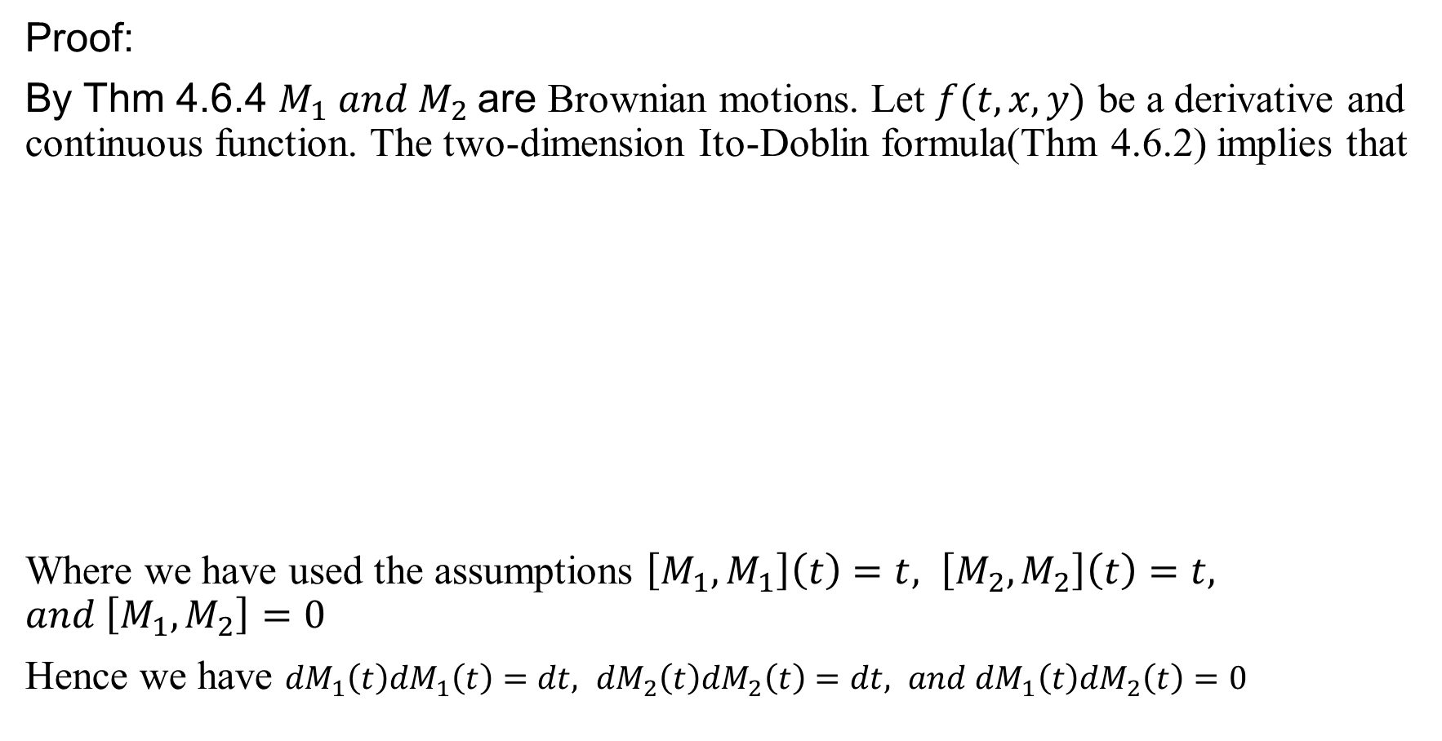
Proof:
By Thm 4.6.4 $M_{1} and M_{2}$are Brownian motions. Let $f(t,x,y)$ be a derivative and continuous function. The two-dimension Ito-Doblin formula(Thm 4.6.2) implies that
Where we have used the assumptions $\left[M_{1},M_{1}\right]\left(t\right)=t, \left[M_{2},M_{2}\right]\left(t\right)=t, and \left[M_{1},M_{2}\right]=0$
Hence we have ${dM}_{1}\left(t\right){dM}_{1}\left(t\right)=dt, {dM}_{2}\left(t\right){dM}_{2}\left(t\right)=dt, and {dM}_{1}\left(t\right){dM}_{2}\left(t\right)=0$

Slide 20
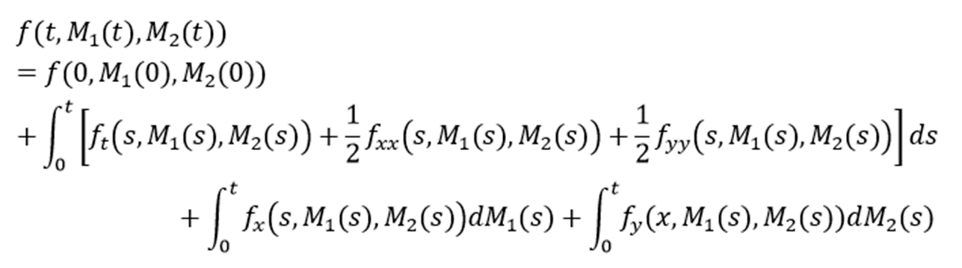
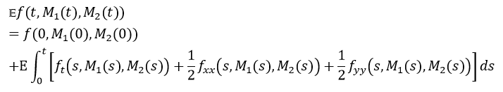
Integrate both sides, obtain
The last two form on RHS are martingales, hence having expectation zero, Therefore
(4.6.14)

Slide 21
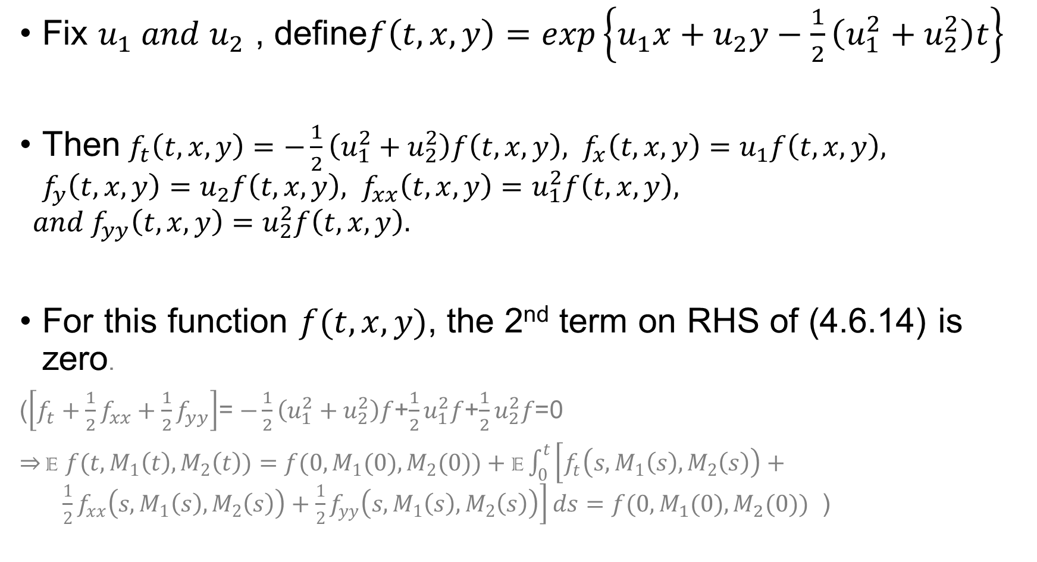
Fix $u_{1} and u_{2}$ , define$f\left(t,x,y\right)=exp\left\{u_{1}x+u_{2}y−\frac{1}{2}\left(u_{1}^{2}+u_{2}^{2}\right)t\right\}$
Then $f_{t}\left(t,x,y\right)=−\frac{1}{2}\left(u_{1}^{2}+u_{2}^{2}\right)f\left(t,x,y\right), f_{x}\left(t,x,y\right)=u_{1}f\left(t,x,y\right), f_{y}\left(t,x,y\right)=u_{2}f\left(t,x,y\right), f_{xx}\left(t,x,y\right)=u_{1}^{2}f\left(t,x,y\right),$
$$and f_{yy}\left(t,x,y\right)=u_{2}^{2}f\left(t,x,y\right).$$
For this function $f(t,x,y)$, the 2nd term on RHS of (4.6.14) is zero.
($\left[f_{t}+\frac{1}{2}f_{xx}+\frac{1}{2}f_{yy}\right]$= $−\frac{1}{2}\left(u_{1}^{2}+u_{2}^{2}\right)f$+$\frac{1}{2}u_{1}^{2}f$+$\frac{1}{2}u_{2}^{2}f$=0
$\overset{⇒}{}{\text{E} f(t,M}_{1}\left(t\right),M_{2}\left(t\right))={f(0,M}_{1}(0),M_{2}(0))+\text{E}\int_{0}^{t}{\left[f_{t}\left(s,M_{1}\left(s\right),M_{2}\left(s\right)\right)+ \frac{1}{2}f_{xx}\left(s,M_{1}\left(s\right),M_{2}\left(s\right)\right)+\frac{1}{2}f_{yy}\left({s,M}_{1}\left(s\right),M_{2}\left(s\right)\right)\right]ds}={f(0,M}_{1}(0),M_{2}(0))$ )

Slide 22
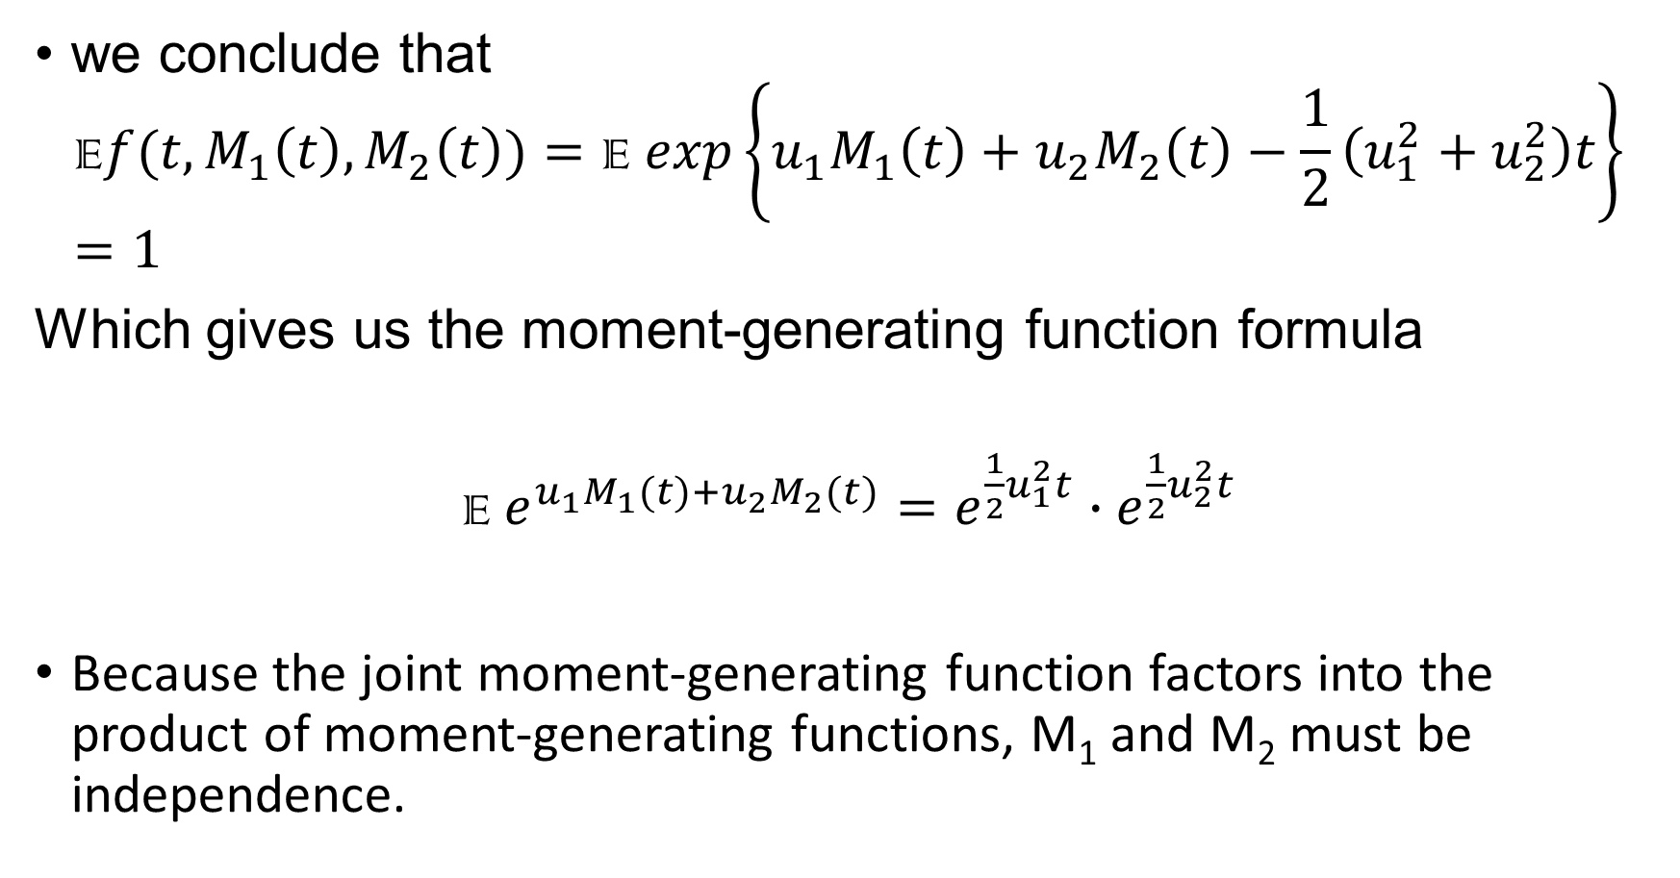
we conclude that
$${\text{E}f(t,M}_{1}\left(t\right),M_{2}\left(t\right))=\text{E} exp\left\{u_{1}M_{1}\left(t\right)+u_{2}M_{2}\left(t\right)−\frac{1}{2}\left(u_{1}^{2}+u_{2}^{2}\right)t\right\}=1$$
Which gives us the moment-generating function formula
E$e^{u_{1}M_{1}(t)+u_{2}M_{2}(t)}=e^{\frac{1}{2}u_{1}^{2}t}∙e^{\frac{1}{2}u_{2}^{2}t}$
Because the joint moment-generating function factors into the product of moment-generating functions, M₁ and M₂ must be independence.

Slide 23
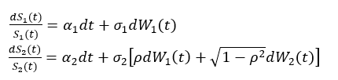
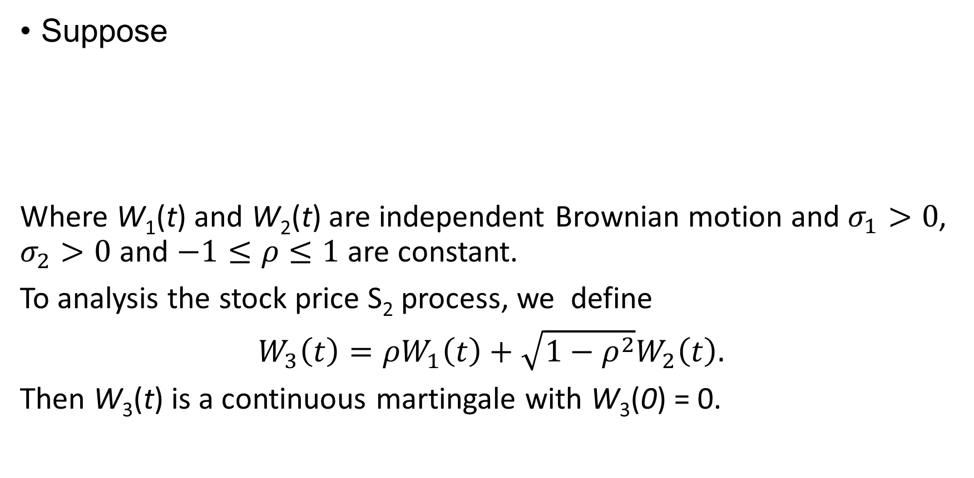
Example 4.6.6(correlated stock prices)
Suppose
Where W₁(t) and W₂(t) are independent Brownian motion and $σ_{1}>0$, $σ_{2}>0$ and $−1≤ρ≤1$ are constant.
To analysis the stock price S₂ process, we define
$W_{3}\left(t\right)=ρW_{1}\left(t\right)+\sqrt{1−ρ^{2}}W_{2}\left(t\right).$
Then W₃(t) is a continuous martingale with W₃(0) = 0.

Slide 24
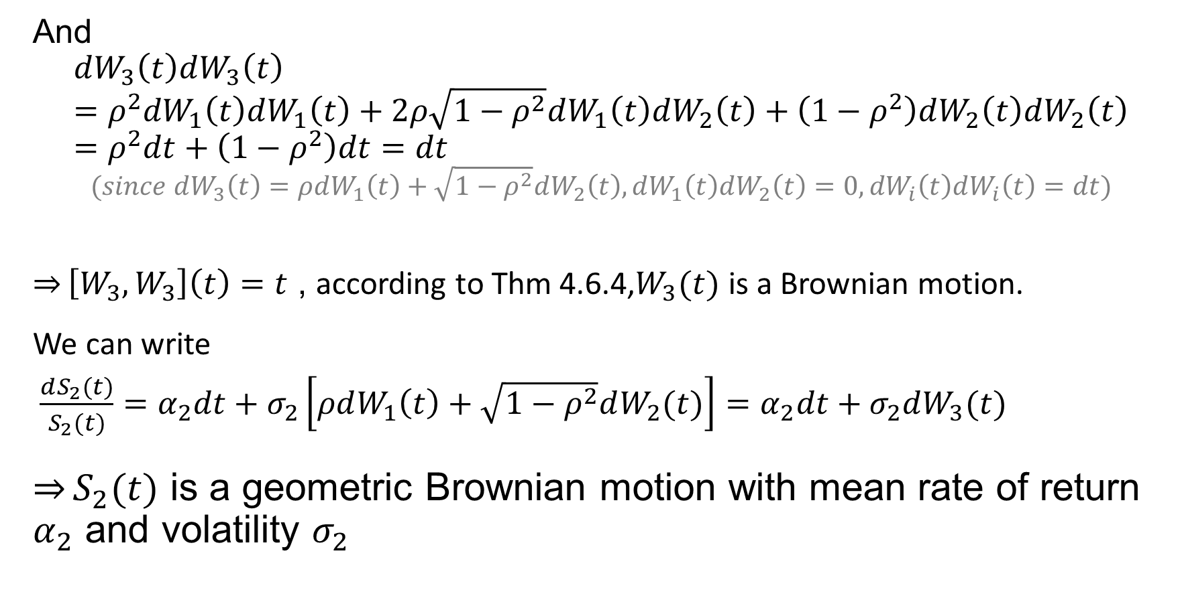
And
  $$dW_{3}\left(t\right)dW_{3}\left(t\right)=ρ^{2}{dW}_{1}\left(t\right)dW_{1}\left(t\right)+2ρ\sqrt{1−ρ^{2}}dW_{1}\left(t\right)dW_{2}\left(t\right)+\left(1−ρ^{2}\right)dW_{2}\left(t\right)dW_{2}\left(t\right)=ρ^{2}dt+\left(1−ρ^{2}\right)dt=dt$$
  $$(since dW_{3}\left(t\right)=ρdW_{1}\left(t\right)+\sqrt{1−ρ^{2}}dW_{2}\left(t\right), dW_{1}\left(t\right)dW_{2}\left(t\right)=0, {dW}_{i}\left(t\right)dW_{i}\left(t\right)=dt)$$
  $\overset{⇒}{}\left[W_{3},W_{3}\right]\left(t\right)=t$ , according to Thm 4.6.4,$W_{3}(t)$ is a Brownian motion.
We can write
$\frac{dS_{2}(t)}{S_{2}(t)}=α_{2}dt+σ_{2}\left[ρdW_{1}\left(t\right)+\sqrt{1−ρ^{2}}dW_{2}(t)\right]=α_{2}dt+σ_{2}dW_{3}(t)$
$\underset{⇒}{}S_{2}(t)$ is a geometric Brownian motion with mean rate of return $α_{2}$ and volatility $σ_{2}$

Slide 25
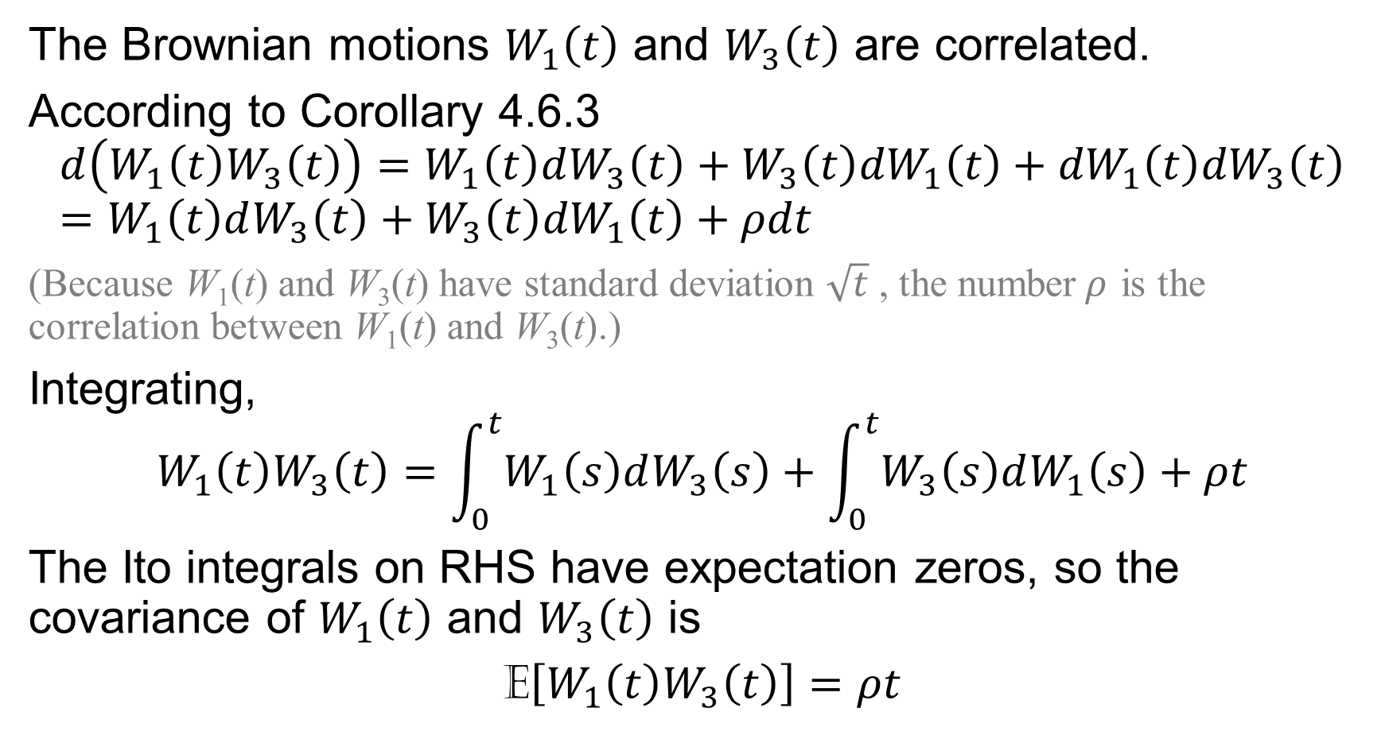
The Brownian motions $W_{1}\left(t\right)$ and $W_{3}\left(t\right)$ are correlated.
According to Corollary 4.6.3
$$d\left(W_{1}\left(t\right)W_{3}\left(t\right)\right)=W_{1}\left(t\right)dW_{3}\left(t\right)+W_{3}\left(t\right){dW}_{1}\left(t\right)+{dW}_{1}\left(t\right){dW}_{3}\left(t\right)=W_{1}\left(t\right)dW_{3}\left(t\right)+W_{3}\left(t\right){dW}_{1}\left(t\right)+ρdt$$
(Because W₁(t) and W₃(t) have standard deviation $\sqrt{t}$ , the number$ρ$ is the correlation between W₁(t) and W₃(t).)
Integrating,
$${W_{1}\left(t\right)W}_{3}\left(t\right)=\int_{0}^{t}{W_{1}\left(s\right)dW_{3}\left(s\right)}+\int_{0}^{t}{W_{3}\left(s\right)dW_{1}\left(s\right)}+ρt$$
The Ito integrals on RHS have expectation zeros, so the covariance of $W_{1}\left(t\right)$ and $W_{3}\left(t\right)$ is
E$\left[W_{1}\left(t\right)W_{3}\left(t\right)\right]=ρt$

