Slide 1
5.4 Fundamental Thoeorems of Asset Pricing(~5.4.2)
報告人 劉佩佳

Slide 2
Extending the discussions of above sections to the case of multiple stocks driven by multiple Brownian motions
Developing and illustrating the two fundamental theorems of asset pricing
Giving the precise definitions of the basic concepts of derivative security in continuous-time models

Slide 3
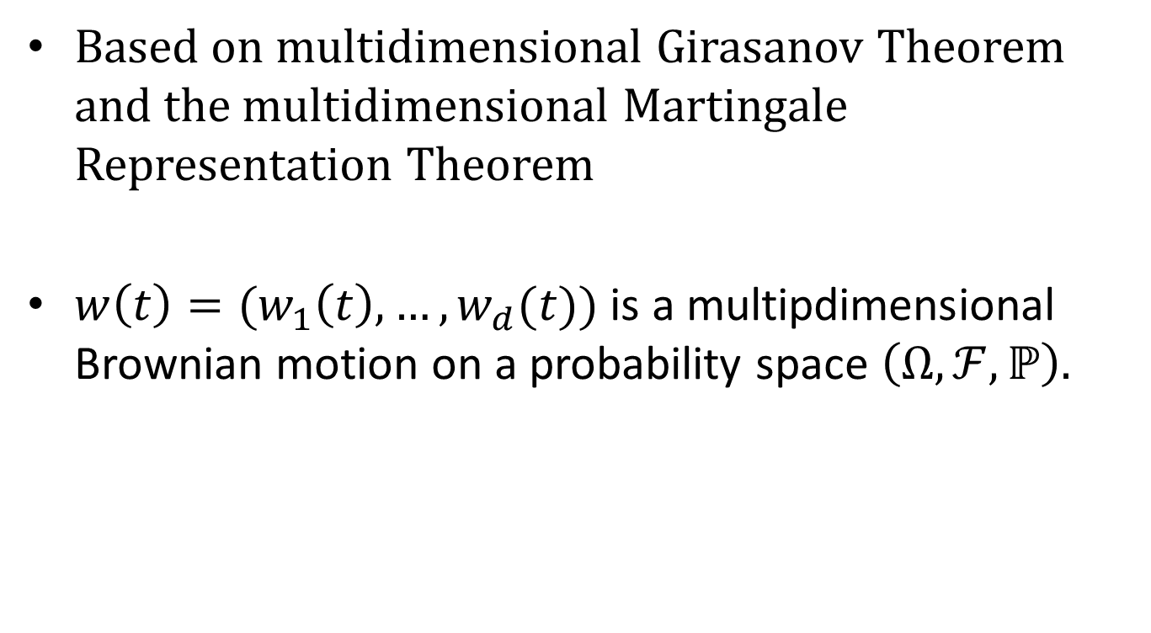
5.4.1 Girsanov and Martingale Representation Theorems
Based on multidimensional Girasanov Theorem and the multidimensional Martingale Representation Theorem
$w\left(t\right)=(w_{1}\left(t\right),…,w_{d}(t))$ is a multipdimensional Brownian motion on a probability space $\left(Ω,ℱ,ℙ\right).$

Slide 4
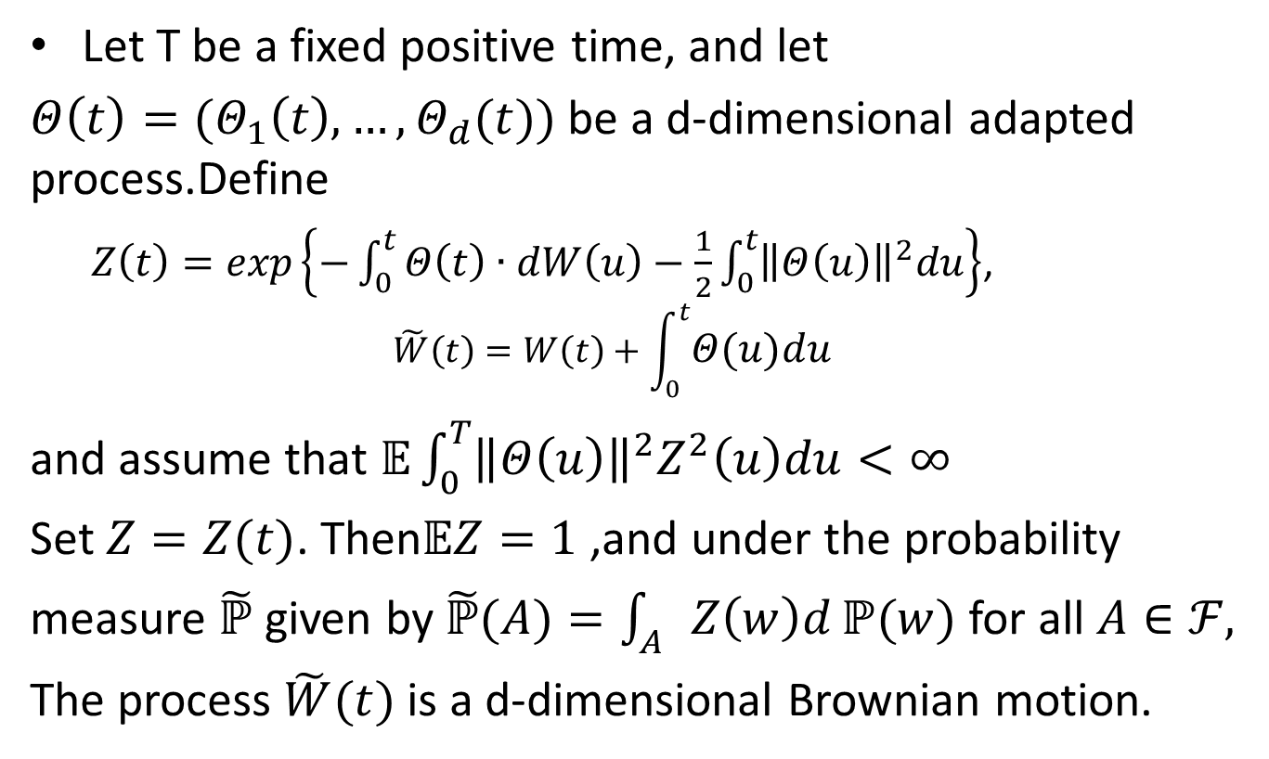
Thm 5.4.1(Girsanov,multiple dimansions)
Let T be a fixed positive time, and let
$Θ\left(t\right)=(Θ_{1}\left(t\right),…,Θ_{d}(t))$ be a d-dimensional adapted process.Define
$Z\left(t\right)=exp\left\{−\int_{0}^{t}{Θ\left(t\right)}∙dW\left(u\right)−\frac{1}{2}\int_{0}^{t}{{\left\|Θ\left(u\right)\right\|}^{2}du}\right\}$,
$$\tilde{W}\left(t\right)=W\left(t\right)+\int_{0}^{t}{Θ\left(u\right)du}$$
and assume that $𝔼\int_{0}^{T}{{\left\|Θ\left(u\right)\right\|}^{2}Z^{2}\left(u\right)du<∞}$
Set $Z=Z(t)$. Then$𝔼Z=1$ ,and under the probability measure $\tilde{ℙ}$ given by $\tilde{ℙ}(A)=\int_{A}{Z\left(w\right)d}ℙ(w)$ for all $A∈ℱ,$
The process $\tilde{W}(t)$ is a d-dimensional Brownian motion.
(5.4.1)
(5.4.2)
(5.4.3)

Slide 5
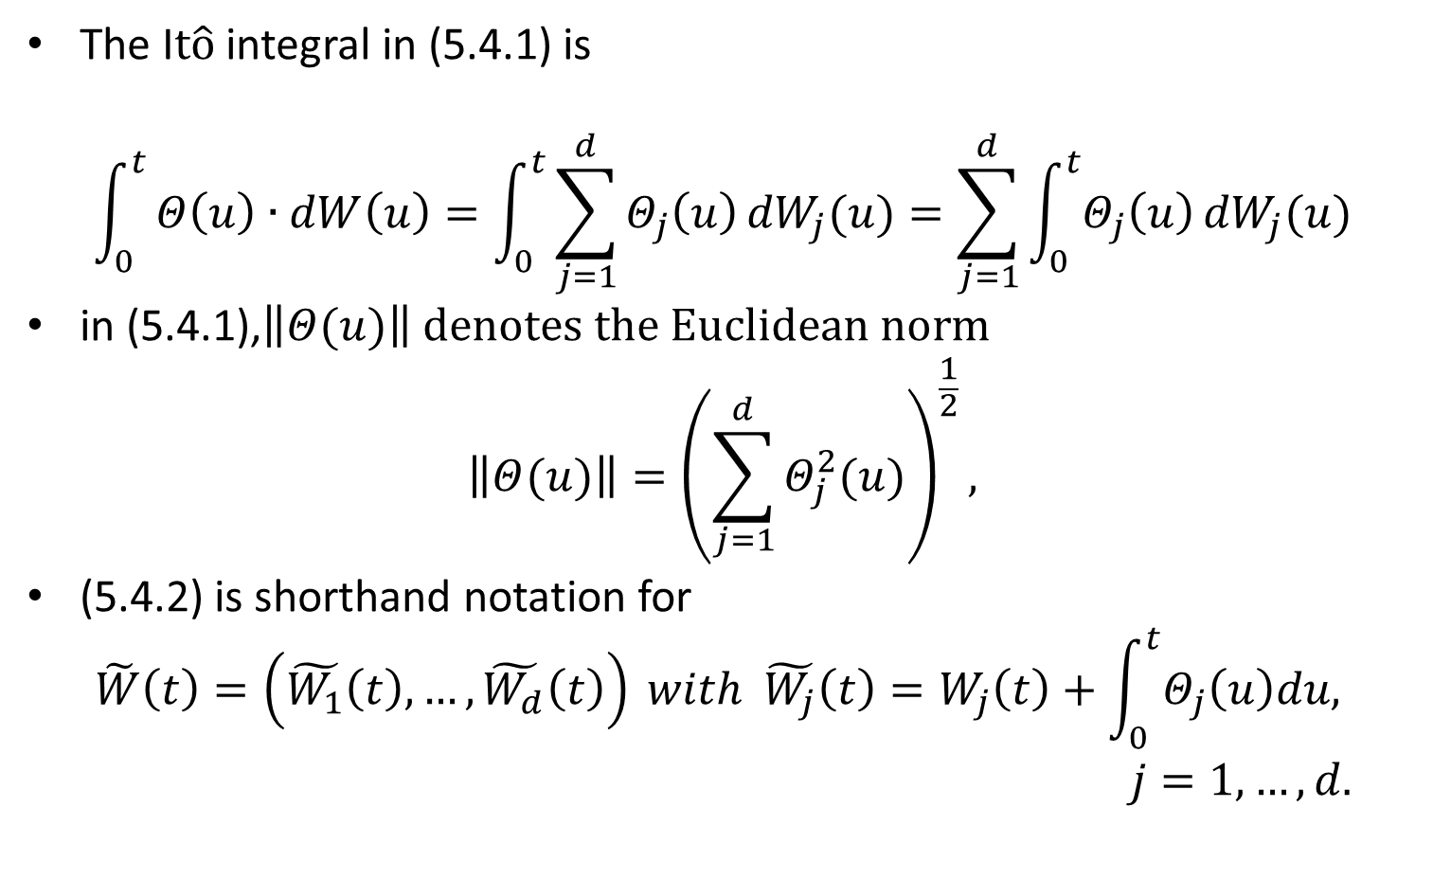
The I$t\hat{o}$ integral in (5.4.1) is
$$\int_{0}^{t}{Θ\left(u\right)∙dW\left(u\right)=\int_{0}^{t}{\sum_{j=1}^{d}{Θ_{j}\left(u\right)}{dW}_{j}(u)=\sum_{j=1}^{d}{\int_{0}^{t}{Θ_{j}\left(u\right)}}{dW}_{j}(u)}}$$
in (5.4.1),$\left\|Θ(u)\right\| denotes the Euclidean norm$
$$\left\|Θ(u)\right\|={\left(\sum_{j=1}^{d}{Θ_{j}^{2}(u)}\right)}^{\frac{1}{2}},$$
(5.4.2) is shorthand notation for
$$\tilde{W}\left(t\right)=\left(\tilde{W_{1}}\left(t\right),…,\tilde{W_{d}}\left(t\right)\right) with \tilde{W_{j}}\left(t\right)=W_{j}\left(t\right)+\int_{0}^{t}{Θ_{j}\left(u\right)du,}$$
$j=1,…,d.$

Slide 6
The conclusions of the multidimensional Girsanov Theorem
The component process of are independent under
The component process of are independent under P, but each of the processes can depend in a path-dependent, adapted way on all of the Brownian motions
Under P, the components of can be far from independent, however, after the change to the measure , these components are independent
The proof of Theorem 5.4.1 is like that of the one-dimensional Girsanov Theorem

Slide 7
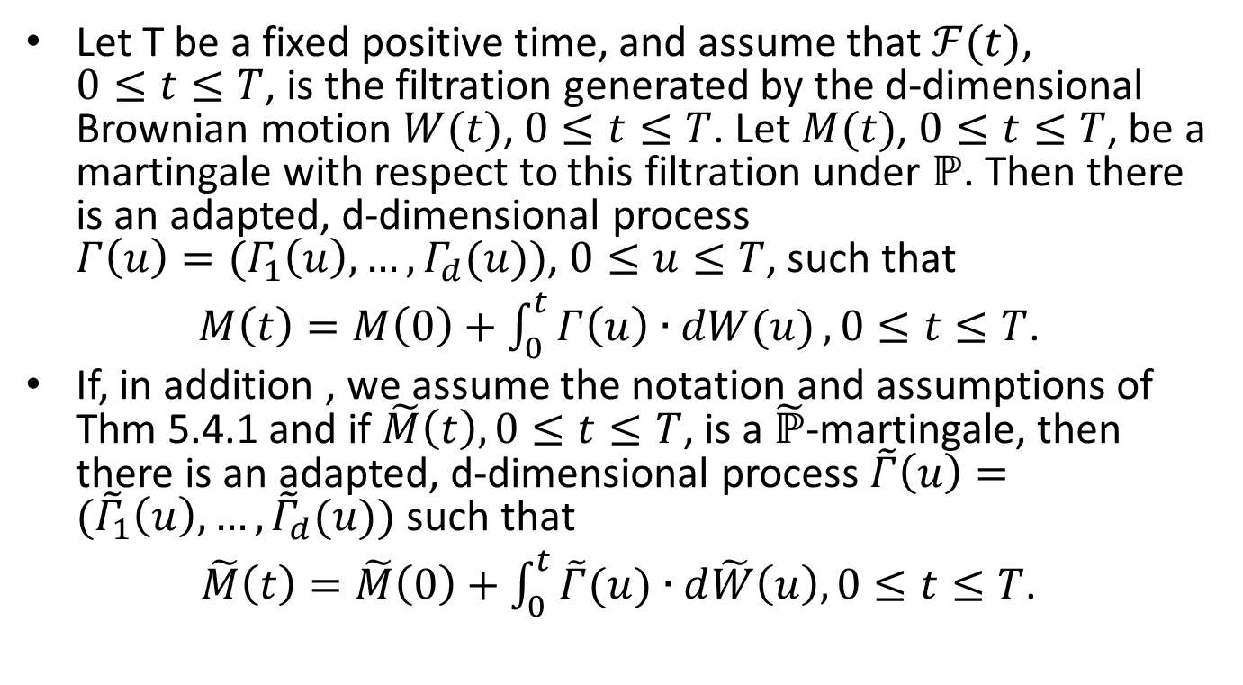
Thm 5.4.2 (Martingale representation, multiple dimensions)
Let T be a fixed positive time, and assume that $ℱ(t)$, $0≤t≤T$, is the filtration generated by the d-dimensional Brownian motion $W(t)$, $0≤t≤T$. Let $M(t)$, $0≤t≤T$, be a martingale with respect to this filtration under $ℙ$. Then there is an adapted, d-dimensional process $Γ\left(u\right)=(Γ_{1}\left(u\right),…,Γ_{d}(u))$, $0≤u≤T$, such that
$M\left(t\right)=M\left(0\right)+\int_{0}^{t}{Γ\left(u\right)∙dW(u)},0≤t≤T$.
If, in addition , we assume the notation and assumptions of Thm 5.4.1 and if $\tilde{M}\left(t\right), 0≤t≤T$, is a $\tilde{ℙ}$-martingale, then there is an adapted, d-dimensional process $\tilde{Γ}\left(u\right)=({\tilde{Γ}}_{1}\left(u\right),…,{\tilde{Γ}}_{d}(u))$ such that
$\tilde{M}\left(t\right)=\tilde{M}\left(0\right)+\int_{0}^{t}{\tilde{Γ}(u)}∙d\tilde{W}\left(u\right), 0≤t≤T$.
(5.4.4)
(5.4.5)

Slide 8
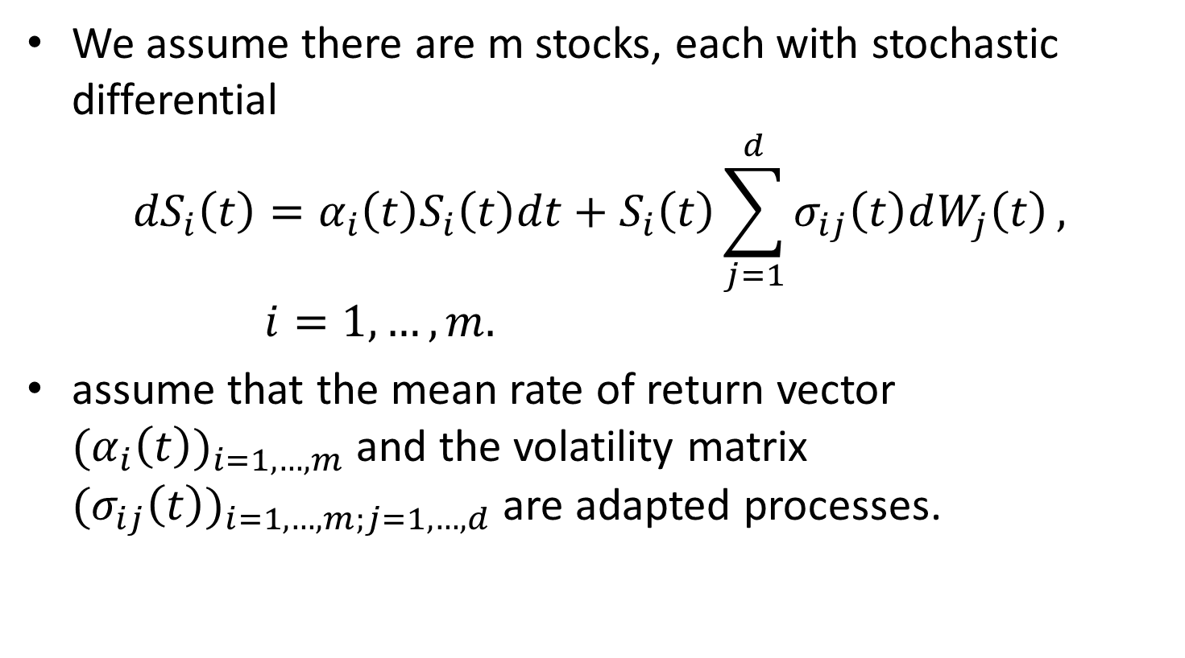
5.4.2 Multidimensional Market Model
We assume there are m stocks, each with stochastic differential
$${dS}_{i}\left(t\right)=α_{i}{\left(t\right)S}_{i}\left(t\right){dt+S}_{i}\left(t\right)\sum_{j=1}^{d}{σ_{ij}\left(t\right)dW_{j}\left(t\right)}, i=1,…,m.$$
assume that the mean rate of return vector ${(α_{i}\left(t\right))}_{i=1,…,m}$ and the volatility matrix ${(σ_{ij}\left(t\right))}_{i=1,…,m;j=1,…,d}$ are adapted processes.
(5.4.6)

Slide 9
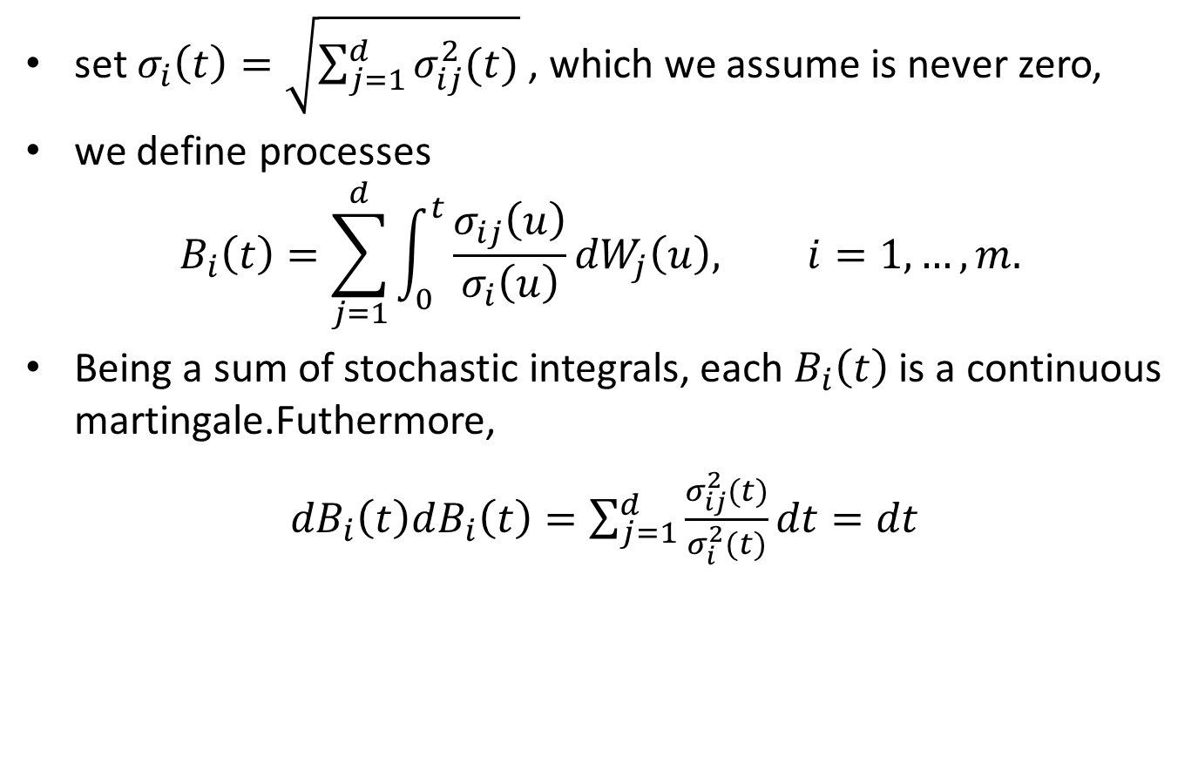
set $σ_{i}\left(t\right)=\sqrt{\sum_{j=1}^{d}{σ_{ij}^{2}(t)}}$ , which we assume is never zero,
we define processes
$$B_{i}\left(t\right)=\sum_{j=1}^{d}{\int_{0}^{t}{\frac{σ_{ij}\left(u\right)}{σ_{i}\left(u\right)}}}{dW}_{j}\left(u\right), i=1,…,m.$$
Being a sum of stochastic integrals, each $B_{i}\left(t\right)$ is a continuous martingale.Futhermore,
${dB}_{i}\left(t\right)dB_{i}\left(t\right)=\sum_{j=1}^{d}{\frac{σ_{ij}^{2}(t)}{σ_{i}^{2}(t)}dt=dt}$
(5.4.7)

Slide 10
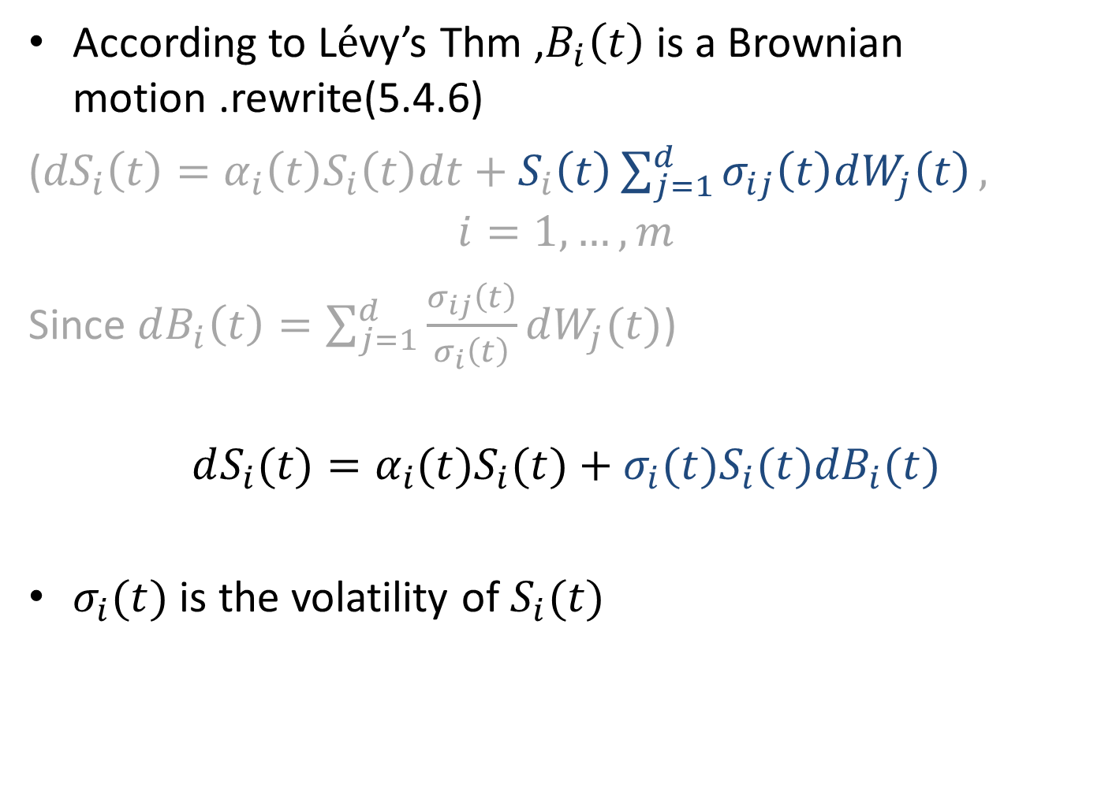
According to L$\acute{e}$vy’s Thm ,$B_{i}\left(t\right)$ is a Brownian motion .rewrite(5.4.6)
(${dS}_{i}\left(t\right)=α_{i}{\left(t\right)S}_{i}\left(t\right){dt+S}_{i}\left(t\right)\sum_{j=1}^{d}{σ_{ij}\left(t\right)dW_{j}\left(t\right)},$
$$i=1,…,m$$
Since $dB_{i}\left(t\right)=\sum_{j=1}^{d}{\frac{σ_{ij}\left(t\right)}{σ_{i}\left(t\right)}dW_{j}(t)}$)
$$dS_{i}(t)=α_{i}(t)S_{i}(t)+σ_{i}(t)S_{i}(t){dB}_{i}(t)$$
$σ_{i}(t)$ is the volatility of $S_{i}(t)$
(5.4.8)

Slide 11
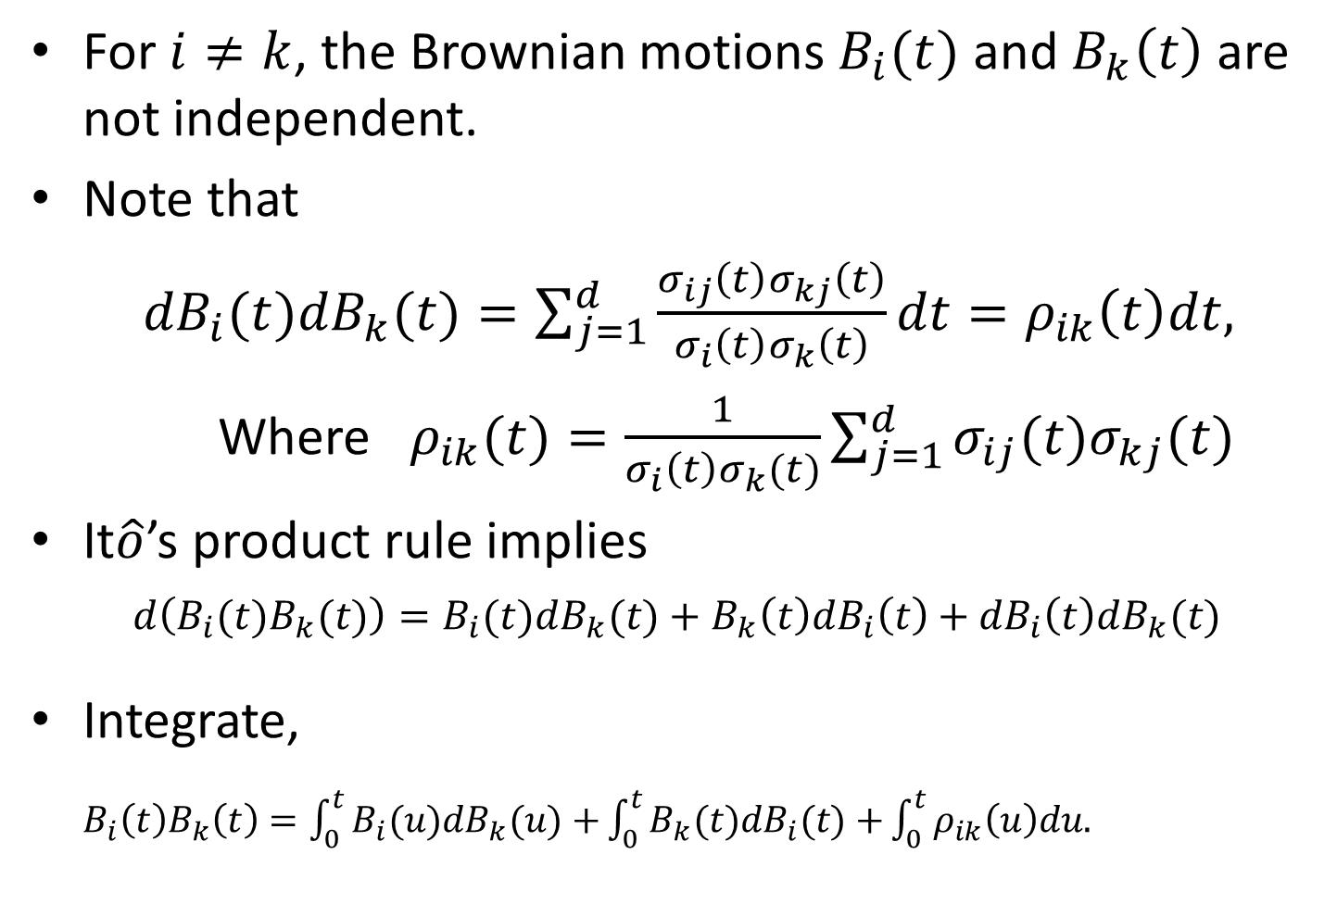
For $i≠k$, the Brownian motions $B_{i}(t)$ and $B_{k}\left(t\right)$ are not independent.
Note that
${dB}_{i}(t){dB}_{k}(t)=\sum_{j=1}^{d}{\frac{σ_{ij}\left(t\right)σ_{kj}\left(t\right)}{σ_{i}\left(t\right)σ_{k}\left(t\right)}}dt=ρ_{ik}\left(t\right)dt,$
Where $ρ_{ik}(t)=\frac{1}{σ_{i}{\left(t\right)σ}_{k}(t)}\sum_{j=1}^{d}{σ_{ij}(t)σ_{kj}(t)}$
It$\hat{o}$’s product rule implies
$$d\left(B_{i}(t)B_{k}(t)\right)=B_{i}(t){dB}_{k}(t)+B_{k}\left(t\right){dB}_{i}\left(t\right)+{dB}_{i}\left(t\right){dB}_{k}(t)$$
Integrate, $B_{i}\left(t\right)B_{k}\left(t\right)=\int_{0}^{t}{B_{i}(u){dB}_{k}(u)+}\int_{0}^{t}{B_{k}(t){dB}_{i}(t)+}\int_{0}^{t}{ρ_{ik}\left(u\right)du.}$
(5.4.9)
(5.4.10)
(5.4.11)

Slide 12
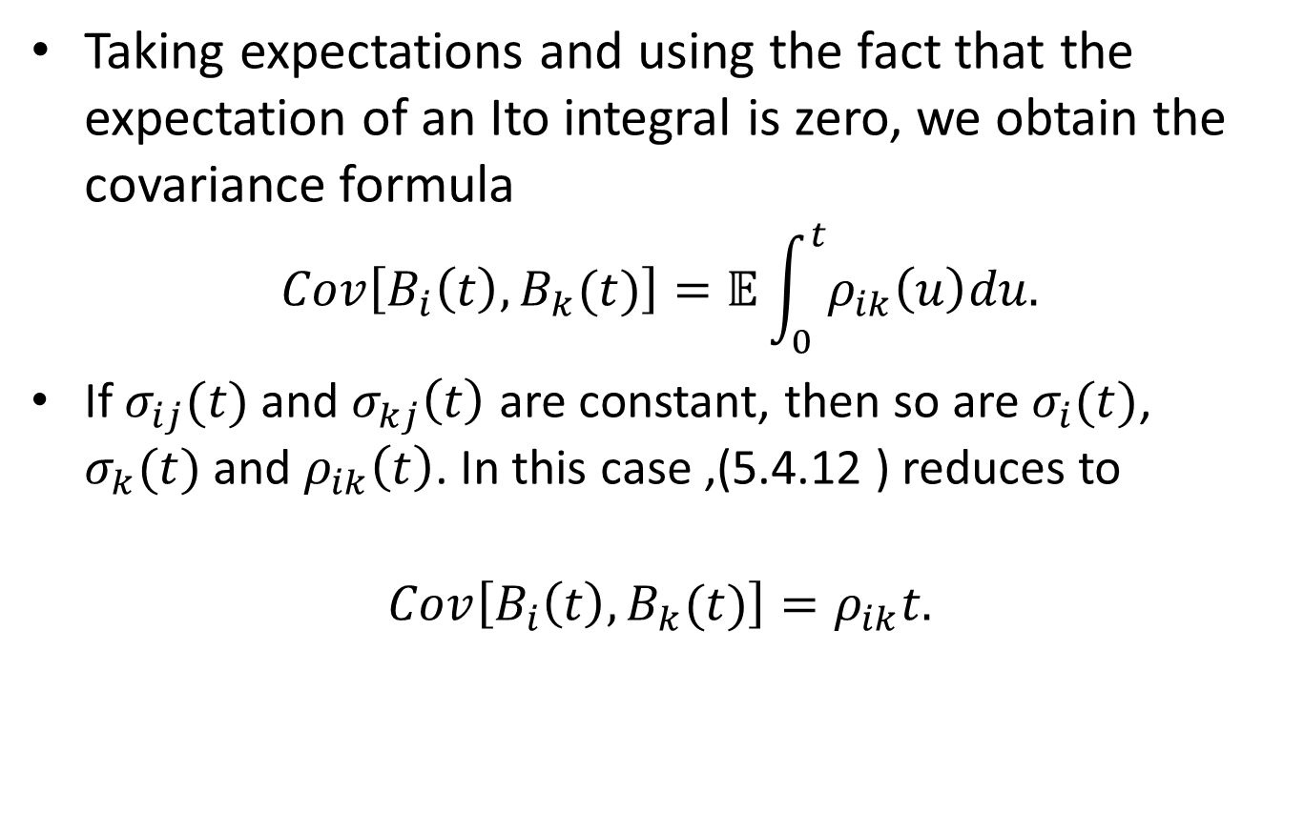
Covariance formula
Taking expectations and using the fact that the expectation of an Ito integral is zero, we obtain the covariance formula
$$Cov\left[B_{i}\left(t\right),B_{k}(t)\right]=𝔼\int_{0}^{t}{ρ_{ik}\left(u\right)du.}$$
If $σ_{ij}(t)$ and $σ_{kj}\left(t\right)$ are constant, then so are $σ_{i}(t)$, $σ_{k}(t)$ and $ρ_{ik}\left(t\right)$. In this case ,(5.4.12 ) reduces to
$$Cov\left[B_{i}\left(t\right),B_{k}(t)\right]=ρ_{ik}t.$$
(5.4.12)

Slide 13
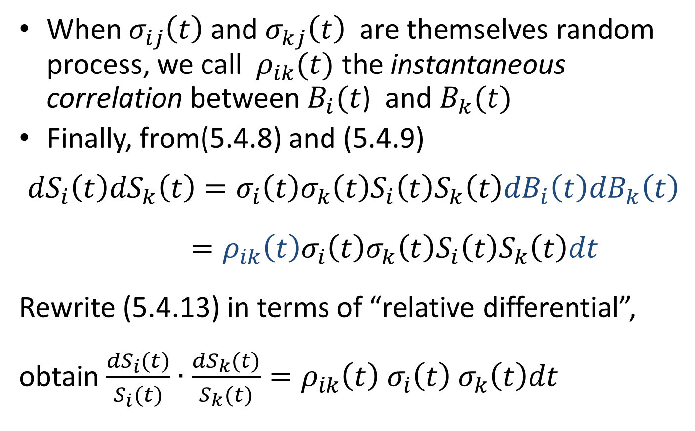
When $σ_{ij}\left(t\right)$ and $σ_{kj}\left(t\right)$ are themselves random process, we call $ρ_{ik}(t)$ the instantaneous correlation between $B_{i}(t$) and $B_{k}(t)$
Finally, from(5.4.8) and (5.4.9)
$${dS}_{i}\left(t\right){dS}_{k}\left(t\right)=σ_{i}\left(t\right)σ_{k}\left(t\right)S_{i}\left(t\right)S_{k}\left(t\right){dB}_{i}\left(t\right){dB}_{k}\left(t\right)$$
$=ρ_{ik}\left(t\right)σ_{i}\left(t\right)σ_{k}{\left(t\right)S}_{i}{\left(t\right)S}_{k}\left(t\right)dt$
Rewrite (5.4.13) in terms of “relative differential”, obtain $\frac{{dS}_{i}(t)}{S_{i}(t)}∙\frac{{dS}_{k}(t)}{S_{k}(t)}=ρ_{ik}{\left(t\right) σ}_{i}{\left(t\right) σ}_{k}\left(t\right)dt$
(5.4.13)

Slide 14
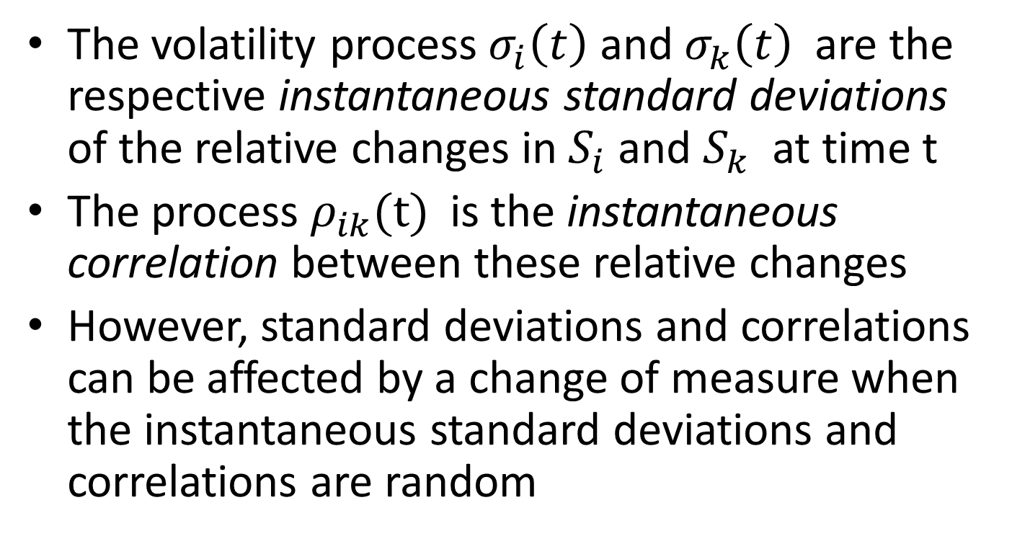
The volatility process $σ_{i}\left(t\right)$ and $σ_{k}\left(t\right)$ are the respective instantaneous standard deviations of the relative changes in $S_{i}$ and $S_{k}$ at time t
The process $ρ_{ik}(t)$ is the instantaneous correlation between these relative changes
However, standard deviations and correlations can be affected by a change of measure when the instantaneous standard deviations and correlations are random

Slide 15
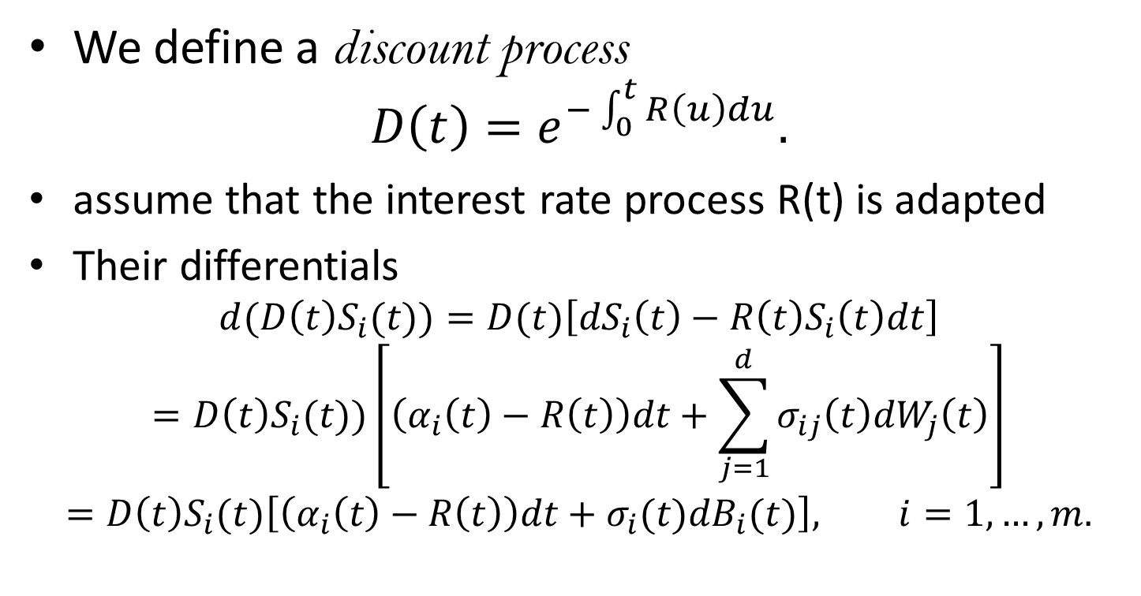
Discount process of stocks
We define a discount process
$$D\left(t\right)=e^{−\int_{0}^{t}{R\left(u\right)du}}.$$
assume that the interest rate process R(t) is adapted
Their differentials
$${d(D\left(t\right)S}_{i}(t))=D(t)\left[{dS}_{i}\left(t\right)−{R\left(t\right)S}_{i}\left(t\right)dt\right]={D\left(t\right)S}_{i}(t))\left[\left(α_{i}\left(t\right)−R\left(t\right)\right)dt+\sum_{j=1}^{d}{σ_{ij}\left(t\right){dW}_{j}\left(t\right)}\right]={D\left(t\right)S}_{i}(t)\left[\left(α_{i}\left(t\right)−R\left(t\right)\right)dt+σ_{i}(t){dB}_{i}(t)\right], i=1,…,m.$$
d(DS)=DdS+SdD+dDdS
by (5.4.6)
by( 5.4.8)
(5.4.15)

