Slide 1
4.3 Ito's Integral for General Integrands

Slide 2
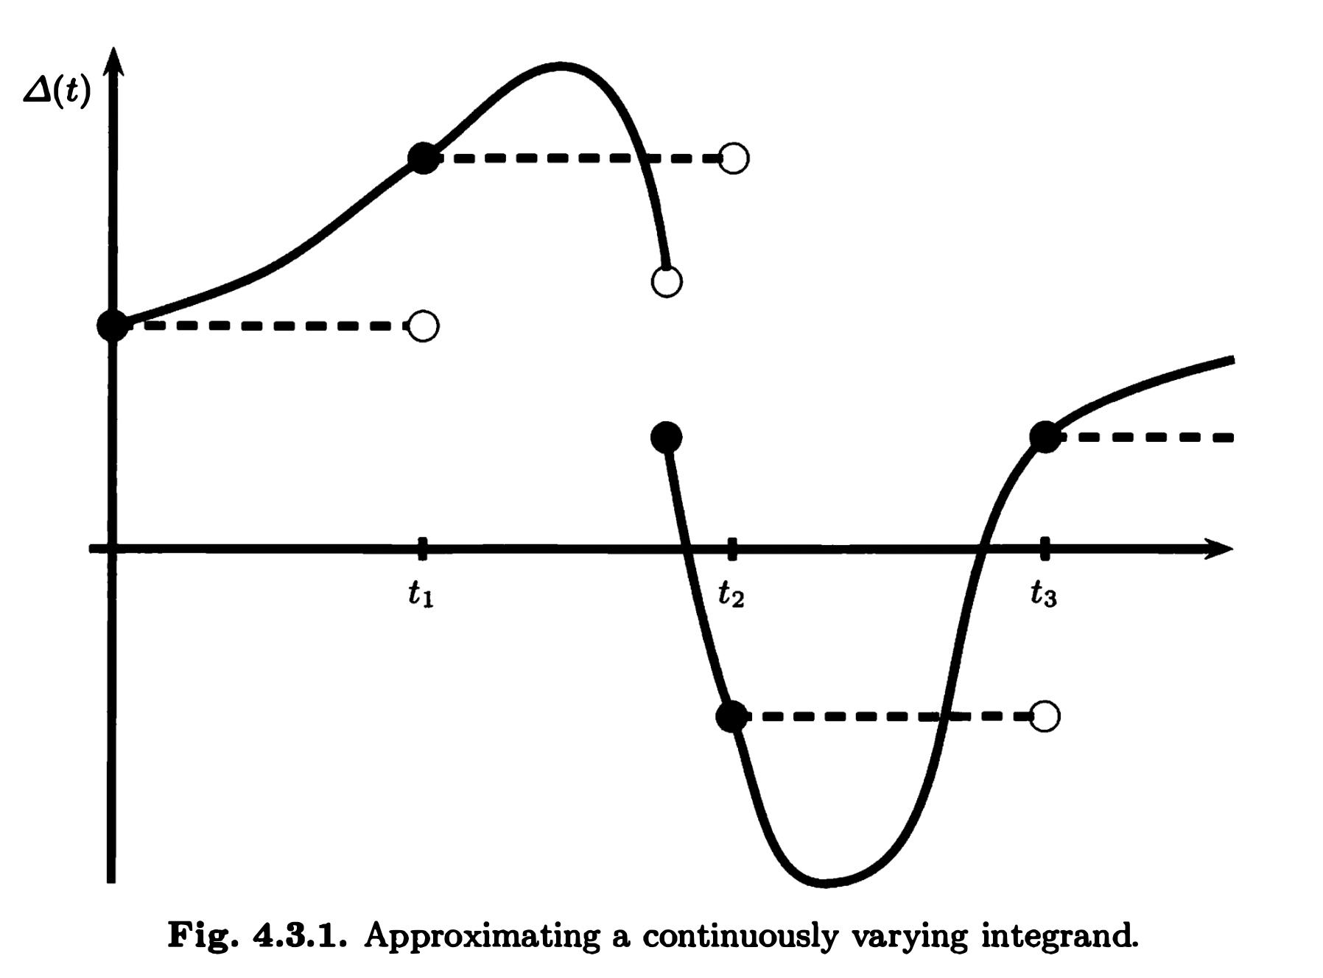

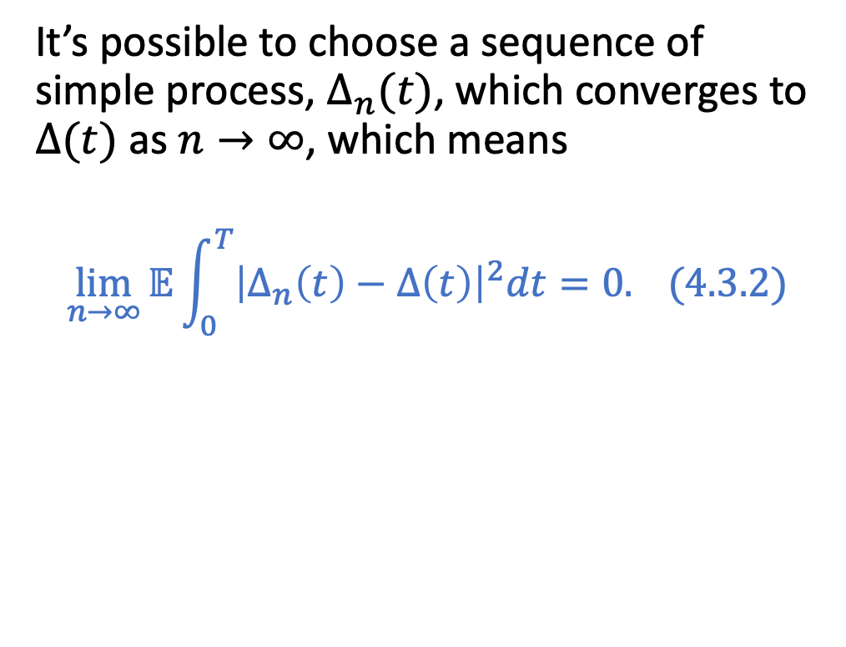
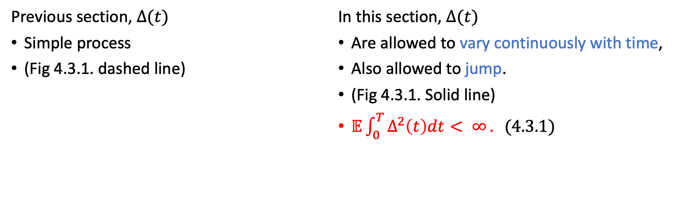
Previous section, $Δ(t)$
Simple process
(Fig 4.3.1. dashed line)
In this section, $Δ(t)$
Are allowed to vary continuously with time,
Also allowed to jump.
(Fig 4.3.1. Solid line)
$𝔼\int_{0}^{T}{Δ^{2}\left(t\right)dt< ∞}. (4.3.1)$
$$Ito Isometry exist$$
It’s possible to choose a sequence of simple process, $Δ_{n}(t)$, which converges to $Δ(t)$ as $n→∞$, which means
$$\lim_{n→∞}{𝔼\int_{0}^{T}{{\left|Δ_{n}\left(t\right)−Δ\left(t\right)\right|}^{2}dt}}=0. (4.3.2)$$
Fig. 4.3.1. Approximating a continuously varying integrand.

Slide 3
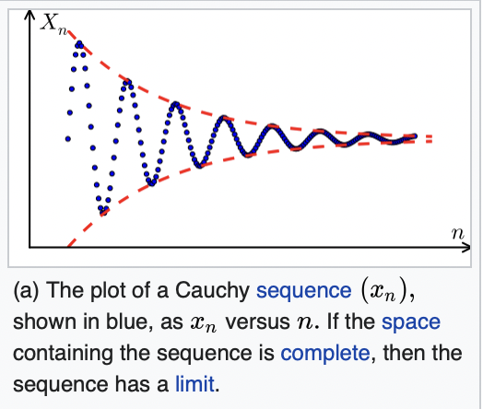
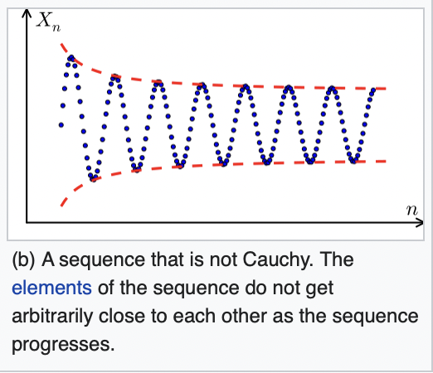
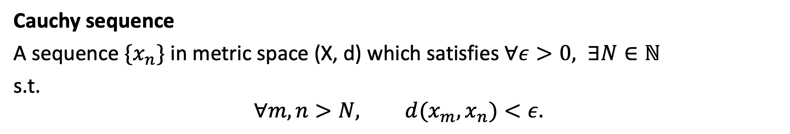
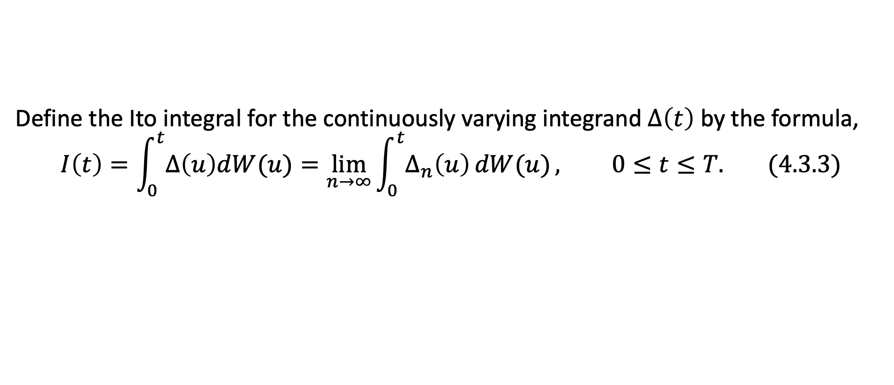
Define the Ito integral for the continuously varying integrand $Δ\left(t\right)$ by the formula,
$$I\left(t\right)=\int_{0}^{t}{Δ\left(u\right)dW(u)}=\lim_{n→∞}{\int_{0}^{t}{Δ_{n}\left(u\right)}dW(u)}, 0≤t≤T. (4.3.3)$$
Cauchy sequence
A sequence $\{x_{n}\}$ in metric space (X, d) which satisfies $∀ε>0, ∃N∈ℕ$
s.t.
$$∀m, n>N, d(x_{m},x_{n})<ε.$$
Figure from
Wikipedia/Cauchy_sequence

Slide 4
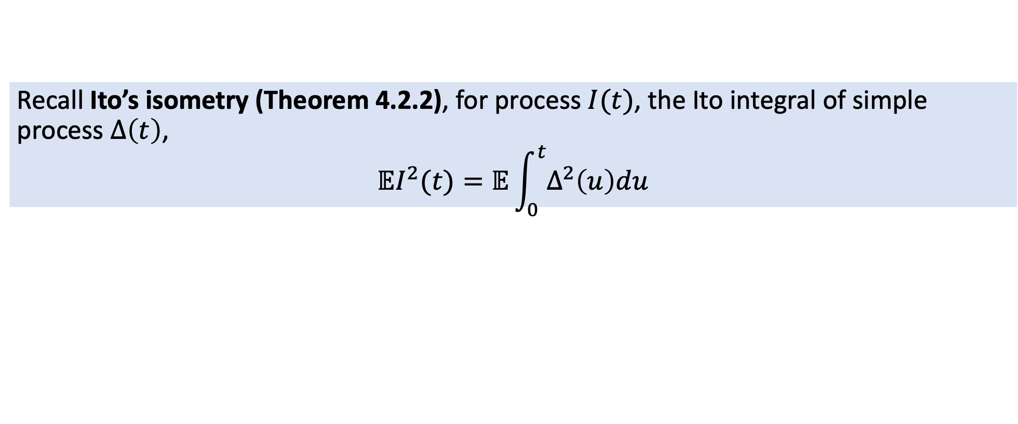
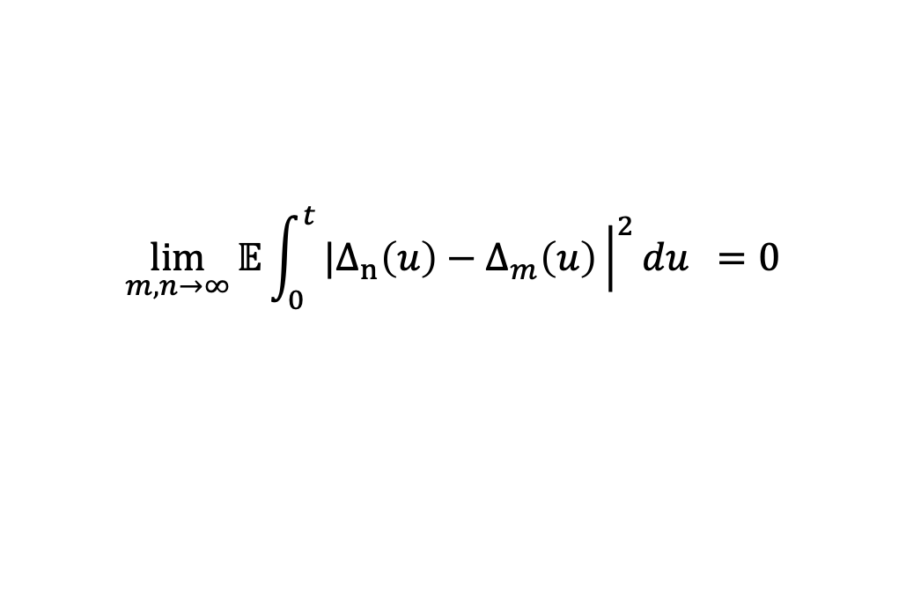
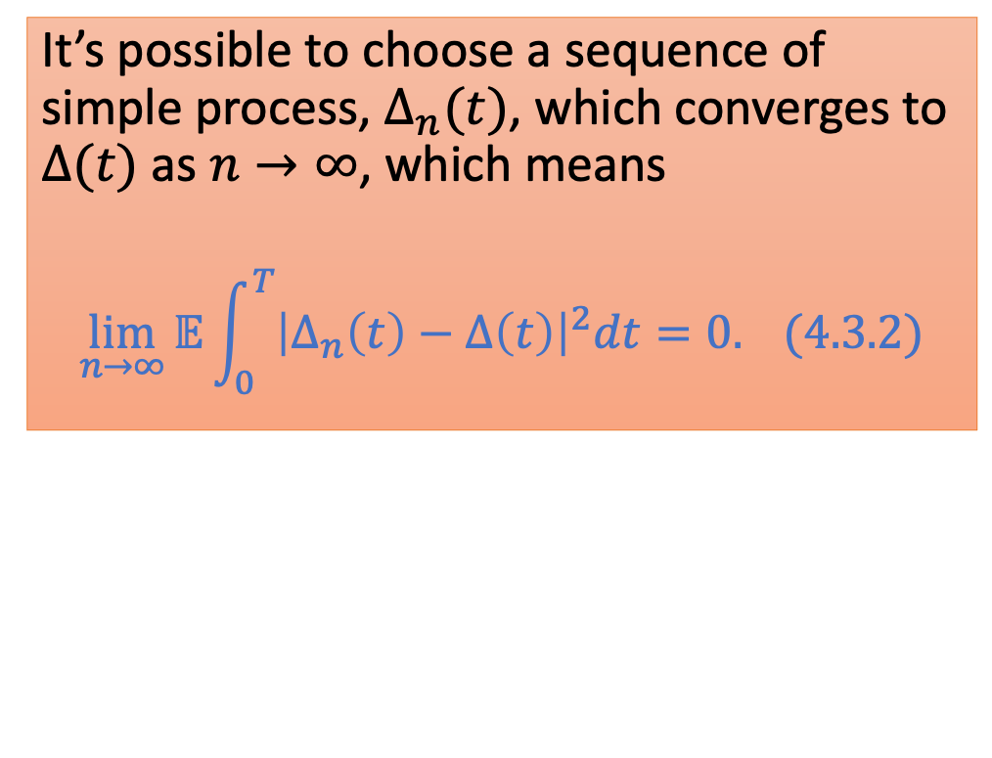
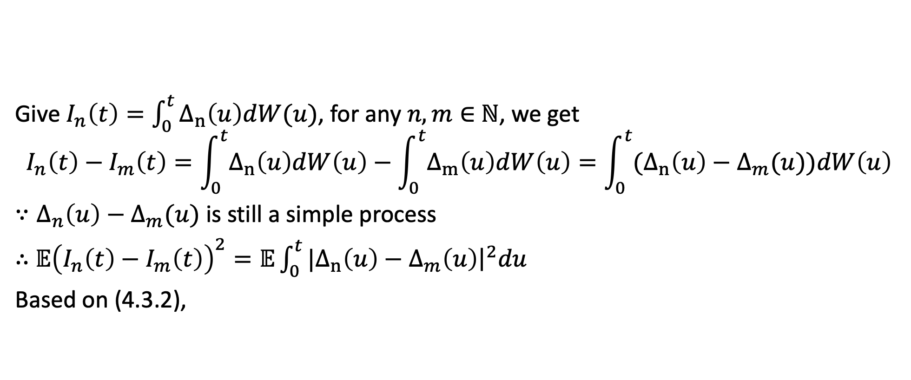
Define the Ito integral for the continuously varying integrand $Δ\left(t\right)$ by the formula,
$$I\left(t\right)=\int_{0}^{t}{Δ\left(u\right)dW(u)}=\lim_{n→∞}{\int_{0}^{t}{Δ_{n}\left(u\right)}dW(u)}, 0≤t≤T. (4.3.3)$$
Recall Ito’s isometry (Theorem 4.2.2), for process $I(t)$, the Ito integral of simple process $Δ\left(t\right)$,
$$𝔼I^{2}(t)=𝔼\int_{0}^{t}{Δ^{2}\left(u\right)du}$$
It’s possible to choose a sequence of simple process, $Δ_{n}(t)$, which converges to $Δ(t)$ as $n→∞$, which means
$$\lim_{n→∞}{𝔼\int_{0}^{T}{{\left|Δ_{n}\left(t\right)−Δ\left(t\right)\right|}^{2}dt}}=0. (4.3.2)$$
Give $I_{n}\left(t\right)=\int_{0}^{t}{Δ_{n}\left(u\right)dW(u)}$, for any $n, m∈$ $ℕ$, we get
$$I_{n}\left(t\right)−I_{m}\left(t\right)=\int_{0}^{t}{Δ_{n}\left(u\right)dW\left(u\right)}−\int_{0}^{t}{Δ_{m}\left(u\right)dW\left(u\right)}=\int_{0}^{t}{{(Δ}_{n}\left(u\right)−Δ_{m}(u))dW\left(u\right)}$$
$∵Δ_{n}\left(u\right)−Δ_{m}(u)$ is still a simple process
$∴$ $𝔼{\left(I_{n}\left(t\right)−I_{m}\left(t\right)\right)}^{2}=𝔼\int_{0}^{t}{{|Δ}_{n}\left(u\right)−Δ_{m}\left(u\right){\left.​\right|}^{2}du}$
Based on (4.3.2),
$$\lim_{m,n→∞}{𝔼\int_{0}^{t}{{|Δ}_{n}\left(u\right)−Δ_{m}\left(u\right){\left.​\right|}^{2}du} }=0$$

Slide 5
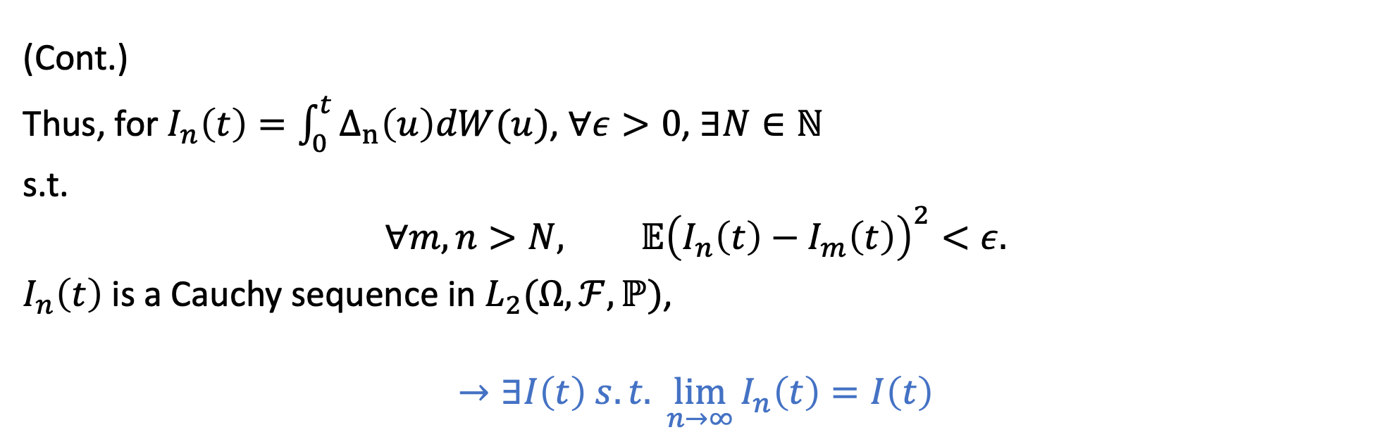
Define the Ito integral for the continuously varying integrand $Δ\left(t\right)$ by the formula,
$$I\left(t\right)=\int_{0}^{t}{Δ\left(u\right)dW(u)}=\lim_{n→∞}{\int_{0}^{t}{Δ_{n}\left(u\right)}dW(u)}, 0≤t≤T. (4.3.3)$$
(Cont.)
Thus, for $I_{n}\left(t\right)=\int_{0}^{t}{Δ_{n}\left(u\right)dW(u)}$, $∀ε>0$, $∃N∈ℕ$
s.t.
$$∀m, n>N, 𝔼{\left(I_{n}\left(t\right)−I_{m}\left(t\right)\right)}^{2}<ε.$$
$I_{n}\left(t\right)$ is a Cauchy sequence in $L_{2}(Ω, ℱ,ℙ)$,
$$→∃I\left(t\right) s.t. \lim_{n→∞}{I_{n}\left(t\right)}=I\left(t\right)$$

Slide 6
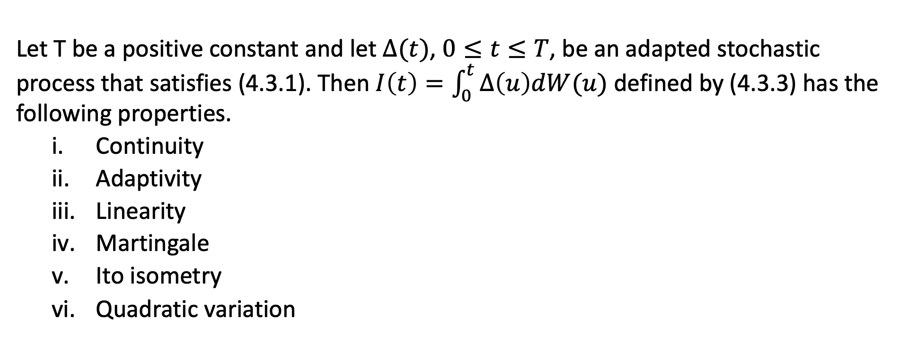
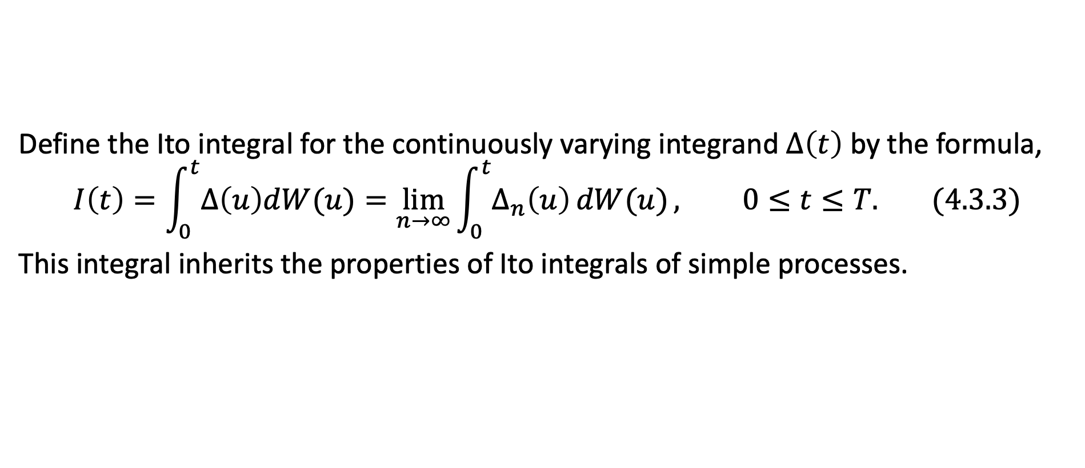
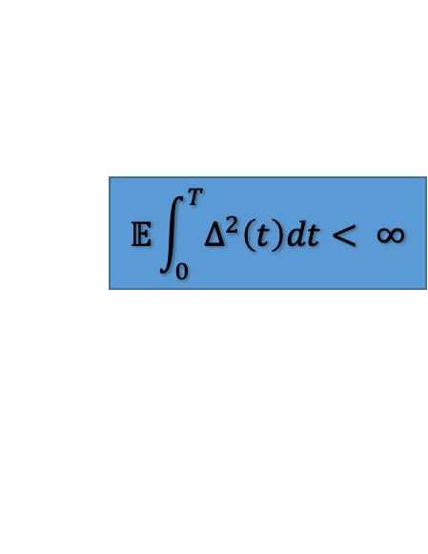
Define the Ito integral for the continuously varying integrand $Δ\left(t\right)$ by the formula,
$$I\left(t\right)=\int_{0}^{t}{Δ\left(u\right)dW(u)}=\lim_{n→∞}{\int_{0}^{t}{Δ_{n}\left(u\right)}dW(u)}, 0≤t≤T. (4.3.3)$$
This integral inherits the properties of Ito integrals of simple processes.
Theorem 4.3.1.
Let T be a positive constant and let $Δ(t)$, $0≤t≤T$, be an adapted stochastic process that satisfies (4.3.1). Then $I\left(t\right)=\int_{0}^{t}{Δ\left(u\right)dW(u)}$ defined by (4.3.3) has the following properties.
Continuity
Adaptivity
Linearity
Martingale
Ito isometry
Quadratic variation
$$𝔼\int_{0}^{T}{Δ^{2}\left(t\right)dt< ∞}$$

Slide 7
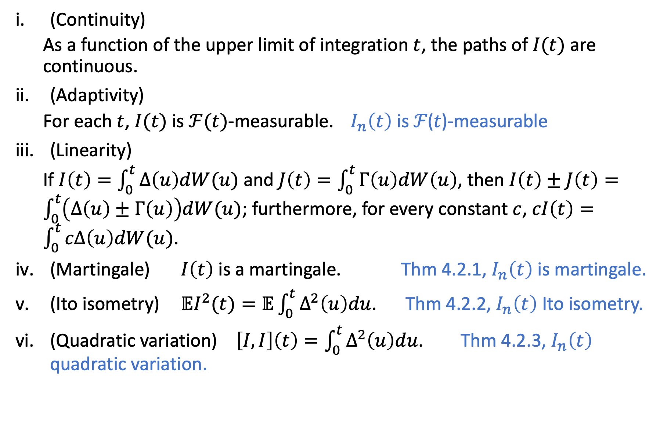
(Continuity)
As a function of the upper limit of integration $t$, the paths of $I(t)$ are continuous.
(Adaptivity)
For each $t$, $I(t)$ is $ℱ(t)$-measurable. $I_{n}\left(t\right)$ is ℱ(𝑡)-measurable
(Linearity)
If $I\left(t\right)=\int_{0}^{t}{Δ\left(u\right)dW(u)}$ and $J\left(t\right)=\int_{0}^{t}{Γ\left(u\right)dW\left(u\right)}$, then $I\left(t\right)±J\left(t\right)=\int_{0}^{t}{\left(Δ\left(u\right)±Γ\left(u\right)\right)dW(u)}$; furthermore, for every constant $c$, $cI\left(t\right)=\int_{0}^{t}{cΔ\left(u\right)dW(u)}$.
(Martingale) $I\left(t\right)$ is a martingale. Thm 4.2.1, $I_{n}\left(t\right)$ is martingale.
(Ito isometry) $𝔼I^{2}(t)=𝔼\int_{0}^{t}{Δ^{2}\left(u\right)du}$. Thm 4.2.2, $I_{n}\left(t\right)$ Ito isometry.
(Quadratic variation) $\left[I,I\right]\left(t\right)=\int_{0}^{t}{Δ^{2}\left(u\right)du}$. Thm 4.2.3, $I_{n}\left(t\right)$ quadratic variation.

Slide 8
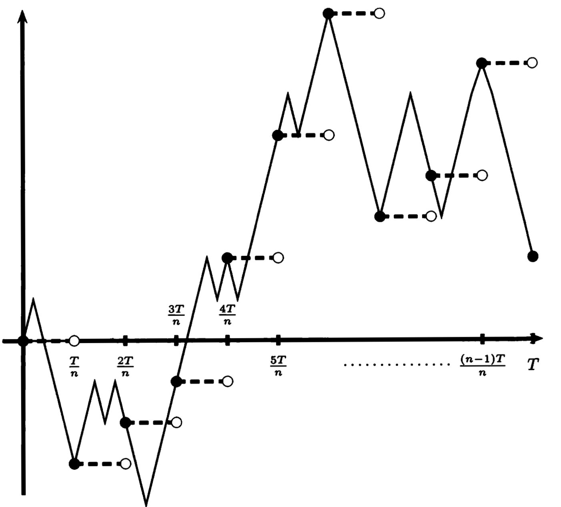
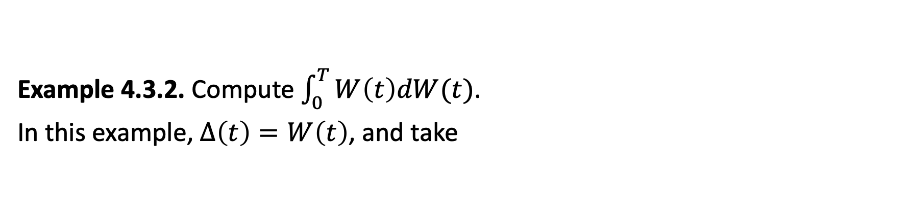
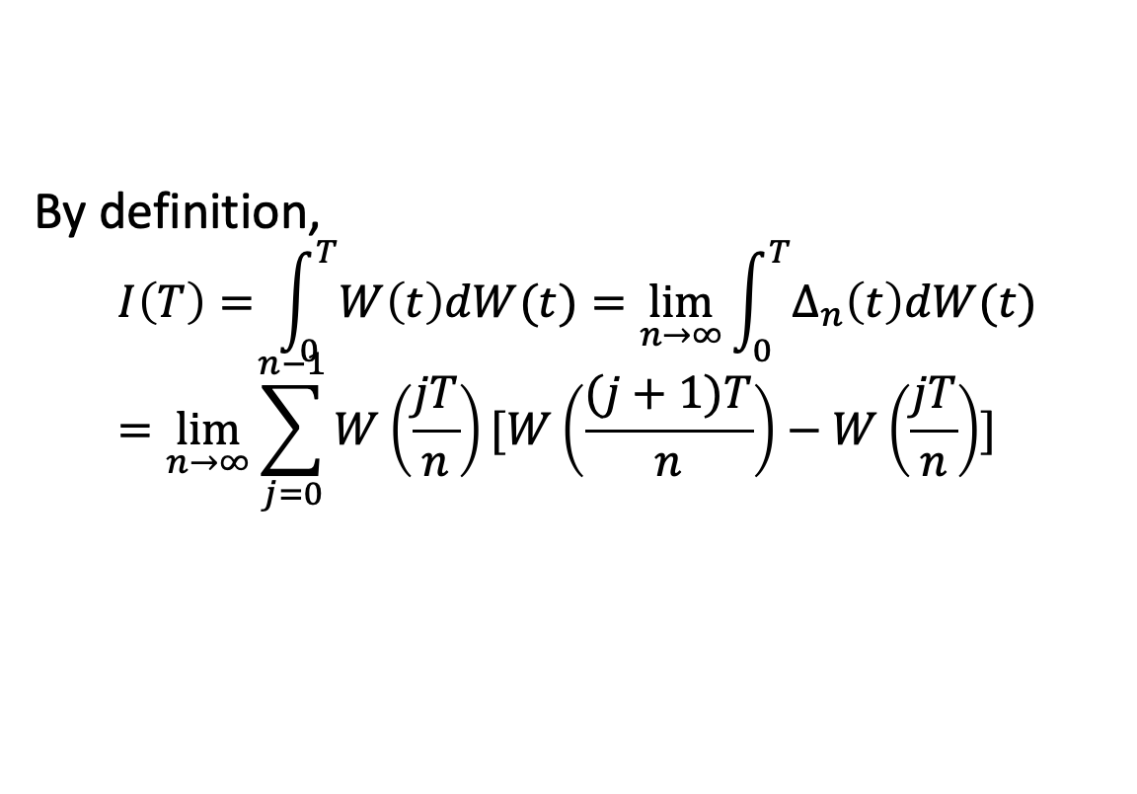
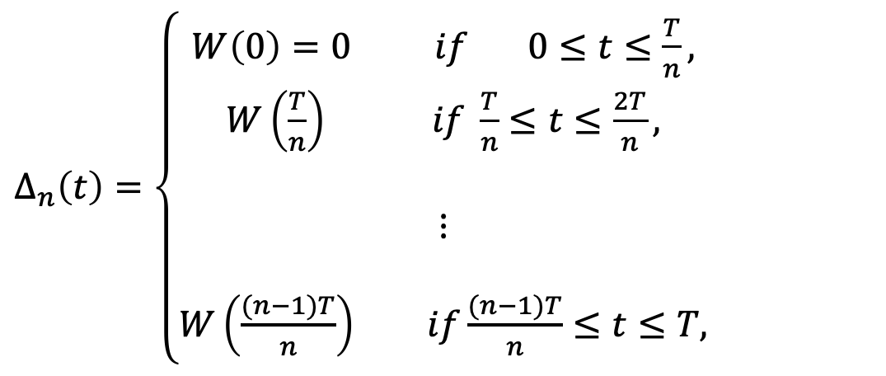
Example 4.3.2. Compute $\int_{0}^{T}{W\left(t\right)dW(t)}$.
In this example, $Δ\left(t\right)=W\left(t\right)$, and take
$Δ_{n}\left(t\right)=\left\{\begin{aligned}W\left(0\right)=0 if 0≤t≤\frac{T}{n}, \\ W\left(\frac{T}{n}\right) if \frac{T}{n}≤t≤\frac{2T}{n}, \\ \\ ⋮ \\ \\ W\left(\frac{(n−1)T}{n}\right) if\frac{(n−1)T}{n}≤t≤T,\end{aligned}\right.$
By definition,
$$I\left(T\right)= \int_{0}^{T}{W\left(t\right)dW(t)}=\lim_{n→∞}{\int_{0}^{T}{Δ_{n}\left(t\right)dW(t)}}=\lim_{n→∞}{\sum_{j=0}^{n−1}{W\left(\frac{jT}{n}\right)[W\left(\frac{(j+1)T}{n}\right)−W\left(\frac{jT}{n}\right)]}}$$
Fig. 4.3.2. Simple process approximating Brownian motion.
(4.3.4)

Slide 9
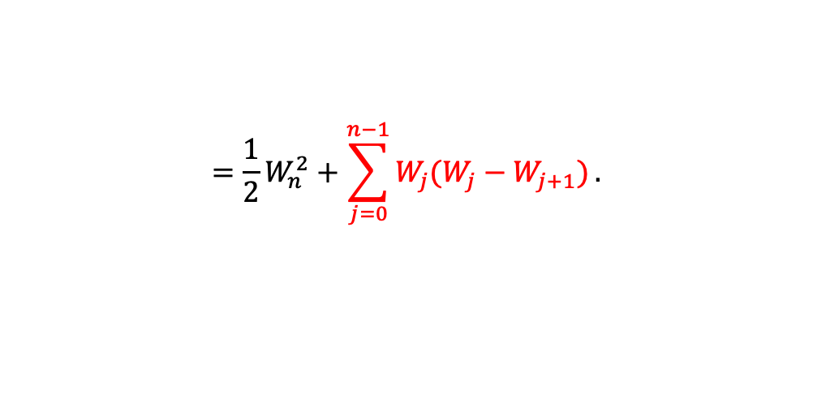
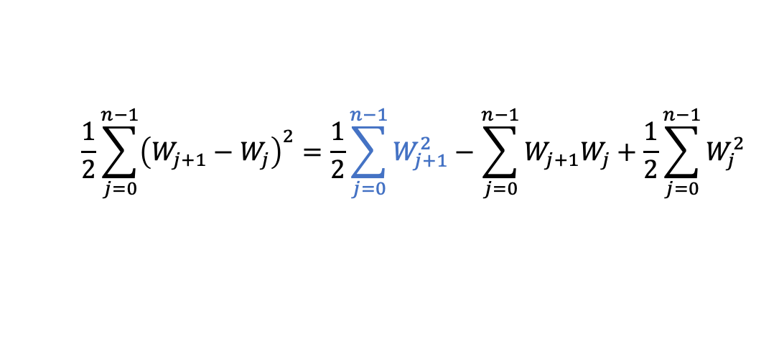
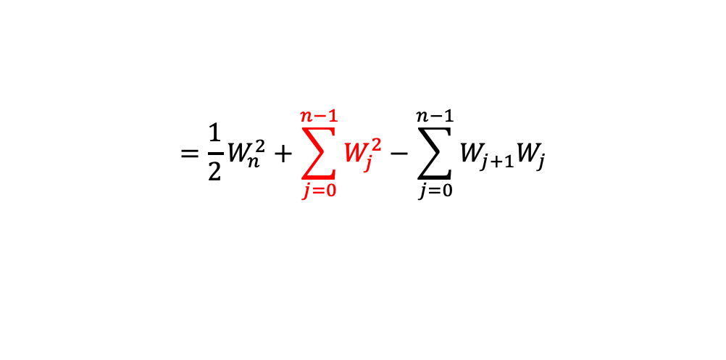
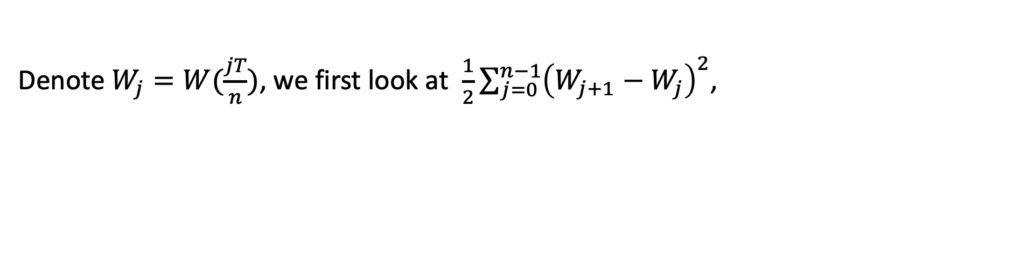
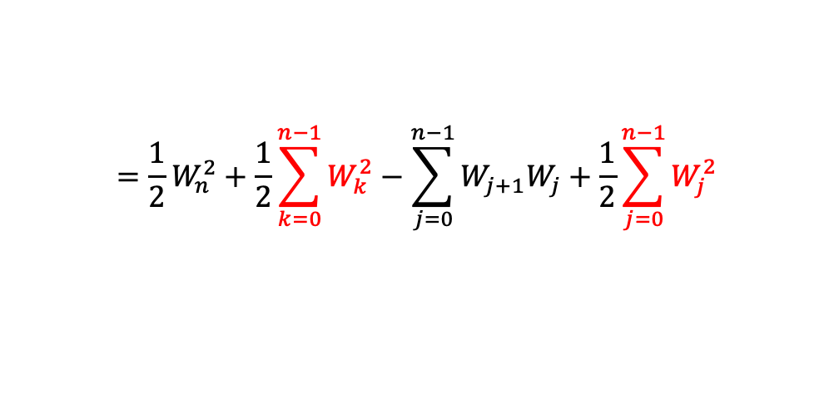
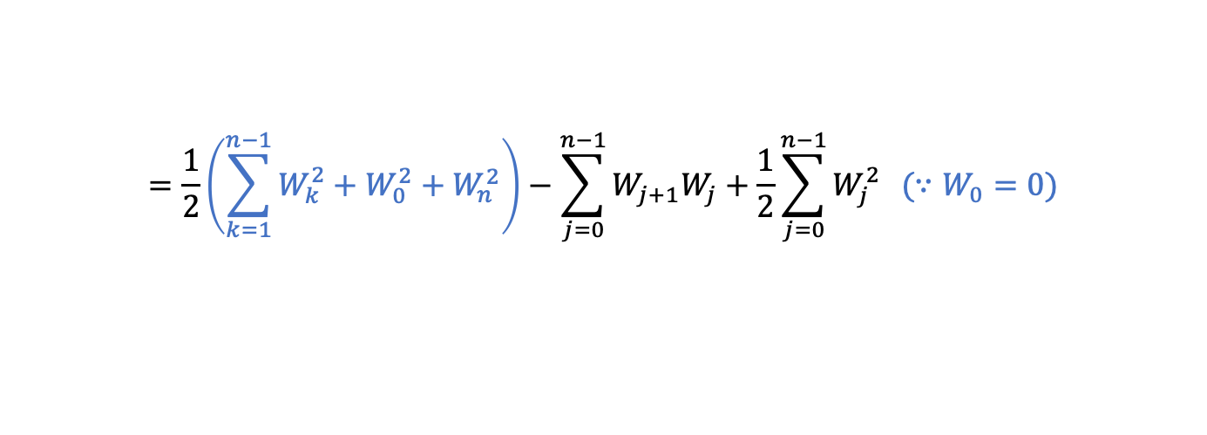
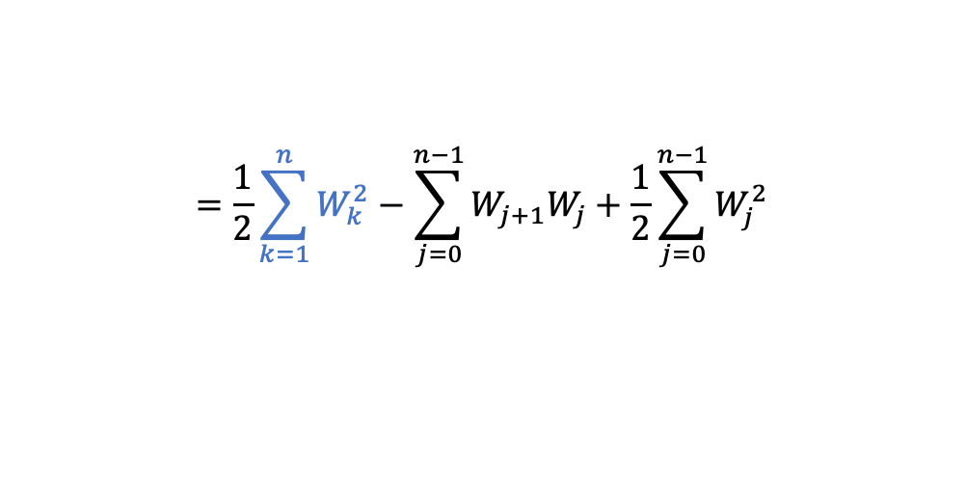
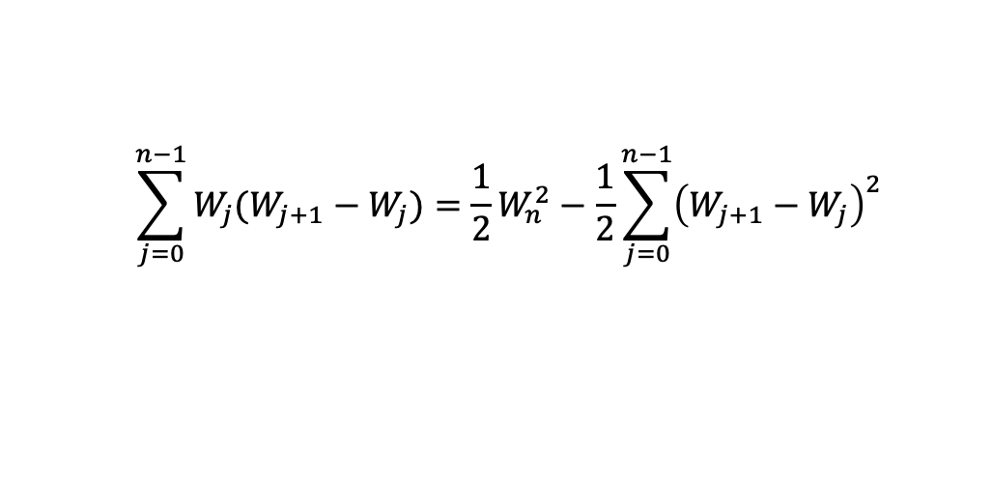
Denote $W_{j}=W(\frac{jT}{n})$, we first look at $\frac{1}{2}\sum_{j=0}^{n−1}{{\left(W_{j+1}−W_{j}\right)}^{2}}$,
$$\frac{1}{2}\sum_{j=0}^{n−1}{{\left(W_{j+1}−W_{j}\right)}^{2}}=\frac{1}{2}\sum_{j=0}^{n−1}{W_{j+1}^{2}}−\sum_{j=0}^{n−1}{W_{j+1}W_{j}}+\frac{1}{2}\sum_{j=0}^{n−1}{W_{j}^{2}}$$
$$=\frac{1}{2}\sum_{k=1}^{n}{W_{k}^{2}}−\sum_{j=0}^{n−1}{W_{j+1}W_{j}}+\frac{1}{2}\sum_{j=0}^{n−1}{W_{j}^{2}}$$
$$=\frac{1}{2}\left(\sum_{k=1}^{n−1}{W_{k}^{2}}+W_{0}^{2}+W_{n}^{2}\right)−\sum_{j=0}^{n−1}{W_{j+1}W_{j}}+\frac{1}{2}\sum_{j=0}^{n−1}{W_{j}^{2}} (∵W_{0}=0)$$
$$={\frac{1}{2}W}_{n}^{2}+\frac{1}{2}\sum_{k=0}^{n−1}{W_{k}^{2}}−\sum_{j=0}^{n−1}{W_{j+1}W_{j}}+\frac{1}{2}\sum_{j=0}^{n−1}{W_{j}^{2}}$$
$$={\frac{1}{2}W}_{n}^{2}+\sum_{j=0}^{n−1}{W_{j}^{2}}−\sum_{j=0}^{n−1}{W_{j+1}W_{j}}$$
$$={\frac{1}{2}W}_{n}^{2}+\sum_{j=0}^{n−1}{W_{j}(W_{j}−W_{j+1})}.$$
(4.3.5)
Rewrite (4.3.5.),
$$\sum_{j=0}^{n−1}{W_{j}(W_{j+1}−W_{j})}={\frac{1}{2}W}_{n}^{2}−\frac{1}{2}\sum_{j=0}^{n−1}{{\left(W_{j+1}−W_{j}\right)}^{2}}$$

Slide 10

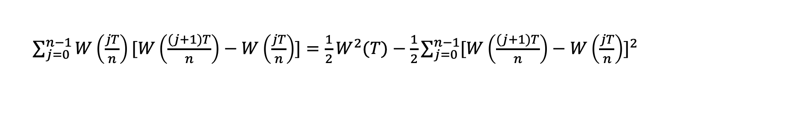

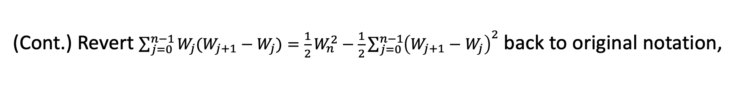
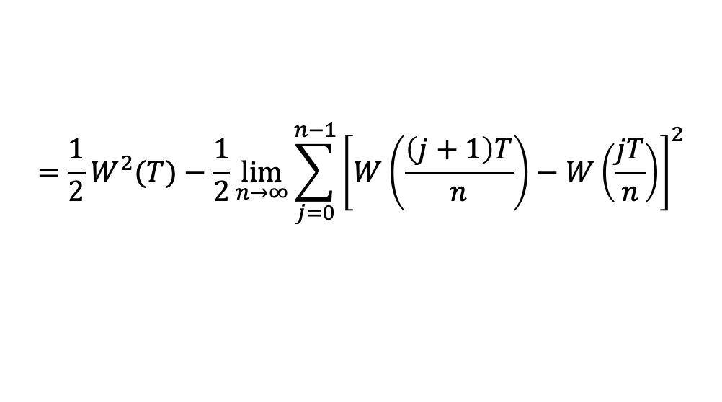
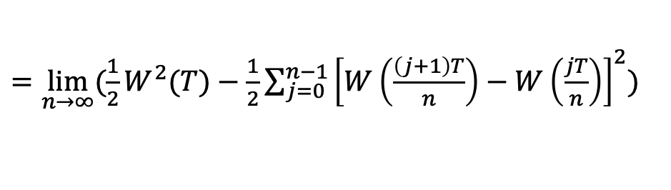
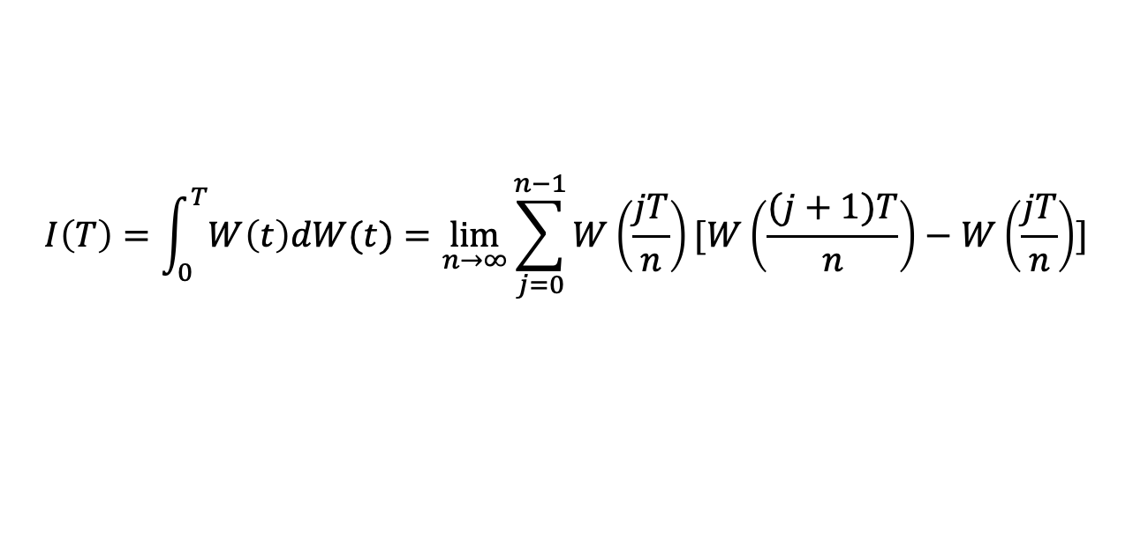
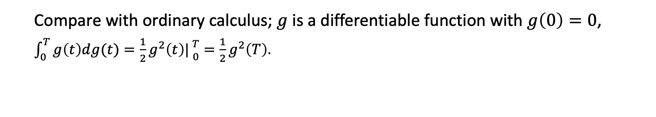
(Cont.) Revert $\sum_{j=0}^{n−1}{W_{j}(W_{j+1}−W_{j})}={\frac{1}{2}W}_{n}^{2}−\frac{1}{2}\sum_{j=0}^{n−1}{{\left(W_{j+1}−W_{j}\right)}^{2}}$ back to original notation,
$\sum_{j=0}^{n−1}{W\left(\frac{jT}{n}\right)[W\left(\frac{(j+1)T}{n}\right)−W\left(\frac{jT}{n}\right)]}=\frac{1}{2}W^{2}(T)−\frac{1}{2}\sum_{j=0}^{n−1}{{[W\left(\frac{(j+1)T}{n}\right)−W\left(\frac{jT}{n}\right)]}^{2}}$
Back to (4.3.4.)
$$I\left(T\right)=\int_{0}^{T}{W\left(t\right)dW(t)}=\lim_{n→∞}{\sum_{j=0}^{n−1}{W\left(\frac{jT}{n}\right)[W\left(\frac{(j+1)T}{n}\right)−W\left(\frac{jT}{n}\right)]}}$$
$=\lim_{n→∞}(\frac{1}{2}W^{2}(T)−\frac{1}{2}\sum_{j=0}^{n−1}{{\left[W\left(\frac{\left(j+1\right)T}{n}\right)−W\left(\frac{jT}{n}\right)\right]}^{2}})$
$$=\frac{1}{2}W^{2}(T)−\frac{1}{2}\lim_{n→∞}\sum_{j=0}^{n−1}{{\left[W\left(\frac{\left(j+1\right)T}{n}\right)−W\left(\frac{jT}{n}\right)\right]}^{2}}$$
$$=\frac{1}{2}W^{2}(T)−\frac{1}{2}[W,W](T)$$
$$=\frac{1}{2}W^{2}(T)−\frac{1}{2}T$$
(4.3.6)
Compare with ordinary calculus; $g$ is a differentiable function with $g\left(0\right)=0$,
$\int_{0}^{T}{g\left(t\right)dg(t)}=\frac{1}{2}g^{2}\left(t\right)|{T \atop 0}=\frac{1}{2}g^{2}\left(T\right)$.

Slide 11
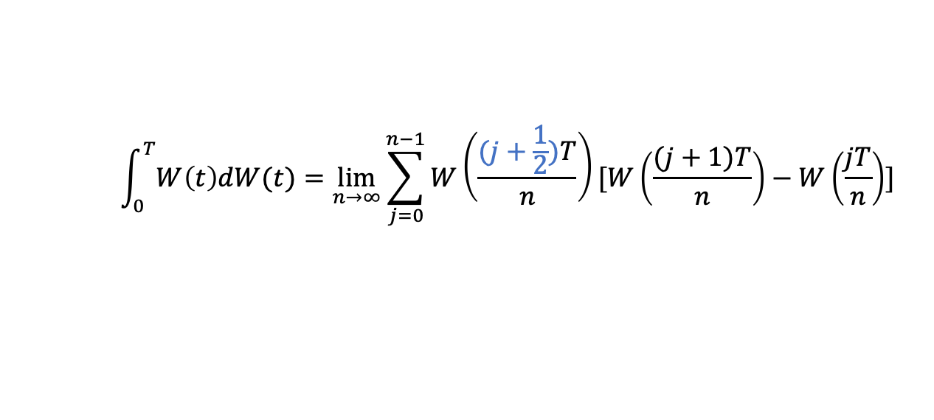
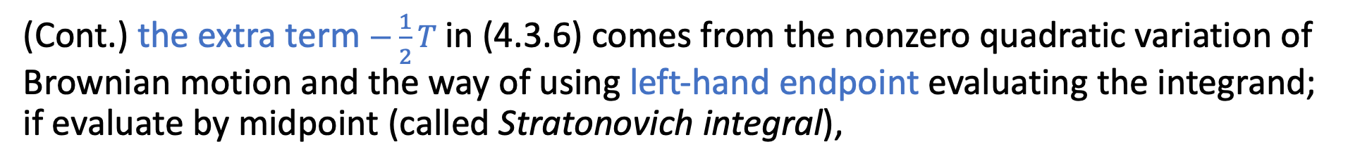
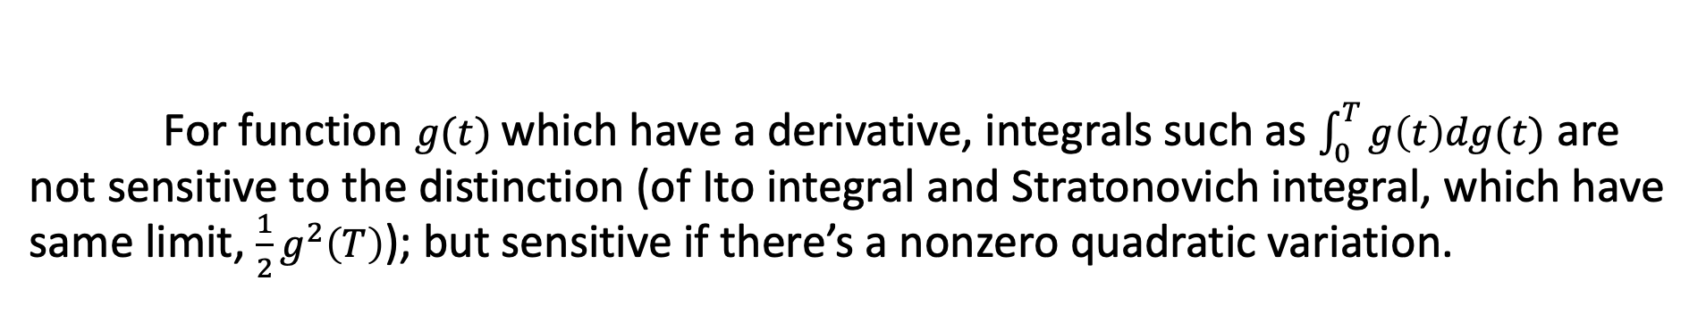
(Cont.) the extra term $−\frac{1}{2}T$ in (4.3.6) comes from the nonzero quadratic variation of Brownian motion and the way of using left-hand endpoint evaluating the integrand; if evaluate by midpoint (called Stratonovich integral),
$$\int_{0}^{T}{W\left(t\right)dW(t)}=\lim_{n→∞}{\sum_{j=0}^{n−1}{W\left(\frac{(j+\frac{1}{2})T}{n}\right)[W\left(\frac{(j+1)T}{n}\right)−W\left(\frac{jT}{n}\right)]}}$$
The $−\frac{1}{2}T$ term doesn’t stand.
For function $g(t)$ which have a derivative, integrals such as $\int_{0}^{T}{g\left(t\right)dg(t)}$ are not sensitive to the distinction (of Ito integral and Stratonovich integral, which have same limit, $\frac{1}{2}g^{2}\left(T\right)$); but sensitive if there’s a nonzero quadratic variation.
<Note> Stratonovich integral is inappropriate for finance.
In finance, We must decide the position at the beginning of each time interval.

Slide 12
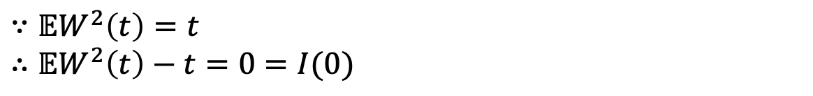
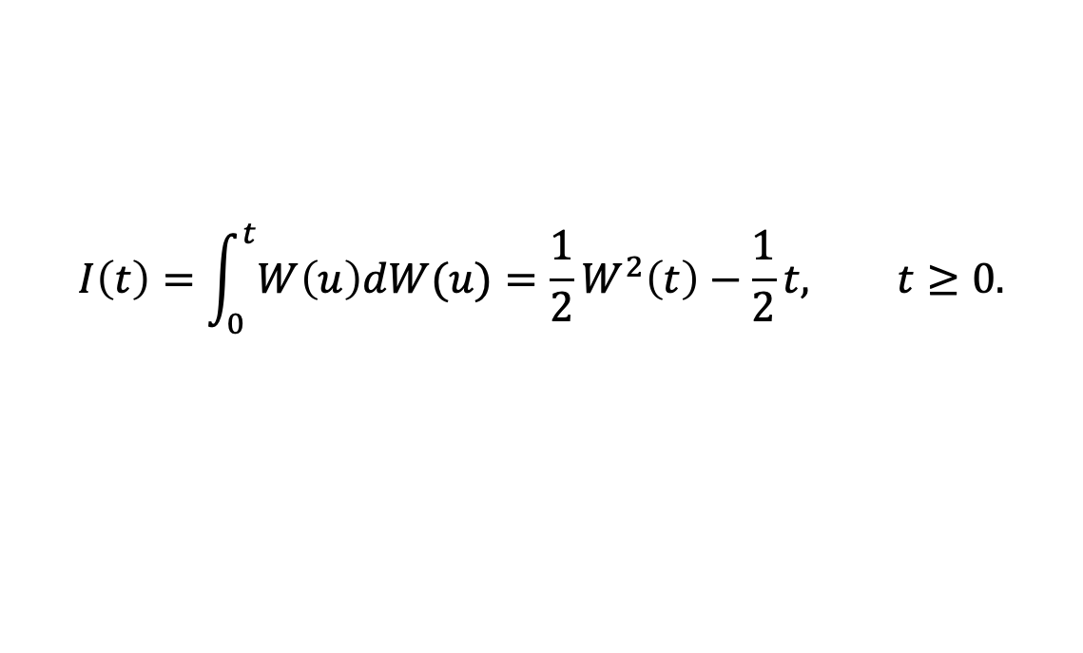

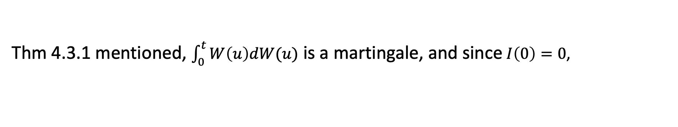
(Cont.) the upper limit of integration $T$ is arbitrary that can be replaced by any $t≥0.$ Rewrite (4.3.6),
$$I\left(t\right)=\int_{0}^{t}{W\left(u\right)dW(u)}=\frac{1}{2}W^{2}\left(t\right)−\frac{1}{2}t, t≥0.$$
(4.3.8)
Thm 4.3.1 mentioned, $\int_{0}^{t}{W\left(u\right)dW(u)}$ is a martingale, and since $I\left(0\right)=0$,
$$𝔼\left(I(t)\right)=𝔼\left(I\left(t\right)|\text{ℱ}(0)\right)=I\left(0\right)=0$$
Also,
$$𝔼\left(I(t)\right)=𝔼\left(\frac{1}{2}W^{2}\left(t\right)−\frac{1}{2}t\right)=\frac{1}{2}(𝔼W^{2}\left(t\right)−t)$$
$∵𝔼W^{2}\left(t\right)=t$
$∴𝔼W^{2}\left(t\right)−t=0=I(0)$
If $−\frac{1}{2}t$ was not present, we would not have a martingale.

