Slide 1
Ch11 VWAP Trading Strategies
Presenter : 宋忻祖

Slide 2
Table of Contents
VWAP strategy introduction
VWAP distribution
Other VWAP strategy
VWAP hedge strategy
VWAP strategy execution result

Slide 3
VWAP Strategy Introduction

Slide 4
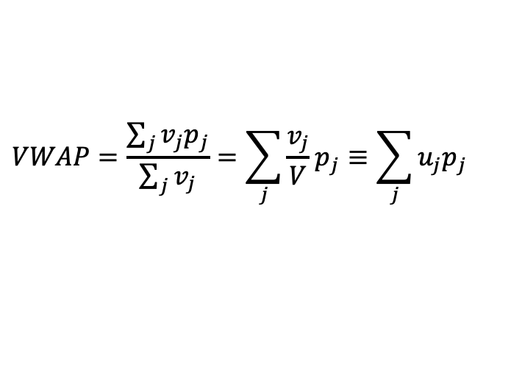
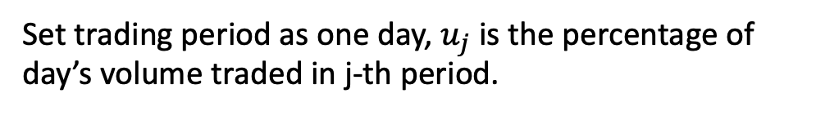
VWAP(Volume-Weighted Average Price)
VWAP Strategy – set VWAP as the target of the average execution price
Minimize market impact.
Regarded as a benchmark for traders’ execution performance.
Do not assure to minimize risk exposure or higher price appreciation cost.
If there’s no anticipated natural price appreciation => VWAP strategy has the lowest trading cost as market impact is the only cost component.
How to do VWAP strategy?
Traders participate in every single market transaction with the proportion of trader’s order to total market volume.(Impossible to practical)
To execute the order in proportion follows the percentage of volume traded in specified trading period, aka slicing strategy.

Slide 5
Comparison of AC model and VWAP strategy
Both AC model and VWAP strategy have mentioned the lowest cost strategy, but two strategies are different, below is the comparisons and to see what causes the differences.
Almgren & Chriss model – Naïve strategy
Market impact model has only considered trading velocity and information state proxy(exogenous)
No impact to other market traders’ behaviour.
Minimum cost strategy is to trade equally over the period
VWAP Strategy
Market impact includes the information leakage from the trading strategy
The other market traders’ behaviour may be impacted
Minimum cost strategy is to minimize the information leakage which could cause the cost increases.

Slide 6
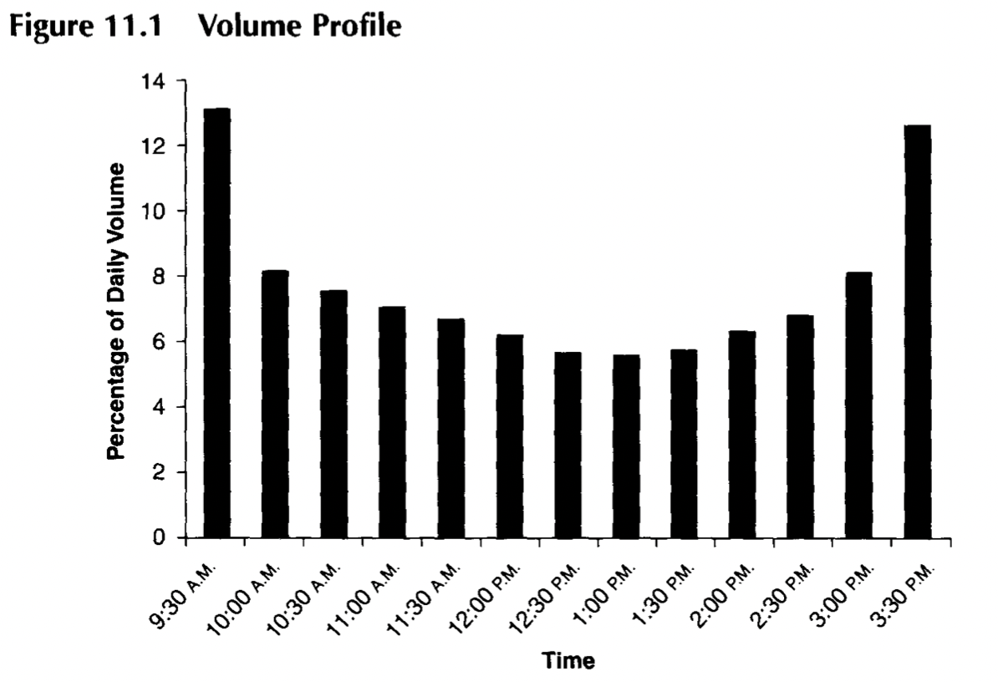
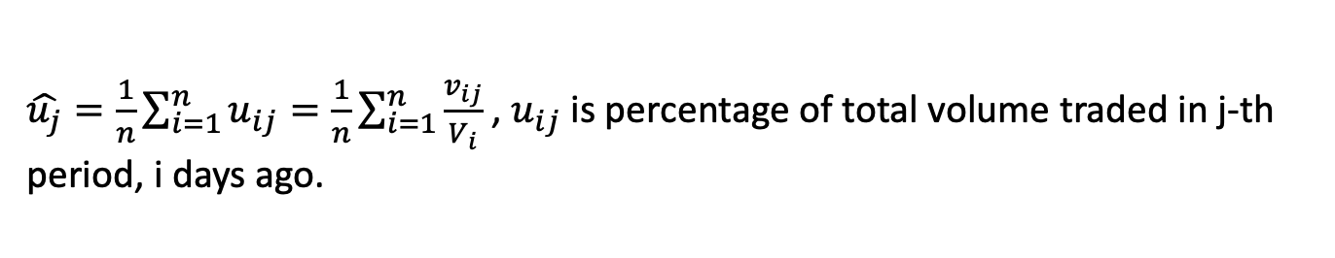
Volume Profile
Profile the percentages of total volume traded in each period.
Higher proportions are traded at opening and closing.
Patterns are stable and consistent.
No statistical improvement by using more than 30 days data.
Estimate Volume Profile
Profile the percentages of total volume

Slide 7
VWAP Distribution

Slide 8
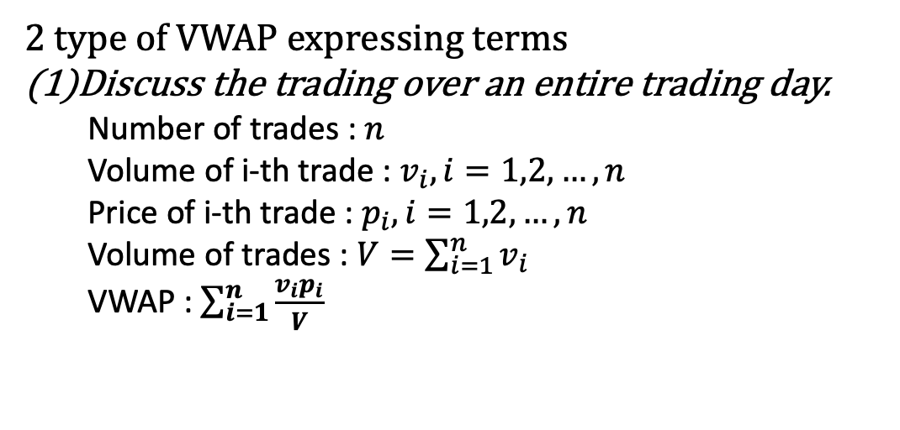
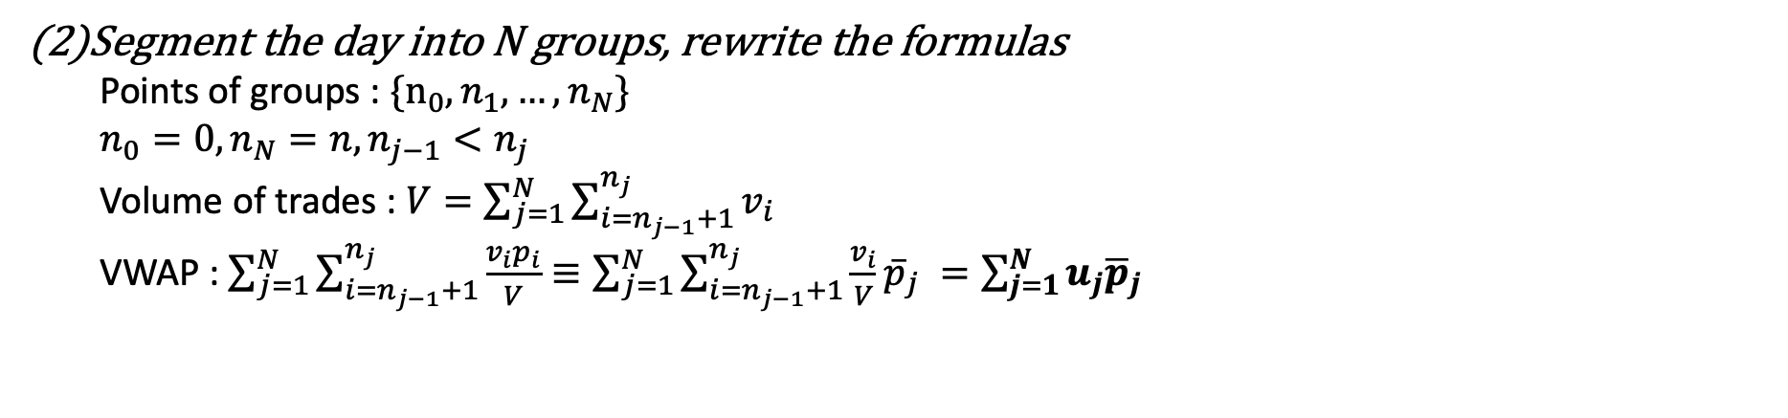
Mathematical Analysis of VWAP – Introduce Notations

Slide 9


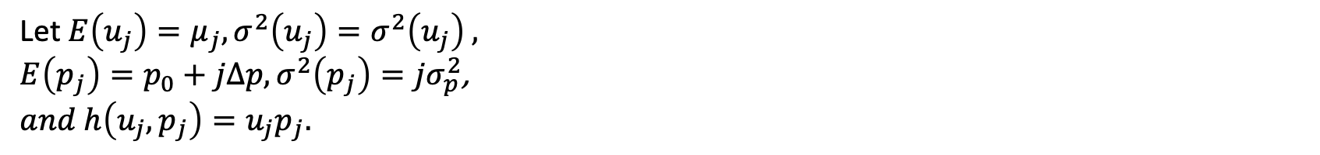
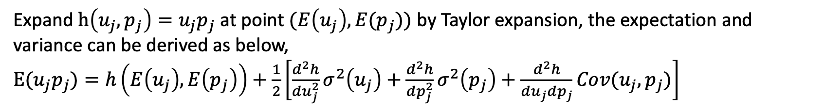
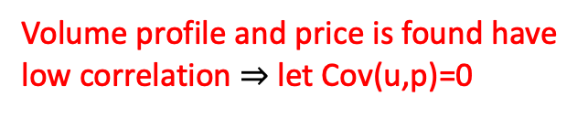
(!)Square is missed in book.

Slide 10
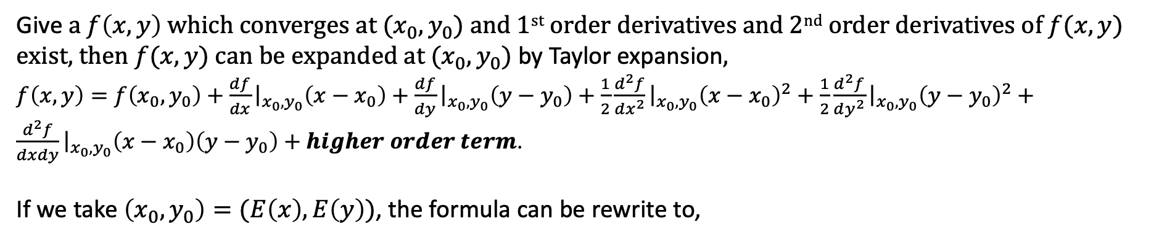
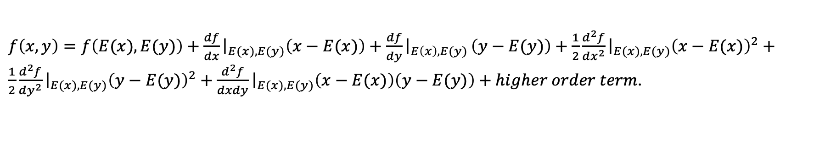
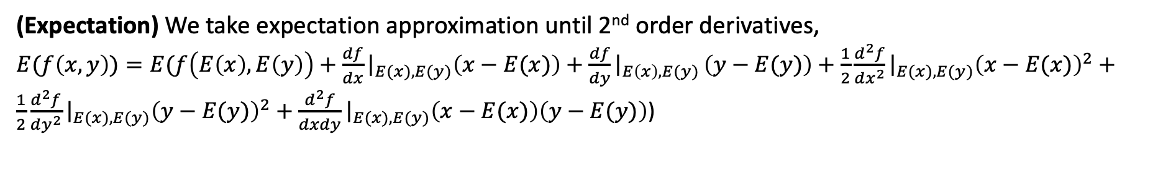
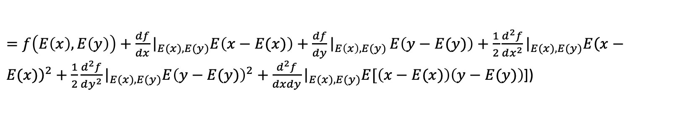
Approximation of Expectation and Variance by Taylor Expansion Method
(Cont.)

Slide 11
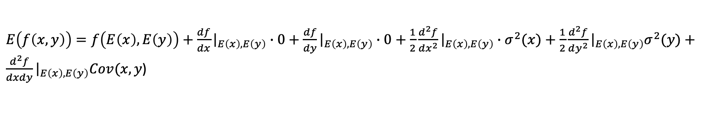
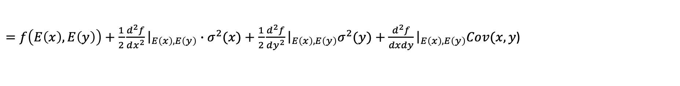
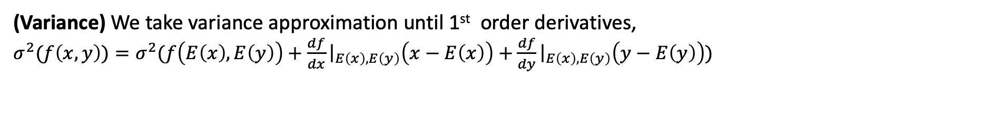
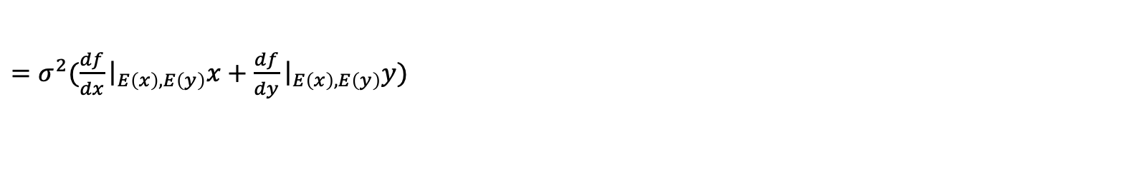
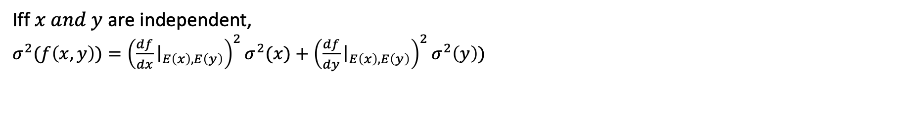
Approximation of Expectation and Variance by Taylor Expansion Method
(Cont.)

Slide 12
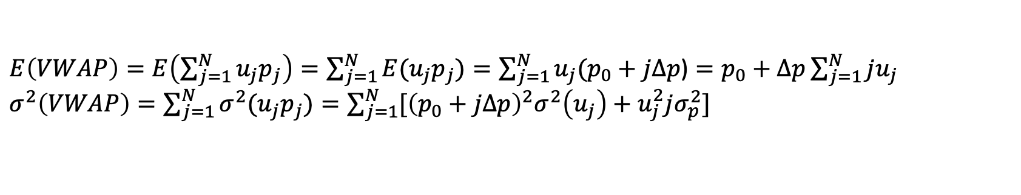
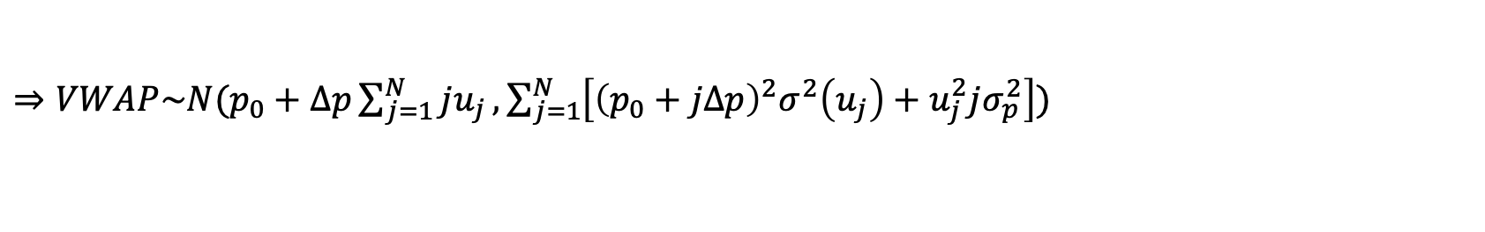
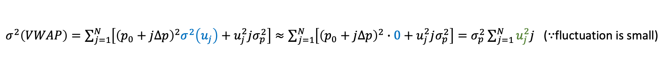
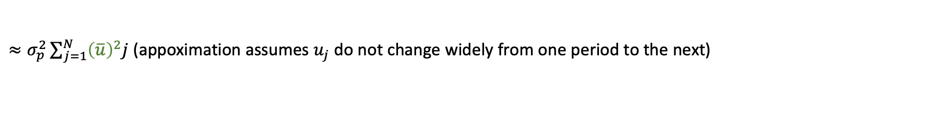
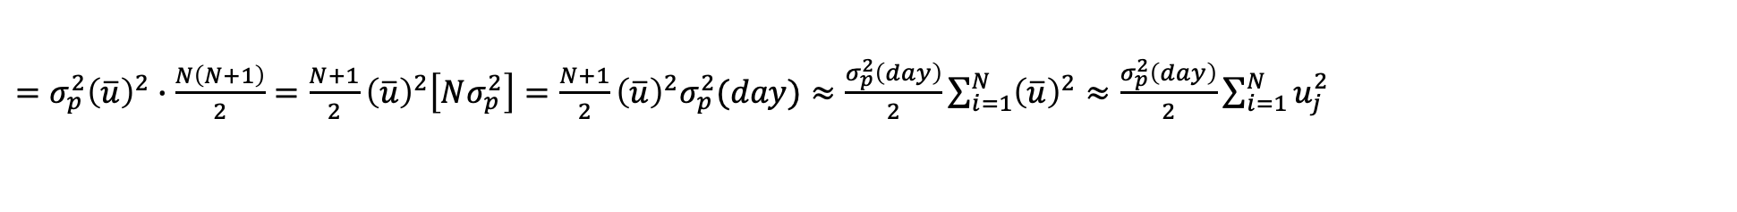
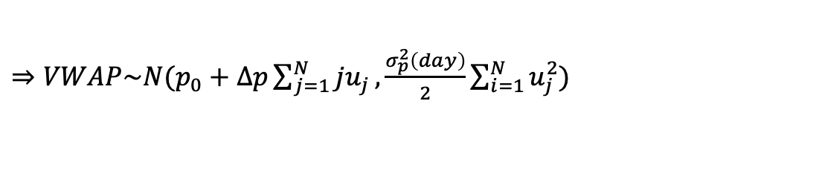

Slide 13
VWAP Hedge Strategy

Slide 14
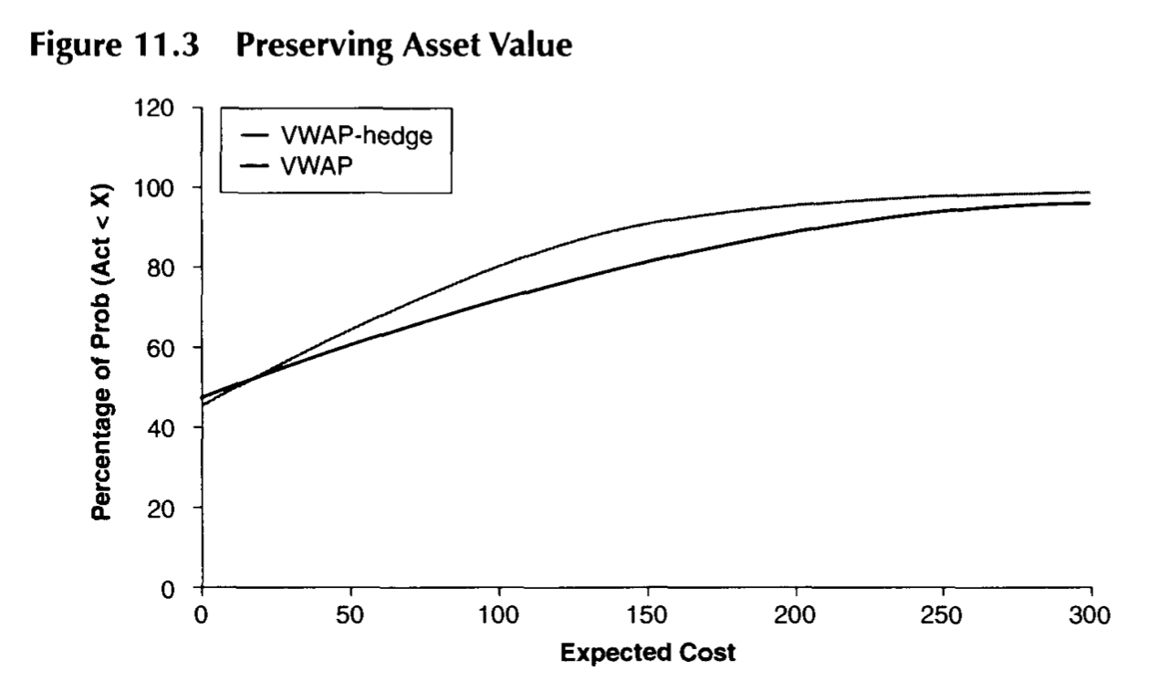
VWAP-hedge Strategy
Still follow volume profile to execute the order
but does not necessarily execute the order over entire day.
-> Smaller orders are executed within a shorter period.
VWAP-hedge
VWAP

Slide 15
End

