Slide 1
Calibrating Cat bonds for Mexican earthquakes
Wolfgang Karl Hardle,Brenda Lopez Cabrera

Slide 2
1.Introduciton
Since the its geographical location, Mexico finds itself under threat from a great variety of natural phenomena that can cause disasters, such as earthquakes, volcanic eruptions, hurricanes.
In the event of a disaster, the effects on financial and natural resources are huge and volatile.
Mexico’s first priority is to transfer seismic risk, because although it is the less recurrent, it has the biggest impact on the population and the country.
For insurers,reinsurers and other corporations, CAT bonds are hedging instruments that offer multiyear protection without the credit risk present in reinsurance by providing full collateral for the risk limits offered through the transaction.
For investors, CAT bonds offer attractive returns and reduction of portfolio risk, since CAT bonds defaults are uncorrelated to the defaults of other securities.

Slide 3
2.Related literature
Baryshnikov, Mayo, and Taylor (2001) present an arbitrage-free solution to the pricing of CAT bonds under conditions of continuous trading and according to the statistical characteristics of the dominant underlying processes.
Under an arbitrage-free framework, Vaugirard (2003) evaluates CAT bonds by Monte Carlo simulation methods and stochastic interest rates.
Burnecki and Kukla (2003) and Burnecki, H¨ardle, and Weron (2005) correct and apply the results of Baryshnikov, Mayo, and Taylor to calculate non-arbitrage prices of a zero-coupon and coupon CAT bond.
Lee and Yu(2002) develop a methodology that incorporates stochastic interest rates and more generic loss processes to price default-risky CAT bonds. They also analyze the value of the bond under the considerations of default risk, moral hazard, and basis risk.

Slide 4
Croson and Kunreuther (2000) , focus on the CAT management and their combination with reinsurance.
Lee and Yu (2007) examine how a reinsurance company can increase the value of a reinsurance contract and reduce its default risk by issuing CAT bonds.
Barrieu and Louberg´e (2009) point out that the downside risk aversion and ambiguity aversion have caused the limited success of CAT bonds; therefore, they propose to replace simple CAT bonds with hybrid CAT bonds, providing catastrophic risk transfer with protection against a stock crash to complete the market.
Cummins and Weiss (2009) and Cummins and Trainar (2009) argue that securitization permits insurers and reinsurers to achieve optimal combination of diversification and shifting of catastrophic risk to the capital markets.

Slide 5
the main motivation of this article is the analysis of pricing CAT bonds.
In particular, we examine the calibration of a pure parametric CAT bond for earthquakes, which was sponsored by the Mexican government in May 2006.
The calibration is based on the estimation of the implied trigger intensity rate from the two sides of the contract: from the reinsurance market and from the capital market.
A comparative analysis of the risk-neutral trigger intensity rates with respect to the historical (physical) intensity rate is conducted to know whether the sponsor company is getting protection at a fair price or whether the CAT bond is sold to the investors for a reasonable price.
Our results demonstrate that the trigger intensities are lower than the historical one, meaning that the direct access of the CAT bond into capital markets expands the risk-bearing capacity beyond the limited capital held by reinsurers.

Slide 6
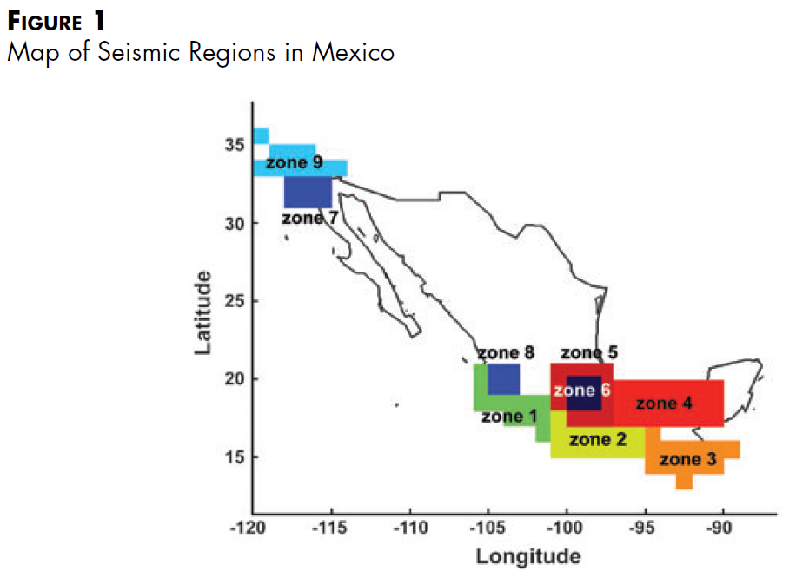
Calibrating a Mexican parametric Cat bond
Faced with the shortage of resources of the Mexico’s Fund for Natural Disasters(FONDEN) and the high probability of earthquake occurrence, in May 2006 the Mexican government sponsored a pure parametric CAT bond against earthquake risk.
For the transaction, FONDEN hired Swiss Re Capital Markets (SRCM), Swiss Reinsurance Company (SRC), and Deutsche Bank Securities.
The 160 million CAT bond is part of a 450 million insurance contract against earthquake risk covering equally three out of the nine zones (Zone 1, Zone 2, and Zone 5) in 3 years for a premium totaling 26 million .

Slide 7
The CAT bond payment would be triggered if there is an event, that is, an earthquake higher than or equal to 8Mw hitting Zone 1 or Zone 2, or an earthquake higher than or equal to 7.5Mw hitting Zone 5;
The payment of losses is conditional upon confirmation by an event verification agent (Applied Insurance Research Worldwide Corporation [AIR]), which modeled the seismic risk.
SRC would pay the covered insured amount to the government, which would then stop paying premiums at that time and investors would sacrifice their full principal and coupons.

Slide 8
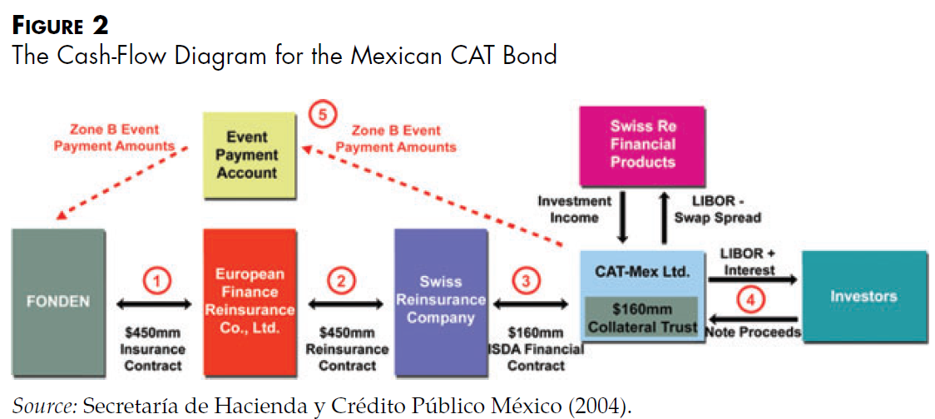
The cash-flow diagram for the Mexican CAT bond is described in Figure 2.
SRCM designed a financial structure for transferring earthquake risk where FONDEN enters into an insurance contract with European Finance Reinsurance (EFR), an indirect, wholly owned subsidiary of SRC, which transfers 100 percent of the risk to SRC via the Reinsurance Agreement.
SCR retained 290 million of the contract exposure and issued a 160 million CAT bond for 3 years through a special purpose vehicle, CAT-Mex Ltd class B insurer.

Slide 9
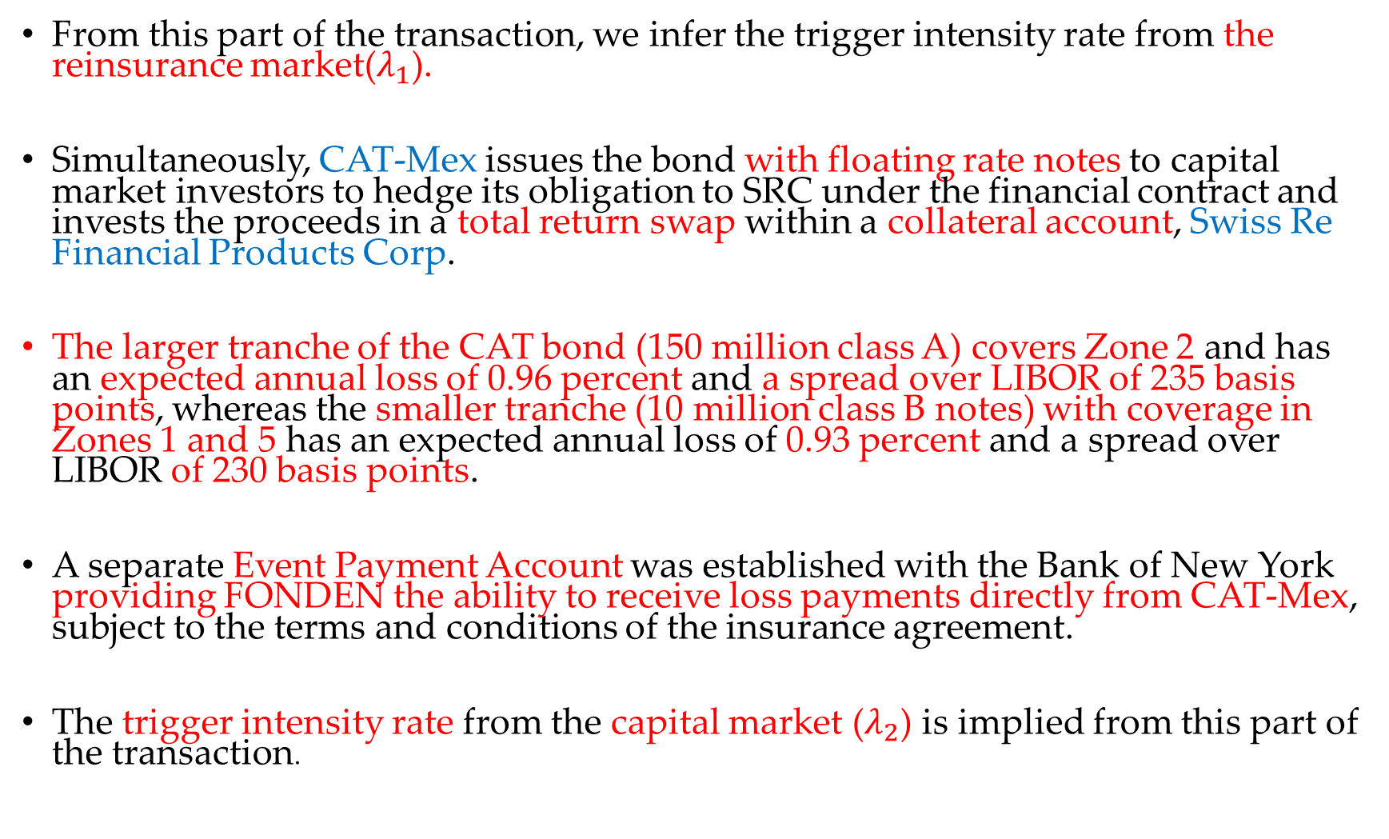
From this part of the transaction, we infer the trigger intensity rate from the reinsurance market($λ_{1}$).
Simultaneously, CAT-Mex issues the bond with floating rate notes to capital market investors to hedge its obligation to SRC under the financial contract and invests the proceeds in a total return swap within a collateral account, Swiss Re Financial Products Corp.
The larger tranche of the CAT bond (150 million class A) covers Zone 2 and has an expected annual loss of 0.96 percent and a spread over LIBOR of 235 basis points, whereas the smaller tranche (10 million class B notes) with coverage in Zones 1 and 5 has an expected annual loss of 0.93 percent and a spread over LIBOR of 230 basis points.
A separate Event Payment Account was established with the Bank of New York providing FONDEN the ability to receive loss payments directly from CAT-Mex, subject to the terms and conditions of the insurance agreement.
The trigger intensity rate from the capital market ($λ_{2}$) is implied from this part of the transaction.

Slide 10
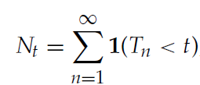
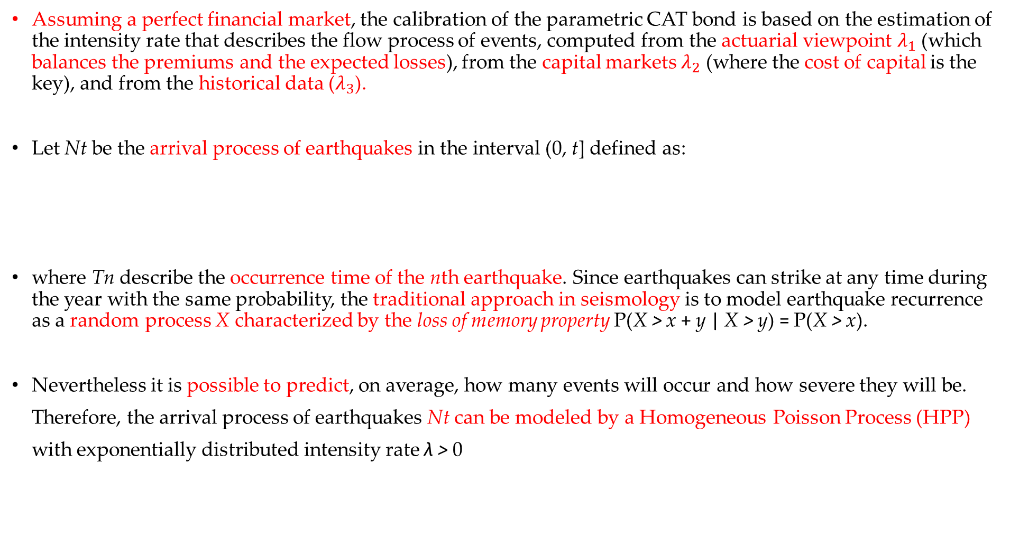
Assuming a perfect financial market, the calibration of the parametric CAT bond is based on the estimation of the intensity rate that describes the flow process of events, computed from the actuarial viewpoint $λ_{1}$ (which balances the premiums and the expected losses), from the capital markets $λ_{2}$ (where the cost of capital is the key), and from the historical data ($λ_{3}$).
Let Nt be the arrival process of earthquakes in the interval (0, t] defined as:
where Tn describe the occurrence time of the nth earthquake. Since earthquakes can strike at any time during the year with the same probability, the traditional approach in seismology is to model earthquake recurrence as a random process X characterized by the loss of memory property P(X > x + y | X > y) = P(X > x).
Nevertheless it is possible to predict, on average, how many events will occur and how severe they will be.
Therefore, the arrival process of earthquakes Nt can be modeled by a Homogeneous Poisson Process (HPP)
with exponentially distributed intensity rate λ > 0

Slide 11


Hence, the probability of occurrence of an earthquake is
with waiting times $τ_{i}$ = $T_{i}$ − $T_{i−1}$. The occurrence of the first trigger event can be define as the stopping time τ = min{t : $N_{t}$ > 0} occurred in insured zones with cdf Fτ (t) = P(τ < t) = P(Nt > 0) = 1 − $e^{−λt}$ and fτ (t) = λ$e^{−λt}$.

Slide 12
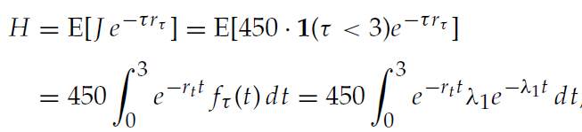
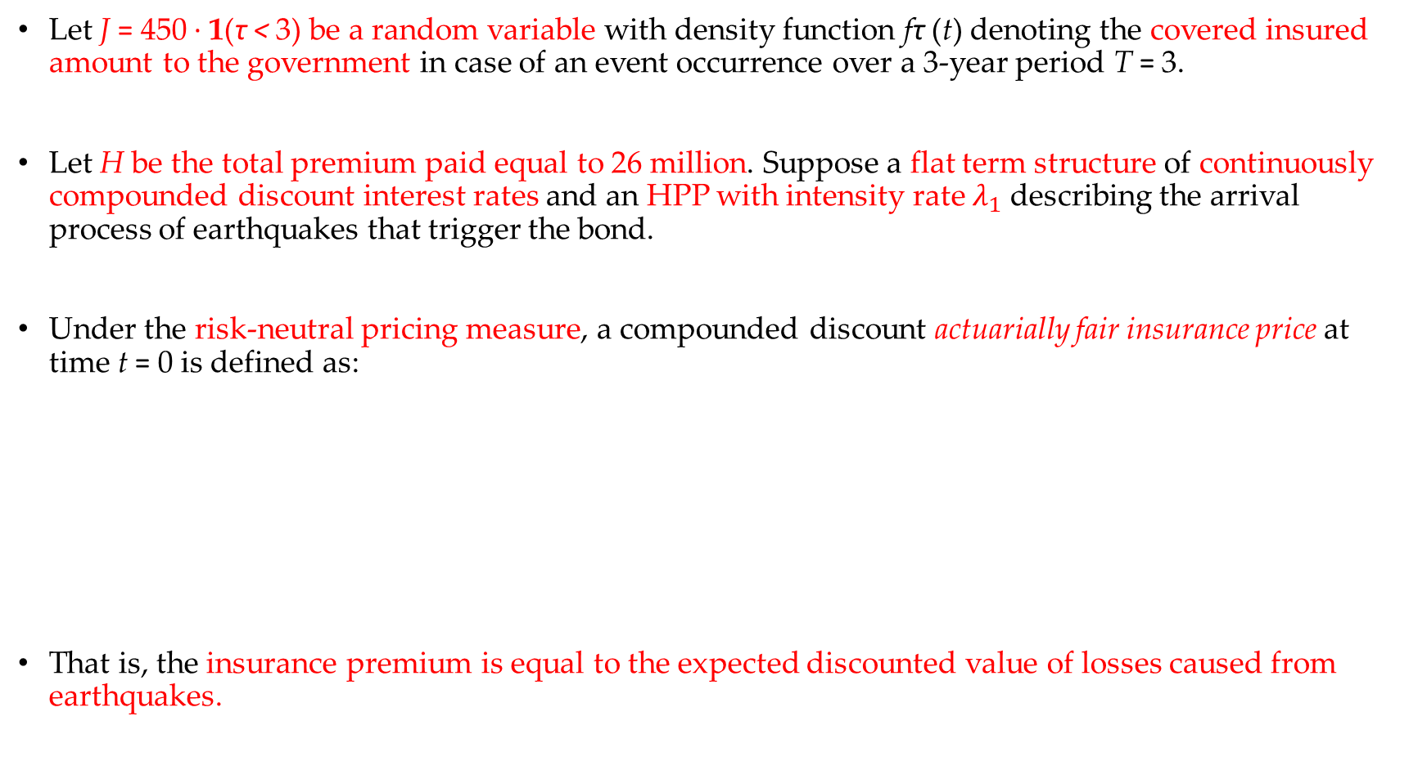
Calibration in the reinsurance market
Let J = 450 · 1(τ < 3) be a random variable with density function fτ (t) denoting the covered insured amount to the government in case of an event occurrence over a 3-year period T = 3.
Let H be the total premium paid equal to 26 million. Suppose a flat term structure of continuously compounded discount interest rates and an HPP with intensity rate $λ_{1}$ describing the arrival process of earthquakes that trigger the bond.
Under the risk-neutral pricing measure, a compounded discount actuarially fair insurance price at time t = 0 is defined as:
That is, the insurance premium is equal to the expected discounted value of losses caused from earthquakes.

Slide 13

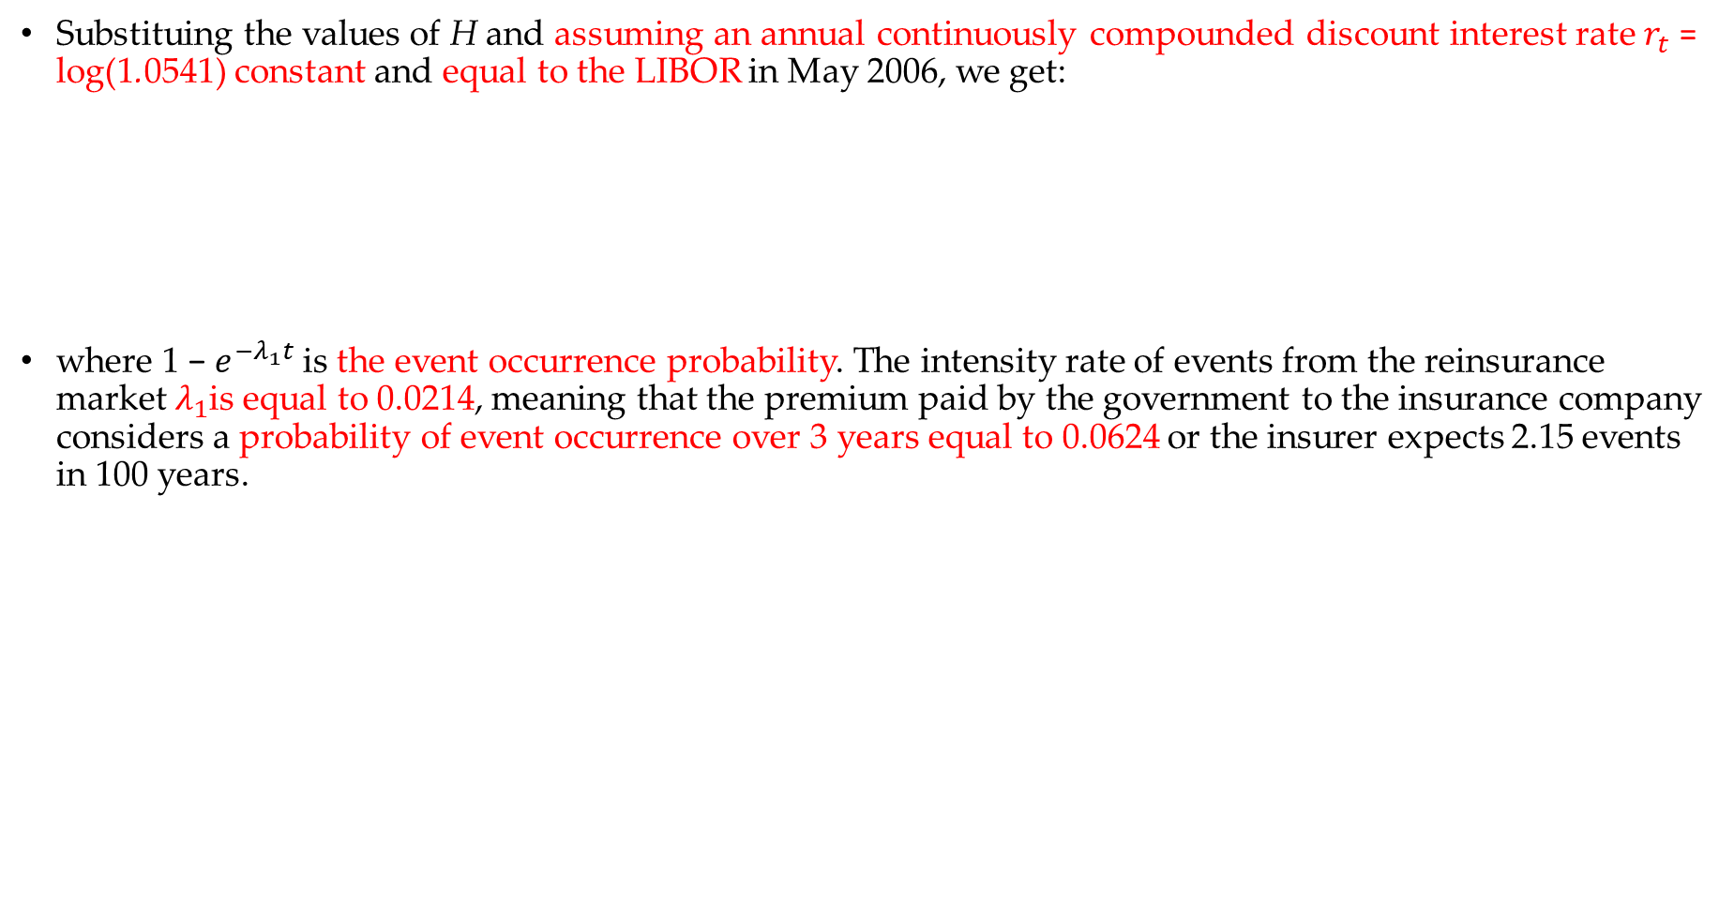
Substituing the values of H and assuming an annual continuously compounded discount interest rate $r_{t}$ = log(1.0541) constant and equal to the LIBOR in May 2006, we get:
where 1 − $e^{−λ_{1}t}$ is the event occurrence probability. The intensity rate of events from the reinsurance market $λ_{1}$is equal to 0.0214, meaning that the premium paid by the government to the insurance company considers a probability of event occurrence over 3 years equal to 0.0624 or the insurer expects 2.15 events in 100 years.

Slide 14
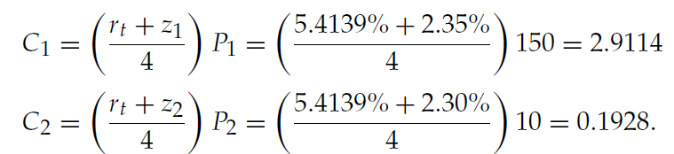
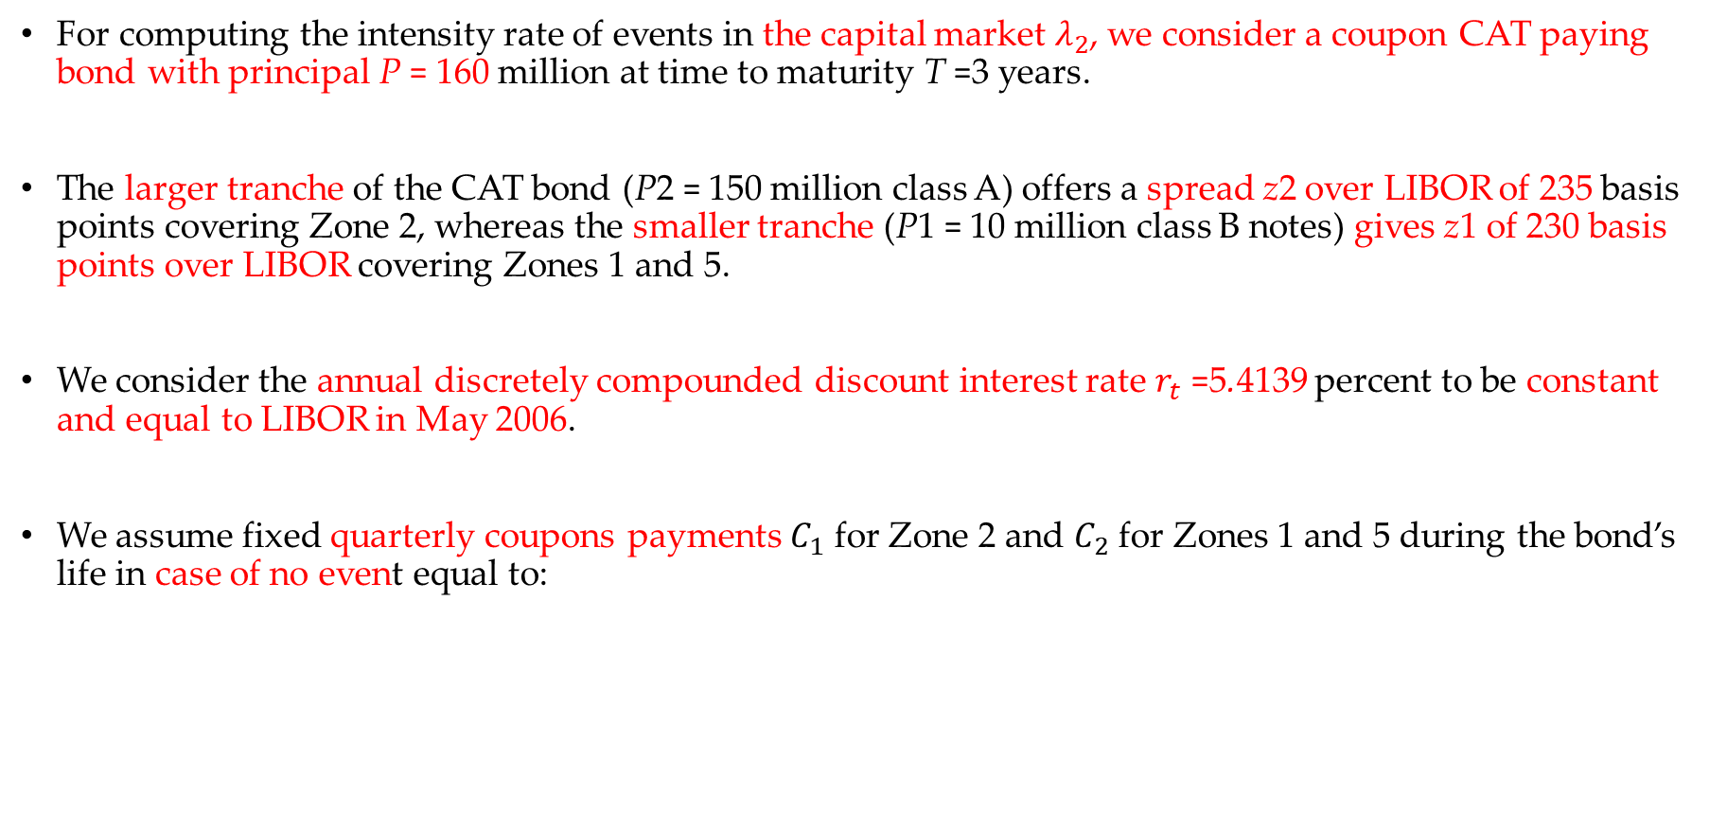
Calibration in the capital market
For computing the intensity rate of events in the capital market $λ_{2}$, we consider a coupon CAT paying bond with principal P = 160 million at time to maturity T =3 years.
The larger tranche of the CAT bond (P2 = 150 million class A) offers a spread z2 over LIBOR of 235 basis points covering Zone 2, whereas the smaller tranche (P1 = 10 million class B notes) gives z1 of 230 basis points over LIBOR covering Zones 1 and 5.
We consider the annual discretely compounded discount interest rate $r_{t}$ =5.4139 percent to be constant and equal to LIBOR in May 2006.
We assume fixed quarterly coupons payments $C_{1}$ for Zone 2 and $C_{2}$ for Zones 1 and 5 during the bond’s life in case of no event equal to:

Slide 15
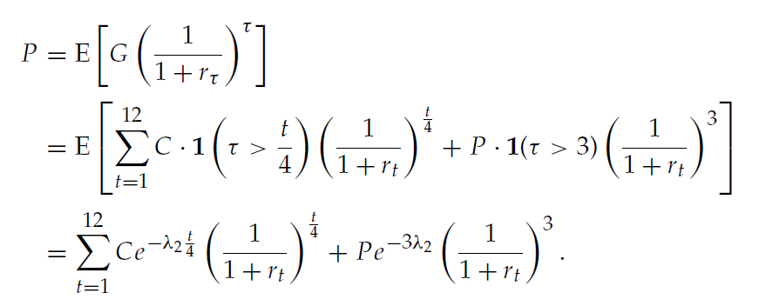

Since the coupons of each insured area are independent of each other, the total value of coupon payments is C = $C_{1}+C_{2}$ = 3.1043.
Assume that the arrival process of earthquakes that trigger the bond follows an HPP with intensity $λ_{2}$. Let G be a random variable defining the investors’ payoff betting that a trigger event will not occur in Zone 2 or Zones 1 and Zone 5.
Under the risk-neutral pricing measure, the discretely discount fair bond price at time t = 0 is given by

Slide 16
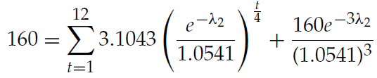

Substituting the values of the principal P = 160 million and the coupons C = 3.1043 million , it follows:
Solving the equation, the intensity rate of events from the capital market $λ_{2}$ is equal to 0.0241. In other words, the capital market estimates a probability of occurrence of an event equal to 0.0699, equivalently to 2.4 events in 100 years.

Slide 17
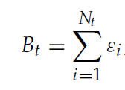
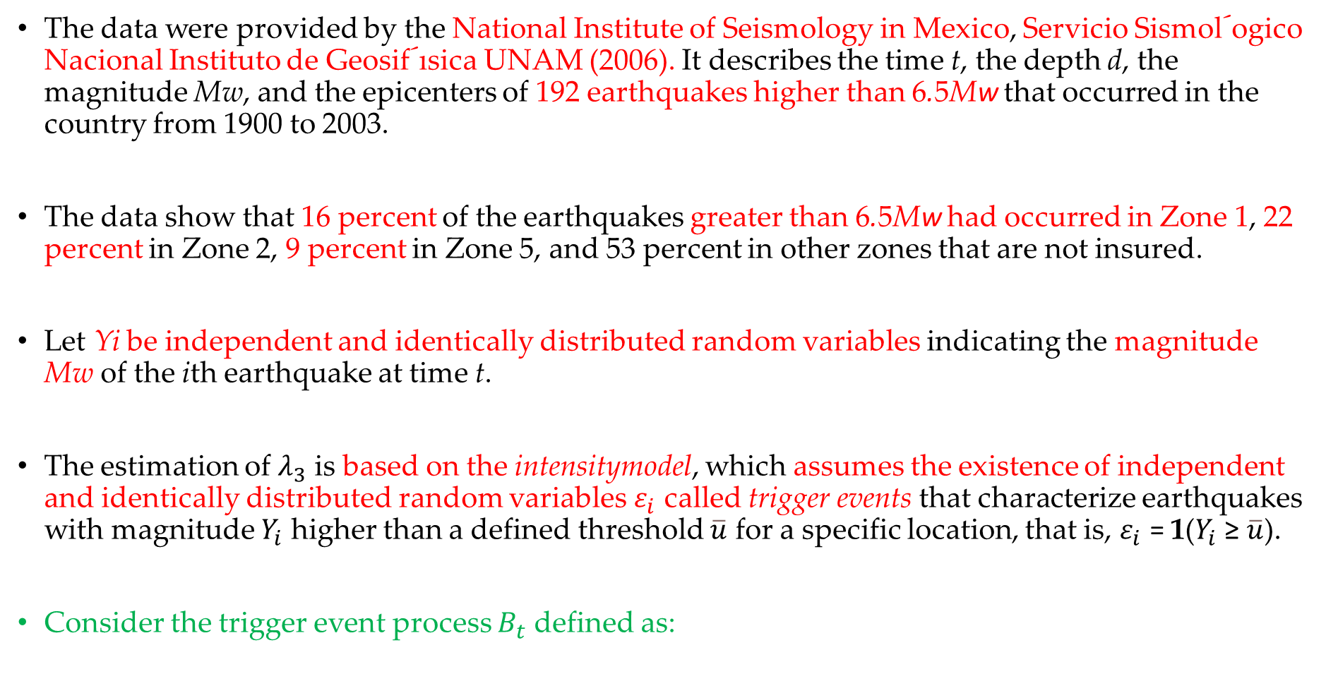
Calibration via historical data
The data were provided by the National Institute of Seismology in Mexico, Servicio Sismol´ogico Nacional Instituto de Geosif´ısica UNAM (2006). It describes the time t, the depth d, the magnitude Mw, and the epicenters of 192 earthquakes higher than 6.5Mw that occurred in the country from 1900 to 2003.
The data show that 16 percent of the earthquakes greater than 6.5Mw had occurred in Zone 1, 22 percent in Zone 2, 9 percent in Zone 5, and 53 percent in other zones that are not insured.
Let Yi be independent and identically distributed random variables indicating the magnitude Mw of the ith earthquake at time t.
The estimation of $λ_{3}$ is based on the intensitymodel, which assumes the existence of independent and identically distributed random variables $ε_{i}$ called trigger events that characterize earthquakes with magnitude $Y_{i}$ higher than a defined threshold $\overline{u}$ for a specific location, that is, $ε_{i}$ = 1($Y_{i}$ ≥ $\overline{u}$).
Consider the trigger event process $B_{t}$ defined as:

Slide 18
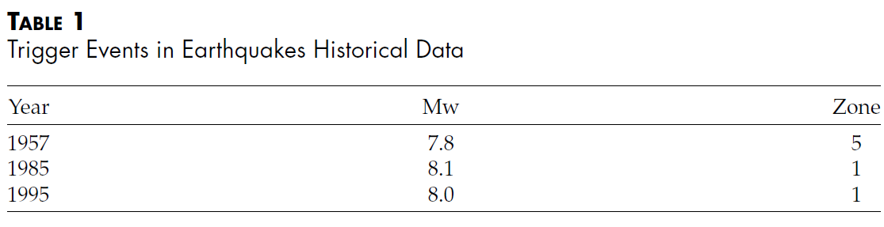
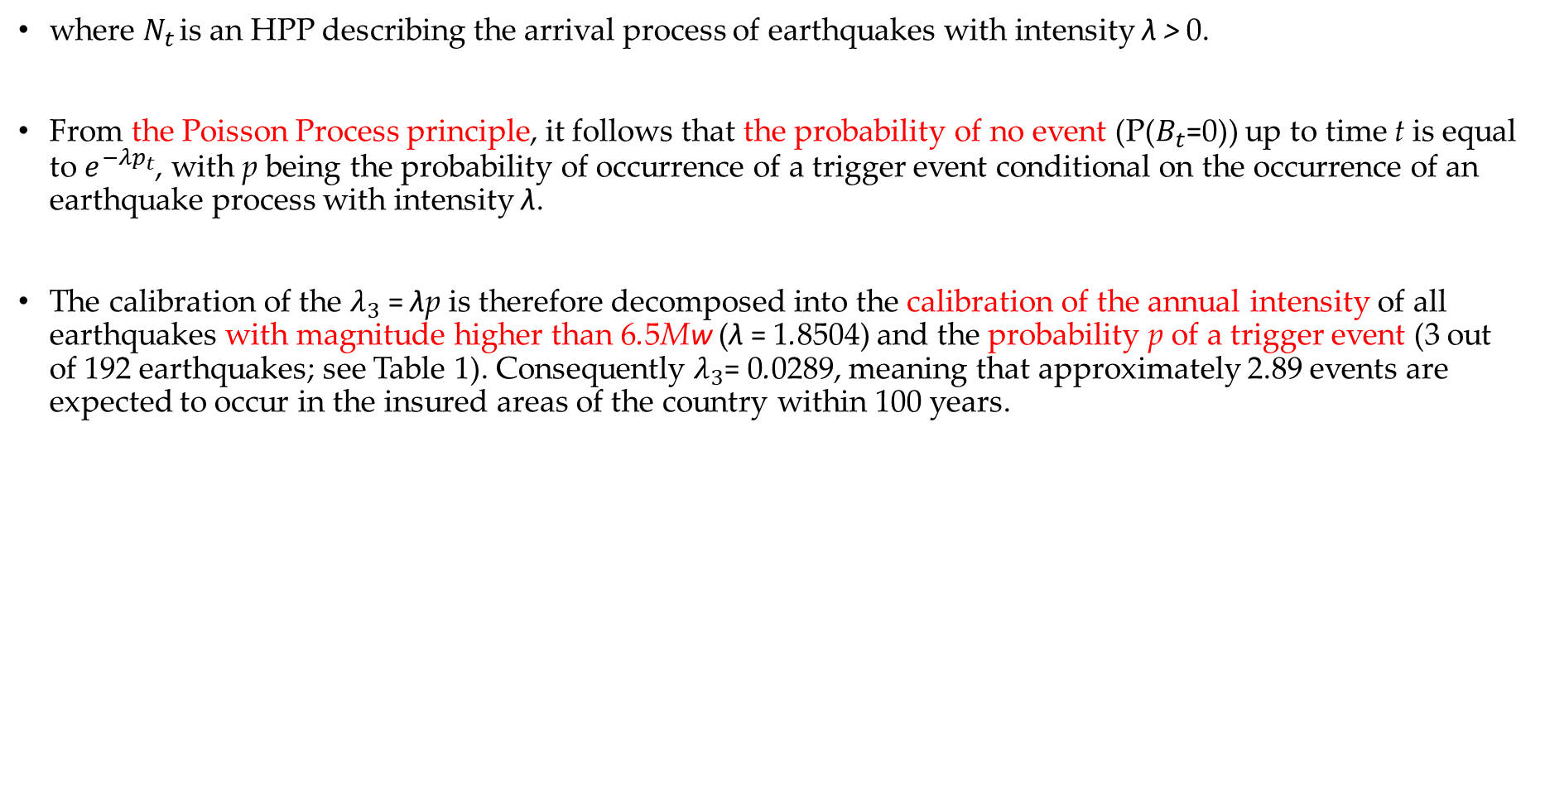
where $N_{t }$is an HPP describing the arrival process of earthquakes with intensity λ > 0.
From the Poisson Process principle, it follows that the probability of no event (P($B_{t}$=0)) up to time t is equal to $e^{−λp_{t}}$, with p being the probability of occurrence of a trigger event conditional on the occurrence of an earthquake process with intensity λ.
The calibration of the $λ_{3}$ = λp is therefore decomposed into the calibration of the annual intensity of all earthquakes with magnitude higher than 6.5Mw (λ = 1.8504) and the probability p of a trigger event (3 out of 192 earthquakes; see Table 1). Consequently $λ_{3}$= 0.0289, meaning that approximately 2.89 events are expected to occur in the insured areas of the country within 100 years.

Slide 19
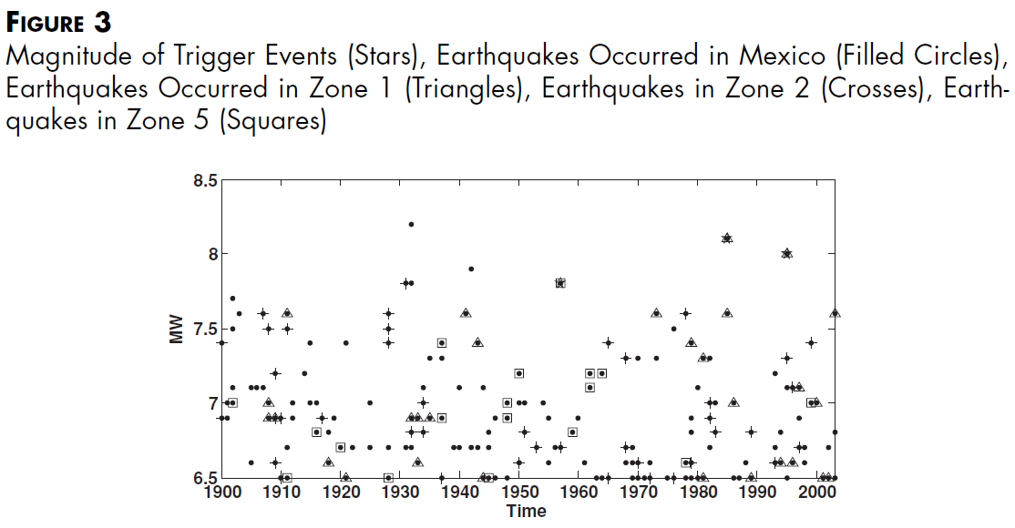
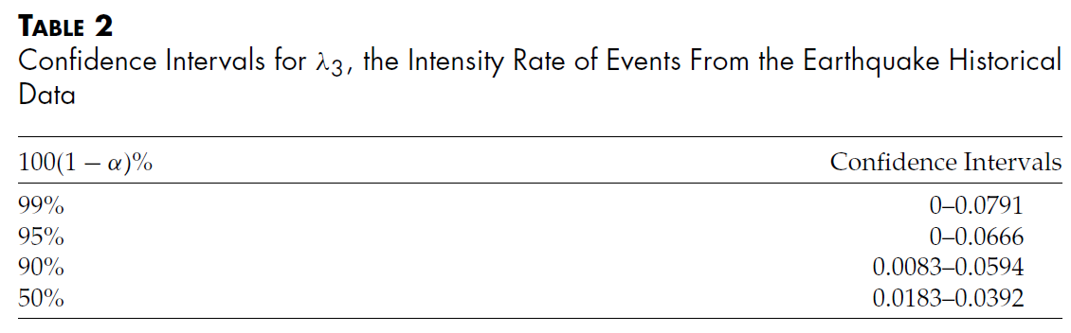

Table 2 displays the confidence intervals for $λ_{3}$ , which are very large since the value of $λ_{3}$ depends on the time period of the historical data and the number of trigger events.
Figure 3 shows the magnitude of earthquakes above 6.5Mw and trigger events that occurred in Mexico during 1900 to 2003.

Slide 20
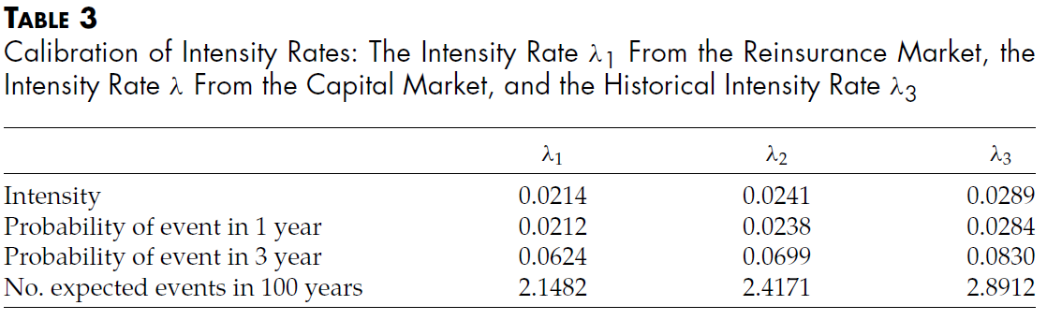
Table 3 summarizes the values of the intensity rates λ and the probabilities of occurrence of a trigger event in 1 and 3 years.
Whereas the reinsurance market expects approximately 2.15 events to occur in 100 years, the capital market anticipates 2.42 events and the historical data predict 2.89 events

Slide 21
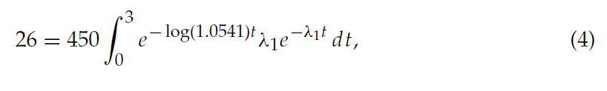
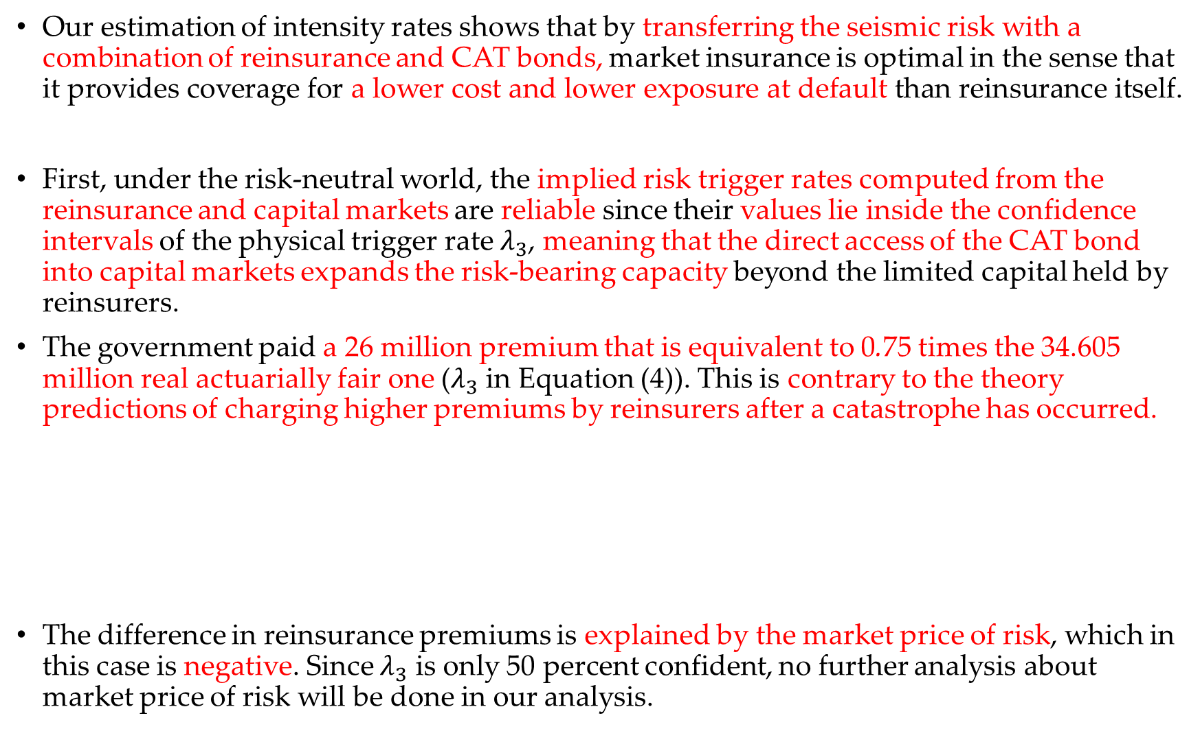
Our estimation of intensity rates shows that by transferring the seismic risk with a combination of reinsurance and CAT bonds, market insurance is optimal in the sense that it provides coverage for a lower cost and lower exposure at default than reinsurance itself.
First, under the risk-neutral world, the implied risk trigger rates computed from the reinsurance and capital markets are reliable since their values lie inside the confidence intervals of the physical trigger rate $λ_{3}$, meaning that the direct access of the CAT bond into capital markets expands the risk-bearing capacity beyond the limited capital held by reinsurers.
The government paid a 26 million premium that is equivalent to 0.75 times the 34.605 million real actuarially fair one ($λ_{3}$ in Equation (4)). This is contrary to the theory predictions of charging higher premiums by reinsurers after a catastrophe has occurred.
The difference in reinsurance premiums is explained by the market price of risk, which in this case is negative. Since $λ_{3}$ is only 50 percent confident, no further analysis about market price of risk will be done in our analysis.

Slide 22
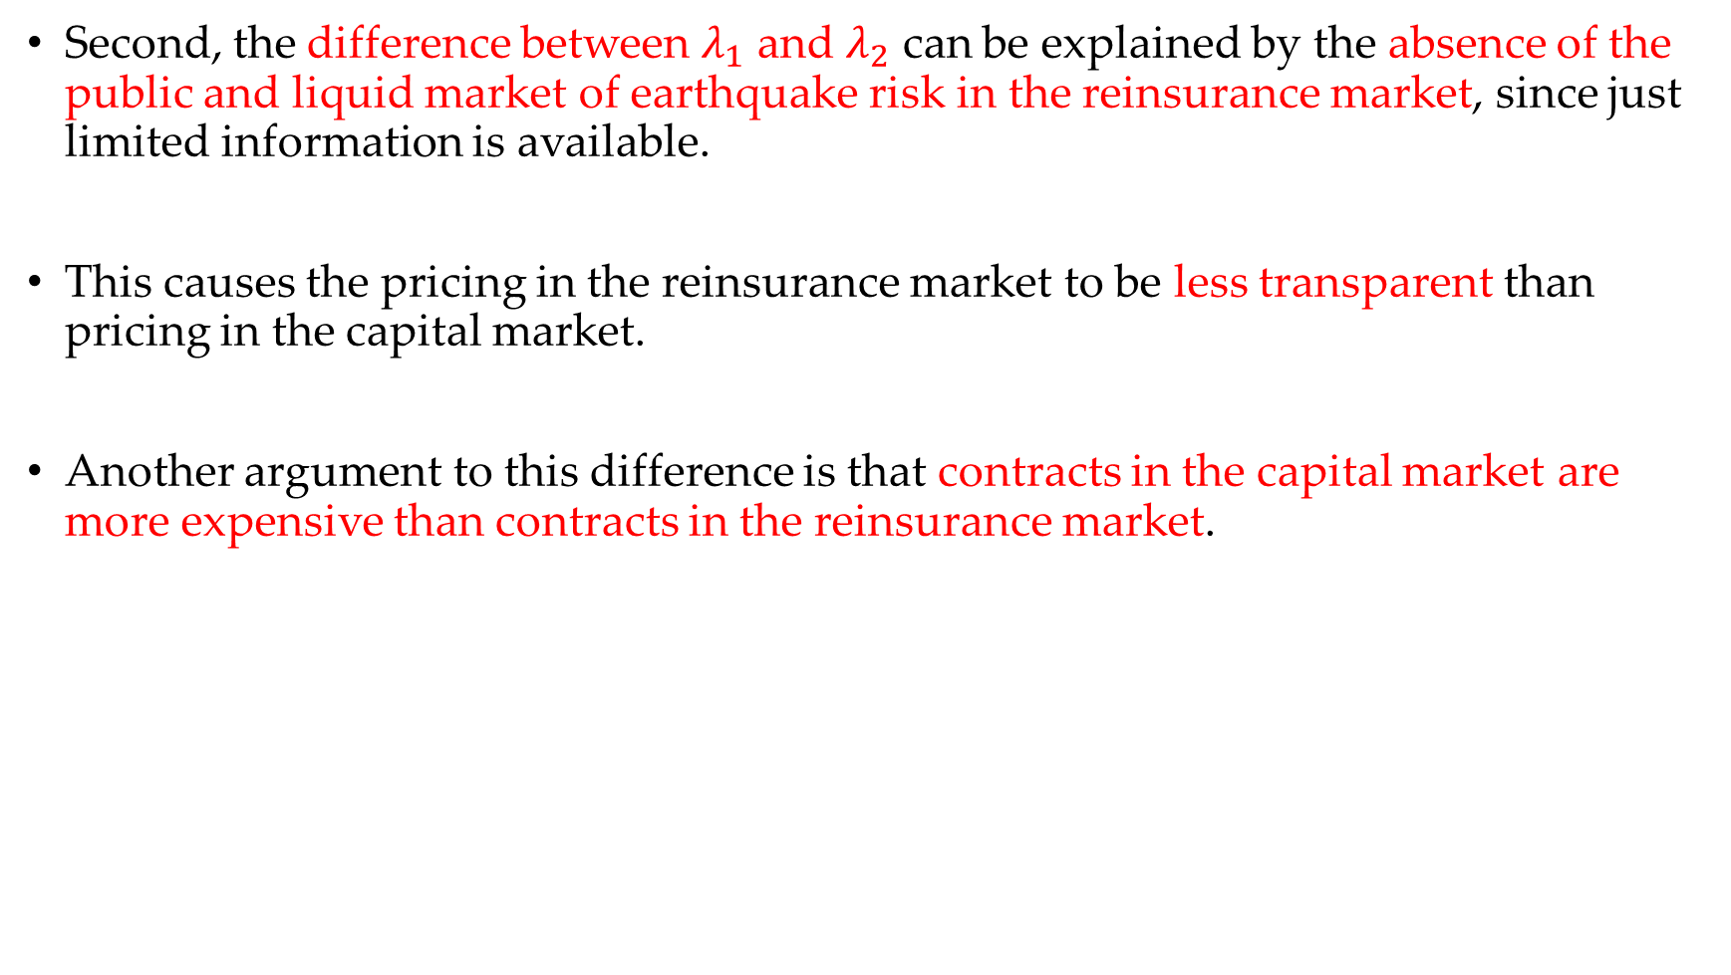
Second, the difference between $λ_{1}$ and $λ_{2}$ can be explained by the absence of the public and liquid market of earthquake risk in the reinsurance market, since just limited information is available.
This causes the pricing in the reinsurance market to be less transparent than pricing in the capital market.
Another argument to this difference is that contracts in the capital market are more expensive than contracts in the reinsurance market.

Slide 23
Since the insured loss faced by the government is independent of the state of insolvency of the reinsurer, our results indicate that the default probability of the reinsurer in this transaction over the next 3 years can be approximately equal to the price discount that the government gets for transferring the earthquake risk from the reinsurance market to the capital market.
In other words, the reinsurer default probability is implied by the relative difference of the premiums estimated in the reinsurance and the capital markets.
Finally, the mix of reinsurance and CAT bonds not only eliminates restrictions in the budget when considering interest payments but also protects and magnifies the resources of the trust.
However, this financial strategy does not eliminate completely the costs imposed by market imperfections.

