Slide 1
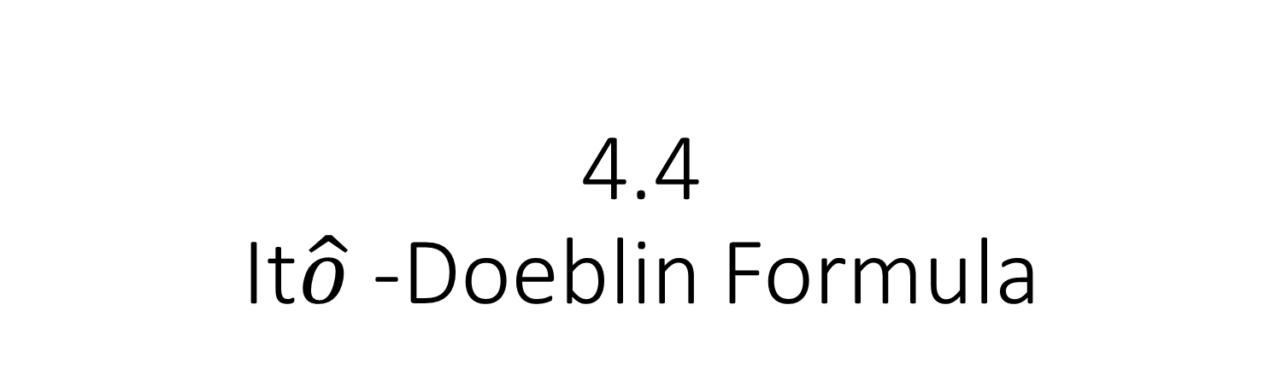
4.4 It$\hat{o}$ -Doeblin Formula

Slide 2
4.4.1 Formula for Brownian Motion
f(x) is a differentiable function,and W(t) is a Brownian motion.
If W(t) is also differentiable,then the chain rule from ordinary calculus
Which could be written in differential notation as

Slide 3
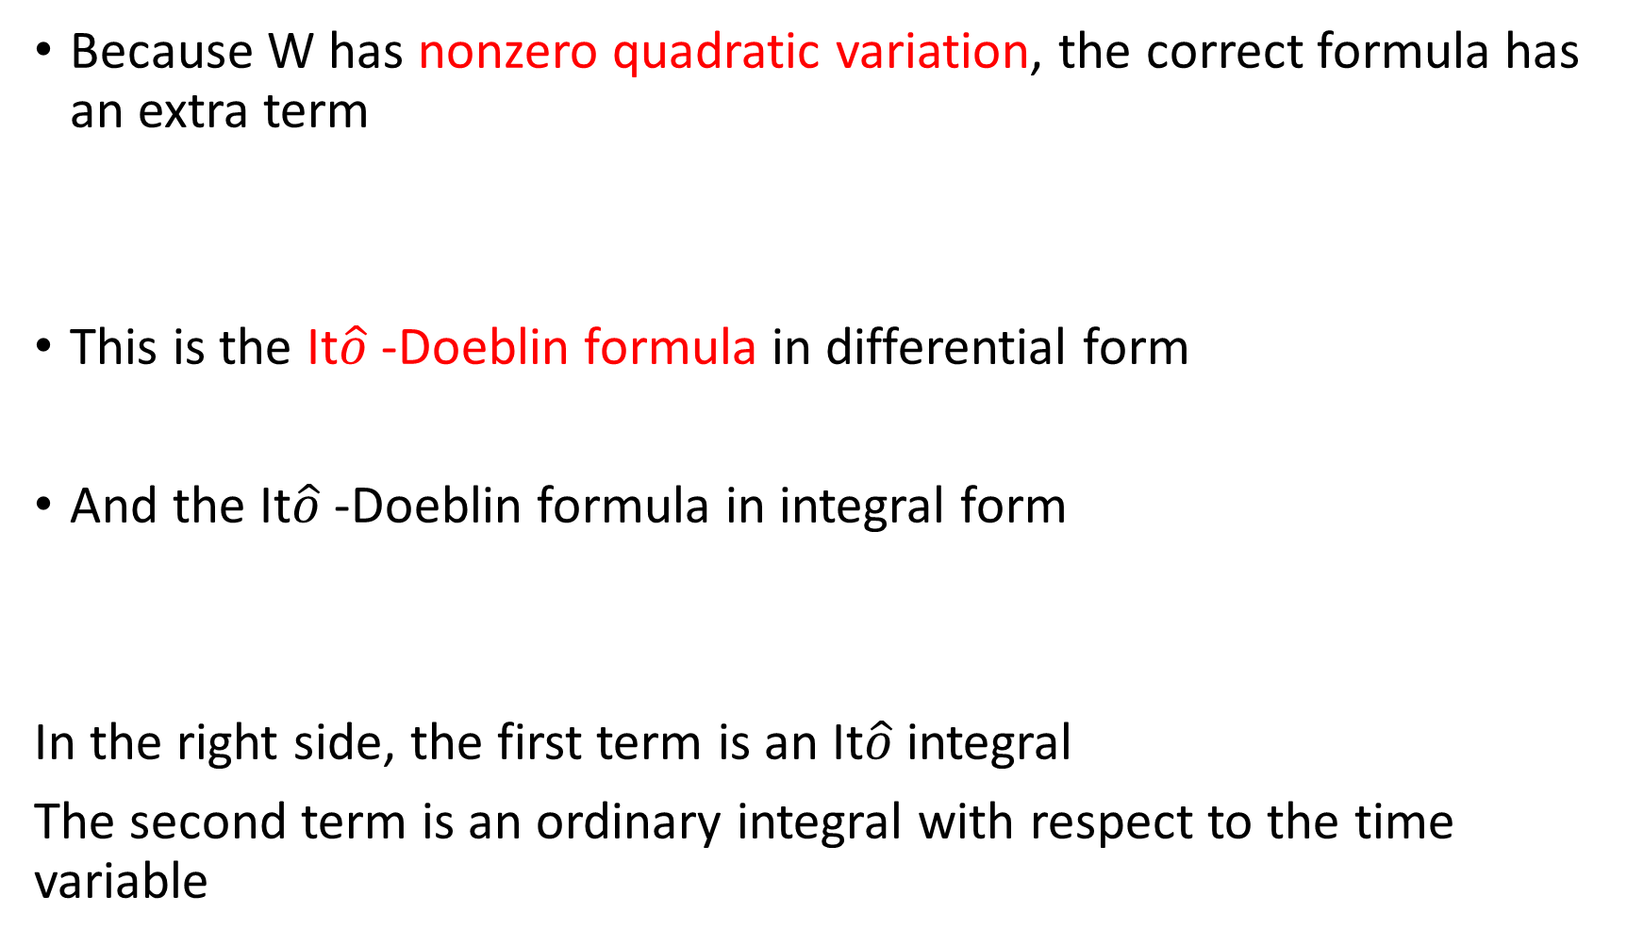
Because W has nonzero quadratic variation, the correct formula has an extra term
This is the It$\hat{o}$ -Doeblin formula in differential form
And the It$\hat{o}$ -Doeblin formula in integral form
In the right side, the first term is an It$\hat{o}$ integral
The second term is an ordinary integral with respect to the time variable

Slide 4

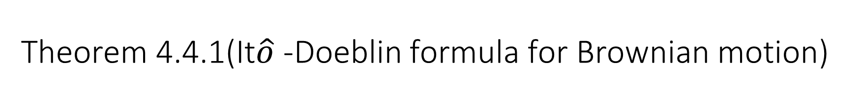
Theorem 4.4.1(It$\hat{o}$ -Doeblin formula for Brownian motion)
f(t,x) be a function for which the partial derivatives $f_{x}(t,x)$、 $f_{t}\left(t,x\right) 、f_{xx}\left(t,x\right)$ are defined and continuous, and let W(t) be a Brownian motion.
Then, for every T>=0

Slide 5
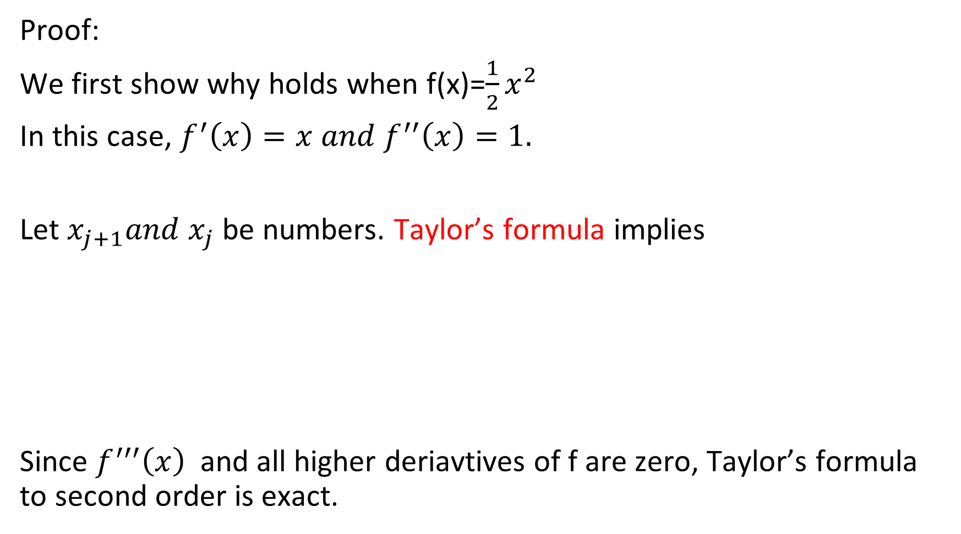
Theorem 4.4.1(It𝑜 ̂ -Doeblin formula for Brownian motion)
Proof:
We first show why holds when f(x)=$\frac{1}{2}x^{2}$
In this case, $f^{′}\left(x\right)=x and f^{′′}\left(x\right)=1.$
Let $x_{j+1}and x_{j}$ be numbers. Taylor’s formula implies
Since $f^{′′′}\left(x\right)$and all higher deriavtives of f are zero, Taylor’s formula to second order is exact.

Slide 6
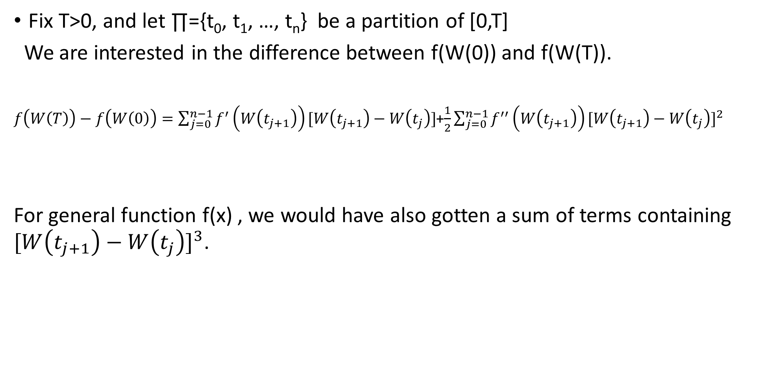
Theorem 4.4.1(It𝑜 ̂ -Doeblin formula for Brownian motion)
Fix T>0, and let ∏={t₀, t₁, …, t_{n}} be a partition of [0,T]
We are interested in the difference between f(W(0)) and f(W(T)).
$f\left(W\left(T\right)\right)−f\left(W\left(0\right)\right)=\sum_{j=0}^{n−1}{f^{′}\left(W\left(t_{j+1}\right)\right)[W\left(t_{j+1}\right)−W\left(t_{j}\right)]}$+$\frac{1}{2}\sum_{j=0}^{n−1}{f^{′′}\left(W\left(t_{j+1}\right)\right){[W\left(t_{j+1}\right)−W\left(t_{j}\right)]}^{2}}$
For general function f(x) , we would have also gotten a sum of terms containing ${[W\left(t_{j+1}\right)−W\left(t_{j}\right)]}^{3}$.
Since quadratic variation of Brownian motion is finite
Notes:
By Taylor’s formula, f(W(t))-f(W(0)) can be obtained by the summation of f(W(t j+1))-f(W(t j))

Slide 7
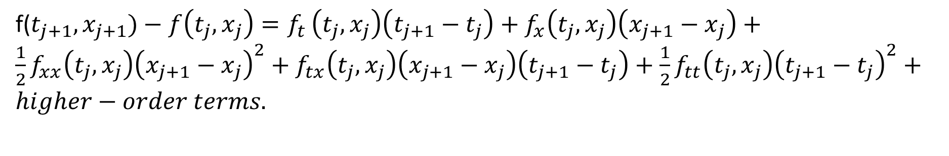
If we take a function f(t,x) of both the time variable t and the variable x, then Taylor’s Theorem says that
f($t_{j+1},x_{j+1})−f\left(t_{j},x_{j}\right)=f_{t }\left(t_{j},x_{j}\right)\left(t_{j+1}−t_{j}\right)+f_{x}\left(t_{j},x_{j}\right)\left(x_{j+1}−x_{j}\right)+\frac{1}{2}f_{xx}\left(t_{j},x_{j}\right){\left(x_{j+1}−x_{j}\right)}^{2}+f_{tx}\left(t_{j},x_{j}\right)\left(x_{j+1}−x_{j}\right)\left(t_{j+1}−t_{j}\right)+\frac{1}{2}f_{tt}\left(t_{j},x_{j}\right){\left(t_{j+1}−t_{j}\right)}^{2}+higher−order terms.$

Slide 8

We replace $x_{j}$ by W($t_{j}), replace x_{j+1} by W\left(t_{j+1}\right), and sum:$

Slide 9

As $\left\|Π\right\|$→0
The first term of the right hand side:
The second term of the right hand side:
The third term of the right hand side:
We replace (W(t_{j+1})-W(t_{j}))² by t_{j+1}-tj (its not an exact substitution, but when we sum the terms this substitution gives the correct limit as ||∏||→0)

Slide 10

The forth and fifth terms contribute zero.
For the fourth term:
(4.4.10)
We should assume $f_{tx}$ is integrable

Slide 11

For the fifth term:
(4.4.11)
We should assume $f_{tt}$ is integrable.

Slide 12
Remark 4.4.2
The fact that the sum (4.4.10) of terms containing the product (t_{j+1}-t_{j})(W(t_{j+1})-W(t_{j})) has limit zero can be informally recorded by the formula dtdW(t)=0.
Similarly, the sum (4.4.11) of terms containing (t_{j+1}-t_{j})² also has limit zero, and this can be recorded by the formula dtdt=0.

Slide 13
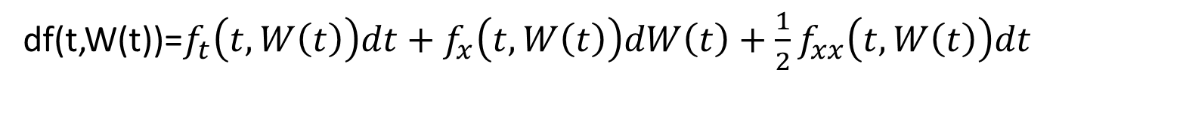
the Itô-Doeblin formula in differential form simplifies to
df(t,W(t))=$f_{t}\left(t,W\left(t\right)\right)dt+f_{x}\left(t,W\left(t\right)\right)dW\left(t\right)+\frac{1}{2}f_{xx}\left(t,W\left(t\right)\right)dt$

Slide 14
In Figure 4.4.1, the Taylor series approximation of the difference f(W(t_{j+1}))-f(W(t_{j})) for a function f(x) that does not depend on t.
The first-order approximation, which is f’(W(t_{j}))(W(t_{j+1})-W(t_{j})), has an error due to the convexity of the function f(x).
Most of this error is removed by adding in the second-order term ,which captures the curvature of the function f(x) at x=W(t_{j}).
Fig. 4.4.1 Taylor approximation to f(W(t_{j+1}))-f(W(t_{j}))

Slide 15
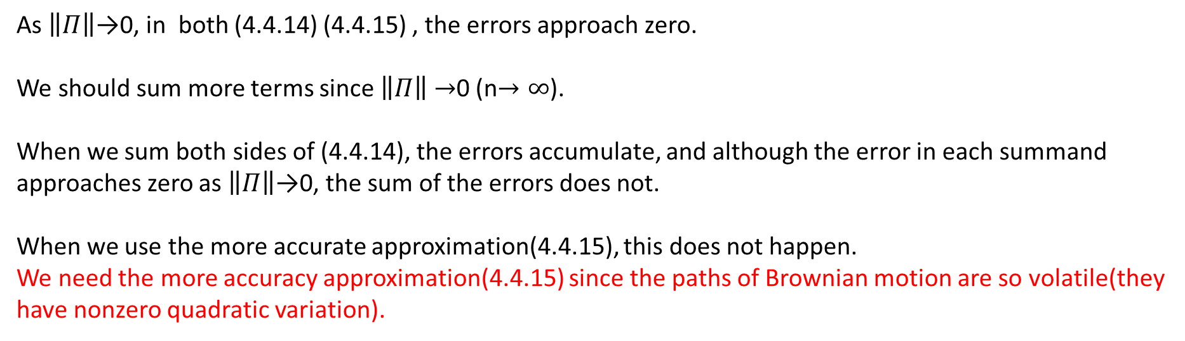
(4.4.14)
(4.4.15)
As $\left\|Π\right\|$→0, in both (4.4.14) (4.4.15) , the errors approach zero.
We should sum more terms since $\left\|Π\right\|$ $→$0 (n$→∞$).
When we sum both sides of (4.4.14), the errors accumulate, and although the error in each summand approaches zero as $\left\|Π\right\|$→0, the sum of the errors does not.
When we use the more accurate approximation(4.4.15), this does not happen.
We need the more accuracy approximation(4.4.15) since the paths of Brownian motion are so volatile(they have nonzero quadratic variation).

Slide 16
4.4.2 Formula for Itô Processes
We extend the Itô-Doeblin formula to stochastic processes more general than Brownian motion.
Almost all stochastic processes, except those that have jumps, are Itô process.

Slide 17

Definition 4.4.3
Let W(t), t≥0, be a Brownian motion, and let F(t), t≥0, be an associated filtration. An Itô process is a stochastic process of the form
Where X(0) is nonrandom and Δ(u) and Θ(u) are adapted stochastic processes.
We assume that and are finite for every t>0 so that the integrals on the right-hand side of (4.4.16) are defined and the Itô integral is a martingale.
(4.4.16)
I$t\hat{o}$ isometry(Theorem 4.3.1(v))
Theorem 4.3.1(iv)

Slide 18
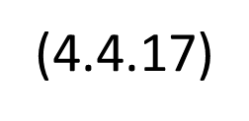
Lemma 4.4.4
The quadratic variation of the Itô process (4.4.16) is

Slide 19
Proof of Lemma 4.4.4
We introduce the notation
Both these processes are continuous in their upper limit of integration t.
To determine the quadratic variation of X on [0,t], we choose a partition ∏={t₀,t₁,…,t_{n}} of [0,t] (i.e, 0=t₀<t₁<…<t_{n}=t) and we write the sampled quadratic variation

Slide 20

As $\left\|Π\right\|$→0, the first term on the right-hand side, converge to the quadratic variation of I on [0,t] which according to Theorem 4.3.1(vi).

Slide 21
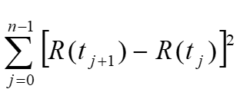

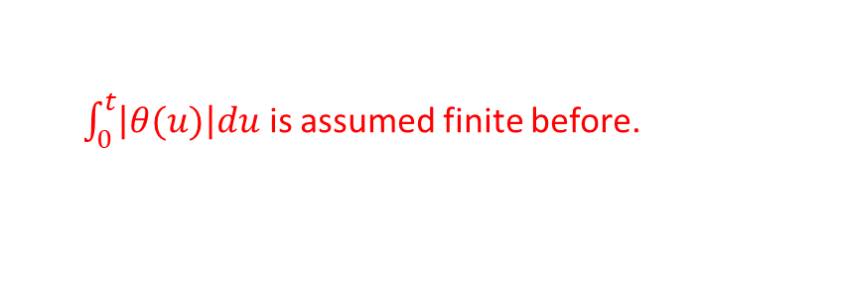
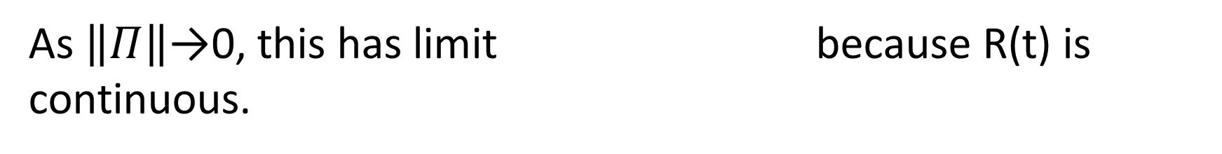
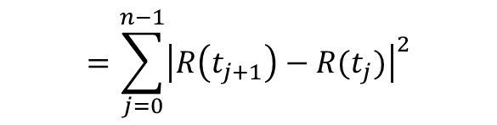
The absolute value of the second term is bounded above by
$$=\sum_{j=0}^{n−1}{{\left|R\left(t_{j+1}\right)−R(t_{j})\right|}^{2}}$$
$$≤$$
$\int_{0}^{t}{\left|θ(u)\right|du}$ is assumed finite before.
As $\left\|Π\right\|$→0, this has limit because R(t) is continuous.

Slide 22
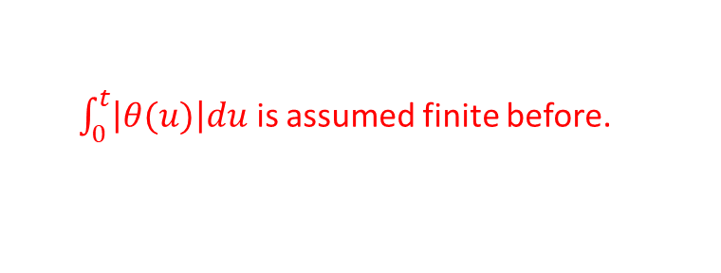

And this has limit $0∗\int_{0}^{t}{\left|θ(u)\right|du=0}$ as $\left\|Π\right\|$→0 because I(t) is continuous.
We conclude that
The absolute value of third term is bounded above by
$\int_{0}^{t}{\left|θ(u)\right|du}$ is assumed finite before.

Slide 23
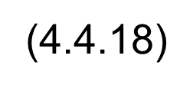
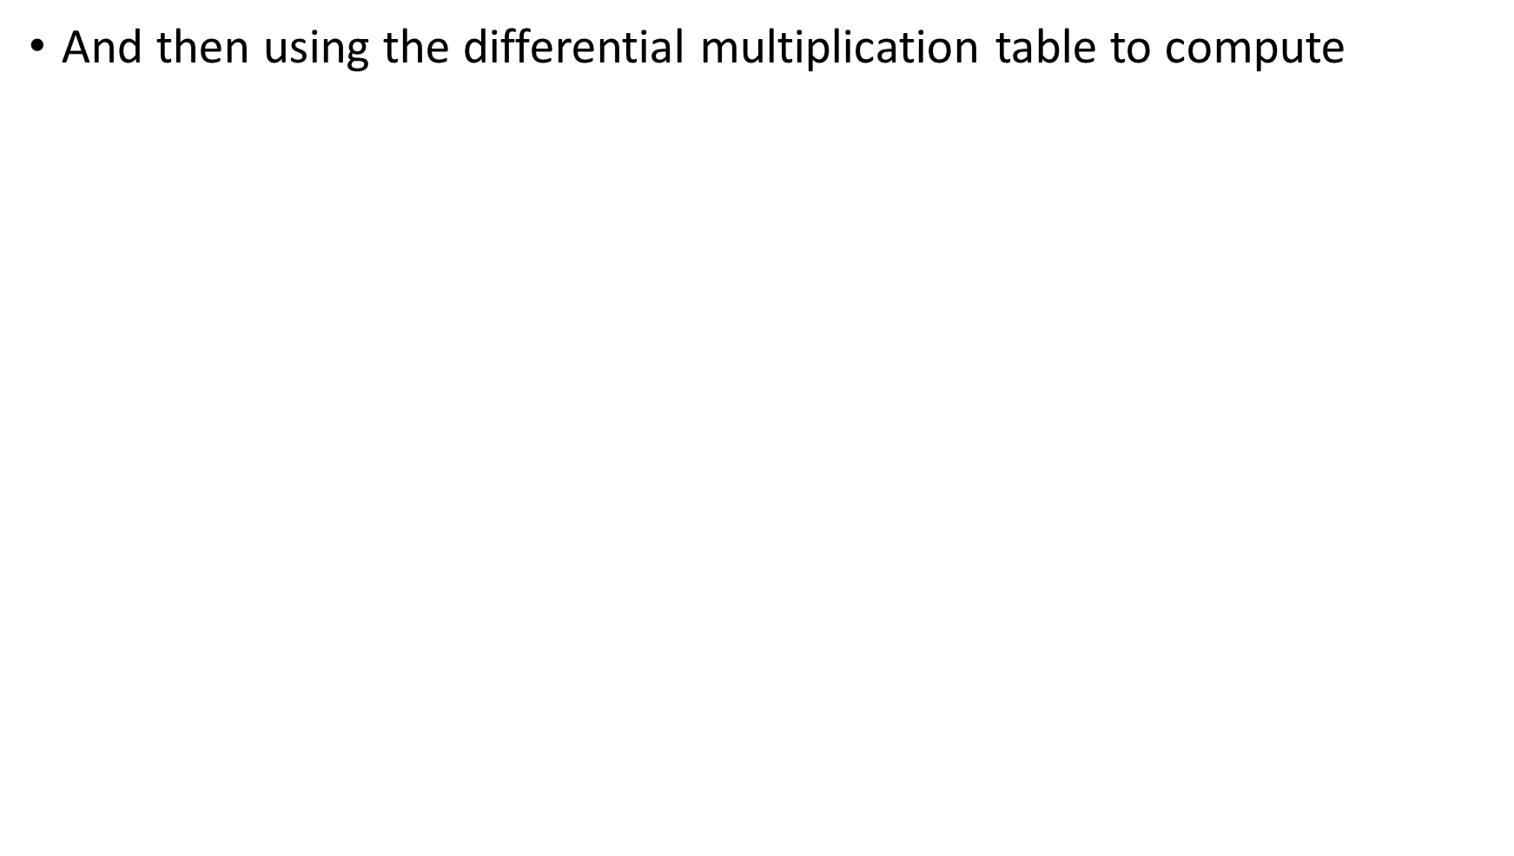
The conclusion of Lemma 4.4.4 is most easily remembered by first writing (4.4.16) in the differential notation

Slide 24
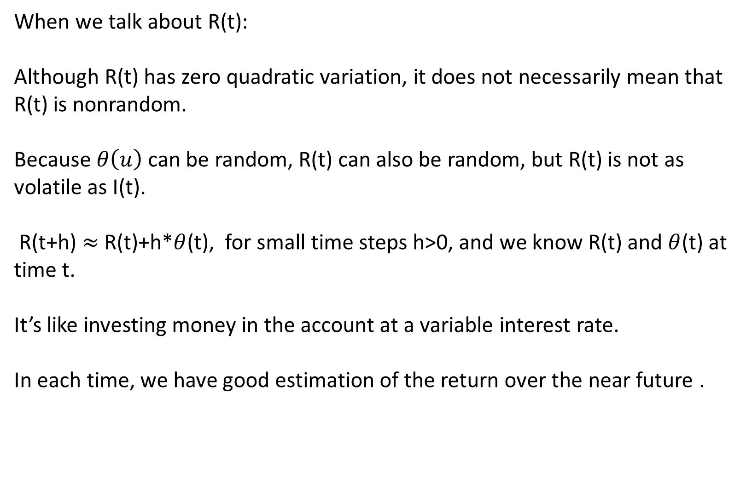
When we talk about R(t):
Although R(t) has zero quadratic variation, it does not necessarily mean that R(t) is nonrandom.
Because $θ\left(u\right)$ can be random, R(t) can also be random, but R(t) is not as volatile as I(t).
R(t+h) $≈$ R(t)+h*$θ$(t), for small time steps h>0, and we know R(t) and $θ$(t) at time t.
It’s like investing money in the account at a variable interest rate.
In each time, we have good estimation of the return over the near future .

Slide 25

When we talk about I(t):
I(t+h)$≈$ I(t)+$∆$(t)(W(t+h)-W(t)) for small time steps h>0.
Since (W(t+h)-W(t)) is independent increment, we don’t know (W(t+h)-W(t))
at time t.
This is like investing a stock.

