Slide 1
10/4 presentation

Slide 2
Arbitrage pricing theory(APT)
Vaugirard (2003) vindicates APT for CAT bonds based on the argument that continuous changes in the risk index can be mimicked by available instruments such as energy, power, and weather derivatives or contingent claims on certain commodities.
Muermann (2008) applies APT to CAT derivatives on a compound Poisson catastrophic loss process, which, under a martingale pricing measure characterized by Delbaen and Haezendonck (1989) and Aase (1992), is still a compound Poisson process but with severity and frequency both modified by the corresponding market prices of risk.
Jarrow (2010) applies APT to pricing CAT bonds. Assuming that the market for the LIBOR and CAT bonds is arbitrage free (martingale pricing measure exists), he obtains a closed-form solution for valuing CAT bonds following the pricing methodology based on the reduced-form models used to price credit derivatives.

Slide 3
Probability transform
Dates back to Venter (1991), who discovers that various pricing frameworks in insurance and finance are established under a risk-adjusted probability distribution.
Lane (2000)proposes a 3-parameter model to calculate risk premiums of CAT bonds by using the Cobb–Douglas function to link the probability of the first loss and the conditional expected loss.
Wang (1996, 2000, 2002, 2004) introduces a class of probability transforms including in particular the Wang transform (see relation (3.3) below) , and develops an insurance pricing framework using these transforms.
The Wang transform has been widely applied to price various kinds of ILS ; see Lin and Cox (2005, 2008), Denuit et al. (2007), Chen and Cox (2009), and Chen and Cummins (2010), among many others.

Slide 4
Econometric approach
An econometric approach to CAT bond pricing first identifies the factors that determine the bond premium and then uses the factors to price the bond.
Braun (2016) tests a number of hypotheses about the reliance of CAT bond spread on its rating class, reinsurance underwriting cycle, etc., and proposes an econometric model to price CAT bonds in the primary market.
Gürtler et al. (2016) use an econometric approach to examine whether and how financial crises and natural catastrophes affect CAT bond premiums and analyze which bond-specific and macroeconomic factors influence CAT bond premiums.
Stupfler and Yang (2018) apply an econometric approach to analyze the determining factors of the CAT bond premium.

Slide 5
Indifference pricing
This approach can be understood as an extension of the certainty equivalence principle to more general and possibly dynamic settings. It aims to find an agent’s bid and ask indifference prices according to his/her risk preference described by a utility function.
The bid indifference price, for example, is the price at which he/she is indifferent, in terms of his/her expected utility of the optimal terminal wealth, between investing and not investing in this particular security.
Under dynamic settings, the prices are usually obtained in an implicit form as solutions to partial differential equations.
Its first introduction by Hodges and Neuberger (1989), indifference pricing approach has been widely used in the literature of pricing in incomplete markets. For example, Egami and Young (2008), Barrieu and Loubergé (2009), and Leobacher and Ngare (2016) for recent applications to pricing CAT bonds and derivatives.

Slide 6
Two-step valuation
For a security that involves both financial and insurance risks, under a dynamic setting Pelsser and Stadje (2014) aim to identify its price that is both market consistent and time consistent.
The two-step approach combines financial pricing with actuarial valuation, by first valuating, based on an actuarial premium principle, the security conditional on the future development of the financial risks, and then taking an expectation of the value under a financial-risk adjusted probability measure.
Dhaene et al. (2017) also investigate the two-step valuation approach in an adapted version and show that their classes of fair valuations, hedge-based valuations, and two-step valuations are identical.

Slide 7
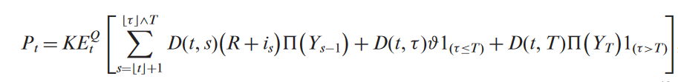



Pricing
Express the price of the Cat bond as the expectation, under a certain pricing measure, of the discounted values of cash flows, conditional on the available information about the development of the trigger and the performance of the financial market.
Where

Slide 8
Advantage:
It enables us to price securities that contain not only a terminal payoff but also intermediate payments.
Like APT, the pricing formula expressed as the conditional expectation under a pricing measure Q is automatically time consistent, while time inconsistency is often an issue in many other pricing frameworks in incomplete markets.

Slide 9
A perfect replication of CAT bond is hard to come by. This means that, usually, CAT bonds cannot be simply priced in terms of assets already traded and priced in the market.
The authors instead develop a hybrid pricing framework in which the probability transform approach is employed to price the underlying catastrophe risks and the APT approach is employed to price the interest rate risk.
Because the floating coupons are linked to a reference rate, CAT bonds are subject to minimum interest rate risk, but it is hard to argue that there is no interest rate risk at all.

Slide 10
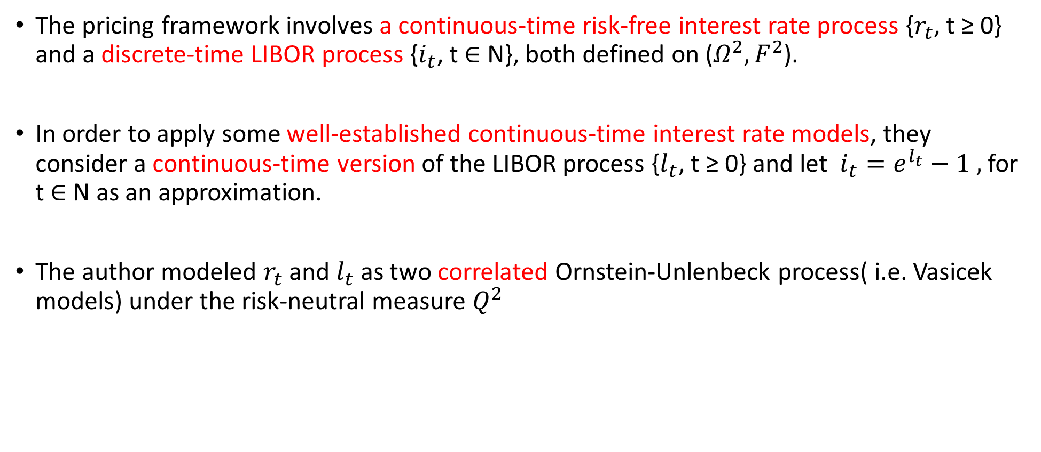
Appendix
The pricing framework involves a continuous-time risk-free interest rate process {$r_{t}$, t ≥ 0} and a discrete-time LIBOR process {$i_{t}$, t ∈ N}, both defined on ($Ω^{2},F^{2}$).
In order to apply some well-established continuous-time interest rate models, they consider a continuous-time version of the LIBOR process {$l_{t}$, t ≥ 0} and let $i_{t}=e^{l_{t}}−1 ,$for t ∈ N as an approximation.
The author modeled $r_{t}$ and $l_{t}$ as two correlated Ornstein-Unlenbeck process( i.e. Vasicek models) under the risk-neutral measure $Q^{2}$

Slide 11

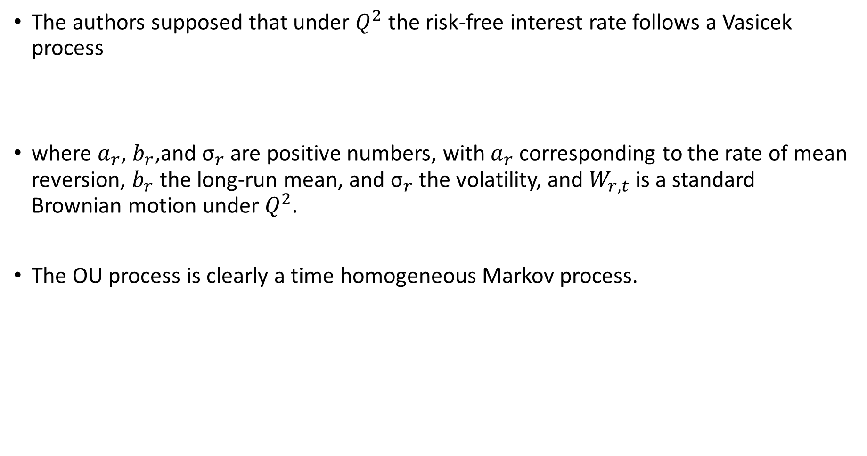
The authors supposed that under $Q^{2}$ the risk-free interest rate follows a Vasicek process
where $a_{r}$, $b_{r}$,and ${\text{σ}}_{r}$ are positive numbers, with $a_{r}$ corresponding to the rate of mean reversion, $b_{r}$ the long-run mean, and ${\text{σ}}_{r}$ the volatility, and $W_{r,t}$ is a standard Brownian motion under $Q^{2}$.
The OU process is clearly a time homogeneous Markov process.

Slide 12


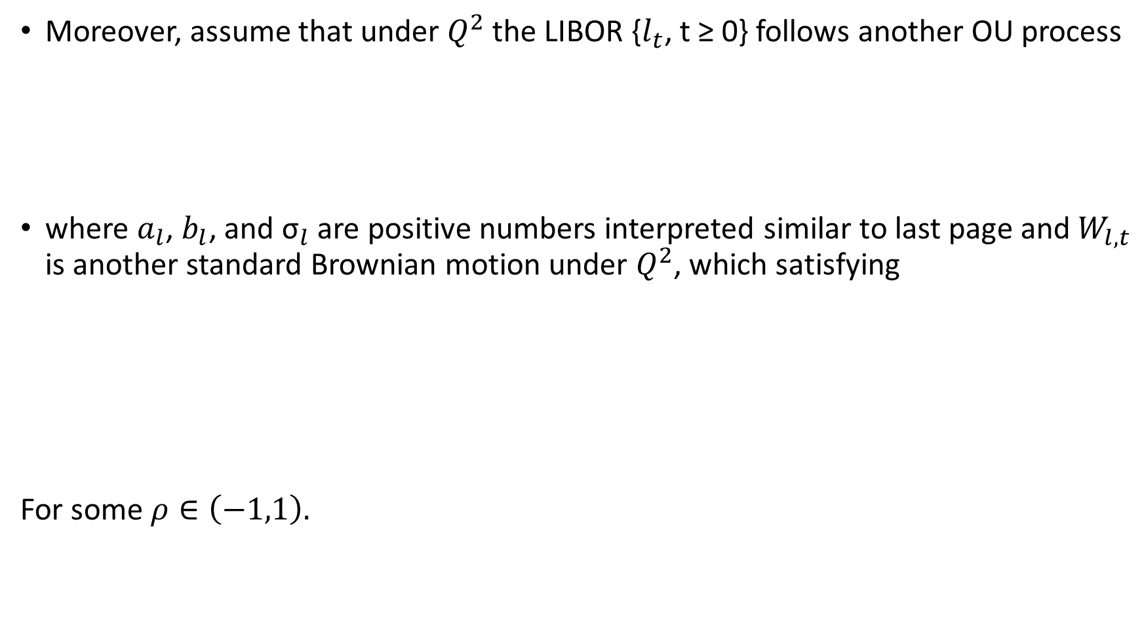
Moreover, assume that under $Q^{2}$ the LIBOR {$l_{t}$, t ≥ 0} follows another OU process
where $a_{l}$, $b_{l}$, and ${\text{σ}}_{l}$ are positive numbers interpreted similar to last page and $W_{l,t}$ is another standard Brownian motion under $Q^{2}$, which satisfying
For some $ρ∈\left(−1,1\right).$

