Slide 1
3.6 First Passage Time Distribution
Author: Eric Hsu

Slide 2
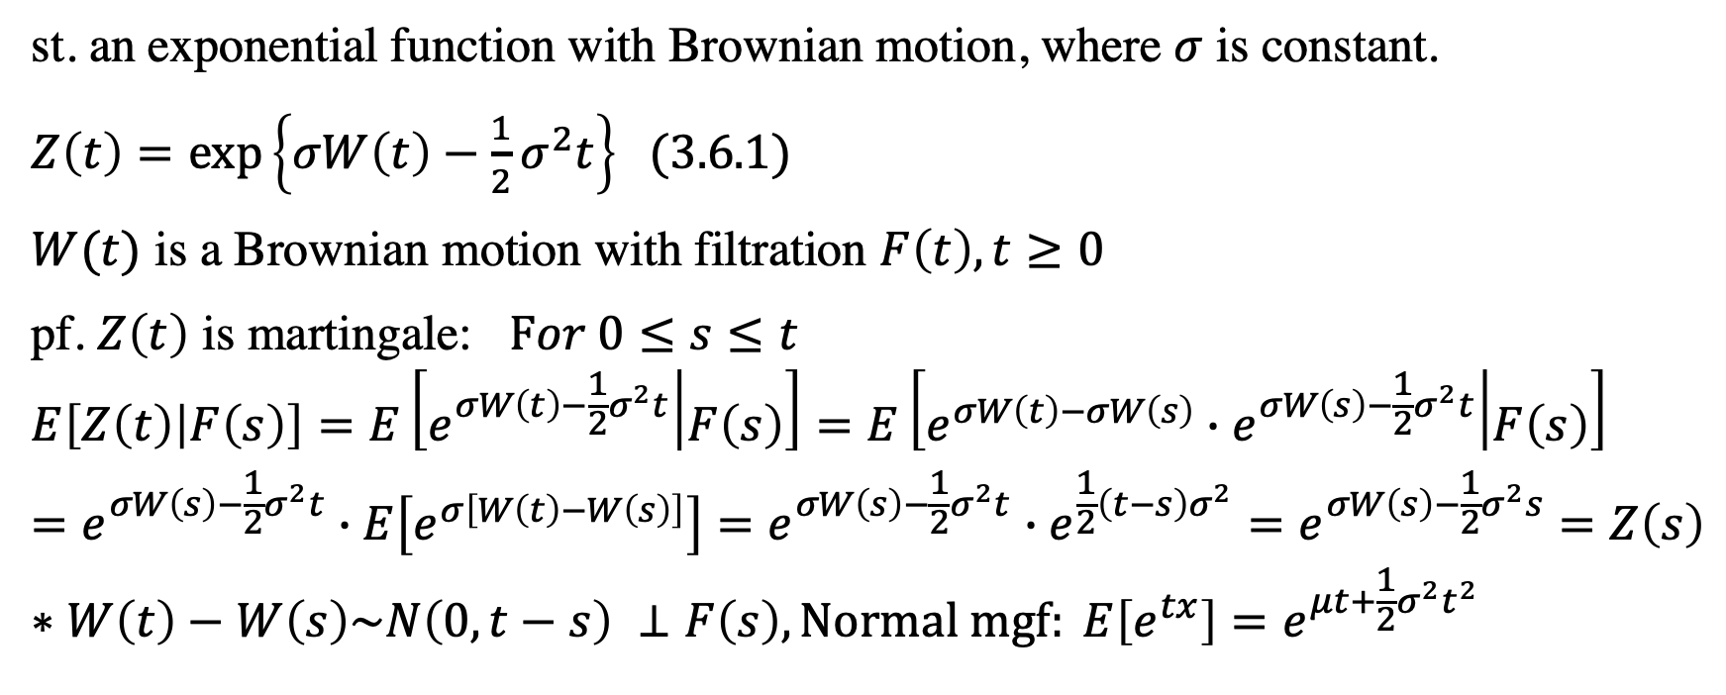
Theorem 3.6.1 Exponential Martingale
st. an exponential function with Brownian motion, where $σ$ is constant.
$Z\left(t\right)=\exp\left\{σW\left(t\right)−\frac{1}{2}σ^{2}t\right\}$ (3.6.1)
$W(t)$ is a Brownian motion with filtration $F\left(t\right), t≥0$
pf. $Z\left(t\right)$ is martingale: $For 0≤s≤t$
$$E\left[Z\left(t\right) | F\left(s\right)\right]=E\left[e^{σW\left(t\right)−\frac{1}{2}σ^{2}t} | F\left(s\right)\right]=E\left[e^{σW\left(t\right)−σW\left(s\right)}∙e^{σW\left(s\right)−\frac{1}{2}σ^{2}t} | F\left(s\right)\right]=e^{σW\left(s\right)−\frac{1}{2}σ^{2}t}∙E\left[e^{σ\left[W\left(t\right)−W\left(s\right)\right]}\right]=e^{σW\left(s\right)−\frac{1}{2}σ^{2}t}∙e^{\frac{1}{2}\left(t−s\right)σ^{2}}=e^{σW\left(s\right)−\frac{1}{2}σ^{2}s}=Z\left(s\right)$$
$$∗W\left(t\right)−W\left(s\right)\sim N\left(0,t−s\right) ⊥F\left(s\right), \text{Normal} \text{mgf}: E\left[e^{tx}\right]=e^{μt+\frac{1}{2}σ^{2}t^{2}}$$

Slide 3
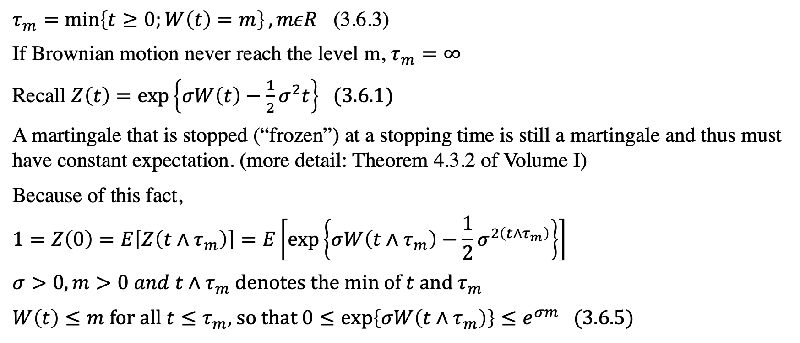
Define the Frist Passage Time
$τ_{m}=\min\left\{t≥0;W\left(t\right)=m\right\}, mεR$ (3.6.3)
If Brownian motion never reach the level m, $τ_{m}=∞$
Recall $Z\left(t\right)=\exp\left\{σW\left(t\right)−\frac{1}{2}σ^{2}t\right\}$ (3.6.1)
A martingale that is stopped (“frozen”) at a stopping time is still a martingale and thus must have constant expectation. (more detail: Theorem 4.3.2 of Volume I)
Because of this fact,
$$1=Z\left(0\right)=E\left[Z\left(t∧τ_{m}\right)\right]=E\left[\exp\left\{σW\left(t∧τ_{m}\right)−\frac{1}{2}σ^{2\left(t∧τ_{m}\right)}\right\}\right]$$
$σ>0, m>0 and t∧τ_{m}$ denotes the min of $t$ and $τ_{m}$
$W\left(t\right)≤m$ for all $t≤τ_{m}$, so that $0≤\exp\left\{σW\left({t∧τ}_{m}\right)\right\}≤e^{σm}$ (3.6.5)

Slide 4
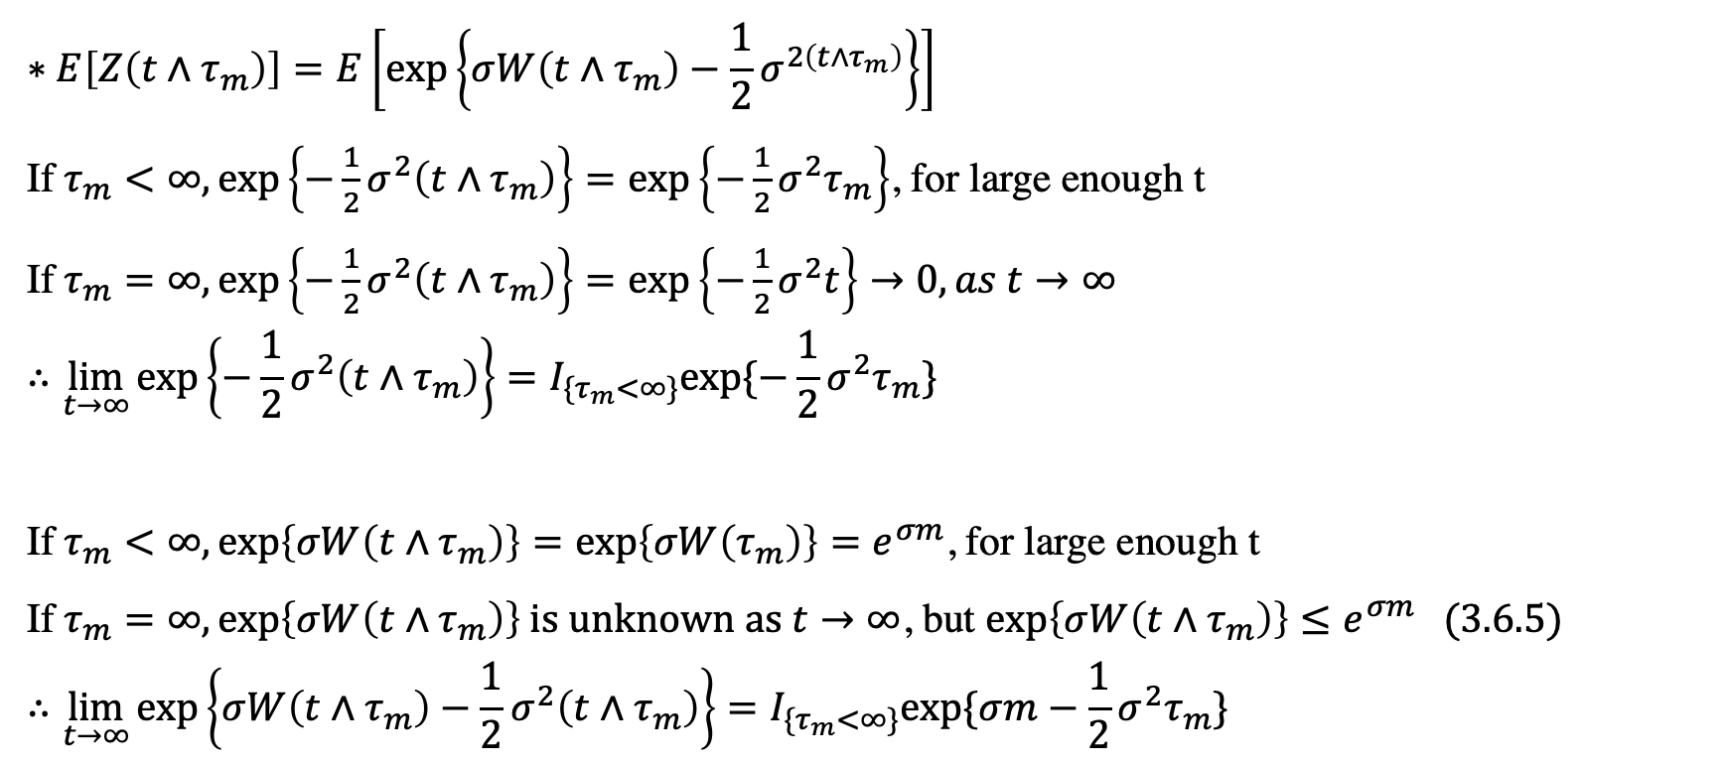
Continue
$$∗E\left[Z\left(t∧τ_{m}\right)\right]=E\left[\exp\left\{σW\left(t∧τ_{m}\right)−\frac{1}{2}σ^{2\left(t∧τ_{m}\right)}\right\}\right]$$
If$τ_{m}<∞, exp\left\{−\frac{1}{2}σ^{2}\left(t∧τ_{m}\right)\right\}=exp\left\{−\frac{1}{2}σ^{2}τ_{m}\right\}$, for large enough t
If$τ_{m}=∞, exp\left\{−\frac{1}{2}σ^{2}\left(t∧τ_{m}\right)\right\}=exp\left\{−\frac{1}{2}σ^{2}t\right\}→0, as t→∞$
$$∴\lim_{t→∞}{exp\left\{−\frac{1}{2}σ^{2}\left(t∧τ_{m}\right)\right\}=I_{\{τ_{m}<∞\}}exp⁡\{−\frac{1}{2}σ^{2}τ_{m}\}}$$
If$τ_{m}<∞, exp\left\{σW\left(t∧τ_{m}\right)\right\}=exp\left\{σW\left(τ_{m}\right)\right\}=e^{σm}$, for large enough t
If$τ_{m}=∞, exp\left\{σW\left(t∧τ_{m}\right)\right\} \text{is} \text{unknown} \text{as} t→∞$, but $\exp\left\{σW\left({t∧τ}_{m}\right)\right\}≤e^{σm}$ (3.6.5)
$$∴\lim_{t→∞}{exp\left\{σW\left(t∧τ_{m}\right)−\frac{1}{2}σ^{2}\left(t∧τ_{m}\right)\right\}=I_{\{τ_{m}<∞\}}exp⁡\{σm−\frac{1}{2}σ^{2}τ_{m}\}}$$

Slide 5
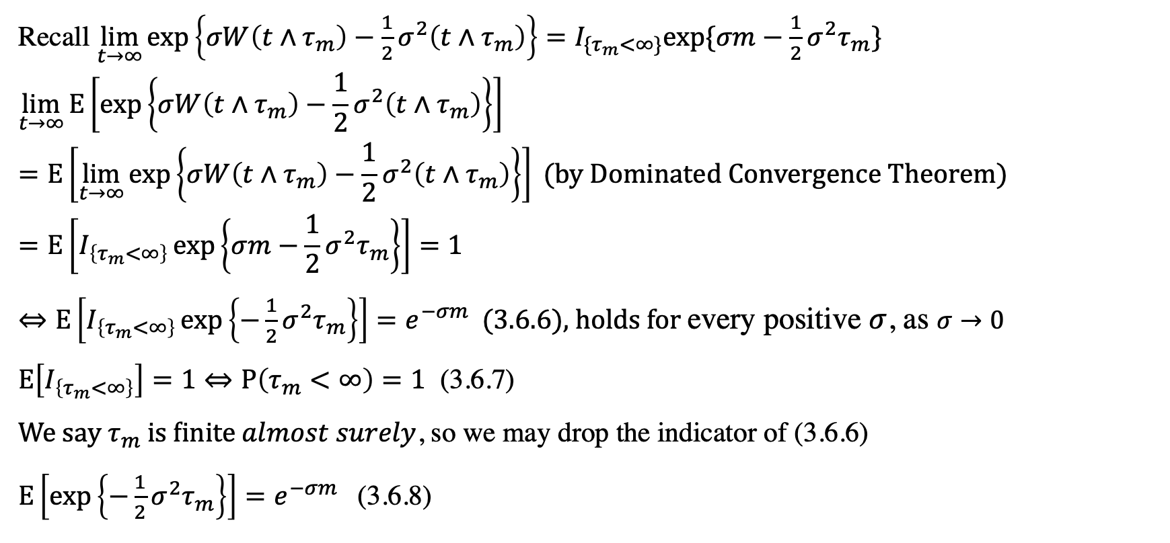
Continue
Recall $\lim_{t→∞}{exp\left\{σW\left(t∧τ_{m}\right)−\frac{1}{2}σ^{2}\left(t∧τ_{m}\right)\right\}=I_{\{τ_{m}<∞\}}exp⁡\{σm−\frac{1}{2}σ^{2}τ_{m}\}}$
$$\lim_{t→∞}{E\left[\exp\left\{σW\left(t∧τ_{m}\right)−\frac{1}{2}σ^{2}\left(t∧τ_{m}\right)\right\}\right]}=E\left[\lim_{t→∞}{\exp\left\{σW\left(t∧τ_{m}\right)−\frac{1}{2}σ^{2}\left(t∧τ_{m}\right)\right\}}\right]\text{ (}\text{by} \text{Dominate}d Convergence Theorem)=E\left[I_{\left\{τ_{m}<∞\right\}}\exp\left\{σm−\frac{1}{2}σ^{2}τ_{m}\right\}\right]=1$$
$⇔E\left[I_{\left\{τ_{m}<∞\right\}}\exp\left\{−\frac{1}{2}σ^{2}τ_{m}\right\}\right]=e^{−σm} \text{ (3.6.6)}$, holds for every positive $σ$, as $σ→0$
$E\left[I_{\left\{τ_{m}<∞\right\}}\right]=1⇔P\left(τ_{m}<∞\right)=1$ (3.6.7)
$\text{We} \text{say} τ_{m} \text{is} \text{finite} almost surely$, so we may drop the indicator of (3.6.6)
$E\left[\exp\left\{−\frac{1}{2}σ^{2}τ_{m}\right\}\right]=e^{−σm}$ (3.6.8)

Slide 6
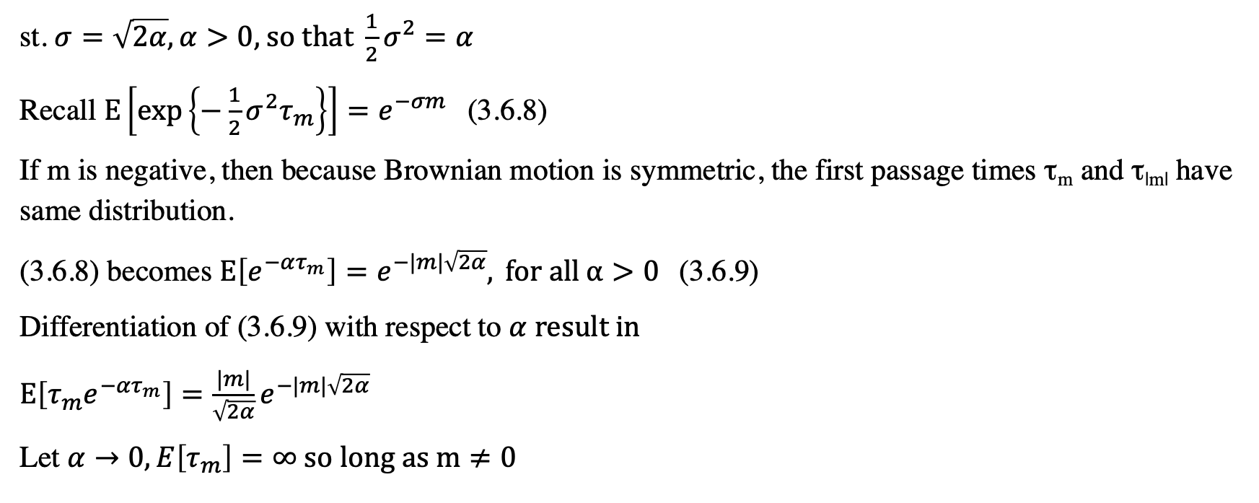
Theorem 3.6.2
st. $σ=\sqrt{2α}, α>0\text{, }\text{so} \text{that} \frac{1}{2}σ^{2}=α$
Recall $E\left[\exp\left\{−\frac{1}{2}σ^{2}τ_{m}\right\}\right]=e^{−σm}$ (3.6.8)
If m is negative, then because Brownian motion is symmetric, the first passage times τ_{m} and τ_{|m|} have same distribution.
(3.6.8) becomes $E\left[e^{−ατ_{m}}\right]=e^{−|m|\sqrt{2α}}, \text{for} \text{all} α>0$(3.6.9)
Differentiation of (3.6.9) with respect to $α \text{result} \text{in}$
$E\left[τ_{m}e^{−ατ_{m}}\right]=\frac{|m|}{\sqrt{2α}}e^{−|m|\sqrt{2α}}$
Let $α→0, E\left[τ_{m}\right]=∞ \text{so} \text{long} \text{as} \text{m}≠0$

