Slide 1
Polynomial Option Pricing -Using Finite Difference Method
Author: Hsiu-Ming, Hsu

Slide 2
Content
Partial Differential Equation
Explicit Finite Difference Method
Implicit Finite Difference Method

Slide 3
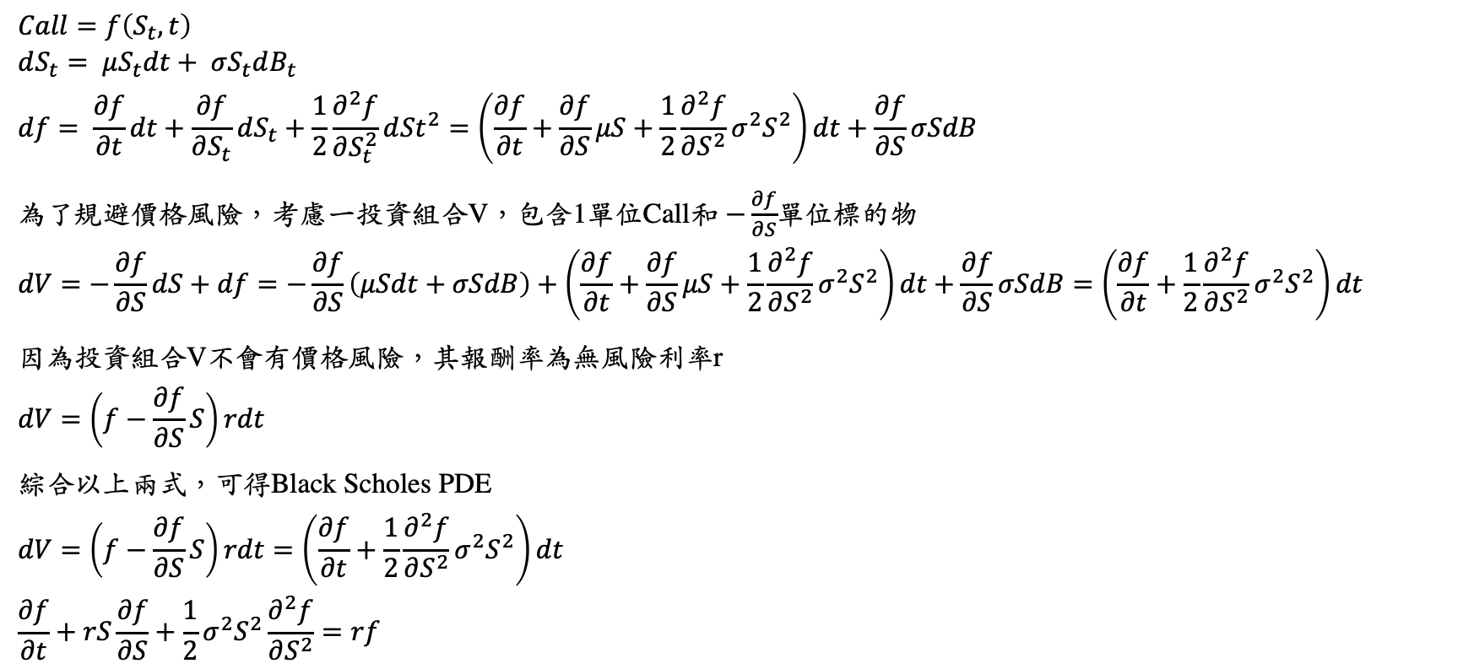
Partial Differential Equation (PDE)
$$Call=f\left(S_{t},t\right)$$
$$dS_{t}= μS_{t}dt+ σS_{t}dB_{t} \\ df= \frac{∂f}{∂t}dt+\frac{∂f}{∂S_{t}}dS_{t}+\frac{1}{2}\frac{∂^{2}f}{∂S_{t}^{2}}d{St}^{2}=\left(\frac{∂f}{∂t}+\frac{∂f}{∂S}μS+\frac{1}{2}\frac{∂^{2}f}{∂S^{2}}σ^{2}S^{2}\right)dt+\frac{∂f}{∂S}σSdB$$
為了規避價格風險，考慮一投資組合V，包含1單位Call和 $−\frac{∂f}{∂S}$單位標的物
$$dV=−\frac{∂f}{∂S}dS+df=−\frac{∂f}{∂S}\left(μSdt+σSdB\right)+\left(\frac{∂f}{∂t}+\frac{∂f}{∂S}μS+\frac{1}{2}\frac{∂^{2}f}{∂S^{2}}σ^{2}S^{2}\right)dt+\frac{∂f}{∂S}σSdB=\left(\frac{∂f}{∂t}+\frac{1}{2}\frac{∂^{2}f}{∂S^{2}}σ^{2}S^{2}\right)dt$$ 因為投資組合V不會有價格風險，其報酬率為無風險利率r
$$dV=\left(f−\frac{∂f}{∂S}S\right)rdt$$ 綜合以上兩式，可得Black Scholes PDE
$$dV=\left(f−\frac{∂f}{∂S}S\right)rdt=\left(\frac{∂f}{∂t}+\frac{1}{2}\frac{∂^{2}f}{∂S^{2}}σ^{2}S^{2}\right)dt$$
$$\frac{∂f}{∂t}+rS\frac{∂f}{∂S}+\frac{1}{2}σ^{2}S^{2}\frac{∂^{2}f}{∂S^{2}}=rf$$

Slide 4
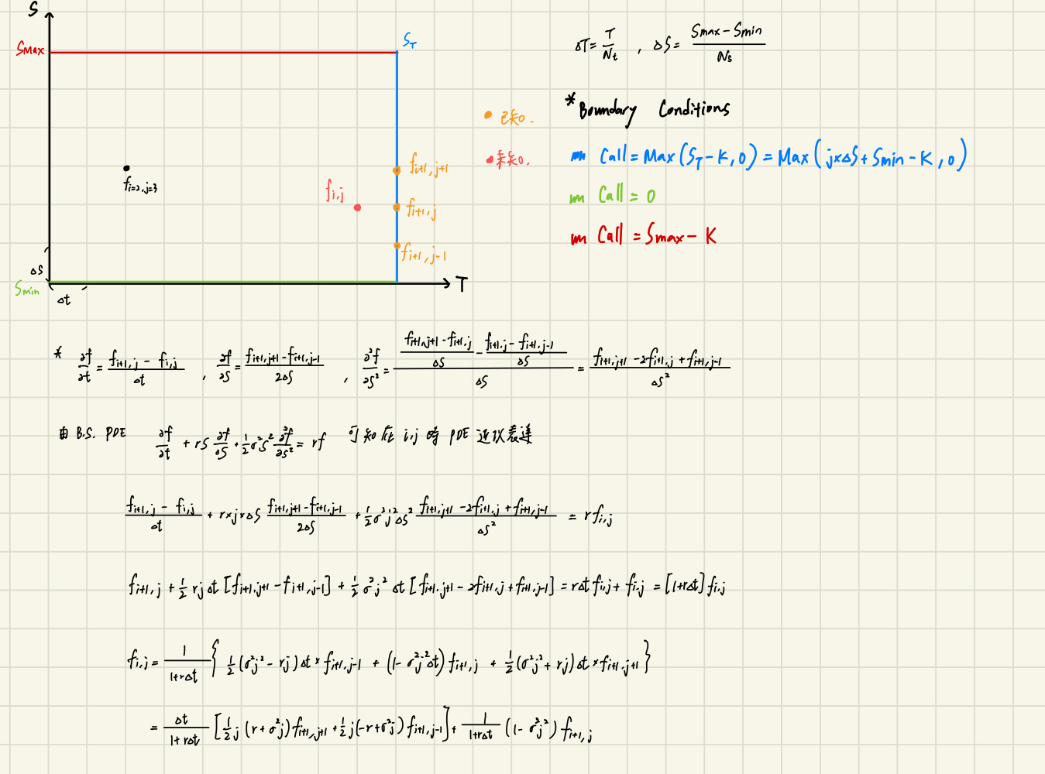
Explicit Finite Difference Method

Slide 5
Explicit Finite Difference Method

Slide 6
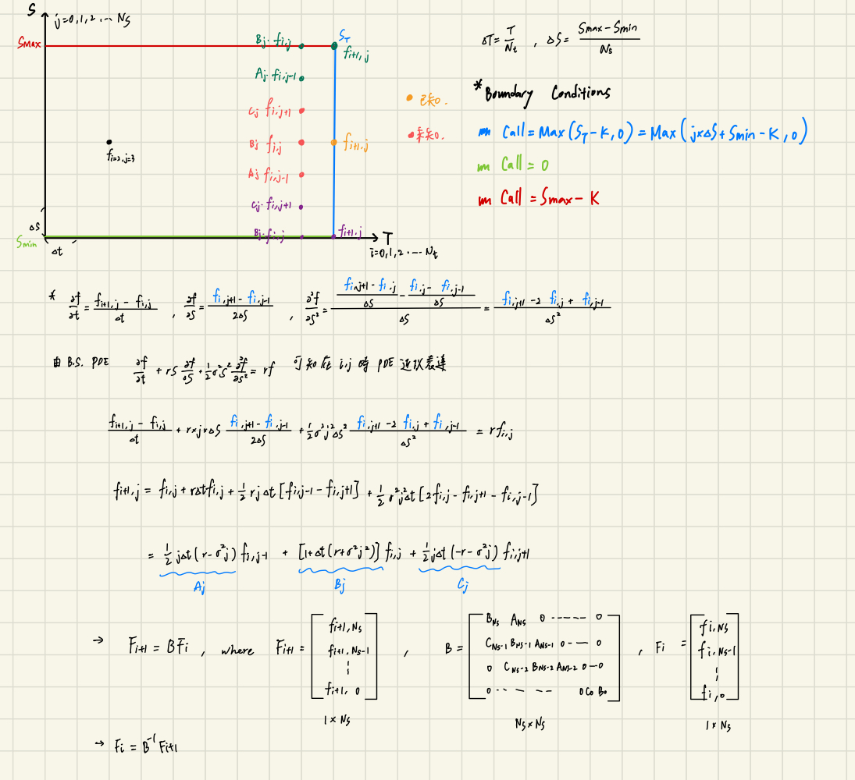
Implicit Finite Difference Method

Slide 7
Implicit Finite Difference Method

Slide 8
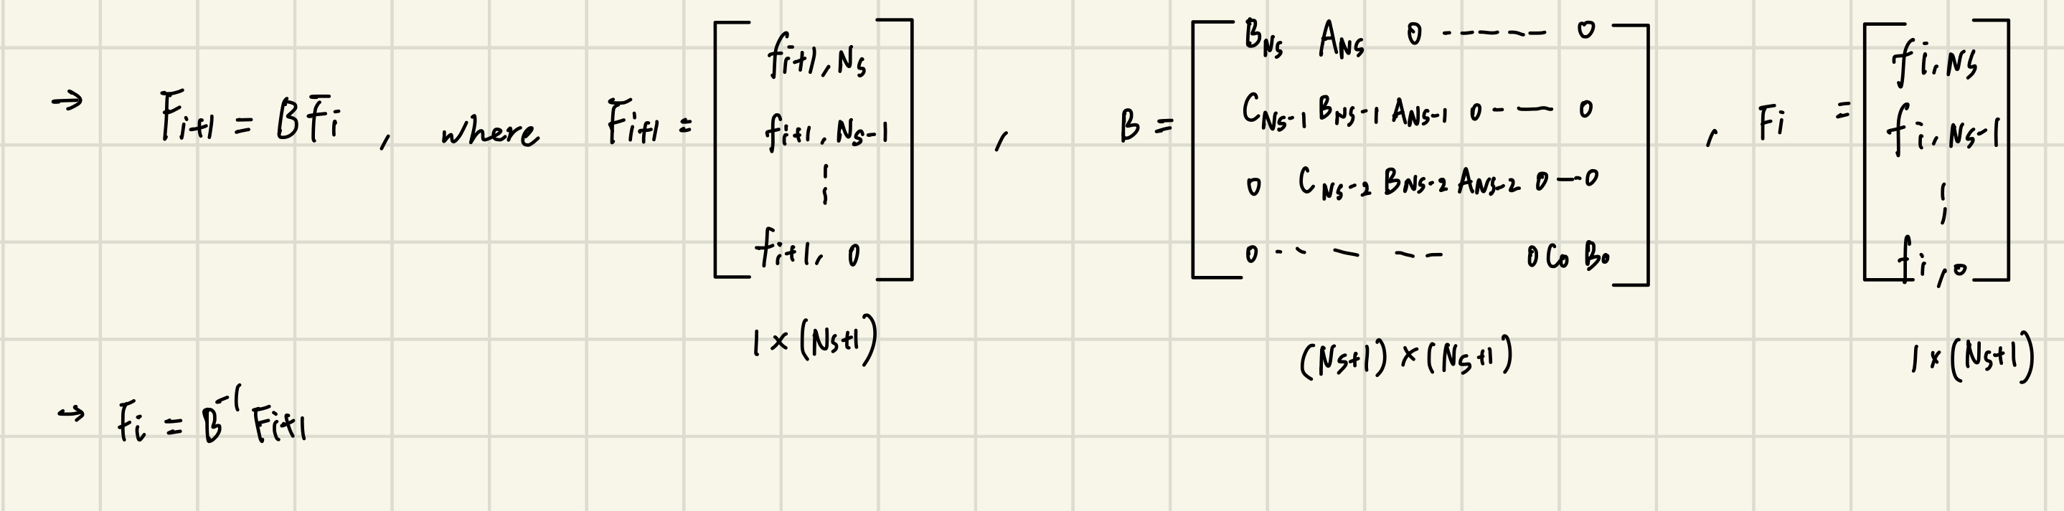
Implicit Finite Difference Method

Slide 9
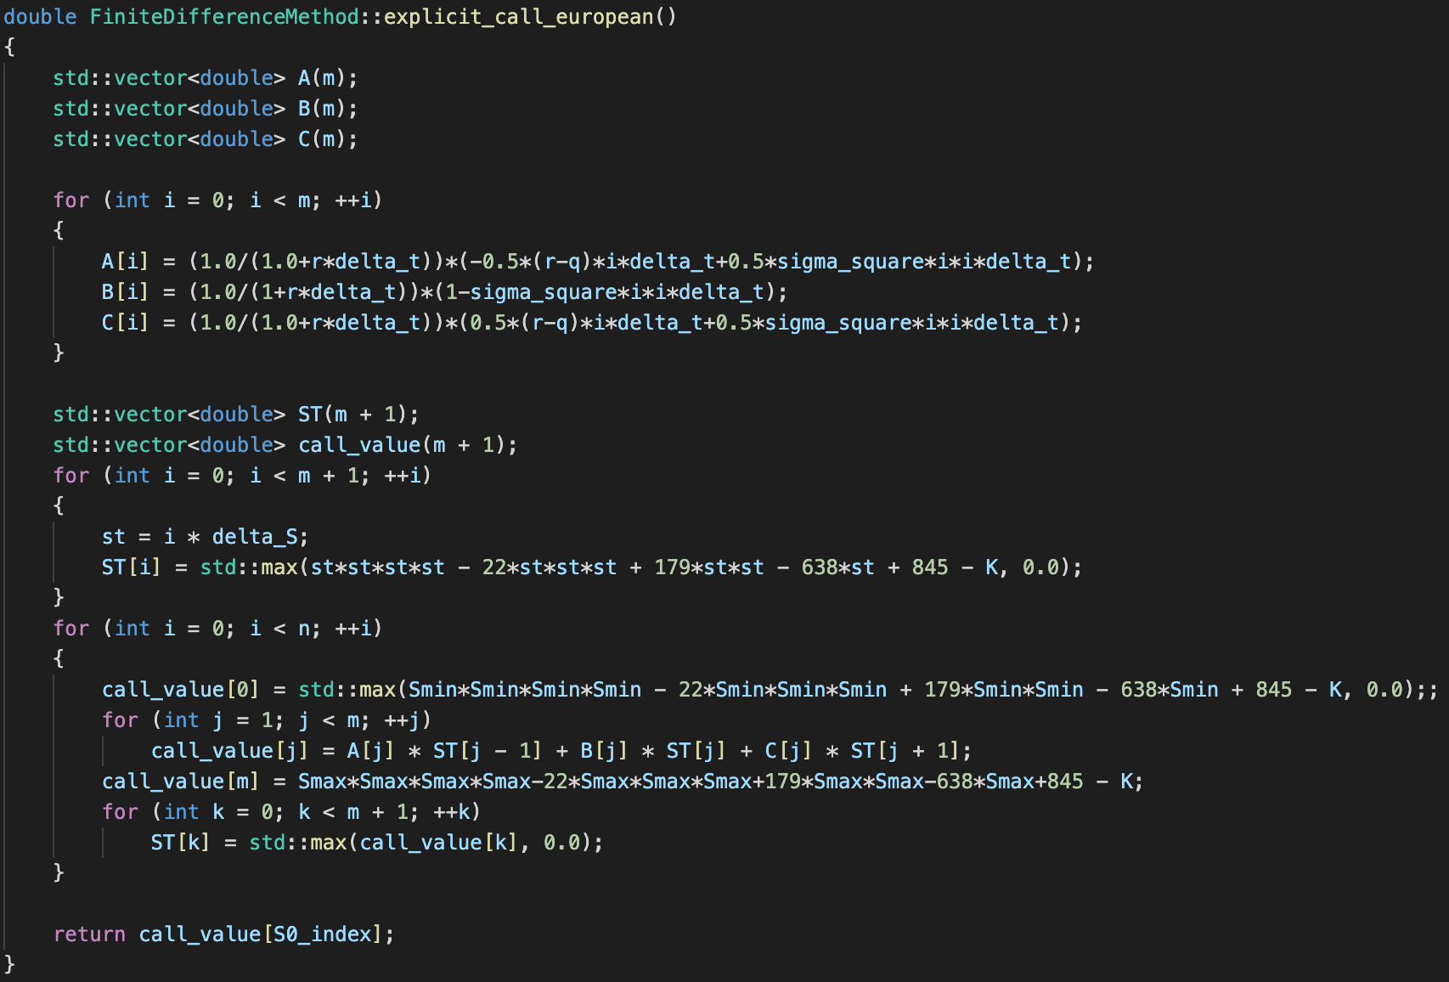
Explicit Finite Difference Method

Slide 10
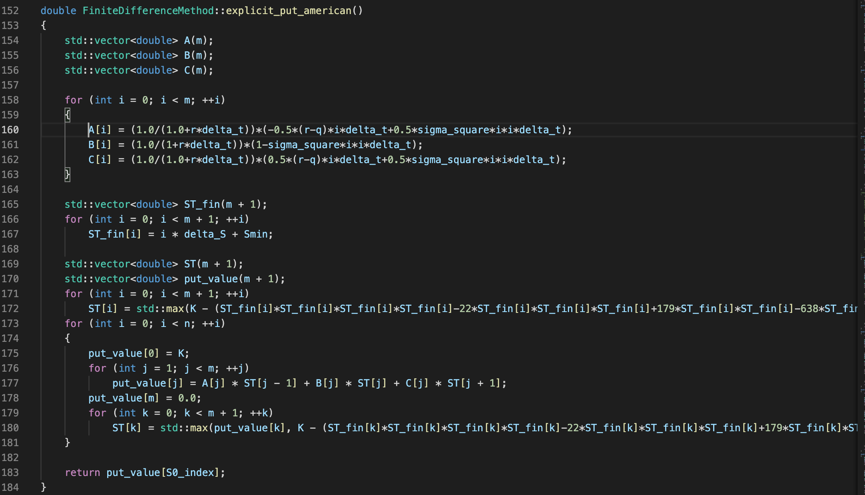
Explicit Finite Difference Method

Slide 11
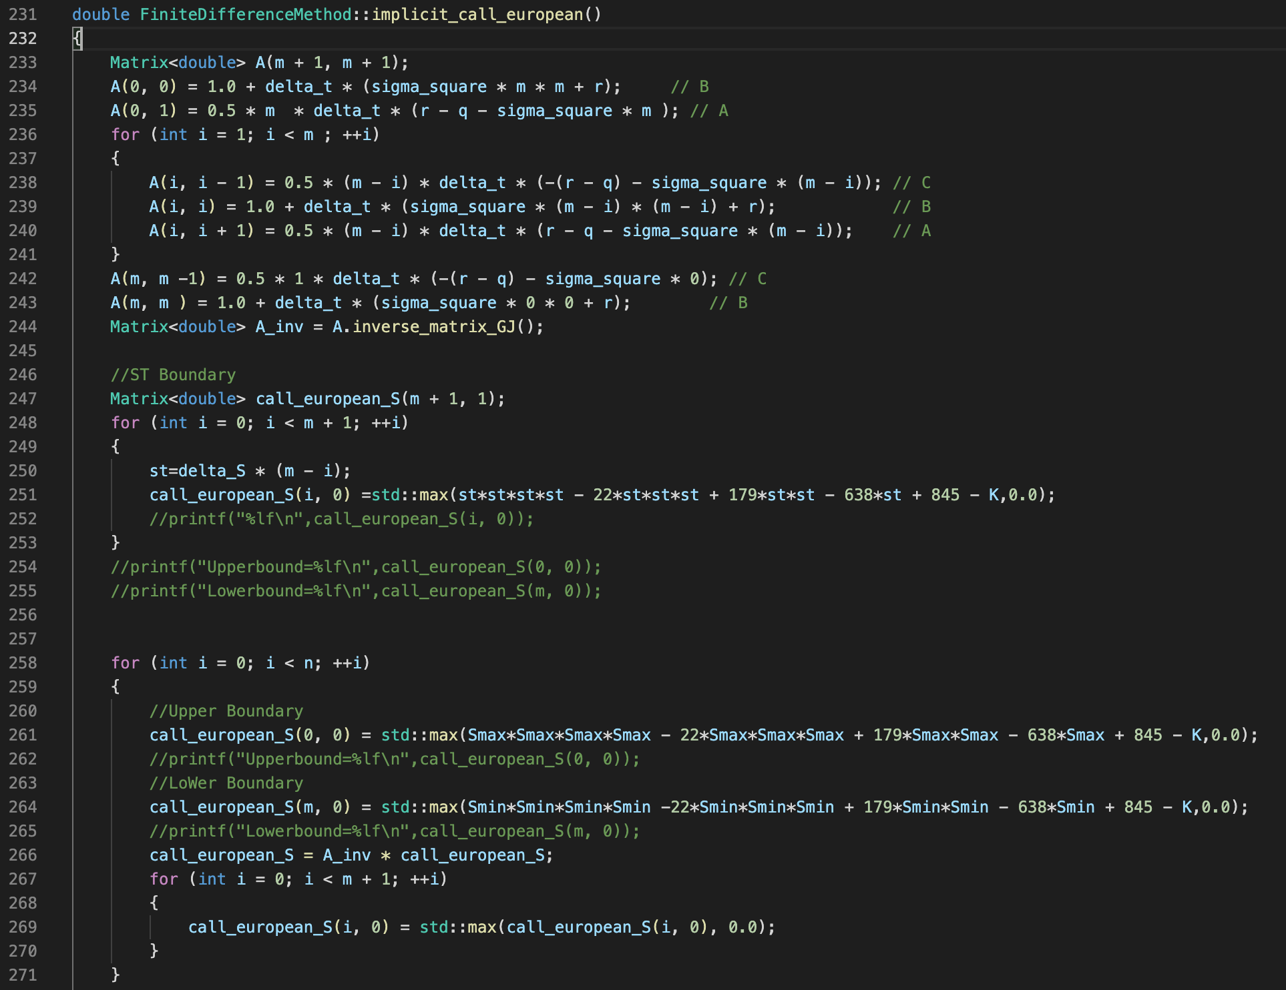
Implicit Finite Difference Method

Slide 12
Thank You!

