Slide 1
4.2 Ito’s Integral for Simple Integrands

Slide 2

Let $Π=\{t_{0},t_{1},⋯,t_{n}\}$ be a partition of [0, T]; i.e.,
$$0=t_{0}≤t_{1}≤⋯≤t_{n}=T$$
Assume that $Δ\left(t\right)$ is constant in t on each subinterval $[t_{j},t_{j+1})$. Such a process $Δ(t)$ is a simple process.

Slide 3
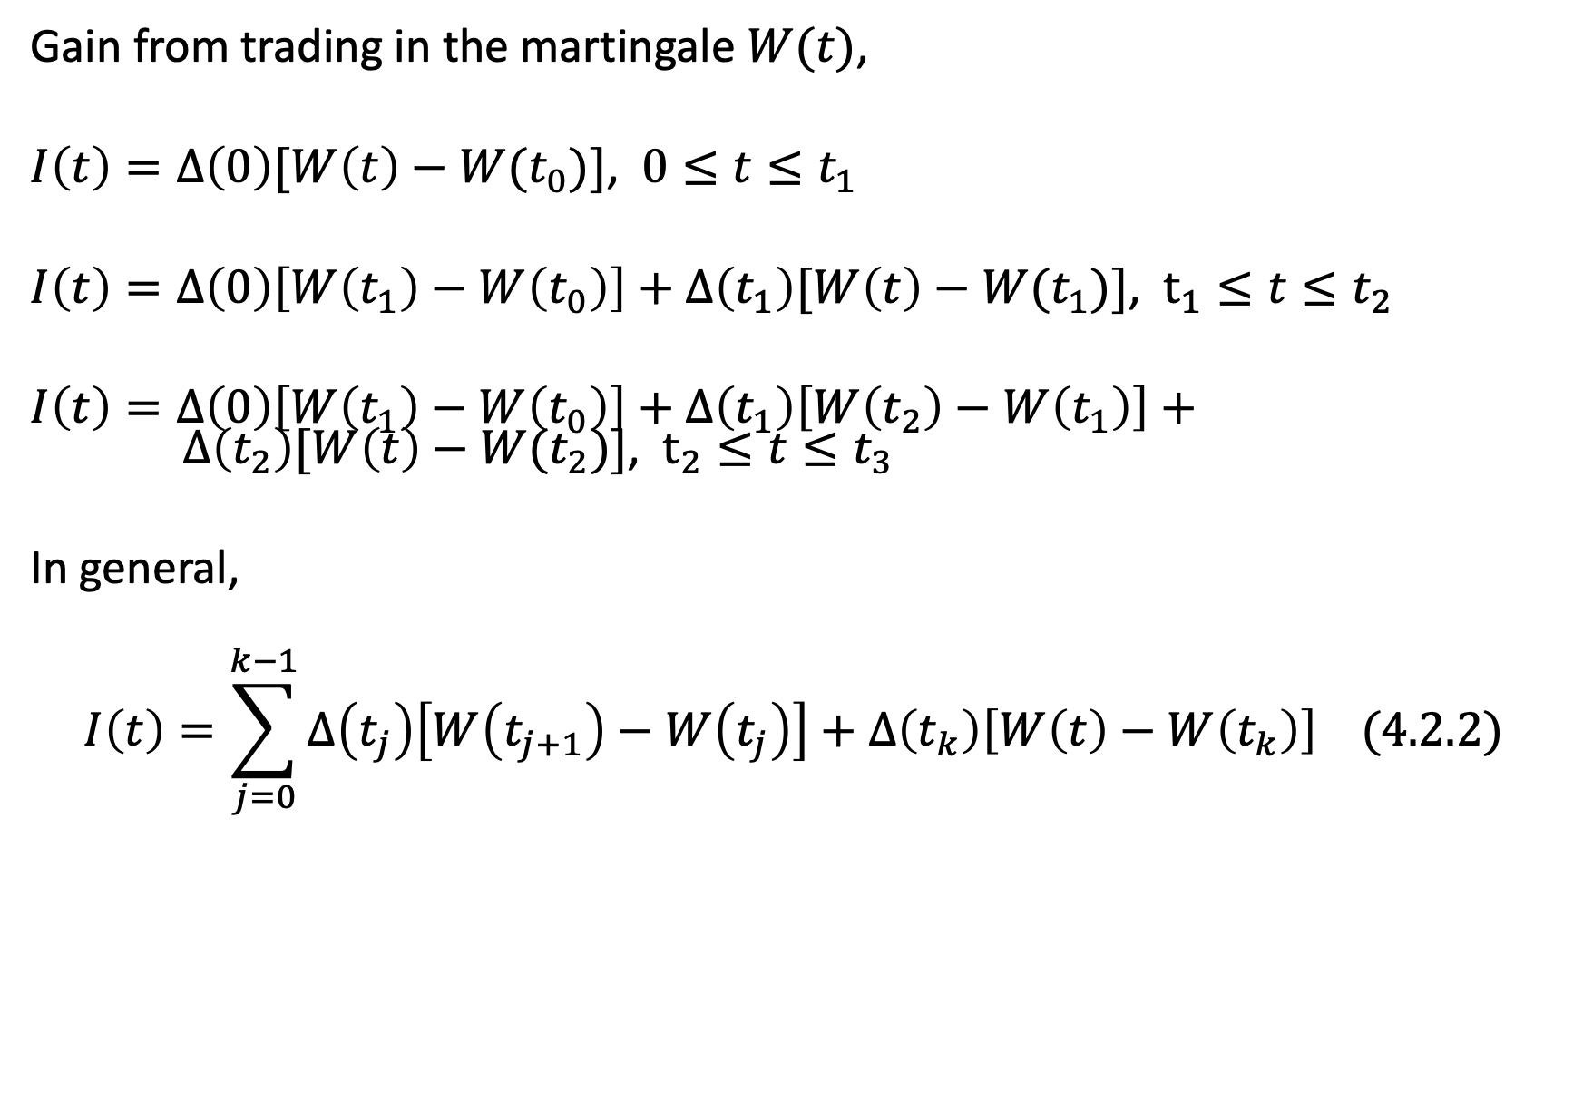
Gain from trading in the martingale $W(t)$,
$I\left(t\right)=Δ\left(0\right)[W\left(t\right)−W(t_{0})]$, $0≤t≤t_{1}$
$I\left(t\right)=Δ\left(0\right)\left[W\left(t_{1}\right)−W\left(t_{0}\right)\right]+Δ\left(t_{1}\right)[W\left(t\right)−W(t_{1})]$, $t_{1}≤t≤t_{2}$
$I\left(t\right)=Δ\left(0\right)\left[W\left(t_{1}\right)−W\left(t_{0}\right)\right]+Δ\left(t_{1}\right)\left[W\left(t_{2}\right)−W\left(t_{1}\right)\right]+ Δ\left(t_{2}\right)[W\left(t\right)−W(t_{2})]$, $t_{2}≤t≤t_{3}$
In general,
$$I\left(t\right)=\sum_{j=0}^{k−1}{Δ\left(t_{j}\right)\left[W\left(t_{j+1}\right)−W\left(t_{j}\right)\right]+Δ\left(t_{k}\right)\left[W\left(t\right)−W\left(t_{k}\right)\right] (4.2.2)}$$

Slide 4
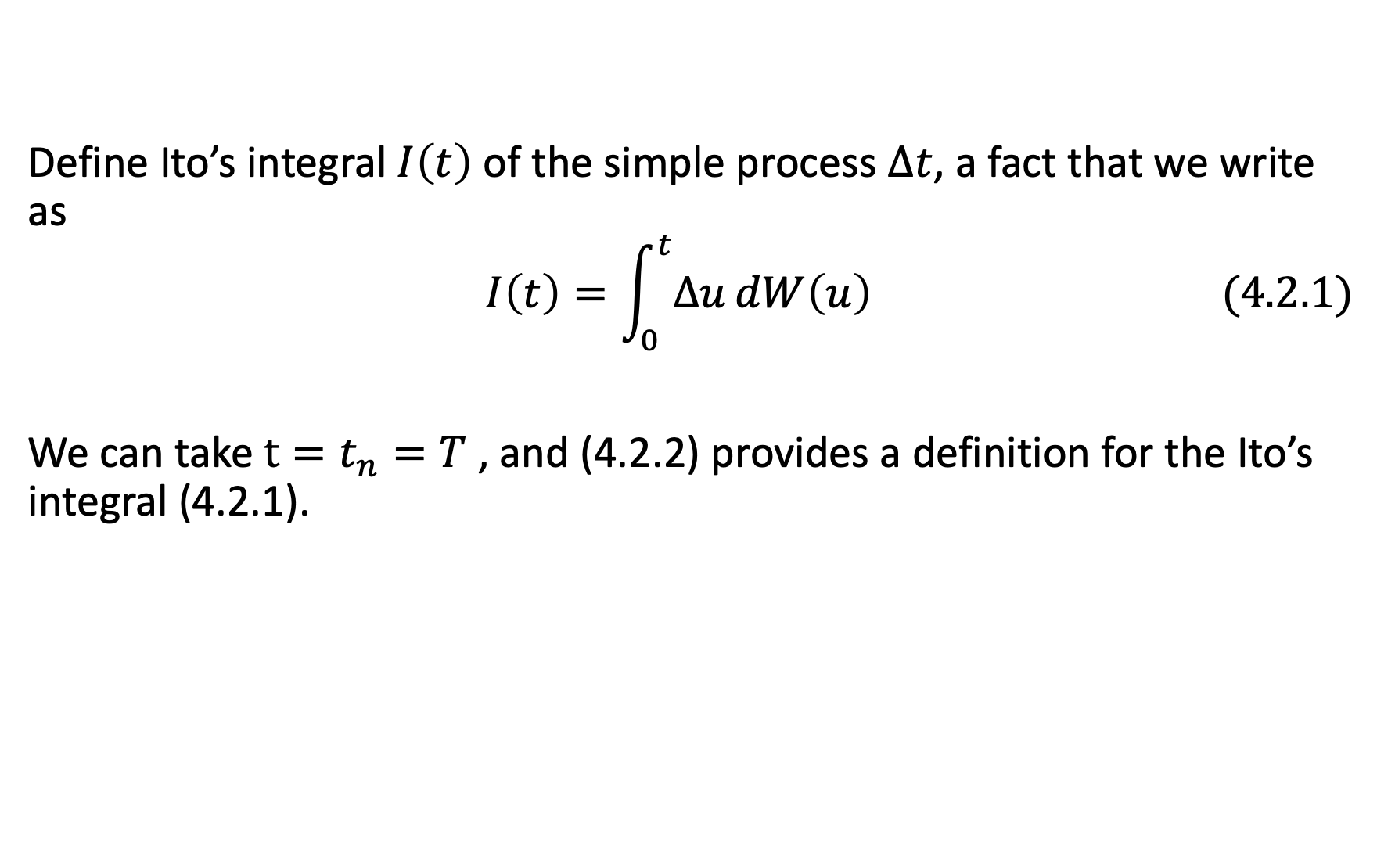
Define Ito’s integral $I\left(t\right)$ of the simple process $Δt$, a fact that we write as
$$I\left(t\right)=\int_{0}^{t}{Δu}dW\left(u\right) (4.2.1)$$
We can take $t=t_{n}=T$ , and (4.2.2) provides a definition for the Ito’s integral (4.2.1).

Slide 5

Theorem 4.2.1.
The Ito’s integral defined by (4.2.2) is a martingale.
$$I\left(t\right)=\sum_{j=0}^{k−1}{Δ\left(t_{j}\right)\left[W\left(t_{j+1}\right)−W\left(t_{j}\right)\right]+Δ\left(t_{k}\right)\left[W\left(t\right)−W\left(t_{k}\right)\right] (4.2.2)}$$

Slide 6
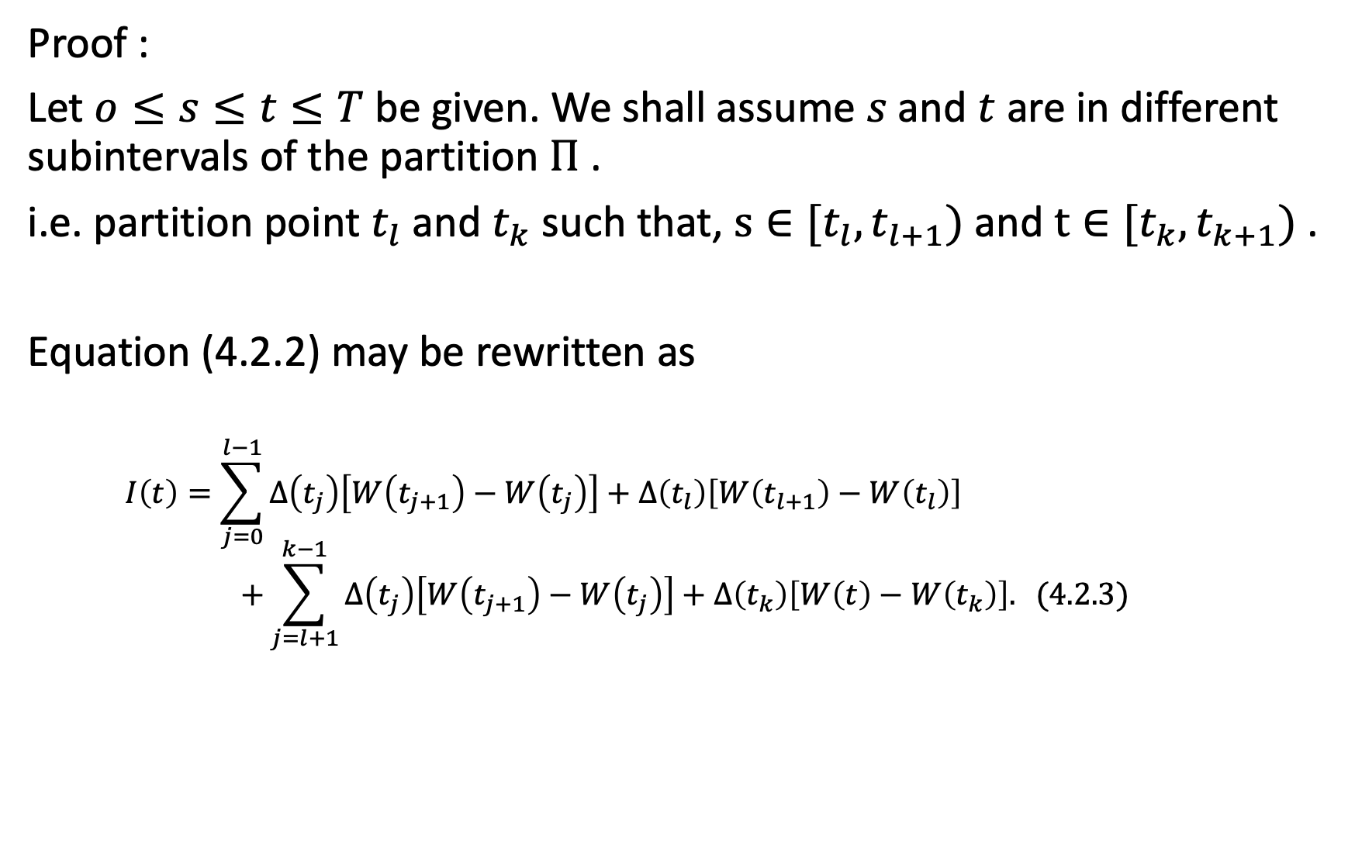
Proof :
Let $o≤s≤t≤T$be given. We shall assume $s$and $t$ are in different subintervals of the partition $Π$ .
i.e. partition point $t_{l}$and $t_{k}$such that, $s∈[t_{l},t_{l+1})$and $t∈[t_{k},t_{k+1})$.
Equation (4.2.2) may be rewritten as
$$I\left(t\right)=\sum_{j=0}^{l−1}{Δ\left(t_{j}\right)\left[W\left(t_{j+1}\right)−W\left(t_{j}\right)\right]+Δ\left(t_{l}\right)\left[W\left(t_{l+1}\right)−W\left(t_{l}\right)\right] }$$
$$+\sum_{j=l+1}^{k−1}{Δ\left(t_{j}\right)\left[W\left(t_{j+1}\right)−W\left(t_{j}\right)\right]+Δ\left(t_{k}\right)\left[W\left(t\right)−W\left(t_{k}\right)\right]. (4.2.3)}$$

Slide 7
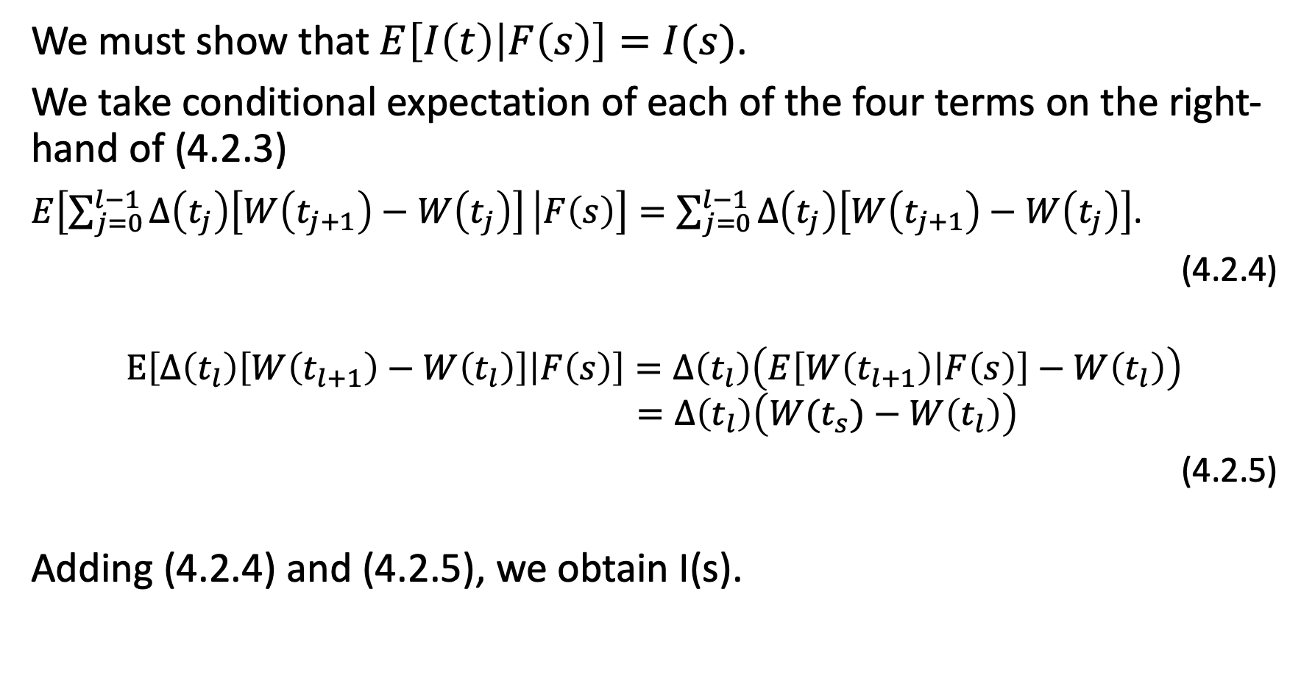
We must show that $E\left[I\left(t\right) | F\left(s\right)\right]=I(s)$.
We take conditional expectation of each of the four terms on the right-hand of (4.2.3)
$E\left[\sum_{j=0}^{l−1}{Δ\left(t_{j}\right)\left[W\left(t_{j+1}\right)−W\left(t_{j}\right)\right]} | F\left(s\right)\right]=\sum_{j=0}^{l−1}{Δ\left(t_{j}\right)\left[W\left(t_{j+1}\right)−W\left(t_{j}\right)\right]}$.
(4.2.4)
$$E\left[Δ\left(t_{l}\right)\left[W\left(t_{l+1}\right)−W\left(t_{l}\right)\right] | F\left(s\right)\right]=Δ\left(t_{l}\right)\left(E\left[W\left(t_{l+1}\right) | F\left(s\right)\right]−W\left(t_{l}\right)\right)$$
$$=Δ\left(t_{l}\right)\left(W(t_{s})−W\left(t_{l}\right)\right)$$
(4.2.5)
Adding (4.2.4) and (4.2.5), we obtain I(s).

Slide 8
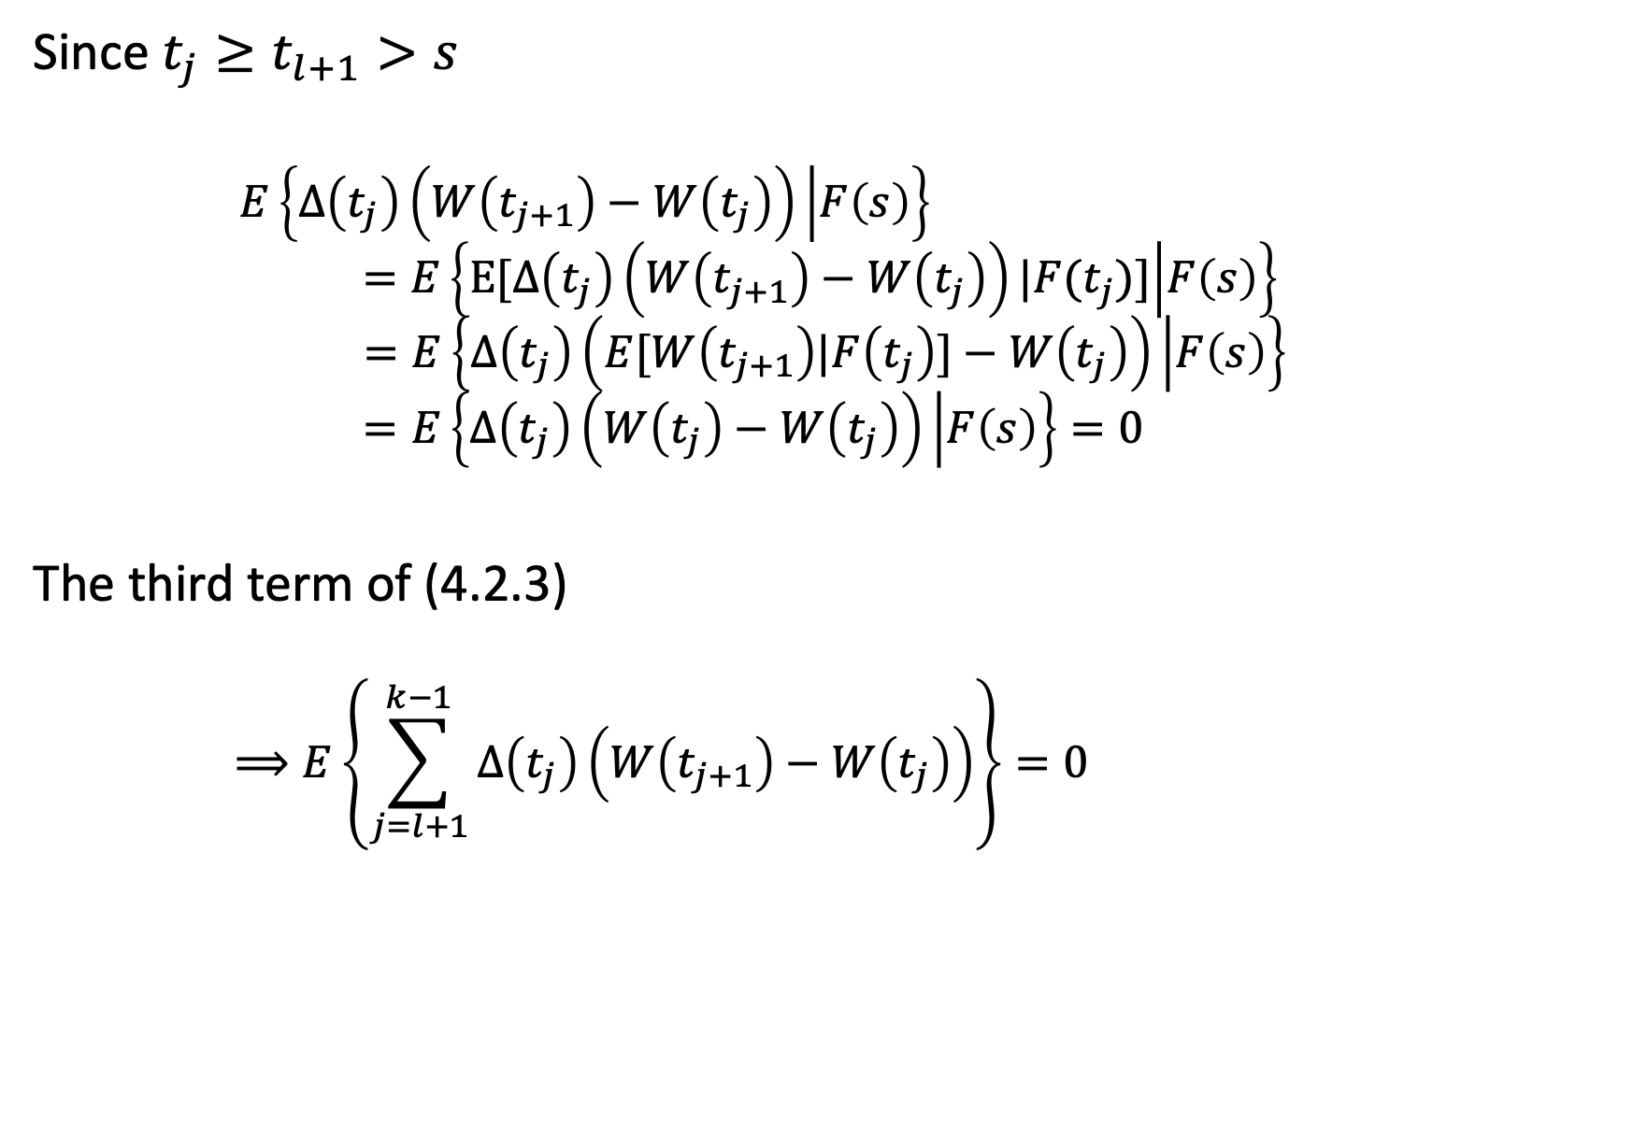
Since $t_{j}≥t_{l+1}>s$
$$E\left\{Δ\left(t_{j}\right)\left(W\left(t_{j+1}\right)−W\left(t_{j}\right)\right) | F\left(s\right)\right\}$$
$$=E\left\{E[Δ\left(t_{j}\right)\left(W\left(t_{j+1}\right)−W\left(t_{j}\right)\right)|F(t_{j})] | F\left(s\right)\right\}$$
$$=E\left\{Δ\left(t_{j}\right)\left(E[W\left(t_{j+1}\right)|F\left(t_{j}\right)]−W\left(t_{j}\right)\right) | F\left(s\right)\right\}$$
$$=E\left\{Δ\left(t_{j}\right)\left(W\left(t_{j}\right)−W\left(t_{j}\right)\right) | F\left(s\right)\right\}=0$$
The third term of (4.2.3)
$$⟹E\left\{\sum_{j=l+1}^{k−1}{Δ\left(t_{j}\right)\left(W\left(t_{j+1}\right)−W\left(t_{j}\right)\right)}\right\}=0$$

Slide 9
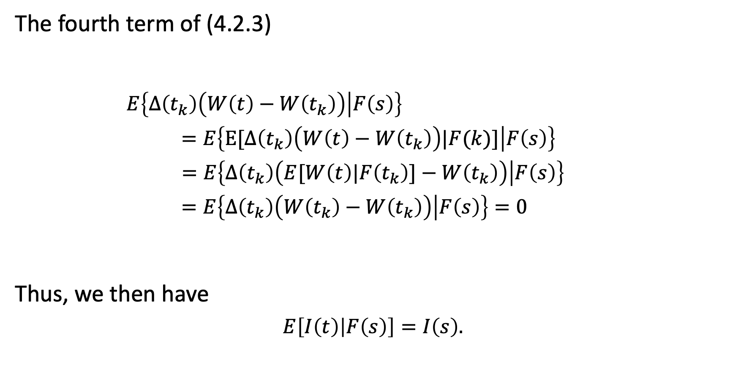
The fourth term of (4.2.3)
$$E\left\{Δ\left(t_{k}\right)\left(W\left(t\right)−W\left(t_{k}\right)\right) | F\left(s\right)\right\}$$
$$=E\left\{E[Δ\left(t_{k}\right)\left(W\left(t\right)−W\left(t_{k}\right)\right)|F(k)] | F\left(s\right)\right\}$$
$$=E\left\{Δ\left(t_{k}\right)\left(E[W\left(t\right)|F\left(t_{k}\right)]−W\left(t_{k}\right)\right) | F\left(s\right)\right\}$$
$$=E\left\{Δ\left(t_{k}\right)\left(W\left(t_{k}\right)−W\left(t_{k}\right)\right) | F\left(s\right)\right\}=0$$
Thus, we then have
$$E\left[I\left(t\right) | F\left(s\right)\right]=I\left(s\right).$$

Slide 10

Theorem 4.2.2 (Ito’s isometry)
The Ito’s integral defined by (4.2.2) satisfies
$$E{ I}^{2}\left(t\right)=E\int_{0}^{t}{Δ^{2}\left(u\right)du} (4.2.6)$$

Slide 11
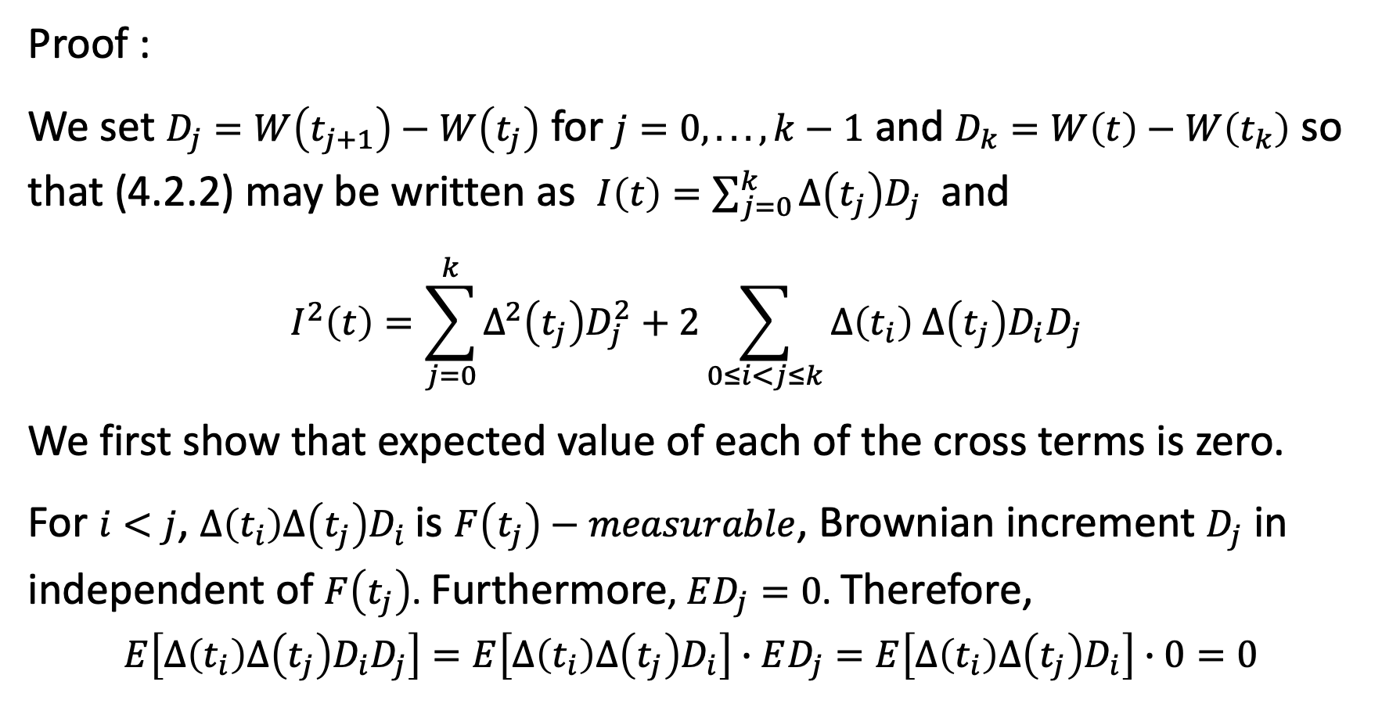
Proof :
We set $D_{j}=W\left(t_{j+1}\right)−W\left(t_{j}\right)$ for $j=0, . .. , k−1$ and $D_{k}=W\left(t\right)−W\left(t_{k}\right)$ so that (4.2.2) may be written as $I\left(t\right)=\sum_{j=0}^{k}{Δ\left(t_{j}\right)D_{j}}$ and
$$I^{2}\left(t\right)=\sum_{j=0}^{k}{Δ^{2}\left(t_{j}\right)D_{j}^{2}+2\sum_{0≤i<j≤k}{Δ\left(t_{i}\right) Δ\left(t_{j}\right)D_{i}D_{j} }}$$
We first show that expected value of each of the cross terms is zero.
For $i<j$, $Δ\left(t_{i}\right)Δ\left(t_{j}\right)D_{i}$ is $F\left(t_{j}\right)−measurable$, Brownian increment $D_{j}$ in independent of $F\left(t_{j}\right)$. Furthermore, $ED_{j}=0$. Therefore,
$$E\left[Δ\left(t_{i}\right)Δ\left(t_{j}\right)D_{i}D_{j}\right]=E\left[Δ\left(t_{i}\right)Δ\left(t_{j}\right)D_{i}\right]∙ED_{j}=E\left[Δ\left(t_{i}\right)Δ\left(t_{j}\right)D_{i}\right]∙0=0$$

Slide 12
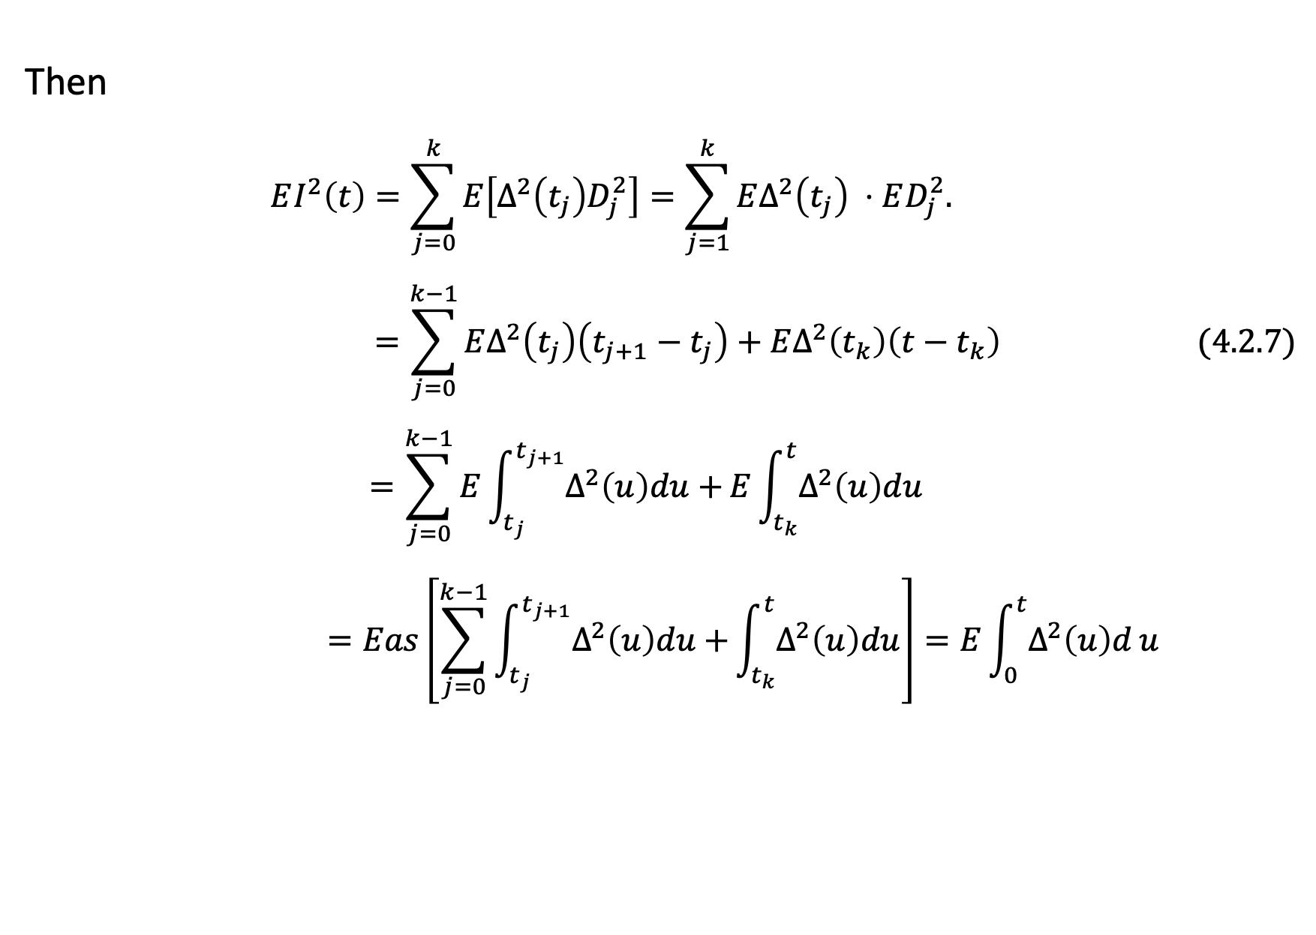
Then
$$EI^{2}\left(t\right)=\sum_{j=0}^{k}{E\left[Δ^{2}\left(t_{j}\right)D_{j}^{2}\right]=\sum_{j=1}^{k}{EΔ^{2}\left(t_{j}\right) ⋅ED_{j}^{2}. }}$$
$$=\sum_{j=0}^{k−1}{EΔ^{2}\left(t_{j}\right)\left(t_{j+1}−t_{j}\right)+EΔ^{2}\left(t_{k}\right)\left(t−t_{k}\right)} (4.2.7)$$
$$=\sum_{j=0}^{k−1}{E\int_{t_{j}}^{t_{j+1}}{Δ^{2}\left(u\right)du}+}E\int_{t_{k}}^{t}{Δ^{2}\left(u\right)du}$$
$$=Eas\left[\sum_{j=0}^{k−1}{\int_{t_{j}}^{t_{j+1}}{Δ^{2}\left(u\right)du}+}\int_{t_{k}}^{t}{Δ^{2}\left(u\right)du}\right]=E\int_{0}^{t}{Δ^{2}\left(u\right)d}u$$

Slide 13

Theorem 4.2.3
The quadratic variation accumulated up to time $t$ by the Ito’s integral (4.2.2) is
$$\left[I,I\right]\left(t\right)=\int_{0}^{t}{Δ^{2}\left(u\right)du} (4.2.8)$$

Slide 14
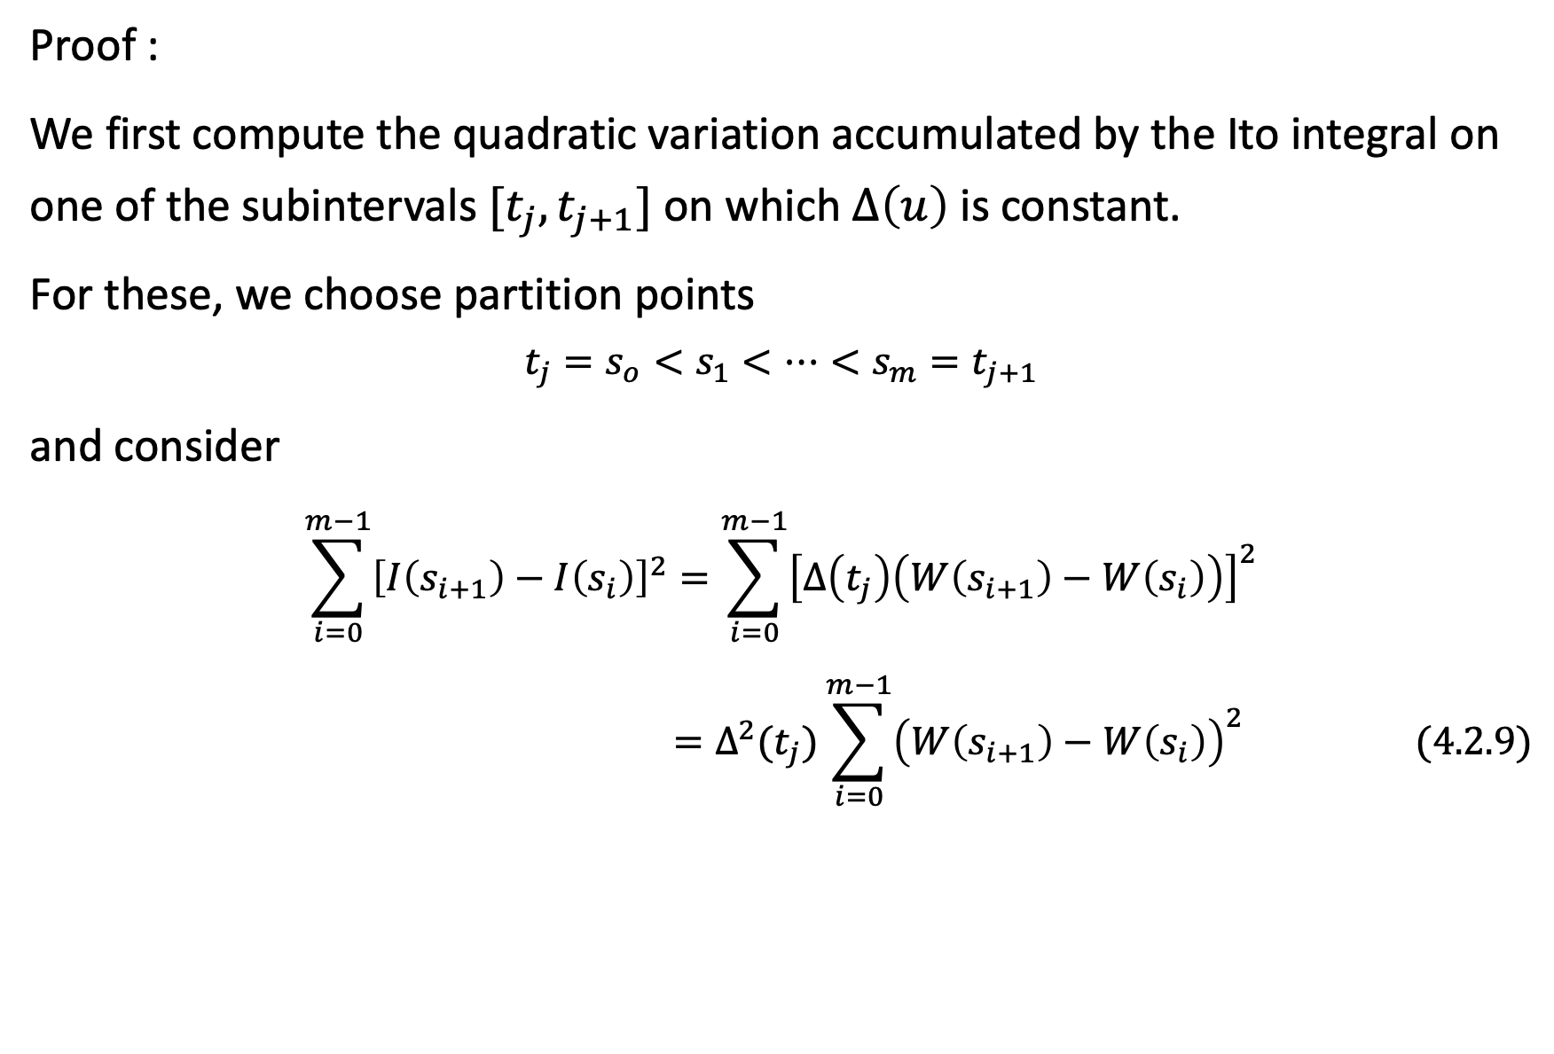
Proof :
We first compute the quadratic variation accumulated by the Ito integral on one of the subintervals $[t_{j},t_{j+1}]$ on which $Δ\left(u\right)$ is constant.
For these, we choose partition points
$$t_{j}=s_{o}<s_{1}<…<s_{m}=t_{j+1}$$
and consider
$$\sum_{i=0}^{m−1}{{\left[I\left(s_{i+1}\right)−I\left(s_{i}\right)\right]}^{2}}=\sum_{i=0}^{m−1}{{\left[Δ\left(t_{j}\right)\left(W\left(s_{i+1}\right)−W\left(s_{i}\right)\right)\right]}^{2}}$$
$$=Δ^{2}(t_{j})\sum_{i=0}^{m−1}{{\left(W\left(s_{i+1}\right)−W\left(s_{i}\right)\right)}^{2} (4.2.9)}$$

Slide 15
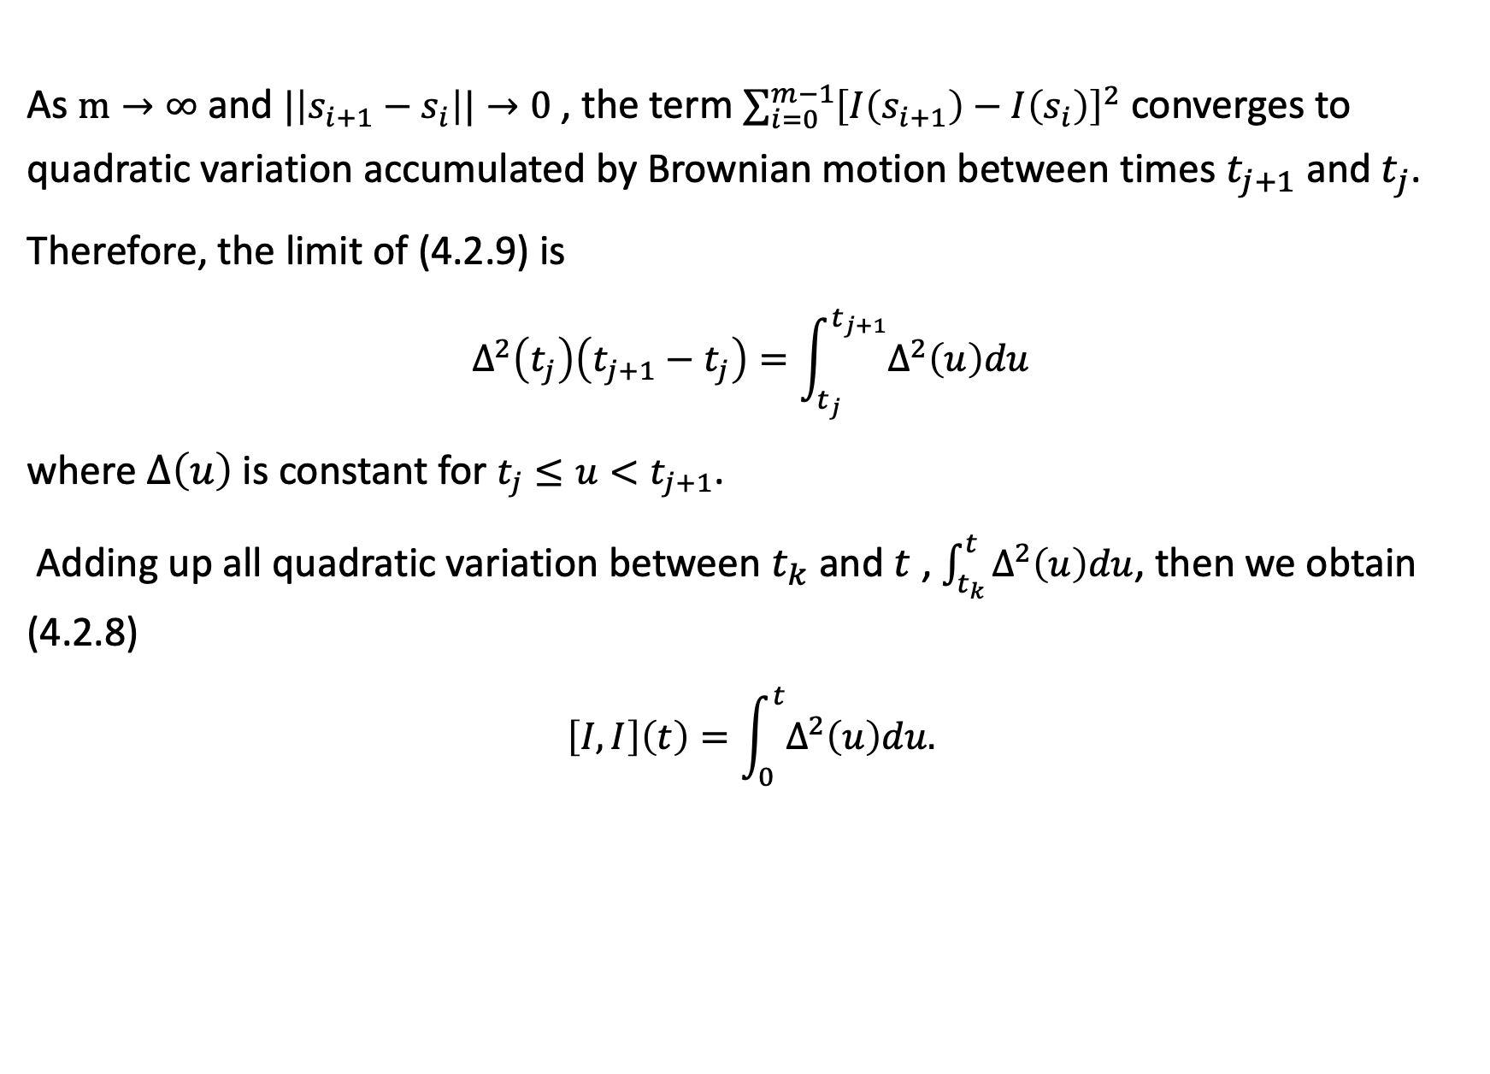
As $m→∞$ and $|\left|s_{i+1}−s_{i}\right||→0$ , the term $\sum_{i=0}^{m−1}{{\left[I\left(s_{i+1}\right)−I\left(s_{i}\right)\right]}^{2}}$ converges to quadratic variation accumulated by Brownian motion between times $t_{j+1}$ and $t_{j}$.
Therefore, the limit of (4.2.9) is
$$Δ^{2}\left(t_{j}\right)\left(t_{j+1}−t_{j}\right)=\int_{t_{j}}^{t_{j+1}}{Δ^{2}\left(u\right)du}$$
where $Δ\left(u\right)$ is constant for $t_{j}≤u<t_{j+1}$.
Adding up all quadratic variation between $t_{k}$ and $t$ , $\int_{t_{k}}^{t}{Δ^{2}\left(u\right)du}$, then we obtain (4.2.8)
$$\left[I,I\right]\left(t\right)=\int_{0}^{t}{Δ^{2}\left(u\right)du.}$$

Slide 16
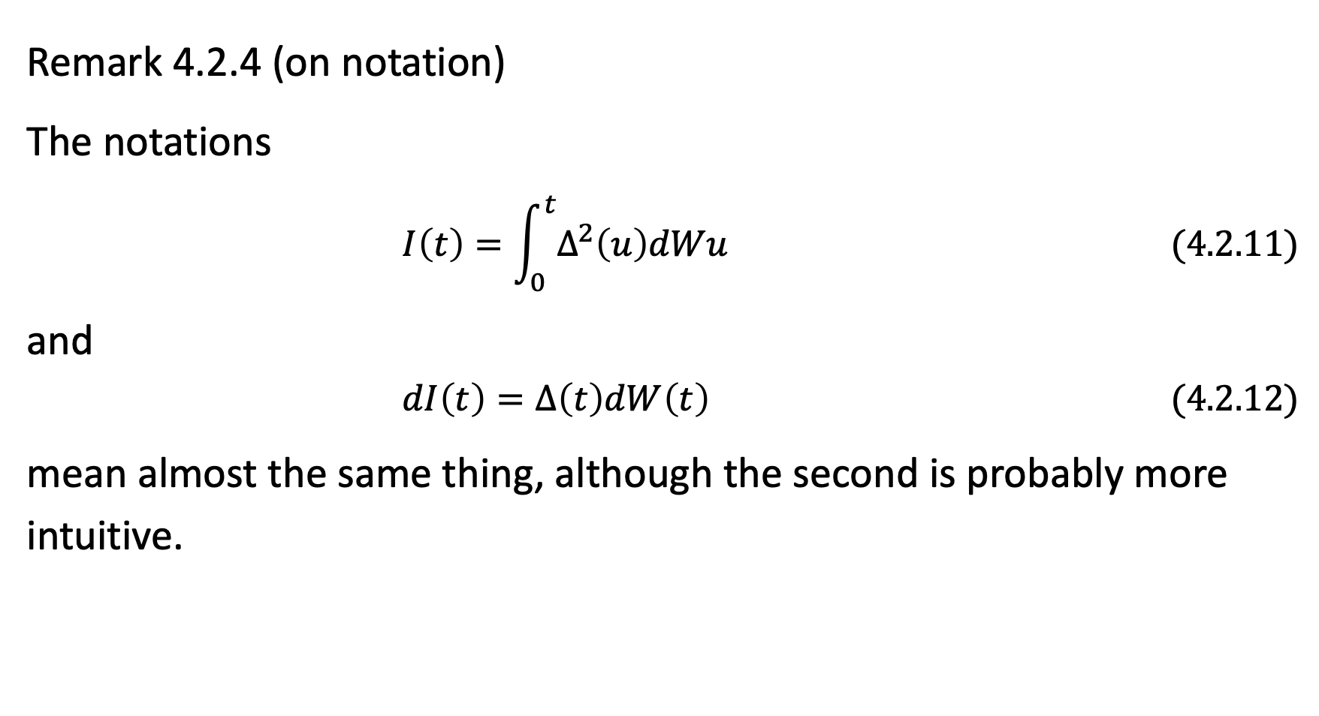
Remark 4.2.4 (on notation)
The notations
$$I\left(t\right)=\int_{0}^{t}{Δ^{2}\left(u\right)dWu} (4.2.11)$$
and
$$dI\left(t\right)=Δ\left(t\right)dW\left(t\right) (4.2.12)$$
mean almost the same thing, although the second is probably more intuitive.

