Slide 1
meeting0906 CPT模型部分履約測試

Slide 2

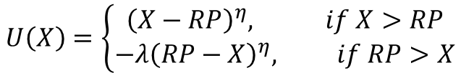

$${CE}_{total}=wage+CE_{CPT} ×e^{−rt}$$
$$U\left(X\right)=\left\{\begin{aligned}{\left(X−RP\right)}^{η}, if X>RP \\ −λ{\left(RP−X\right)}^{η}, if RP>X\end{aligned}\right.$$
$$U_{total}=U\left({CE}_{total}\right)$$
原版(元靖)
$$U_{total}=U (wage)+U (CE_{CPT}×e^{−rt})$$
$${CE}_{total}=U^{−1}\left(U_{total}\right)=U^{−1}\left(U\left(wage\right)+U\left(CE_{CPT}×e^{−rt}\right)\right)$$
改版(類似名勛的作法)

Slide 3
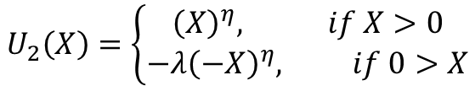
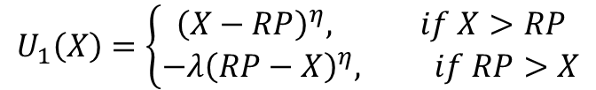


$$U_{1}\left(X\right)=\left\{\begin{aligned}{\left(X−RP\right)}^{η}, if X>RP \\ −λ{\left(RP−X\right)}^{η}, if RP>X\end{aligned}\right.$$
$$U_{1}^{−1}\left(X\right)=\left\{\begin{aligned}RP+X^{\frac{1}{η}} \\ RP−{\left(−\frac{X}{λ}\right)}^{\frac{1}{η}}\end{aligned}\right.$$
where RP=稅後所得+未來薪資折現
RP_value(a,b,i_node,j) = Wealth + Future_wage(type_tax_employee,tax_employee,t,wage,additional_wealth,r,step,j);
$$U_{2}\left(X\right)=\left\{\begin{aligned}{\left(X\right)}^{η}, if X>0 \\ −λ{\left(−X\right)}^{η}, if 0>X\end{aligned}\right.$$
$$U_{2}^{−1}\left(X\right)=\left\{\begin{aligned}X^{\frac{1}{η}} \\ −{\left(−\frac{X}{λ}\right)}^{\frac{1}{η}}\end{aligned}\right.$$
where RP=0

Slide 4
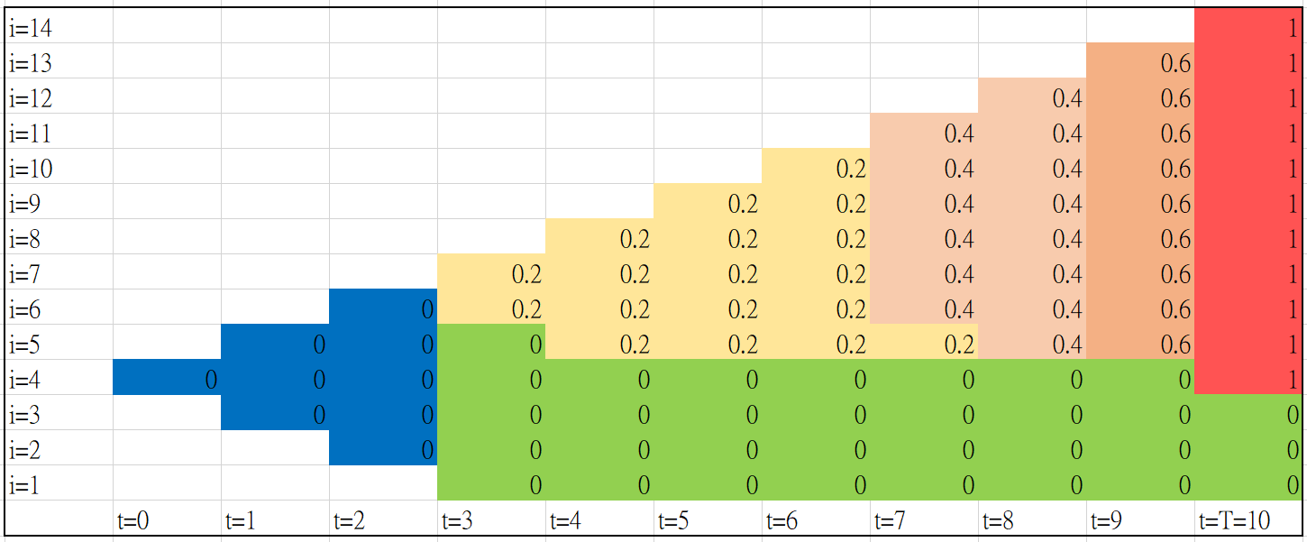
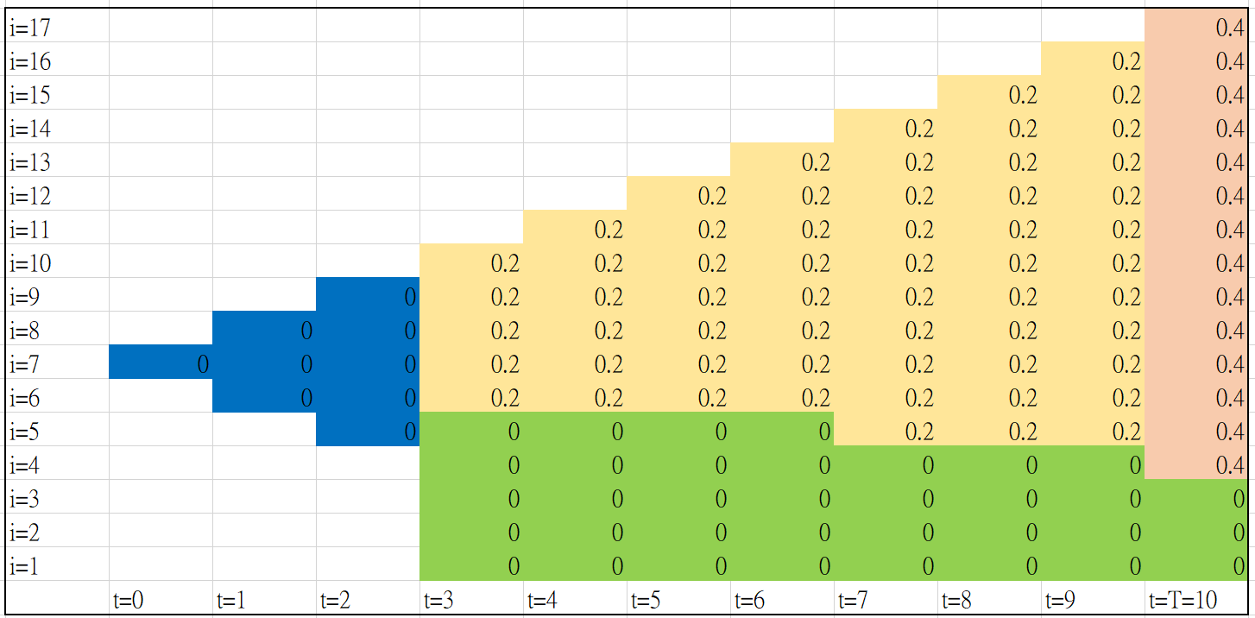
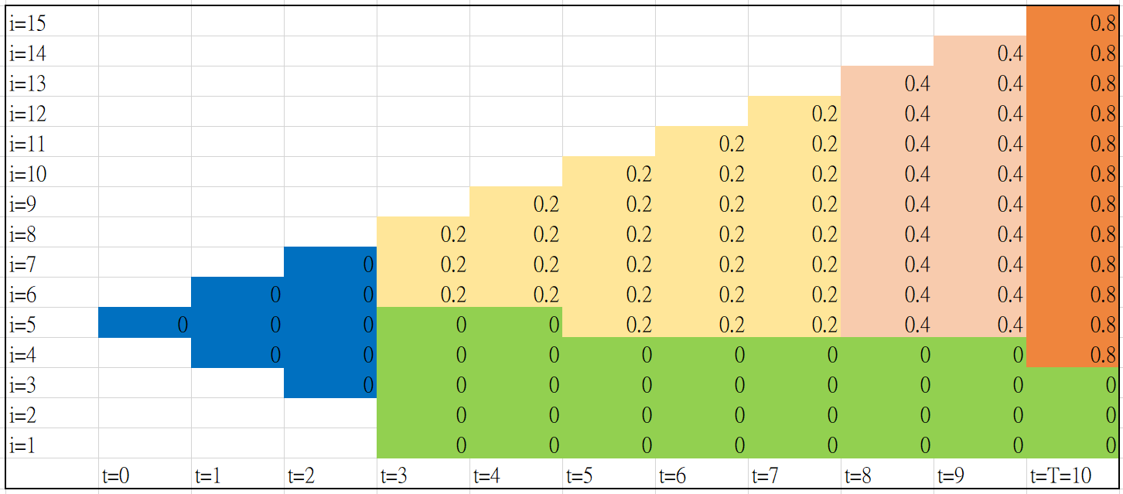
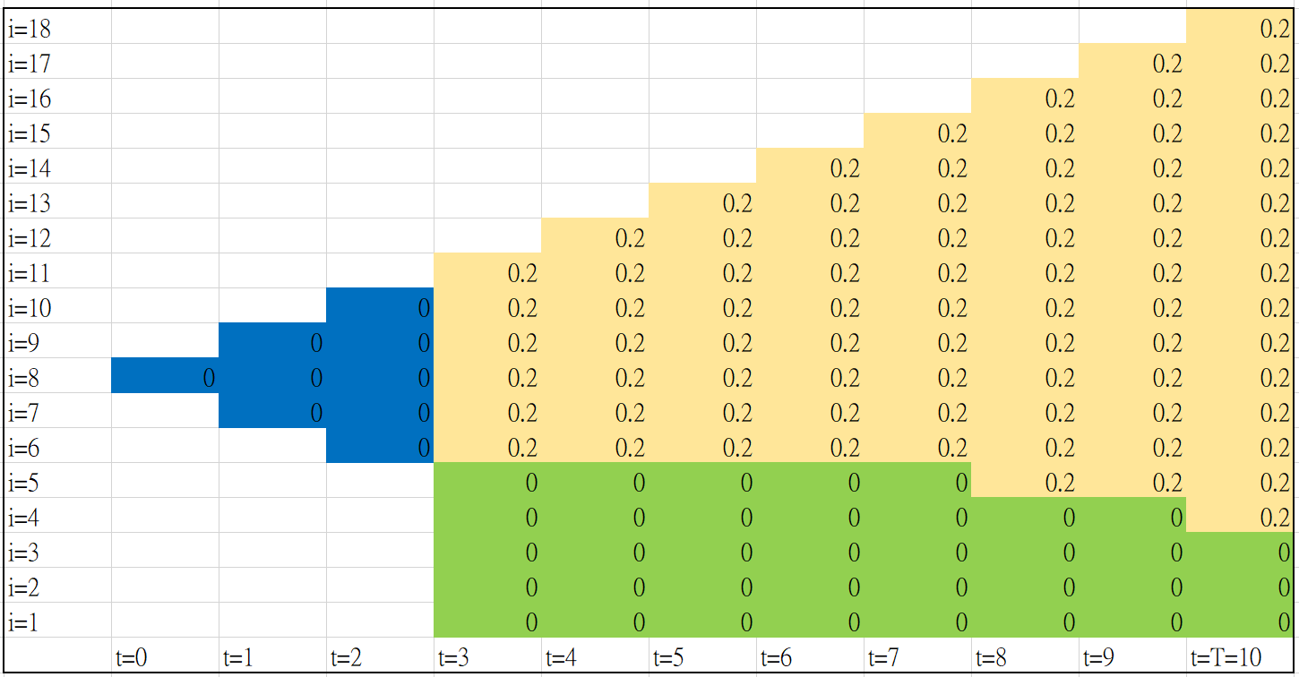
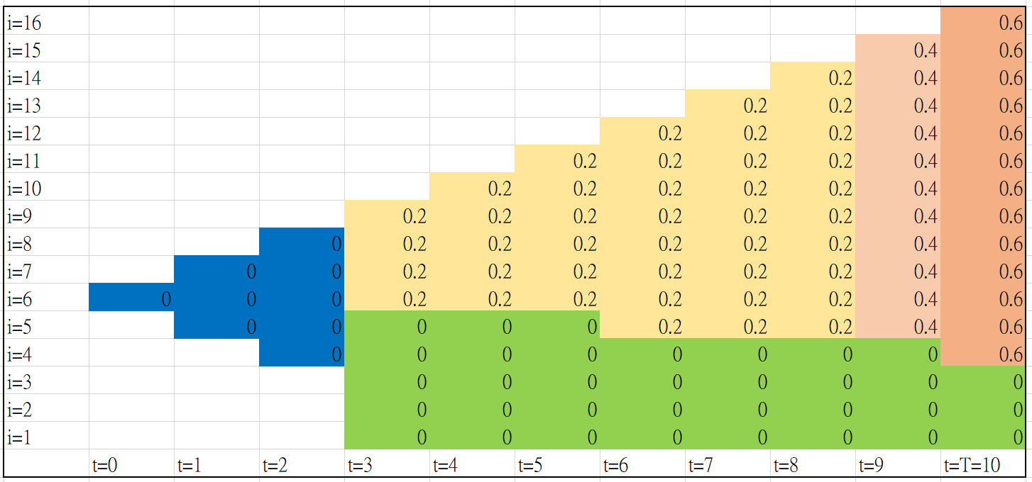
RP設為0
←已履約0%
已履約60%→
←已履約20%
已履約80%→
←已履約40%

Slide 5
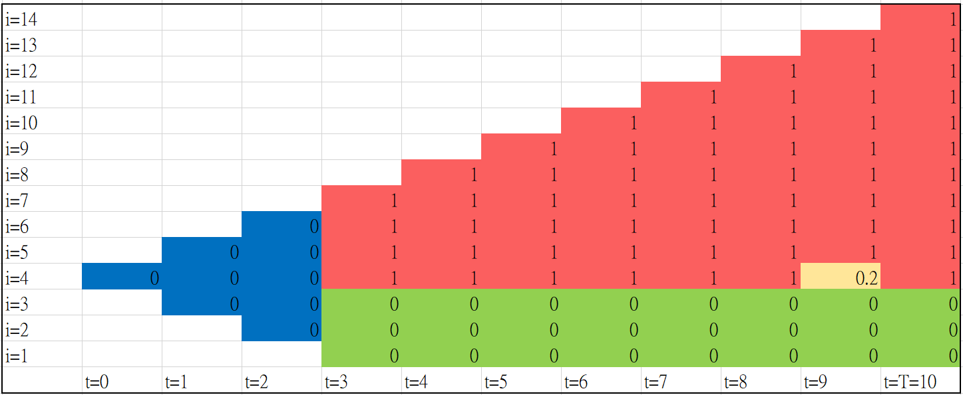
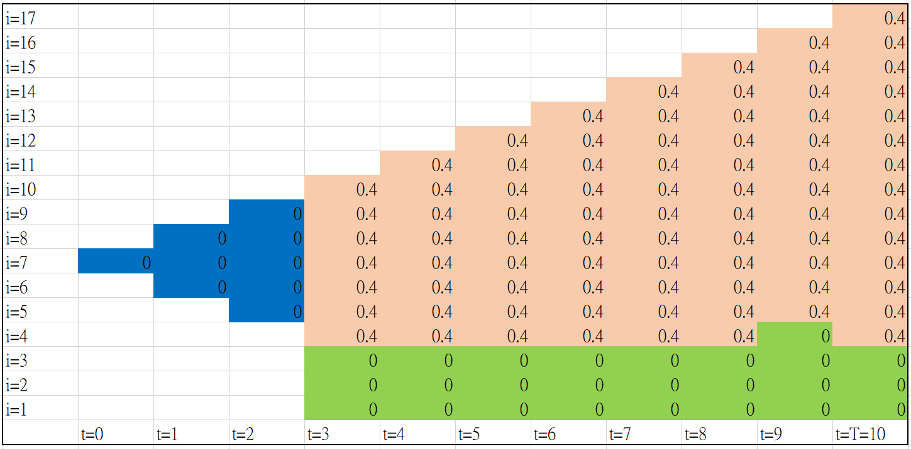
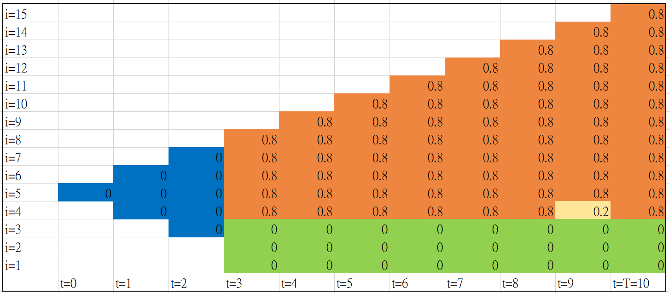
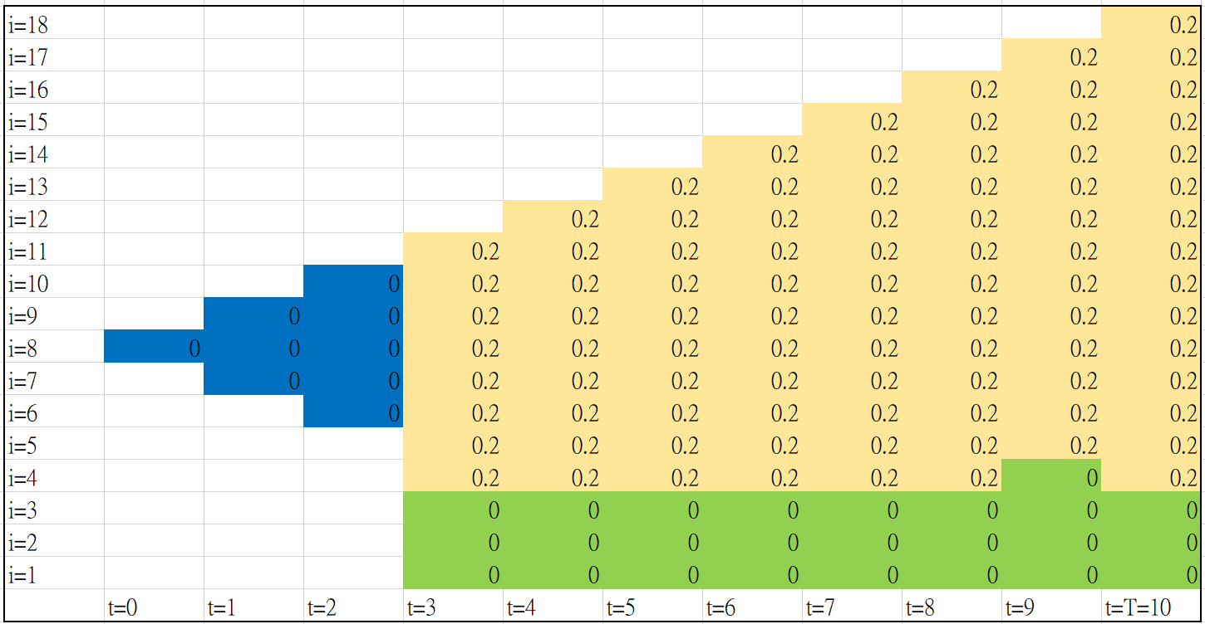
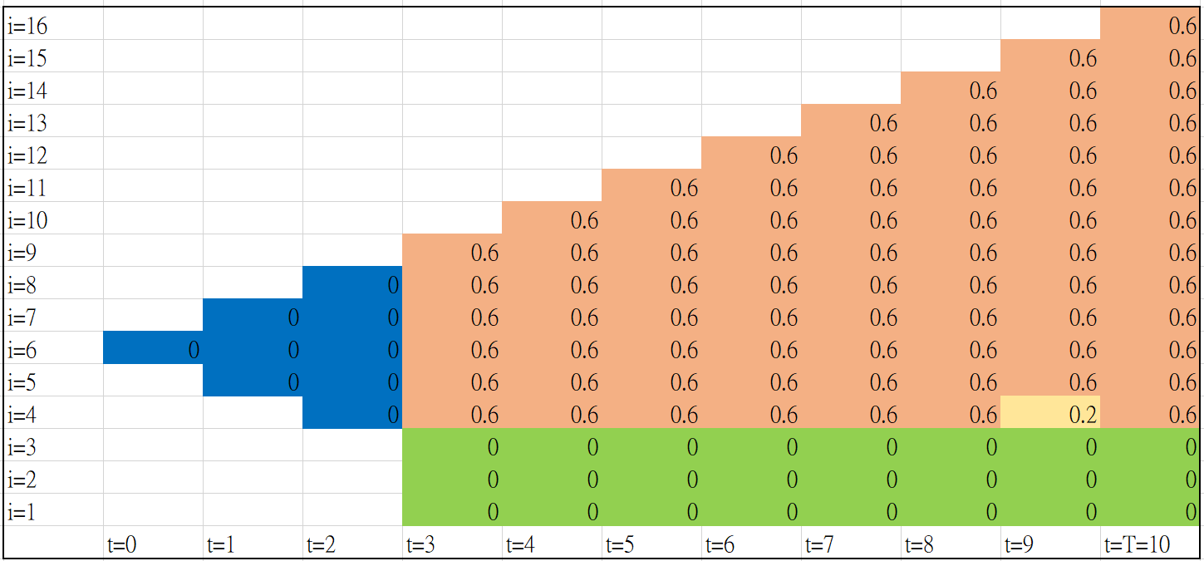
RP沿用元靖原先程式所使用的
←已履約0%
已履約60%→
←已履約20%
已履約80%→
←已履約40%

