Slide 1
meeting1011

Slide 2
Type_tax_employee=1
type_default=2
Method=1 最佳化員工效用
RP_method=1
Optm=1
U_method=1
CE_method=1
J時間點(右到左)、i垂直樹高(上到下)、a履約比例

Slide 3
元靖’s setting – maturity
Tax_employee = [wealth, exercise or not]
[Wealth, exercise] = (wage + exercise payoff + Div) * (1 - Tax) , if exercise = True = (wage) * (1 - Tax) , if exercise = False
RP = Tax_employee(a->100%)
Wealth = Tax_employee(a->b) , b=a~100% all possible percentage
CE = wealth
Utility = U(wealth, RP)

Slide 4
元靖’s setting – before maturity
Optimal_alpha = max{CE(a,b~100%)}
[Wealth, exercise] = (wage + exercise payoff + Div) * (1 - Tax) , if exercise = True = (wage) * (1 - Tax) , if exercise = False
RP = Tax_employee(a->100%) + Future_wage
Wealth = Tax_employee(a->b) , b=a~100% all possible percentage
CE = wealth+CPT_CE(E_U)*discount , E_U: future expected utility
Future_wage , discount value of next step wage
E_U = E{U_u, U_m, U_d} , U_u = U(CE_u)
Utility = U(CE, RP)

Slide 5
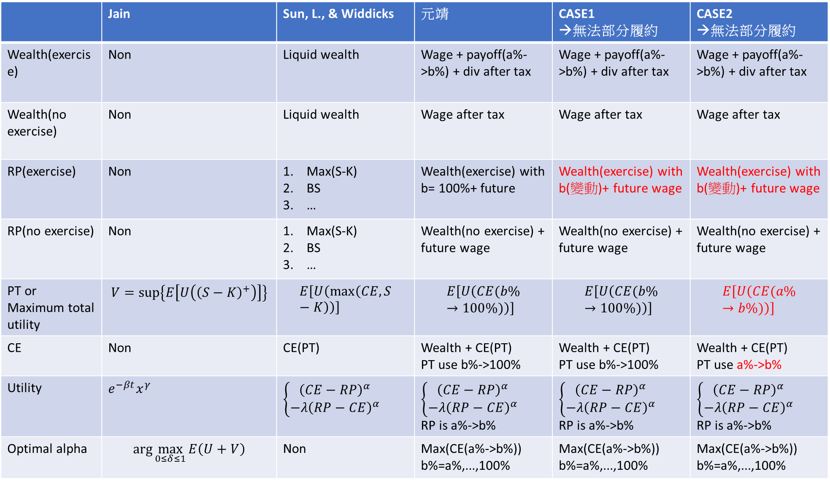
 | Jain | Sun, L., & Widdicks | 元靖 | CASE1 →無法部分履約 | CASE2 →無法部分履約
Wealth(exercise) | Non | Liquid wealth | Wage + payoff(a%->b%) + div after tax | Wage + payoff(a%->b%) + div after tax | Wage + payoff(a%->b%) + div after tax
Wealth(no exercise) | Non | Liquid wealth | Wage after tax | Wage after tax | Wage after tax
RP(exercise) | Non | Max(S-K) BS … | Wealth(exercise) with b= 100%+ future | Wealth(exercise) with b(變動)+ future wage | Wealth(exercise) with b(變動)+ future wage
RP(no exercise) | Non | Max(S-K) BS … | Wealth(no exercise) + future wage | Wealth(no exercise) + future wage | Wealth(no exercise) + future wage
PT or Maximum total utility | $$V=sup\left\{E\left[U\left({\left(S−K\right)}^{+}\right)\right]\right\}$$ | $$E\left[U\left(\max\left(CE,S−K\right)\right)\right]$$ | $$E\left[U\left(CE(b\%→100\%)\right)\right]$$ | $$E\left[U\left(CE(b\%→100\%)\right)\right]$$ | $$E\left[U\left(CE(a\%→b\%)\right)\right]$$
CE | Non | CE(PT) | Wealth + CE(PT) PT use b%->100% | Wealth + CE(PT) PT use b%->100% | Wealth + CE(PT) PT use a%->b%
Utility | $$e^{−βt}x^{γ}$$ | $$\left\{\begin{aligned}{\left(CE−RP\right)}^{α} \\ −λ{\left(RP−CE\right)}^{α}\end{aligned}\right.$$ | $$\left\{\begin{aligned}{\left(CE−RP\right)}^{α} \\ −λ{\left(RP−CE\right)}^{α}\end{aligned}\right.$$ RP is a%->b% | $$\left\{\begin{aligned}{\left(CE−RP\right)}^{α} \\ −λ{\left(RP−CE\right)}^{α}\end{aligned}\right.$$ RP is a%->b% | $$\left\{\begin{aligned}{\left(CE−RP\right)}^{α} \\ −λ{\left(RP−CE\right)}^{α}\end{aligned}\right.$$ RP is a%->b%
Optimal alpha | $$\arg{\max_{0≤δ≤1}{E\left(U+V\right)}}$$ | Non | Max(CE(a%->b%)) b%=a%,...,100% | Max(CE(a%->b%)) b%=a%,...,100% | Max(CE(a%->b%)) b%=a%,...,100%

