Slide 1
9.3.6 Garman-Kohlhagen Formula
邢子謙 06/13

Slide 2
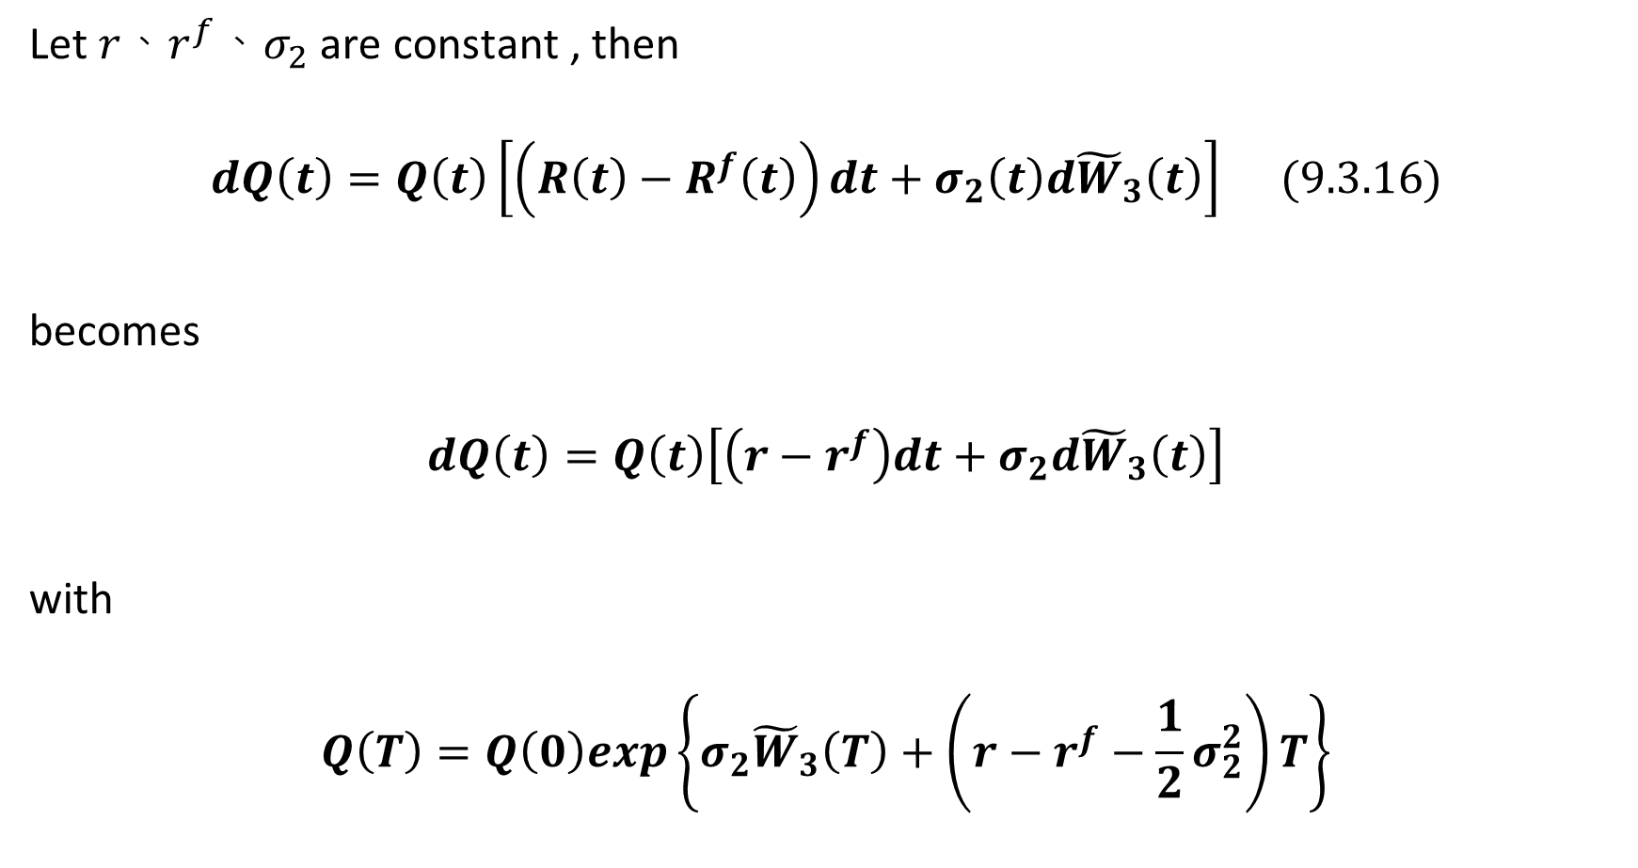
Let $r、r^{f}、σ_{2}$ are constant , then
$$dQ\left(t\right)=Q\left(t\right)\left[\left(R\left(t\right)−R^{f}\left(t\right)\right)dt+σ_{2}\left(t\right)d{\tilde{W}}_{3}\left(t\right)\right] (9.3.16)$$
becomes
$$dQ\left(t\right)=Q\left(t\right)\left[\left(r−r^{f}\right)dt+σ_{2}d{\tilde{W}}_{3}\left(t\right)\right]$$
with
$$Q\left(T\right)=Q\left(0\right)exp\left\{σ_{2}{\tilde{W}}_{3}\left(T\right)+\left(r−r^{f}−\frac{1}{2}σ_{2}^{2}\right)T\right\}$$

Slide 3

A call on a unit of foreign currency whose payoff in domestic currency is
$${(Q\left(T\right)−K)}^{+}$$
The value of it at t=0 is
$$\tilde{E}\left[e^{−rT}{\left(Q\left(T\right)−K\right)}^{+}\right]$$

Slide 4
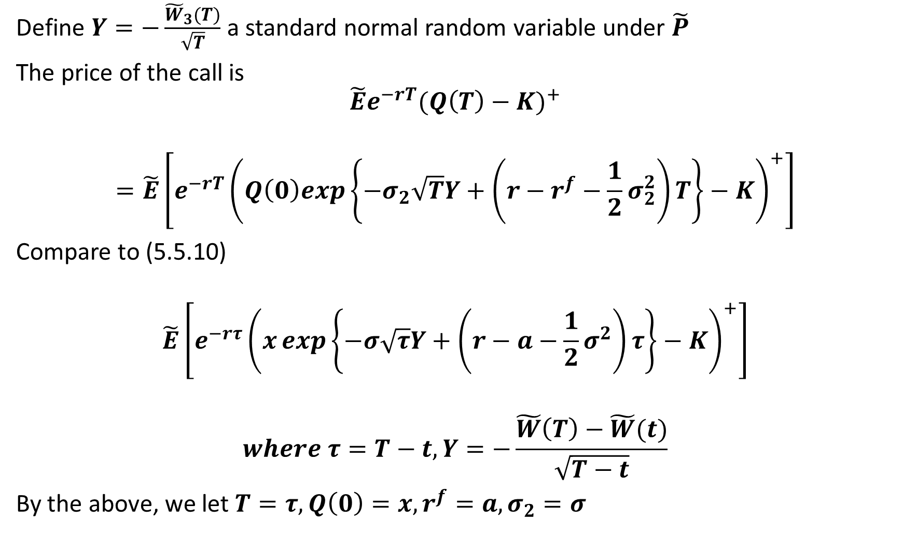
Define $Y=−\frac{{\tilde{W}}_{3}(T)}{\sqrt{T}}$ a standard normal random variable under $\tilde{P}$
The price of the call is
$$\tilde{E}e^{−rT}{(Q\left(T\right)−K)}^{+}$$
$$=\tilde{E}\left[e^{−rT}{\left(Q\left(0\right)exp\left\{−σ_{2}\sqrt{T}Y+\left(r−r^{f}−\frac{1}{2}σ_{2}^{2}\right)T\right\}−K\right)}^{+}\right]$$
Compare to (5.5.10)
$$\tilde{E}\left[e^{−rτ}{\left(x\exp\left\{−σ\sqrt{τ}Y+\left(r−a−\frac{1}{2}σ^{2}\right)τ\right\}−K\right)}^{+}\right]$$
$$where τ=T−t, Y=−\frac{\tilde{W}\left(T\right)−\tilde{W}(t)}{\sqrt{T−t}}$$
By the above, we let $T=τ, Q\left(0\right)=x, r^{f}=a, σ_{2}=σ$

Slide 5
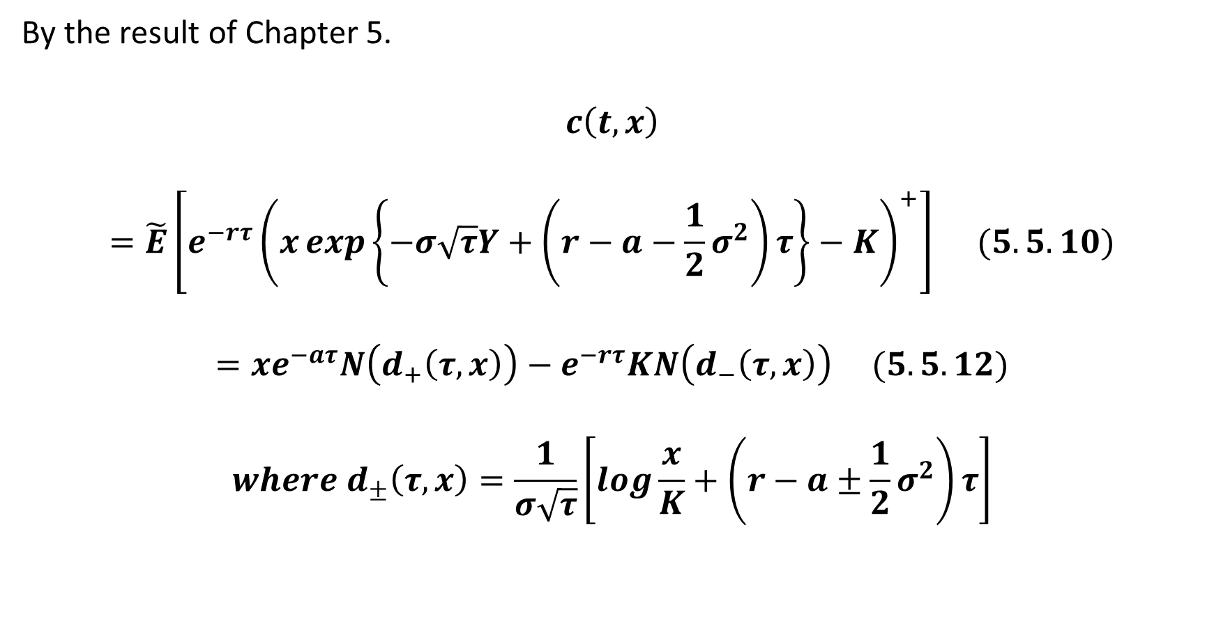
By the result of Chapter 5.
$$c\left(t, x\right)$$
$$=\tilde{E}\left[e^{−rτ}{\left(x\exp\left\{−σ\sqrt{τ}Y+\left(r−a−\frac{1}{2}σ^{2}\right)τ\right\}−K\right)}^{+}\right] (5.5.10)$$
$$=xe^{−aτ}N\left(d_{+}\left(τ, x\right)\right)−e^{−rτ}KN\left(d_{−}\left(τ, x\right)\right) (5.5.12)$$
$$where d_{±}\left(τ, x\right)=\frac{1}{σ\sqrt{τ}}\left[log\frac{x}{K}+\left(r−a±\frac{1}{2}σ^{2}\right)τ\right]$$

Slide 6
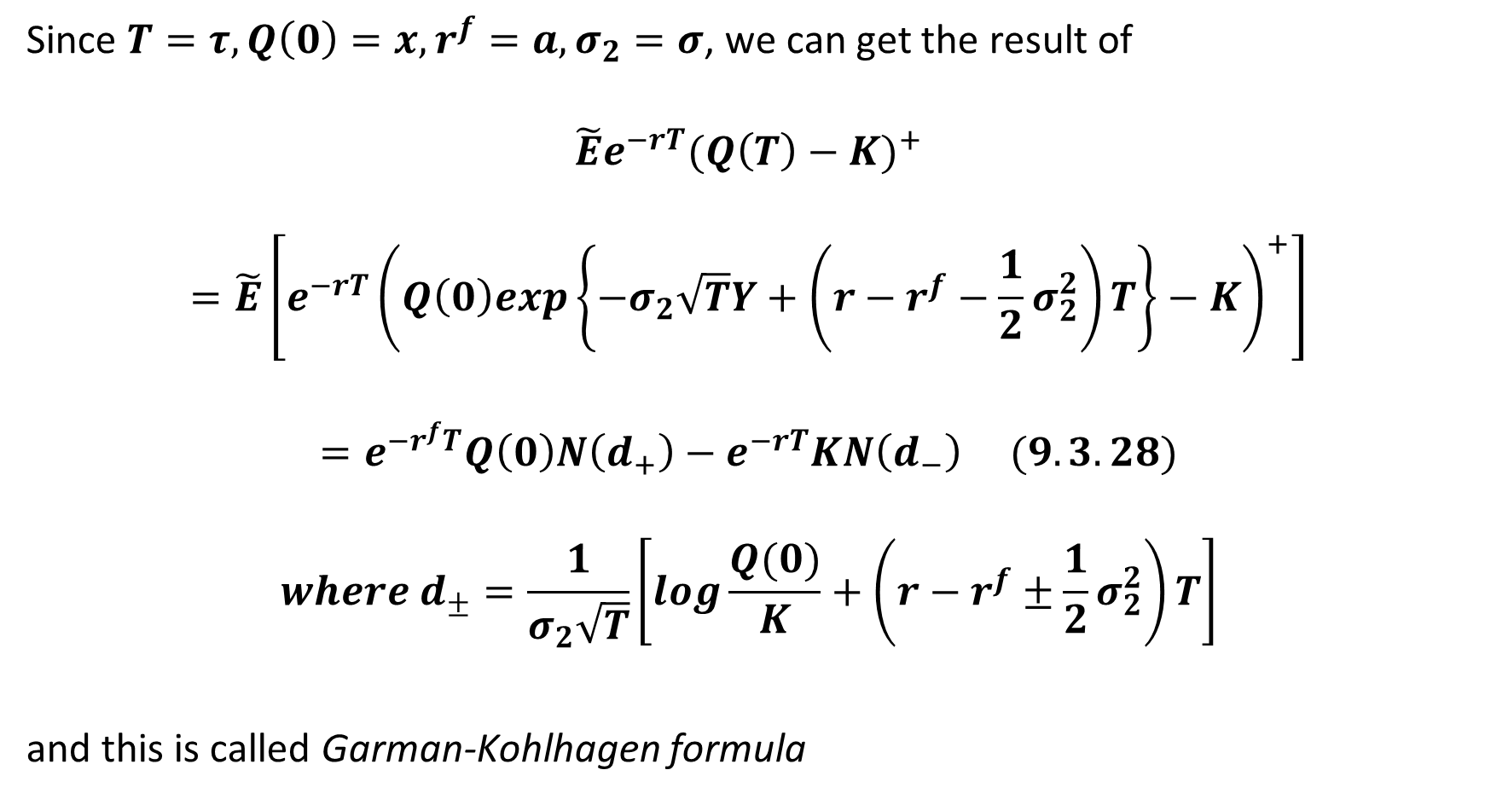
Since $T=τ, Q\left(0\right)=x, r^{f}=a, σ_{2}=σ$, we can get the result of
$$\tilde{E}e^{−rT}{(Q\left(T\right)−K)}^{+}$$
$$=\tilde{E}\left[e^{−rT}{\left(Q\left(0\right)exp\left\{−σ_{2}\sqrt{T}Y+\left(r−r^{f}−\frac{1}{2}σ_{2}^{2}\right)T\right\}−K\right)}^{+}\right]$$
$$=e^{−r^{f}T}Q\left(0\right)N\left(d_{+}\right)−e^{−rT}KN\left(d_{−}\right) (9.3.28)$$
$$where d_{±}=\frac{1}{σ_{2}\sqrt{T}}\left[log\frac{Q(0)}{K}+\left(r−r^{f}±\frac{1}{2}σ_{2}^{2}\right)T\right]$$
and this is called Garman-Kohlhagen formula

Slide 7
9.3.7 Exchange Rate Put-Call Duality

Slide 8
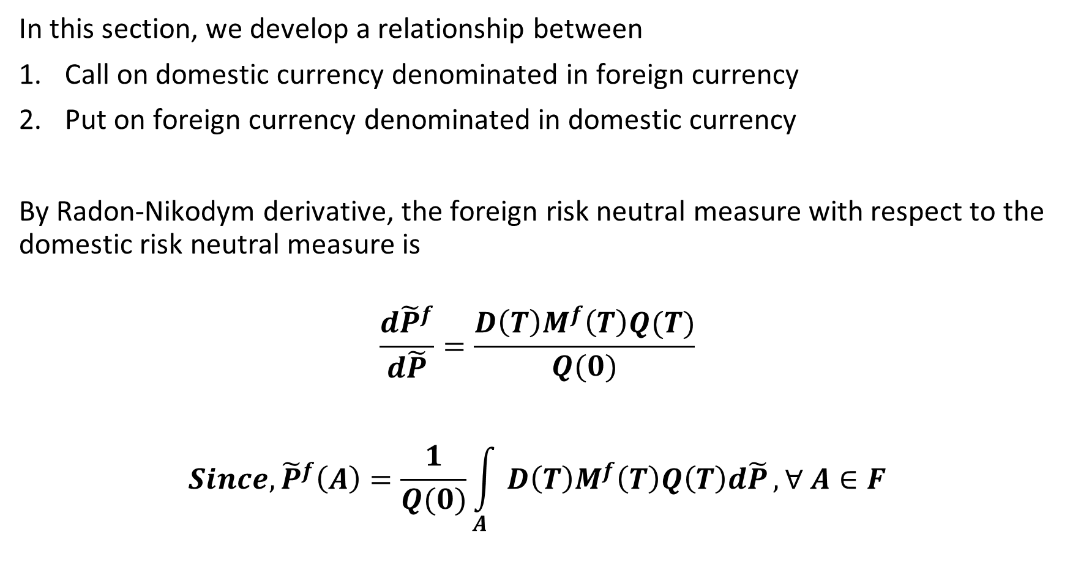
In this section, we develop a relationship between
Call on domestic currency denominated in foreign currency
Put on foreign currency denominated in domestic currency
By Radon-Nikodym derivative, the foreign risk neutral measure with respect to the domestic risk neutral measure is
$$\frac{d{\tilde{P}}^{f}}{d\tilde{P}}=\frac{D\left(T\right)M^{f}\left(T\right)Q(T)}{Q(0)}$$
$$Since, {\tilde{P}}^{f}\left(A\right)=\frac{1}{Q(0)}\int_{A}{D\left(T\right)M^{f}\left(T\right)Q\left(T\right)d\tilde{P}}, ∀ A∈F$$

Slide 9

And then since
$$\frac{d{\tilde{P}}^{f}}{d\tilde{P}}=\frac{D\left(T\right)M^{f}\left(T\right)Q(T)}{Q(0)}$$
For any random variable $X$
$${\tilde{E}}^{f}\left(X\right)=\tilde{E}\left[\frac{D\left(T\right)M^{f}\left(T\right)Q\left(T\right)}{Q\left(0\right)}X\right]$$

Slide 10
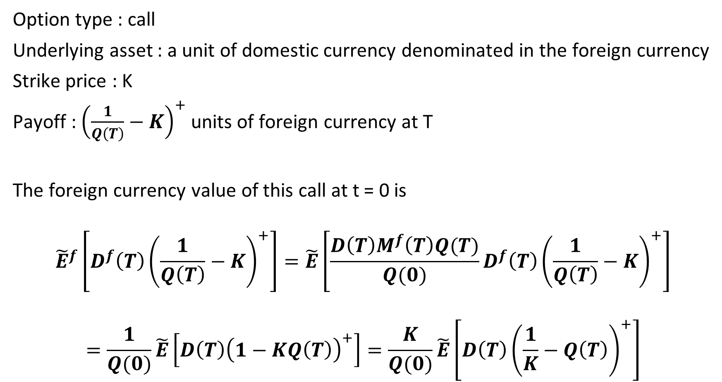
Option type : call
Underlying asset : a unit of domestic currency denominated in the foreign currency
Strike price : K
Payoff : ${\left(\frac{1}{Q\left(T\right)}−K\right)}^{+}$ units of foreign currency at T
The foreign currency value of this call at t = 0 is
$${\tilde{E}}^{f}\left[D^{f}\left(T\right){\left(\frac{1}{Q\left(T\right)}−K\right)}^{+}\right]=\tilde{E}\left[\frac{D\left(T\right)M^{f}\left(T\right)Q(T)}{Q(0)}D^{f}\left(T\right){\left(\frac{1}{Q\left(T\right)}−K\right)}^{+}\right]$$
$$=\frac{1}{Q(0)}\tilde{E}\left[D\left(T\right){\left(1−KQ\left(T\right)\right)}^{+}\right]=\frac{K}{Q(0)}\tilde{E}\left[D\left(T\right){\left(\frac{1}{K}−Q\left(T\right)\right)}^{+}\right]$$

Slide 11
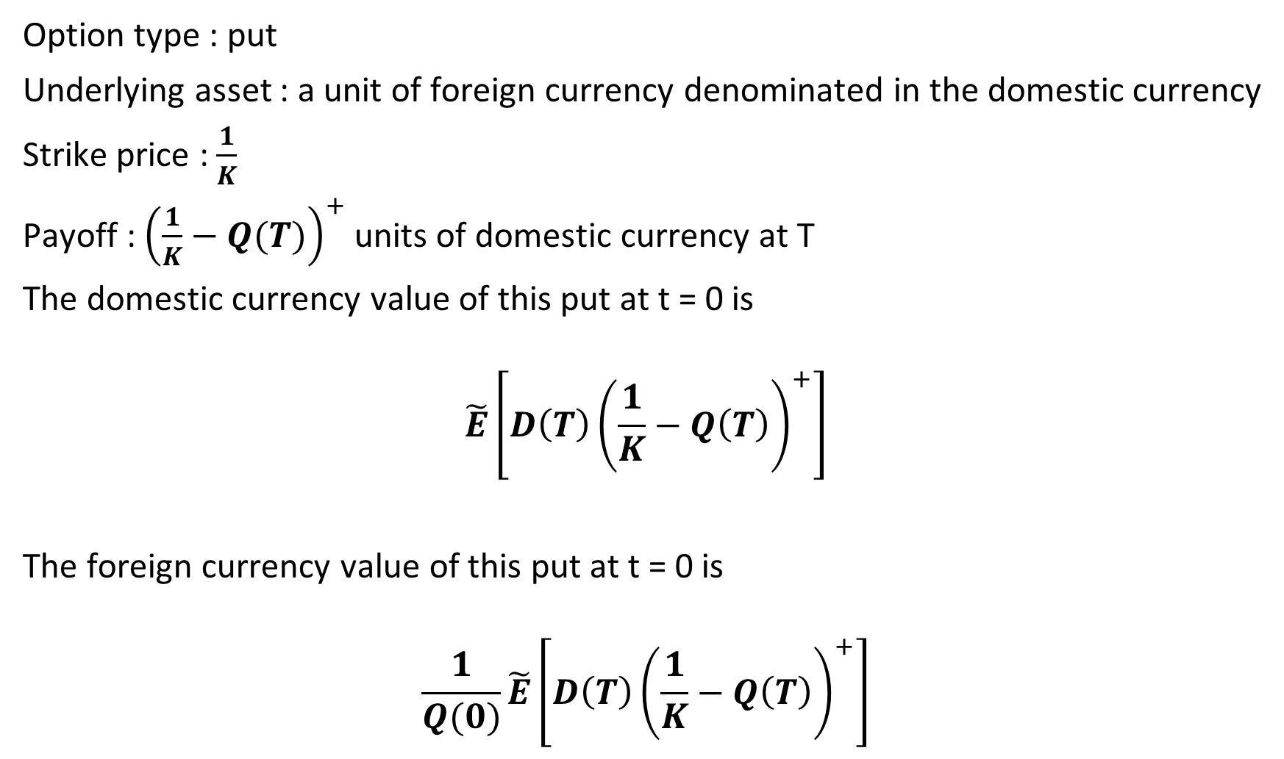
Option type : put
Underlying asset : a unit of foreign currency denominated in the domestic currency
Strike price : $\frac{1}{K}$
Payoff : ${\left(\frac{1}{K}−Q(T)\right)}^{+}$ units of domestic currency at T
The domestic currency value of this put at t = 0 is
$$\tilde{E}\left[D\left(T\right){\left(\frac{1}{K}−Q\left(T\right)\right)}^{+}\right]$$
The foreign currency value of this put at t = 0 is
$$\frac{1}{Q(0)}\tilde{E}\left[D\left(T\right){\left(\frac{1}{K}−Q\left(T\right)\right)}^{+}\right]$$

Slide 12
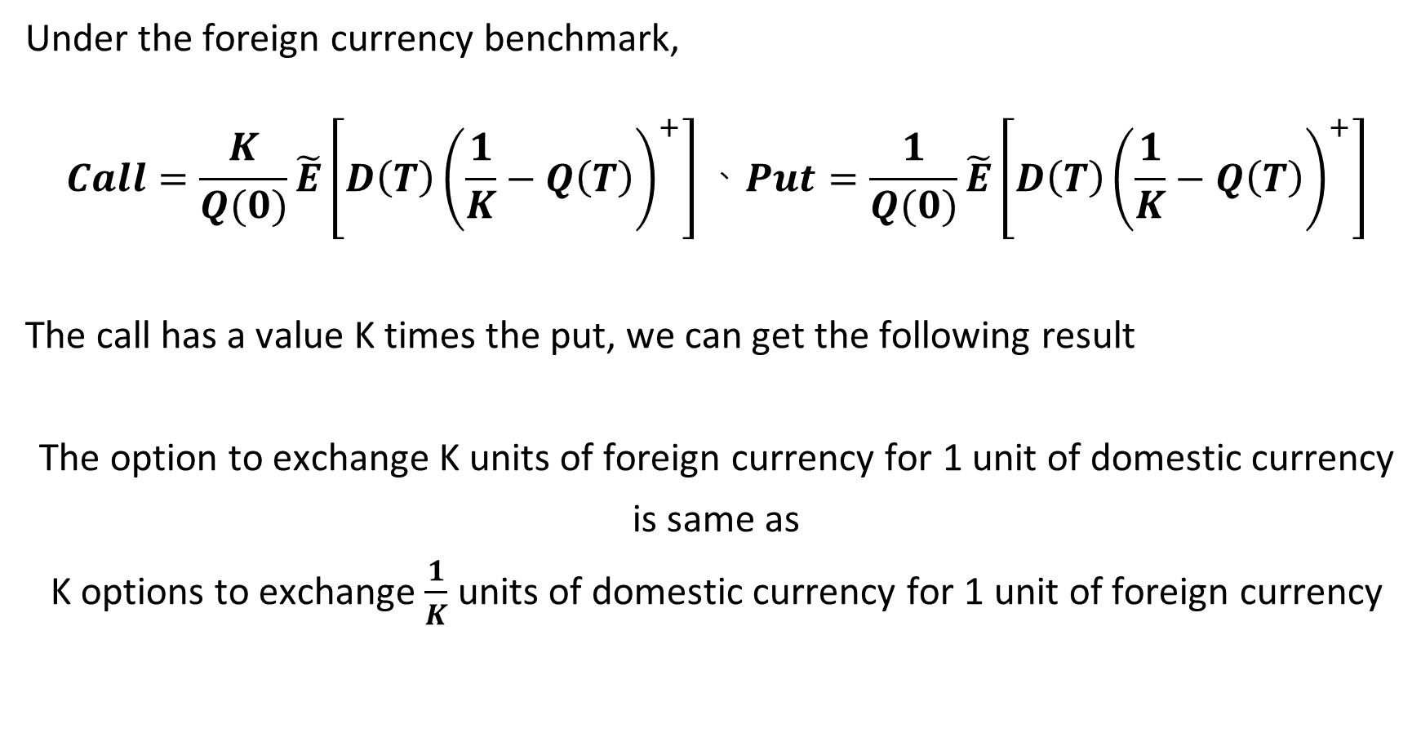
Under the foreign currency benchmark,
$$Call=\frac{K}{Q(0)}\tilde{E}\left[D\left(T\right){\left(\frac{1}{K}−Q\left(T\right)\right)}^{+}\right]、Put=\frac{1}{Q(0)}\tilde{E}\left[D\left(T\right){\left(\frac{1}{K}−Q\left(T\right)\right)}^{+}\right]$$
The call has a value K times the put, we can get the following result
The option to exchange K units of foreign currency for 1 unit of domestic currency
is same as
K options to exchange $\frac{1}{K}$ units of domestic currency for 1 unit of foreign currency

Slide 13
9.4.1 Forward Price

Slide 14
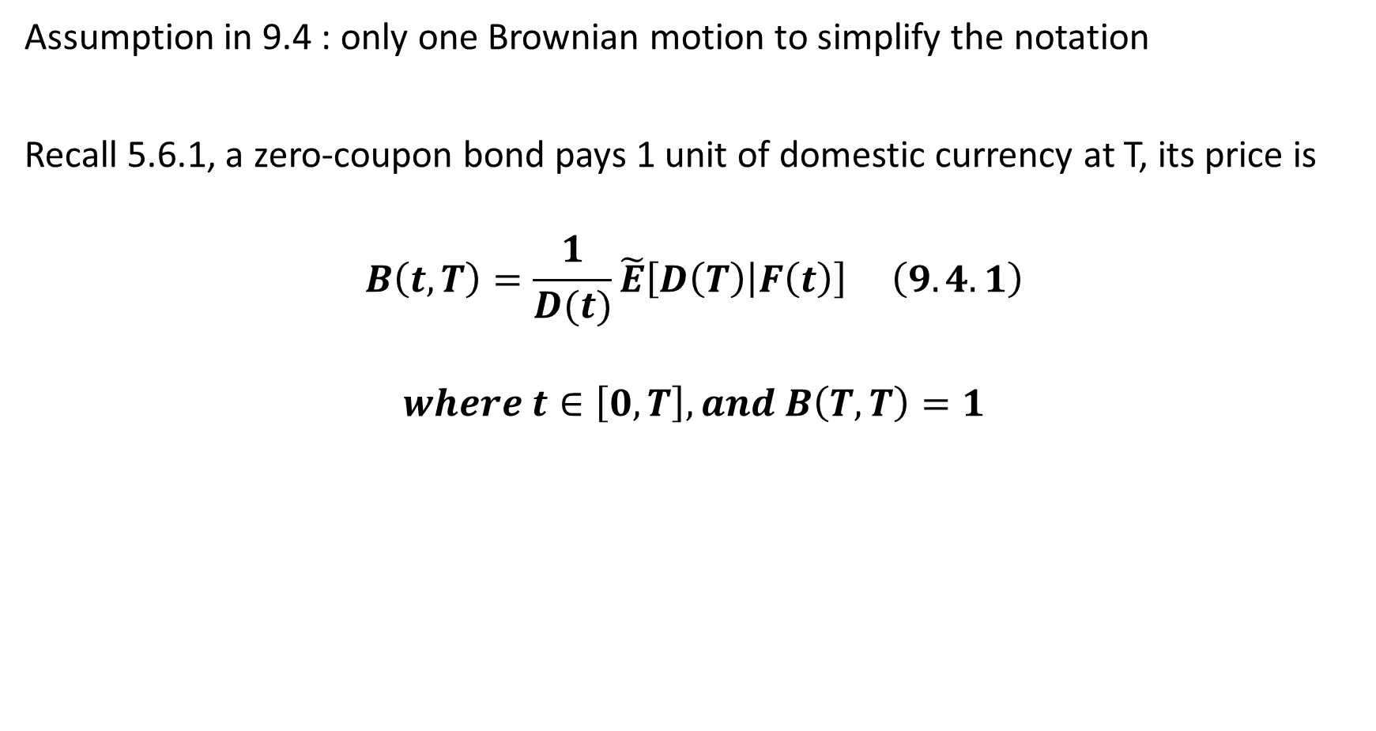
Assumption in 9.4 : only one Brownian motion to simplify the notation
Recall 5.6.1, a zero-coupon bond pays 1 unit of domestic currency at T, its price is
$$B\left(t, T\right)=\frac{1}{D(t)}\tilde{E}\left[D\left(T\right) | F\left(t\right)\right] \left(9.4.1\right)$$
$$where t∈\left[0, T\right], and B\left(T, T\right)=1$$

Slide 15

Consider an asset denominated in domestic currency is $S(t)$
Payoff for a forward contract that deliver 1 share of asset in exchange for K at T is
$$S\left(T\right)−K$$
Payoff at earlier time t is
$$V\left(t\right)=\frac{1}{D(t)}\tilde{E}\left[D\left(T\right)\left(S\left(T\right)−K\right) | F\left(t\right)\right]$$

Slide 16
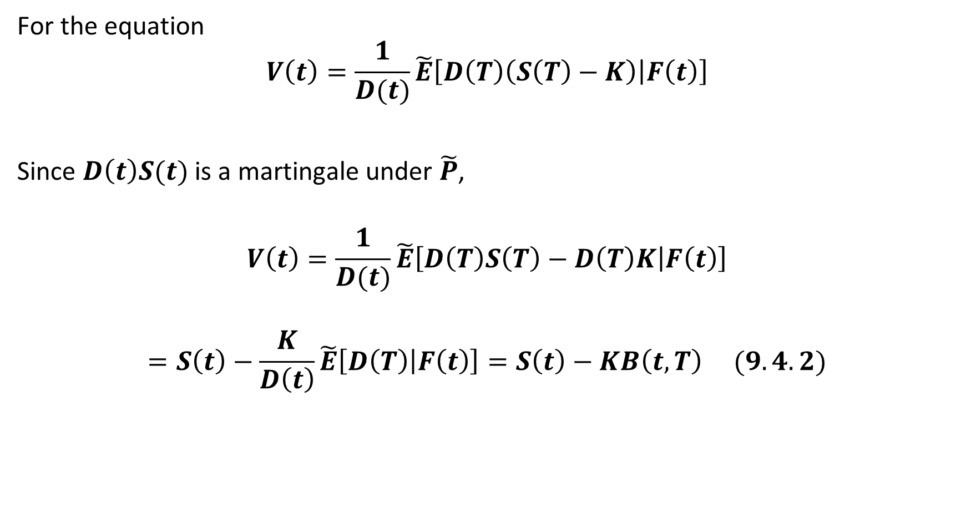
For the equation
$$V\left(t\right)=\frac{1}{D(t)}\tilde{E}\left[D\left(T\right)\left(S\left(T\right)−K\right) | F\left(t\right)\right]$$
Since $D\left(t\right)S(t)$ is a martingale under $\tilde{P}$,
$$V\left(t\right)=\frac{1}{D(t)}\tilde{E}\left[D\left(T\right)S\left(T\right)−D\left(T\right)K | F\left(t\right)\right]$$
$$=S\left(t\right)−\frac{K}{D\left(t\right)}\tilde{E}\left[D\left(T\right) | F\left(t\right)\right]=S\left(t\right)−KB\left(t, T\right) (9.4.2)$$

Slide 17

The T-forward price of an asset ${For}_{S}\left(t, T\right)$ at $t∈\left[0, T\right]$ is the value of K causes $\left(9.4.2\right)=0$
$$S\left(t\right)−KB\left(t, T\right)=0$$
$$→ {For}_{S}\left(t, T\right)=K=\frac{S(t)}{B(t, T)} (9.4.3)$$

