Slide 1
Implementation of HJM
邢子謙 09/18

Slide 2
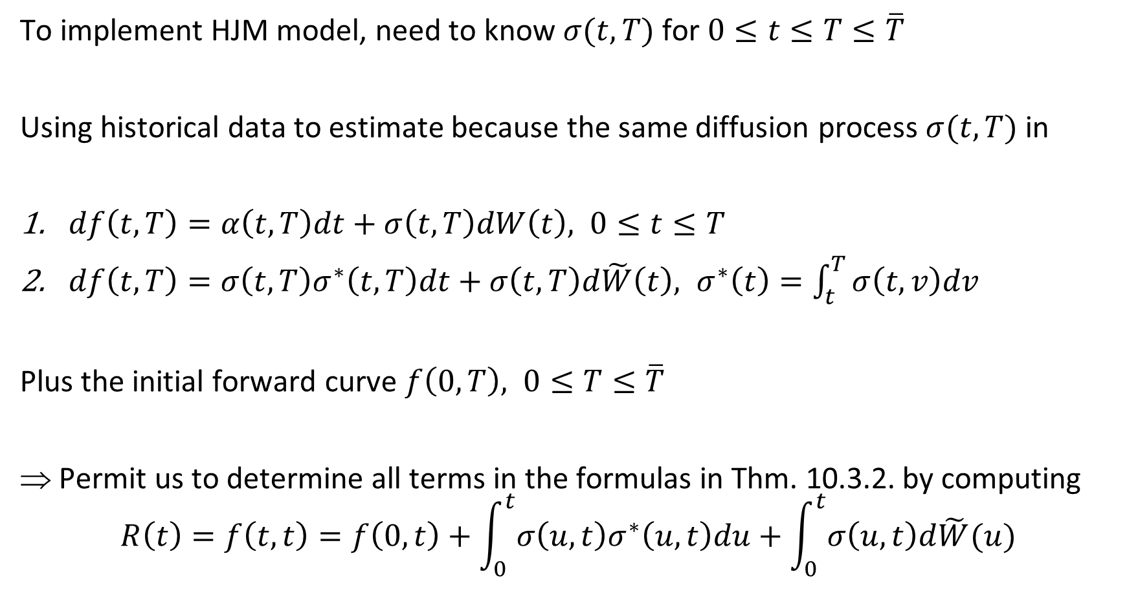
To implement HJM model, need to know $σ(t, T)$ for $0≤t≤T≤\overline{T}$
Using historical data to estimate because the same diffusion process $σ(t, T)$ in
$df\left(t, T\right)=α\left(t,T\right)dt+σ\left(t,T\right)dW\left(t\right), 0≤t≤T$
$df\left(t, T\right)=σ\left(t,T\right)σ^{∗}\left(t, T\right)dt+σ\left(t,T\right)d\tilde{W}\left(t\right), σ^{∗}\left(t\right)=\int_{t}^{T}{σ\left(t, v\right)dv}$
Plus the initial forward curve $f\left(0, T\right), 0≤T≤\overline{T}$
Permit us to determine all terms in the formulas in Thm. 10.3.2. by computing
$$R\left(t\right)=f\left(t,t\right)=f\left(0,t\right)+\int_{0}^{t}{σ\left(u,t\right)σ^{∗}\left(u,t\right)du}+\int_{0}^{t}{σ\left(u,t\right)d\tilde{W}(u)}$$

Slide 3
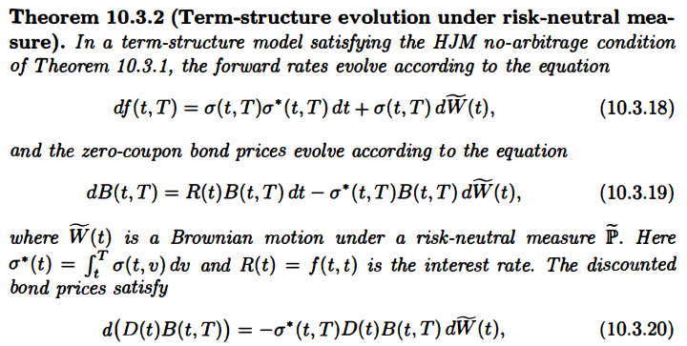
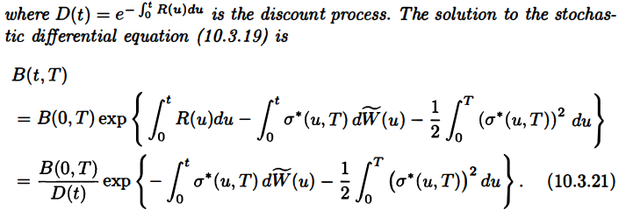

Slide 4
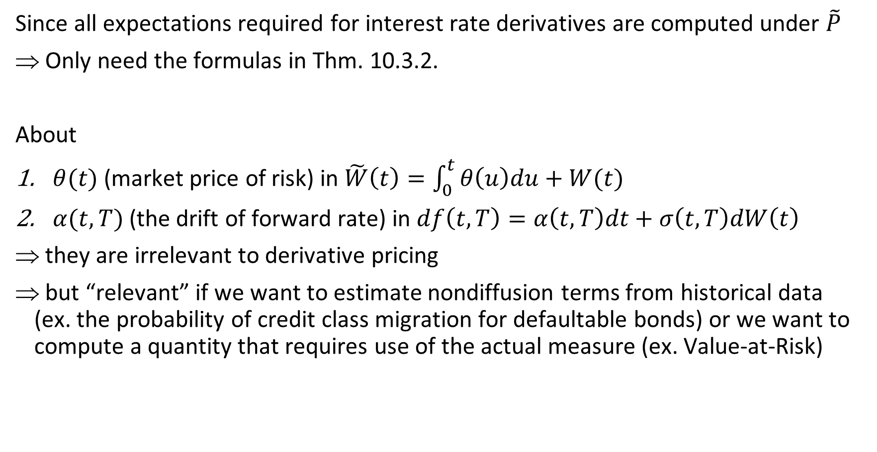
Since all expectations required for interest rate derivatives are computed under $\tilde{P}$
Only need the formulas in Thm. 10.3.2.
About
$θ(t)$ (market price of risk) in $\tilde{W}\left(t\right)=\int_{0}^{t}{θ\left(u\right)du}+W(t)$
$α(t, T)$ (the drift of forward rate) in $df\left(t, T\right)=α\left(t,T\right)dt+σ\left(t,T\right)dW\left(t\right)$
they are irrelevant to derivative pricing
but “relevant” if we want to estimate nondiffusion terms from historical data (ex. the probability of credit class migration for defaultable bonds) or we want to compute a quantity that requires use of the actual measure (ex. Value-at-Risk)

Slide 5
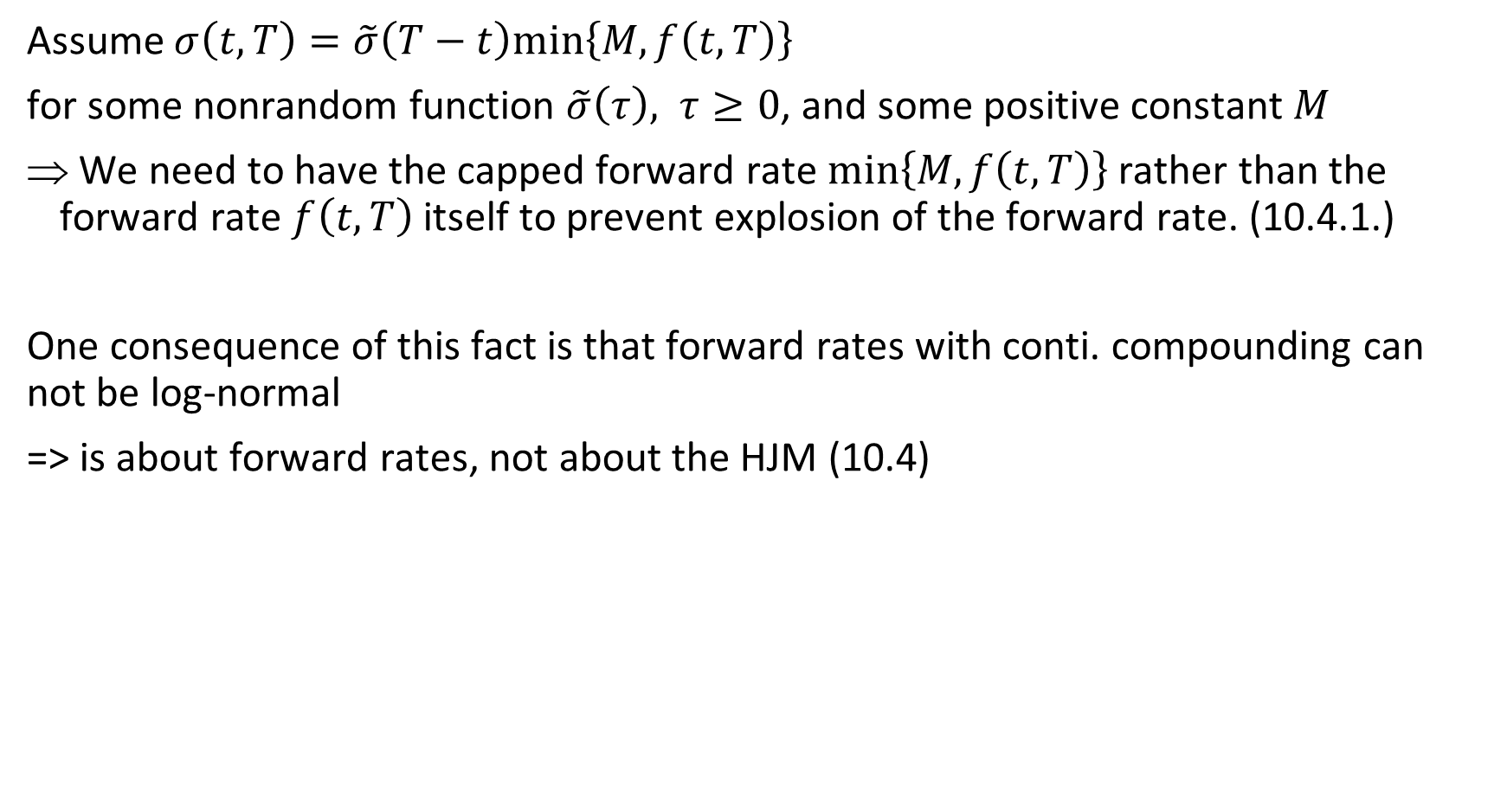
Assume $σ\left(t,T\right)=\tilde{σ}\left(T−t\right)min\left\{M,f\left(t,T\right)\right\}$
for some nonrandom function $\tilde{σ}\left(τ\right), τ≥0$, and some positive constant $M$
We need to have the capped forward rate $min\left\{M,f\left(t,T\right)\right\}$ rather than the forward rate $f\left(t,T\right)$ itself to prevent explosion of the forward rate. (10.4.1.)
One consequence of this fact is that forward rates with conti. compounding can not be log-normal
=> is about forward rates, not about the HJM (10.4)

Slide 6
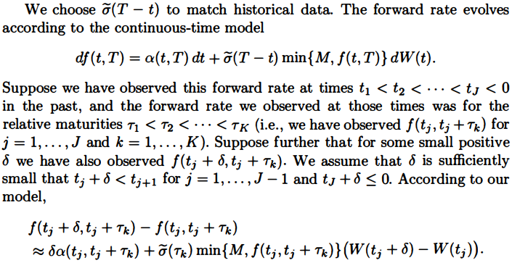

Slide 7

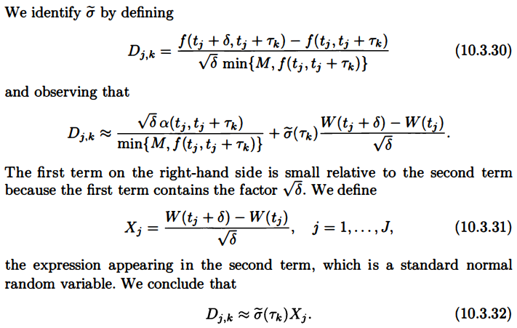

Slide 8

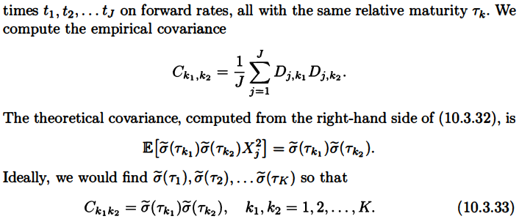

Slide 9
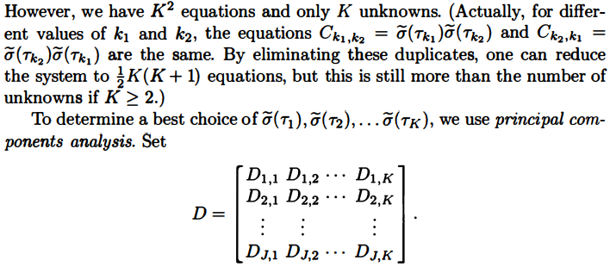

Slide 10
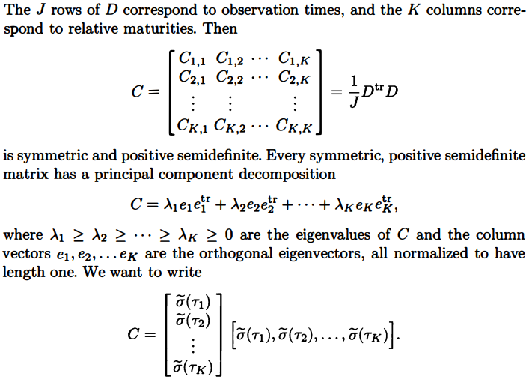

Slide 11
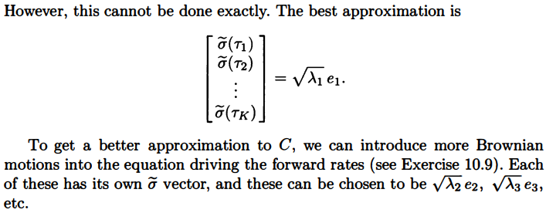

Slide 12
