Slide 1
Tighter Robust Upper Bounds for Options via No-Regret Learning
10/29 邢子謙

Slide 2
選擇權定價研究方向
引入更多模型來處理標的物更一般化的動態變化
為不同選擇權制定與模型無關的邊界
本文 :
no-regret learning which called η-momentum trading strategy, derive tighter robust upper bounds for options.

Slide 3
No-Regret Learning
About regret :
類似於機會成本，定義為被拒絕選項與所選之選項的實際結果差值。例如當今天有A、B兩檔股票，若我先買了A，而後B上漲、A下跌，則會對此決策產生後悔。
最小化最大後悔原則 : 先計算每個選項對應的可能最大後悔值，再選出最大後悔值中最小的。
About no-regret :
採用基於後悔值的學習方法後，根據各個行為的後悔值做出選擇，若有一種算法能夠保證最大後悔值漸進為零，則該算法可稱為無悔學習算法。

Slide 4
Pricing and Learning
基本概念來自於 no-regret learning。
考慮初始資金為 I 的投資人有一個動態策略，會在股票和債券之間分配資金。
假設在任何的股票價格過程中，他在 T 時間的資本都不低於選擇權的收益加上履約價 K，根據無套利原則，選擇權的價格上限為 I-K。

Slide 5
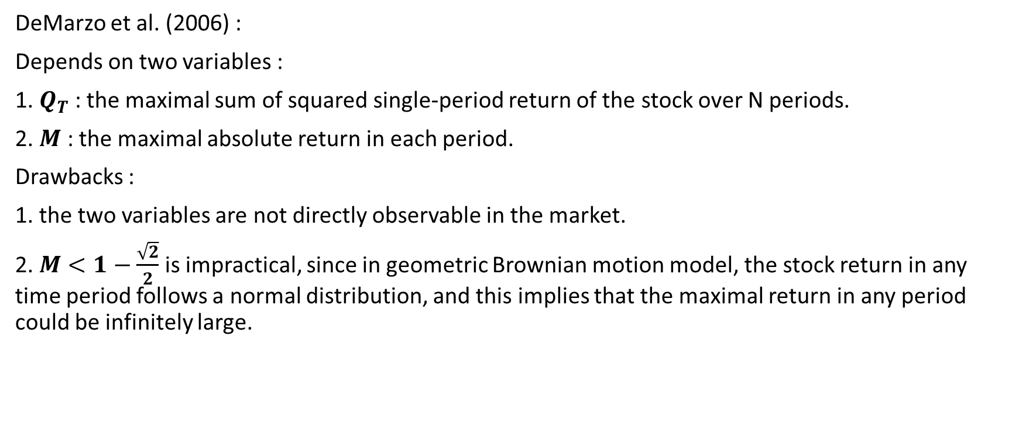
過去文獻的缺點
DeMarzo et al. (2006) :
Depends on two variables :
1. $Q_{T}$ : the maximal sum of squared single-period return of the stock over N periods.
2. $M$ : the maximal absolute return in each period.
Drawbacks :
1. the two variables are not directly observable in the market.
2. $M<1−\frac{\sqrt{2}}{2}$ is impractical, since in geometric Brownian motion model, the stock return in any time period follows a normal distribution, and this implies that the maximal return in any period could be infinitely large.

Slide 6
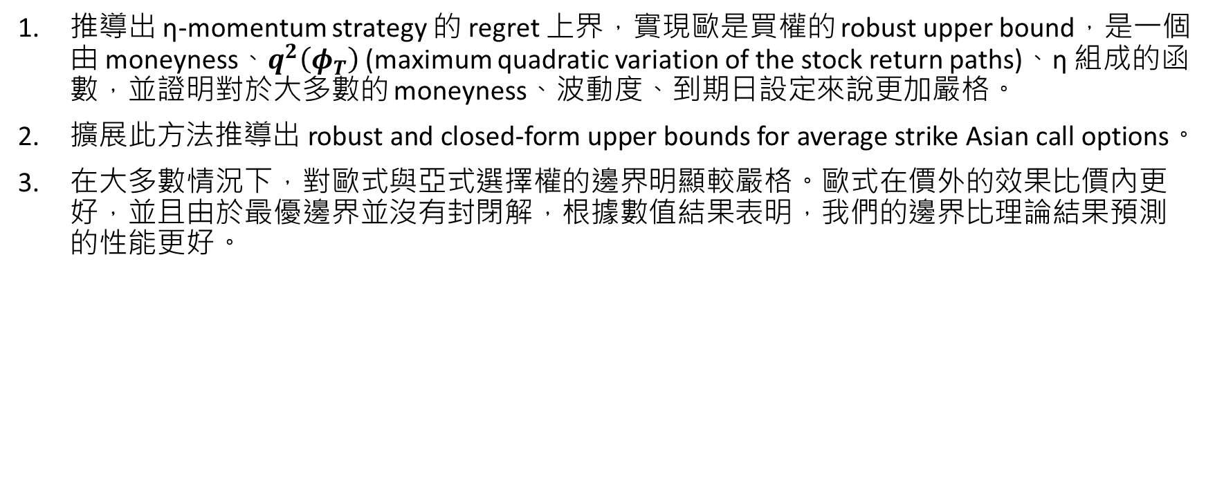
本文貢獻
推導出 η-momentum strategy 的 regret 上界，實現歐是買權的 robust upper bound，是一個由 moneyness、$q^{2}\left(φ_{T}\right)$ (maximum quadratic variation of the stock return paths)、η 組成的函數，並證明對於大多數的 moneyness、波動度、到期日設定來說更加嚴格。
擴展此方法推導出 robust and closed-form upper bounds for average strike Asian call options。
在大多數情況下，對歐式與亞式選擇權的邊界明顯較嚴格。歐式在價外的效果比價內更好，並且由於最優邊界並沒有封閉解，根據數值結果表明，我們的邊界比理論結果預測的性能更好。

Slide 7
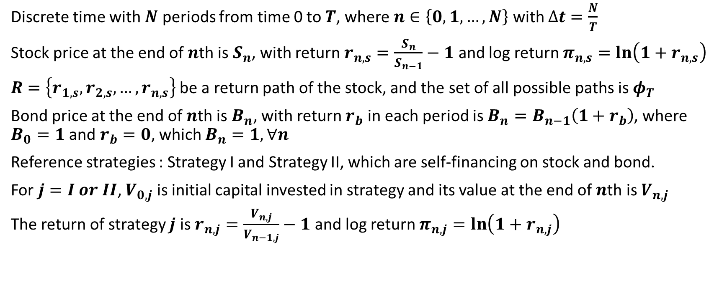
η-Momentum Trading Strategy
Discrete time with $N$ periods from time 0 to $T$, where $n∈\left\{0, 1, …, N\right\}$ with $∆t=\frac{N}{T}$
Stock price at the end of $n$th is $S_{n}$, with return $r_{n,s}=\frac{S_{n}}{S_{n−1}}−1$ and log return $π_{n,s}=\ln\left(1+r_{n,s}\right)$
$R=\left\{r_{1,s},r_{2,s},…,r_{n,s}\right\}$ be a return path of the stock, and the set of all possible paths is $φ_{T}$
Bond price at the end of $n$th is $B_{n}$, with return $r_{b}$ in each period is $B_{n}=B_{n−1}\left(1+r_{b}\right)$, where $B_{0}=1$ and $r_{b}=0$, which $B_{n}=1, ∀n$
Reference strategies : Strategy I and Strategy II, which are self-financing on stock and bond.
For $j=I or II$, $V_{0,j}$ is initial capital invested in strategy and its value at the end of $n$th is $V_{n,j}$
The return of strategy $j$ is $r_{n,j}=\frac{V_{n, j}}{V_{n−1,j}}−1$ and log return $π_{n,j}=\ln\left(1+r_{n,j}\right)$

Slide 8
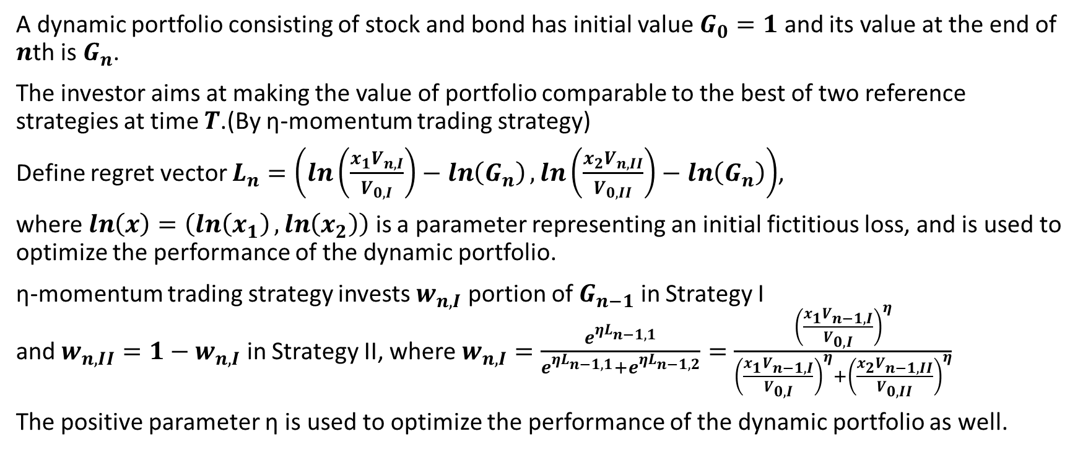
η-Momentum Trading Strategy
A dynamic portfolio consisting of stock and bond has initial value $G_{0}=1$ and its value at the end of $n$th is $G_{n}$.
The investor aims at making the value of portfolio comparable to the best of two reference strategies at time $T$.(By η-momentum trading strategy)
Define regret vector $L_{n}=\left(\ln\left(\frac{x_{1}V_{n,I}}{V_{0,I}}\right)−\ln\left(G_{n}\right),\ln\left(\frac{x_{2}V_{n,II}}{V_{0,II}}\right)−\ln\left(G_{n}\right)\right)$,
where $\ln\left(x\right)=\left(\ln\left(x_{1}\right),\ln\left(x_{2}\right)\right)$ is a parameter representing an initial fictitious loss, and is used to optimize the performance of the dynamic portfolio.
η-momentum trading strategy invests $w_{n,I}$ portion of $G_{n−1}$ in Strategy I and $w_{n,II}=1−w_{n,I}$ in Strategy II, where $w_{n,I}=\frac{e^{ηL_{n−1,1}}}{e^{ηL_{n−1,1}}+e^{ηL_{n−1,2}}}=\frac{{\left(\frac{x_{1}V_{n−1,I}}{V_{0,I}}\right)}^{η}}{{\left(\frac{x_{1}V_{n−1,I}}{V_{0,I}}\right)}^{η}+{\left(\frac{x_{2}V_{n−1,II}}{V_{0,II}}\right)}^{η}}$
The positive parameter η is used to optimize the performance of the dynamic portfolio as well.

Slide 9

The Regret Bound of the η-Momentum Trading Strategy
Thm 1.
$$\max\left(\ln\left(\frac{x_{1}V_{N,I}}{V_{0,I}}\right),\ln\left(\frac{x_{2}V_{N,II}}{V_{0,II}}\right)\right)−\ln\left(G_{N}\right)≤\frac{\ln\left({x_{1}}^{η}+{x_{2}}^{η}\right)}{η}+\frac{ηq^{2}\left(R\right)}{8}, \\ where q^{2}\left(R\right)=\sum_{n=1}^{N}{{\left(π_{n,I}−π_{n,II}\right)}^{2}}$$

Slide 10
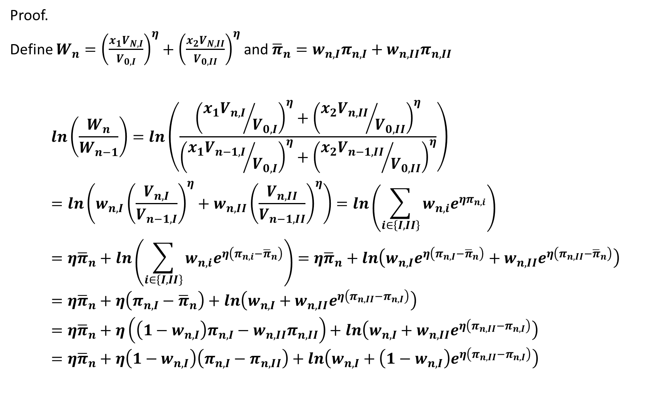
Proof.
Define $W_{n}={\left(\frac{x_{1}V_{N,I}}{V_{0,I}}\right)}^{η}+{\left(\frac{x_{2}V_{N,II}}{V_{0,II}}\right)}^{η}$ and ${\overline{π}}_{n}=w_{n,I}π_{n,I}+w_{n,II}π_{n,II}$
$$\ln\left(\frac{W_{n}}{W_{n−1}}\right)=\ln\left(\frac{{\left({x_{1}V_{n,I}}/{V_{0,I}}\right)}^{η}+{\left({x_{2}V_{n,II}}/{V_{0,II}}\right)}^{η}}{{\left({x_{1}V_{n−1,I}}/{V_{0,I}}\right)}^{η}+{\left({x_{2}V_{n−1,II}}/{V_{0,II}}\right)}^{η}}\right) \\ =\ln\left(w_{n,I}{\left(\frac{V_{n,I}}{V_{n−1,I}}\right)}^{η}+w_{n,II}{\left(\frac{V_{n,II}}{V_{n−1,II}}\right)}^{η}\right)=\ln\left(\sum_{i∈\left\{I,II\right\}}{w_{n,i}e^{ηπ_{n,i}}}\right) \\ =η{\overline{π}}_{n}+\ln\left(\sum_{i∈\left\{I,II\right\}}{w_{n,i}e^{η\left(π_{n,i}−{\overline{π}}_{n}\right)}}\right)=η{\overline{π}}_{n}+ln\left(w_{n,I}e^{η\left(π_{n,I}−{\overline{π}}_{n}\right)}+w_{n,II}e^{η\left(π_{n,II}−{\overline{π}}_{n}\right)}\right) \\ =η{\overline{π}}_{n}+η\left(π_{n,I}−{\overline{π}}_{n}\right)+ln\left(w_{n,I}+w_{n,II}e^{η\left(π_{n,II}−π_{n,I}\right)}\right) \\ =η{\overline{π}}_{n}+η\left(\left(1−w_{n,I}\right)π_{n,I}−w_{n,II}π_{n,II}\right)+ln\left(w_{n,I}+w_{n,II}e^{η\left(π_{n,II}−π_{n,I}\right)}\right) \\ =η{\overline{π}}_{n}+η\left(1−w_{n,I}\right)\left(π_{n,I}−π_{n,II}\right)+ln\left(w_{n,I}+\left(1−w_{n,I}\right)e^{η\left(π_{n,II}−π_{n,I}\right)}\right)$$

Slide 11
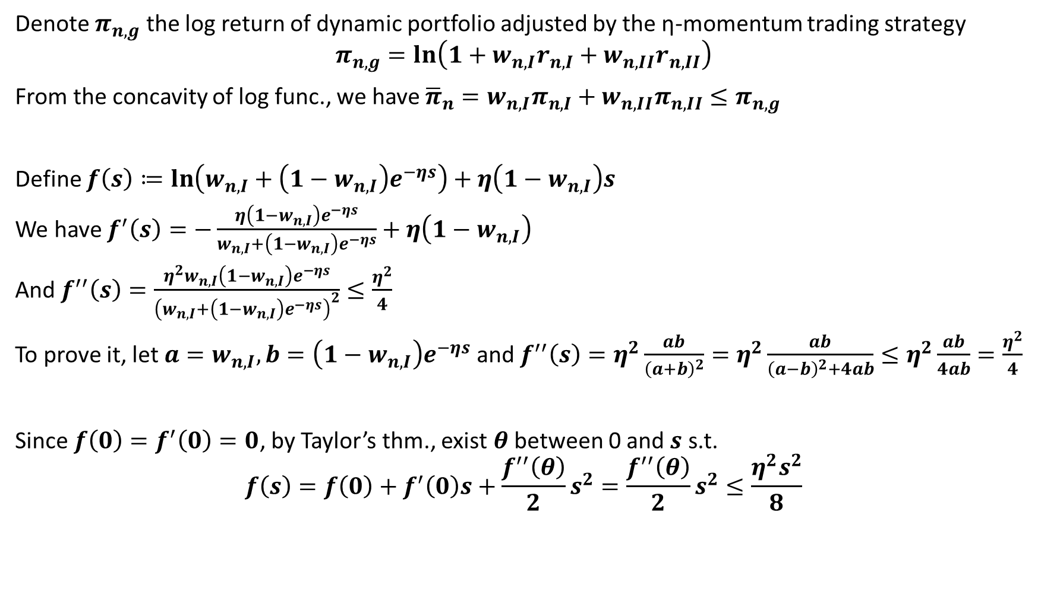
Denote $π_{n,g}$ the log return of dynamic portfolio adjusted by the η-momentum trading strategy
$$π_{n,g}=\ln\left(1+w_{n,I}r_{n,I}+w_{n,II}r_{n,II}\right)$$
From the concavity of log func., we have ${\overline{π}}_{n}=w_{n,I}π_{n,I}+w_{n,II}π_{n,II}≤π_{n,g}$
Define $f\left(s\right)≔\ln\left(w_{n,I}+\left(1−w_{n,I}\right)e^{−ηs}\right)+η\left(1−w_{n,I}\right)s$
We have $f^{′}\left(s\right)=−\frac{η\left(1−w_{n,I}\right)e^{−ηs}}{w_{n,I}+\left(1−w_{n,I}\right)e^{−ηs}}+η\left(1−w_{n,I}\right)$
And $f^{′′}\left(s\right)=\frac{η^{2}w_{n,I}\left(1−w_{n,I}\right)e^{−ηs}}{{\left(w_{n,I}+\left(1−w_{n,I}\right)e^{−ηs}\right)}^{2}}≤\frac{η^{2}}{4}$
To prove it, let $a=w_{n,I}, b=\left(1−w_{n,I}\right)e^{−ηs}$ and $f^{′′}\left(s\right)=η^{2}\frac{ab}{{\left(a+b\right)}^{2}}=η^{2}\frac{ab}{{\left(a−b\right)}^{2}+4ab}≤η^{2}\frac{ab}{4ab}=\frac{η^{2}}{4}$
Since $f\left(0\right)=f^{′}\left(0\right)=0$, by Taylor’s thm., exist $θ$ between 0 and $s$ s.t.
$$f\left(s\right)=f\left(0\right)+f^{′}\left(0\right)s+\frac{f^{′′}\left(θ\right)}{2}s^{2}=\frac{f^{′′}\left(θ\right)}{2}s^{2}≤\frac{η^{2}s^{2}}{8}$$

Slide 12
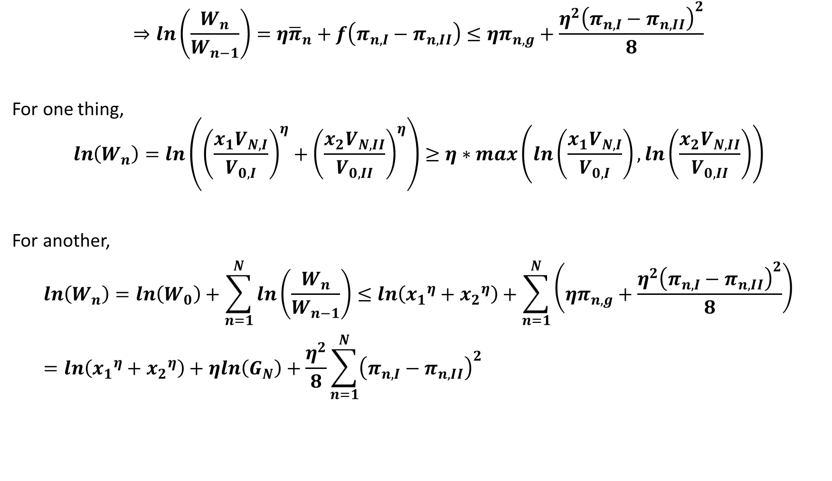
$$⇒ln\left(\frac{W_{n}}{W_{n−1}}\right)=η{\overline{π}}_{n}+f\left(π_{n,I}−π_{n,II}\right)≤ηπ_{n,g}+\frac{η^{2}{\left(π_{n,I}−π_{n,II}\right)}^{2}}{8}$$
For one thing,
$$\ln\left(W_{n}\right)=\ln\left({\left(\frac{x_{1}V_{N,I}}{V_{0,I}}\right)}^{η}+{\left(\frac{x_{2}V_{N,II}}{V_{0,II}}\right)}^{η}\right)≥η∗max\left(ln\left(\frac{x_{1}V_{N,I}}{V_{0,I}}\right), ln\left(\frac{x_{2}V_{N,II}}{V_{0,II}}\right)\right)$$
For another,
$$\ln\left(W_{n}\right)=\ln\left(W_{0}\right)+\sum_{n=1}^{N}{ln\left(\frac{W_{n}}{W_{n−1}}\right)}≤ln\left({x_{1}}^{η}+{x_{2}}^{η}\right)+\sum_{n=1}^{N}{\left(ηπ_{n,g}+\frac{η^{2}{\left(π_{n,I}−π_{n,II}\right)}^{2}}{8}\right)} \\ =ln\left({x_{1}}^{η}+{x_{2}}^{η}\right)+ηln\left(G_{N}\right)+\frac{η^{2}}{8}\sum_{n=1}^{N}{{\left(π_{n,I}−π_{n,II}\right)}^{2}}$$

Slide 13
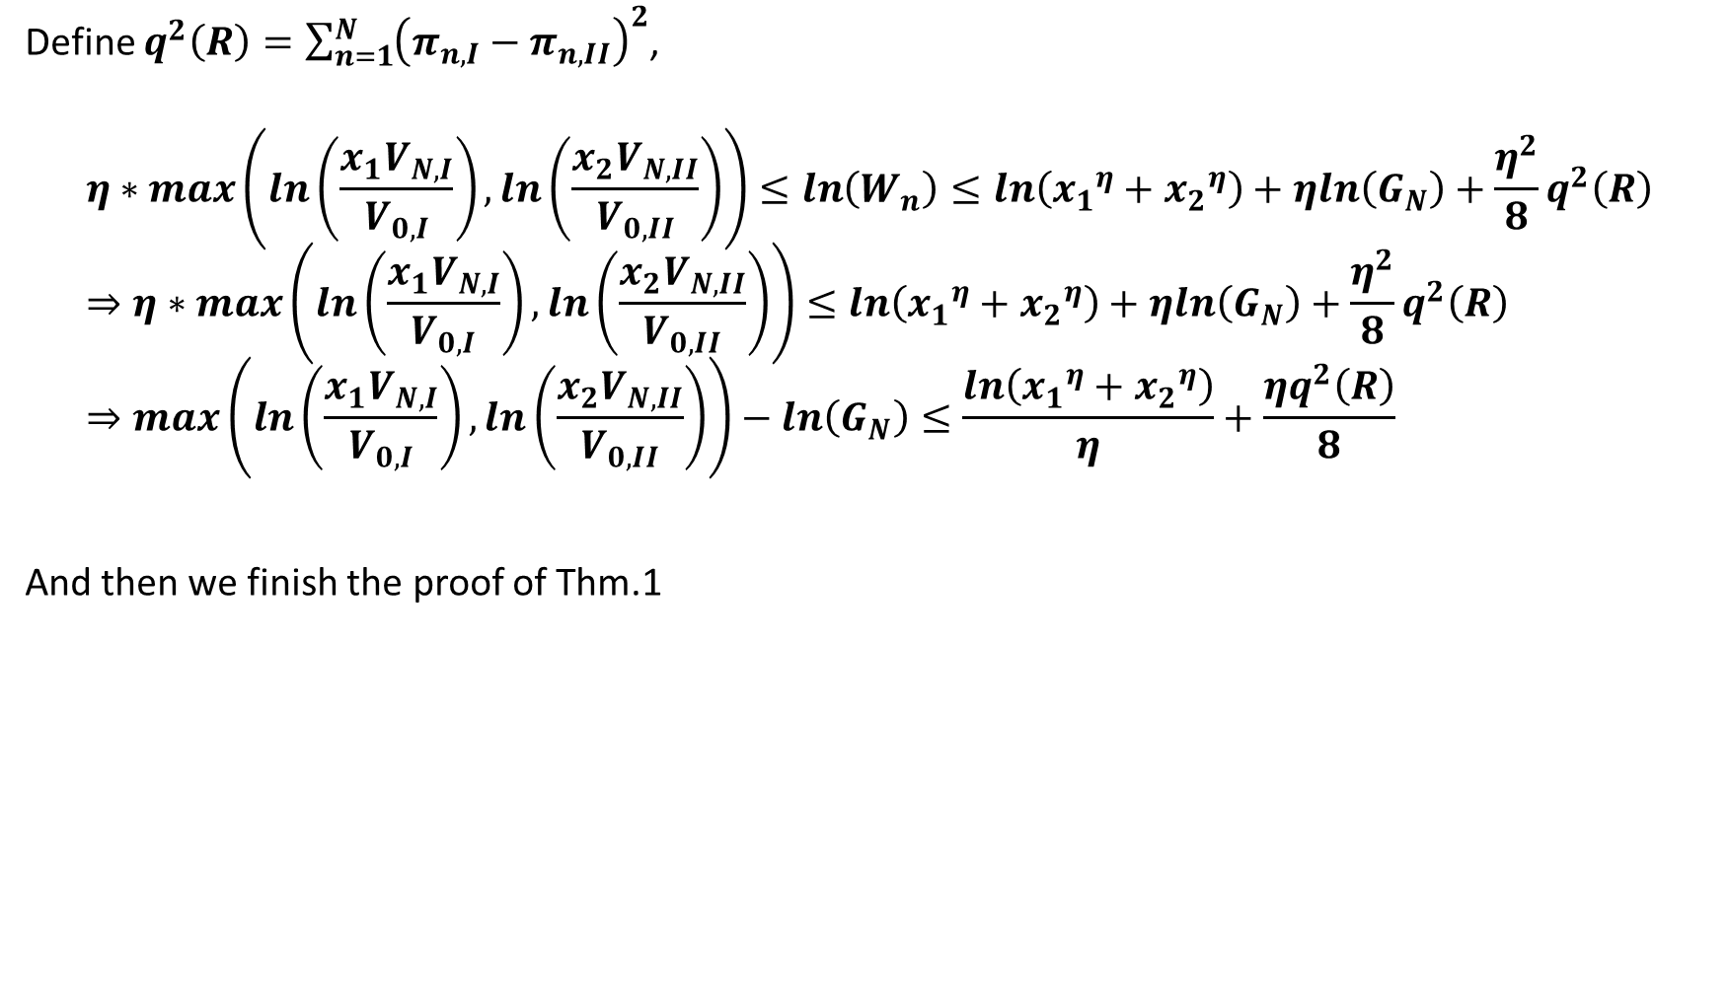
Define $q^{2}\left(R\right)=\sum_{n=1}^{N}{{\left(π_{n,I}−π_{n,II}\right)}^{2}}$,
$$η∗max\left(ln\left(\frac{x_{1}V_{N,I}}{V_{0,I}}\right), ln\left(\frac{x_{2}V_{N,II}}{V_{0,II}}\right)\right)≤\ln\left(W_{n}\right)≤ln\left({x_{1}}^{η}+{x_{2}}^{η}\right)+ηln\left(G_{N}\right)+\frac{η^{2}}{8}q^{2}\left(R\right) \\ ⇒η∗max\left(ln\left(\frac{x_{1}V_{N,I}}{V_{0,I}}\right), ln\left(\frac{x_{2}V_{N,II}}{V_{0,II}}\right)\right)≤ln\left({x_{1}}^{η}+{x_{2}}^{η}\right)+ηln\left(G_{N}\right)+\frac{η^{2}}{8}q^{2}\left(R\right) \\ ⇒max\left(ln\left(\frac{x_{1}V_{N,I}}{V_{0,I}}\right), ln\left(\frac{x_{2}V_{N,II}}{V_{0,II}}\right)\right)−ln\left(G_{N}\right)≤\frac{ln\left({x_{1}}^{η}+{x_{2}}^{η}\right)}{η}+\frac{ηq^{2}\left(R\right)}{8}$$
And then we finish the proof of Thm.1

Slide 14
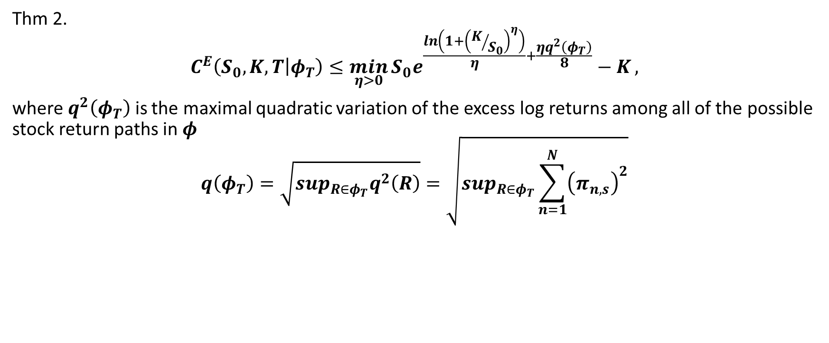
Robust Upper Bounds for European Call Options
Thm 2.
$$C^{E}\left(S_{0},K,T | φ_{T}\right)≤\min_{η>0}{S_{0}e^{\frac{\ln\left(1+{\left(K/{S_{0}}\right)}^{η}\right)}{η}+\frac{ηq^{2}\left(φ_{T}\right)}{8}}−K},$$
where $q^{2}\left(φ_{T}\right)$ is the maximal quadratic variation of the excess log returns among all of the possible stock return paths in $φ$
$$q\left(φ_{T}\right)=\sqrt{\sup_{R∈φ_{T}}q^{2}\left(R\right)}=\sqrt{\sup_{R∈φ_{T}}\sum_{n=1}^{N}{{\left(π_{n,s}\right)}^{2}}}$$

Slide 15
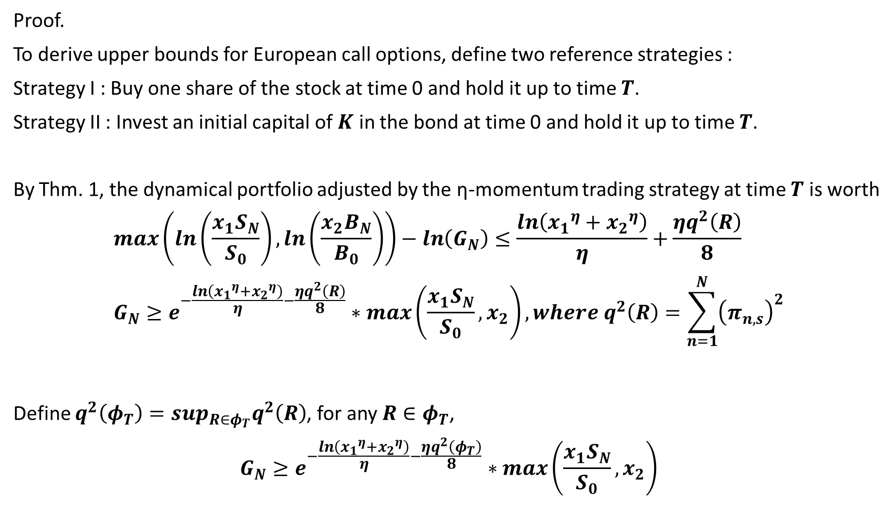
Proof.
To derive upper bounds for European call options, define two reference strategies :
Strategy I : Buy one share of the stock at time 0 and hold it up to time $T$.
Strategy II : Invest an initial capital of $K$ in the bond at time 0 and hold it up to time $T$.
By Thm. 1, the dynamical portfolio adjusted by the η-momentum trading strategy at time $T$ is worth
$$\max\left(\ln\left(\frac{x_{1}S_{N}}{S_{0}}\right),\ln\left(\frac{x_{2}B_{N}}{B_{0}}\right)\right)−\ln\left(G_{N}\right)≤\frac{\ln\left({x_{1}}^{η}+{x_{2}}^{η}\right)}{η}+\frac{ηq^{2}\left(R\right)}{8} \\ G_{N}≥e^{−\frac{\ln\left({x_{1}}^{η}+{x_{2}}^{η}\right)}{η}−\frac{ηq^{2}\left(R\right)}{8}}∗max\left(\frac{x_{1}S_{N}}{S_{0}},x_{2}\right), where q^{2}\left(R\right)=\sum_{n=1}^{N}{{\left(π_{n,s}\right)}^{2}}$$
Define $q^{2}\left(φ_{T}\right)=\sup_{R∈φ_{T}}q^{2}\left(R\right)$, for any $R∈φ_{T}$,
$$G_{N}≥e^{−\frac{\ln\left({x_{1}}^{η}+{x_{2}}^{η}\right)}{η}−\frac{ηq^{2}\left(φ_{T}\right)}{8}}∗max\left(\frac{x_{1}S_{N}}{S_{0}},x_{2}\right)$$

Slide 16
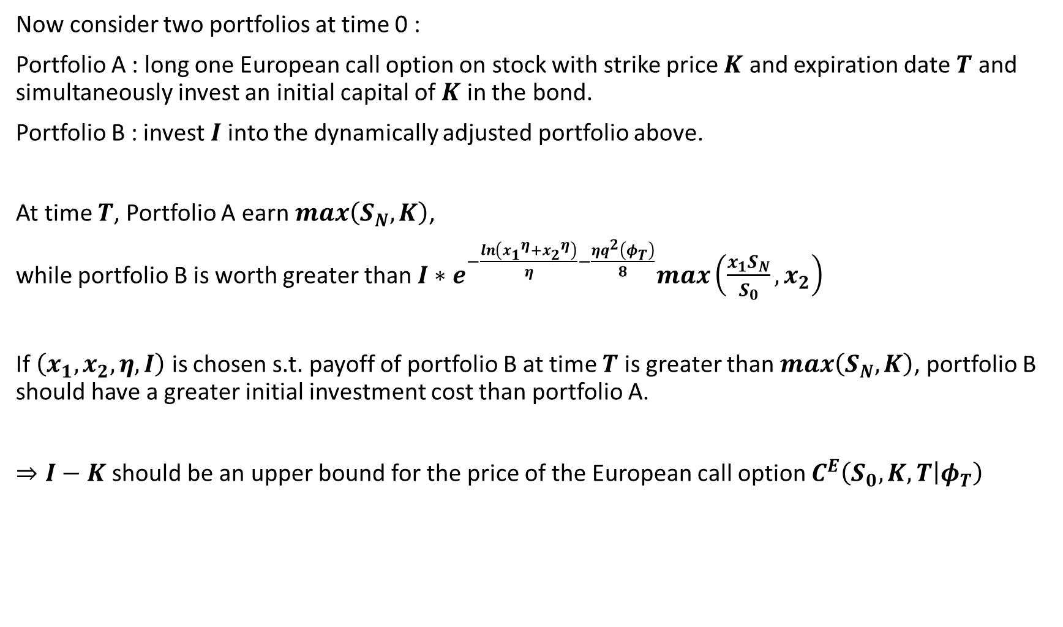
Now consider two portfolios at time 0 :
Portfolio A : long one European call option on stock with strike price $K$ and expiration date $T$ and simultaneously invest an initial capital of $K$ in the bond.
Portfolio B : invest $I$ into the dynamically adjusted portfolio above.
At time $T$, Portfolio A earn $max\left(S_{N},K\right)$,
while portfolio B is worth greater than $I∗e^{−\frac{\ln\left({x_{1}}^{η}+{x_{2}}^{η}\right)}{η}−\frac{ηq^{2}\left(φ_{T}\right)}{8}}max\left(\frac{x_{1}S_{N}}{S_{0}},x_{2}\right)$
If $\left(x_{1}, x_{2},η,I\right)$ is chosen s.t. payoff of portfolio B at time $T$ is greater than $max\left(S_{N},K\right)$, portfolio B should have a greater initial investment cost than portfolio A.
$⇒I−K$ should be an upper bound for the price of the European call option $C^{E}\left(S_{0},K,T | φ_{T}\right)$

Slide 17
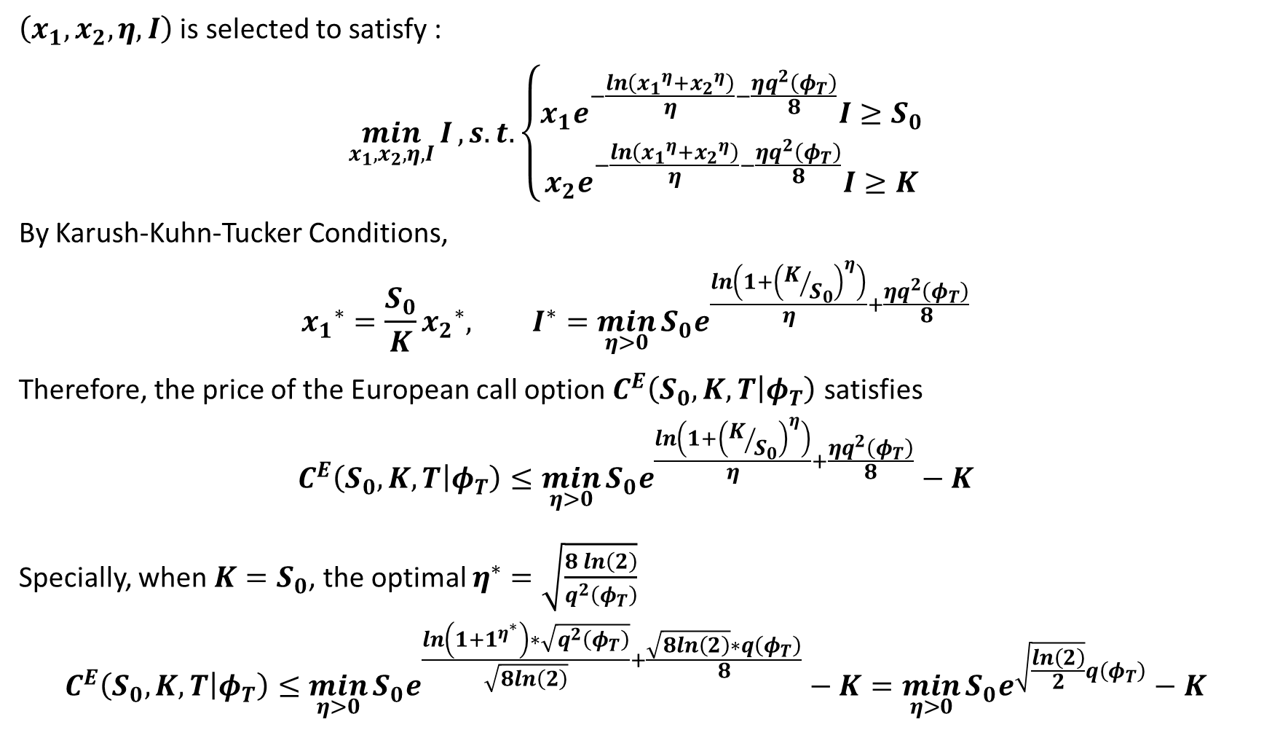
$\left(x_{1}, x_{2},η,I\right)$ is selected to satisfy :
$$\min_{x_{1}, x_{2},η,I}{I}, s.t.\left\{\begin{aligned}x_{1}e^{−\frac{\ln\left({x_{1}}^{η}+{x_{2}}^{η}\right)}{η}−\frac{ηq^{2}\left(φ_{T}\right)}{8}}I≥S_{0} \\ x_{2}e^{−\frac{\ln\left({x_{1}}^{η}+{x_{2}}^{η}\right)}{η}−\frac{ηq^{2}\left(φ_{T}\right)}{8}}I≥K\end{aligned}\right.$$
By Karush-Kuhn-Tucker Conditions,
$${x_{1}}^{∗}=\frac{S_{0}}{K}{x_{2}}^{∗}, I^{∗}=\min_{η>0}{S_{0}e^{\frac{\ln\left(1+{\left(K/{S_{0}}\right)}^{η}\right)}{η}+\frac{ηq^{2}\left(φ_{T}\right)}{8}}}$$
Therefore, the price of the European call option $C^{E}\left(S_{0},K,T | φ_{T}\right)$ satisfies
$$C^{E}\left(S_{0},K,T | φ_{T}\right)≤\min_{η>0}{S_{0}e^{\frac{\ln\left(1+{\left(K/{S_{0}}\right)}^{η}\right)}{η}+\frac{ηq^{2}\left(φ_{T}\right)}{8}}}−K$$
Specially, when $K=S_{0}$, the optimal $η^{∗}=\sqrt{\frac{8\ln\left(2\right)}{q^{2}\left(φ_{T}\right)}}$
$$C^{E}\left(S_{0},K,T | φ_{T}\right)≤\min_{η>0}{S_{0}e^{\frac{\ln\left(1+1^{η^{∗}}\right)∗\sqrt{q^{2}\left(φ_{T}\right)}}{\sqrt{8ln\left(2\right)}}+\frac{\sqrt{8ln\left(2\right)}∗q\left(φ_{T}\right)}{8}}}−K=\min_{η>0}{S_{0}e^{\sqrt{\frac{ln\left(2\right)}{2}}q\left(φ_{T}\right)}}−K$$

Slide 18
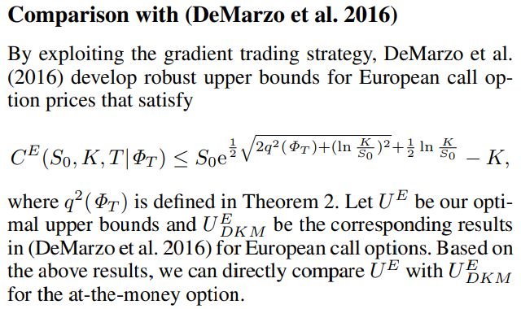

Slide 19
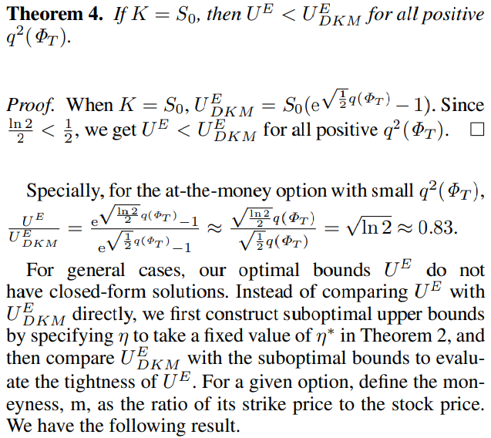
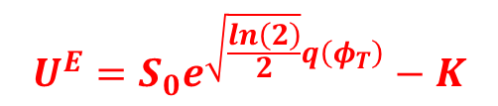
$$U^{E}=S_{0}e^{\sqrt{\frac{ln\left(2\right)}{2}}q\left(φ_{T}\right)}−K$$

Slide 20
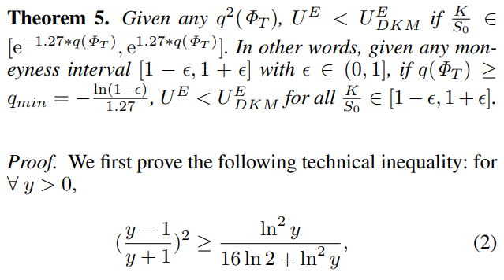

Slide 21
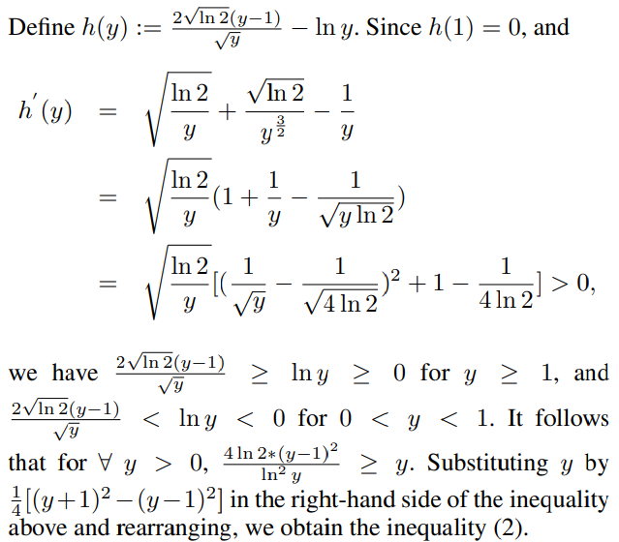
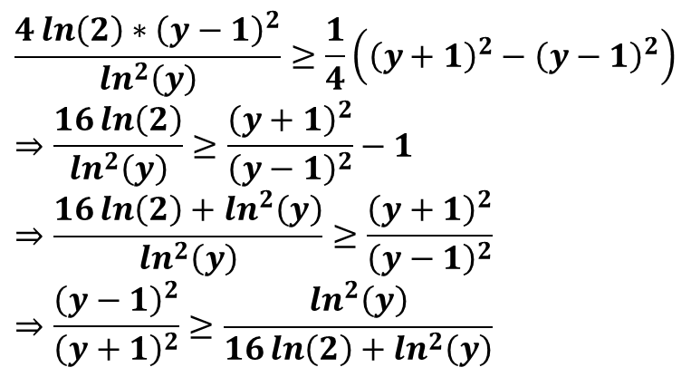
$$\frac{4\ln\left(2\right)∗{\left(y−1\right)}^{2}}{\ln^{2}\left(y\right)}≥\frac{1}{4}\left({\left(y+1\right)}^{2}−{\left(y−1\right)}^{2}\right) \\ ⇒\frac{16\ln\left(2\right)}{\ln^{2}\left(y\right)}≥\frac{{\left(y+1\right)}^{2}}{{\left(y−1\right)}^{2}}−1 \\ ⇒\frac{16\ln\left(2\right)+\ln^{2}\left(y\right)}{\ln^{2}\left(y\right)}≥\frac{{\left(y+1\right)}^{2}}{{\left(y−1\right)}^{2}} \\ ⇒\frac{{\left(y−1\right)}^{2}}{{\left(y+1\right)}^{2}}≥\frac{\ln^{2}\left(y\right)}{16\ln\left(2\right)+\ln^{2}\left(y\right)}$$

Slide 22
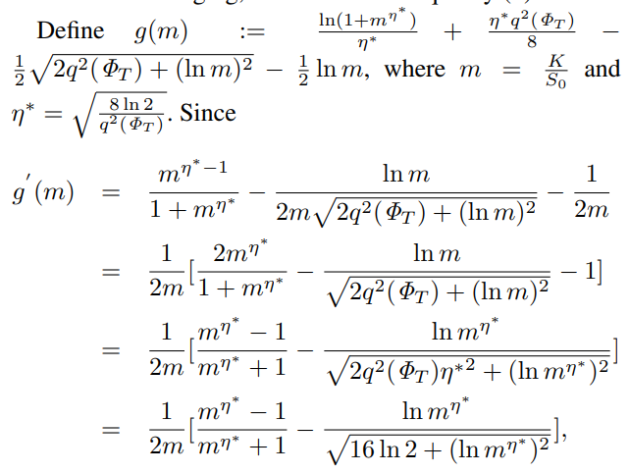
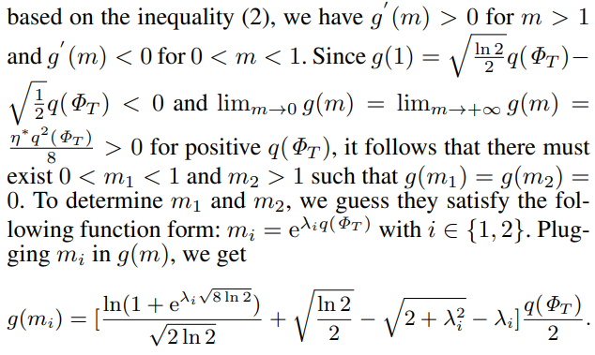

Slide 23
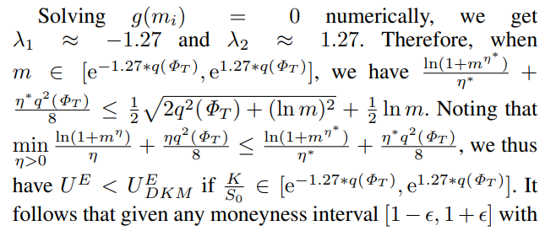


Slide 24
