Slide 1
論文進度報告
指導教授 戴天時 博士
學生 林昆鋒

Slide 2
Straight bond
利率固定，到期一次償還固定本金的債券
Coupon + Face value
Coupon
Coupon
0
T
P
Notes:
Coupon 和 face valu 都是固定的

Slide 3
Reverse exchangeable
cash
投資人
花旗銀行
Reverse exchangeable
Underlying stock
台積電
Notes:
RE到期時需償還的本金和台積電的股價有關

Slide 4
Cont.
Coupon + Terminal value(S_{T} ,S₀)
Coupon
Coupon
0
T
P

Slide 5
Cont.
Terminal value of reverse exchangeable
Terminal value
F
0
S₀
S_{T}

Slide 6
What if…
cash
投資人
花旗銀行
債權人
台積電
Reverse exchangeable
Underlying stock
Underlying stock
台積電
Notes:
RE到期時需償還的本金和台積電的股價有關

Slide 7
考慮到Reverse Exchangeable的發行公司同時也是 uderlying stock的股票發行公司，所以當公司不破產(firm asset value>(1-τ)c)且S_{T}<S₀時，可能有
(1)發現金 (2)發新股 (3)庫藏股 等三種delivery方式
Notes:
Eos=outstanding shares
REos=reverse exchangable發行張數

Slide 8
(1)發現金
Debt value at T=
F+C , if S_{T} ≧ S₀ and A_{T} ≧ (1-τ)C
(F/S₀)S_{T} ,if S_{T} ≦S₀ and A_{T} ≧(1- τ)C
(1-α)A_{T} , if A_{T} < (1- τ)C
Equity value at T=
A_{T}-F-(1-τ)C (=S_{T}*Eos) ,if S_{T} ≧ S0 and A_{T} ≧ (1-τ)C
A_{T}-(F/S₀)S_{T}- (1-τ)C (=S_{T}*Eos) ,if S_{T} ≦S0 and A_{T} ≧(1- τ)C
0 ,if A_{T} < (1- τ)C
When S_{T}=S₀, A_{T}-F-(1-τ)C= S₀*Eos =>A_{T} =F +(1-τ)C+S₀*Eos
A_{T}-(F/S₀)S₀-(1-τ)C= S₀*Eos
A_{T} ≧ F +(1-τ)C+S₀*Eos
(1- τ)C ≦ A_{T} < F +(1-τ)C+S₀*Eos
A_{T} ≧ F +(1-τ)C+S₀*Eos
(1- τ)C ≦ A_{T} < F +(1-τ)C+S₀*Eos

Slide 9
(2)發新股
Debt value at T=
F+C , if S_{T} ≧ S₀ and A_{T} ≧ (1-τ)C
(F/S₀)S_{T} ,if S_{T} ≦S₀ and A_{T} ≧(1- τ)C
(1-α)A_{T} , if A_{T} < (1- τ)C
Equity value at T=
A_{T} - F-(1-τ)C (=S_{T}*Eos) ,if S_{T} ≧ S₀ and A_{T} ≧ (1-τ)C
(A_{T} - (1-τ)C)/(Eos+ F/S₀)*Eos (=S_{T}*Eos) ,if S_{T} ≦S₀ and A_{T} ≧(1- τ)C
0 ,if A_{T} < (1- τ)C
When S_{T}=S₀, A_{T} - F - (1-τ)C= S₀*Eos =>A_{T} =F+(1-τ)C+S₀*Eos
A_{T} ≧ F +(1-τ)C+S₀*Eos
(1- τ)C ≦ A_{T} < F +(1-τ)C+S₀*Eos
A_{T} ≧ F +(1-τ)C+S₀*Eos
(1- τ)C ≦ A_{T} < F +(1-τ)C+S₀*Eos

Slide 10
Firm A
B/S
Firm B
B/S
Debt
(Straight bond)
Debt
(Reverse Exchangeable)
Asset
Asset
Equity
Equity
Leverage Firm value
= Unleveraged Firm value + Tax Benefit - Bankruptcy cost
Show Firm B value > Firm A value

Slide 11
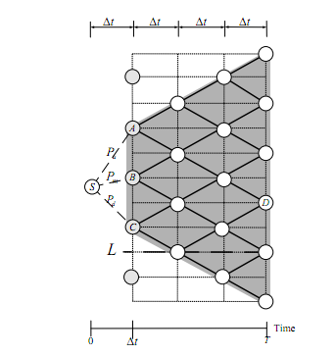
Valuing firm A value(straight bond)
Assume the firm’s asset value follows this lognormal diffusion process:
665
`
Default boundary

Slide 12
Valuing firm A value, example
A公司發行一張面額800一年期的straight bond， 票面利率5%，到期時償還本金及利息，中間不支息
其他參數：initial asset value= 1000
tax rate τ=0.5
bankruptcy cost α=0.5
volatility of asset value σ=0.3
risk-free rate=3%
time steps =2
outstanding shares Eos=100
Default boundary=F+(1-τ)C=800+(1-0.5)*800*0.05=820

Slide 13
1915.65
F+C=840
A_{E}-F-(1-τ)C=1095.65
E
0.4825
1549.5
827.49
741.73
1253.34
F+C=840
A_{F}-F-(1-τ)C=433.34
Pu
0.5175
F
1000
771.76
225.69
1013.78
827.49
205.98
Pm
820
F+C=840
0
G
Pd
663.34
536.03
0
Firm A value=
997.45
H
536.57
(1-α)A_{H}=268.29
0

Slide 14
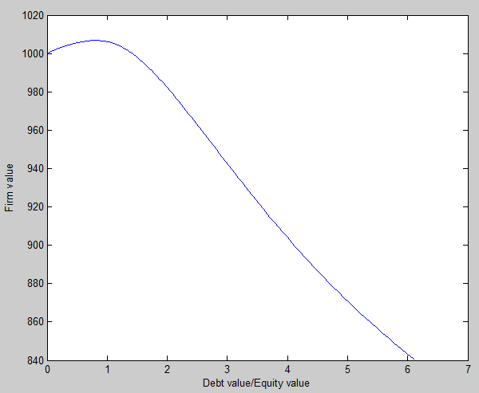
Time steps =252
r=0.03
σ=0.3
Tax rate=0.35
Bankruptcy cost=0.4
Coupon rate=5%

Slide 15
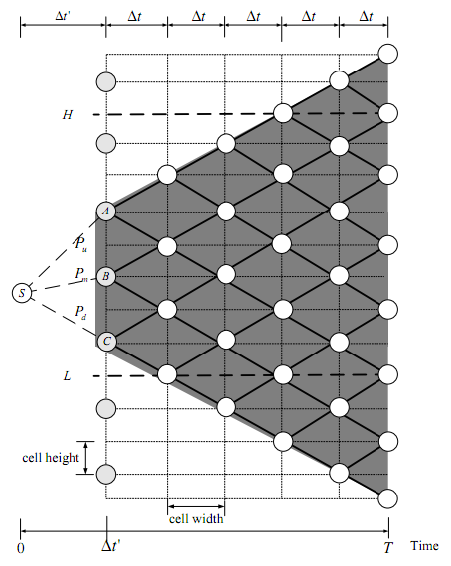
Valuing firm B (Reverse exchangeable)
F+(1-τ)C+S₀*Eos
Default boundary

Slide 16
Valuing firm B value, example
B公司發行一張面額800一年期的Reverse exchangeable,票面利率10% ,到期時償還本金及利息,中間不支息
其他參數：initial asset value= 1000
tax rate τ=0.5
bankruptcy cost α=0.5
volatility of asset value σ=0.3
risk-free rate=3%
time steps =2
Eos=100
initial stock price S₀ = 3.1348
Default boundary= (1-τ)C = (1-0.5)*800*0.1= 40
F+(1-τ)C+S₀*Eos = 800+(1-0.5)*80+3.1348*100=1153.48

Slide 17
1755.91
F+C=800+80=880
A_{E}-F-(1-τ)C=1755.91-800-0.5*80=915.91
E
0.4827
1423.17
867.15
595.43
F
1153.48
F+C=880
A_{F}-F-(1-τ)C=1153.48-800-0.5*80=313.48
0.5173
0.2109
1000
725.72
313.48
934.89
722.21
252.1
0.7201
G
757.73
(F/S0)*S_{G}+C=595.67
S_{G}*Eos=202
0.0689
614.14
491.75
128.87
Firm B value=
1039.2
H
602.71
(F/S0)*S_{H}+C=409.2
S_{H}*Eos=129

Slide 18
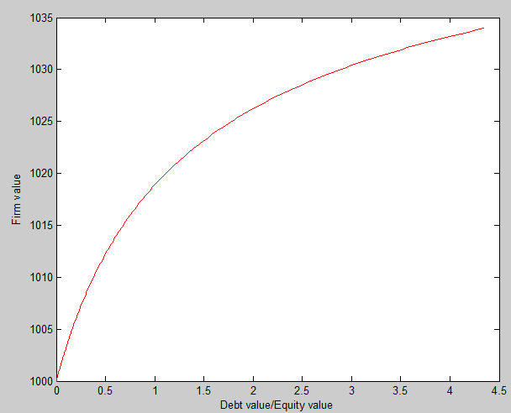
Time steps =252
r=0.03
σ=0.3
Tax rate=0.35
Bankruptcy cost=0.4
Coupon rate=10%

Slide 19
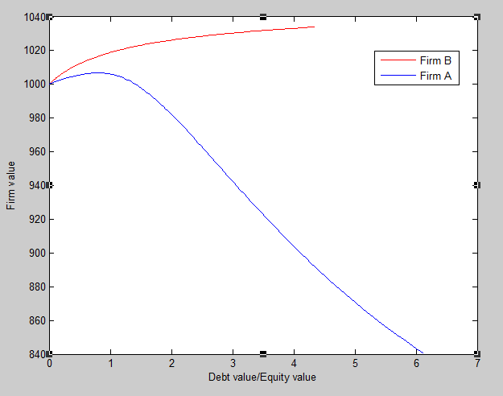
Tax Benefit – Bankruptcy cost

