Slide 1
論文進度報告
指導教授 戴天時 博士
學生 鄭傑仁

Slide 2
Agenda
Introduction
Merton’s Model
Black and Cox’s Model

Slide 3
Introduction
VL=D+E
=VA+TB-BC
VL: Leverage value of the firm
VA: Asset value of the firm
TB: Tax benefit
BC: Bankruptcy cost
E: Equity
D: Debt

Slide 4
Merton’s Model

Slide 5
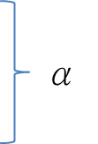
Merton:
45度線
Leverage Value
Equity
BC
Debt
Debt
Asset Value
D

Slide 6
Merton:
45度線
Leverage Value
TB
Equity
τCDT
α
BC
Debt
Debt
Asset Value
D+(1-τ)CDT

Slide 7
VL=D+E
Equity
Debt
Asset Value
D+(1-τ)CDT
D+(1-τ)CDT
α
BC
1-α
Debt
D+(1-τ)CDT
Debt
Asset Value
D+(1-τ)CDT

Slide 8
VL=VA+TB-BC
45度線
45度線
TB
Asset Value
τCDT
D+(1-τ)CDT
α
α
BC
BC
Debt
Asset Value
D+(1-τ)CDT

Slide 9
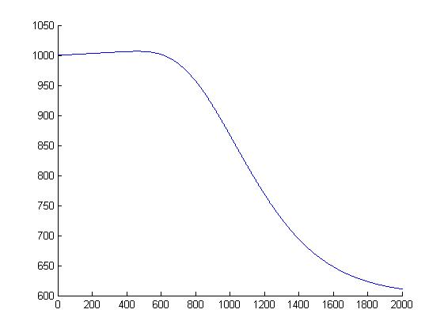
Initial asset value=1000, Coupon rate=0.05, Maturity=1, Tax rate=0.35, 破產成本比例(α)=0.4, Risk free rate=0.1, Volatility=0.3, Debt=0~2000
The Optimal Debt=463,
Equity holder=567.5968, Debt holder=439.0555, VL=1006.6523

Slide 10
Merton(SB+RE):
45度線
TB2
Leverage Value
Equity
TB1
RE
mixEquity
τCDT
α
BC
SB
SB
SB
Asset Value
D1+(1-τ)C1D1T
V”

Slide 11
VL=D+E, Equity部分
Equity
V”
45度線
mixEquity
D1+(1-τ)C1D1T
mixEquity
D1+(1-τ)C1D1T
V”

Slide 12
VL=D+E, Debt部分
RE
SB
Asset Value
Asset Value
V”
D1+(1-τ)C1D1T
α
BC
1-α
SB
D1+(1-τ)C1D1T
SB
Asset Value
D+(1-τ)CDT

Slide 13
Equity:
+
乘上比例
mixEquity
Equity
D1+(1-τ)C1D1T
V”
RE:
+
乘上比例
RE
mixEquity
Asset Value
D1+(1-τ)C1D1T
V”
+
SB:
1-α
SB
SB
Asset Value
D1+(1-τ)C1D1T
D1+(1-τ)C1D1T

Slide 14
VL=VA+TB-BC
45度線
45度線
45度線
TB1
TB2
Asset Value
τ(C1D1+C2D2)T
τC1D1T
D1+(1-τ)C1D1T
V”
α
α
BC
BC
SB
Asset Value
D+(1-τ)CDT

Slide 15
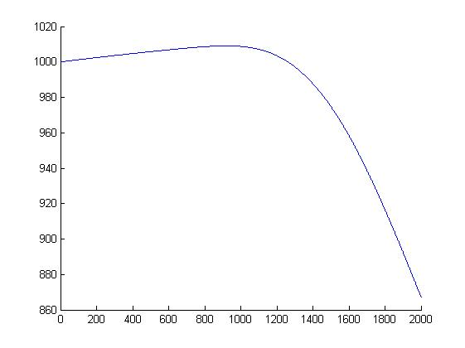
Initial asset value=1000, SB Coupon rate=0.05, RE Coupon rate=0.05, Maturity=1, Tax rate=0.35,破產成本比例(α)=0.4, Risk free rate=0.1, Volatility=0.3, Number of initial Stock=100,SB/D=0.5, Debt=0~2000
The Optimal Debt=922,
Equity holder=255.3810, SB holder=437.1939, RE holder=316.4728, VL=1009.0478

Slide 16
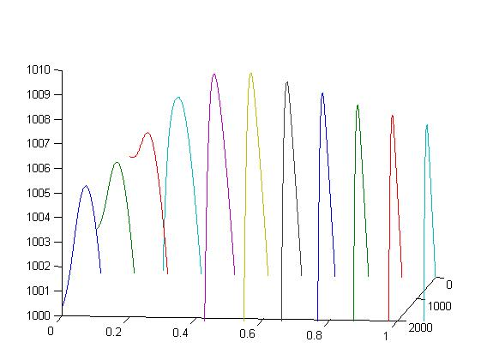
D_ratio=SB佔全部Debt的比例,
Initial asset value=1000,
SB Coupon rate=0.05,
RE Coupon rate=0.05, Maturity=1,
Tax rate=0.35,
破產成本比例(α)=0.4,
Risk free rate=0.1, Volatility=0.3,
Number of initial Stock=100,
Debt=0~2000
D_ratio | VL | E | RE | SB | 最適舉債
0 | 1004.258 | 339.873 | 664.384 | 0.000 | 853
0.1 | 1005.365 | 252.727 | 659.245 | 93.393 | 983
0.2 | 1006.715 | 159.886 | 629.451 | 217.378 | 1144
0.3 | 1008.322 | 90.871 | 547.882 | 369.569 | 1297
0.4 | 1009.136 | 162.555 | 427.516 | 419.065 | 1104
0.5 | 1009.048 | 255.381 | 316.473 | 437.194 | 922
0.6 | 1008.585 | 342.514 | 222.926 | 443.146 | 779
0.7 | 1008.040 | 416.456 | 147.603 | 443.981 | 669
0.8 | 1007.521 | 477.010 | 87.551 | 442.960 | 584
0.9 | 1007.057 | 526.572 | 39.291 | 441.195 | 517
1 | 1006.652 | 567.597 | 0.000 | 439.056 | 463

Slide 17
Merton(SB+RE):
45度線
TB2
Leverage Value
Equity
TB1
RE
mixEquity
τCDT
α
BC
SB
SB
SB
Asset Value
？
D1+(1-τ)C1D1T
V”

Slide 18
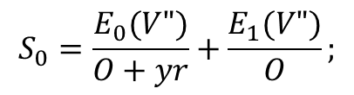
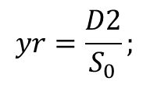
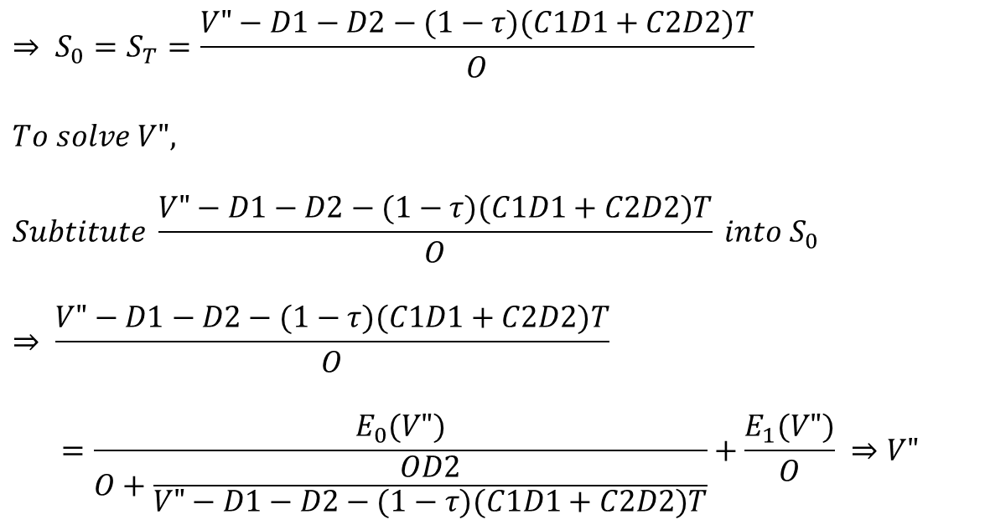
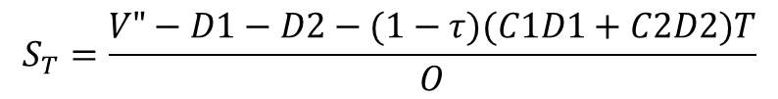
To solve V”
$If VA\left(T\right)=V" , E_{0}(V")=mixEquity;$ $E_{1}(V“)=Equity$
$$yr=\frac{D2}{S_{0}};$$
$$S_{0}=\frac{E_{0}(V")}{O+yr}+\frac{E_{1}(V")}{O};$$
$$S_{T}=\frac{V"−D1−D2−(1−τ)(C1D1+C2D2)T}{O}$$
$$⇒ S_{0}=S_{T}=\frac{V"−D1−D2−(1−τ)(C1D1+C2D2)T}{O}$$
$$To solve V",$$
$$Subtitute \frac{V"−D1−D2−(1−τ)(C1D1+C2D2)T}{O} into S_{0}$$
$$⇒ \frac{V"−D1−D2−(1−τ)(C1D1+C2D2)T}{O}$$
$$=\frac{E_{0}(V")}{O+\frac{OD2}{V"−D1−D2−(1−τ)(C1D1+C2D2)T}}+\frac{E_{1}(V")}{O} ⇒V"$$

Slide 19
Black and Cox’s Model (First-Passage Model)

Slide 20
Black and Cox:
45度線
Leverage Value
Equity
BC
Debt
BC
α
Debt
Debt
Asset Value
DB
D

Slide 21
Black and Cox:
45度線
Leverage Value
TB
Equity
τCDT
α
BC
Debt
BC
α
Debt
Debt
Asset Value
DB
D+(1-τ)CDT

Slide 22
Black and Cox:
Leverage Value
D+(1-τ)CDT
DB
Time
T

Slide 23
VL=D+E
Debt
Equity
Asset Value
D+(1-τ)CDT
D+(1-τ)CDT
Leverage Value
Leverage Value
α
BC
1-α
BC
α
Debt
Debt
Debt
Debt
Asset Value
Asset Value
DB
D+(1-τ)CDT
DB
D+(1-τ)CDT

Slide 24
VL=VA+TB-BC
45度線
45度線
TB
Asset Value
τCDT
DB
D+(1-τ)CDT
Leverage Value
Leverage Value
α
α
BC
BC
BC
α
BC
α
Debt
Debt
Asset Value
Asset Value
DB
D+(1-τ)CDT
DB
D+(1-τ)CDT

Slide 25
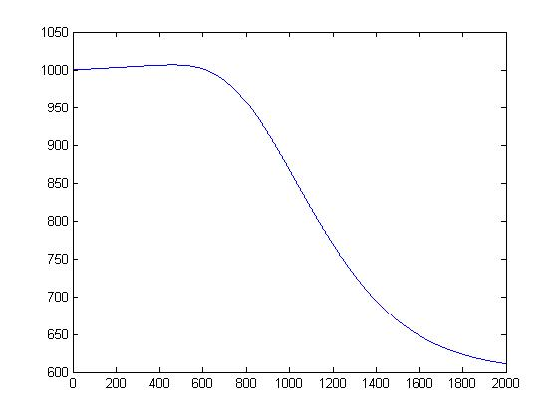
Initial asset value=1000, Coupon rate=0.05, Maturity=1, Tax rate=0.35, 破產成本比例(α)=0.4, Risk free rate=0.1, Volatility=0.3, Debt=0~2000
Default Boundary=(D+(1-tau)*C*D*T)*0.2
The Optimal Debt=463,
Equity holder=567.5968, Debt holder=439.0555, VL=1006.6523

Slide 26
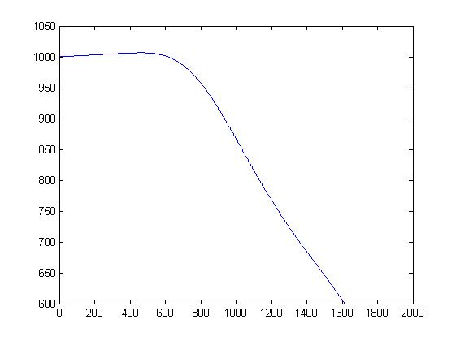
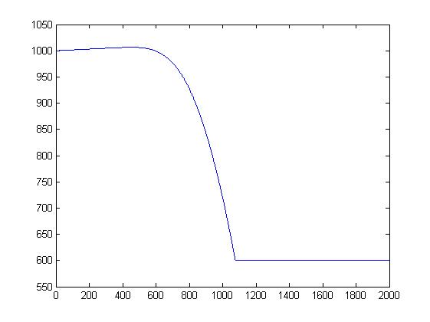
Initial asset value=1000, Coupon rate=0.05, Maturity=1, Tax rate=0.35, 破產成本比例(α)=0.4, Risk free rate=0.1, Volatility=0.3, Debt=0~2000
Default Boundary=(D+(1-tau)*C*D*T)*0.9
The Optimal Debt=455,
Equity holder=575.0264, Debt holder=431.5437, VL=1006.5701

Slide 27
Black and Cox:(SB+RE):
45度線
TB2
Leverage Value
Equity
TB1
RE
mixEquity
τCDT
α
BC
SB
SB
BC
α
SB
SB
Asset Value
DB
D1+(1-τ)C1D1T
V”

Slide 28
VL=D+E, Equity部分
Equity
V”
45度線
mixEquity
D1+(1-τ)C1D1T
mixEquity
D1+(1-τ)C1D1T
V”

Slide 29
VL=D+E, Debt部分
RE
SB
Asset Value
Asset Value
V”
D1+(1-τ)C1D1T
Leverage Value
Leverage Value
α
BC
1-α
BC
α
SB
SB
SB
SB
Asset Value
Asset Value
DB
D+(1-τ)CDT
DB
D+(1-τ)CDT

Slide 30
Equity:
+
乘上比例
mixEquity
Equity
D1+(1-τ)C1D1T
V”
RE:
+
乘上比例
RE
mixEquity
Asset Value
D1+(1-τ)C1D1T
V”
+
SB:
SB
1-α
Asset Value
SB
SB
D1+(1-τ)C1D1T
D+(1-τ)CDT
DB

Slide 31
VL=VA+TB-BC
45度線
45度線
45度線
TB1
TB2
Asset Value
τ(C1D1+C2D2)T
τC1D1T
DB
D1+(1-τ)C1D1T
V”
Leverage Value
Leverage Value
α
α
BC
BC
BC
α
BC
α
SB
SB
Asset Value
Asset Value
DB
D+(1-τ)CDT
DB
D+(1-τ)CDT

Slide 32
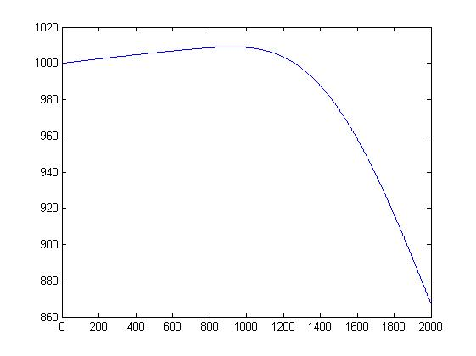
Initial asset value=1000, SB Coupon rate=0.05, RE Coupon rate=0.05, Maturity=1, Tax rate=0.35,破產成本比例(α)=0.4, Risk free rate=0.1, Volatility=0.3, Number of initial Stock=100,SB/D=0.5, Debt=0~2000
Default Boundary=(D+(1-tau)*C*D*T)*0.2
The Optimal Debt=922,
Equity holder=255.3810, SB holder=437.1939, RE holder=316.4728, VL=1009.0478

Slide 33
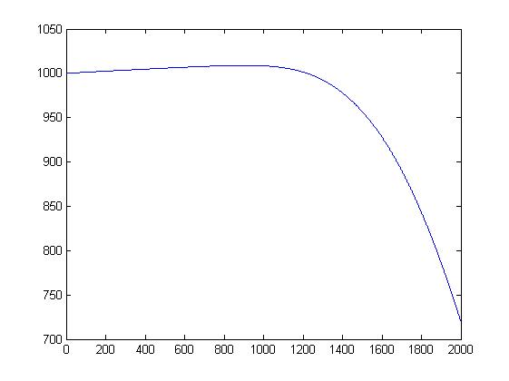
Initial asset value=1000, SB Coupon rate=0.05, RE Coupon rate=0.05, Maturity=1, Tax rate=0.35,破產成本比例(α)=0.4, Risk free rate=0.1, Volatility=0.3, Number of initial Stock=100,SB/D=0.5, Debt=0~2000
Default Boundary=(D+(1-tau)*C*D*T)*0.9
The Optimal Debt=909,
Equity holder=263.7002, SB holder=431.0778, RE holder=314.1912, VL=1008.9692

