Slide 1
論文進度報告
指導教授 戴天時 博士
學生 鄭傑仁

Slide 2
Recall
以公司債(SB)及反轉可替換債券(RE)舉債，且RE的債券標的為發行公司股票，在加入稅盾後的Merton、Black and Cox模型下，找出公司的最適舉債面額。
主要參數假設:
SB: Face value=D₁，Coupon rate=C₁
RE: Face value=D₂，Coupon rate=C₂

Slide 3
Merton(SB+RE):
45度線
TB
Leverage Value
Equity
mixEquity
RE
RE
τ(C₁D₁+C₂D₂)T
α
BC
SB
SB
SB+RE
Asset Value
V”
D₁+(1-τ)(C₁D₁+C₂D₂)T

Slide 4
Black and Cox:(SB+RE):
45度線
TB
Leverage Value
Equity
mixEquity
RE
RE
τ(C₁D₁+C₂D₂)T
α
BC
SB
SB
BC
α
SB+RE
SB+RE
Asset Value
DB
V”
D₁+(1-τ)(C₁D₁+C₂D₂)T

Slide 5
New
以公司債(SB)及反轉可替換債券(RE)舉債，且RE債券標的為其他公司股票，在加入稅盾後的Merton、Black and Cox模型下，找出公司的最適舉債面額。
主要參數假設:
SB: Face value=D₁，Coupon rate=C₁
RE: Face value=D₂，Coupon rate=C₂

Slide 6

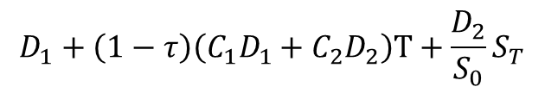
Merton(SB+RE):
$$D_{1}+D_{2}+\left(1−τ\right)\left(C_{1}D_{1}+C_{2}D_{2}\right)T$$
Stock Price
Case2
Case1
$$S_{0}$$
Case4
Case3
Asset Value
$$D_{1}+\left(1−τ\right)\left(C_{1}D_{1}+C_{2}D_{2}\right)T+\frac{D_{2}}{S_{0}}S_{T}$$

Slide 7
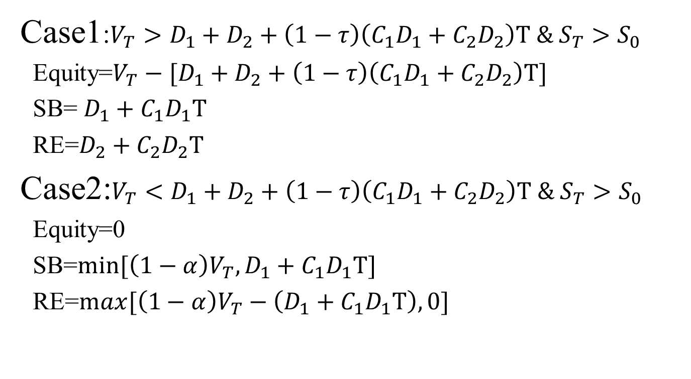
Merton(SB+RE): at time T
Case1:$V_{T}>D_{1}+D_{2}+\left(1−τ\right)\left(C_{1}D_{1}+C_{2}D_{2}\right)T \& S_{T}>S_{0}$
Equity=$V_{T}−[D_{1}+D_{2}+\left(1−τ\right)\left(C_{1}D_{1}+C_{2}D_{2}\right)T]$
SB= $D_{1}+C_{1}D_{1}T$
RE=$D_{2}+C_{2}D_{2}T$
Case2:$V_{T}<D_{1}+D_{2}+\left(1−τ\right)\left(C_{1}D_{1}+C_{2}D_{2}\right)T \& S_{T}>S_{0}$
Equity=0
SB=$min⁡[\left(1−α\right)V_{T},D_{1}+C_{1}D_{1}T]$
RE=$max⁡[\left(1−α\right)V_{T}−\left(D_{1}+C_{1}D_{1}T\right),0]$

Slide 8
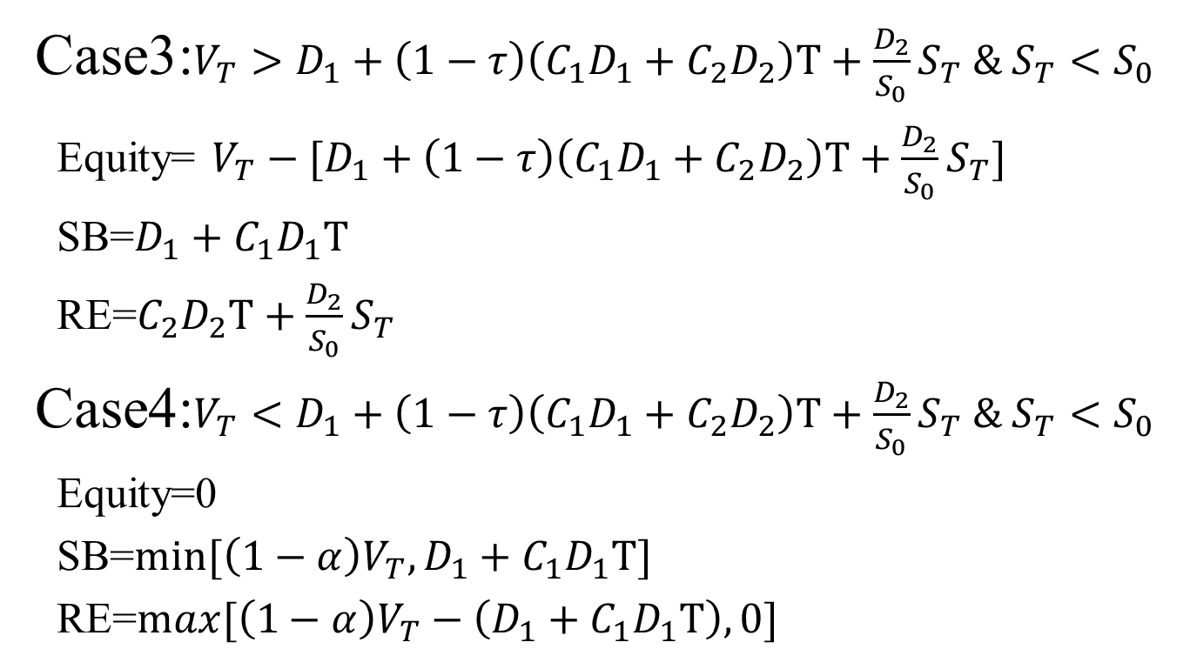
Merton(SB+RE): at time T
Case3:$V_{T}>D_{1}+\left(1−τ\right)\left(C_{1}D_{1}+C_{2}D_{2}\right)T+\frac{D_{2}}{S_{0}}S_{T} \& S_{T}<S_{0}$
Equity= $V_{T}−[D_{1}+\left(1−τ\right)\left(C_{1}D_{1}+C_{2}D_{2}\right)T+\frac{D_{2}}{S_{0}}S_{T}]$
SB=$D_{1}+C_{1}D_{1}T$
RE=$C_{2}D_{2}T+\frac{D_{2}}{S_{0}}S_{T}$
Case4:$V_{T}<D_{1}+\left(1−τ\right)\left(C_{1}D_{1}+C_{2}D_{2}\right)T+\frac{D_{2}}{S_{0}}S_{T} \& S_{T}<S_{0}$
Equity=0
SB=$min⁡[\left(1−α\right)V_{T},D_{1}+C_{1}D_{1}T]$
RE=$max⁡[\left(1−α\right)V_{T}−\left(D_{1}+C_{1}D_{1}T\right),0]$

Slide 9
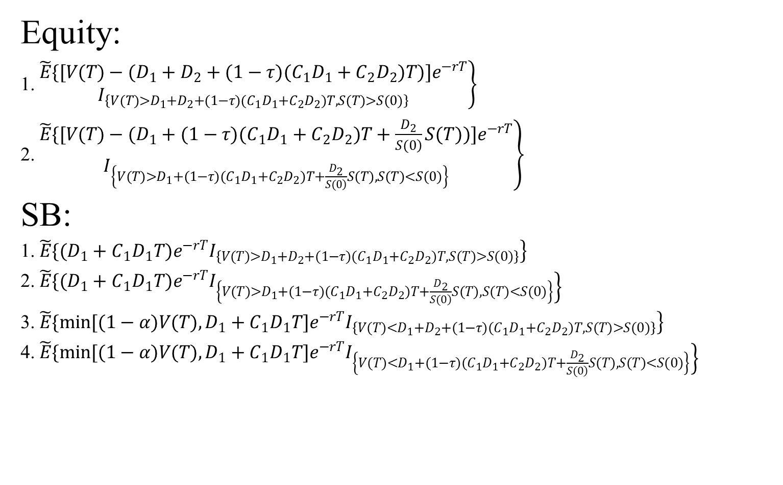
Merton(SB+RE): at time T
Equity:
1. $\left.\begin{aligned}\tilde{E}\{[V(T)−(D_{1}+D_{2}+(1−τ)(C_{1}D_{1}+C_{2}D_{2})T)]e^{−rT} \\ I_{\left\{V(T)>D_{1}+D_{2}+(1−τ)(C_{1}D_{1}+C_{2}D_{2})T,S(T)>S(0)\right\}}\end{aligned}\right\}$
2. $\left.\begin{aligned}\tilde{E}\{[V(T)−(D_{1}+(1−τ)(C_{1}D_{1}+C_{2}D_{2})T+\frac{D_{2}}{\left.S(0\right)}S(T))]e^{−rT} \\ I_{\left\{V(T)>D_{1}+(1−τ)(C_{1}D_{1}+C_{2}D_{2})T+\frac{D_{2}}{\left.S(0\right)}S(T),S(T)<S(0)\right\}}\end{aligned}\right\}$
SB:
1. $\left.\tilde{E}\{(D_{1}+C_{1}D_{1}T)e^{−rT}I_{\left\{V(T)>D_{1}+D_{2}+(1−τ)(C_{1}D_{1}+C_{2}D_{2})T,S(T)>S(0)\right\}}\right\}$
2. $\left.\tilde{E}\{(D_{1}+C_{1}D_{1}T)e^{−rT}I_{\left\{V(T)>D_{1}+(1−τ)(C_{1}D_{1}+C_{2}D_{2})T+\frac{D_{2}}{\left.S(0\right)}S(T),S(T)<S(0)\right\}}\right\}$
3. $\left.\tilde{E}\{min[(1−α)V(T),D_{1}+C_{1}D_{1}T]e^{−rT}I_{\left\{V(T)<D_{1}+D_{2}+(1−τ)(C_{1}D_{1}+C_{2}D_{2})T,S(T)>S(0)\right\}}\right\}$
4. $\left.\tilde{E}\{min[(1−α)V(T),D_{1}+C_{1}D_{1}T]e^{−rT}I_{\left\{V(T)<D_{1}+(1−τ)(C_{1}D_{1}+C_{2}D_{2})T+\frac{D_{2}}{\left.S(0\right)}S(T),S(T)<S(0)\right\}}\right\}$

Slide 10
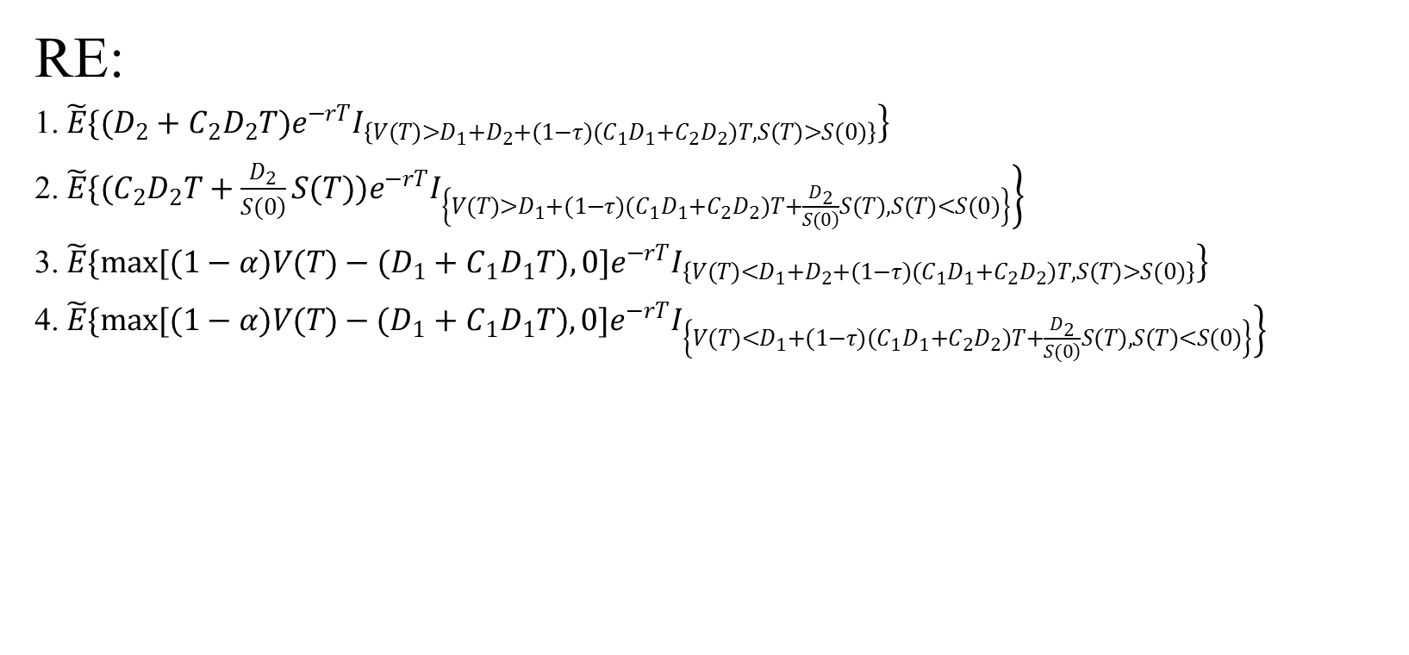
Merton(SB+RE): at time T
RE:
1. $\left.\tilde{E}\{(D_{2}+C_{2}D_{2}T)e^{−rT}I_{\left\{V(T)>D_{1}+D_{2}+(1−τ)(C_{1}D_{1}+C_{2}D_{2})T,S(T)>S(0)\right\}}\right\}$
2. $\left.\tilde{E}\{(C_{2}D_{2}T+\frac{D_{2}}{\left.S(0\right)}S(T))e^{−rT}I_{\left\{V(T)>D_{1}+(1−τ)(C_{1}D_{1}+C_{2}D_{2})T+\frac{D_{2}}{\left.S(0\right)}S(T),S(T)<S(0)\right\}}\right\}$
3. $\left.\tilde{E}\{max[(1−α)V(T)−(D_{1}+C_{1}D_{1}T),0]e^{−rT}I_{\left\{V(T)<D_{1}+D_{2}+(1−τ)(C_{1}D_{1}+C_{2}D_{2})T,S(T)>S(0)\right\}}\right\}$
4. $\left.\tilde{E}\{max[(1−α)V(T)−(D_{1}+C_{1}D_{1}T),0]e^{−rT}I_{\left\{V(T)<D_{1}+(1−τ)(C_{1}D_{1}+C_{2}D_{2})T+\frac{D_{2}}{\left.S(0\right)}S(T),S(T)<S(0)\right\}}\right\}$

Slide 11

Black and Cox:(SB+RE):
$$D_{1}+D_{2}+\left(1−τ\right)\left(C_{1}D_{1}+C_{2}D_{2}\right)T$$
Stock Price
DB
Case2
Case1
$$S_{0}$$
Case5
Case4
Case3
Asset Value
$$D_{1}+\left(1−τ\right)\left(C_{1}D_{1}+C_{2}D_{2}\right)T+\frac{D_{2}}{S_{0}}S_{T}$$

Slide 12
Black and Cox:(SB+RE): at time T
Case1:$V_{T}>D_{1}+D_{2}+\left(1−τ\right)\left(C_{1}D_{1}+C_{2}D_{2}\right)T \& S_{T}>S_{0}$
Equity=$V_{T}−[D_{1}+D_{2}+\left(1−τ\right)\left(C_{1}D_{1}+C_{2}D_{2}\right)T]$
SB= $D_{1}+C_{1}D_{1}T$
RE=$D_{2}+C_{2}D_{2}T$
Case2:$V_{T}<D_{1}+D_{2}+\left(1−τ\right)\left(C_{1}D_{1}+C_{2}D_{2}\right)T \& S_{T}>S_{0}$
Equity=0
SB=$min⁡[\left(1−α\right)V_{T},D_{1}+C_{1}D_{1}T]$
RE=$max⁡[\left(1−α\right)V_{T}−\left(D_{1}+C_{1}D_{1}T\right),0]$
Case1、Case2:$\min_{0≤t<T}V_{t}>L_{t}$,

Slide 13
Black and Cox:(SB+RE): at time T
Case3:$V_{T}>D_{1}+\left(1−τ\right)\left(C_{1}D_{1}+C_{2}D_{2}\right)T+\frac{D_{2}}{S_{0}}S_{T} \& S_{T}<S_{0}$
Equity= $V_{T}−[D_{1}+\left(1−τ\right)\left(C_{1}D_{1}+C_{2}D_{2}\right)T+\frac{D_{2}}{S_{0}}S_{T}]$
SB=$D_{1}+C_{1}D_{1}T$
RE=$C_{2}D_{2}T+\frac{D_{2}}{S_{0}}S_{T}$
Case4:$V_{T}<D_{1}+\left(1−τ\right)\left(C_{1}D_{1}+C_{2}D_{2}\right)T+\frac{D_{2}}{S_{0}}S_{T} \& S_{T}<S_{0}$
Equity=0
SB=$min⁡[\left(1−α\right)V_{T},D_{1}+C_{1}D_{1}T]$
RE=$max⁡[\left(1−α\right)V_{T}−\left(D_{1}+C_{1}D_{1}T\right),0]$
Case3、Case4:$\min_{0≤t<T}V_{t}>L_{t}$,

Slide 14

Black and Cox:(SB+RE): at time T
Case5:$\min_{0≤t<T}V_{t}≤L_{t}$
Equity=0
SB=$min⁡[\left(1−α\right)L_{t},D_{1}+C_{1}D_{1}T]$
RE=$max⁡[\left(1−α\right)L_{t}−\left(D_{1}+C_{1}D_{1}T\right),0]$

Slide 15
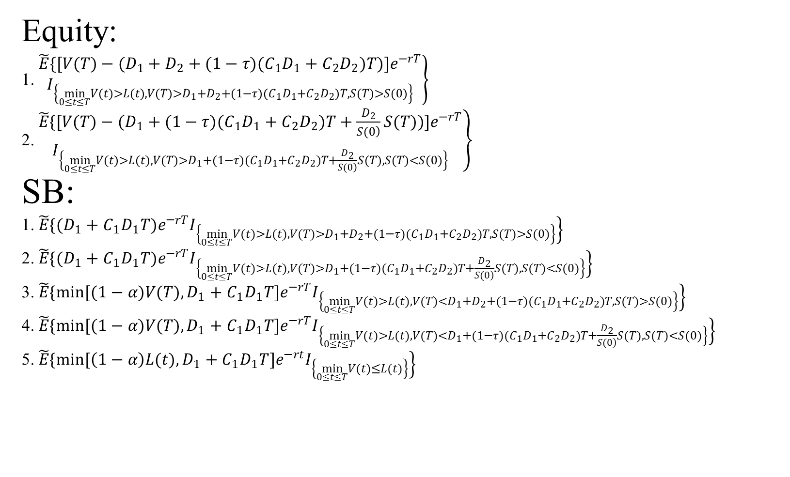
Black and Cox:(SB+RE): at time T
Equity:
1. $\left.\begin{aligned}\tilde{E}\{[V(T)−(D_{1}+D_{2}+(1−τ)(C_{1}D_{1}+C_{2}D_{2})T)]e^{−rT} \\ I_{\left\{\min_{0≤t≤T}V(t)>L(t),V(T)>D_{1}+D_{2}+(1−τ)(C_{1}D_{1}+C_{2}D_{2})T,S(T)>S(0)\right\}}\end{aligned}\right\}$
2. $\left.\begin{aligned}\tilde{E}\{[V(T)−(D_{1}+(1−τ)(C_{1}D_{1}+C_{2}D_{2})T+\frac{D_{2}}{\left.S(0\right)}S(T))]e^{−rT} \\ I_{\left\{\min_{0≤t≤T}V(t)>L(t),V(T)>D_{1}+(1−τ)(C_{1}D_{1}+C_{2}D_{2})T+\frac{D_{2}}{\left.S(0\right)}S(T),S(T)<S(0)\right\}}\end{aligned}\right\}$
SB:
1. $\left.\tilde{E}\{(D_{1}+C_{1}D_{1}T)e^{−rT}I_{\left\{\min_{0≤t≤T}V(t)>L(t),V(T)>D_{1}+D_{2}+(1−τ)(C_{1}D_{1}+C_{2}D_{2})T,S(T)>S(0)\right\}}\right\}$
2. $\left.\tilde{E}\{(D_{1}+C_{1}D_{1}T)e^{−rT}I_{\left\{\min_{0≤t≤T}V(t)>L(t),V(T)>D_{1}+(1−τ)(C_{1}D_{1}+C_{2}D_{2})T+\frac{D_{2}}{\left.S(0\right)}S(T),S(T)<S(0)\right\}}\right\}$
3. $\left.\tilde{E}\{min[(1−α)V(T),D_{1}+C_{1}D_{1}T]e^{−rT}I_{\left\{\min_{0≤t≤T}V(t)>L(t),V(T)<D_{1}+D_{2}+(1−τ)(C_{1}D_{1}+C_{2}D_{2})T,S(T)>S(0)\right\}}\right\}$
4. $\left.\tilde{E}\{min[(1−α)V(T),D_{1}+C_{1}D_{1}T]e^{−rT}I_{\left\{\min_{0≤t≤T}V(t)>L(t),V(T)<D_{1}+(1−τ)(C_{1}D_{1}+C_{2}D_{2})T+\frac{D_{2}}{\left.S(0\right)}S(T),S(T)<S(0)\right\}}\right\}$
5. $\left.\tilde{E}\{min[\left(1−α\right)L(t),D_{1}+C_{1}D_{1}T]e^{−rt}I_{\left\{\min_{0≤t≤T}V(t)≤L(t)\right\}}\right\}$

Slide 16

Black and Cox:(SB+RE): at time T
RE:
1. $\left.\tilde{E}\{(D_{2}+C_{2}D_{2}T)e^{−rT}I_{\left\{\min_{0≤t≤T}V(t)>L(t),V(T)>D_{1}+D_{2}+(1−τ)(C_{1}D_{1}+C_{2}D_{2})T,S(T)>S(0)\right\}}\right\}$
2. $\left.\tilde{E}\{(C_{2}D_{2}T+\frac{D_{2}}{\left.S(0\right)}S(T))e^{−rT}I_{\left\{\min_{0≤t≤T}V(t)>L(t),V(T)>D_{1}+(1−τ)(C_{1}D_{1}+C_{2}D_{2})T+\frac{D_{2}}{\left.S(0\right)}S(T),S(T)<S(0)\right\}}\right\}$
3. $\left.\tilde{E}\{max[(1−α)V(T)−(D_{1}+C_{1}D_{1}T),0]e^{−rT}I_{\left\{\min_{0≤t≤T}V(t)>L(t),V(T)<D_{1}+D_{2}+(1−τ)(C_{1}D_{1}+C_{2}D_{2})T,S(T)>S(0)\right\}}\right\}$
4. $\left.\tilde{E}\{max[(1−α)V(T)−(D_{1}+C_{1}D_{1}T),0]e^{−rT}I_{\left\{\min_{0≤t≤T}V(t)>L(t),V(T)<D_{1}+(1−τ)(C_{1}D_{1}+C_{2}D_{2})T+\frac{D_{2}}{\left.S(0\right)}S(T),S(T)<S(0)\right\}}\right\}$
5. $\left.\tilde{E}\{max[\left(1−α\right)L(t)−(D_{1}+C_{1}D_{1}T),0]e^{−rt}I_{\left\{\min_{0≤t≤T}V(t)≤L(t)\right\}}\right\}$

