Slide 1
論文大綱報告 2011/11/15
指導老師：戴天時 老師
學生：陳詩凱

Slide 2
Outline
Introduction.
Searching for high-frequency trading opportunities.
Statistical arbitrage in high-frequency.

Slide 3
CUDA Introduction

Slide 4
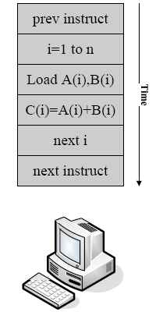
一般計算 (Serial Computing)

Slide 5
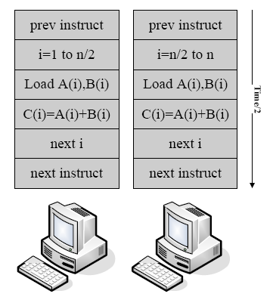
平行計算：二處理器

Slide 6
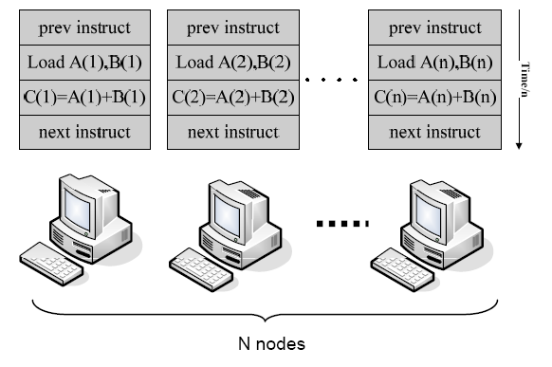
N Processors

Slide 7
GPGPU
將GPU用在非傳統的3D圖形顯示卡方面的應用，一般會把這樣的應用叫作GPGPU ( General-purpose computing on graphics processing units ) 。
適用問題：
大多是把一個可以用來大量拆解成多個相同、但彼此並不相關的小問題的情況；在這種情況下，用GPGPU的方法，就可以把這些一樣的小問題，給顯示卡的GPU來大量平行化的處理。
缺點：
傳統的GPGPU的開發方法，都是透過OpenGL 或 Direct3D這一類現有的圖形函式庫，來做到想要的計算

Slide 8
CUDA 介紹
統一計算架構 (Compute Unified Device Architecture)
是NVIDIA所推出的一種整合技術，是該公司對於GPGPU的正式名稱。利用GPU的強大威力，此架構能大幅提昇運算效能。
CUDA架構可以相容OpenCL或者自家的C-編譯器。無論是C-語言或是OpenCL，指令最終都會被驅動程式轉換成PTX代碼，交由顯示核心計算。

Slide 9
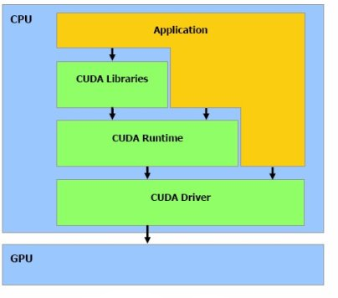
CUDA - 硬體架構
CUDA的程式架構
Host (CPU)
Device (GPU)

Slide 10
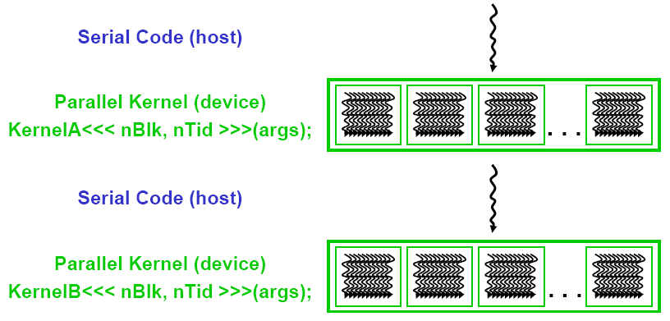
CUDA – 軟體架構
Integrated host + device app C program
Serial or modestly parallel parts in C code
Highly parallel parts in device SPMD kernel C code

Slide 11
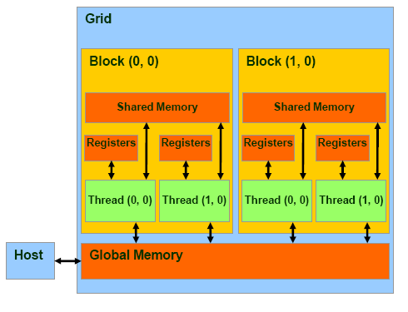
CUDA Device Memory Allocation
cudaMalloc()
Allocates object in the device Global Memory
Require two parameters
Address of a pointer to the allocated object
Size of allocated object
cudaFree()
Frees object from device Global Memory
Pointer to freed object

Slide 12
CUDA Device Memory Allocation
Example：
int width = 32;
float* Array;
int size = width * width * sizeof(float);
cudaMalloc((void**) &Array, size);
.
.
.
.
cudaFree(Array);

Slide 13
CUDA Host-Device Data Transfer
cudaMemcpy()
Memory data transfer
Requires four parameters
Pointer to destination
Pointer to source
Number of bytes copied
Type of transfer
Host to Host
Host to Device
Device to Host
Device to Device

Slide 14
CUDA Host-Device Data Transfer(續)
Example：
int width = 32; float* Array; float HostArray[width * width] int size = width * width * sizeof(float);
cudaMalloc((void**) &Array, size); cudaMemcpy(&Array, HostArray, size, cudaMemcpyHostToDevice); . . .
cudaMemcpy(HostArray, Array, size, cudaMemcpyDeviceToDevice);
cudaFree(Array);

Slide 15
CUDA Function Declarations
 | Executed on the： | Only callable from the：
__device__ float DeviceFunc() | device | device
__global__ void KernelFunc() | device | host
__host__ float HostFunc() | host | host
__global__ defines a kernel function
Must return void
__device__ and __host__ can be used together

Slide 16
High Frequency Trading Introduction

Slide 17
History
高頻交易對華爾街帶來極大的影響：大量的獲利
Over 60% of trading volume are high-frequency trading through the financial exchanges.
Jim Simons of Renaissance Technologies Corp. earned $2.5billion in 2008 alone.
The majority of high-frequency managers delivered positive returns in 2008.
Whereas 70% of low-frequency managers lost money.
Notes:
Immense：巨大的

Slide 18
What is High-Frequency Trading
在快速的電腦反應時間下，面對不斷變化的市場條件擁有極高的成交量。
交易策略通常擁有兩種特點：大量交易單以及平均每次交易僅有少量利潤
相較於一般策略可能長達6個月到2年，HFT通常小於1個月

Slide 19
HFT 的分類
Strategy | Description | Typical Holding Period
Automated liquidity provision | Quantitative algorithms for optimal pricing and execution of market-making positions | < 1 minute
Market microstructure trading | Identifying trading party order ﬂow through reverse engineering of observed quotes | < 10 minutes
Event trading | Short-term trading on macro events | < 1 hour
Deviations arbitrage | Statistical arbitrage of deviations from equilibrium: triangle trades, basis trades, and the like | < 1 day
Notes:
查內容

Slide 20
HFT 的優點
隨著全球市場的連續性，波動通常是24小時不間斷的，因此HFT可避開隔夜交易(overnight position)的風險。
允許帳戶持有充分的透明度和消除需要的資本鎖定 。
隨著利率的波動以及未來可能的惡性通貨膨脹，要付的保證金使得隔夜交易的商品變得非常昂貴。HFT可以替投資者省下不少隔夜交易所帶來的成本。
與傳統長時策略彼此較無相關，且擁有較高獲益。
Notes:
隔夜交易
投資者不一定只受外匯所影響

Slide 21
HFT 的影響
對企業來說：
節省營運開銷 (情緒、猶豫所帶來的機會損失)
對社會來說：
刺激電腦技術的創新→(cpu以及網路)
增加市場的成交率、增加資產流動性→(市場曲線更加平滑)
穩定市場機制→(去除錯誤定價)

Slide 22
HFT 的建立
處理大量的資料(intra-day data)
Signal的出現 = 對的下手時點
快速的處理速度
預防問題：電腦病毒、網路駭客、資訊安全
隨時更新硬體、軟體、規則

Slide 23
小結
High-frequency trading 很困難處理但在適當的調整下卻能夠在不同市場情況下穩定的產生定量的獲利。

Slide 24
Searching for High-Frequency Trading Opportunities

Slide 25
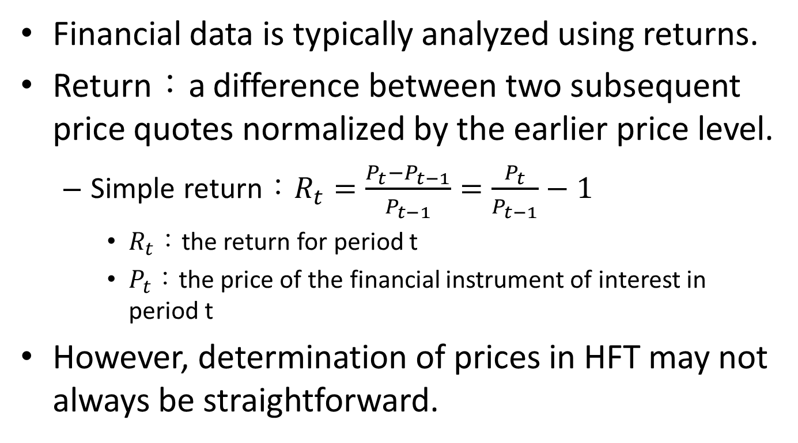
1. Statistical Properties of Returns
Financial data is typically analyzed using returns.
Return：a difference between two subsequent price quotes normalized by the earlier price level.
Simple return：$R_{t}=\frac{P_{t}−P_{t−1}}{P_{t−1}}=\frac{P_{t}}{P_{t−1}}−1$
$R_{t}$：the return for period t
$P_{t}$：the price of the financial instrument of interest in period t
However, determination of prices in HFT may not always be straightforward.

Slide 26
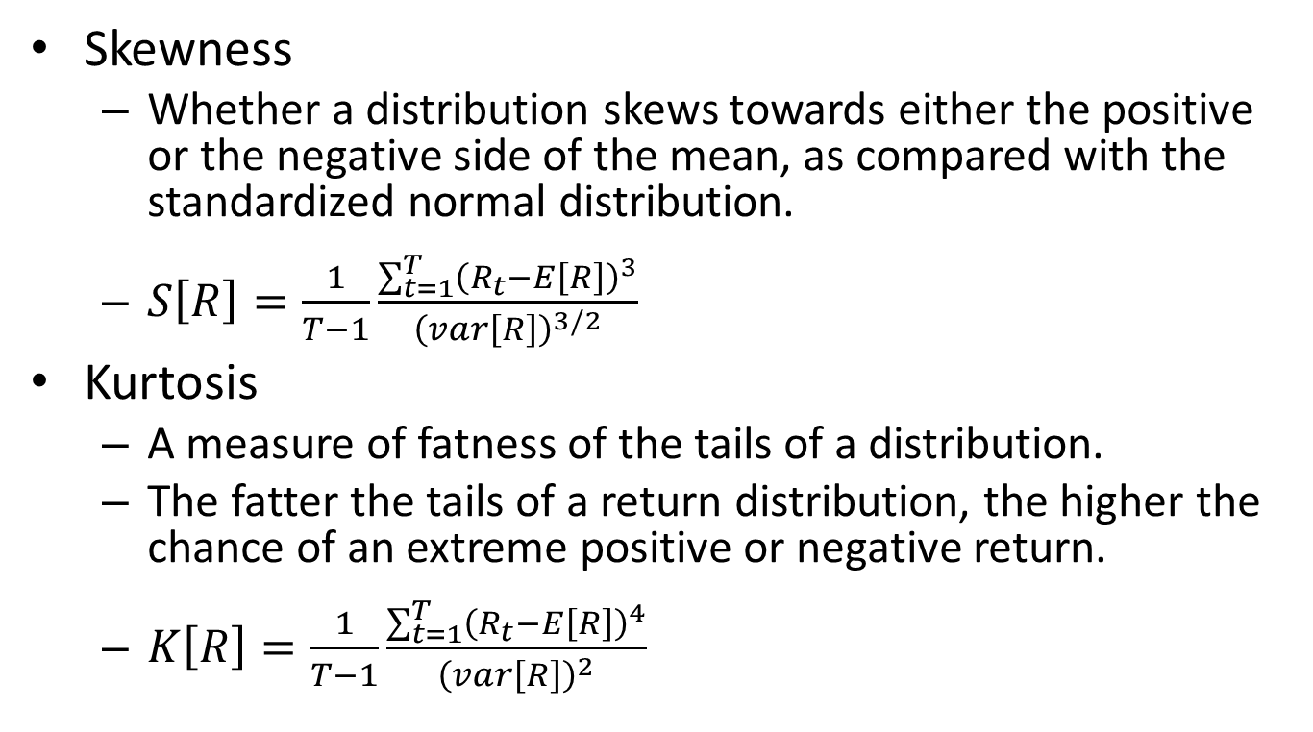
Other common statistics used to describe distributions of prices or simple or log retures.
Skewness
Whether a distribution skews towards either the positive or the negative side of the mean, as compared with the standardized normal distribution.
$S\left[R\right]=\frac{1}{T−1}\frac{\sum_{t=1}^{T}{{\left(R_{t}−E\left[R\right]\right)}^{3}}}{{\left(var\left[R\right]\right)}^{3/2}}$
Kurtosis
A measure of fatness of the tails of a distribution.
The fatter the tails of a return distribution, the higher the chance of an extreme positive or negative return.
$K\left[R\right]=\frac{1}{T−1}\frac{\sum_{t=1}^{T}{{\left(R_{t}−E\left[R\right]\right)}^{4}}}{{\left(var\left[R\right]\right)}^{2}}$
Notes:
S：三階動差(偏態係數)衡量分配的不對稱程度
K：四階動差(峰度係數)衡量資料分配在尾端的多寡

Slide 27
2.Models
Linear Econometric Models
Volatility Modes
Nonlinear Models

Slide 28
Statistical Arbitrage in High-Frequency Settings

Slide 29
Practical Applications of Statistical Arbitrage
Foreign exchange
Triangular arbitrage
Uncovered interest parity arbitrage
Equities
Arbitraging different equity classes of the same issuer
Market-neutral arbitrage
Liquidity arbitrage
Large-to-small information spillovers
Futures
Basic trading
Futures/equity arbitrage
Indexes and ETFs
Options
Volatility Curve Arbitrage
Notes:
ETF英文原文為Exchange Traded Funds，中文稱為「指數股票型證券投資信託基金」，簡稱為「指數股票型基金」，ETF即 為將指數予以證券化，由於指數係衡量市場漲跌趨勢之指標，因此所謂指數證券化，係指投資人不以傳統方式直接進行一籃子股票之投資，而是透過持有表彰指數標的股票權益的受益憑證來間接投資；因此簡而言之，ETF是一種在證券交易所買賣，提供投資人參與指數表現的基金，ETF基金以持有與指數相同之股票為主，分割成眾多單價較低之投資單位，發行受益憑證。

Slide 30
研究進度
修改威辰學長C code
研究文獻：
Irene Aldridge, High-Frequency Trading A Practical Guide to Algorithmic Strategies and Trading Systems.pdf
OS環境：
Windows 7
軟體環境：
Microsoft Visual Studio 2010
CUDA 4.0
C++

Slide 31
Thank You

