Slide 1
碩士論文進度報告
指導老師 戴天時 老師
資管所 黃立文

Slide 2
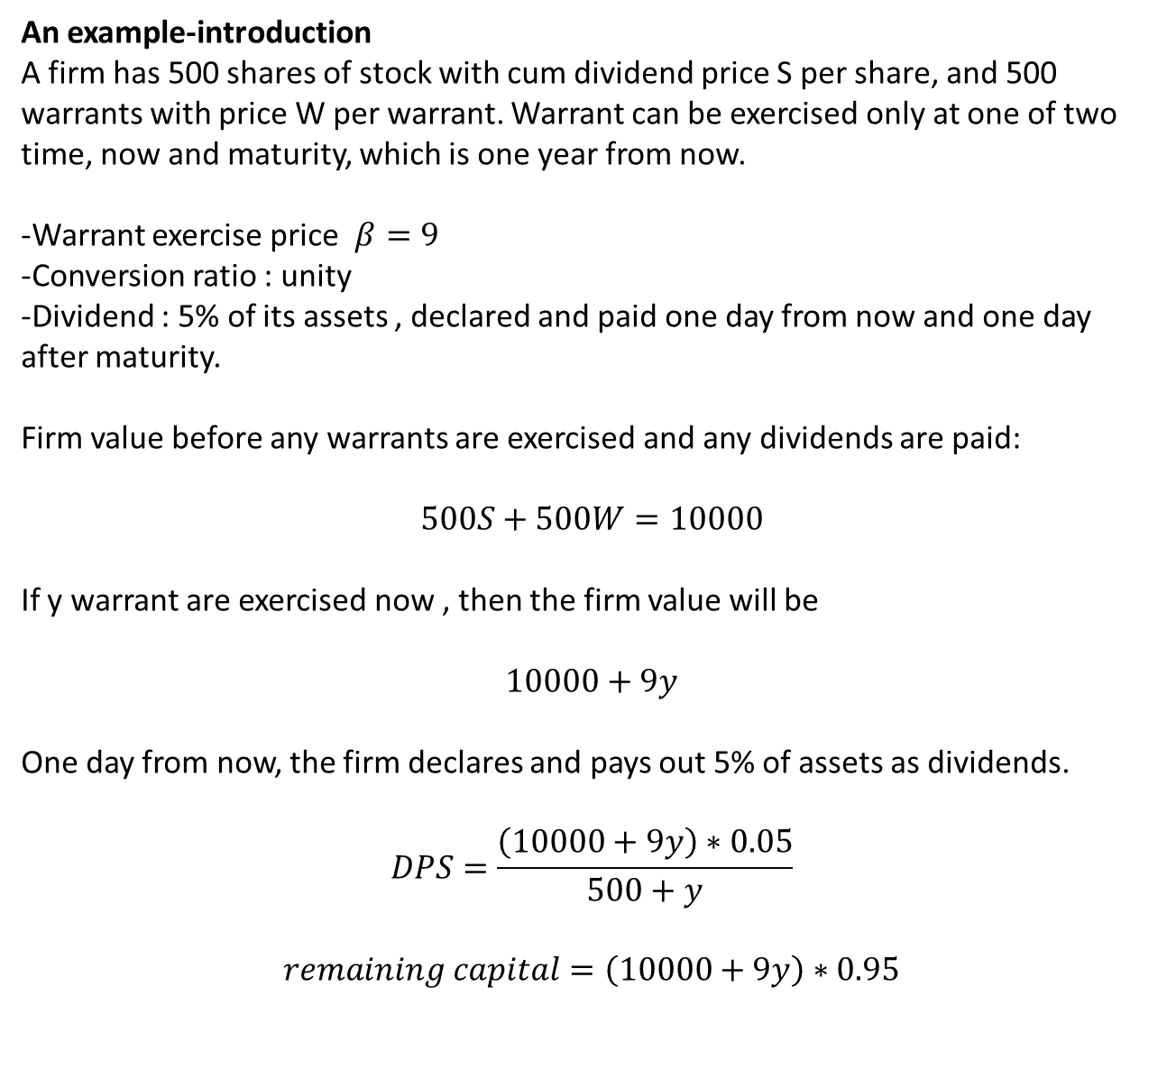
An example-introduction
A firm has 500 shares of stock with cum dividend price S per share, and 500 warrants with price W per warrant. Warrant can be exercised only at one of two time, now and maturity, which is one year from now.
-Warrant exercise price $β=9$
-Conversion ratio : unity
-Dividend : 5% of its assets , declared and paid one day from now and one day after maturity.
Firm value before any warrants are exercised and any dividends are paid:
$$500S+500W=10000$$
If y warrant are exercised now , then the firm value will be
$$10000+9y$$
One day from now, the firm declares and pays out 5% of assets as dividends.
$$DPS=\frac{\left(10000+9y\right)∗0.05}{500+y}$$
$$remaining capital=\left(10000+9y\right)∗0.95$$

Slide 3
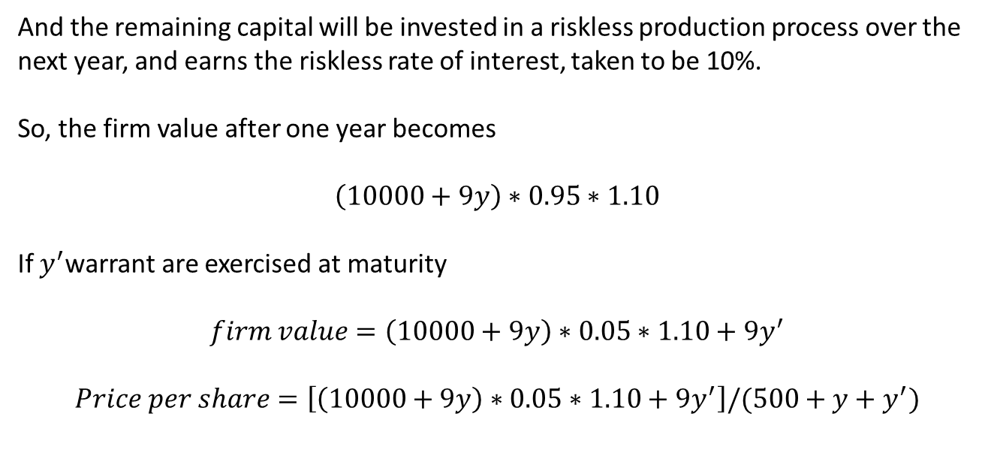
And the remaining capital will be invested in a riskless production process over the
next year, and earns the riskless rate of interest, taken to be 10%.
So, the firm value after one year becomes
$$\left(10000+9y\right)∗0.95∗1.10$$
If $y^{′}$warrant are exercised at maturity
$$firm value=\left(10000+9y\right)∗0.05∗1.10+9y^{′}$$
$$Price per share=\left[\left(10000+9y\right)∗0.05∗1.10+9y^{′}\right]/(500+y+y^{′})$$

Slide 4
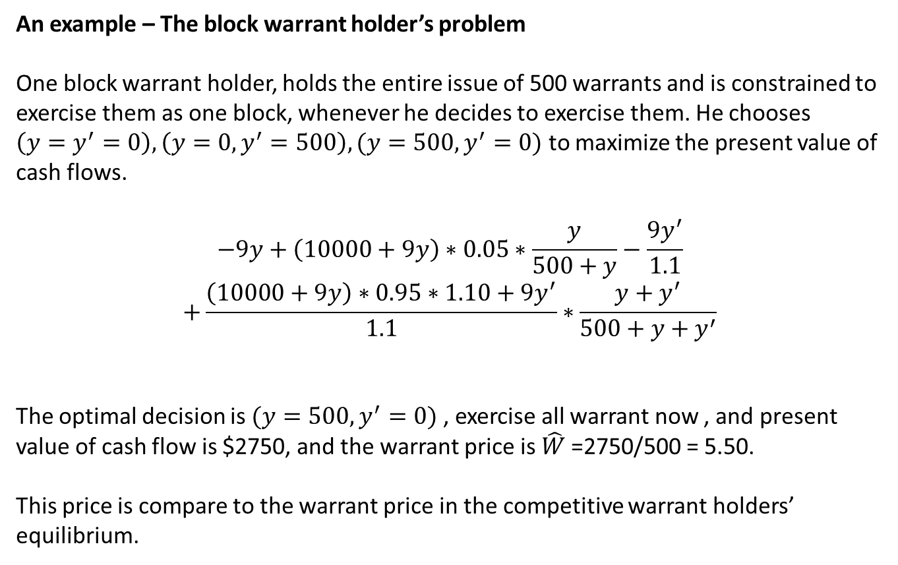
An example – The block warrant holder’s problem
One block warrant holder, holds the entire issue of 500 warrants and is constrained to exercise them as one block, whenever he decides to exercise them. He chooses $\left(y=y^{′}=0\right),\left(y=0,y^{′}=500\right),(y=500,y^{′}=0)$ to maximize the present value of cash flows.
$$−9y+\left(10000+9y\right)∗0.05∗\frac{y}{500+y}−\frac{9y^{′}}{1.1}$$
$$+\frac{\left(10000+9y\right)∗0.95∗1.10+9y^{′}}{1.1}∗\frac{y+y^{′}}{500+y+y^{′}}$$
The optimal decision is $(y=500,y^{′}=0)$ , exercise all warrant now , and present value of cash flow is $2750, and the warrant price is ${\hat{W}}_{ }$=2750/500 = 5.50.
This price is compare to the warrant price in the competitive warrant holders’ equilibrium.

Slide 5
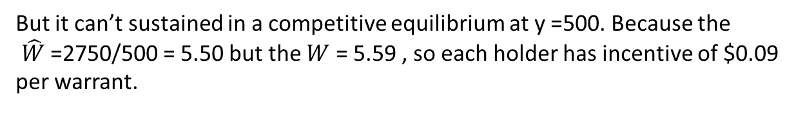
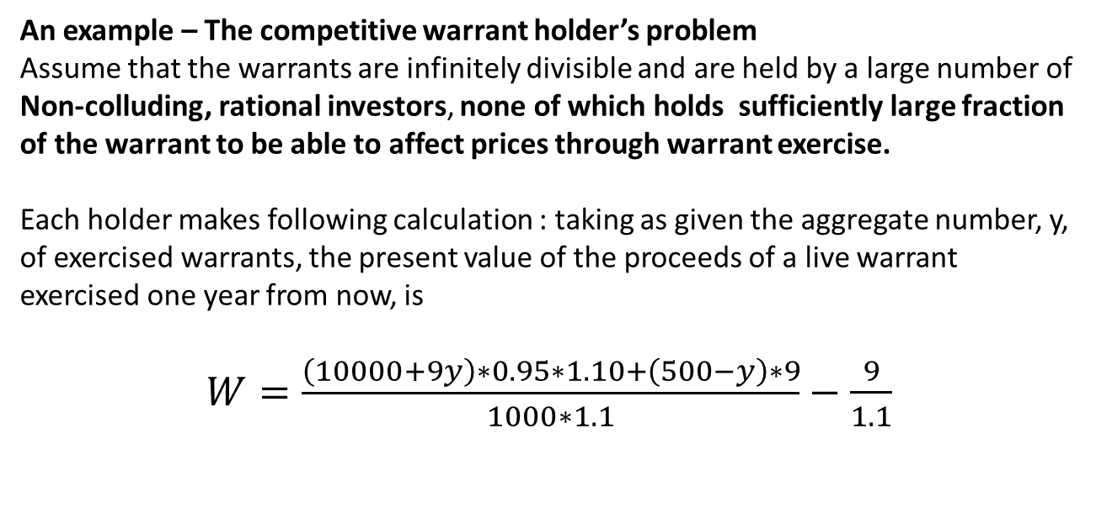
An example – The competitive warrant holder’s problem
Assume that the warrants are infinitely divisible and are held by a large number of
Non-colluding, rational investors, none of which holds sufficiently large fraction of the warrant to be able to affect prices through warrant exercise.
Each holder makes following calculation : taking as given the aggregate number, y, of exercised warrants, the present value of the proceeds of a live warrant exercised one year from now, is
$W=\frac{\left(10000+9y\right)∗0.95∗1.10+\left(500−y\right)∗9}{1000∗1.1}−\frac{9}{1.1}$
But it can’t sustained in a competitive equilibrium at y =500. Because the
${\hat{W}}_{ }$=2750/500 = 5.50 but the $W$ = 5.59 , so each holder has incentive of $0.09
per warrant.

Slide 6
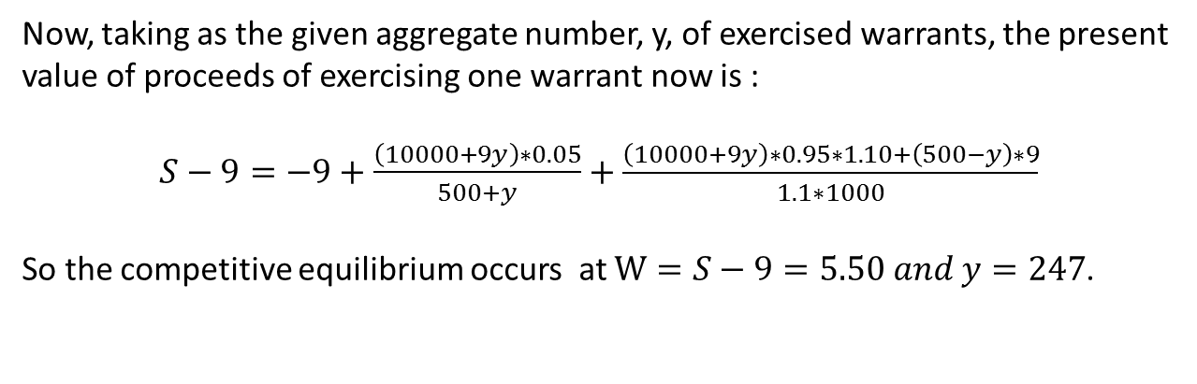
Now, taking as the given aggregate number, y, of exercised warrants, the present
value of proceeds of exercising one warrant now is :
$S−9=−9+\frac{\left(10000+9y\right)∗0.05}{500+y}+\frac{\left(10000+9y\right)∗0.95∗1.10+\left(500−y\right)∗9}{1.1∗1000}$
So the competitive equilibrium occurs at $W=S−9=5.50 and y=247$.

Slide 7
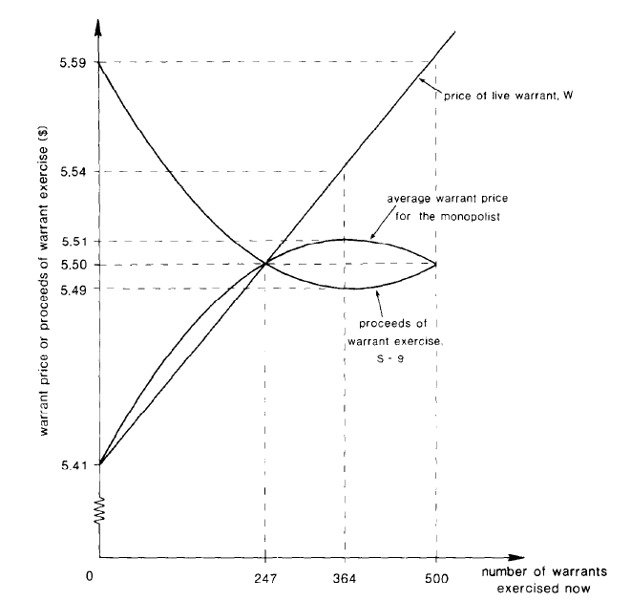

Slide 8
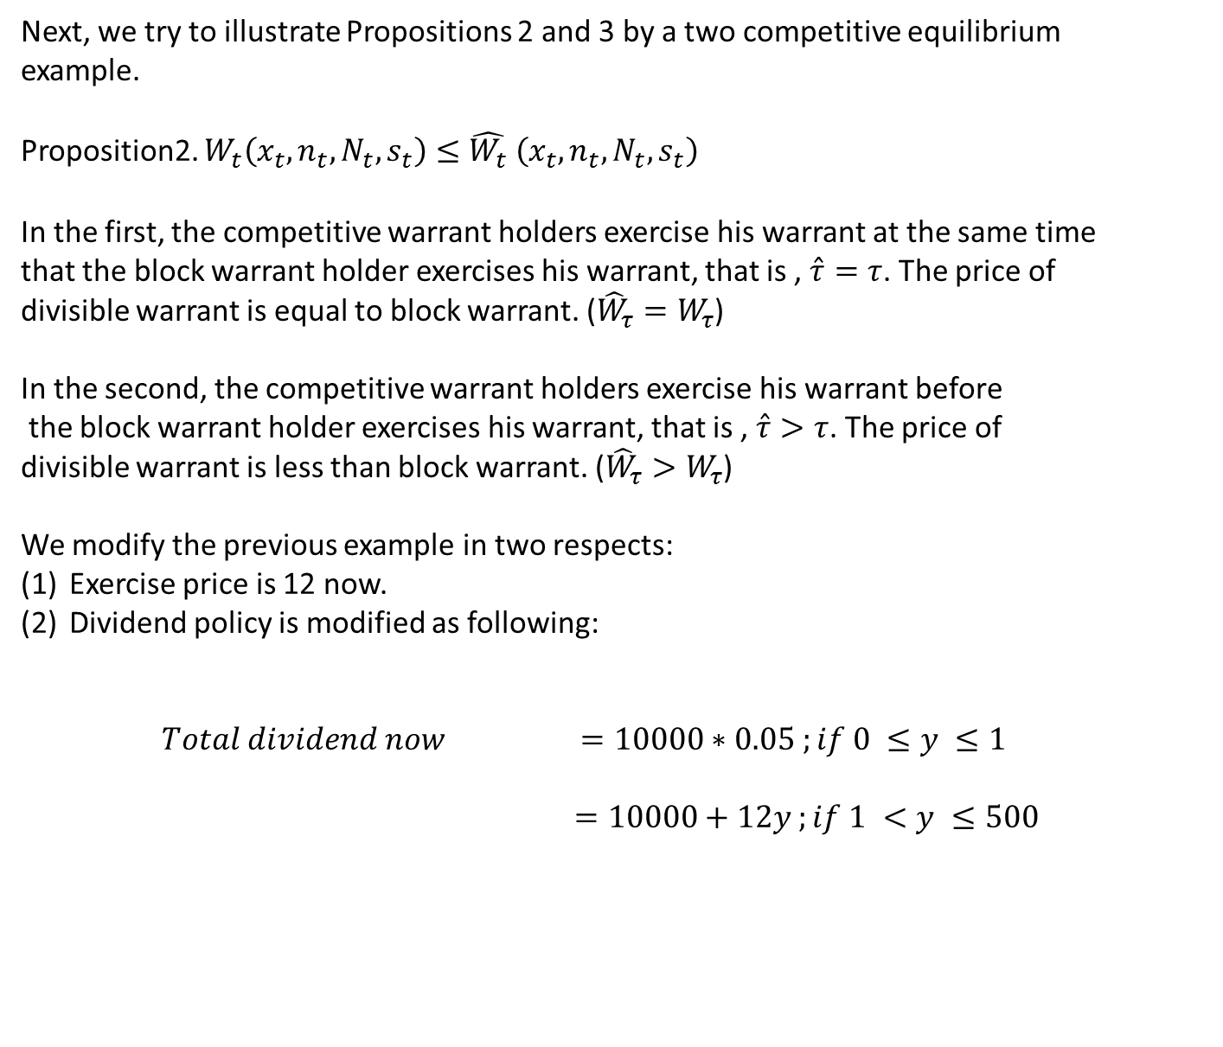
Next, we try to illustrate Propositions 2 and 3 by a two competitive equilibrium
example.
Proposition2. $W_{t}\left(x_{t},n_{t},N_{t},s_{t}\right)≤{\hat{W_{t}}}_{ }\left(x_{t},n_{t},N_{t},s_{t}\right)$
In the first, the competitive warrant holders exercise his warrant at the same time
that the block warrant holder exercises his warrant, that is , $\hat{τ}=τ$. The price of
divisible warrant is equal to block warrant. (${\hat{W}}_{τ}=W_{τ}$)
In the second, the competitive warrant holders exercise his warrant before
the block warrant holder exercises his warrant, that is , $\hat{τ}>τ$. The price of
divisible warrant is less than block warrant. (${\hat{W}}_{τ}>W_{τ}$)
We modify the previous example in two respects:
Exercise price is 12 now.
Dividend policy is modified as following:
$Total dividend now$ $=10000∗0.05 ;if 0 ≤y ≤1$
$=10000+12y ;if 1 <y ≤500$

Slide 9
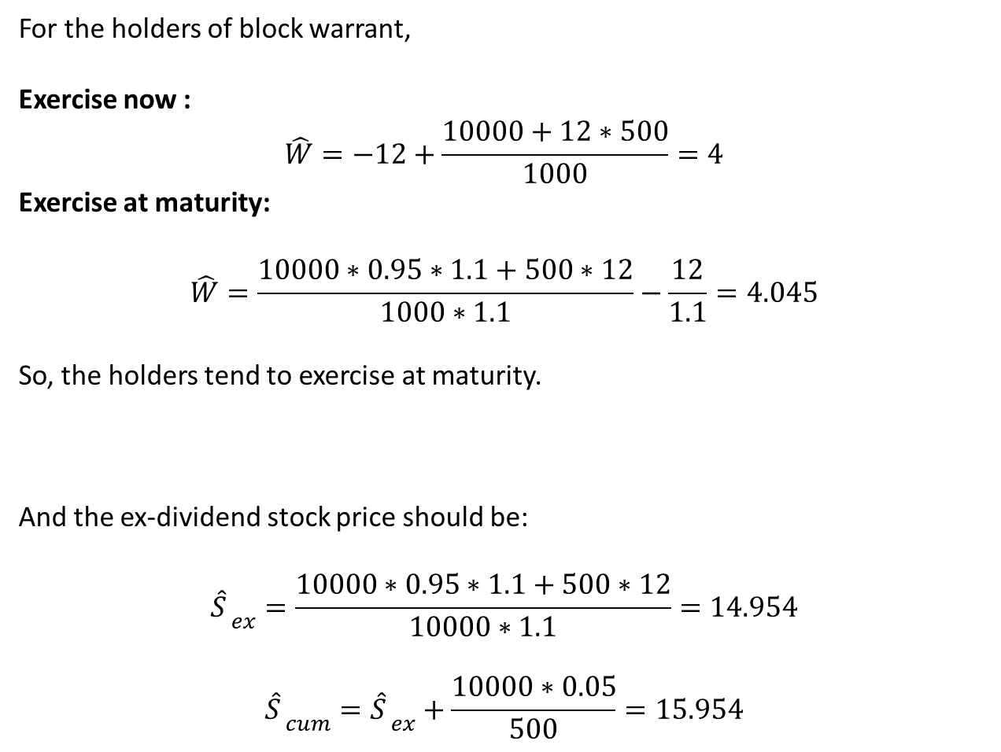
For the holders of block warrant,
Exercise now :
$${\hat{W}}_{ }=−12+\frac{10000+12∗500}{1000}=4$$
Exercise at maturity:
$${\hat{W}}_{ }=\frac{10000∗0.95∗1.1+500∗12}{1000∗1.1}−\frac{12}{1.1}=4.045$$
So, the holders tend to exercise at maturity.
And the ex-dividend stock price should be:
$${{\hat{S}}_{ }}_{ex}=\frac{10000∗0.95∗1.1+500∗12}{10000∗1.1}=14.954$$
$${{\hat{S}}_{ }}_{cum}={{\hat{S}}_{ }}_{ex}+\frac{10000∗0.05}{500}=15.954$$

Slide 10
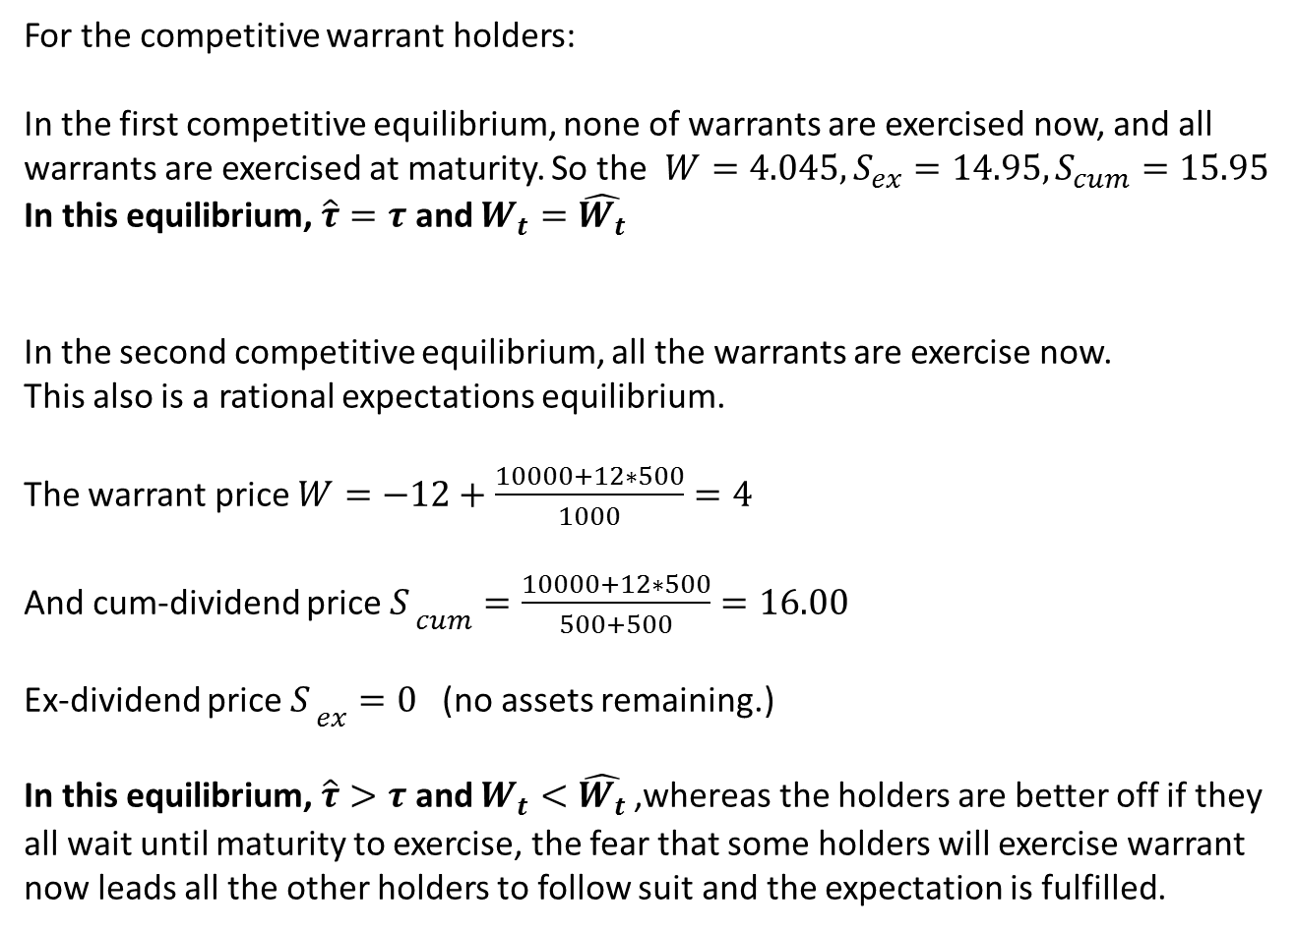
For the competitive warrant holders:
In the first competitive equilibrium, none of warrants are exercised now, and all
warrants are exercised at maturity. So the ${W=4.045,S}_{ex}=14.95,S_{cum}=15.95$
In this equilibrium, $\hat{τ}=τ$ and $W_{t}={\hat{W_{t}}}_{ }$
In the second competitive equilibrium, all the warrants are exercise now.
This also is a rational expectations equilibrium.
The warrant price $W=−12+\frac{10000+12∗500}{1000}=4$
And cum-dividend price ${S_{ }}_{cum}=\frac{10000+12∗500}{500+500}=16.00$
Ex-dividend price ${S_{ }}_{ex}=0$(no assets remaining.)
In this equilibrium, $\hat{τ}>τ$ and $W_{t}<{\hat{W_{t}}}_{ }$,whereas the holders are better off if they
all wait until maturity to exercise, the fear that some holders will exercise warrant
now leads all the other holders to follow suit and the expectation is fulfilled.

Slide 11

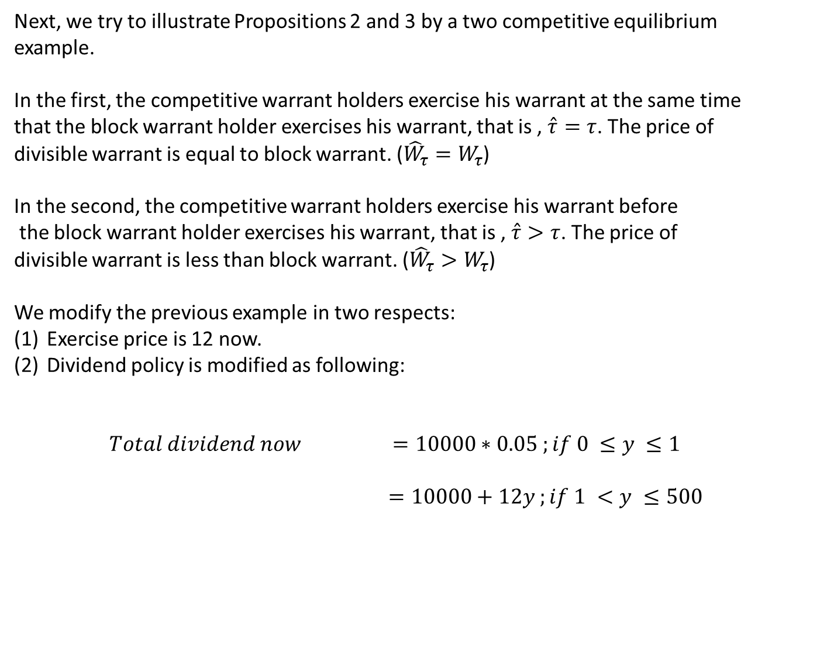



Part II. A dual case of Reverse Exchange
At maturity
$$V_{L}$$
$$τ(C_{C}D_{C})$$
Mixed equity
Equity
$τ$($C_{S}D_{S}+C_{C}D_{C}$)
CB
Bankruptcy cost
SB
Mixed
Debt.
Convertible bond + straight bond
(Face value + coupon)
$${45}^{。}$$
CB exercise
$$V_{A}$$
$$D_{S}+D_{C}+\left(1−τ\right)(C_{S}D_{S}+C_{C}D_{C})$$

Slide 12

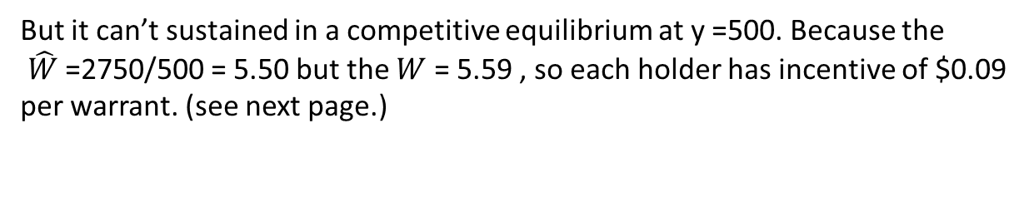
Now we simplify the case…
there are only convertible bonds.
At maturity
$$V_{L}$$
$$τ(C_{C}D_{C})$$
Equity
$τ$($C_{C}D_{C}$)
Mixed equity
Bankruptcy cost
Convertible bond
Debt.
(Face + coupon)
CB
Debt.
$${45}^{。}$$
$$D_{C}+\left(1−τ\right)(C_{C}D_{C})$$
CB exercise
$$V_{A}$$

