Slide 1
Warrant exercise and bond conversion in competitive market
資管所 黃立文

Slide 2
Properties of all competitive equilibria
An example

Slide 3
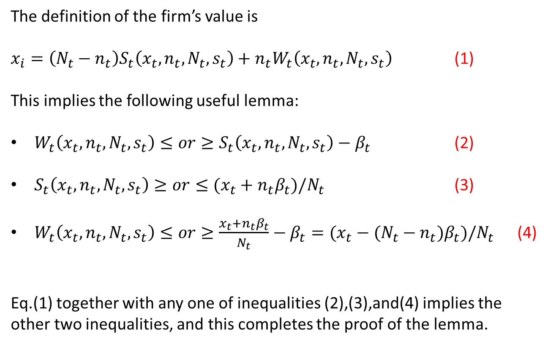
The definition of the firm’s value is
$x_{i}=\left(N_{t}−n_{t}\right)S_{t}\left(x_{t},n_{t},N_{t},s_{t}\right)+n_{t}W_{t}\left(x_{t},n_{t},N_{t},s_{t}\right)$ (1)
This implies the following useful lemma:
$W_{t}\left(x_{t},n_{t},N_{t},s_{t}\right)≤or≥S_{t}\left(x_{t},n_{t},N_{t},s_{t}\right)−β_{t}$ (2)
$S_{t}\left(x_{t},n_{t},N_{t},s_{t}\right)≥or≤(x_{t}+n_{t}β_{t})/N_{t}$ (3)
$W_{t}\left(x_{t},n_{t},N_{t},s_{t}\right)≤or≥\frac{x_{t}+n_{t}β_{t}}{N_{t}}−β_{t}=(x_{t}−(N_{t}−n_{t})β_{t})/N_{t}$ (4)
Eq.(1) together with any one of inequalities (2),(3),and(4) implies the other two inequalities, and this completes the proof of the lemma.

Slide 4

By (1)
$$W_{t}=\frac{X_{t}−(N_{t}−n_{t})S_{t}}{n_{t}}$$
If (2)
$$W_{t}>S_{t}−β_{t}$$
$\frac{X_{t}−(N_{t}−n_{t})S_{t}}{n_{t}}$>$S_{t}−β_{t}$
$$X_{t}−\left(N_{t}−n_{t}\right)S_{t}>n_{t}S_{t}−n_{t}β_{t}$$
$$X_{t}+n_{t}β_{t}>n_{t}S_{t}+(N_{t}−n_{t})S_{t}$$
$$X_{t}+n_{t}β_{t}>N_{t}S_{t}$$
$$\frac{X_{t}+n_{t}β_{t}}{N_{t}}>S_{t} (3)$$

Slide 5
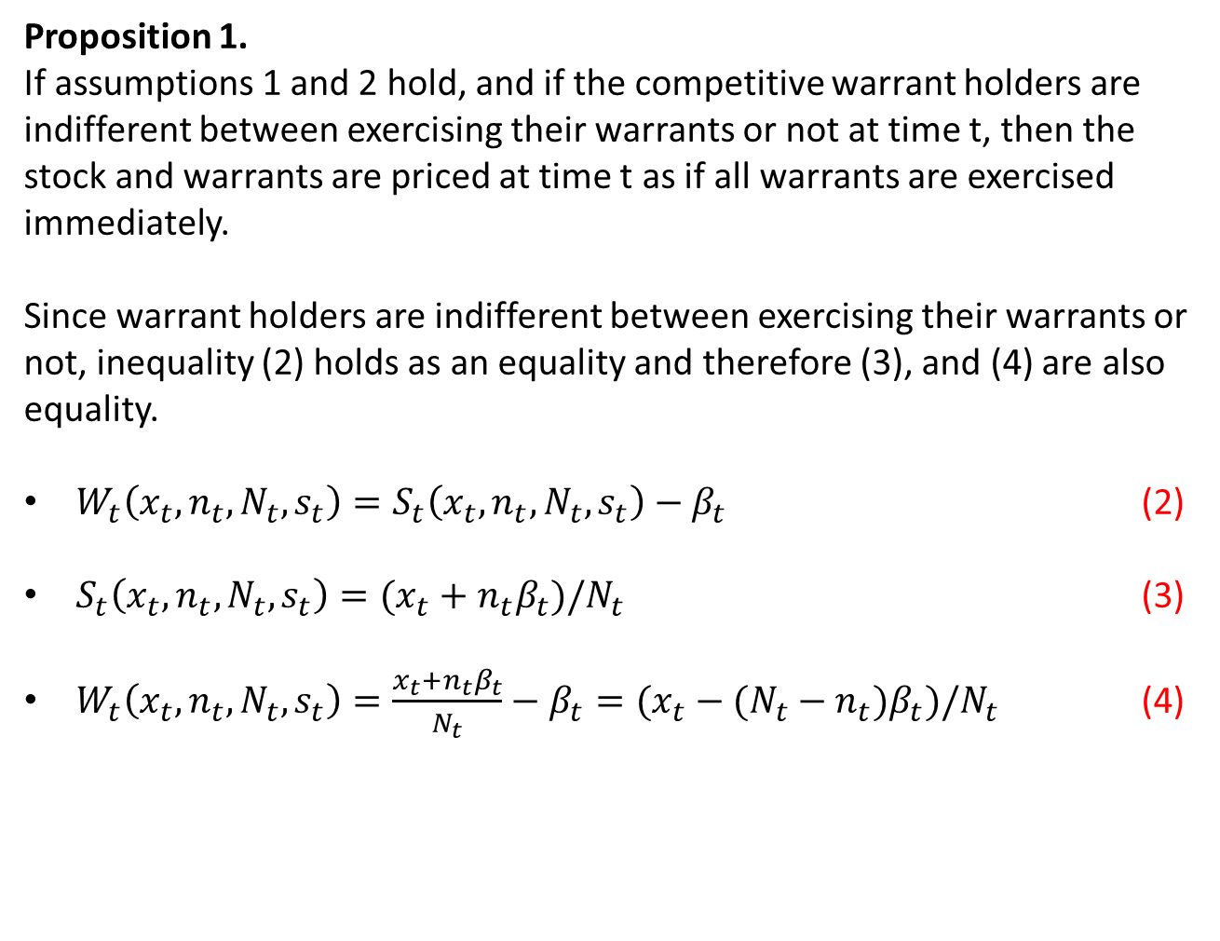
Proposition 1.
If assumptions 1 and 2 hold, and if the competitive warrant holders are indifferent between exercising their warrants or not at time t, then the stock and warrants are priced at time t as if all warrants are exercised immediately.
Since warrant holders are indifferent between exercising their warrants or not, inequality (2) holds as an equality and therefore (3), and (4) are also equality.
$W_{t}\left(x_{t},n_{t},N_{t},s_{t}\right)=S_{t}\left(x_{t},n_{t},N_{t},s_{t}\right)−β_{t}$ (2)
$S_{t}\left(x_{t},n_{t},N_{t},s_{t}\right)=(x_{t}+n_{t}β_{t})/N_{t}$ (3)
$W_{t}\left(x_{t},n_{t},N_{t},s_{t}\right)=\frac{x_{t}+n_{t}β_{t}}{N_{t}}−β_{t}=(x_{t}−(N_{t}−n_{t})β_{t})/N_{t}$ (4)

Slide 6
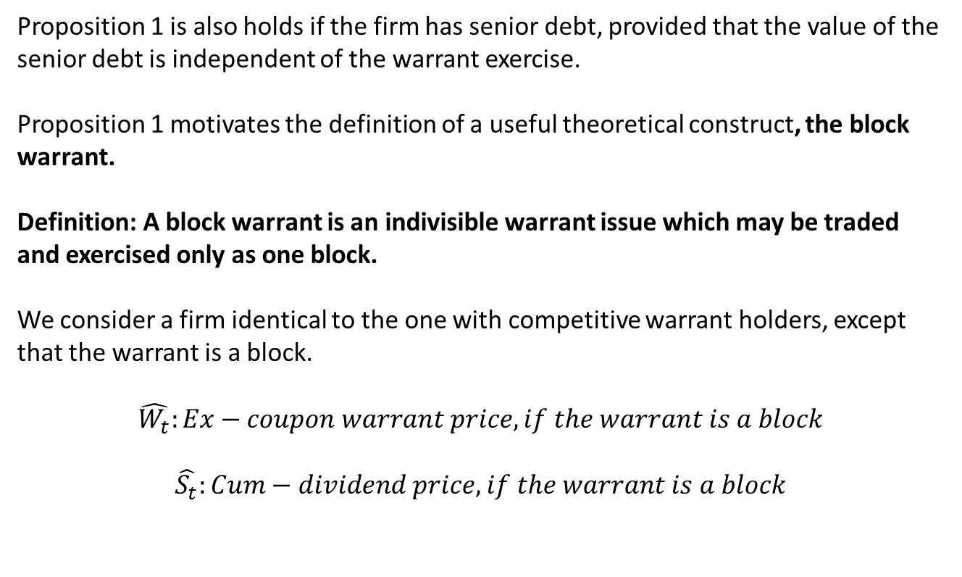
Proposition 1 is also holds if the firm has senior debt, provided that the value of the senior debt is independent of the warrant exercise.
Proposition 1 motivates the definition of a useful theoretical construct, the block warrant.
Definition: A block warrant is an indivisible warrant issue which may be traded and exercised only as one block.
We consider a firm identical to the one with competitive warrant holders, except that the warrant is a block.
$$\hat{W_{t}}:Ex−coupon warrant price, if the warrant is a block$$
$$\hat{S_{t}}:Cum−dividend price, if the warrant is a block$$

Slide 7
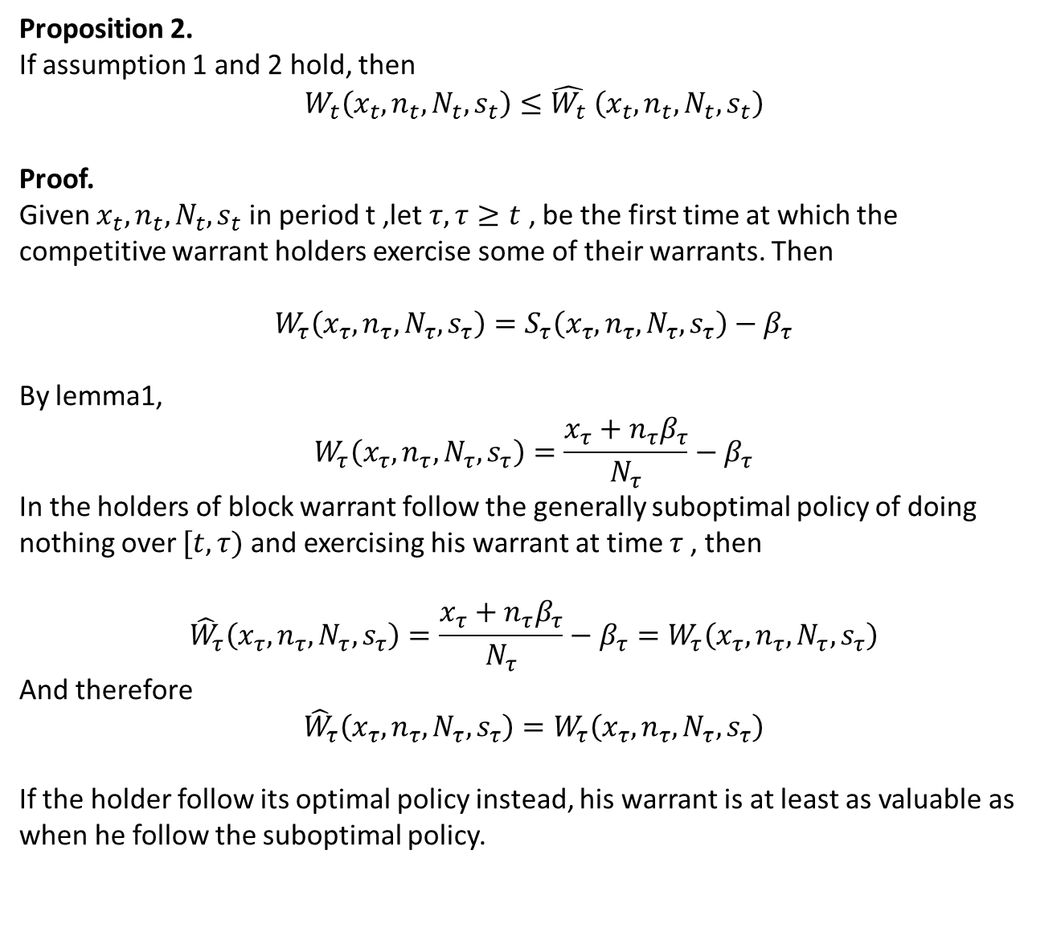
Proposition 2.
If assumption 1 and 2 hold, then
$$W_{t}\left(x_{t},n_{t},N_{t},s_{t}\right)≤{\hat{W_{t}}}_{ }\left(x_{t},n_{t},N_{t},s_{t}\right)$$
Proof.
Given $x_{t},n_{t},N_{t},s_{t}$ in period t ,let $τ,τ≥t$ , be the first time at which the competitive warrant holders exercise some of their warrants. Then
$$W_{τ}\left(x_{τ},n_{τ},N_{τ},s_{τ}\right)=S_{τ}\left(x_{τ},n_{τ},N_{τ},s_{τ}\right)−β_{τ}$$
By lemma1,
$$W_{τ}\left(x_{τ},n_{τ},N_{τ},s_{τ}\right)=\frac{x_{τ}+n_{τ}β_{τ}}{N_{τ}}−β_{τ}$$
In the holders of block warrant follow the generally suboptimal policy of doing nothing over $[t,τ)$ and exercising his warrant at time $τ$, then
$${\hat{W}}_{τ}\left(x_{τ},n_{τ},N_{τ},s_{τ}\right)=\frac{x_{τ}+n_{τ}β_{τ}}{N_{τ}}−β_{τ}=W_{τ}\left(x_{τ},n_{τ},N_{τ},s_{τ}\right)$$
And therefore
$${\hat{W}}_{τ}\left(x_{τ},n_{τ},N_{τ},s_{τ}\right)=W_{τ}\left(x_{τ},n_{τ},N_{τ},s_{τ}\right)$$
If the holder follow its optimal policy instead, his warrant is at least as valuable as when he follow the suboptimal policy.

Slide 8
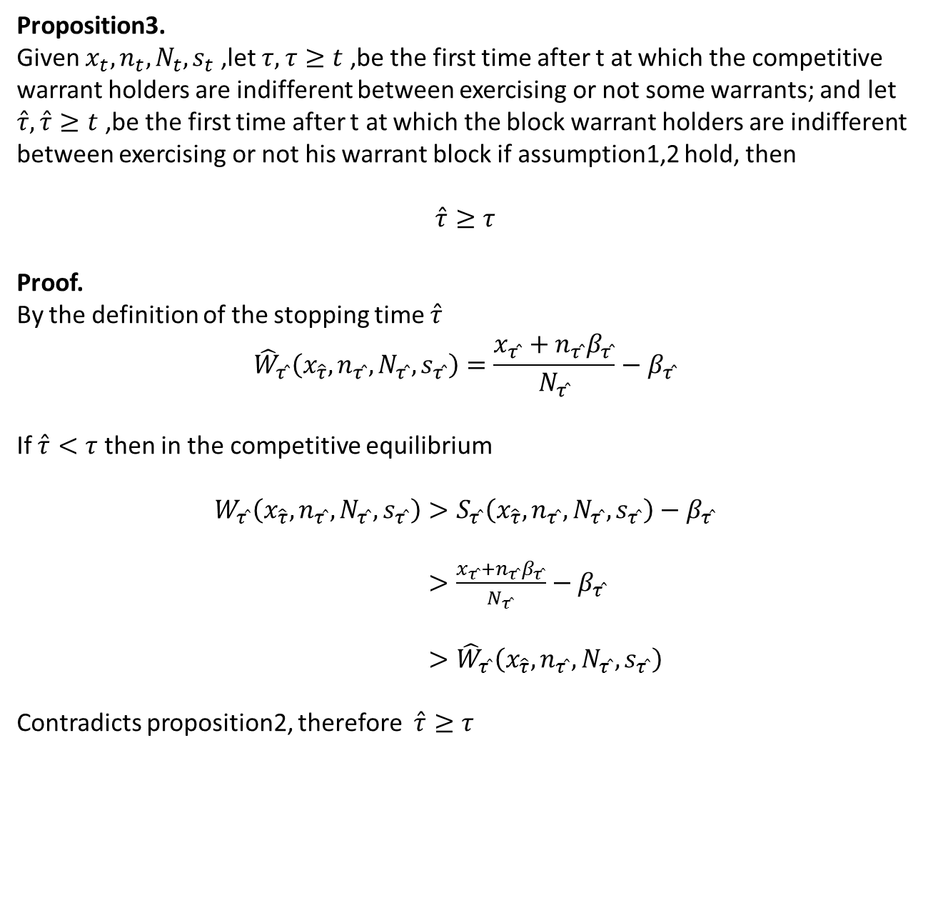
Proposition3.
Given $x_{t},n_{t},N_{t},s_{t}$ ,let $τ,τ≥t$ ,be the first time after t at which the competitive warrant holders are indifferent between exercising or not some warrants; and let $\hat{τ}, \hat{τ}≥t$ ,be the first time after t at which the block warrant holders are indifferent between exercising or not his warrant block if assumption1,2 hold, then
$$\hat{τ}≥τ$$
Proof.
By the definition of the stopping time $\hat{τ}$
$${\hat{W}}_{τ ̂}\left(x_{\hat{τ}},n_{τ ̂},N_{τ ̂},s_{τ ̂}\right)=\frac{x_{τ ̂}+n_{τ ̂}β_{τ ̂}}{N_{τ ̂}}−β_{τ ̂}$$
If $\hat{τ}<τ$ then in the competitive equilibrium
$W_{τ ̂}\left(x_{\hat{τ}},n_{τ ̂},N_{τ ̂},s_{τ ̂}\right)>S_{τ ̂}\left(x_{\hat{τ}},n_{τ ̂},N_{τ ̂},s_{τ ̂}\right)−$ $β_{τ ̂}$
$>\frac{x_{τ ̂}+n_{τ ̂}β_{τ ̂}}{N_{τ ̂}}−β_{τ ̂}$
$>{\hat{W}}_{τ ̂}\left(x_{\hat{τ}},n_{τ ̂},N_{τ ̂},s_{τ ̂}\right)$
Contradicts proposition2, therefore $\hat{τ}≥τ$

Slide 9
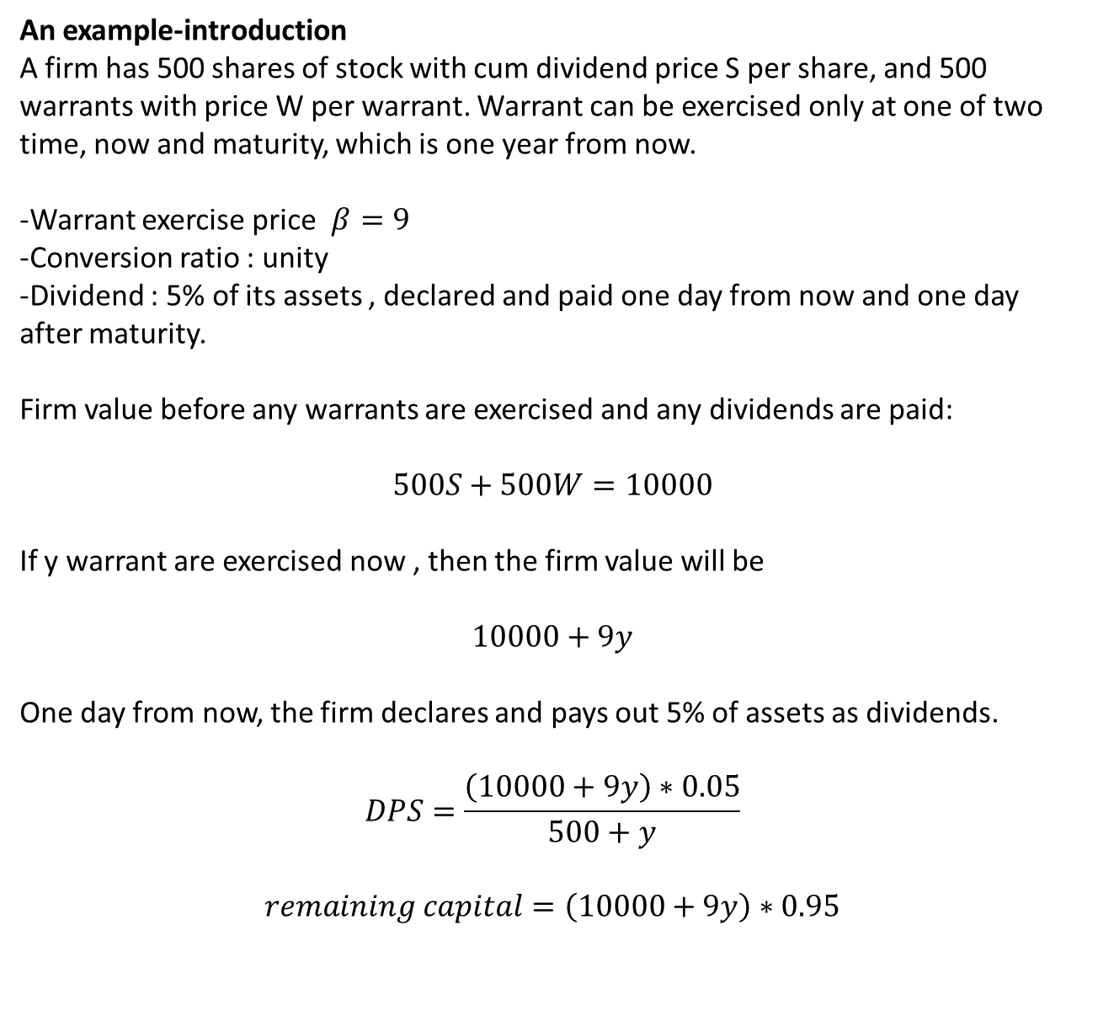
An example-introduction
A firm has 500 shares of stock with cum dividend price S per share, and 500 warrants with price W per warrant. Warrant can be exercised only at one of two time, now and maturity, which is one year from now.
-Warrant exercise price $β=9$
-Conversion ratio : unity
-Dividend : 5% of its assets , declared and paid one day from now and one day after maturity.
Firm value before any warrants are exercised and any dividends are paid:
$$500S+500W=10000$$
If y warrant are exercised now , then the firm value will be
$$10000+9y$$
One day from now, the firm declares and pays out 5% of assets as dividends.
$$DPS=\frac{\left(10000+9y\right)∗0.05}{500+y}$$
$$remaining capital=\left(10000+9y\right)∗0.95$$

Slide 10
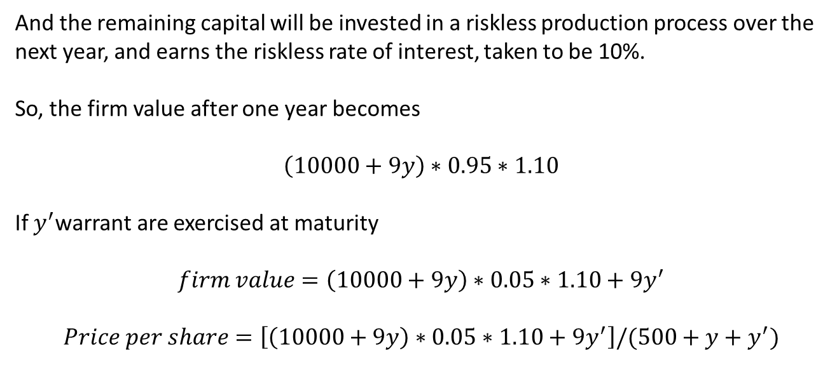
And the remaining capital will be invested in a riskless production process over the
next year, and earns the riskless rate of interest, taken to be 10%.
So, the firm value after one year becomes
$$\left(10000+9y\right)∗0.95∗1.10$$
If $y^{′}$warrant are exercised at maturity
$$firm value=\left(10000+9y\right)∗0.05∗1.10+9y^{′}$$
$$Price per share=\left[\left(10000+9y\right)∗0.05∗1.10+9y^{′}\right]/(500+y+y^{′})$$

Slide 11
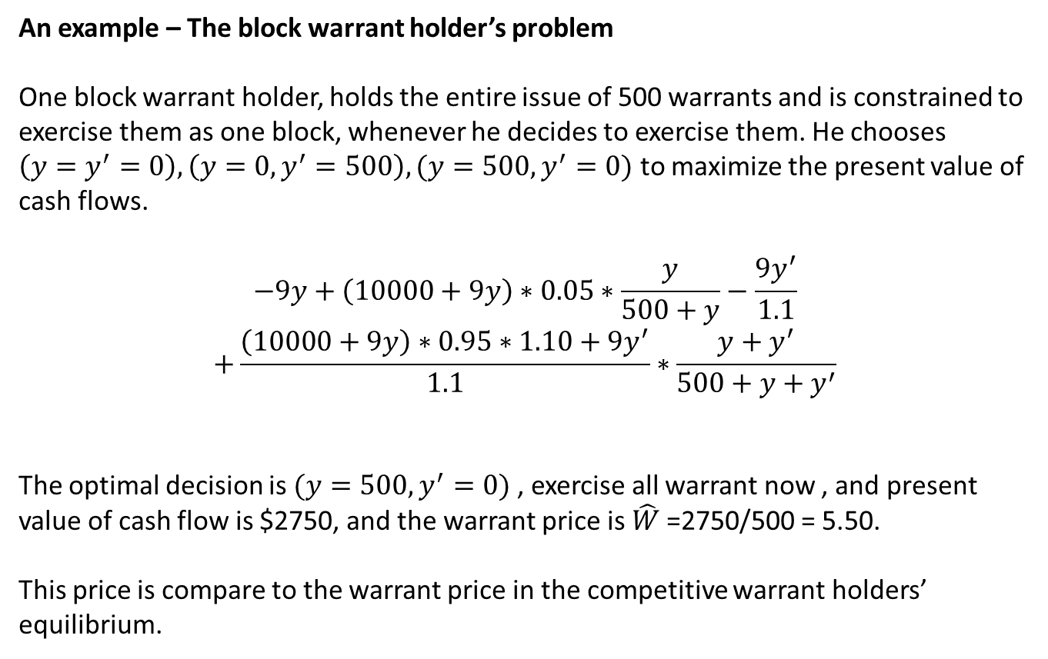
An example – The block warrant holder’s problem
One block warrant holder, holds the entire issue of 500 warrants and is constrained to exercise them as one block, whenever he decides to exercise them. He chooses $\left(y=y^{′}=0\right),\left(y=0,y^{′}=500\right),(y=500,y^{′}=0)$ to maximize the present value of cash flows.
$$−9y+\left(10000+9y\right)∗0.05∗\frac{y}{500+y}−\frac{9y^{′}}{1.1}$$
$$+\frac{\left(10000+9y\right)∗0.95∗1.10+9y^{′}}{1.1}∗\frac{y+y^{′}}{500+y+y^{′}}$$
The optimal decision is $(y=500,y^{′}=0)$ , exercise all warrant now , and present value of cash flow is $2750, and the warrant price is ${\hat{W}}_{ }$=2750/500 = 5.50.
This price is compare to the warrant price in the competitive warrant holders’ equilibrium.

Slide 12
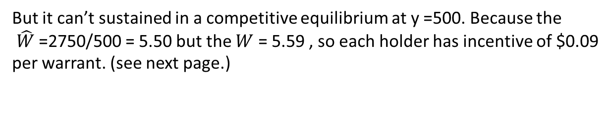
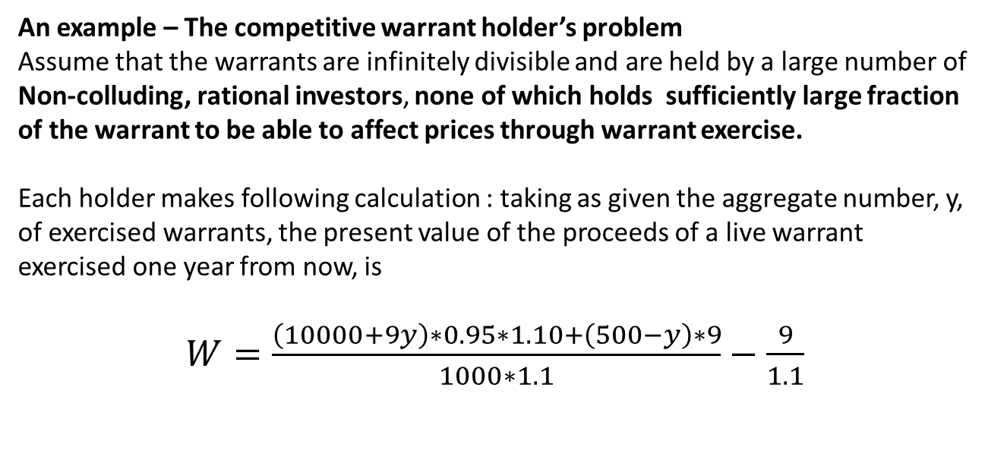
An example – The competitive warrant holder’s problem
Assume that the warrants are infinitely divisible and are held by a large number of
Non-colluding, rational investors, none of which holds sufficiently large fraction of the warrant to be able to affect prices through warrant exercise.
Each holder makes following calculation : taking as given the aggregate number, y, of exercised warrants, the present value of the proceeds of a live warrant exercised one year from now, is
$W=\frac{\left(10000+9y\right)∗0.95∗1.10+\left(500−y\right)∗9}{1000∗1.1}−\frac{9}{1.1}$
But it can’t sustained in a competitive equilibrium at y =500. Because the
${\hat{W}}_{ }$=2750/500 = 5.50 but the $W$ = 5.59 , so each holder has incentive of $0.09
per warrant. (see next page.)

Slide 13
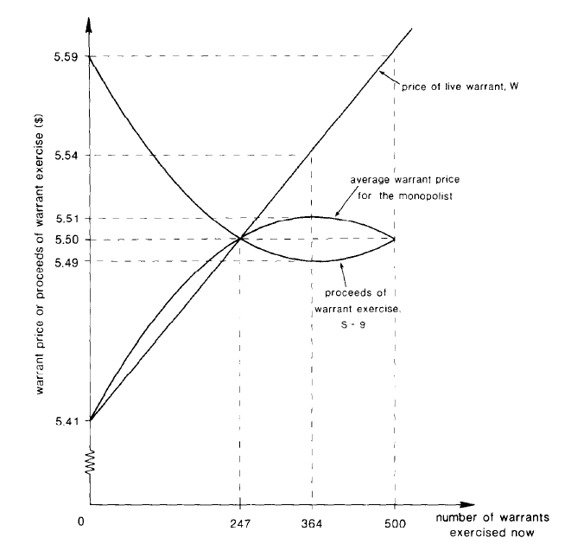

Slide 14
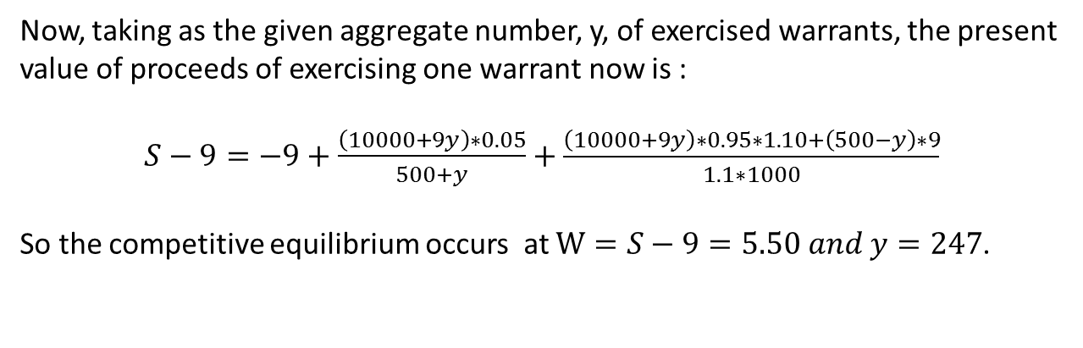
Now, taking as the given aggregate number, y, of exercised warrants, the present
value of proceeds of exercising one warrant now is :
$S−9=−9+\frac{\left(10000+9y\right)∗0.05}{500+y}+\frac{\left(10000+9y\right)∗0.95∗1.10+\left(500−y\right)∗9}{1.1∗1000}$
So the competitive equilibrium occurs at $W=S−9=5.50 and y=247$.

Slide 15
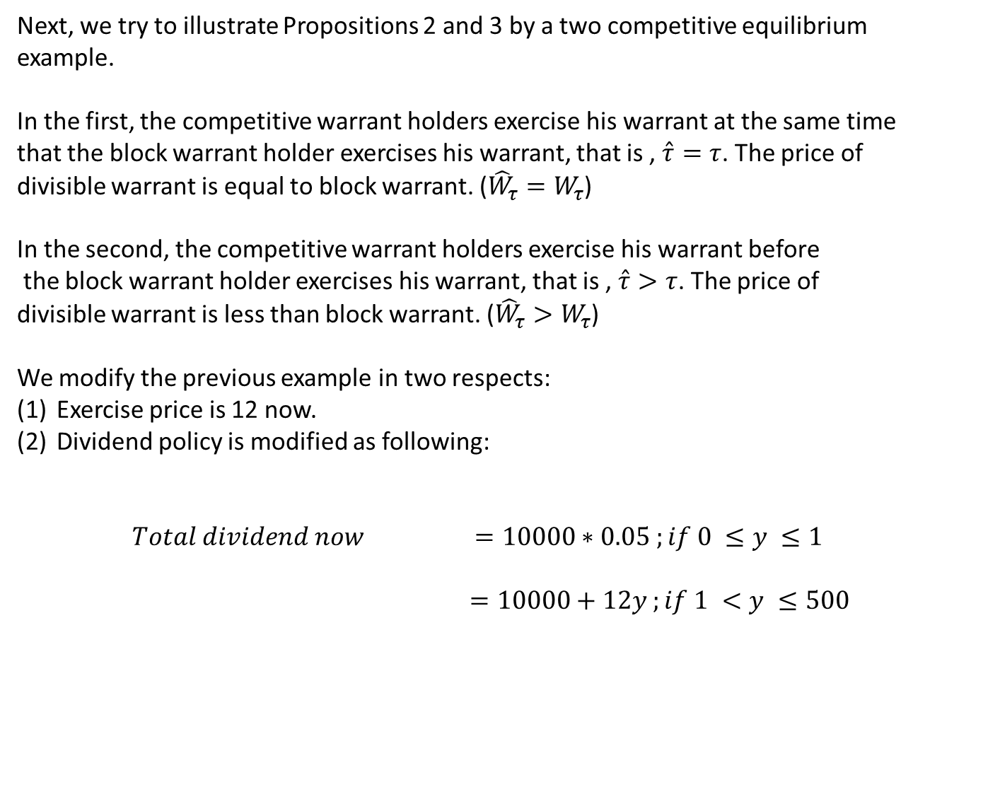
Next, we try to illustrate Propositions 2 and 3 by a two competitive equilibrium
example.
In the first, the competitive warrant holders exercise his warrant at the same time
that the block warrant holder exercises his warrant, that is , $\hat{τ}=τ$. The price of
divisible warrant is equal to block warrant. (${\hat{W}}_{τ}=W_{τ}$)
In the second, the competitive warrant holders exercise his warrant before
the block warrant holder exercises his warrant, that is , $\hat{τ}>τ$. The price of
divisible warrant is less than block warrant. (${\hat{W}}_{τ}>W_{τ}$)
We modify the previous example in two respects:
Exercise price is 12 now.
Dividend policy is modified as following:
$Total dividend now$ $=10000∗0.05 ;if 0 ≤y ≤1$
$=10000+12y ;if 1 <y ≤500$

Slide 16
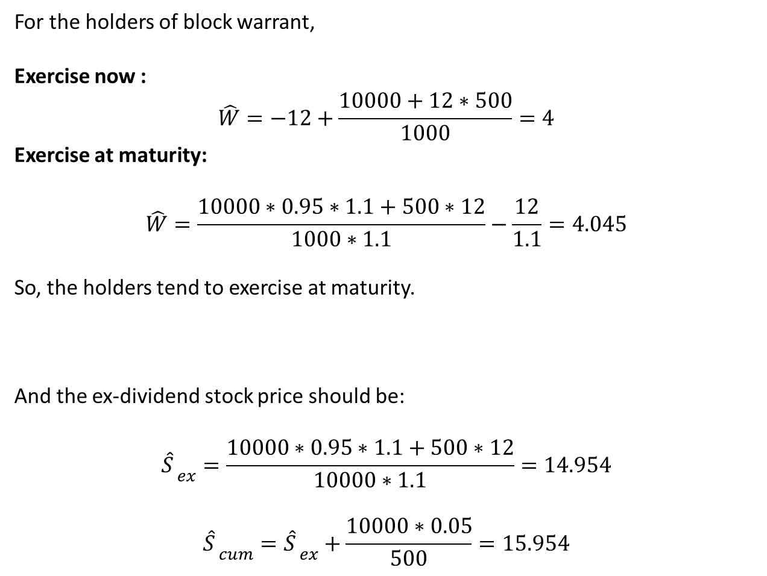
For the holders of block warrant,
Exercise now :
$${\hat{W}}_{ }=−12+\frac{10000+12∗500}{1000}=4$$
Exercise at maturity:
$${\hat{W}}_{ }=\frac{10000∗0.95∗1.1+500∗12}{1000∗1.1}−\frac{12}{1.1}=4.045$$
So, the holders tend to exercise at maturity.
And the ex-dividend stock price should be:
$${{\hat{S}}_{ }}_{ex}=\frac{10000∗0.95∗1.1+500∗12}{10000∗1.1}=14.954$$
$${{\hat{S}}_{ }}_{cum}={{\hat{S}}_{ }}_{ex}+\frac{10000∗0.05}{500}=15.954$$

Slide 17
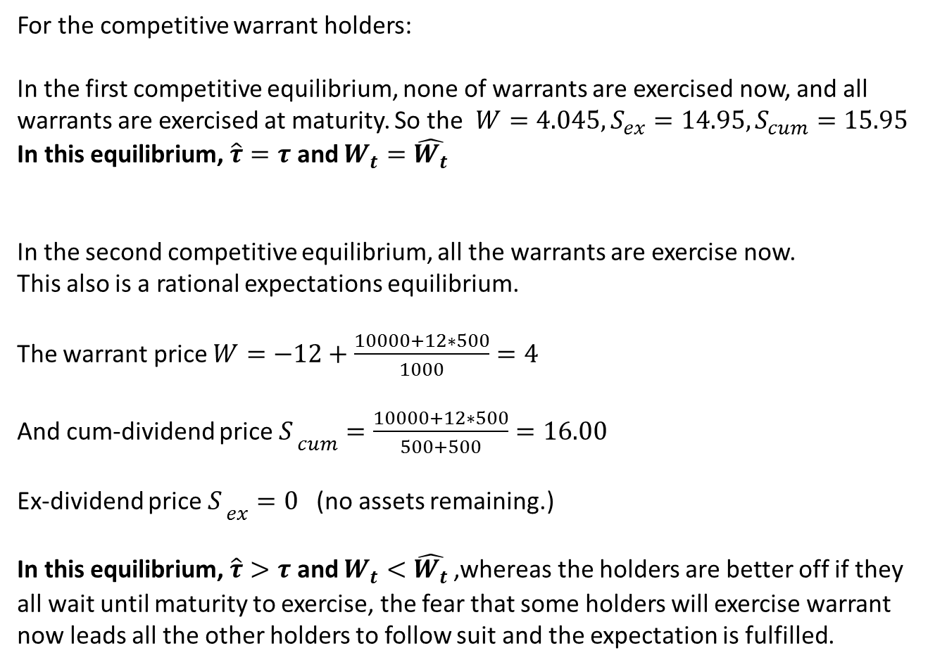
For the competitive warrant holders:
In the first competitive equilibrium, none of warrants are exercised now, and all
warrants are exercised at maturity. So the ${W=4.045,S}_{ex}=14.95,S_{cum}=15.95$
In this equilibrium, $\hat{τ}=τ$ and $W_{t}={\hat{W_{t}}}_{ }$
In the second competitive equilibrium, all the warrants are exercise now.
This also is a rational expectations equilibrium.
The warrant price $W=−12+\frac{10000+12∗500}{1000}=4$
And cum-dividend price ${S_{ }}_{cum}=\frac{10000+12∗500}{500+500}=16.00$
Ex-dividend price ${S_{ }}_{ex}=0$(no assets remaining.)
In this equilibrium, $\hat{τ}>τ$ and $W_{t}<{\hat{W_{t}}}_{ }$,whereas the holders are better off if they
all wait until maturity to exercise, the fear that some holders will exercise warrant
now leads all the other holders to follow suit and the expectation is fulfilled.

