Slide 1
Two-dimensional binomial lattice for the resulting orthogonalized diffusions.
報告者:鍾明璋

Slide 2
大綱
Structural form信用風險模型(FPM)>>二維標的物single barrier option(down and out)
建構資產與利率tree(具變動相關性)
正交化:(dV,dr)>>變數變換(dX,dY)獨立(機率好計算)>>inv function計算V(X),r(Y)

Slide 3
目的
概念就是將兩個資產與利率具有(變動)相關性的隨機過程，經由變數變換轉換成 no correlation & constant volatility的隨機過程。
如此一來在計算資產利率變動機率時只要相乘就ok了!

Slide 4
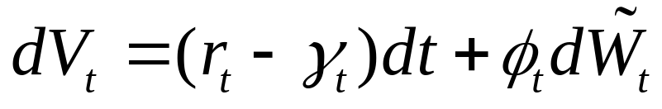
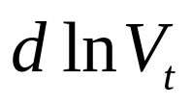
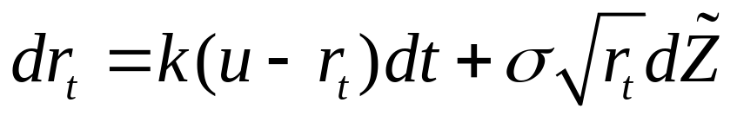
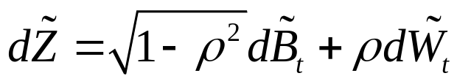
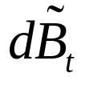
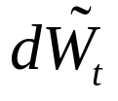
Two-dimensional diffusions
公司資產標GMB:
( )
利率CIR:
其中 ， 與 獨立

Slide 5
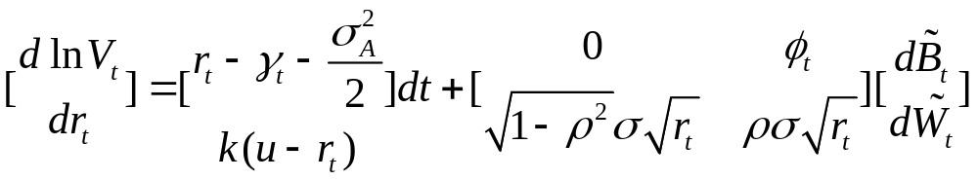
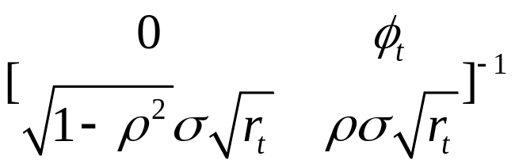
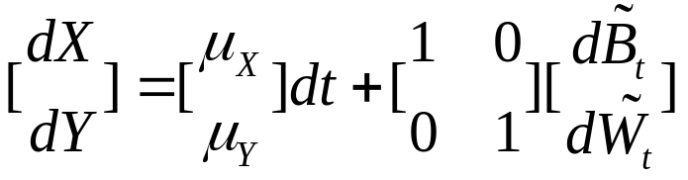
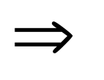
想法
資產利率表成矩陣形式
Find to orthogonalize these interest and firm value.

Slide 6
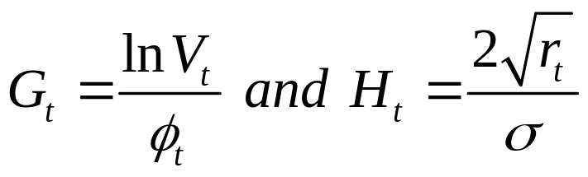
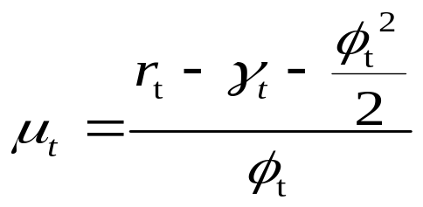
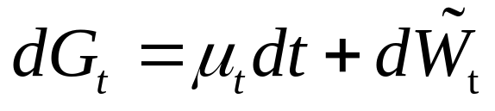
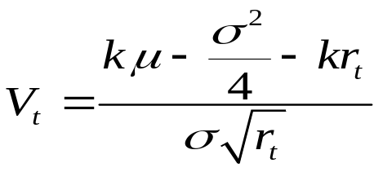
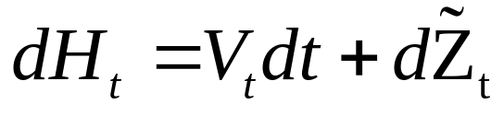
計算部份
1.單位化volatility部份使之為常數:
Let
By Ito’s Lemma,
,
,

Slide 7
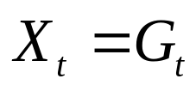
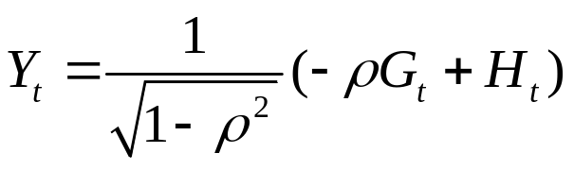
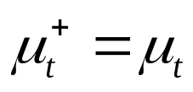
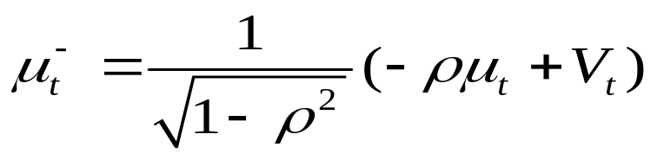
計算部份
2.正交化(使資產與利率Brownian motion項獨立)
Let and .Then X and Y are diffusions with unit instantaneous variance and zero cross-variation.
The drift of X is and the drift of Y is

Slide 8
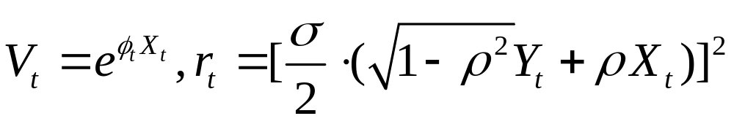
計算資產與利率
The inverse transformation to obtain and from are
( )

Slide 9
tree立體示意圖
X與Y個別的tree
X:
Y:
t=0 t=1 t=2
t=0 t=1 t=2
(X+,Y+)
(X+,Y-)
(X-,Y+)
(X-,Y-)

Slide 10

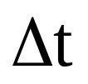
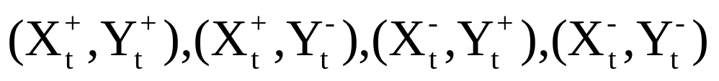
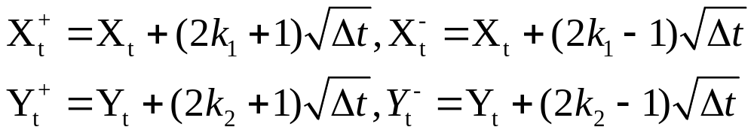
X and Y two-dimension binomial lattice tree.
選擇權到期日為T，我們將0~T切割n等分，每段長度為 ，每經過一期( )節點到下一期皆有4個情況:
X與Y的上漲下跌幅度分別為(整數K1,K2為高度的調整)

Slide 11
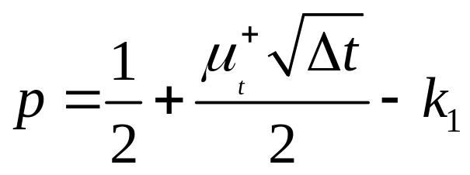
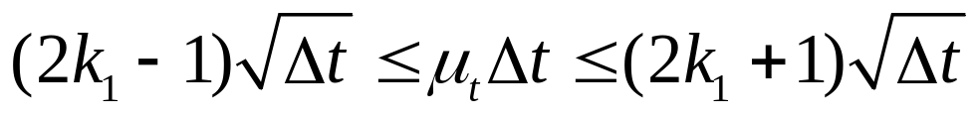
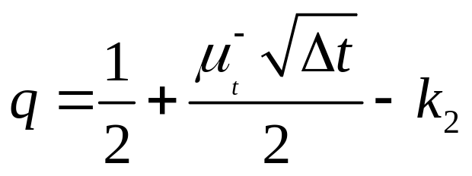
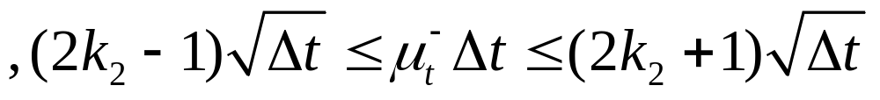
機率的計算
由Matching first moment得到X(資產)上升機率p，Y(利率)上升機率q
K1和K2必須調整使得pq機率介於0到1間。
；其中K1,K2為整數使得

Slide 12

機率的計算
4種情況的風險中立機率為 pq, p(1-q) , (1-p)q, (1-p)(1-q)
The two-factor binomial process converges in distribution to the original continuous-time process as .

Slide 13




Tree的特性
To make the lattice for each state variable recombine, the variable can only move an integral number of increments.
When the drift terms and are large in magnitude, for instance, at low interest rate when the speed of mean reversion is high, multiple jump, that is, or nonzeroor, occur.

Slide 14
Tree的特性
當利率水準很高或很低時，為了使機率維持0~1，所以Y-tree會出現同漲同跌以描述利率mean reversion現象:
The interest is high level.
K2=-1
K2=1

Slide 15
Tree的特性
當利率水準很高時，此時資產drift term很大所以X-tree可能會出現同漲 :
K2=1
The interest is high level.

Slide 16
THE END

