Slide 1
Using The LIBOR Market Model to Price The Interest Rate Derivatives: A Recombining Binomial Tree Methodology
研 究 生: 何俊儒
指導教授: 鍾惠民 博士
戴天時 博士
2008/06/26

Slide 2
Agenda
Introduction
Review of interest rate models
Market conventions of LMM and the discrete-time version of LMM
Introducing the HSS recombining node methodology and applying to the LIBOR market model
The pricing of the interest rate derivatives in LMM
Conclusions

Slide 3
Introduction
We can’t observe the instantaneous short rate and instantaneous forward rate in the traditional interest rate models
We adapt LIBOR market model which is based on the forward LIBOR rate that we can observe from the daily market
When implementing LMM in lattice method, we face the explosive tree due to the non-Markov property

Slide 4
Introduction
The nonrecombining node make our pricing procedure inefficient and don’t satisfy the market requirement
We apply the HSS methodology into LMM that make the nodes combine and make the pricing the derivatives feasible
The method we proposed make our valuation more efficient and more accurate

Slide 5
Review of Interest Rate Models
Equilibrium models
No-arbitrage models
Instantaneous short rate models
Instantaneous forward rate model
Forward rate model

Slide 6
Forward rate model LIBOR Market Model (LMM)
The LMM was discovered by Brace, Gatarek, and Musiela (1997) and was initially referred to as the BGM model by practitioners
There are two commonly used versions of the LMM:
one is the lognormal forward LIBOR model (LFM) for pricing caps
the other is the lognormal swap model (LSM) for pricing swaptions

Slide 7
Forward rate model LIBOR Market Model (LMM)
The LFM specifies the forward rate following zero-drift stochastic process under its own forward measure:
is a Brownian motion under the forward measure defined with respect to the numeraire asset
measures the volatility of the forward rate process

Slide 8
Market Conventions of the LMM and the Discrete-Time Version of the LMM
The relationship between the discrete LIBOR rate
for the term and the zero coupon bond price , given as follows:
where is the time line and is called the tenor for the period to

Slide 9
methodology
HSS recombining nodes methodology
conditional prob.
down movement
up movement
forward rate binomial tree
drift of the discrete time forward rate
Poon and Stapleton text (2005)

Slide 10
Introducing the HSS Recombining Node Methodology
Ho, Stapleton and Subrahmanyam (1995) [HSS] suggest a general methodology for creating a recombining multi-variate binomial tree to approximate a multi-variate lognormal process
Our assumption about LMM satisfies the conditions in the HSS methodology and apply it into LMM

Slide 11
HSS methodology
HSS assume the price of underlying asset follows a lognormal diffusion process:
where and are the instantaneous drift and volatility of , and is a standard Brownian motion
They denote the unconditional mean of the logarithmic asset return at time i as
The conditional volatility over the period i -1 to i is denoted as
The unconditional volatility is

Slide 12
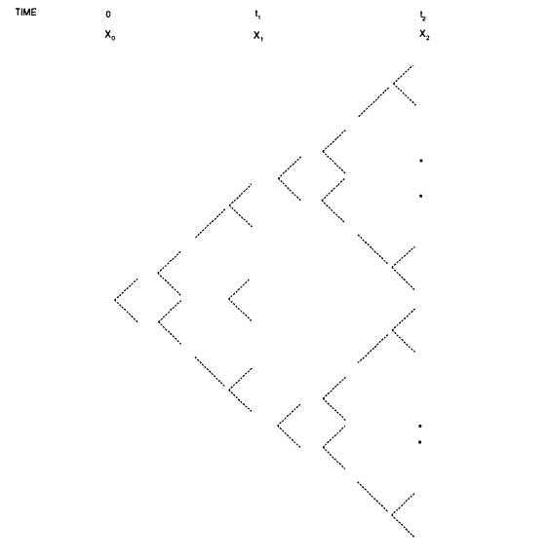

Slide 13
HSS methodology
HSS method involves the construction of m separate binomial distribution, where the time periods are denoted
And have the set of a discrete stochastic for , where is only defined at time
The general form of at node r
where

Slide 14
HSS methodology
They denote and the probabilities to reach given a node at as
Lemma 1 Suppose that the up and down movements and are chosen so that

Slide 15
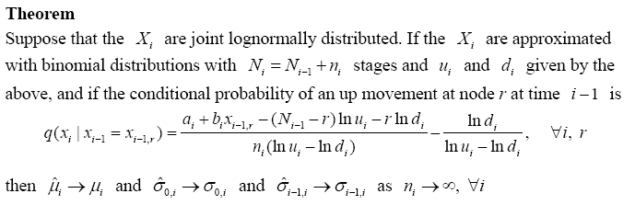
HSS methodology

Slide 16
Applying HSS methodology into lMM
We apply this methodology into the LMM and make some change to satisfy our conventions
We have the following propositions

Slide 17
Proposition 1
For the forward LIBOR rate which follows the lognormal distribution, we can choose the proper up and down movements to determine the i-th period of the -maturity forward LIBOR rate and have the form
where

Slide 18
the binomial trees in discrete time forward rate
f(1;1,2)
f(2;2,3)
f(0;1,2)
f(1;2,3)
f(0;2,3)

Slide 19
The structure of the binomial tree
With nodes at numbered There are nodes at numbered Here we write the forward rate
in abbreviated form
and take n₁ = n₂ = 2,

Slide 20
Proposition 2
Suppose that the forward LIBOR rate are joint lognormally distributed. If the
, are approximated with binomial distributions with stages and and given by proposition 1, and if the conditional probability of an up movement at node r at time is

Slide 21
Proposition 2
where
To determining the conditional probability, it has some skills to use for the term
We first derive term . Since forward rate is lognormally distributed, we have

Slide 22
The derivation of expectation
The most important result in Poon and Stapleton text is the drift of the discrete time forward rate and we rewrite as
Then multiple the term on both side to get the general form of

Slide 23
The derivation of expectation
The general form of expectation is given as

Slide 24
Special case
When n_{l} stages approach infinite , the sum of n_{l} stages also approach infinite, that is
We can reduce the up and down movements to the briefer form which is easier to calculate and show as follows
The conditional probability as

Slide 25
The valuation of embedded option on zero coupon bond in Lmm
The embedded option on ZCB is a bond that can be callable before maturity date with a callable price K
We have a three years maturity zero coupon bond with a callable price K equal to 0.952381 dollar at year two
option maturity
bond maturity
C0
Time 0 1y 2y 3y
one year

Slide 26
The valuation of embedded option on zero coupon bond in Lmm
Pricing the option value C₀ of this callable bond at time 0
Here, we take the flat forward rate 5% and constant volatility 10%

Slide 27
Sensitive analysis – strike price
We change strike price from 0.952381 to 0.96 which vary 0.001 to see the relationship between strike price and embedded option value
We find that when the strike price increases, the embedded option value decreases

Slide 29
Sensitive analysis – volatility
We increase 1% of the volatility from 10% until reach 30% to see the impact of volatility on the embedded option value
We find that when the volatility increases, the embedded option value increases
It is consistent with the inference for the Greek letter vega when the underlying asset’s volatility increases the option value increases, too.

Slide 31
The valuation of caplets in LMM
The payoff function of a caplet at time is
It is a caplet on the spot rate observed at time with payoff occurring at time
The cap is a portfolio consisted of n such call options which the underlying is known as caplet

Slide 32
The theroetical value of caplet
We use the Black’s formula for the caplet to get the theoretical value of caplet and rewrite as
where

Slide 33
Numerical method of caplet
We use the payoff function to compute the price in lattice method
To get the payoff function at time , we have to know the evolution of the forward rate at time
We construct the binomial tree of and known the , r = 0, 1, …, i.
Calculating the expectation of the payoff at time and then multiple the ZCB of to get the caplet value at time t.

Slide 34
example
Assume , , forward curve is flat equal to 5% and
We have the one period caplet at time 0 caplet₁(0)

Slide 35
Numerical result
Besides the relative difference, we use the RMSE to see the difference between the lattice value and Black’s model for the whole maturity
Table 2 is the results for different maturity caplets
We find that when we increase the stage between periods, the difference between lattice method and Black’s model is close

Slide 36
Table 2 volatility is 10% and stage for every period is 25
Maturity | Black | Lattice | Difference | Relative Difference (%)
1 | 0.0018085085 | 0.0018242781 | 0.0000157696 | 0.8719669656
2 | 0.0024348117 | 0.0024407546 | 0.0000059429 | 0.2440786919
3 | 0.0028388399 | 0.0028374958 | -0.0000013441 | 0.0473484800
4 | 0.0031206153 | 0.0031282191 | 0.0000076038 | 0.2436631792
5 | 0.0033214311 | 0.0033204098 | -0.0000010214 | 0.0307505629
6 | 0.0034637453 | 0.0034664184 | 0.0000026731 | 0.0771737036
7 | 0.0035616356 | 0.0035658574 | 0.0000042219 | 0.1185369137
8 | 0.0036247299 | 0.0036200240 | -0.0000047059 | 0.1298286011
9 | 0.0036600091 | 0.0036633313 | 0.0000033221 | 0.0907678678
10 | 0.0036727489 | 0.0036743568 | 0.0000016079 | 0.0437804213
 |  | RMSE | 0.0000063671
1. Caplet assume δ = 1 and stage 25
2. Assume volatility is 10%, the forward curve is flat 5%

Slide 37
Table 2 volatility is 10% and stage for every period is 50
Maturity | Black | Lattice | Difference | Relative Difference (%)
1 | 0.0018085085 | 0.0018099405 | 0.0000014320 | 0.0791823392
2 | 0.0024348117 | 0.0024397802 | 0.0000049685 | 0.2040608652
3 | 0.0028388399 | 0.0028434461 | 0.0000046061 | 0.1622542164
4 | 0.0031206153 | 0.0031230795 | 0.0000024643 | 0.0789673074
5 | 0.0033214311 | 0.0033207434 | -0.0000006878 | 0.0207066243
6 | 0.0034637453 | 0.0034620815 | -0.0000016638 | 0.0480341136
7 | 0.0035616356 | 0.0035626664 | 0.0000010308 | 0.0289416315
8 | 0.0036247299 | 0.0036267433 | 0.0000020134 | 0.0555455781
9 | 0.0036600091 | 0.0036617883 | 0.0000017792 | 0.0486107386
10 | 0.0036727489 | 0.0036734197 | 0.0000006708 | 0.0182649876
 |  | RMSE | 0.0000025690
1. Caplet assume δ = 1 and stage 50
2. Assume volatility is 10%, the forward curve is flat 5%

Slide 38
Convergence behavior vs. volatlity
We change the volatility from 10% to 20% to see the convergence behavior of RMSE at different volatility level
We find that when the volatility at low level, the convergent rate is fast to zero. However, the volatility at high level the convergence behavior is slow

Slide 40
Conclusions
Constructing the recombining binomial tree, the payoff of the interest rate derivatives on each node can be obtained
Comparing to the theoretical value, we find the theoretical value and lattice method is close when we increase the stages.
The sensitive analysis results of embedded option are consistent with inference of Greek letters

Slide 41
Future works
Deriving the joint probability between the states of different binomial forward rate trees.
Adjusting the stages between period by period to fit the strike price to reduce the nonlinearity error
Trying to change the constant volatility to stochastic volatility to fit the volatility term structure.

Slide 42
Thank you for your listening
The End

Slide 43
The relationship between discrete time forward rate
Time 0 | Time 1 | Time 2 | Time 3 | …
f(0;0,1)
f(0;1,2) | f(1;1,2)
f(0;2,3) | f(1;2,3) | f(2;2,3)
f(0;3,4) | f(1;3,4) | f(2;3,4) | f(3;3,4)
. | . | . | . | .
. | . | . | . | .
. | . | . | . | .
(1) drift
(3) covariance
(2) volatility

Slide 44
The discrete time version of LMM
The most important results which are under the “risk neutral” measure in the Poon and Stapleton text (2005)
For a zero-coupon bond price is given by
The drift of the forward bond price is given by

Slide 45
The most important results in text
The drift of T-period forward rate is given by

Slide 46
Discrete-time version of LMM
We now apply the results to the LIBOR basis for the FRA and rewrite as follows
where and we assume all the tenors are same to make the equation brief, that is

Slide 47
Discrete-time version of LMM
We use the above results and similar steps to derive the FRA value at time t to generalize the maturity forward rate

Slide 48
Discrete-time version of LMM
We assume that the forward rate is the lognormal for all forward maturities
We use the approximate result for the covariance term, i.e. for the small change around the value
, we have
Here, we take and to evaluate , then we have

Slide 49
Discrete-time version of LMM
Using the property of logarithms to express the drift of -maturity forward rate as the sum of a series of covariance term
Using Stein’s lemma to make covariance terms in a recognizable form and can be express as

Slide 50
Discrete-time version of LMM
Define
Then, we can rewrite the drift of the forward LIBOR rate as

