Slide 1
Using The LIBOR Market Model to Price The Interest Rate Derivatives: A Recombining Binomial Tree Methodology
交通大學 財務金融研究所 -財務工程組
研 究 生: 何俊儒
指導教授: 鍾惠民 博士
戴天時 博士

Slide 2
Agenda
Introduction
Model and Methodology
Application
Conclusions

Slide 3
Introduction
-Review of Interest Rate Models
-Motivation
-Contribution

Slide 4
Review of Interest Rate Models
Black’s Model
Short Rate Model
one factor
do not match the volatility structure
Forward Rate Model
HJM (Instantaneous forward rate)
LIBOR Market Model (LMM) Non-Markov Property No analytical and Numerical solution
Notes:
Black’s model: 1973
(pro) futures contract and option 必須有同樣的到期日，因為futures price和spot price到期日價格一樣
不假設V或F服從GBM，只要V(T)在T時間是lognormal
(con) 參數都假設為constant，discount process 要stochastic; E(V(T))=?F0 (在risk neutral world下成立)
Short Rate:
(con) one factor / do not match the volatility structure

Slide 5
Motivation
We can’t observe the instantaneous short rate and instantaneous forward rate in the traditional interest rate models
We adapt LIBOR market model which is based on the forward LIBOR rate that we can observe from the daily market
When implementing LMM in lattice method, we face the explosive tree due to the non-Markov property

Slide 6
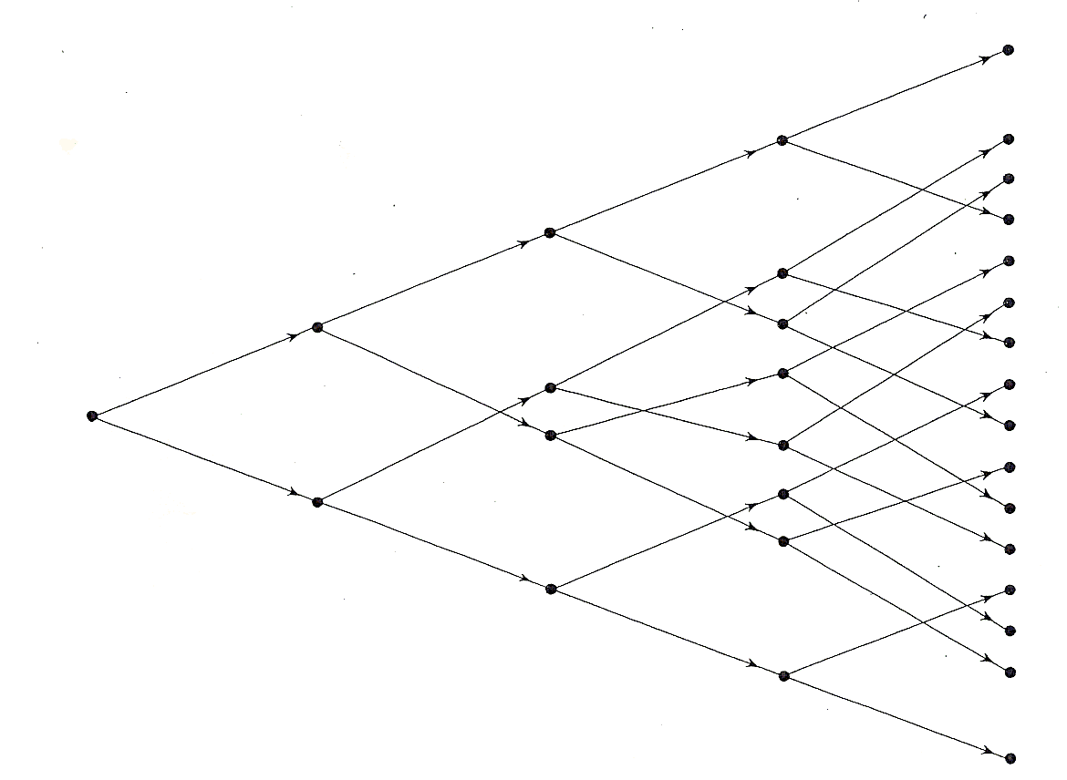
Motivation
The non-recombining nodes make our pricing procedure inefficient and don’t satisfy the market requirement

Slide 7
Contribution
We apply the HSS methodology into LMM that make the nodes combine and make the pricing the derivatives feasible
The method we proposed make our valuation more efficient and more accurate

Slide 8
Model and Methodology
- HSS Methodology
- Propositions
- The Derivation of Expectation

Slide 9
Poon and Stapleton text (2005)
HSS Multivariate Binomial methodology (1995)
Conditional Probability
Drift of the discrete time forward rate
Up/ Down movement
Forward Rate Recombining Binomial Tree

Slide 10
HSS Methodology
Ho, Stapleton and Subrahmanyam (1995) [HSS] suggest a general methodology for creating a recombining multi-variant binomial tree to approximate a multi-variant lognormal process
Our assumption about LMM satisfies the conditions in the HSS methodology and apply it into LMM

Slide 11
HSS Methodology
TIME 0 1 2

Slide 12
We apply this methodology into the LMM and make some change to satisfy our conventions Let X_{t,r}= f (t ;T_{n} ,T_{n+1})_{r} , X₀ = f (0 ;T_{n} ,T_{n+1})
Ex:
We have the following propositions
f (0;2,3)
Time 0 1y 2y 3y
one year

Slide 13
Proposition 1
For the forward LIBOR rate which follows the lognormal distribution, we can choose the proper up and down movements to determine the i-th period of the -maturity forward LIBOR rate and have the form
where

Slide 14
The Binomial Trees in Discrete Time Forward Rate
f(1;1,2)
f(0;1,2)
f(2;2,3)
f(1;2,3)
f(0;2,3)
TIME 0 1 2

Slide 15
Proposition 2
Suppose that the forward LIBOR rate are joint lognormally distributed. If the are approximated with binomial distributions with stages and and given by proposition 1, and if the conditional probability of an up movement at node r at time is

Slide 16
Proposition 2
where
To determining the conditional probability, it has some skills to use for the term
We first derive term . Since forward rate is log normally distributed, we have

Slide 17
The Derivation of Expectation
The most important result in Poon and Stapleton text is the drift of the discrete time forward rate and we rewrite as
Then multiple the term on both side to get the general form of

Slide 18
The Derivation of Expectation
The general form of expectation is given as

Slide 19
Special Case
When n_{l} stages approach infinite , the sum of n_{l} stages also approach infinite, that is
We can reduce the up and down movements to the briefer form which is easier to calculate and show as follows
The conditional probability as

Slide 20
Application
- Bond Option
- Cap
- Sensitive Analysis

Slide 21
The Valuation of Embedded Option on Zero Coupon Bond in LMM
The embedded option on ZCB is a bond that can be callable before maturity date with a callable price K
We have a three years maturity zero coupon bond with a callable price K equal to 0.952381 dollar at year two.
option maturity
bond maturity
C0
Time 0 1y 2y 3y
one year

Slide 22
Sensitive Analysis – Strike Price

Slide 23
Sensitive Analysis – Volatility

Slide 24
The Valuation of Caplets in LMM
The payoff function of a caplet at time is
It is a caplet on the spot rate observed at time with payoff occurring at time
The cap is a portfolio consisted of n such call options which the underlying is known as caplet

Slide 25
The Theoretical Value of Caplet
We use the Black’s formula for the caplet to get the theoretical value of caplet and rewrite as
where

Slide 26
Example
Assume , , forward curve is flat equal to 5% and
We have the one period caplet at time 0 caplet₁(0)

Slide 27
Table 1 Volatility is 10% and stage for every period is 25
Maturity | Black | Lattice | Difference | Relative Difference (%)
1 | 0.0018085085 | 0.0018242781 | 0.0000157696 | 0.8719669656
2 | 0.0024348117 | 0.0024407546 | 0.0000059429 | 0.2440786919
3 | 0.0028388399 | 0.0028374958 | -0.0000013441 | 0.0473484800
4 | 0.0031206153 | 0.0031282191 | 0.0000076038 | 0.2436631792
5 | 0.0033214311 | 0.0033204098 | -0.0000010214 | 0.0307505629
6 | 0.0034637453 | 0.0034664184 | 0.0000026731 | 0.0771737036
7 | 0.0035616356 | 0.0035658574 | 0.0000042219 | 0.1185369137
8 | 0.0036247299 | 0.0036200240 | -0.0000047059 | 0.1298286011
9 | 0.0036600091 | 0.0036633313 | 0.0000033221 | 0.0907678678
10 | 0.0036727489 | 0.0036743568 | 0.0000016079 | 0.0437804213
 |  | RMSE | 0.0000063671
1. Caplet assume δ = 1 and stage 25
2. Assume volatility is 10%, the forward curve is flat 5%

Slide 29
Conclusions

Slide 30
Conclusions
Constructing the recombining binomial tree, the payoff of the interest rate derivatives on each node can be obtained
Comparing to the theoretical value, we find the theoretical value and lattice method is close when we increase the stages.
The sensitive analysis results of embedded option are consistent with inference of Greek letters

Slide 31
Thank you for your listening
~ The End ~

Slide 32
Future works
Deriving the joint probability between the states of different binomial forward rate trees.
Adjusting the stages between period by period to fit the strike price to reduce the nonlinearity error
Trying to change the constant volatility to stochastic volatility to fit the volatility term structure.

Slide 33
Review of Interest Rate Models
Equilibrium models
No-arbitrage models
Instantaneous short rate models
Instantaneous forward rate model
Forward rate model

Slide 34
Forward rate model LIBOR Market Model (LMM)
The LMM was discovered by Brace, Gatarek, and Musiela (1997) and was initially referred to as the BGM model by practitioners
There are two commonly used versions of the LMM:
one is the lognormal forward LIBOR model (LFM) for pricing caps
the other is the lognormal swap model (LSM) for pricing swaptions

Slide 35
Forward rate model LIBOR Market Model (LMM)
The LFM specifies the forward rate following zero-drift stochastic process under its own forward measure:
is a Brownian motion under the forward measure defined with respect to the numeraire asset
measures the volatility of the forward rate process

Slide 36
Market Conventions of the LMM
The relationship between the discrete LIBOR rate
for the term and the zero coupon bond price , given as follows:
where is the time line and is called the tenor for the period to

Slide 37
Forward rate agreement (FRA)
Definition A forward rate agreement (FRA) is an agreement made at time t to exchange fixed-rate interest payments at rate k for variable rate payments, on a principal amount A, for the loan period t+T to t+T+1.
a T-maturity FRA
Ay_{t+T}
t
t+T
t+T+1
-Ak

Slide 38
Forward rate agreement (FRA)
The contract is usually settled in cash at t+T on a discounted basis.
One-period case

Slide 39
The Drift of Forward Rate under lognormal
The one-period ahead forward price of the n-period bond is just the expected value of the subsequent period spot price of the bond.

Slide 40
The Drift of Forward Rate under lognormal
general case

Slide 41
HSS Methodology
HSS assume the price of underlying asset follows a lognormal diffusion process:
where and are the instantaneous drift and volatility of , and is a standard Brownian motion
They denote the unconditional mean of the logarithmic asset return at time i as
The conditional volatility over the period i -1 to i is denoted as
The unconditional volatility is

Slide 42
HSS Methodology
The general form of at node r
where
Lemma 1.
Suppose that the up and down movements and are chosen so that

Slide 43
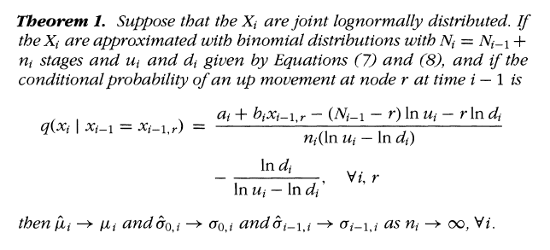
HSS Methodology
They denote and the probabilities to reach given a node at as

Slide 44
HSS Methodology
TIME 0 1 2

Slide 45
The Binomial Tree in Discrete Time Forward Rate
f(2;2,3)
f(1;2,3)
f(0;2,3)
TIME 0 1 2

Slide 46
Using Black’s Model to Price European Options
Let P(t ,T ) as the price at time t of a zero-coupon bond that pays off $1 at time T.
E(V_{T}) = F₀ in a risk neutral world
where

Slide 47
Table 2 Volatility is 10% and stage for every period is 50
Maturity | Black | Lattice | Difference | Relative Difference (%)
1 | 0.0018085085 | 0.0018099405 | 0.0000014320 | 0.0791823392
2 | 0.0024348117 | 0.0024397802 | 0.0000049685 | 0.2040608652
3 | 0.0028388399 | 0.0028434461 | 0.0000046061 | 0.1622542164
4 | 0.0031206153 | 0.0031230795 | 0.0000024643 | 0.0789673074
5 | 0.0033214311 | 0.0033207434 | -0.0000006878 | 0.0207066243
6 | 0.0034637453 | 0.0034620815 | -0.0000016638 | 0.0480341136
7 | 0.0035616356 | 0.0035626664 | 0.0000010308 | 0.0289416315
8 | 0.0036247299 | 0.0036267433 | 0.0000020134 | 0.0555455781
9 | 0.0036600091 | 0.0036617883 | 0.0000017792 | 0.0486107386
10 | 0.0036727489 | 0.0036734197 | 0.0000006708 | 0.0182649876
 |  | RMSE | 0.0000025690
1. Caplet assume δ = 1 and stage 50
2. Assume volatility is 10%, the forward curve is flat 5%

Slide 48
Numerical Method of Caplet
We use the payoff function to compute the price in lattice method
To get the payoff function at time , we have to know the evolution of the forward rate at time
We construct the binomial tree of and known the , r = 0, 1, …, i.
Calculating the expectation of the payoff at time and then multiple the ZCB of to get the caplet value at time t.

