Slide 1
Interest Rate Models
Introduction
報告者：何俊儒

Slide 2
The standard market models
-The models for pricing interest rate options-
Assume that the probability distribution of an interest rate is lognormal
And be widely used for valuing instruments such as
  Caps
  European bond options
  European swap options

Slide 3
The standard market models
But this assumption has the limitation that doesn’t provide a description of how interest rates evolve through time
Consequently, they can’t be used for valuing interest rate derivatives such as
  American-style swaption
  Callable bond
  Structured notes

Slide 4
The term structure model of interest rate
The alternative approaches for overcoming the limitations we met in the standard market models
This is a model describing the evolution of all zero-coupon interest rates
We focus on term structure models constructed by specifying the behavior of the short-term interest rate, r

Slide 5
The interest rate term structure models
Equilibrium models
  One factor models
  Two factor models
No-Arbitrage models
  One factor models
  Two factor models

Slide 6
Equilibrium models
With assumption about economic variables and derive a process for the short rate, r
Usually the risk-neutral process for the short rate is described by an Ito process of the form
dr = m(r)dt + s(r)dz
where
m is the instantaneous drift
s is the instantaneous standard deviation

Slide 7
Equilibrium models
The assumption that the short-term interest rate behaves like a stock price is a natural starting point but is less than ideal
One important difference is that interest rate appear to be pulled back to some long-run average level over time
This phenomenon is known as mean reversion

Slide 8
Mean Reversion
Interest
rate
HIGH interest rate has negative trend
Reversion
Level
LOW interest rate has positive trend

Slide 9
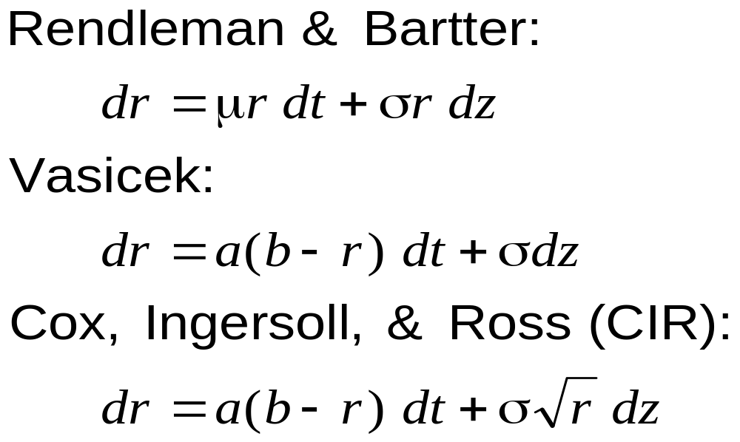
Equilibrium models one factor model

Slide 10
Equilibrium models two factor model
Brennan and Schwartz model (1979)
  have developed a model where the process for the short rate reverts to a long rate, which in turn follows a stochastic process
Longstaff and Schwartz model (1992)
  starts with a general equilibrium model of the economy and derives a term structure model where there is stochastic volatility

Slide 11
No-Arbitrage models
The disadvantage of the equilibrium models is that they don’t automatically fit today’s term structure of interest rates
So a no-arbitrage model is a model designed to be exactly consistent with today’s term structure of interest rates

Slide 12
Equilibrium v.s. No-Arbitrage Models
In an equilibrium model
  today’s term structure is an output
  the drift of the short rate isn’t usually a function of time
In a no-arbitrage model
  today’s term structure is an input
  the drift is, in general, dependent on time
So it turn out that some equilibrium models can be converted to no-arbitrage models by including a function of time in the drift of the short rate

Slide 13
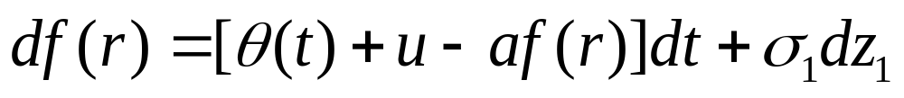
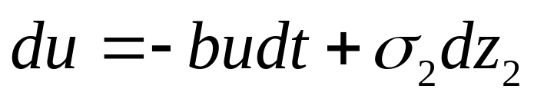
No-Arbitrage models
The Ho-Lee model (1986)
dr = θ(t )dt + σdz
The Hull-White (one-factor) model (1990)
dr = [θ(t ) – ar ]dt + σdz
The Black-Karasinski model (1991)
The Hull-White (two-factor) model (1994)
u with an initial value of zero

Slide 14
Two limitations of the models we mentioned before
Most involve only one factor (i.e., one source of uncertain )
They don’t give the user complete freedom in choosing the volatility structure

Slide 15
The volatility term structure
As it mentioned in the textbook that the volatility term structure is nonstationary
The volatility term structure in the future is liable to be quite different from that observed in the market today
So some general approaches to building term structure models that give the user more flexibility in specifying the volatility environment and allow several factors to be used

Slide 16
HJM Model: Notation
P(t,T ): price at time t of a discount bond with principal of $1 maturing at T
Ω_{t} : vector of past and present values of interest rates and bond prices at time t that are relevant for determining bond price volatilities at that time
v(t,T,Ω_{t} ): volatility of P(t,T)

Slide 17
Notation continued
ƒ(t,T₁,T₂): forward rate as seen at t for the period between T₁ and T₂
F(t,T): instantaneous forward rate as seen at t for a contract maturing at T
r(t): short-term risk-free interest rate at t
dz(t): Wiener process driving term structure movements

Slide 18
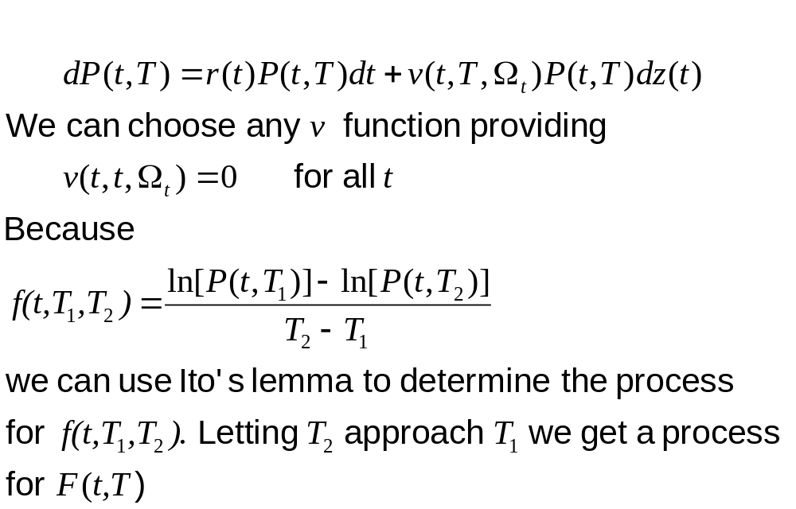
Modeling Bond Prices

Slide 19
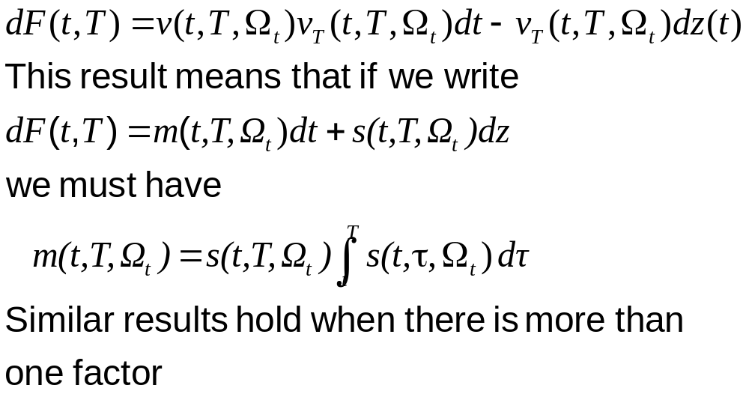
The process for F(t,T)

Slide 20
The drawback of HJM model
One drawback of the HJM model is that it is expressed in terms of instantaneous forward rates and these are not directly observable in the market
Another drawback is that it is difficult to calibrate the model to prices of actively traded instruments

Slide 21
The Libor Market Model
Brace, Gatarek and Musiela (BGM) (1997)
Jamshidian (1997)
Miltersen, Sandmann and Sondermann (1997)
All of above propose an alternative and it is known as the LIBOR market model (LMM) or the BGM model
It is expressed in terms of the forward rates that traders are used to working with

Slide 22
The problems we meet in the BGM model and HJM model
Now we focus on the BGM model
The process for the short rate r in the general BGM model is a non-Markov process
We would find that the process is liable to depend on the particular path followed by the Wiener process z(t) between time 0 and time t

Slide 23
Tree Evolution of Term Structure is Non-Recombining
Tree for the short rate r is non-Markov

Slide 24
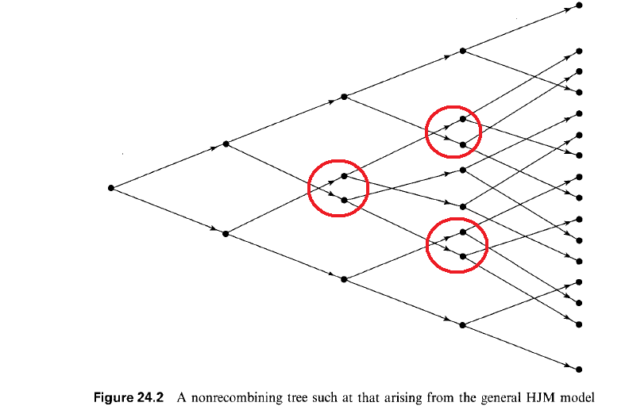

Slide 25
The problems we meet in the BGM model
Trees create difficulties
When we construct a tree representing term structure movement, it is usually nonrecombining
So if we want to implement the BGM model, the approach we can use is the Monte Carlo simulation method
But it is more complicated and takes more time

Slide 26
The goal of my paper
To solve the phenomenon of the non-Markov process in the BGM model and make the nodes recombined when we create the tree from the BGM model
Using the tree computation to implement the BGM model instead of using the Monte Carlo method

