Slide 1
Drift of forward LIBOR rate & HSS recombining tree methodology
何俊儒

Slide 2
The classification of the interest rate model
Standard market model
  Black’s model(1976)
Short rate model
  Equilibrium model
    Vasicek & CIR model
  No-arbitrage model
    Ho-Lee & Hull-White model
Forward rate model
  HJM & BGM model

Slide 3
The structure of the paper
First, to derive the drift of the forward LIBOR which is introduced in the chapter 7 of the “Asset pricing in discrete time.”
Second, using the HSS methodology which is proposed by Ho, Stapleton and Subrahmanyam to construct the interest rate tree that under the BGM model
Third, using the interest rate tree which we obtain from above to price the interest rate derivative such as cap, floor and so on

Slide 4
To model bond price and interest rate with the correct drifts
We derive here the drift of the bond prices and interest rate under the period-by-period risk-neutral measure
We use the following notations through out the all article
  P( t , t+n ): the bond price at time t which can get one dollar at time t+n
  For( t , t+1 , t+n ): the forward price at time t which invest a bond at time t+1 and maturity at time t+n

Slide 5
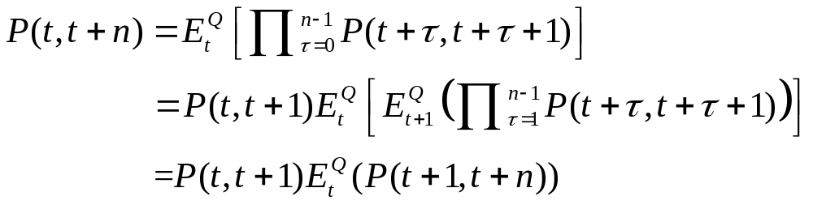
Bond pricing under rational expectations
The value of a zero-coupon bond which has n periods to maturity under the “risk-neutral” measure can be express the convenient form
Using the property of expectations

Slide 6
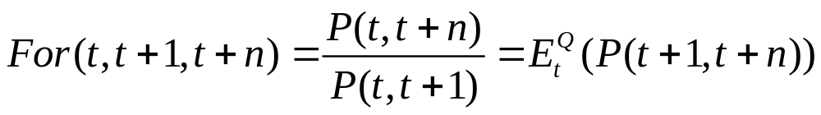
Bond pricing under rational expectations
Consider the spot-forward parity
The one-period-ahead forward price of a bond is the expectation, under the Q measure, of the one-period-ahead spot price of the bond

Slide 7

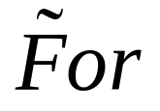
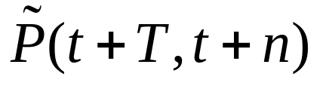
Bond forward price
The forward contract matures at time t+T < t+n, and use the and notation to emphasise the fact that these prices are stochastic
The forward price for delivery of the bond at time t+T converge to the spot price
at time t+n

Slide 8
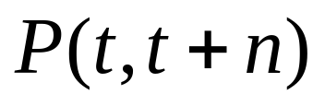
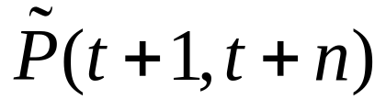
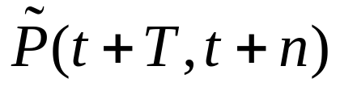



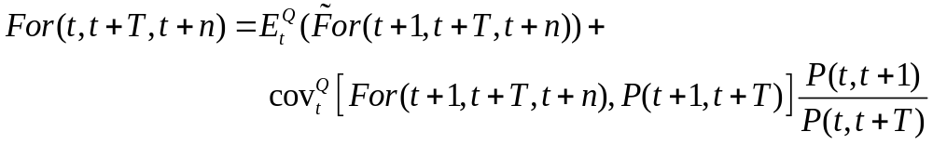
Bond prices and forward prices
t | t+1 | t+T | t+n

Slide 9
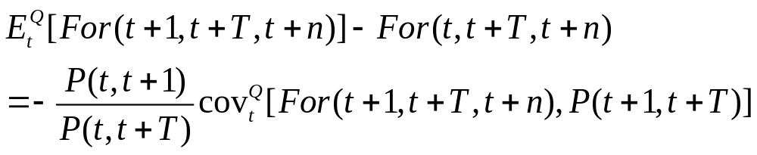
The proof of the second part of the table
The drift of the forward bond price under Q measure is likely to be negative
Using the forward parity, the bond price at time t+1

Slide 10
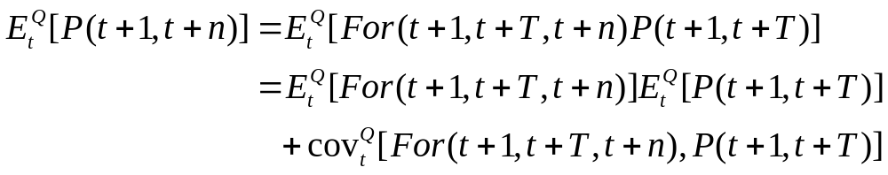
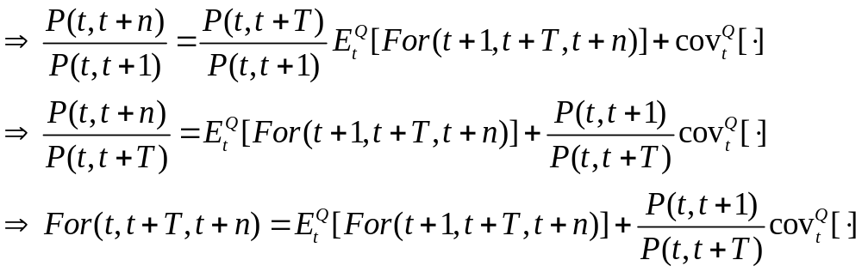
Proof
Taking the expectation at the both side

Slide 11
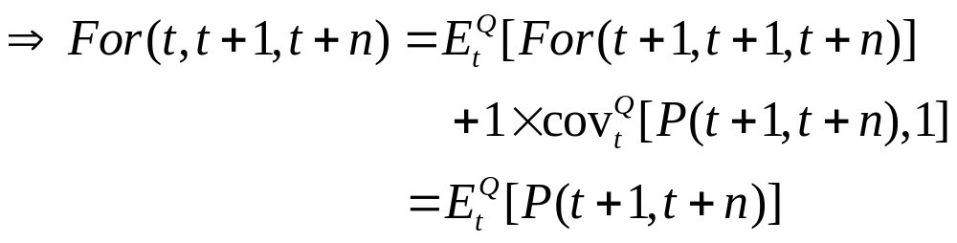
Bond forward price
Consider a special case when T = 1
Hence, the one-period-ahead forward price of the n-period bond is just the expected value of the subsequent period spot price of the bond
i.e. the spot price is the product of successive forward price

Slide 12
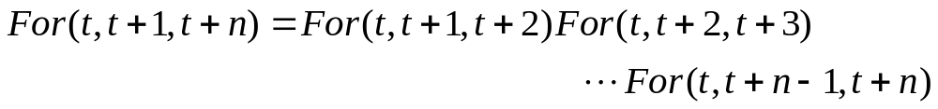
Bond forward price
Also, using the similar argument
The fact that a long-term forward contract can be replicated by a series of short-term contract

Slide 13

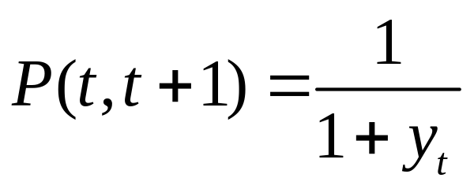
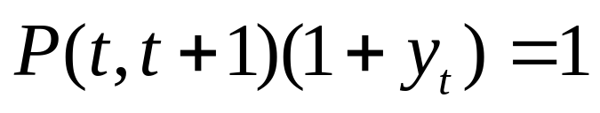
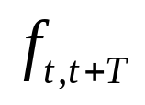
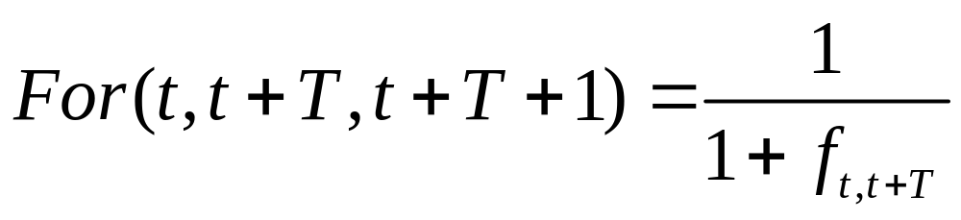
The drift of the forward rate
The annual yield rate at time t is defined
The forward rate at time t is defined

Slide 14
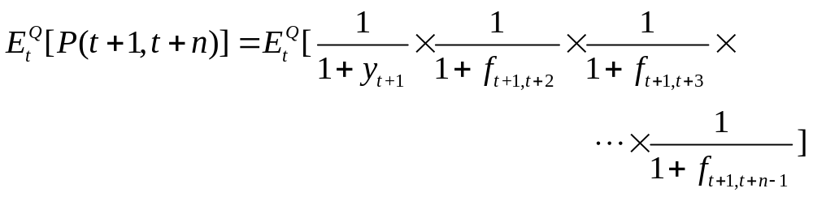
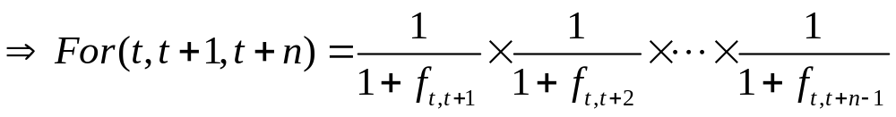
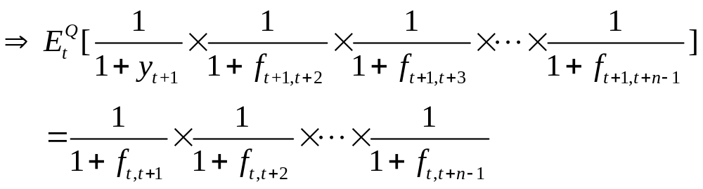
The drift of the forward rate

Slide 15
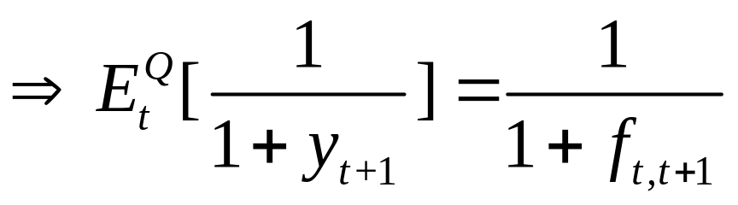
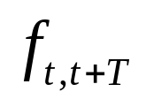
The drift of the forward rate
For special case when T = 1
Question: What is the drift of the forward rate
under the risk-neutral measure?

Slide 16
Forward rate agreement(FRA)
Definition:
A forward rate agreement (FRA) is an agreement made at time t to exchange fixed-rate interest payments at rate k for variable rate payments, on a principal amount A, for the loan period t+T to t+T+1

Slide 17
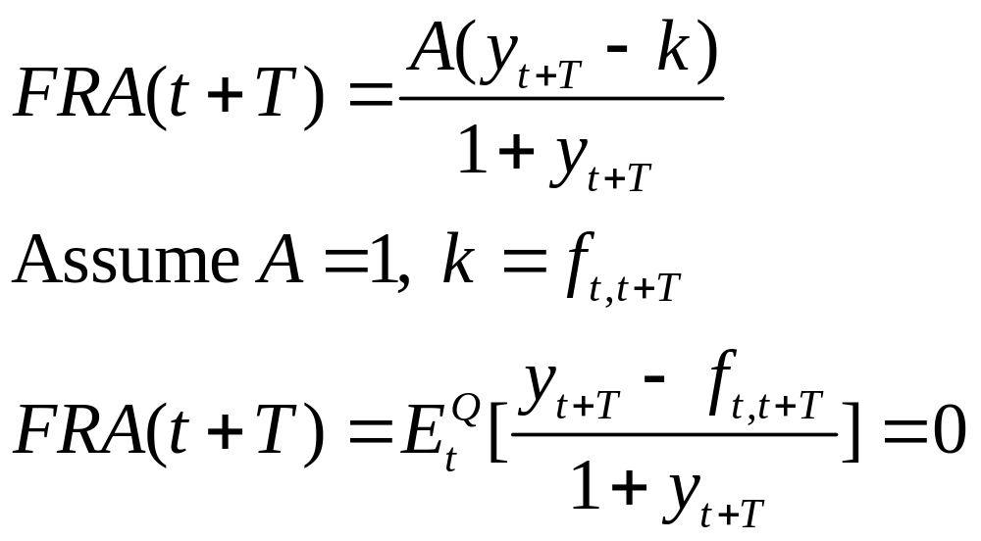
Forward rate agreement(FRA)
The contract is usually settled in cash at t+T on a discounted basis.
The settlement amount at time t+T on a long FRA is

Slide 18
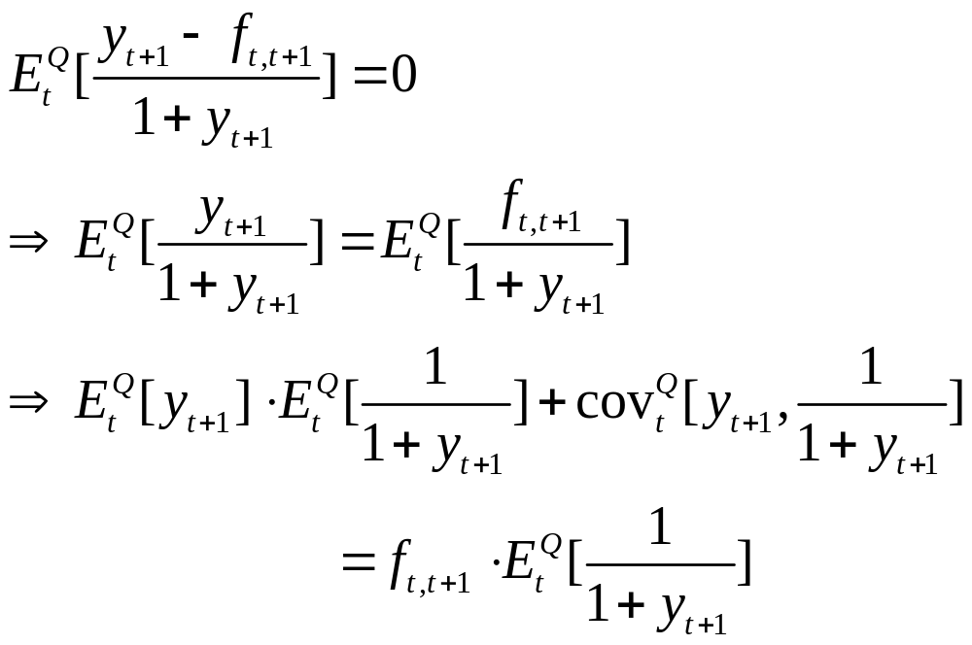
One-period case
Consider a one-year FRA

Slide 19
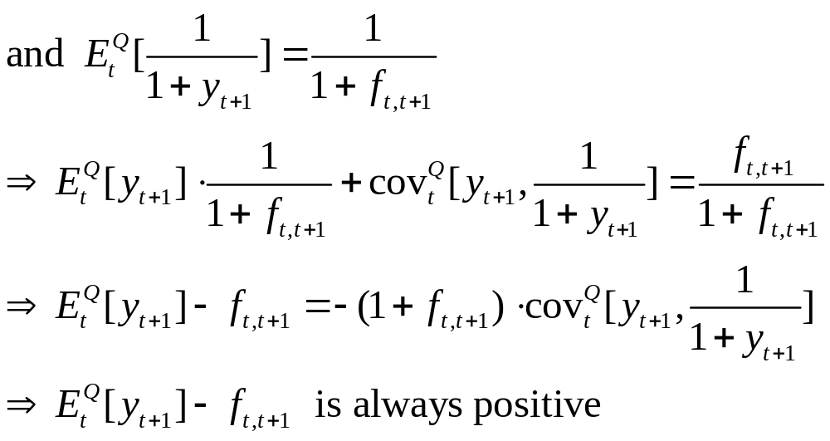
One-period case
-

Slide 20

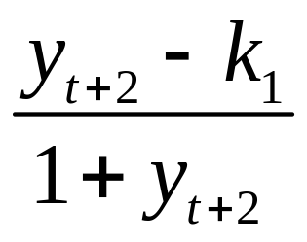
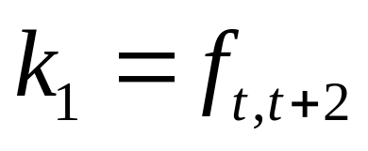
Two-period case
Consider a two-year FRA
At time t, enter a long two-period maturity FRA with strike price . The expected payoff at the maturity date t+2 is
Under no-arbitrage, the strike price must equal the two-year forward rate. i.e.

Slide 21
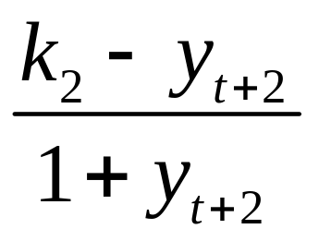

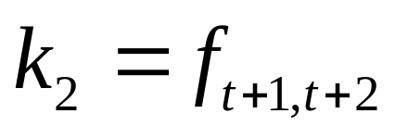
Two-period case
At the end of the first year, we enter a short FRA contract (reversal strategy) with the following payoff
Under no-arbitrage, the strike price must equal the one-period-ahead forward rate at t+1. i.e.

Slide 22
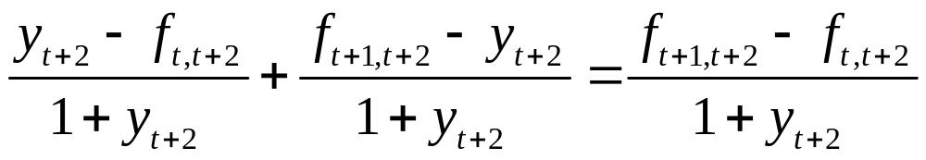
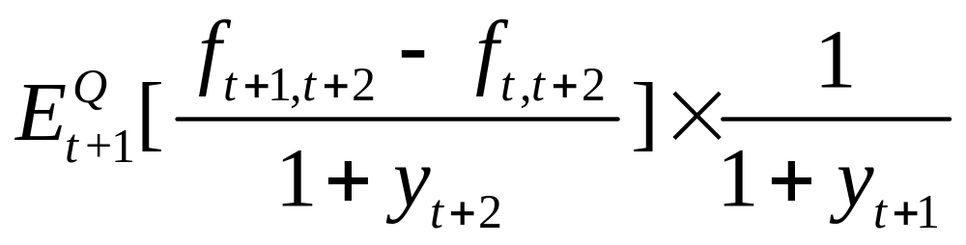
Two-period case
The payoff on the portfolio at time t+2 is given by
The value of the portfolio at time t+1 is found by taking the expected value at t+1. under the Q measure and discounted by the interest rate

Slide 23
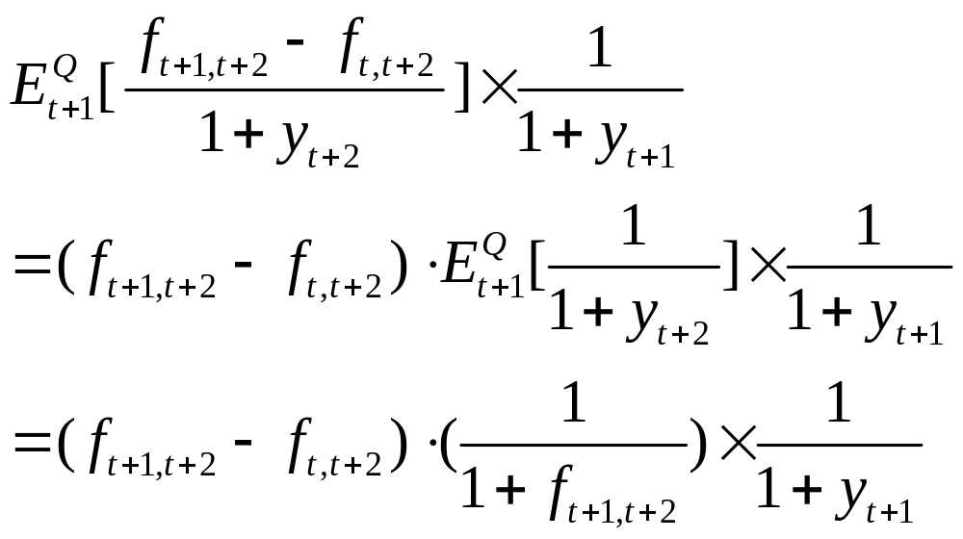
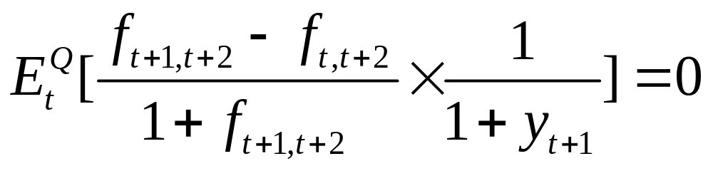
Two-period case
Evaluating the value of the portfolio back at time t, we must have

Slide 24
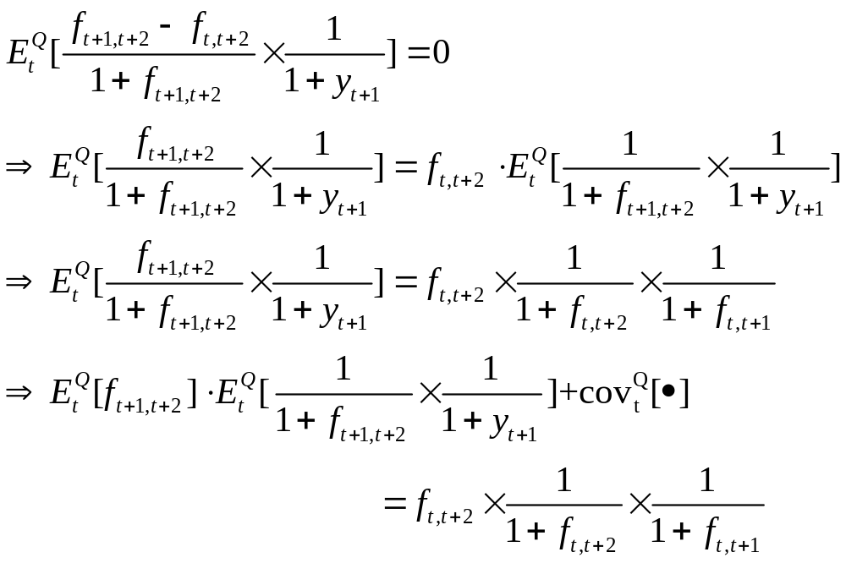
Two-period case

Slide 25
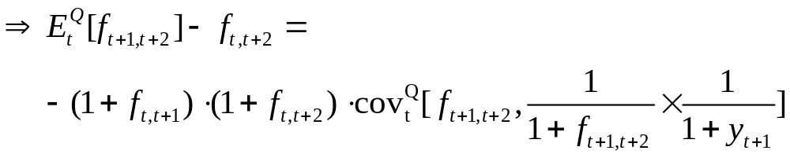
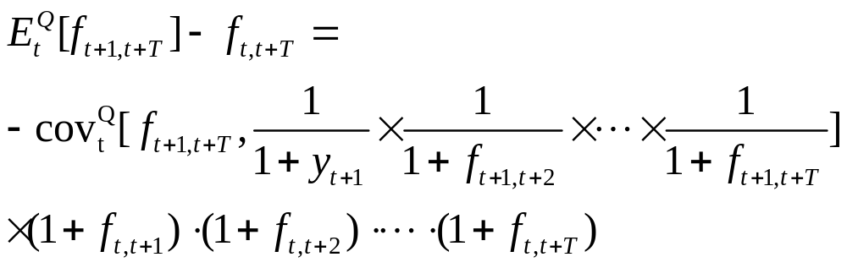
Two-period case
In general, the drift of T-period forward rate

Slide 26
General case
In general, the covariance term is difficult to evaluate
However, if the one-period-ahead spot rate and forward rates are assumed to be lognormal, the covariance can be easily evaluated in terms of logarithmic covariances

Slide 27
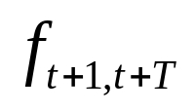
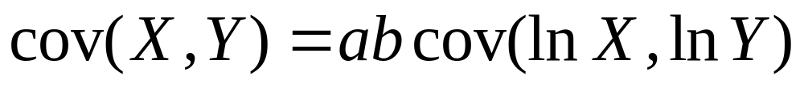
The drift of forward rate under lognormal
We assume that the forward rate is lognormal for all forward maturity T, we can evaluate the covariance term using an approximation
Using the approximate formula

Slide 28
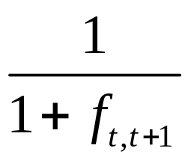
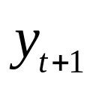
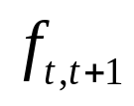
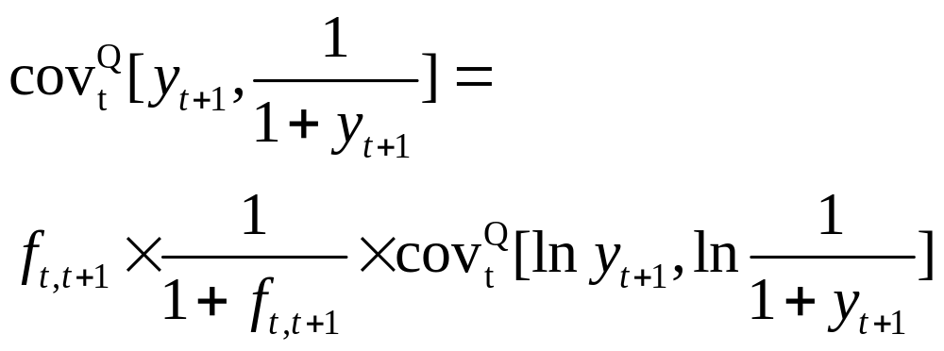
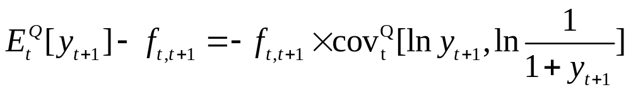
The drift of forward rate under lognormal
Assume is lognormal, take a = , b =
The drift of the one-year forward

Slide 29
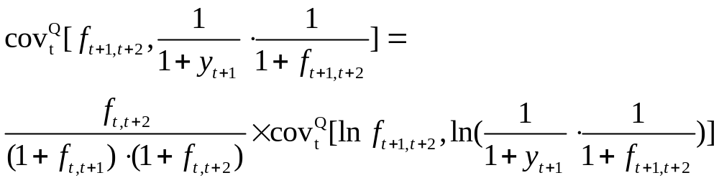
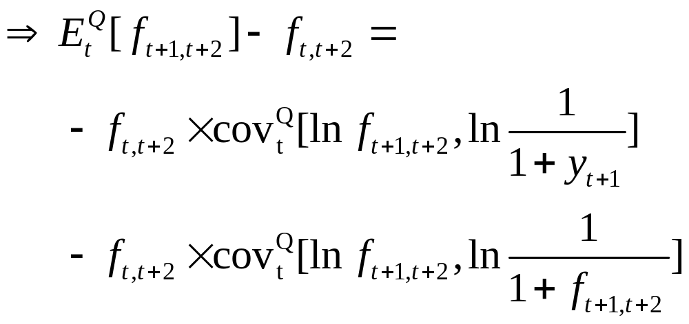
The drift of forward rate under lognormal
Now, evaluating the drift of the two-year forward rate

Slide 30
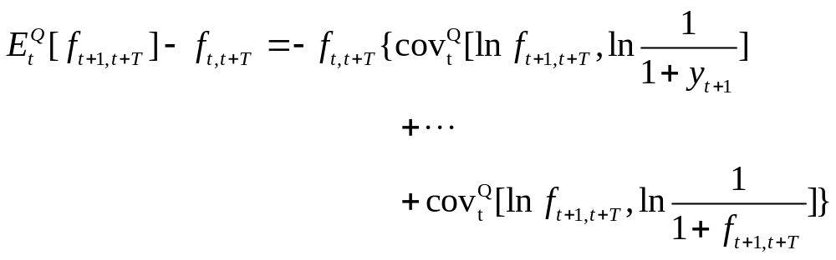
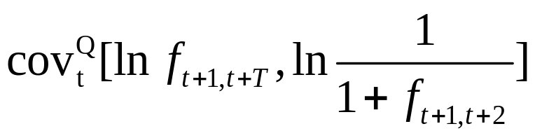
The drift of forward rate under lognormal
In general, the drift of the T-maturity forward rate depends on the sum of a series of covariance terms
Using the Stein’s lemma to evaluate the term with a form

Slide 31
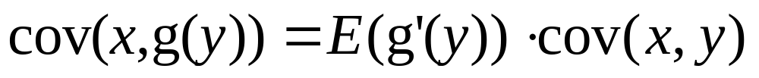
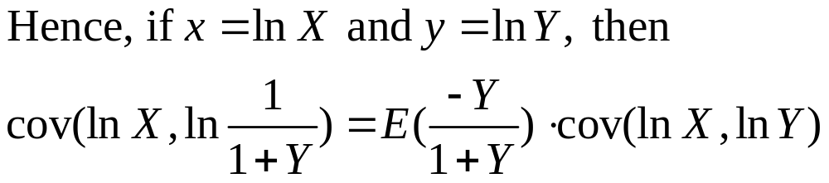
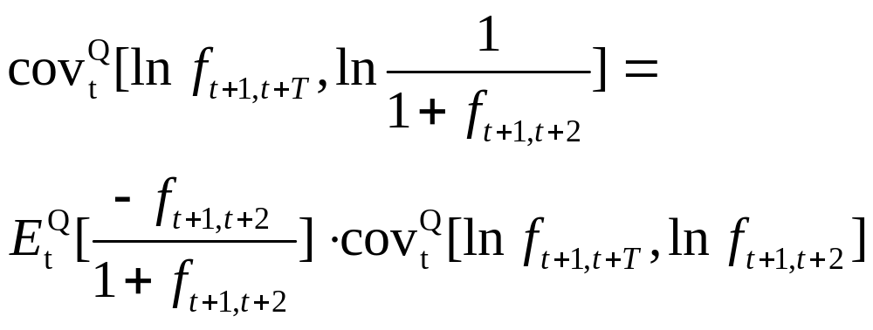
Stein’s lemma
For joint-normal variables X and Y

Slide 32


The drift of forward rate under lognormal

Slide 33

The drift of forward rate under lognormal

Slide 34


An application of the forward drift:
The LIBOR Market Model
Let denote the T-period forward LIBOR at time t. Following the market convention, is quoted as a simple annual rate
For special case, T = 0

Slide 35


An application of the forward drift:
The LIBOR Market Model
Assumption: forward rate in one period’s time are joint lognormal distributed, for all maturity T
Time is now measured in intervals, the settlement payment for an FRA on LIBOR is given by

Slide 36



Slide 37




An application of the forward drift:
The LIBOR Market Model
Assume that the covariance structure is inter-temporally stable and is a function of the forward maturities and is not dependent on t. Write
where is the covariance of the log -period forward LIBOR and the log T-period forward LIBOR

Slide 38


An application of the forward drift:
The LIBOR Market Model
For example t = 0, T = 2

Slide 39
Introducing the HSS Recombining Node Methodology
Ho, Stapleton and Subrahmanyam (1995) [HSS] suggest a general methodology for creating a recombining multi-variate binomial tree to approximate a multi-variate lognormal process
Our assumption about LMM satisfies the conditions in the HSS methodology and apply it into LMM

Slide 40







HSS methodology
HSS assume the price of underlying asset follows a lognormal diffusion process:
where and are the instantaneous drift and volatility of , and is a standard Brownian motion
  They denote the unconditional mean of the logarithmic asset return at time i as
  The conditional volatility over the period i -1 to i is denoted as
  The unconditional volatility is

Slide 41








Slide 42




HSS methodology
To approximate with a binomial process for the true process for underlying asset at time
They denoted the conditional volatilities of the approximated binomial process as and require that
Similarly

Slide 43






HSS methodology
HSS method involves the construction of m separate binomial distribution, where the time periods are denoted
And have the set of a discrete stochastic for , where is only defined at time
The general form of at node r
where

Slide 44








HSS methodology
They denote and the probabilities to reach given a node at as
Lemma 1 Suppose that the up and down movements and are chosen so that

Slide 45

HSS methodology

