Slide 1
Using the LIBOR Market Model to Price the Interest Rate Derivatives:
A Recombining Binomial Tree Methodology
何俊儒
2007/11/27

Slide 2
Agenda
The reason why I choose this issue
The property of the LIBOR Market Model (LMM)
Review of other interest rate models
The procedures which how to complete my paper

Slide 3
Reasons
The lattice based approach provides an efficient alternative to Monte Carlo Simulation
It provides a fast and accurate method for valuation of path dependent interest rate derivatives under one or two factors
The LIBOR Market Model is expressed in terms of the forward rates that traders are used to working with

Slide 4
The property of LIBOR Market Model
Brace, Gatarek and Musiela (BGM) (1997)
Jamshidian (1997)
Miltersen, Sandmann and Sondermann (1997)
All of above propose an alternative and it is known as the LIBOR market model (LMM) or the BGM model
The rate where we use is the forward rate not the instantaneous forward rate

Slide 5
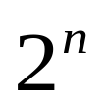
The property of LIBOR Market Model
We can obtain the forward rate by using bootstrap method
It is consistent with the term structure of the interest rate of the market and by using the calibration to make the volatility term structure of forward rate consistent
Assume the LIBOR has a conditional probability distribution which is lognormal
The forward rate evolution process is a
non-Markov process
The nodes at time n is (see Figure 1)

Slide 6
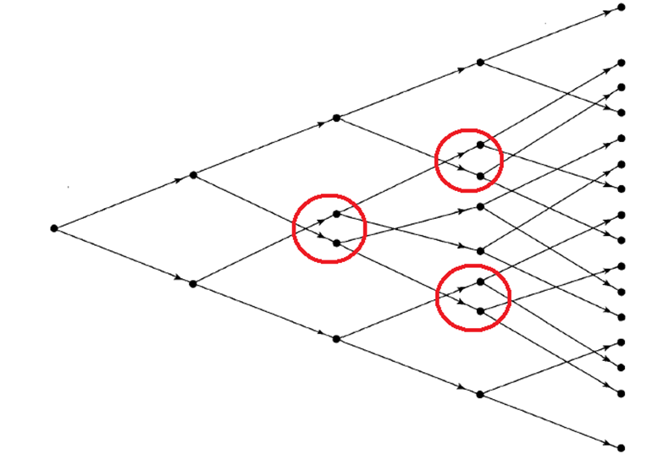
Figure 1 The phenomenon of non-Markov process

Slide 7
The property of LIBOR Market Model
It results that it is hard to implement since the exploding tree of forward and spot rates
When implementing the multi-factor version of the LMM, tree computation is difficult and complicated, the Monte Carlo simulation approach is a better choice

Slide 8
Review of other interest rate models
Standard market model
Short rate model
  Equilibrium model
  No-arbitrage model
Forward rate model

Slide 9
The standard market models
The Black’s models for pricing interest rate options
Assume that the probability distribution of an interest rate is lognormal
It is widely used for valuing instruments such as
  Caps
  European bond options
  European swap options

Slide 10
The standard market models
The lognormal assumption has the limitation that doesn’t provide a description of how interest rates evolve through time
Consequently, they can’t be used for valuing interest rate derivatives such as
  American-style swaption
  Callable bond
  Structured notes

Slide 11
Short-rate models
The alternative approaches for overcoming the limitations we met in the standard market models
This is a model describing the evolution of all zero-coupon interest rates
We focus on term structure models constructed by specifying the behavior of the short-term interest rate, r

Slide 12
Short-rate models
Equilibrium models
  One factor models
  Two factor models
No-Arbitrage models
  One factor models
  Two factor models

Slide 13
Equilibrium models
With assumption about economic variables and derive a process for the short rate, r
Usually the risk-neutral process for the short rate is described by an Ito process of the form
dr = m(r)dt + s(r)dz
where
m is the instantaneous drift
s is the instantaneous standard deviation

Slide 14
Equilibrium models
The assumption that the short-term interest rate behaves like a stock price has a cycle, in some period it has a trend to increasing or decreasing
One important property is that interest rate appear to be pulled back to some long-run average level over time
This phenomenon is known as mean reversion

Slide 15
Mean Reversion
Interest
rate
HIGH interest rate has negative trend
Reversion
Level
LOW interest rate has positive trend

Slide 16
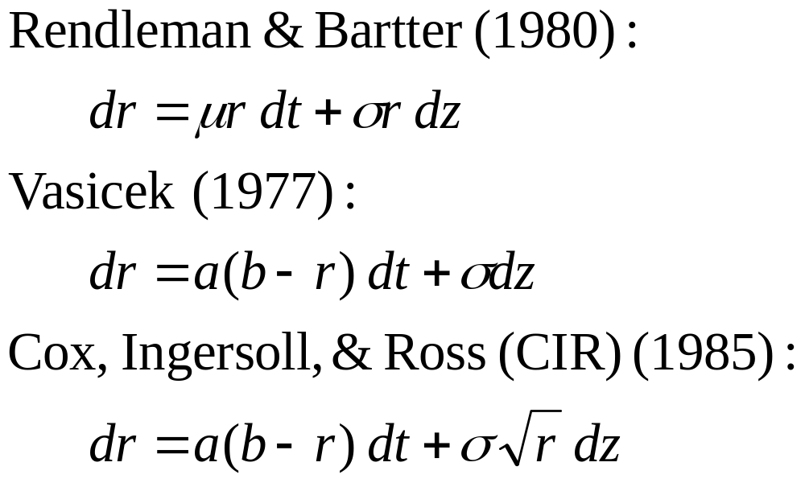
Equilibrium models one factor model

Slide 17
Equilibrium models two factor model
Brennan and Schwartz model (1979)
  have developed a model where the process for the short rate reverts to a long rate, which in turn follows a stochastic process
Longstaff and Schwartz model (1992)
  starts with a general equilibrium model of the economy and derives a term structure model where there is stochastic volatility

Slide 18
No Arbitrage models
The disadvantage of the equilibrium models is that they don’t automatically fit today’s term structure of interest rates
No arbitrage model is a model designed to be exactly consistent with today’s term structure of interest rates

Slide 19
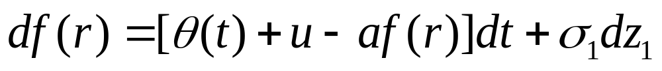
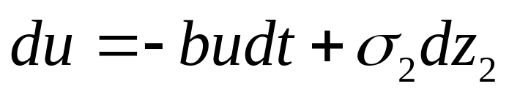
No Arbitrage models
The Ho-Lee model (1986)
dr = θ(t )dt + σdz
The Hull-White (one-factor) model (1990)
dr = [θ(t ) – ar ]dt + σdz
The Black-Karasinski model (1991)
The Hull-White (two-factor) model (1994)
u with an initial value of zero

Slide 20
Summary of the models we mentioned
A good interest rate model should have the following three basic characteristics:
  Interest rates should be positive
  should be autoregressive
  We should get simple formulate for bond prices and for the prices of some derivatives
A model giving a good approximation to what observed in reality is more appropriate than that with elegant formulas

Slide 21
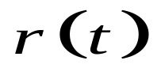




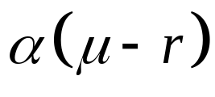

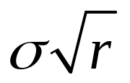
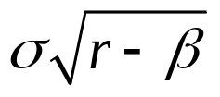
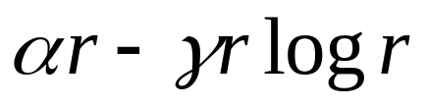

One-factor, time-homogeneous models for
Model | m(r) | s(r)
Merton (1973) (M)
Dothan(1978) (D)
Vasicek (1977) (V)
Cox-Ingersoll-Ross(1985) (CIR)
Pearson-Sun (1994) (PS)
Brennan-Schwartz(1979) (BS)
Black-Karasinski(1991) (BK)

Slide 22
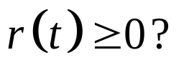

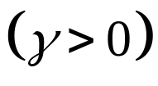
Key characteristics of one-factor models
Model |  | Autoregressive? | Simple formulate?
M | N | N | Y
D | Y | N | N
V | N | Y | Y
CIR | Y | Y | Y
PS | Y if | Y | N
BS | Y | Y | N
BK | Y | Y | N

Slide 23
Two limitations of the models we mentioned before
Most involve only one factor (i.e., one source of uncertain )
They don’t give the user complete freedom in choosing the volatility structure

Slide 24
Forward rate model
HJM model
BGM model

Slide 25
HJM model
It was first proposed in 1992 by Heath, Jarrow and Morton
It gives up the instantaneous short rate which we common used and adapts the instantaneous forward rate
We can express the stochastic process of the zero coupon bond as follows:

Slide 26
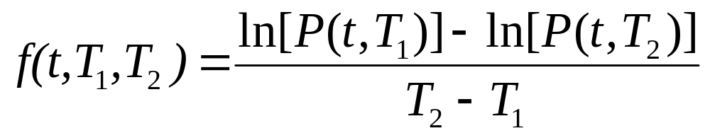
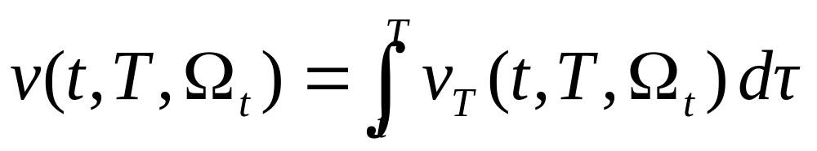
HJM model
According to the relation between zero coupon bond and forward rate, we can obtain
Hence, we can infer the stochastic process of the forward rate as follows
where

Slide 27
HJM model
If we want to use HJM model to price the derivative, we have to input two exogenous conditions:
  The initial term structure of forward rate
  The volatility term structure of forward rate

Slide 28
The procedures of completing the paper
According to HSS(1995) to construct the recombining binomial tree under the LIBOR market model
Using the tree computation skill to price the interest rate derivatives, such as
  Caps, floors and so on
  Bermudan-style swaption
Solving the nonlinearity error of the tree and calibration the parameter to be consistent with the reality

Slide 29
Thank you for your listening

