Slide 1
何俊儒
Using The LIBOR Market Model to Price The Interest Rate Derivatives: A Recombining Binomial Tree Methodology
2008/06/25

Slide 2
Agenda
Introduction
Review of interest rate models
Market conventions of LMM and the discrete-time version of LMM
Introducing the HSS recombining node methodology and applying to the LIBOR market model
The pricing of the interest rate derivatives in LMM
Conclusions

Slide 3
Introduction
Because we can’t observe the instantaneous short rate and instantaneous forward rate in the traditional interest rate models
We adapt LIBOR market model which is based on the forward LIBOR rate that we can observe from the daily market
However, when implementing LMM in lattice method we will face the explosive tree that result from the non-Markov property

Slide 4
Introduction
The nonrecombining tree will make our pricing procedure inefficient and don’t satisfy the market requirement
Therefore, we apply the HSS methodology into the LMM that make the nodes combine and make the pricing the derivatives feasible
The method we proposed make our valuation more efficient and more accurate comparing with Monte Carlo simulation method

Slide 5
Review of Interest Rate Models
Equilibrium models
No-arbitrage models
Instantaneous short rate models
Instantaneous forward rate model
Forward rate model

Slide 6
Equilibrium model
Vasicek Model (1977)
Cox, Ingersoll and Ross (CIR) Model (1985)

Slide 7
No-arbitrage model
Ho-Lee Model (1986)
Hull-White Model (1990)

Slide 8
Affine model
The models we mentioned before are all the affine models with the continuously-compounded spot rate R(t,T) is an function in the short rate r(t)
The relationship between zero coupon bond and affine models can be expressed as

Slide 9
Instantaneous forward rate model HJM Model
Heath, Jarrow and Morton (1992) published an important paper described the evolution of the entire yield curve in continues time
The dynamic form of the instantaneous forward rate for the fixed maturity T under risk-neutral measure as follows:

Slide 10
Instantaneous forward rate model HJM Model
The parameters of the dynamic process are explained as follows:
We can use the Ito’s lemma to obtain the dynamics of the zero-coupon bond price

Slide 11
Forward rate model LIBOR Market Model (LMM)
The LMM was discovered by Brace, Gatarek, and Musiela (1997) and was initially referred to as the BGM model by practitioners
There are two commonly used versions of the LMM:
one is the lognormal forward LIBOR model (LFM) for pricing caps
the other is the lognormal swap model (LSM) for pricing swaptions

Slide 12
Forward rate model LIBOR Market Model (LMM)
The LFM specifies the forward rate following zero-drift stochastic process under its own forward measure:
is a Brownian motion under the forward measure defined with respect to the numeraire asset
measures the volatility of the forward rate process

Slide 13
Forward rate model LIBOR Market Model (LMM)
We use the Ito’s lemma to derive the stochastic process of the logarithm of the forward rate and is given as follows:
The volatility function is deterministic, the logarithm of forward rate is normally distributed, implying that the forward rate is lognormally distributed

Slide 14
Market Conventions of the LMM and the Discrete-Time Version of the LMM
The relationship between the discrete LIBOR rate
for the term and the zero coupon bond price , given as follows:
where is the time line and is called the tenor for the period to

Slide 15
The relationship between discrete forward rate and zero coupon bond
At time t, the relationship between discrete forward rate and two zero coupon bond maturity at time and
When discrete forward rate converges to the future LIBOR rate at time , we can rewrite as

Slide 16
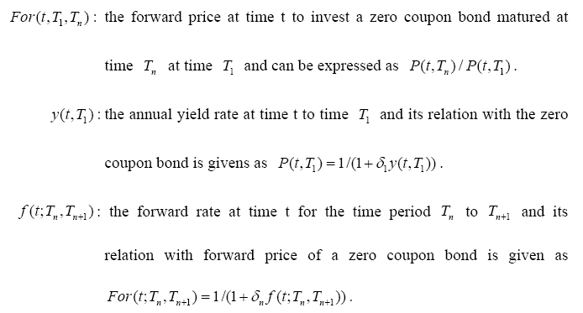
Basic term in the market

Slide 17
Black’s formula for the caplet
Black’s formula for the i-th caplet valued at time t:
where

Slide 18
Forward rate agreement (FRA)
An agreement made at time t to exchange fixed rate interest payments at a rate K for variable rate payments, on a notional amount A, for the loan period and equal to one year.
The settlement amount at time on a long FRA
where is the annual yield at time to

Slide 19
Forward rate agreement (FRA)
At the time t of the contract inception, an FRA is normally structured so that it has zero value
We denote the value of the FRA at time t as which can be expressed as
Here, we set K equal to to avoid the arbitrage

Slide 20
The relationship between discrete time forward rate
Time 0 | Time 1 | Time 2 | Time 3 | …
f(0;0,1)
f(0;1,2) | f(1;1,2)
f(0;2,3) | f(1;2,3) | f(2;2,3)
f(0;3,4) | f(1;3,4) | f(2;3,4) | f(3;3,4)
. | . | . | . | .
. | . | . | . | .
. | . | . | . | .
(1) drift
(3) covariance
(2) volatility

Slide 21
The discrete time version of LMM
We restate the most important results which are under the “risk neutral” measure in the Poon and Stapleton text (2005)
For a zero-coupon bond price is given by
The drift of the forward bond price is given by

Slide 22
The most important results in text
The drift of T-period forward rate is given by

Slide 23
Discrete-time version of LMM
We now apply the results to the LIBOR basis for the FRA and rewrite as follows
where and we assume all the tenors are same to make the equation brief, that is

Slide 24
Discrete-time version of LMM
We use the above results and similar steps to derive the FRA value at time t to generalize the maturity forward rate

Slide 25
Discrete-time version of LMM
We assume that the forward rate is the lognormal for all forward maturities
We use the approximate result for the covariance term, i.e. for the small change around the value
, we have
Here, we take and to evaluate , then we have

Slide 26
Discrete-time version of LMM
Using the property of logarithms to express the drift of -maturity forward rate as the sum of a series of covariance term
Using Stein’s lemma to make covariance terms in a recognizable form and can be express as

Slide 27
Discrete-time version of LMM
Define
Then, we can rewrite the drift of the forward LIBOR rate as

Slide 28
Introducing the HSS Recombining Node Methodology
Ho, Stapleton and Subrahmanyam (1995) [HSS] suggest a general methodology for creating a recombining multi-variate binomial tree to approximate a multi-variate lognormal process
Our assumption about LMM satisfies the conditions in the HSS methodology and apply it into LMM

Slide 29
HSS methodology
HSS assume the price of underlying asset follows a lognormal diffusion process:
where and are the instantaneous drift and volatility of , and is a standard Brownian motion
They denote the unconditional mean of the logarithmic asset return at time i as
The conditional volatility over the period i -1 to i is denoted as
The unconditional volatility is

Slide 30
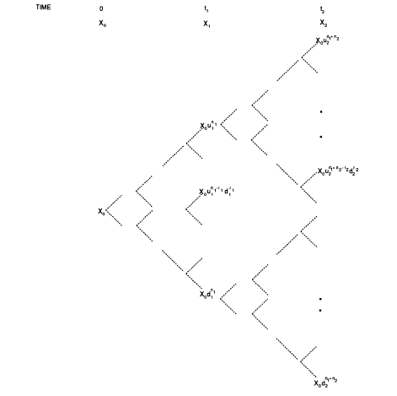

Slide 31
HSS methodology
To approximate with a binomial process for the true process for underlying asset at time
They denoted the conditional volatilities of the approximated binomial process as and require that
Similarly

Slide 32
HSS methodology
HSS method involves the construction of m separate binomial distribution, where the time periods are denoted
And have the set of a discrete stochastic for , where is only defined at time
The general form of at node r
where

Slide 33
HSS methodology
They denote and the probabilities to reach given a node at as
Lemma 1 Suppose that the up and down movements and are chosen so that

Slide 34
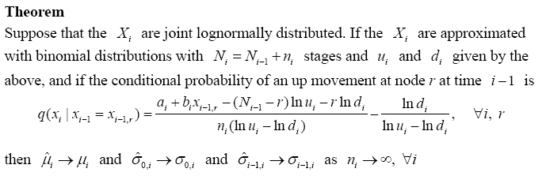
HSS methodology

Slide 35
Applying HSS methodology into lMM
We apply this methodology into the LMM and make some change to satisfy our conventions
We have the following propositions

Slide 36
Proposition 1
For the forward LIBOR rate which follows the lognormal distribution, we can choose the proper up and down movements to determine the i-th period of the -maturity forward LIBOR rate and have the form
where

Slide 37
the binomial trees in discrete time forward rate
f(1;1,2)
f(0;1,2)
f(2;2,3)
f(1;2,3)
f(0;2,3)
f(3;3,4)
f(2;3,4)
f(1;3,4)
f(0;3,4)

Slide 38
The structure of the binomial tree
With nodes at numbered There are nodes at numbered Here we write the forward rate
in abbreviated form
and take n₁ = n₂ = 2,
r₁ = r₂ = 2.

Slide 39
Proposition 2
Suppose that the forward LIBOR rate are joint lognormally distributed. If the
, are approximated with binomial distributions with stages and and given by proposition 1, and if the conditional probability of an up movement at node r at time is

Slide 40
Proposition 2
where
To determining the conditional probability, it has some skills to use for the term
We first derive term . Since forward rate is lognormally distributed, we have

Slide 41
The derivation of expectation
We have the one-period drift of the forward rate result obtained from the last chapter and rewrite it as follows
Then multiple the term on both side to get the general form of

Slide 42
The derivation of expectation
The general form of expectation is given as

Slide 43
Special case
When n_{l} stages approach infinite , the sum of n_{l} stages also approach infinite, that is
We can reduce the up and down movements to the briefer form which is easier to calculate and show as follows
The conditional probability as

Slide 44
The Pricing of The Interest Rate Derivatives in LMM
After we construct out of our forward tree process, we can use it to price the derivatives
Beginning from the embedded option on ZCB then extend to the caplets

Slide 45
The valuation of embedded option on zero coupon bond in Lmm
The embedded option on ZCB is a bond that can be callable before maturity date with a callable price K
We have a three years maturity zero coupon bond with a callable price K equal to 0.952381 dollar at year two
option maturity
bond maturity
C0
Time 0 1y 2y 3y
one year

Slide 46
The valuation of embedded option on zero coupon bond in Lmm
Pricing the option value C₀ of this callable bond at time 0
Here, we take the flat forward rate 5% and constant volatility 10%

Slide 47
Sensitive analysis – strike price
We change strike price from 0.952381 to 0.96 which vary 0.001 to see the relationship between strike price and embedded option value
We find that when the strike price increases, the embedded option value decreases

Slide 49
Sensitive analysis – volatility
We increase 1% of the volatility from 10% until reach 30% to see the impact of volatility on the embedded option value
We find that when the volatility increases, the embedded option value increases
It is consistent with the inference for the Greek letter vega when the underlying asset’s volatility increases the option value increases, too.

Slide 51
The valuation of caplets in LMM
The payoff function of a caplet at time is
It is a caplet on the spot rate observed at time with payoff occurring at time
The cap is a portfolio consisted of n such call options which the underlying is known as caplet

Slide 52
The theroetical value of caplet
We use the Black’s formula for the caplet to get the theoretical value of caplet and rewrite as
where

Slide 53
Numerical method of caplet
We use the payoff function to compute the price in lattice method
To get the payoff function at time , we have to know the evolution of the forward rate at time
We construct the binomial tree of and known the , r = 0, 1, …, i.
Calculating the expectation of the payoff at time and then multiple the ZCB of to get the caplet value at time t.

Slide 54
example
Assume the tenor an notional amount are equal to one, the volatility is constant and equal to 10%, strike price is 5% , forward curve is flat equal to 5% and stages for every period are equal to 25
We have the one period caplet at time 0 caplet₁(0)

Slide 55
Numerical result
Using the RMSE to see the difference between the lattice value and Black’s model for the whole maturity
Table 2 is the results for different maturity caplets
We find that when we increase the stage between periods, the difference between lattice method and Black’s model is close

Slide 56
Table 2 volatility is 10% and stage for every period is 25
Maturity | Black | Lattice | Difference | Relative Difference (%)
1 | 0.0018085085 | 0.0018242781 | 0.0000157696 | 0.8719669656
2 | 0.0024348117 | 0.0024407546 | 0.0000059429 | 0.2440786919
3 | 0.0028388399 | 0.0028374958 | -0.0000013441 | 0.0473484800
4 | 0.0031206153 | 0.0031282191 | 0.0000076038 | 0.2436631792
5 | 0.0033214311 | 0.0033204098 | -0.0000010214 | 0.0307505629
6 | 0.0034637453 | 0.0034664184 | 0.0000026731 | 0.0771737036
7 | 0.0035616356 | 0.0035658574 | 0.0000042219 | 0.1185369137
8 | 0.0036247299 | 0.0036200240 | -0.0000047059 | 0.1298286011
9 | 0.0036600091 | 0.0036633313 | 0.0000033221 | 0.0907678678
10 | 0.0036727489 | 0.0036743568 | 0.0000016079 | 0.0437804213
 |  | RMSE | 0.0000063671
1. Caplet assume δ = 1 and stage 25
2. Assume volatility is 10%, the forward curve is flat 5%

Slide 57
Table 2 volatility is 10% and stage for every period is 50
Maturity | Black | Lattice | Difference | Relative Difference (%)
1 | 0.0018085085 | 0.0018099405 | 0.0000014320 | 0.0791823392
2 | 0.0024348117 | 0.0024397802 | 0.0000049685 | 0.2040608652
3 | 0.0028388399 | 0.0028434461 | 0.0000046061 | 0.1622542164
4 | 0.0031206153 | 0.0031230795 | 0.0000024643 | 0.0789673074
5 | 0.0033214311 | 0.0033207434 | -0.0000006878 | 0.0207066243
6 | 0.0034637453 | 0.0034620815 | -0.0000016638 | 0.0480341136
7 | 0.0035616356 | 0.0035626664 | 0.0000010308 | 0.0289416315
8 | 0.0036247299 | 0.0036267433 | 0.0000020134 | 0.0555455781
9 | 0.0036600091 | 0.0036617883 | 0.0000017792 | 0.0486107386
10 | 0.0036727489 | 0.0036734197 | 0.0000006708 | 0.0182649876
 |  | RMSE | 0.0000025690
1. Caplet assume δ = 1 and stage 50
2. Assume volatility is 10%, the forward curve is flat 5%

Slide 58
Convergence behavior vs. volatlity
We change the volatility from 10% to 30% to see the convergence behavior of RMSE at different volatility level
We find that when the volatility at low level, the convergent rate is fast to zero. Otherwise, the volatility at high level the convergence behavior is slow and strange

Slide 61
Conclusions
Constructing the recombining binomial tree, the payoff of the interest rate derivatives on each node can be obtained
The pricing procedures of the derivatives can be calculated by backward induction with the conditional probability
Comparing to the theoretical value, we find the theoretical value and lattice method is close when we increase the stages.

Slide 62
Conclusions
The sensitive analysis results of embedded option are consistent with inference of Greek letters
Although the convergence behavior of RMSE in caplets at high volatility is abnormal, it coheres with our inference as a whole

Slide 63
Future works
Deriving the joint probability between the states of different binomial forward rate trees.
Adjusting the stages between period by period to fit the strike price to reduce the nonlinearity error
Trying to change the constant volatility to stochastic volatility to fit the volatility term structure.

Slide 64
Thank you for your listening
The End

