Slide 1
4/1進度報告
李承曄
林大為
蘇伯昌

Slide 2
CatEPut (Catastrophe Equity Put Option)
巨災權益賣權

Slide 3
Traditional CatEPut (Double Trigger Put option)
This option allows the owner to issue convertible preferred shares at a fixed price
Satisfy two conditions to be in the money
1. Underlying equity must be below the strike price
2. A specified catastrophe event must have occured

Slide 4
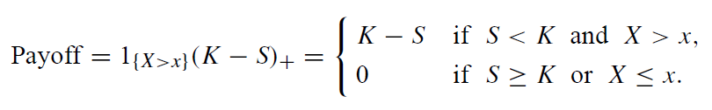
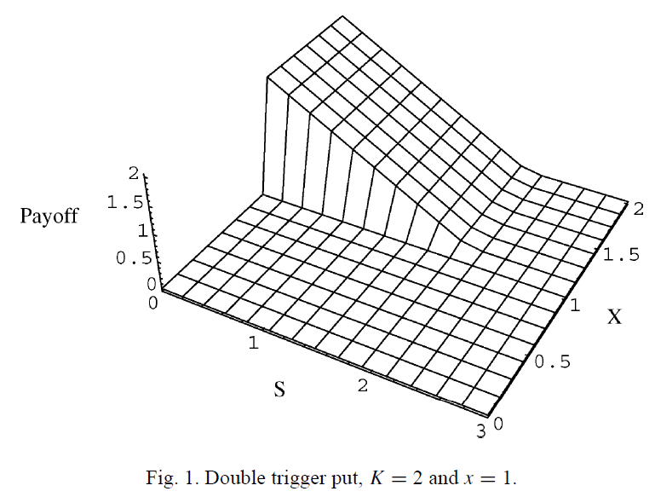
Formula

Slide 5
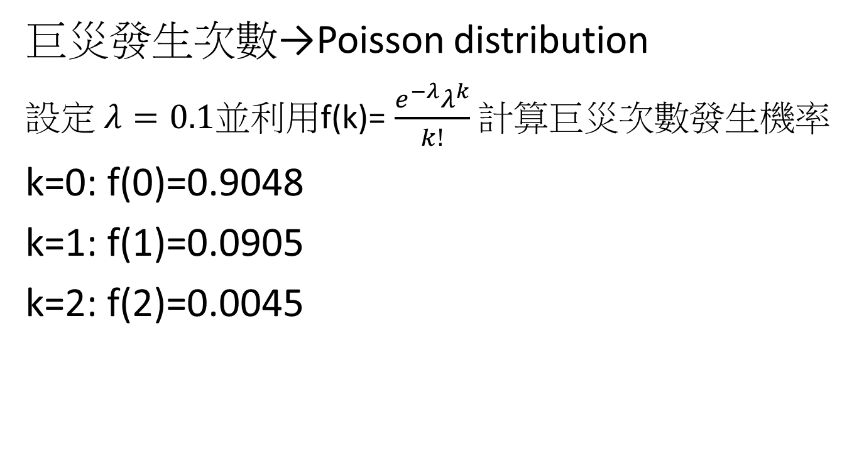
Variables
巨災發生次數→Poisson distribution
設定 $λ=0.1$並利用f(k)= $\frac{e^{−λ}λ^{k}}{k!}$ 計算巨災次數發生機率
k=0: f(0)=0.9048
k=1: f(1)=0.0905
k=2: f(2)=0.0045

Slide 6
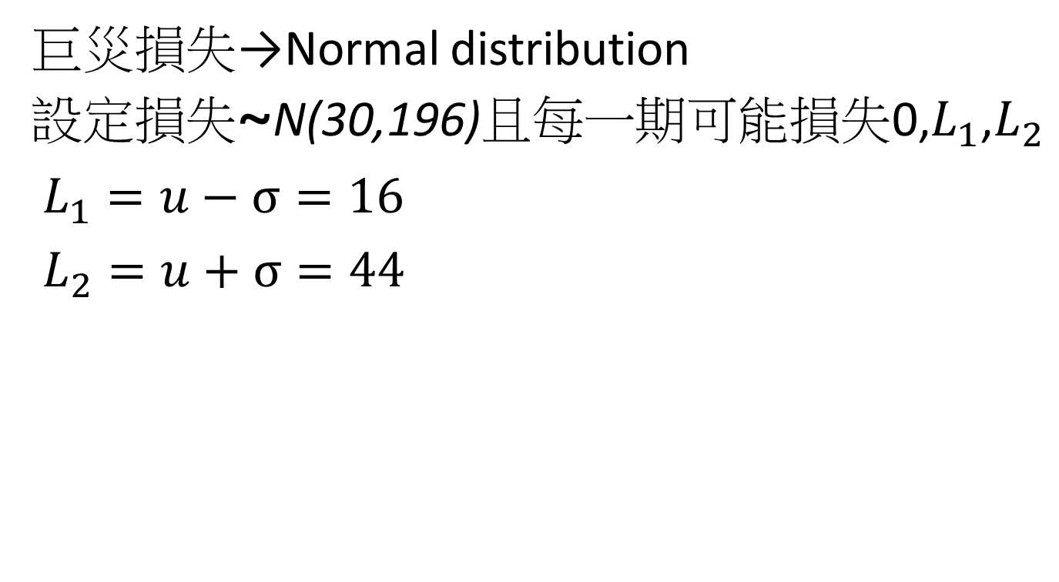
Variables
巨災損失→Normal distribution
設定損失~N(30,196)且每一期可能損失0,$L_{1}$,$L_{2}$
$L_{1}=u−σ=16$
$L_{2}=u+σ=44$

Slide 7




Jump Diffusion Tree
T=0
T=1
T=2
Firm Value
$${−L}_{1}$$
$${−L}_{2}$$
$${−L}_{1}$$
$${−L}_{2}$$

