Slide 1

以結構式信用風險模型評價有違約風險及股權稀釋效果下的巨災賣權
專題生：李承曄
林大為
蘇伯昌
指導教授：戴天時

Slide 2
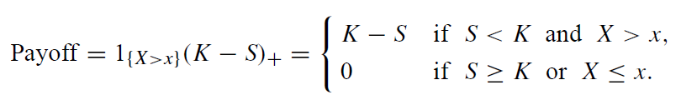
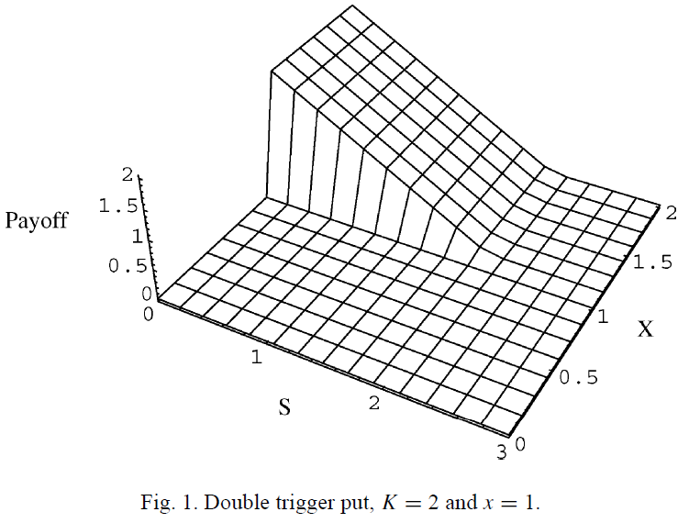
何謂巨災權益賣權(Catastrophe Equity Put)?
定義：保險公司向市場投資者購買此賣權，約定當公司所承保之巨災的發生超過額度且該公司之股價低於履約價時，公司得行使賣權，將發行之新股賣給投資人，並利用獲得資金做為災後融通之用。

Slide 3
1. Introduction
In a lattice, the prices of the derivatives converge when the number of time steps increase.
Nonlinearity error from nonlinearity option value causes the pricing results to converge slowly or oscillate significantly.

Slide 4
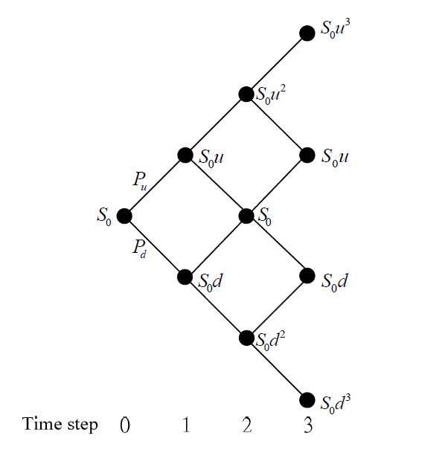
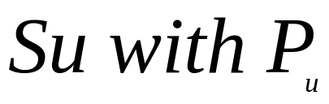
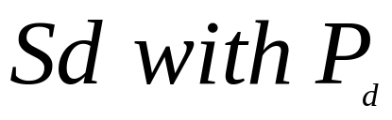
CRR Lattice
Lognormal Diffusion Process

Slide 5
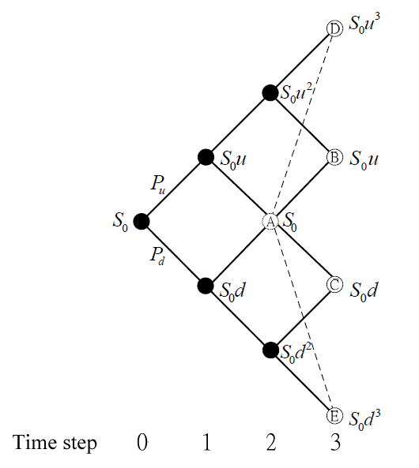
Amin’s Lattice
less accurate !?
Volatility

Slide 6
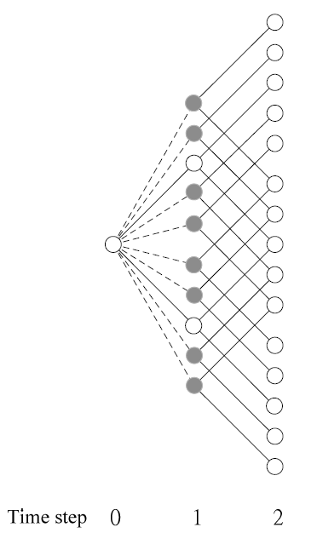
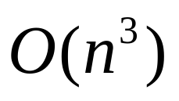
Hilliard and Schwartz’s (HS) Lattice
Diffusion nodes
Jump nodes

Slide 7
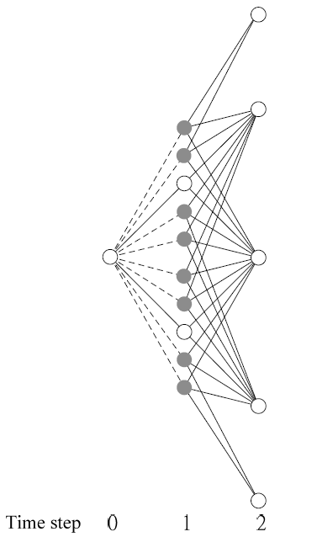
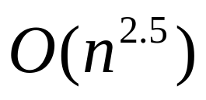
Paper’s Lattice
Bino-Trinomial structure

Slide 8
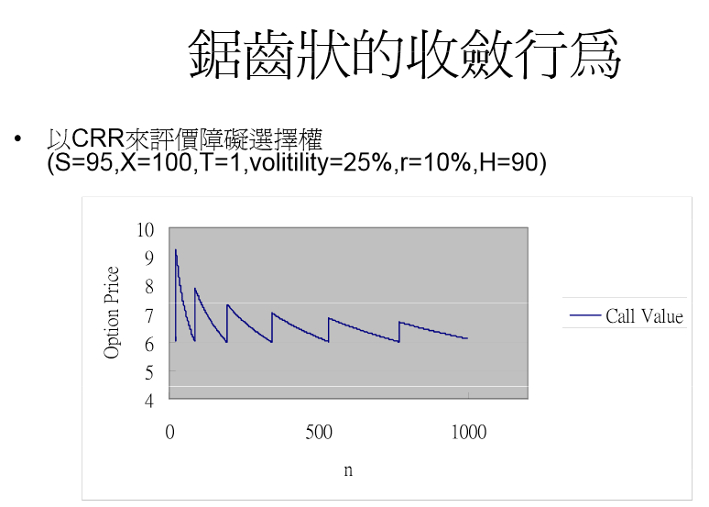
Another Advantage

Slide 9
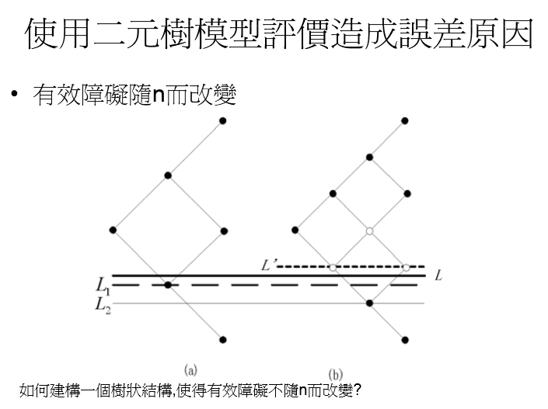

Slide 10
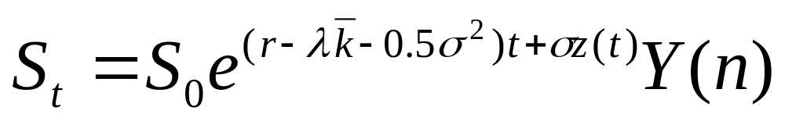
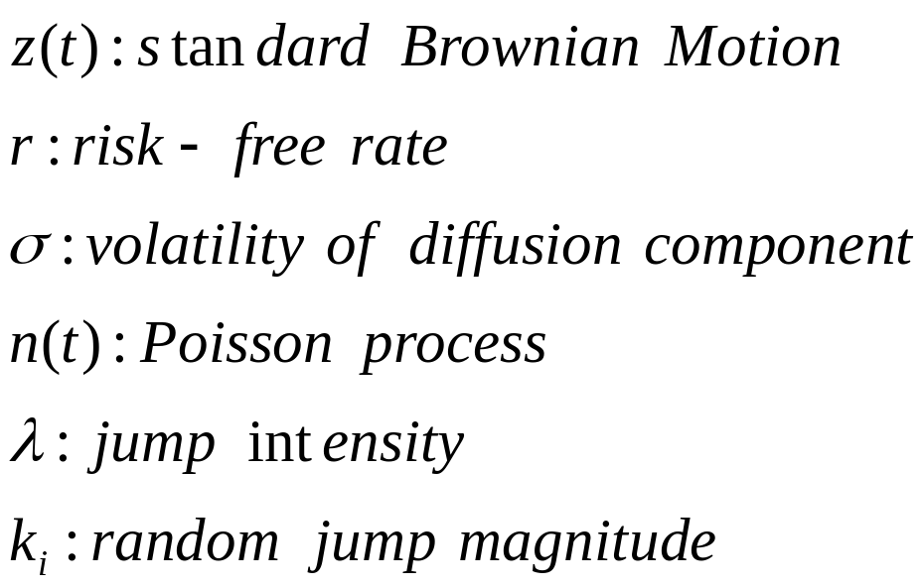
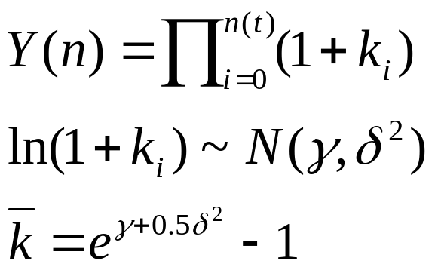
2. Modeling and Definitions
The risk-neutralized version of the underlying asset’s jump diffusion process

Slide 11
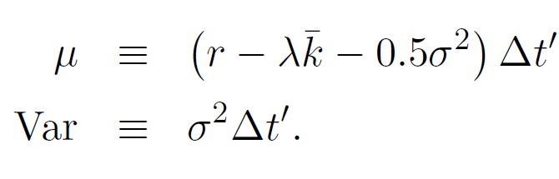


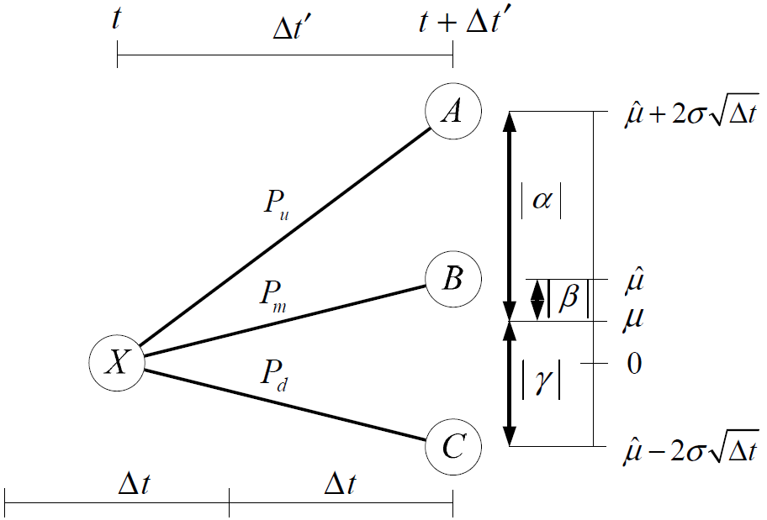

3. Lattice Construction
Trinomial Structure

Slide 12
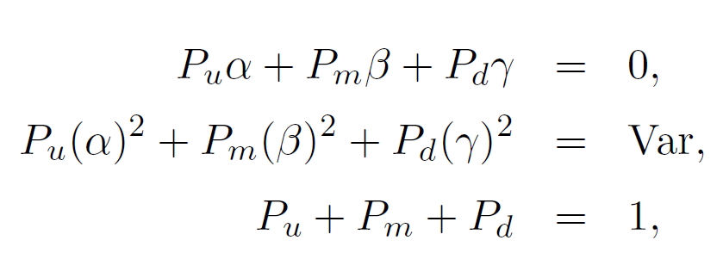
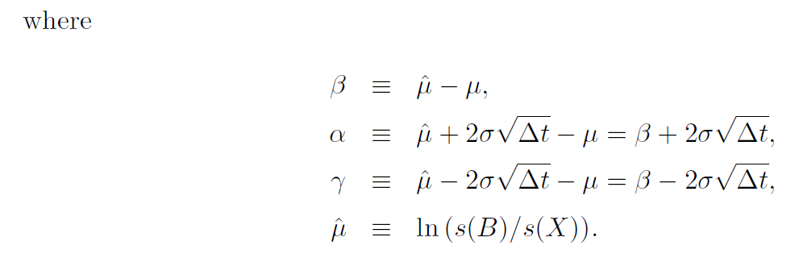

Slide 13
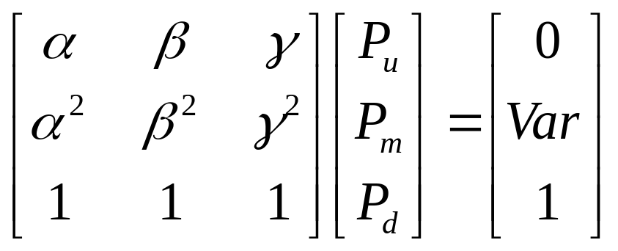
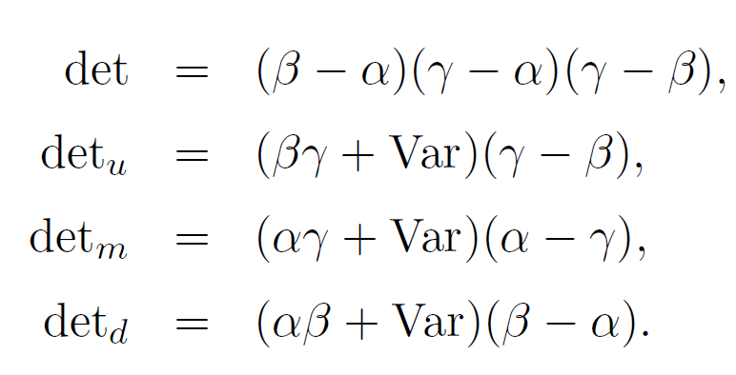



→ Cramer’s rule

Slide 14
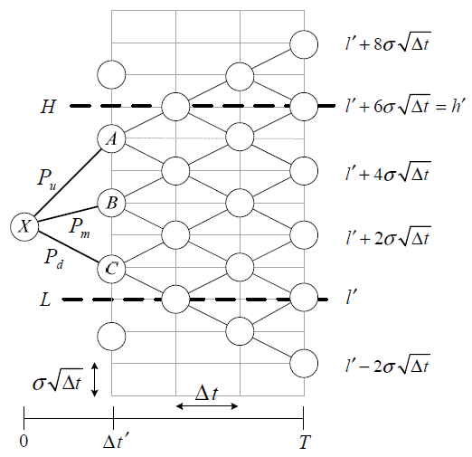


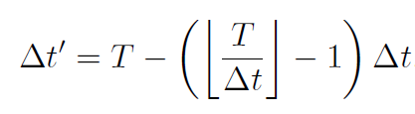

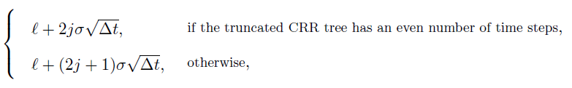
fitting the derivatives specification

Slide 15
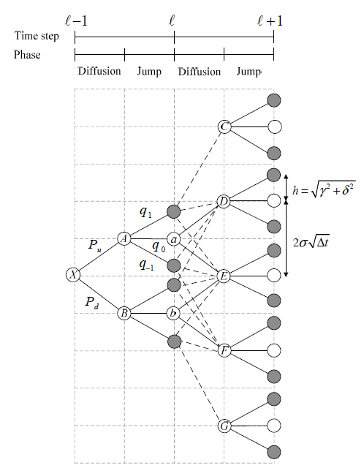


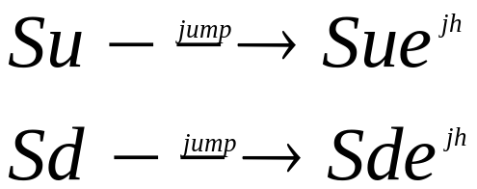

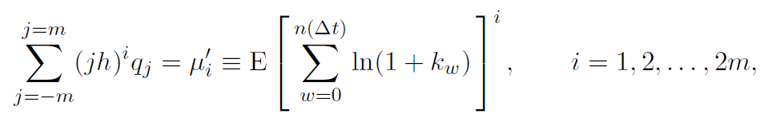
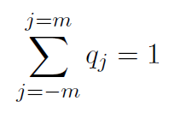

Jump nodes

Slide 16
Tracing code

Slide 17
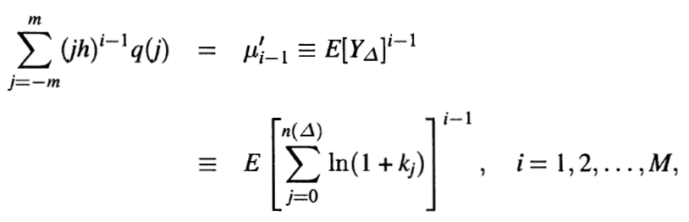
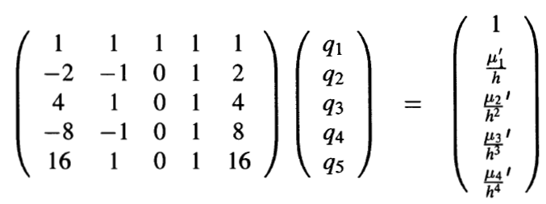
Hilliard & Schwartz

Slide 18
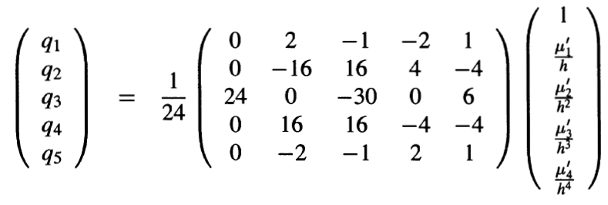

Hilliard & Schwartz

Slide 19
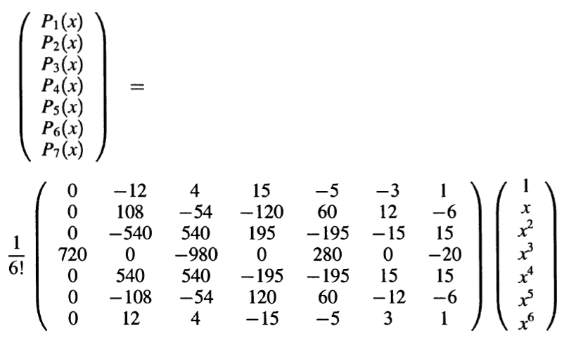
Hilliard & Schwartz

Slide 20
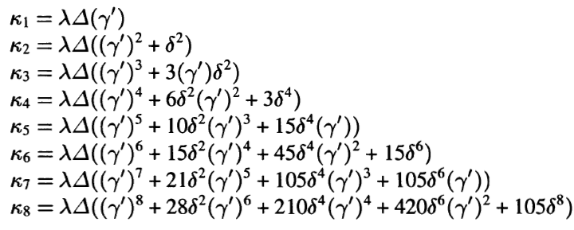
Hilliard & Schwartz

