Slide 1
Fluctuations and response in financial markets: the subtle nature of ‘random’ price changes Bouchaud, Jean-Philippe, et al. "Fluctuations and response in financial markets: the subtle nature ofrandom'price changes." Quantitative finance 4.2 (2003): 176.

Slide 2
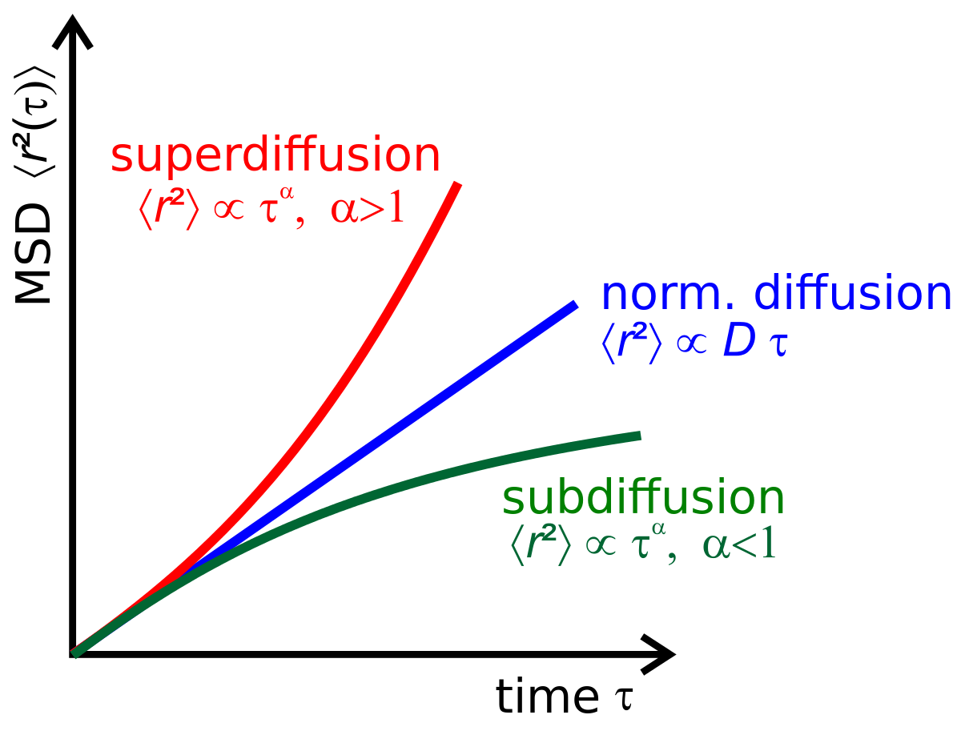
Introduction
The aim of this paper :
Study how price changing at the trade by trade level
Analyze the interplay between the impact of each trade on the price and the volatility
Main concepts :
The random walk nature of prices is in fact highly non trivial and results from a fine-tuned competition between two populations of traders, liquidity providers (Liquidity providers) on the one hand, and liquidity takers (Liquidity takers)
Deliver the observations of price fluctuation, price response and trades’ correlation from empirical data.
Compare the price fluctuation and price response with and without trades correlation exists.
Based on the features of price fluctuations and response in empirical data, construct a pairwise price model and bare impact function(decay function) which can explain the features.

Slide 3
Introduction
Liquidity takers:
Leading to super-diffusion – the autocorrelation of market order flow.
Dividing one’s order in small chunks and disperse these as much as possible over time so as not to appear on the ‘radar screens’.
Liquidity providers(or market makers):
Leading to sub-diffusion – the decay of the bare impact function.
Their profit comes from the bid-ask spread.

Slide 4
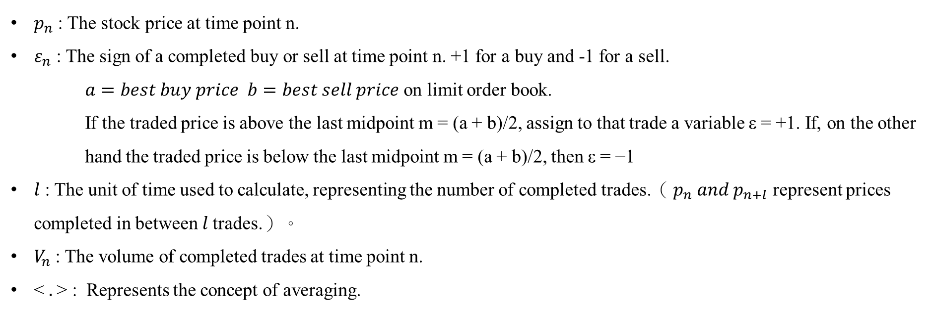
Introduction - Parameters
$p_{n}$ : The stock price at time point n.
$ε_{n}$: The sign of a completed buy or sell at time point n. +1 for a buy and -1 for a sell.
$a=best buy price b=best sell price$ on limit order book.
If the traded price is above the last midpoint m = (a + b)/2, assign to that trade a variable ε = +1. If, on the other hand the traded price is below the last midpoint m = (a + b)/2, then ε = −1
$l$ : The unit of time used to calculate, representing the number of completed trades.（ $p_{n} and p_{n+l}$ represent prices completed in between 𝑙 trades.）。
$V_{n}$ : The volume of completed trades at time point n.
< $.$> : Represents the concept of averaging.

Slide 5
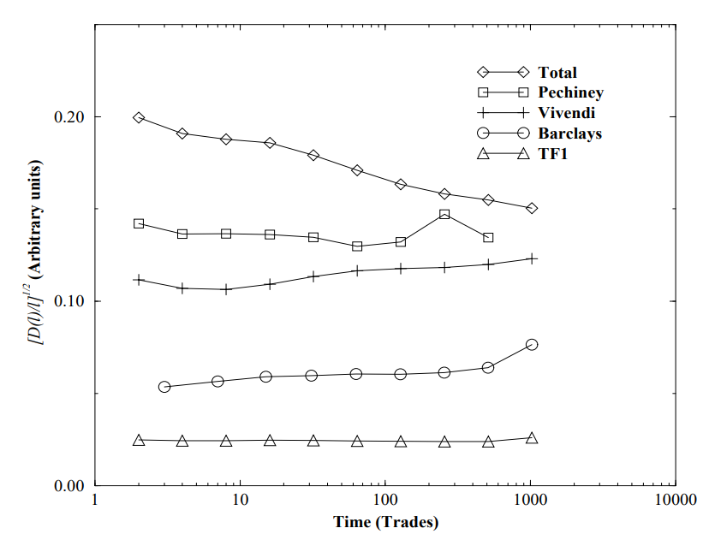
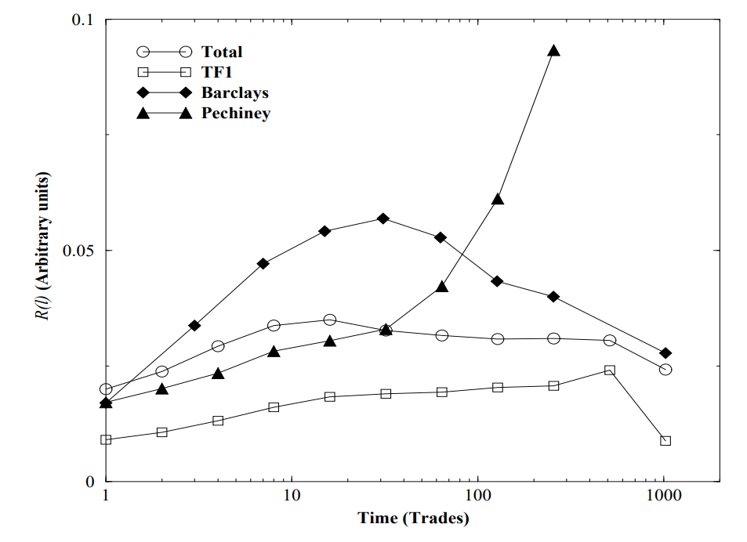
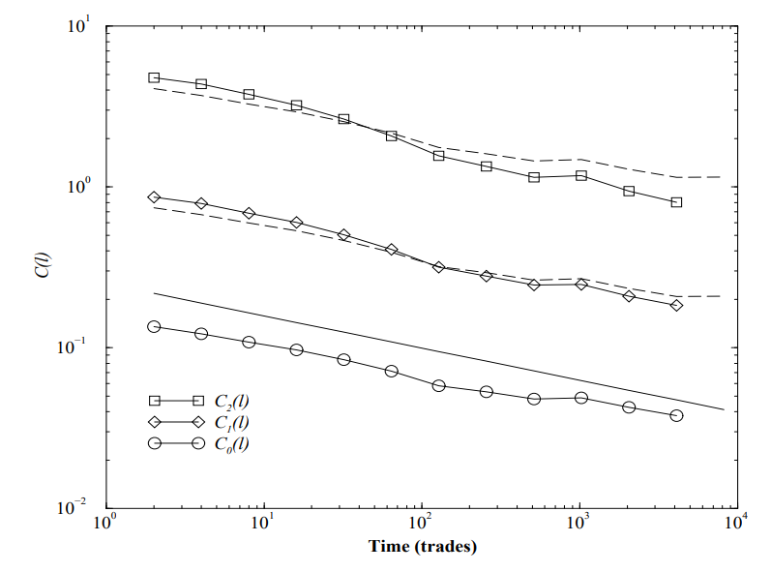
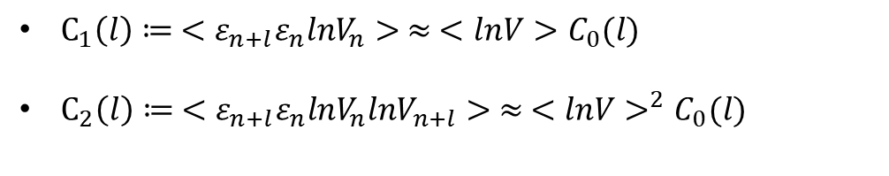
Introduction - Functions
Price fluctuation function $:D\left(l\right)≔<{\left(p_{n+l}−p_{n}\right)}^{2}>$
Response function (impact function):$R\left(l\right)≔<\left(p_{n+l}−p_{n}\right)⋅ε_{n}>$
Correlation function: $C_{0}\left(l\right)=<ε_{n+l}ε_{n}>− <ε_{n}>^{2}≃\frac{C_{0}}{l^{γ}}$
$C_{1}\left(l\right)≔ <ε_{n+l}ε_{n}lnV_{n}> ≈ <lnV>C_{0}(l)$
$C_{2}\left(l\right)≔ <ε_{n+l}ε_{n}lnV_{n}lnV_{n+l}> ≈ <lnV>^{2}C_{0}(l)$
Price fluctuation
Response function
Correlation function

Slide 6
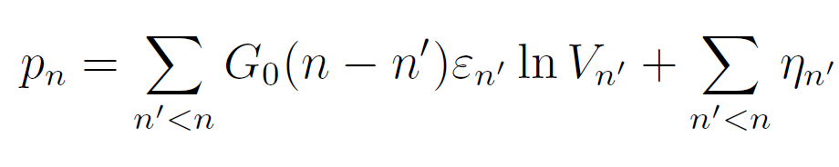
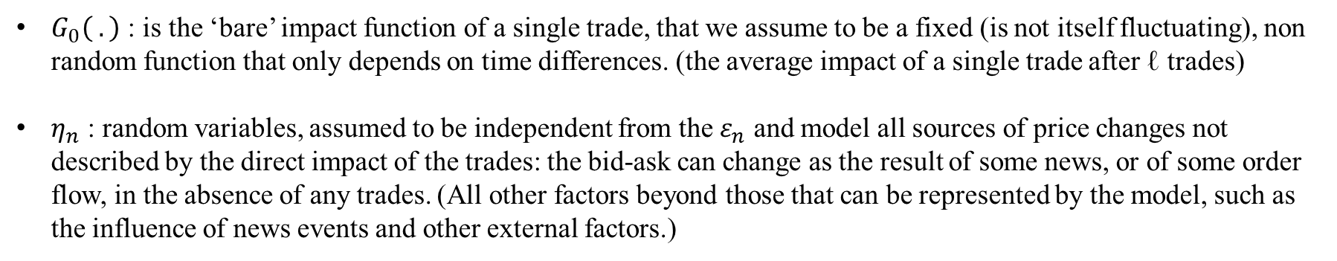
Models - Price
The price at time n is written as a sum over all past trades, of the impact of one given trade propagated up to time n:
$G_{0}\left( .\right)$ : is the ‘bare’ impact function of a single trade, that we assume to be a fixed (is not itself fluctuating), non random function that only depends on time differences. (the average impact of a single trade after ℓ trades)
$η_{n}$ : random variables, assumed to be independent from the $ε_{n}$ and model all sources of price changes not described by the direct impact of the trades: the bid-ask can change as the result of some news, or of some order flow, in the absence of any trades. (All other factors beyond those that can be represented by the model, such as the influence of news events and other external factors.)
Using this representation, the price increment between an arbitrarily chosen initial time 0 and time ℓ is:

Slide 7
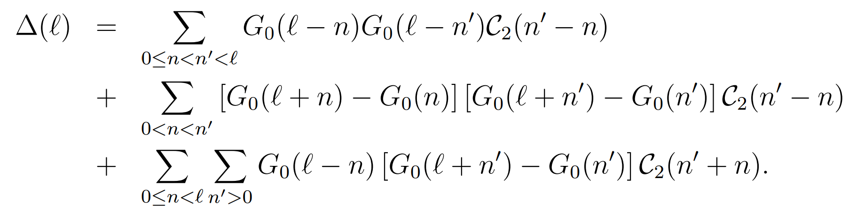
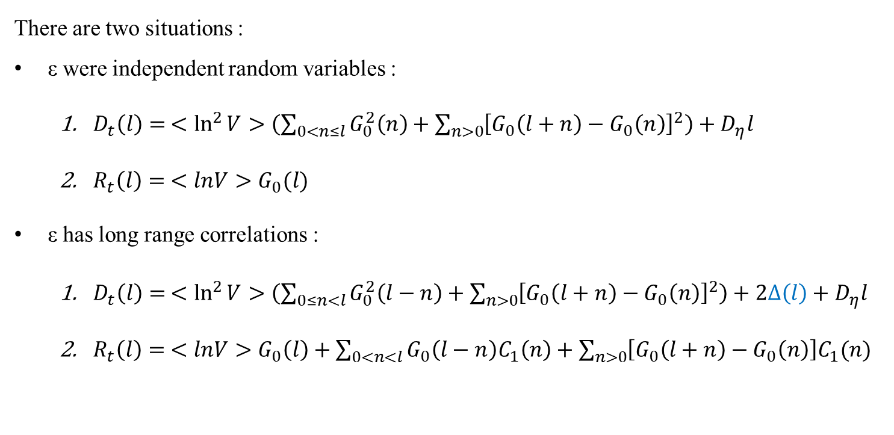
Models – Theoretical models
We put theoretical price increment into definition functions
There are two situations :
ε were independent random variables :
$D_{t}\left(l\right)= <\ln^{2}{V}>\left(\sum_{0<n≤l}{G_{0}^{2}\left(n\right)+\sum_{n>0}{{\left[G_{0}\left(l+n\right)−G_{0}\left(n\right)\right]}^{2}}}\right)+D_{η}l$
$R_{t}\left(l\right)= <lnV>G_{0}(l)$
ε has long range correlations :
$D_{t}\left(l\right)= <\ln^{2}{V}>\left(\sum_{0≤n<l}{G_{0}^{2}\left(l−n\right)+\sum_{n>0}{{\left[G_{0}\left(l+n\right)−G_{0}\left(n\right)\right]}^{2}}}\right)+2Δ\left(l\right)+D_{η}l$
$R_{t}\left(l\right)= <lnV>G_{0}\left(l\right)+\sum_{0<n<l}{G_{0}\left(l−n\right)C_{1}\left(n\right)+\sum_{n>0}{\left[G_{0}\left(l+n\right)−G_{0}\left(n\right)\right]C_{1}(n)} }$

Slide 8
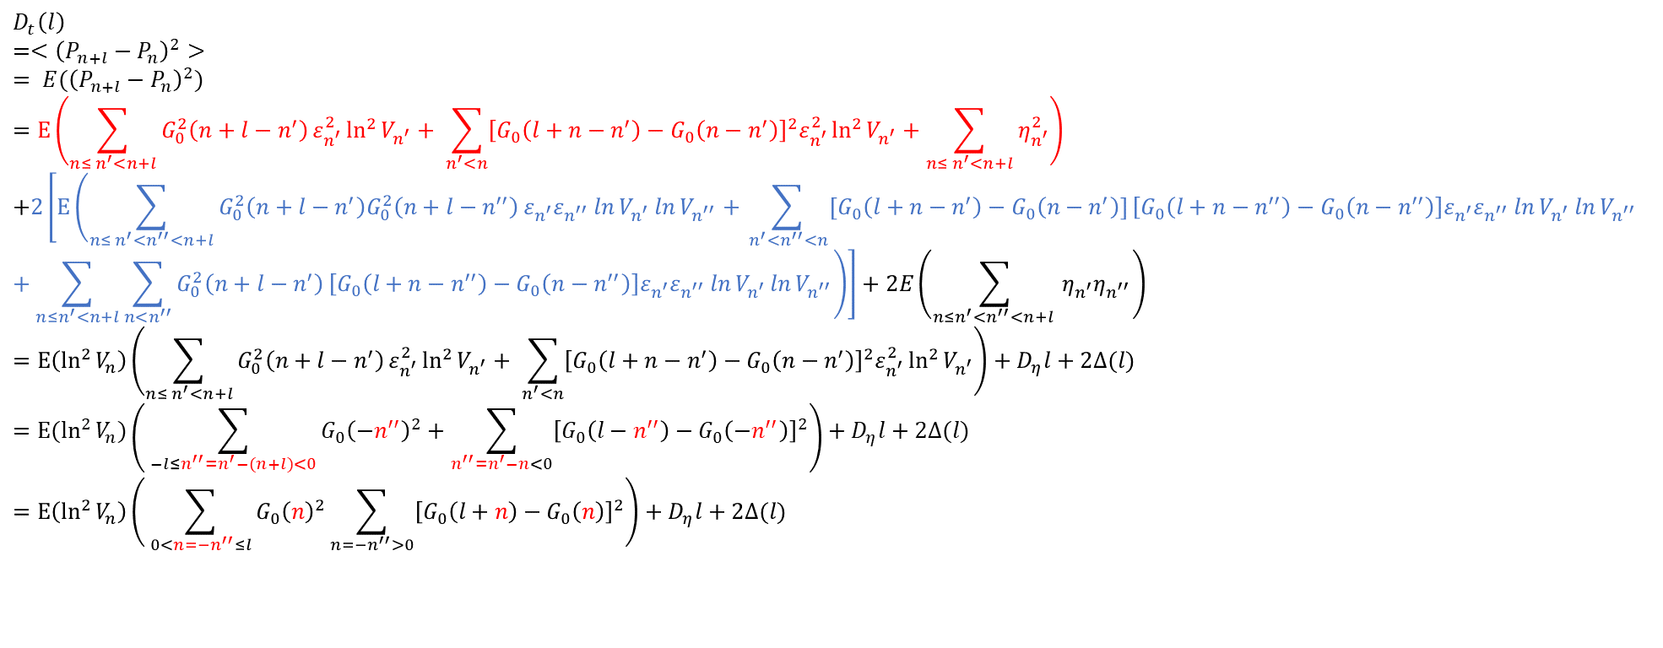
Models – The proof process of the functions
(ε has long range correlations )
Price fluctuation definition function $:D\left(l\right) ≔ <{\left(p_{n+l}−p_{n}\right)}^{2}>$
$$D_{t}\left(l\right)$$
$$=<{\left(P_{n+l}−P_{n}\right)}^{2}>$$
$$= E({\left(P_{n+l}−P_{n}\right)}^{2})$$
$$=E\left(\sum_{{n≤ n}^{′}<n+l}{G_{0}^{2}\left(n+l−n^{′}\right)}ε_{n^{′}}^{2}\ln^{2}{V_{n^{′}}}+ \sum_{n^{′}<n}{{\left[G_{0}\left(l+n−n^{′}\right)−G_{0}\left(n−n^{′}\right)\right]}^{2}ε_{n^{′}}^{2}\ln^{2}{V_{n^{′}}}}+\sum_{n≤ n^{′}<n+l}{η_{n^{′}}^{2}}\right)$$
$$+2\left[E\left(\sum_{{n≤ n}^{′}<n^{′′}<n+l}{G_{0}^{2}\left(n+l−n^{′}\right)G_{0}^{2}\left(n+l−n^{′′}\right)}ε_{n^{′}}ε_{n^{′′}}\ln{V_{n^{′}}\ln{V_{n^{′′}}}}+\sum_{{ n}^{′}<n^{′′}<n}{[G_{0}\left(l+n−n^{′}\right)−G_{0}\left(n−n^{′}\right)]}\left[G_{0}\left(l+n−n^{′′}\right)−G_{0}\left(n−n^{′′}\right)\right]ε_{n^{′}}ε_{n^{′′}}\ln{V_{n^{′}}\ln{V_{n^{′′}}}}+\sum_{n≤n^{′}<n+l}{\sum_{n<n^{′′}}{G_{0}^{2}\left(n+l−n^{′}\right)}}\left[G_{0}\left(l+n−n^{′′}\right)−G_{0}\left(n−n^{′′}\right)\right]ε_{n^{′}}ε_{n^{′′}}\ln{V_{n^{′}}\ln{V_{n^{′′}}}}\right)\right]+2E\left(\sum_{n≤n^{′}<n^{′′}<n+l }{η_{n^{′}}η_{n^{′′}}}\right)$$
$$=E\left(\ln^{2}{V_{n}}\right)\left(\sum_{{n≤ n}^{′}<n+l}{G_{0}^{2}\left(n+l−n^{′}\right)}ε_{n^{′}}^{2}\ln^{2}{V_{n^{′}}}+ \sum_{n^{′}<n}{{\left[G_{0}\left(l+n−n^{′}\right)−G_{0}\left(n−n^{′}\right)\right]}^{2}ε_{n^{′}}^{2}\ln^{2}{V_{n^{′}}}}\right)+D_{η}l+2Δ(l)$$
$$=E(\ln^{2}{V_{n}})\left( \sum_{−l{≤n^{′′}=n}^{′}−(n+l)<0}{G_{0}{\left(−n^{′′}\right)}^{2}+\sum_{n^{′′}=n^{′}−n<0}{{\left[G_{0}\left(l−n^{′′}\right)−G_{0}\left(−n^{′′}\right)\right]}^{2}}}\right)+D_{η}l+2Δ(l)$$
$$=E\left(\ln^{2}{V_{n}}\right)\left( \sum_{0<n=−n^{′′}≤l}{G_{0}{\left(n\right)}^{2}\sum_{{n=−n}^{′′}>0}{{\left[G_{0}\left(l+n\right)−G_{0}\left(n\right)\right]}^{2}}}\right)+D_{η}l+2Δ(l)$$
The red part corresponds to $n_{i}∗n_{j}, where i=j$, while the blue part corresponds to $n_{i}∗n_{j}, where i≠j$.

Slide 9


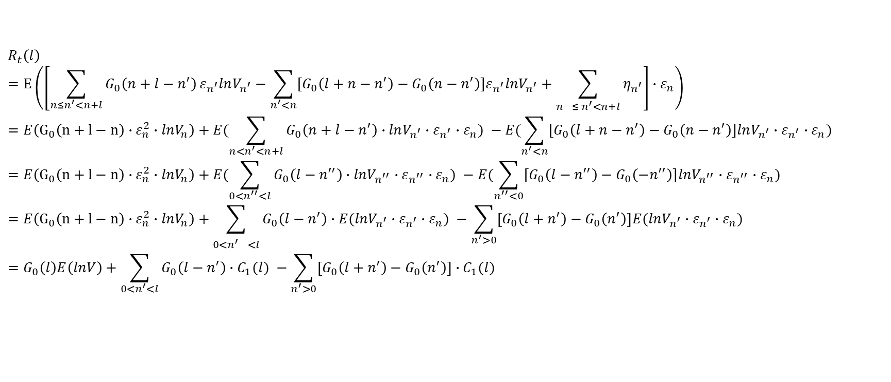

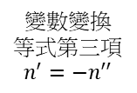
Models – The proof process of the functions
(ε has long range correlations )
Response function (impact function):$R\left(l\right)≔<\left(p_{n+l}−p_{n}\right)⋅ε_{n}>$
Price fluctuation theoretical function $:$
$$R_{t}\left(l\right)$$
$$=E\left(\left[\sum_{{n≤n}^{′}<n+l}{G_{0}\left(n+l−n^{′}\right)}ε_{n^{′}}lnV_{n^{′}}−\sum_{n^{′}<n}{[G_{0}\left(l+n−n^{′}\right)−G_{0}\left(n−n^{′}\right)]ε_{n^{′}}lnV_{n^{′}}}+\sum_{n^{}≤ n^{′}<n+l}{η_{n^{′}}}\right]∙ε_{n}\right)$$
$$=E\left(G_{0}\left(n+l−n\right)∙ε_{n}^{2}∙lnV_{n}\right)+E(\sum_{{n<n}^{′}<n+l}{G_{0}\left(n+l−n^{′}\right)∙lnV_{n^{′}}∙ε_{n^{′}}∙ε_{n}}) −E(\sum_{n^{′}<n}{[G_{0}\left(l+n−n^{′}\right)−G_{0}\left(n−n^{′}\right)]lnV_{n^{′}}}∙ε_{n^{′}}∙ε_{n})$$
$$=E\left(G_{0}\left(n+l−n\right)∙ε_{n}^{2}∙lnV_{n}\right)+E(\sum_{{0<n}^{′′}<l}{G_{0}\left(l−n^{′′}\right)∙lnV_{n^{′′}}∙ε_{n^{′′}}∙ε_{n}}) −E(\sum_{n^{′′}<0}{[G_{0}\left(l−n^{′′}\right)−G_{0}\left(−n^{′′}\right)]lnV_{n^{′′}}}∙ε_{n^{′′}}∙ε_{n})$$
$$=E\left(G_{0}\left(n+l−n\right)∙ε_{n}^{2}∙lnV_{n}\right)+\sum_{{0<n^{′}}^{}<l}{G_{0}\left(l−n^{′}\right)∙E(lnV_{n^{′}}∙ε_{n^{′}}∙ε_{n}}) −\sum_{n^{′}>0}{\left[G_{0}\left(l+n^{′}\right)−G_{0}\left(n^{′}\right)\right]E(lnV_{n^{′}}}∙ε_{n^{′}}∙ε_{n})$$
$$=G_{0}\left(l\right)E\left(lnV\right)+\sum_{0<n^{′}<l}{G_{0}\left(l−n^{′}\right)∙C_{1}(l)} −\sum_{n^{′}>0}{\left[G_{0}\left(l+n^{′}\right)−G_{0}\left(n^{′}\right)\right]}∙C_{1}(l)$$
第一項取$n^{′}=n$
後面兩項取$n^{′}≠n$
變數變換
$$n^{′′}=n^{′}−n$$
變數變換
等式第三項
$$n^{′}={−n}^{′′}$$

Slide 10
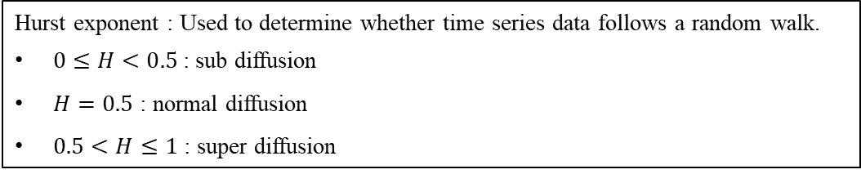
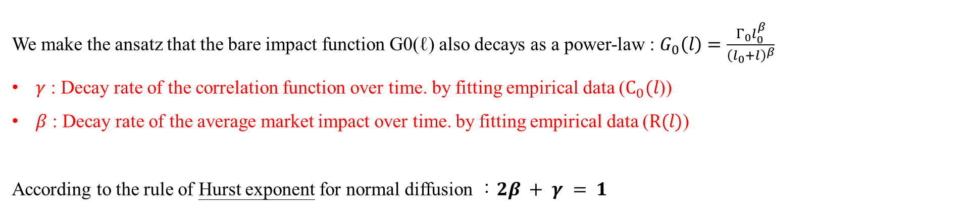
Models – Condition
We make the ansatz that the bare impact function G0(ℓ) also decays as a power-law : $G_{0}\left(l\right)=\frac{Γ_{0}l_{0}^{β}}{{\left(l_{0}+l\right)}^{β}}$
$γ$ : Decay rate of the correlation function over time. by fitting empirical data ($C_{0}(l$))
$β$ : Decay rate of the average market impact over time. by fitting empirical data ($R(l)$)
According to the rule of Hurst exponent for normal diffusion ：$2β + γ = 1$
Hurst exponent : Used to determine whether time series data follows a random walk.
$0≤H<0.5$: sub diffusion
$H=0.5$ : normal diffusion
$0.5<H≤1$ : super diffusion

Slide 11
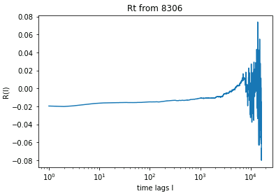
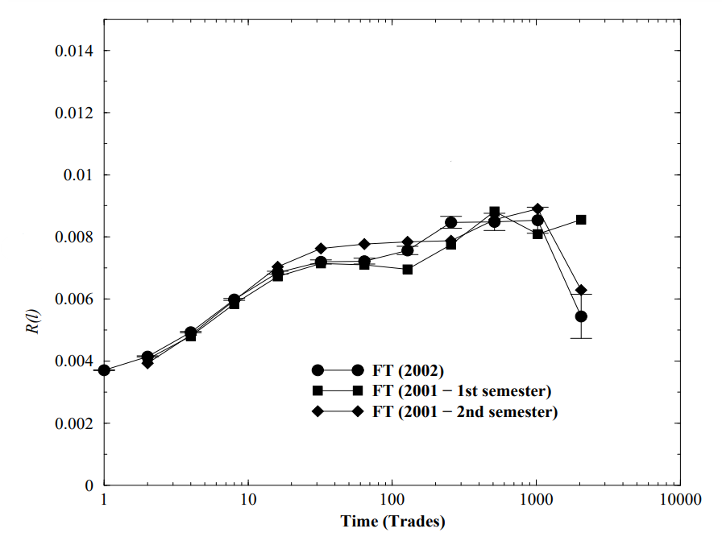
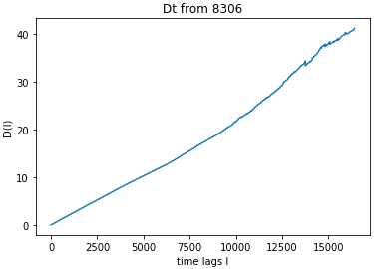
Data we use：8306.T from 2021.07.01 to 2022.06.30
Data used in paper：French stocks in the years 2001 and 2002
Implementation
Response function (impact function):$R\left(l\right)≔<\left(p_{n+l}−p_{n}\right)⋅ε_{n}>$
Price fluctuation function $:D\left(l\right)≔<{\left(p_{n+l}−p_{n}\right)}^{2}>$

Slide 12
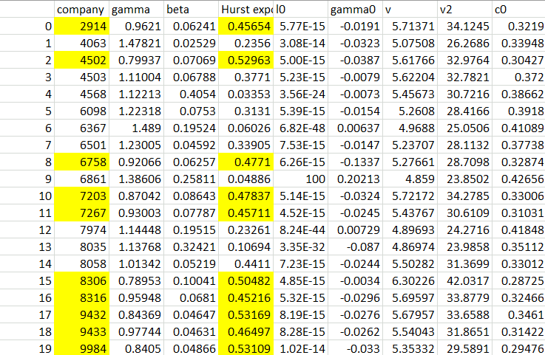
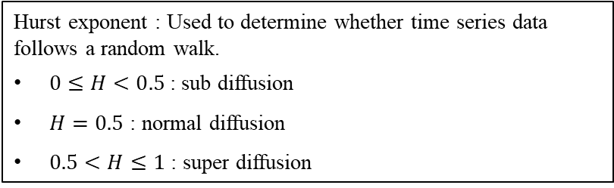
Implementation
$γ$ : Decay rate of the correlation function over time. By fitting empirical data ($C_{0}(l$))
$β$ : Decay rate of the average market impact over time. By fitting empirical data ($R(l)$)
Hurst exponent : Used to determine whether time series data follows a random walk.
$0≤H<0.5$: sub diffusion
$H=0.5$ : normal diffusion
$0.5<H≤1$ : super diffusion
Data is not publicly available.

Slide 13
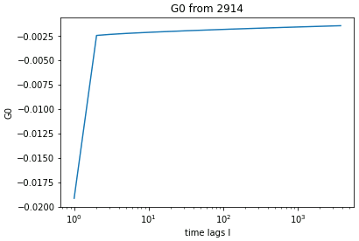
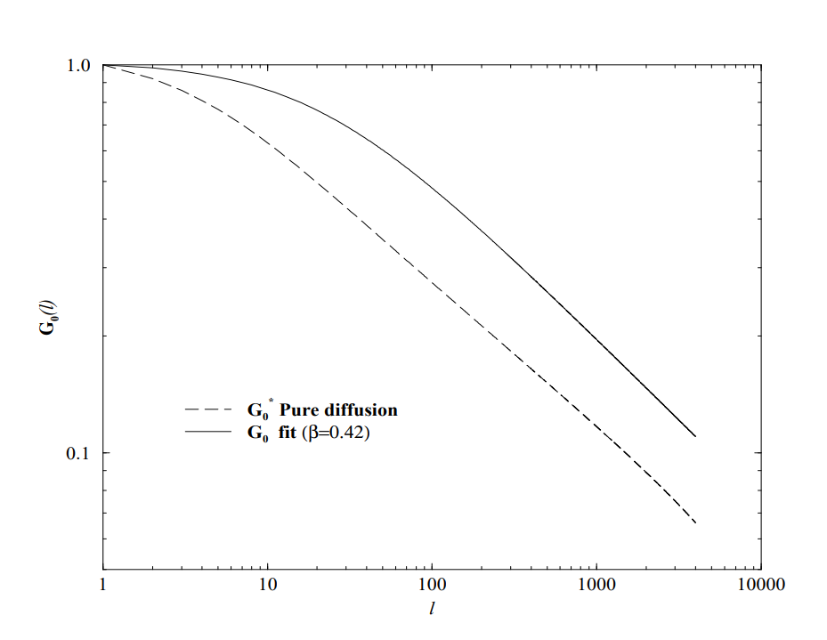
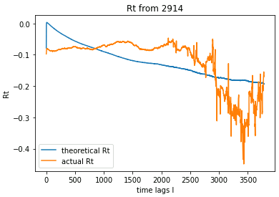
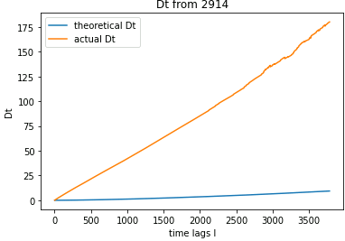
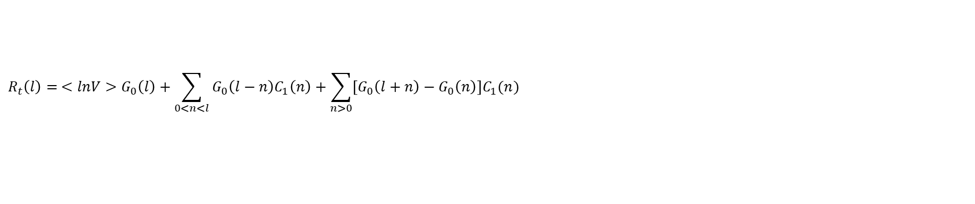
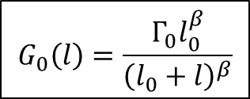
$$G_{0}\left(l\right)=\frac{Γ_{0}l_{0}^{β}}{{\left(l_{0}+l\right)}^{β}}$$
Implementation
Response function：
$$R_{t}\left(l\right)= <lnV>G_{0}\left(l\right)+\sum_{0<n<l}{G_{0}\left(l−n\right)C_{1}\left(n\right)+\sum_{n>0}{\left[G_{0}\left(l+n\right)−G_{0}\left(n\right)\right]C_{1}(n)} }$$
Price fluctuation：
$$D_{t}\left(l\right)= <\ln^{2}{V}>\left(\sum_{0≤n<l}{G_{0}^{2}\left(l−n\right)+\sum_{n>0}{{\left[G_{0}\left(l+n\right)−G_{0}\left(n\right)\right]}^{2}}}\right)+2Δ(l)+D_{η}l$$

Slide 14
Conclusion
The initially calculated values of the Response function no longer align well with the descriptions in the paper.
After data processing, the theoretical responses and price fluctuations calculated using the fitted beta and gamma from historical data also exhibit significant discrepancies from the actual historical data. The reason might be attributed to the significant difference in market trading volume between twenty years ago and the present.

