Slide 1
Optimal execution strategies in limit order books with general shape functions Alfonsi, Aurélien, Antje Fruth, and Alexander Schied. "Optimal execution strategies in limit order books with general shape functions." Quantitative finance 10.2 (2010): 143-157.

Slide 2
Abstract
The phenomenon of returning to the original equilibrium point after undergoing a trade.
In this generalized model, we will consider the following two distinct possibilities for modeling the resilience of the LOB after a large market order：
the exponential recovery of the number of limit orders, i.e., of the volume of the LOB (Model 1),
the exponential recovery of the bid-ask spread (Model 2).
We do not have a classical permanent price impact in our model, since
Adding classical permanent impact, which is proportional to the volume traded, would be somewhat artificial in our model.
This would not change optimal strategies as the optimization problem will be exactly the same as without permanent impact.

Slide 3







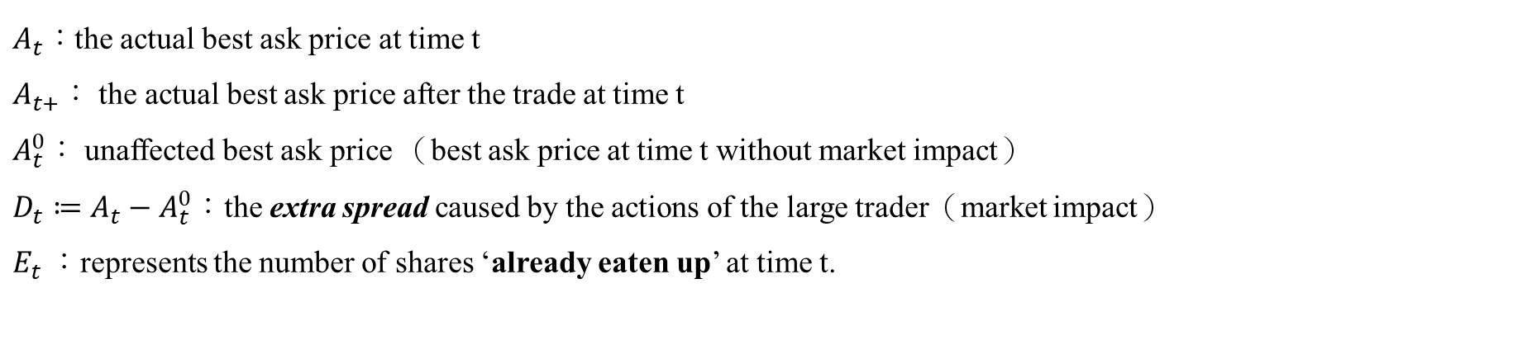








Parameters
We assume that the corresponding unaffected best ask price $A^{0}$ is a martingale on a given filtered probability space
t=1+
p
t=0+
$A_{t}：$the actual best ask price at time t
$A_{t+}：$ the actual best ask price after the trade at time t
$A_{t}^{0}：$ unaffected best ask price （best ask price at time t without market impact）
$D_{t}≔A_{t}−A_{t}^{0}$：the extra spread caused by the actions of the large trader（market impact）
$E_{t}$：represents the number of shares ‘already eaten up’ at time t.
$x_{1}$
…
Trading volume = $x_{0}$
t=2
t=1
t=0
t
f(p)
$$E_{0}=0$$
f(p)
$$E_{t_{0}+}=x_{0}$$
f(p)
f(p)
$$E_{t_{1}+}=E_{t_{1}}+x_{1}$$
f(p)
$$E_{t_{0}+}$$
$$E_{t1}$$
$$E_{t1}$$
$$x_{1}$$
$$E_{t2}$$
p
$$D_{t_{0}+}$$
p
$D_{t1}$
p
$D_{t1+}$
p
$D_{t2}$
p
t=0
t=0+
t=1
t=1+
t=2

Slide 4
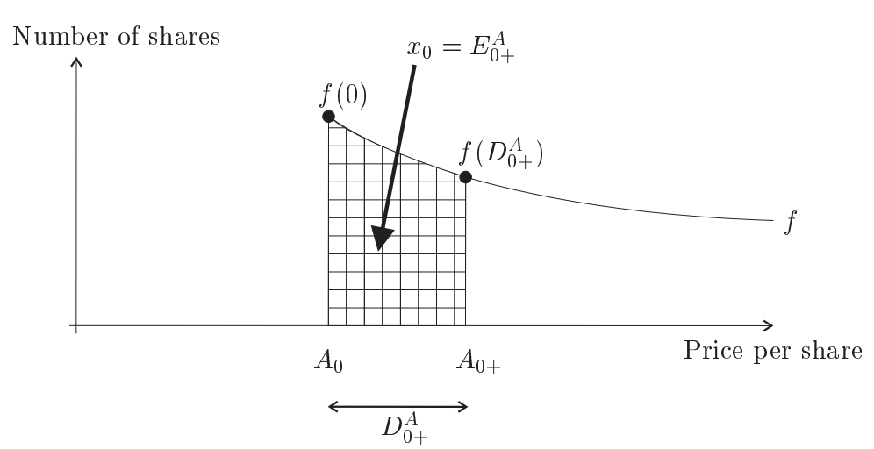
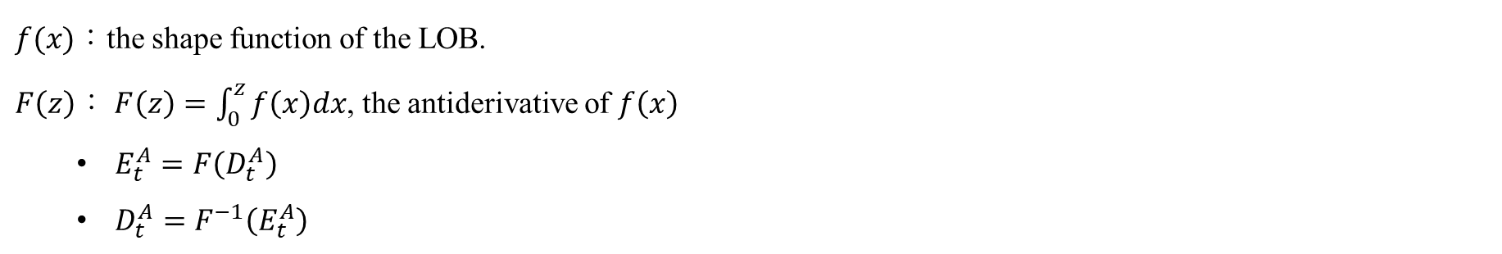
Parameters
$f(x)：$the shape function of the LOB.
$F\left(z\right)：$ $F\left(z\right)=\int_{0}^{z}{f\left(x\right)dx}$, the antiderivative of $f\left(x\right)$
$E_{t}^{A}=F\left(D_{t}^{A}\right)$
$D_{t}^{A}=F^{−1}\left(E_{t}^{A}\right)$
Incorporating the resulting market impact into function F(x) allows us to obtain the volume of large trades executed as the price increases from 0 to$D_{t}^{A}$

Slide 5
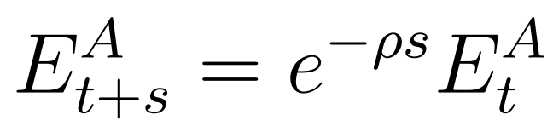
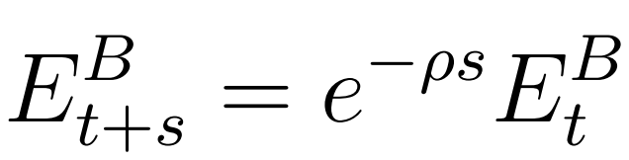
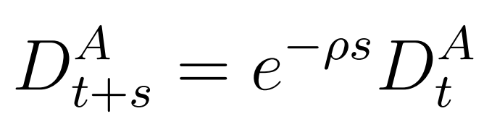
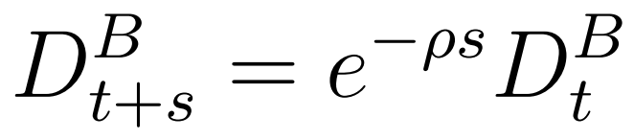
Models
It is a well established empirical fact that order books exhibit a certain resilience as to the price impact of a large buy market orders, i.e., after the initial impact the best ask price reverts back to its previous position.
For modeling this resilience, we follow Obizhaeva and Wang in proposing an exponential recovery of the LOB.
Obizhaeva, A., Wang, J.
Optimal Trading Strategy and Supply/Demand Dynamics
(Second generation)
For buy orders
For sell orders
Model 1：
The volume of the order book recovers exponentially
Model 2：
The extra spread decays exponentially

Slide 6
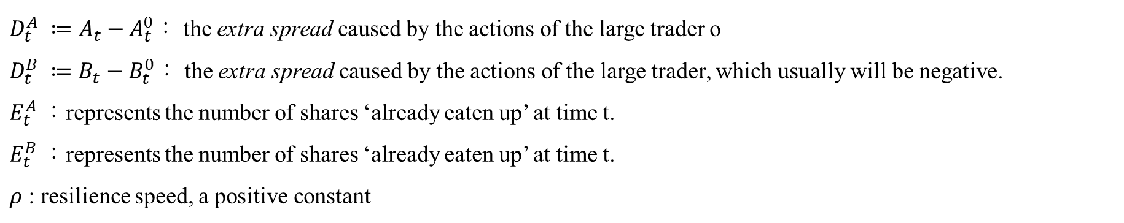
Models
If the large trader is inactive during the time interval [t, t + s]：
For buy orders
For sell orders
Model 1：
The volume of the order book recovers exponentially
Model 2：
The extra spread decays exponentially
$D_{t}^{A} ≔A_{t}−A_{t}^{0}$： the extra spread caused by the actions of the large trader o
$D_{t}^{B} ≔B_{t}−B_{t}^{0}$： the extra spread caused by the actions of the large trader, which usually will be negative.
$E_{t}^{A}$：represents the number of shares ‘already eaten up’ at time t.
$E_{t}^{B}$：represents the number of shares ‘already eaten up’ at time t.
$ρ$ : resilience speed, a positive constant

Slide 7

















t=1+
Models – model1
p
t=0+
$x_{1}$
…
f(p)
$$E_{0}=0$$
f(p)
$$E_{t_{0}+}=E_{0}+x_{0}=x_{0}$$
Trading volume = $x_{0}$
t=0
t=0+
t=1
$$x_{0}$$
t=0
t
p
$$D_{t_{0}+}$$
p
f(p)
$$E_{t_{1}}=E_{t_{0}+}∗e^{−ρτ}$$
f(p)
$$E_{t_{1}+}=E_{t_{1}}+x_{1}$$
f(p)
$$E_{t_{2}}=E_{t_{1}+}∗e^{−ρτ}$$
t=1
t=1+
t=2
$$F(D_{t1})$$
$$E_{t1}$$
$$F(D_{t2})$$
$$x_{1}$$
$$=E_{t1}$$
$$=E_{t2}$$
$D_{t1}$
p
$D_{t1+}$
p
$D_{t2}$
p

Slide 8


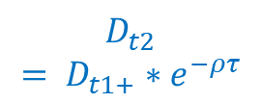
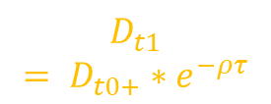

t=1+
Models – model2
p
t=0+
$x_{1}$
…
f(p)
$$E_{0}=0$$
f(p)
Trading volume = $x_{0}$
t=0
t=0+
t=1
$$x_{0}$$
t=0
t
p
$$D_{t_{0}+}$$
p
f(p)
f(p)
f(p)
t=1
t=1+
t=2
$$F(D_{t1})$$
$$E_{t1}$$
$$F(D_{t2})$$
$$x_{1}$$
$$=E_{t1}$$
$$=E_{t2}$$
$D_{t1}$
$$= D_{t0+}∗e^{−ρτ}$$
p
$D_{t1+}$
p
$D_{t2}$
$$= D_{t1+}∗e^{−ρτ}$$
p

Slide 9
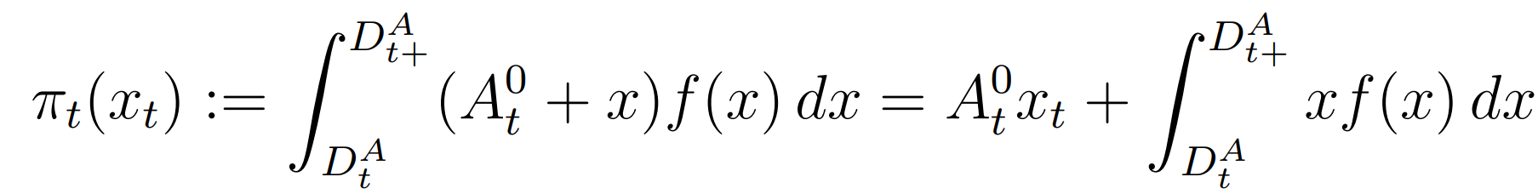
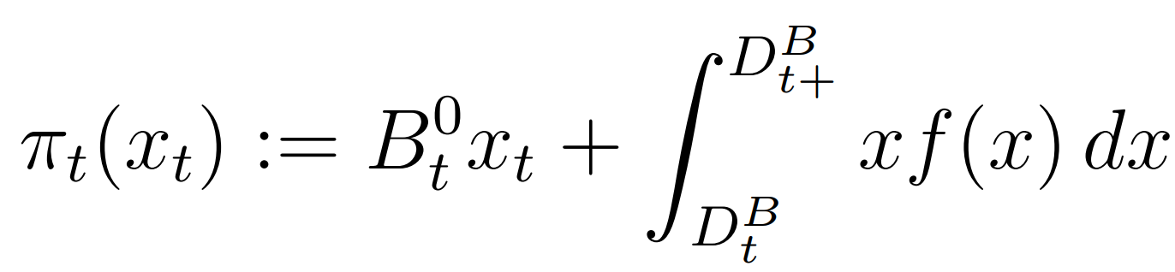

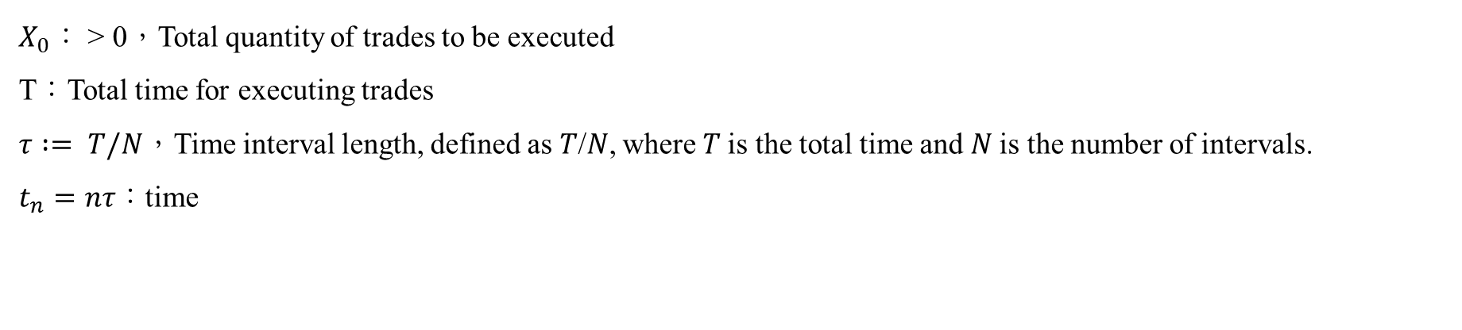
The cost minimization problem
When placing a single buy market order of size $x_{t} ≥ 0$at time t, the large trader will purchase $f(x)dx$shares at price $A_{t}^{0}+x$, with x ranging from $D_{t}^{A}$ to $D_{t+}^{A}$.
The total cost of the buy market order：
The total cost of the sell market order $x_{t} ≤ 0$：
To define the optimal strategy：
$X_{0}：$ > 0，Total quantity of trades to be executed
T：Total time for executing trades
$τ := T/N$，Time interval length, defined as 𝑇/𝑁, where 𝑇 is the total time and 𝑁 is the number of intervals.
$t_{n}=nτ：$time

Slide 10
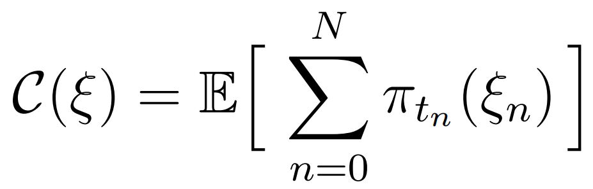

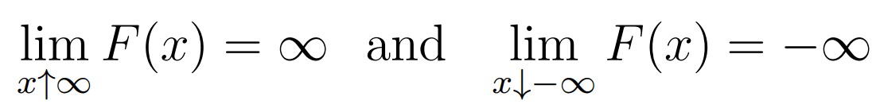
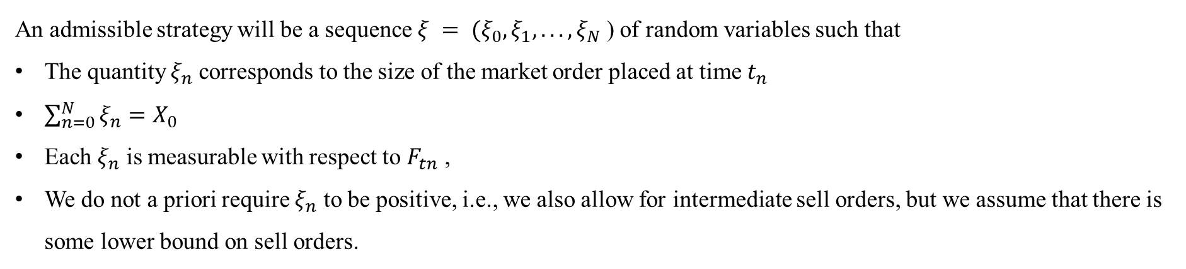
The cost minimization problem
An admissible strategy will be a sequence $ξ = (ξ_{0}, ξ_{1}, . . . , ξ_{N}$) of random variables such that
The quantity $ξ_{n}$corresponds to the size of the market order placed at time $t_{n}$
$\sum_{n=0}^{N}{ξ_{n}=X_{0}}$
Each $ξ_{n}$ is measurable with respect to $F_{tn}$ ,
We do not a priori require $ξ_{n}$ to be positive, i.e., we also allow for intermediate sell orders, but we assume that there is some lower bound on sell orders.
The total cost of the market order of $ξ_{n}$
The average cost C(ξ) =>
Note that the value of C(ξ) depends on whether we choose Model 1 or Model 2
We assume that the function F is supposed to be unbounded =>

Slide 11




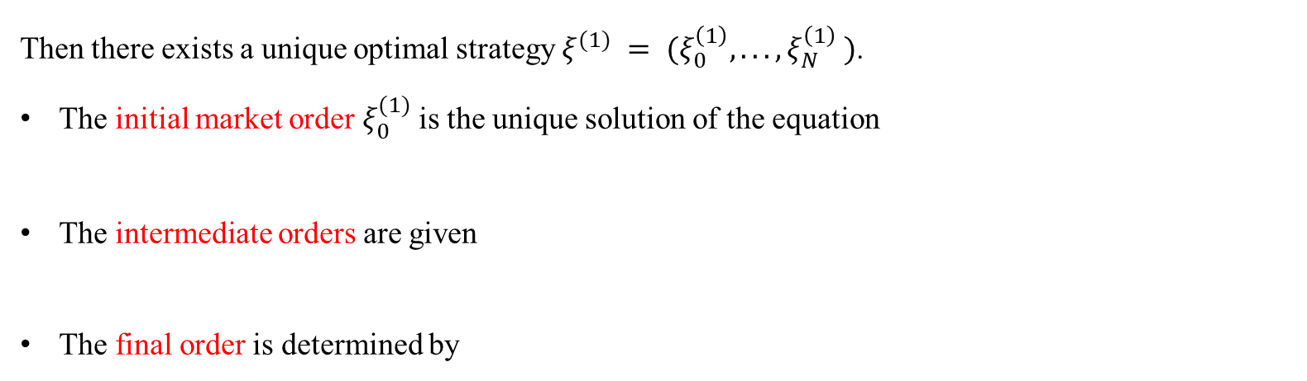
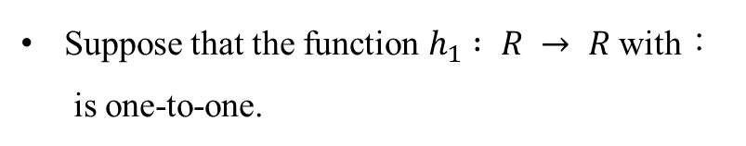
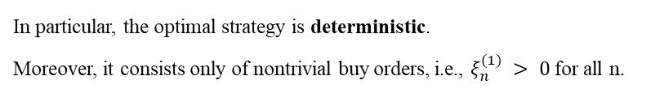
In particular, the optimal strategy is deterministic.
Moreover, it consists only of nontrivial buy orders, i.e., $ξ_{n}^{(1)} > 0$for all n.
Optimal strategy in Model 1
In Model 1, where we assume an exponential recovery of the volume of the order book .
Unaffected by market random fluctuations.
Suppose that the function $h_{1} : R → R$with：
is one-to-one.
Then there exists a unique optimal strategy $ξ^{(1)} = (ξ_{0}^{\left(1\right)}, . . . , ξ_{N}^{\left(1\right)} )$.
The initial market order $ξ_{0}^{(1)}$is the unique solution of the equation
The intermediate orders are given
The final order is determined by

Slide 12
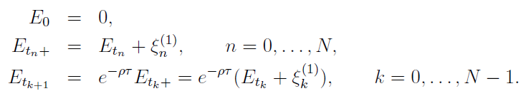


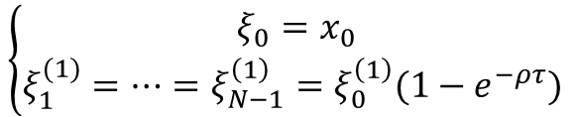










Optimal strategy in Model 1
Each trade only purchases the amount of recovery described in model 1.
Model 1 dynamics：
$$\left\{\begin{aligned}ξ_{0}=x_{0} \\ ξ_{1}^{(1)}=…=ξ_{N−1}^{\left(1\right)}=ξ_{0}^{\left(1\right)}(1−e^{−ρτ}) \end{aligned}\right.$$
By , we can get：
f(p)
f(p)
$$E_{t_{0}+}=E_{0}+x_{0}=x_{0}$$
f(p)
$$E_{t_{1}}=E_{t_{0}+}∗e^{−ρτ}$$
f(p)
$$E_{t_{1}+}=E_{t_{1}}+x_{1}$$
f(p)
$$E_{t_{2}}=E_{t_{1}+}∗e^{−ρτ}$$
$$E_{0}=0$$
…
$$x_{0}$$
$$F(D_{t1})$$
$$E_{t1}$$
$$x_{1}$$
$$F(D_{t2})$$
$$=E_{t1}$$
$$=E_{t2}$$
p
$$D_{t_{0}+}$$
p
$D_{t1}$
p
$D_{t1+}$
p
$D_{t2}$
p
t=0
t=0+
t=1
t=1+
t=2

Slide 13

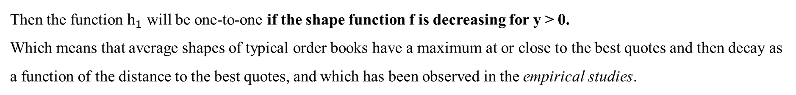

Optimal strategy in Model 1
When is $h_{1}$ one-to-one?
The function $h_{1}$is continuous with $h_{1}\left(0\right)=0$and $h_{1}\left(y\right)>0$ for $y>0$.
Hence, $h_{1}$ is one-to-one if and only if $h_{1}$ is strictly increasing.
The condition：
is equivalent to：
Then the function $h_{1}$ will be one-to-one if the shape function f is decreasing for y > 0.
Which means that average shapes of typical order books have a maximum at or close to the best quotes and then decay as a function of the distance to the best quotes, and which has been observed in the empirical studies.
Biais, B., Hillion, P., Spatt, C. An empirical analysis of the limit order book and order flow in Paris Bourse. Journal of Finance 50, 1655-1689 (1995).
Bouchaud, J. P., Gefen, Y., Potters, M. , Wyart, M. Fluctuations and response in financialmarkets: the subtle nature of ‘random’ price changes. Quantitative Finance 4, 176 (2004).
Obizhaeva, A., Wang, J. Optimal Trading Strategy and Supply/Demand Dynamics, Preprint, forthcoming in Journal of Financial Markets.

Slide 14
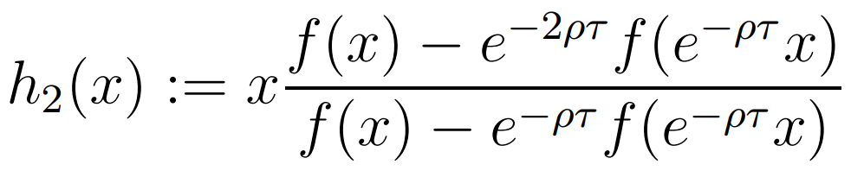


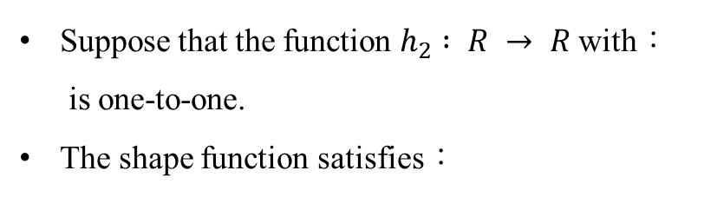

In particular, the optimal strategy is deterministic.
Moreover, it consists only of nontrivial buy orders, i.e., $ξ_{n}^{(1)} > 0$for all n.
Optimal strategy in Model 2
In Model 2, where we assume an exponential recovery of the extra spread.
Unaffected by market random fluctuations.
Suppose that the function $h_{2} : R → R$with：
is one-to-one.
The shape function satisfies：
Then there exists a unique optimal strategy $ξ^{(2)} = (ξ_{0}^{\left(2\right)}, . . . , ξ_{N}^{\left(2\right)} )$.
The initial market order $ξ_{0}^{(2)}$is the unique solution of the equation
The intermediate orders are given
The final order is determined by

Slide 15
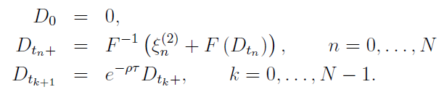

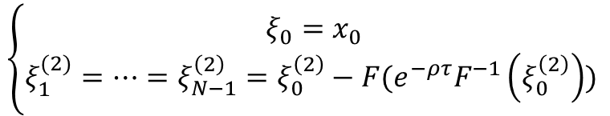

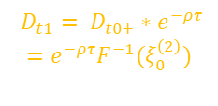

Each trade controls the extent to which the price is pushed upwards, following the price recovery amount described in model 2.
Optimal strategy in Model 2
Model 2 dynamics：
$$\left\{\begin{aligned}ξ_{0}=x_{0} \\ ξ_{1}^{(2)}=…=ξ_{N−1}^{\left(2\right)}=ξ_{0}^{\left(2\right)}−F(e^{−ρτ}F^{−1}\left(ξ_{0}^{\left(2\right)}\right)) \end{aligned}\right.$$
By , we can get：
f(p)
$$E_{0}=0$$
f(p)
$$E_{t_{0}+}=E_{0}+x_{0}=x_{0}$$
f(p)
f(p)
f(p)
…
$$x_{0}$$
$$F(D_{t1})$$
$$E_{t1}$$
$$x_{1}$$
$$F(D_{t2})$$
$$=E_{t1}$$
$$=E_{t2}$$
p
$$D_{t_{0}+}$$
p
$D_{t1}= D_{t0+}∗e^{−ρτ}$
$$=e^{−ρτ}F^{−1}(ξ_{0}^{\left(2\right)})$$
p
$D_{t1+}$
p
$D_{t2}=e^{−ρτ}D_{t1+}$
p
t=0
t=0+
t=1
t=1+
t=2

Slide 16

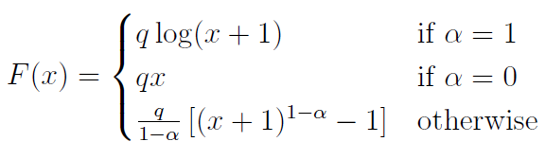
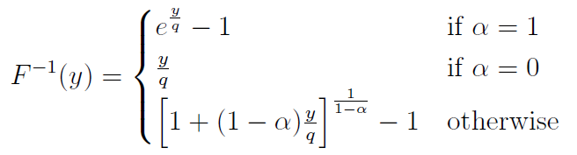
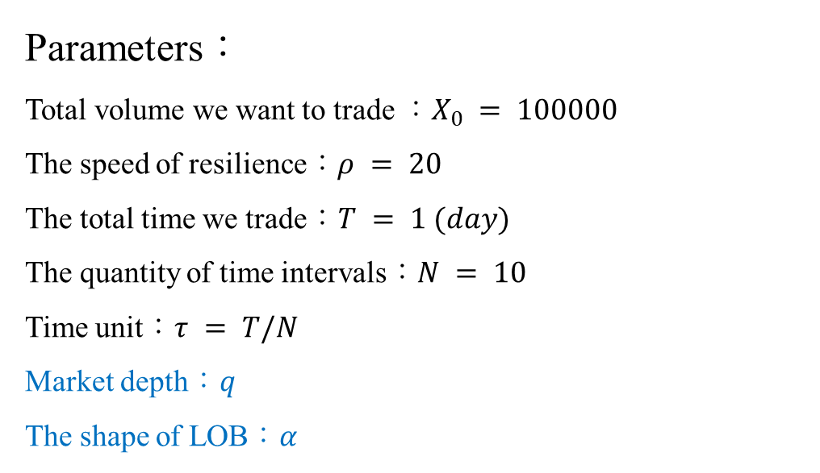
Implementation
Parameters：
Total volume we want to trade ：$X_{0} = 100000$
The speed of resilience：$ρ = 20$
The total time we trade：$T = 1 (day)$
The quantity of time intervals：$N = 10$
Time unit：$τ = T/N$
Market depth：$q$
The shape of LOB：$α$
Assume shape function：
The parameters we want to find

Slide 17
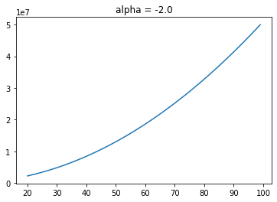
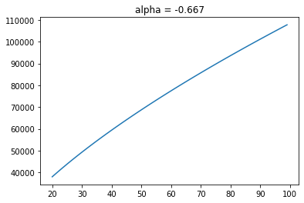
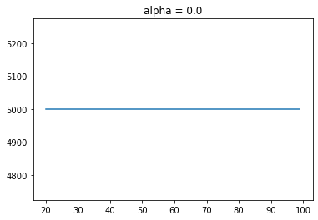
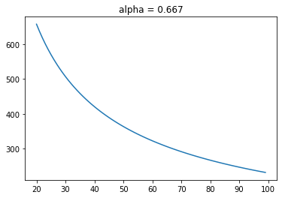
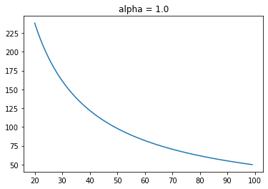
Implementation
Shape function with different $α$ (assume q = 5000)：
The block-shaped LOB we have discussed before

Slide 18
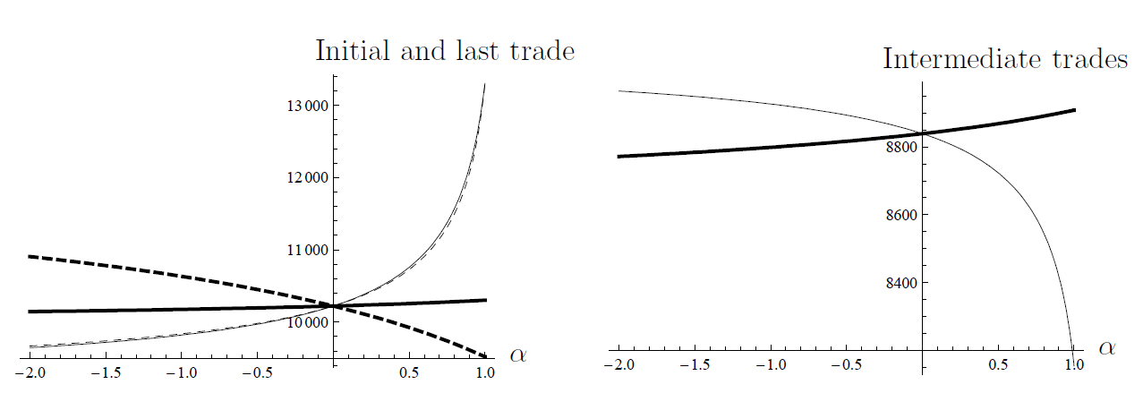

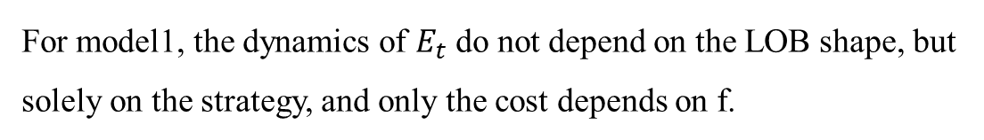
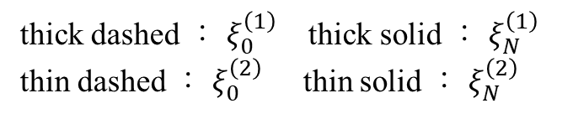
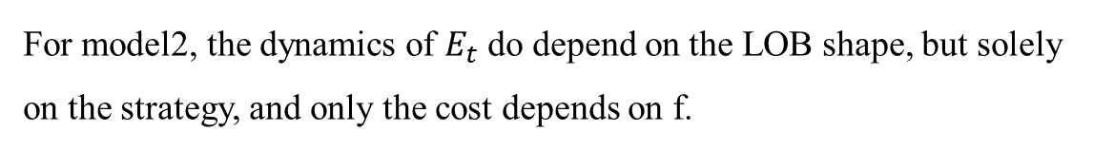
Model 1 dynamics：
Implementation－models
For model1, the dynamics of $E_{t}$ do not depend on the LOB shape, but solely on the strategy, and only the cost depends on f.
Model 2 dynamics：
For model2, the dynamics of $E_{t}$ do depend on the LOB shape, but solely on the strategy, and only the cost depends on f.
thick dashed ： $ξ_{0}^{\left(1\right)}$ thick solid ： $ξ_{N}^{\left(1\right)}$
thin dashed ： $ξ_{0}^{\left(2\right)}$ thin solid ： $ξ_{N}^{\left(2\right)}$
thick ： $ξ_{1}^{\left(1\right)}$ thin ： $ξ_{1}^{\left(2\right)}$

Slide 19
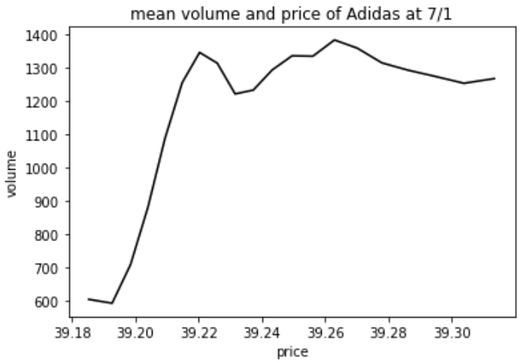
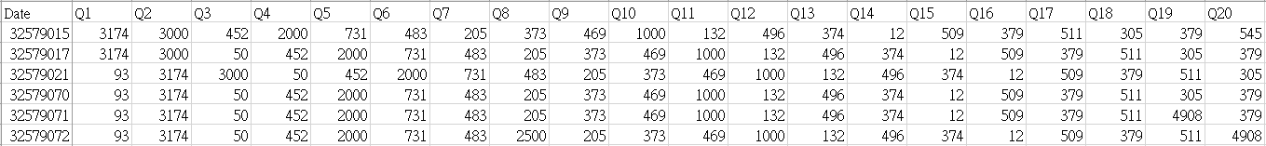
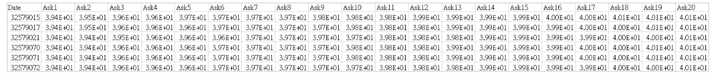
Implementation－data
Data：Adidas, 7/1
Calculate the average of all Limit Order Book (LOB) information on 7/1 and perform fitting.
Data is not publicly available.
Data is not publicly available.

Slide 20
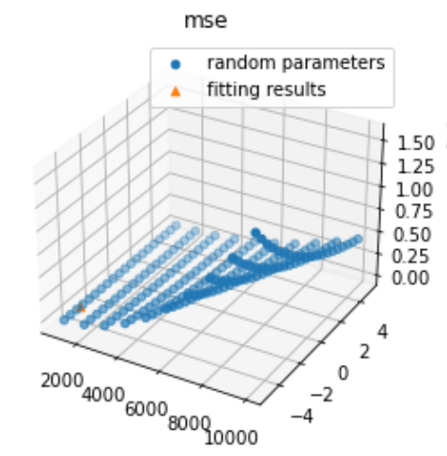
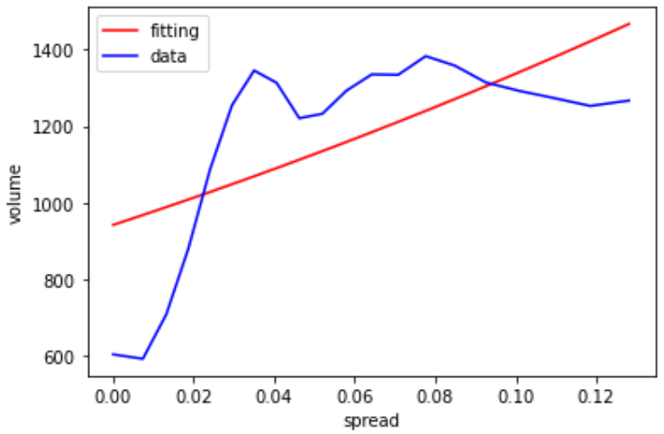
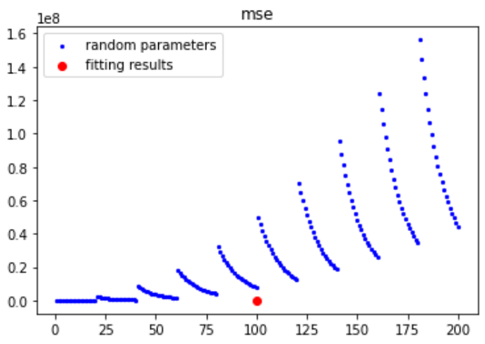
Implementation－fitting
Fitting’s result
$$q = 942.74832 α = −3.66607$$

Slide 21
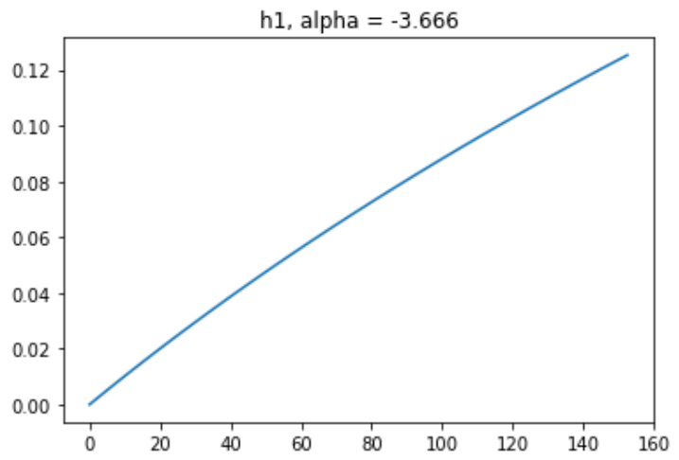
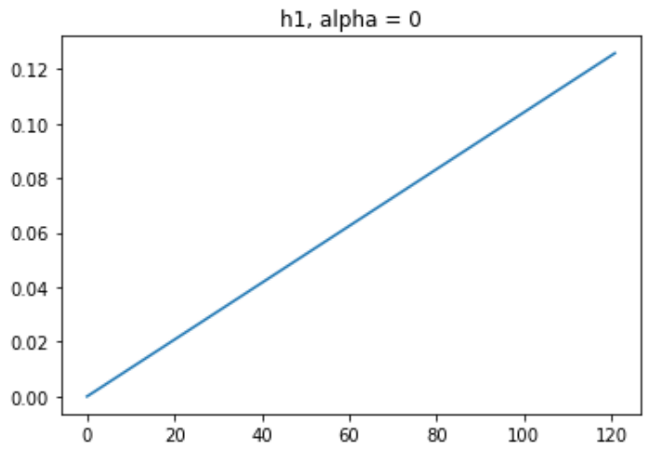
Implementation－model 1
Suppose that the function $h_{1} : R → R$with： is one-to-one.
The function $h_{1}$is continuous with $h_{1}\left(0\right)=0$and $h_{1}\left(y\right)>0$ for $y>0$.

Slide 22
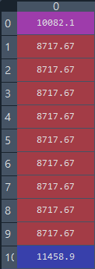
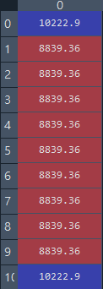
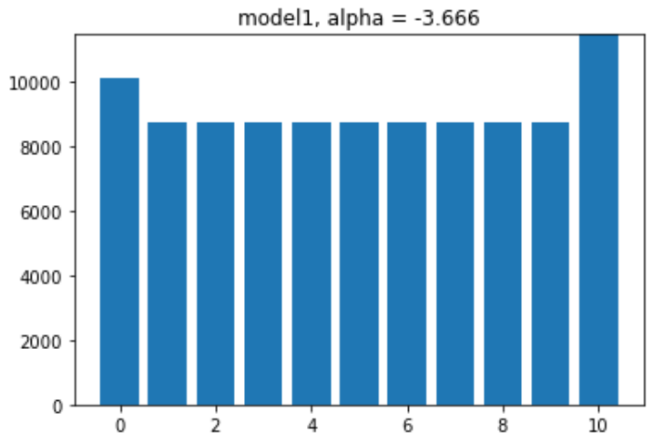

Implementation－model 1
 | Using Adidas’s LOB | Using theoretical LOB (F(X))
Cost (general shape) | 4348792.758942143 | 4348500.049862992
Cost (block-shaped) | 4409651.1618153 | 4409337.355129739

Slide 23


Implementation－model 2
Suppose that the function $h_{2} : R → R$with： is one-to-one.
The function $h_{2}$is continuous with $h_{2}\left(0\right)=0$and $h_{2}\left(y\right)>0$ for $y>0$.

Slide 24




Implementation－model 2
The cost of model 2 can only be calculated using the theoretical limit order book (LOB) here. This is because we are trying to deduce the corresponding quantity based on the spread. In the paper, a continuous function is used for simulation, allowing calculations. However, in our case, the LOB is discrete. If we try to deduce the corresponding quantity using the spread, it will result in a range of values.
 | Using theoretical LOB (F(X))
Cost (general shape) | 3999826.0740794693
Cost (block-shaped) | 4409337.355129739

Slide 25
Implementation－compare
N=10 | [Model1]Using Adidas’s LOB | [Model1]Using theoretical LOB (F(X)) | [Model2]Using theoretical LOB (F(X))
Cost (general shape) | 4348792.758942143 | 4348500.049862992 | 3999826.0740794693
Cost (block-shaped) | 4409651.1618153 | 4409337.355129739 | 4409337.355129739
N=15 | [Model1]Using Adidas’s LOB | [Model1]Using theoretical LOB (F(X)) | [Model2]Using theoretical LOB (F(X))
Cost (general shape) | 5009901.431848694 | 5009288.86171367 | 4182235.483663388
Cost (block-shaped) | 5096217.439004034 | 5095824.435807455 | 5095824.435807455
For block-shaped LOB, the optimal strategies of model 1 and model 2 have the same cost.
According to the results, higher N leads to higher cost.

Slide 26
Conclusion
Using the block-shaped limit order book (LOB) as our benchmark and comparing it with the general-shaped LOB obtained from actual LOB data, we can confirm that it performs better (lower cost).
For this implementation, we are directly using the resilience speed provided in this paper. However, we will continue to explore other feasible methods.
The strategy in this paper is built upon minimizing costs and does not take other factors into consideration (e.g., risks).
This paper assumes that the shape function is a continuous function, but real-world data is not continuous.
In our implementation, we directly use the assumed shape function from the paper. However, its explanatory power is still limited when applied to actual data.
The paper does not address how to define the time unit for fitting the shape function, which is a topic for future exploration.

