Slide 1
Reinforcement learning for optimized trade execution Nevmyvaka, Yuriy, Yi Feng, and Michael Kearns. "Reinforcement learning for optimized trade execution." Proceedings of the 23rd international conference on Machine learning. 2006.
w/ 羅名志

Slide 2
Introduction
The first large-scale empirical application of reinforcement learning to optimized trade execution.
Based on 1.5 years of millisecond time-scale limit order data from NASDAQ (from INET)
Overall, we can achieve improvement in execution of 50% or more over baseline policy (S&L).
Goal :
to SELL V shares of a given stock within a fixed time period H
maximizes the revenue received (use trading cost to measure)
Method :
Q-learning (using Q-table)

Slide 3
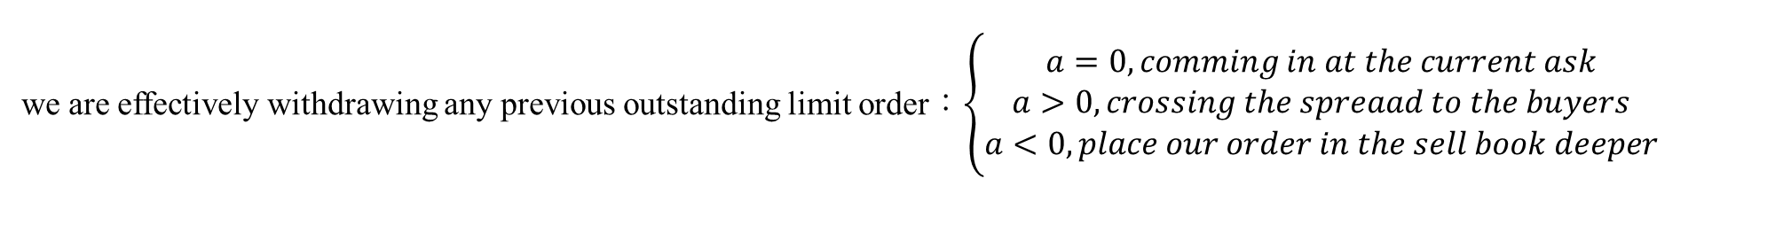
Introduction – Problems and Action
Problems
To sell V shares of a given stock in time horizon H
Baseline : submit and leave (S&L) policies pick a fixed limit order price p, and place a sell order for all V shares
After H minutes, submit a market order for remaining shares and leave
Actions
action a : place a limit order for all of our unexecuted shares at ‘ask-a’
we are effectively withdrawing any previous outstanding limit order：$\left\{\begin{aligned}a=0, comming in at the current ask \\ a>0, crossing the spreaad to the buyers \\ a<0, place our order in the sell book deeper\end{aligned}\right.$

Slide 4
Introduction – States and Rewards
States（includes private and market variables）
Private：
elapsed time : t
remaining inventory : I
Market：
Bid-Ask Spread
Bid-Ask Volume Misbalance : signed difference between volumes quoted at the bid and at the ask
Market Order Cost : how much will it cost to submit a market order for the balance of inventory immediately.
Signed Transaction Volume : the signed volume of all trades within last 15 sec
Rewards
exec price – initial mid price

Slide 5
Introduction – Algorithm
The approximately Markovian nature of trade execution :
The optimal action at any given point in time is approximately independent of any previous actions.
Example :
t = T, forced to submit a market order for all unexecuted shares
we now have all the information we need to determine the optimal action for t = T-1
having done that, we move one step t = T-2 and so on until t = 0
Having arrived at t = 0, we have a globally optimal policy
Assumption：
our actions do not affect the behavior of other market participants ( do not affect market state variables )

Slide 6
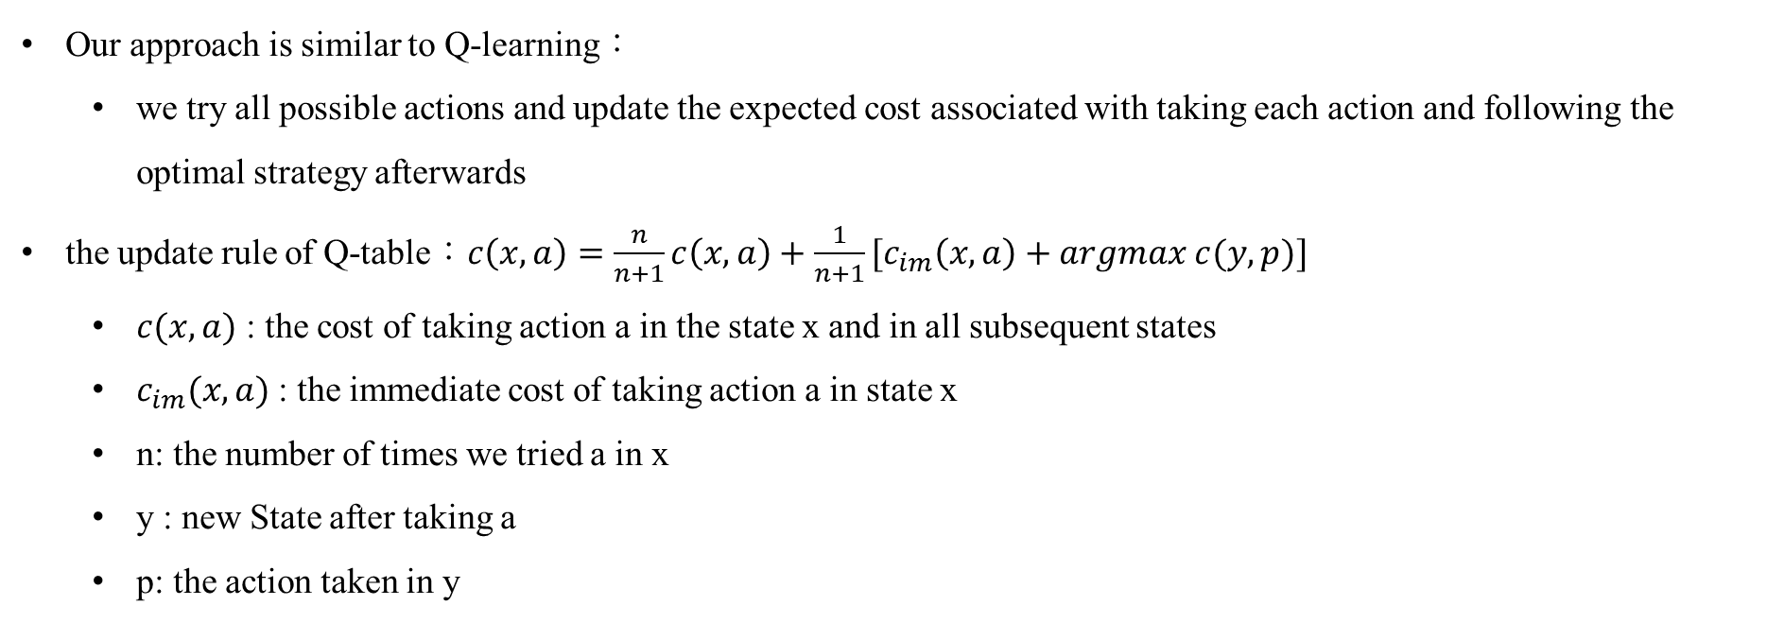
Introduction – Algorithm
Our approach is similar to Q-learning：
we try all possible actions and update the expected cost associated with taking each action and following the optimal strategy afterwards
the update rule of Q-table：$c\left(x, a\right)=\frac{n}{n+1}c\left(x, a\right)+\frac{1}{n+1}[c_{im}\left(x, a\right)+argmax c(y, p)]$
$c(x, a)$ : the cost of taking action a in the state x and in all subsequent states
$c_{im}(x, a)$: the immediate cost of taking action a in state x
n: the number of times we tried a in x
y : new State after taking a
p: the action taken in y

Slide 7
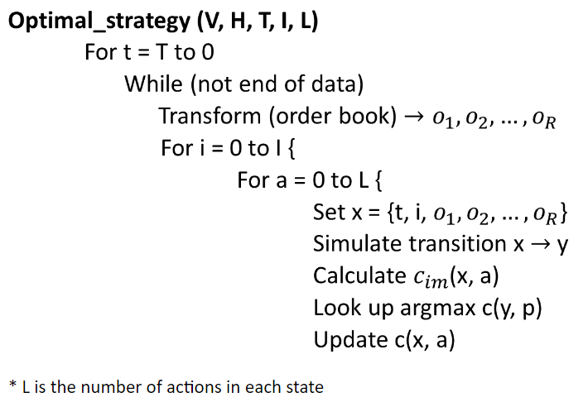
Introduction – Algorithm

Slide 8
Introduction – Experimental Methodology
Investigate 3 stocks : AMZN, NVDA, QCOM; two order sizes : V = 5000 shares / 10,000 shares; two execution horizons : H = 2 min / 8 min
Choice for the I, T was made, which are the resolutions to i, t
Market variables were selected
Apply the algorithm to learn an optimized execution policy over the chosen state space
Compare on the 6 month test set with several baseline strategies

Slide 9
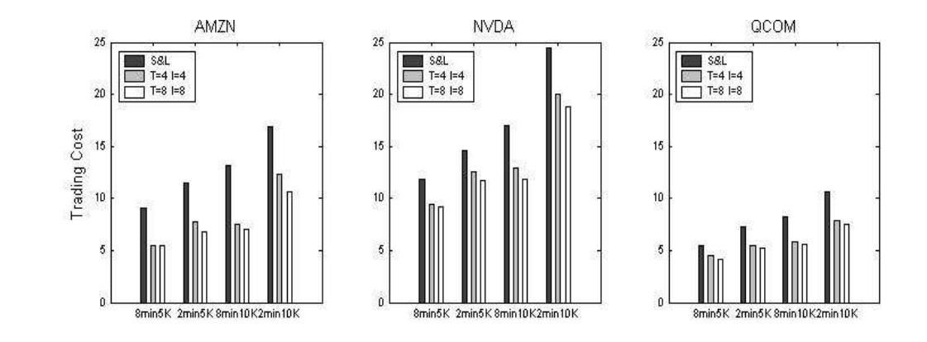
Experimental results (private var only)
T : numbers of time interval
I : numbers of inventory interval
Relative improvement over S&L ranges from 27.16% to 35.50% depending on our choices of T and I

Slide 10
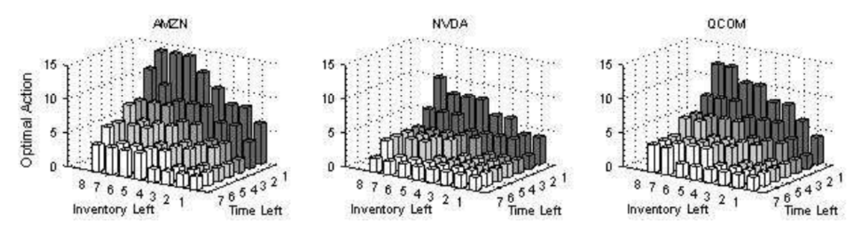
Experimental results (private var only)
* action : ask-a
Discussion and visualization of time and inventory

Slide 11
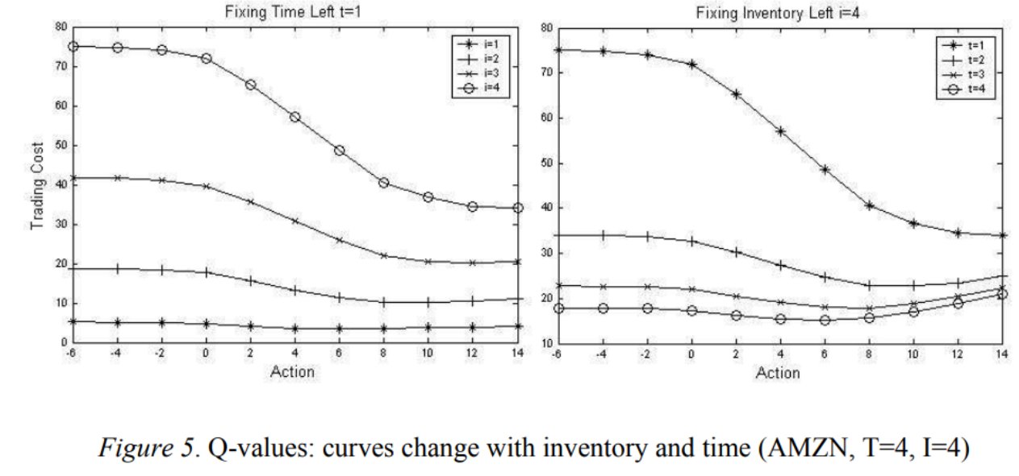
Experimental results (private var only)

Slide 12
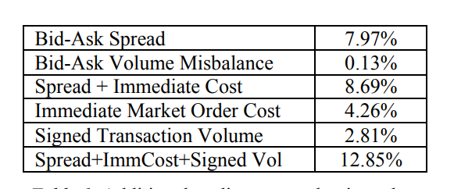
Experimental results (with market var)
Additional trading cost reduction with introducing market variables
with different combinations

Slide 13
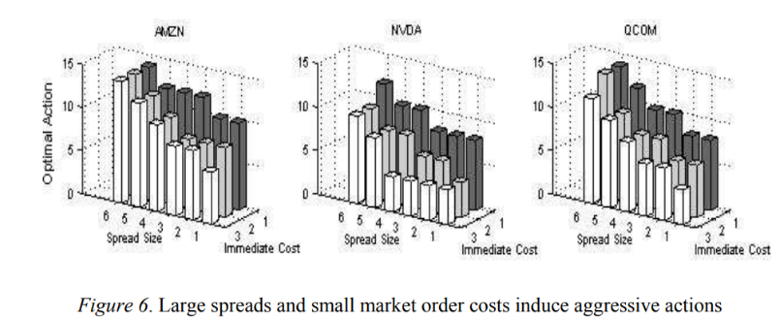
Experimental results (with market var)
* action : ask-a

Slide 14
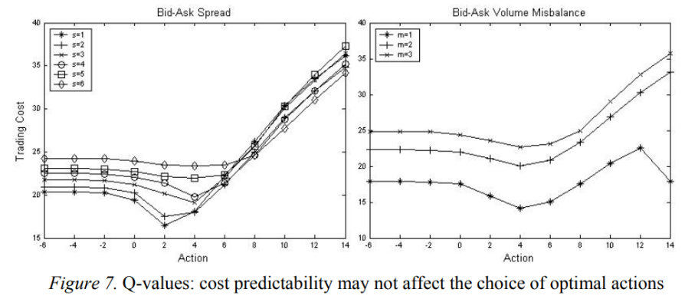
Experimental results (with market var)
some market variables do not improve the performance of our algorithm

Slide 15
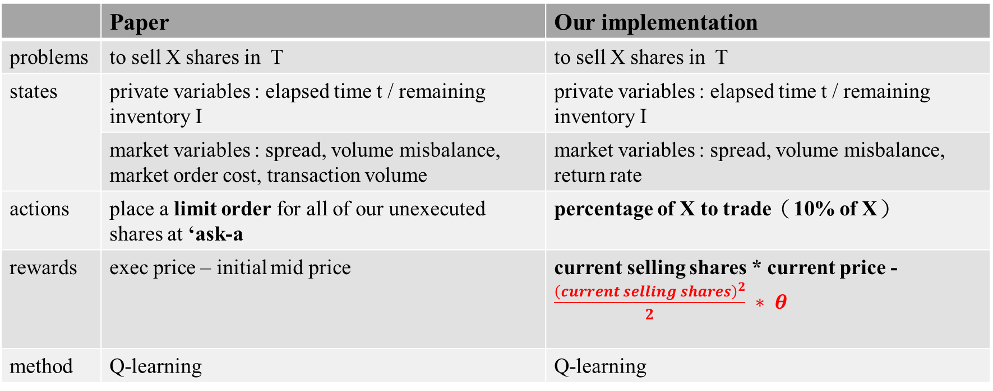
Implementation－Settings
 | Paper | Our implementation
problems | to sell X shares in T | to sell X shares in T
states | private variables : elapsed time t / remaining inventory I | private variables : elapsed time t / remaining inventory I
 | market variables : spread, volume misbalance, market order cost, transaction volume | market variables : spread, volume misbalance, return rate
actions | place a limit order for all of our unexecuted shares at ‘ask-a | percentage of X to trade（10% of X）
rewards | exec price – initial mid price | current selling shares * current price - $\frac{{\left(current selling shares\right)}^{2}}{2} ∗ θ$
method | Q-learning | Q-learning
Since the original setup in the paper requires using Limit Order Book (LOB) data, which we lack, we will need to make modifications to accommodate this limitation.

Slide 16
Implementation－Settings
T = 10 (days) ＆ X = 10000 (shares)
Data :
2914.T (Japan Tobacco Inc.)
training data : 2021 / 7 / 1 – 2022 / 2 / 28 ( 150 trading days)
testing data : 2022 / 3 / 7 – 2022 / 3 / 18 ( 10 trading days)
Overlap
Training with overlap（ex：7/1~7/10、7/2~7/11、...）
Training without overlap（ex：7/1~7/10、7/11~7/20、...）

Slide 17
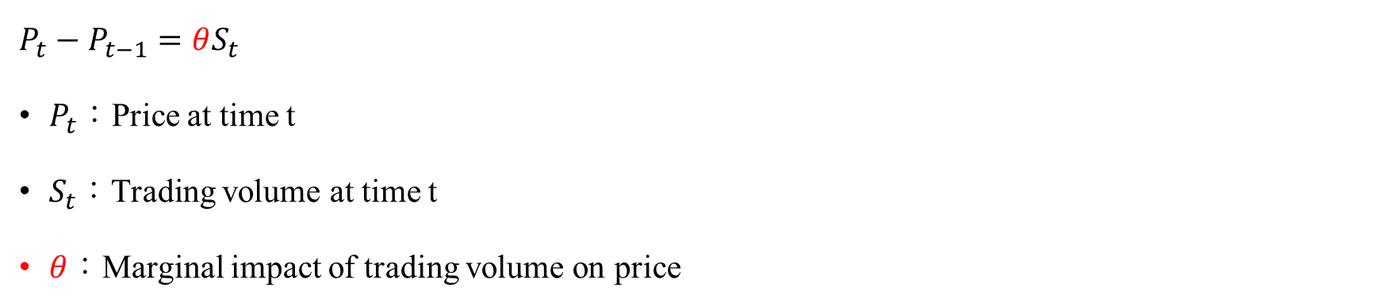



Implementation－ reward function
rewards：current selling shares * current price - $\frac{{\left(current selling shares\right)}^{2}}{2} ∗ θ$
v
p
$$v^{2}$$
$$p/v$$
$$P_{t}−P_{t−1}=θS_{t}$$
$P_{t}$：Price at time t
$S_{t}$：Trading volume at time t
$θ$：Marginal impact of trading volume on price
Total market impact
$$V∗θ$$
0
V
From BL model, first generation

Slide 18
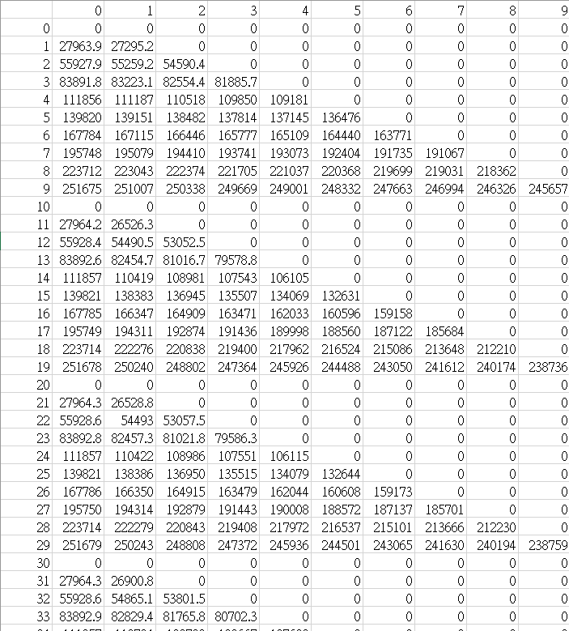
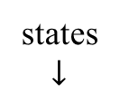

action $→$
Implementation－ Q-table
states
$$↓$$
States：0~99999
Divide the range of each variable's values in the training data into ten equal intervals.
Each digit represents the corresponding variable's interval.
Action：0~9
Trade a quantity of the smallest units(10% * V).

Slide 19
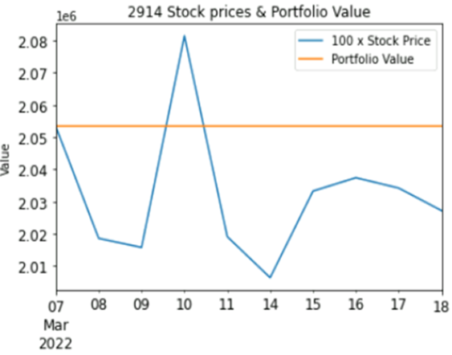
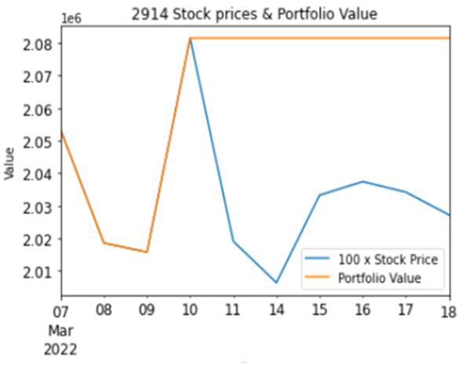
Implementation results－training
 | Training with overlap | Training without overlap
Reward with market impact
Reward without market impact

Slide 20
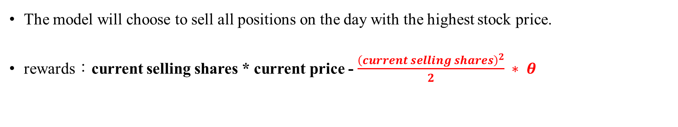
Implementation results－training
 | Training with overlap | Training without overlap
Reward with market impact
The model will choose to sell all positions on the day with the highest stock price.
rewards：current selling shares * current price - $\frac{{\left(current selling shares\right)}^{2}}{2} ∗ θ$

Slide 21
Implementation conclusion
Continuous improvement of the reward function is necessary.
Consider adjusting the trading time to be in hours as a way to enhance the reward function.

