Slide 1
An End-to-End Optimal Trade Execution Framework based on Proximal Policy Optimization Siyu Lin and Peter A. Beling, IJCAI, 2020
2023/9/15 , 羅名志

Slide 2
Outline
Introduction
Problem
Related work
Solution
Experiment
Conclusion

Slide 3
Introduction

Slide 4
Introduction
find optimal trade execution strategy
using an end-to-end adaptive framework based on PPO
input the information of Limit Order Book -> output the optimal strategy
with two different neural networks
Long short-term memory (LSTM)
Fully-connected networks (FCN)

Slide 5
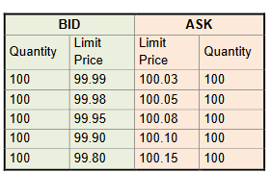
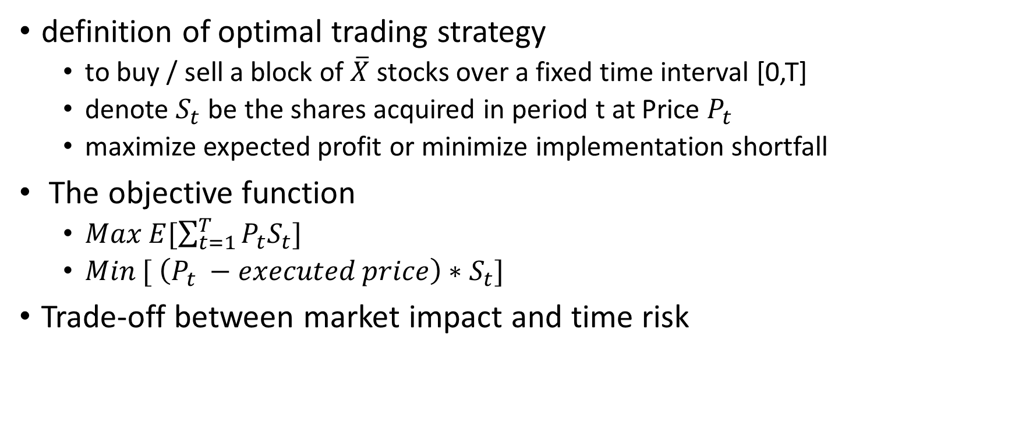


Problem
definition of optimal trading strategy
to buy / sell a block of $\overline{X}$ stocks over a fixed time interval [0,T]
denote $S_{t}$ be the shares acquired in period t at Price $P_{t}$
maximize expected profit or minimize implementation shortfall
The objective function
$Max E[\sum_{t=1}^{T}{P_{t}S_{t}}]$
$Min [ \left(P_{t} −executed price\right)∗S_{t}]$
Trade-off between market impact and time risk
t = 0
$$t=T$$
$$S_{t}$$

Slide 6
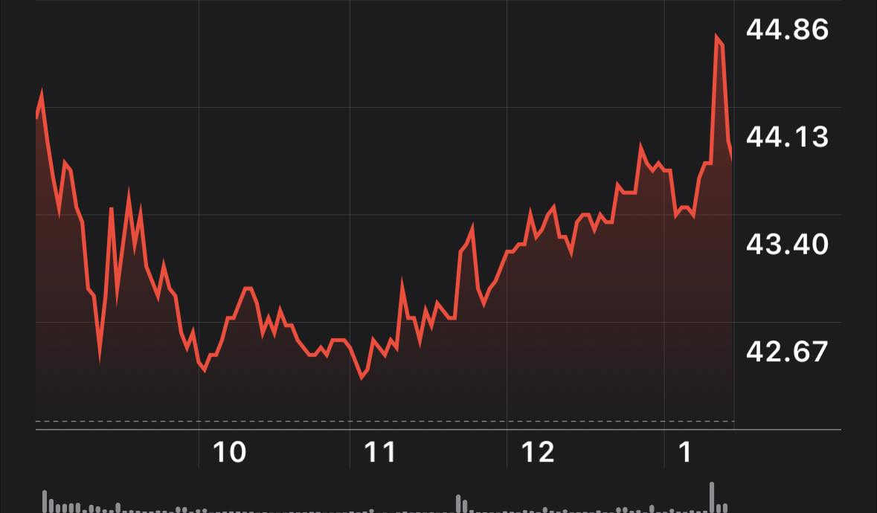
Related Work
TWAP model
VWAP model
Almgren & Chriss model
volume-weight average price
To execute the order in proportion follows the percentage of volume traded in the specified trading period
follow historical volume profile
(e.g. U-shaped pattern)
time-weight average price
trades evenly over a specified time period
ensure execution price closely matches the market price
lower market impact
dynamic programming solution
consider risk aversion
min(E(x) + λV(x))
x is our strategy
λ is risk aversion coefficient
[Bertsimas and Lo, 1998]
[Almgren and Chriss, 2000]

Slide 7
Related Work
Pure - RL solution
combined – RL solution
Deep Q-Network
combine the advice trading volumes of traditional methods with RL
hybrid framework mapping the states to the proportion of the suggested trading volumes
Q-learning
[Hendricks and Wilcox, 2014]
using RL method to interact with the market and learn from its experiences
fewer assumptions than closed-form solution (could be real-time strategy)
Q-learning (Markov Decision Process)
[Nevmyvaka et al., 2006]
using DQN
address high dimensions and sparse Q-table problem
[Lin and Beling, 2019]

Slide 8
Related Work
Problems of previous research
lots of manually designed attributes
require domain knowledge and complicated feature engineering
on most of the paper using RL methods, they use Implementation shortfall as reward function
difficult to tuning its parameters and risk of overfitting
the number of data in LOB is immense and time-dependent
calculation is quite time-consuming
lack of comprehensive pairs of state and action (s,a)

Slide 9
Solution

Slide 10
Solutions
propose an end-to-end optimal trade execution
only need LOB data
using shaped reward function and demonstrate the advantages over IS
using PPO with two different neural network architecture
PPO + LSTM
PPO + FCN

Slide 11
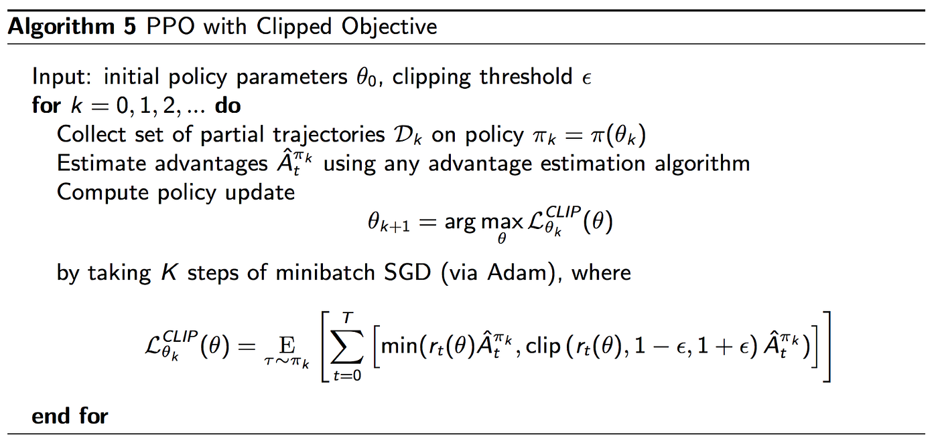
PPO algorithm
on-policy algorithm
applies to both discrete and continuous action spaces

Slide 12
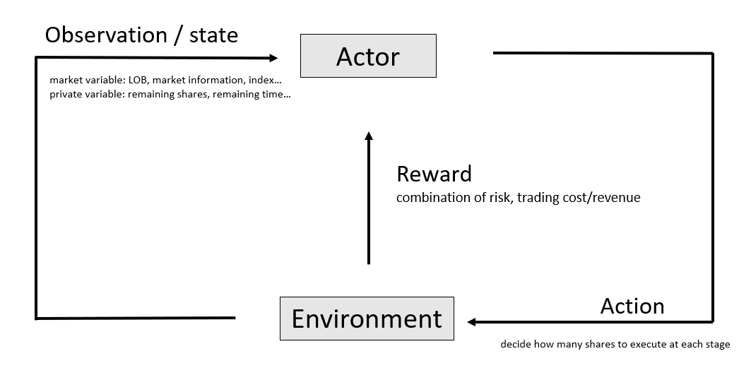
From policy gradient to PPO
π*
actor (policy network) : a function of observation
input : observation / output : action
find a function that maximize reward

Slide 13
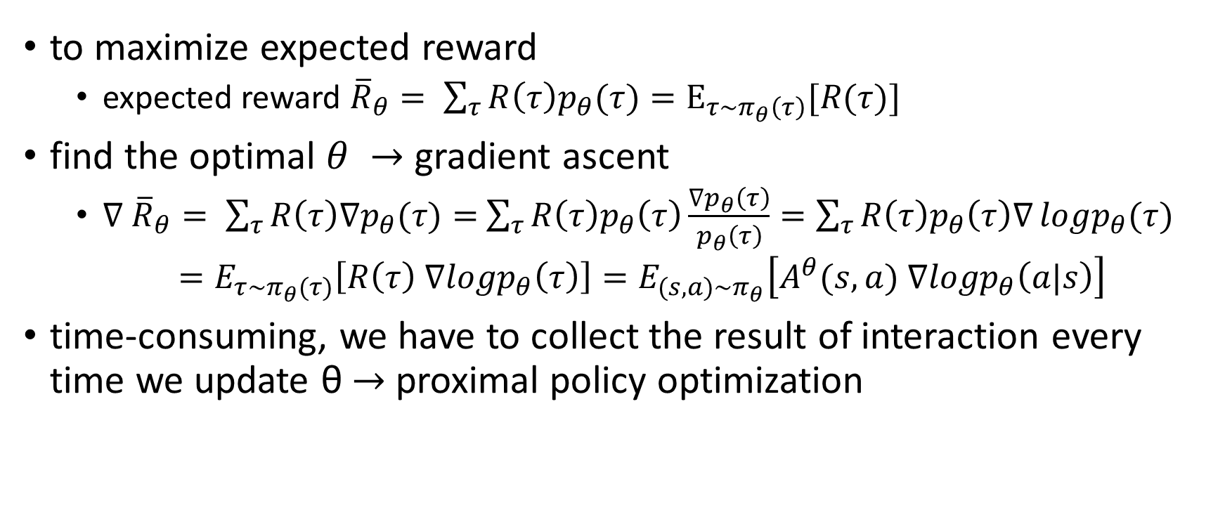
policy gradient
to maximize expected reward
expected reward ${\overline{R}}_{θ}= \sum_{τ}{R\left(τ\right)p_{θ}(τ)}=E_{τ\sim π_{θ}\left(τ\right)}[R(τ)]$
find the optimal $θ →$ gradient ascent
$∇$ ${\overline{R}}_{θ}= \sum_{τ}{R\left(τ\right){∇p}_{θ}(τ)}=$ $\sum_{τ}{R\left(τ\right)p_{θ}\left(τ\right)\frac{{∇p}_{θ}\left(τ\right)}{p_{θ}\left(τ\right)}}=\sum_{τ}{R\left(τ\right)p_{θ}\left(τ\right)∇}logp_{θ}(τ)$
$=E_{τ\sim π_{θ}(τ)}\left[R\left(τ\right) ∇logp_{θ}\left(τ\right)\right]=E_{(s,a)\sim π_{θ}}\left[A^{θ}(s,a) ∇logp_{θ}\left(a|s\right)\right]$
time-consuming, we have to collect the result of interaction every time we update θ $→$ proximal policy optimization

Slide 14
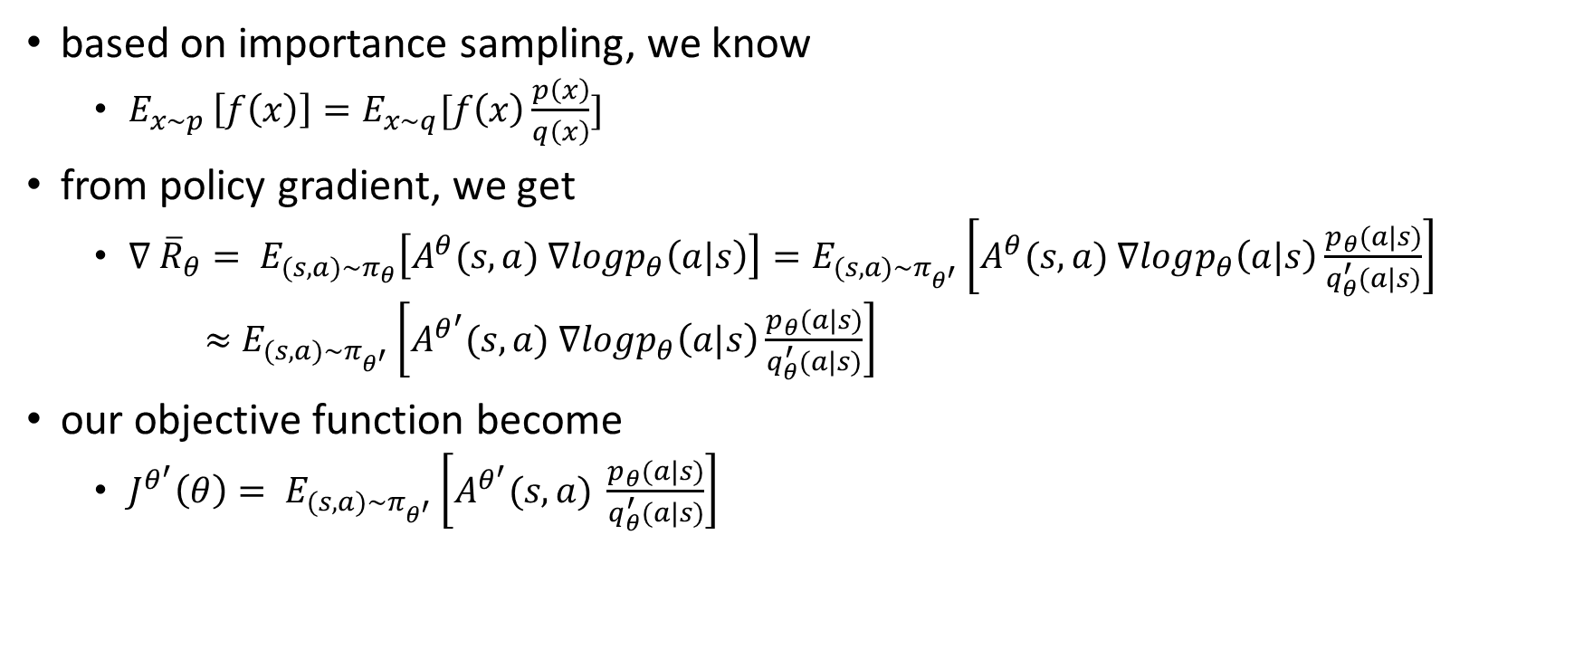
PPO
based on importance sampling, we know
$E_{x\sim p }\left[f\left(x\right)\right]=E_{x\sim q}[f\left(x\right)\frac{p\left(x\right)}{q\left(x\right)}]$
from policy gradient, we get
$∇$ ${\overline{R}}_{θ}= E_{(s,a)\sim π_{θ}}\left[A^{θ}(s,a) ∇logp_{θ}\left(a|s\right)\right]=E_{(s,a)\sim π_{θ^{′}}}\left[A^{θ}(s,a) ∇logp_{θ}\left(a|s\right)\frac{p_{θ}(a|s)}{q_{θ}^{′}(a|s)}\right]$
$≈$ $E_{(s,a)\sim π_{θ^{′}}}\left[A^{θ^{′}}(s,a) ∇logp_{θ}\left(a|s\right)\frac{p_{θ}(a|s)}{q_{θ}^{′}(a|s)}\right]$
our objective function become
${J^{θ^{′}}\left(θ\right)= E}_{(s,a)\sim π_{θ^{′}}}\left[A^{θ^{′}}(s,a) \frac{p_{θ}(a|s)}{q_{θ}^{′}(a|s)}\right]$

Slide 15
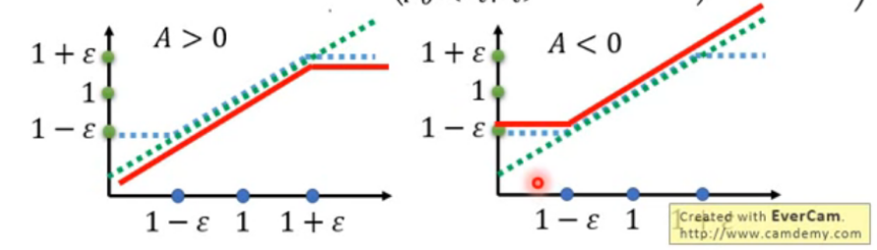
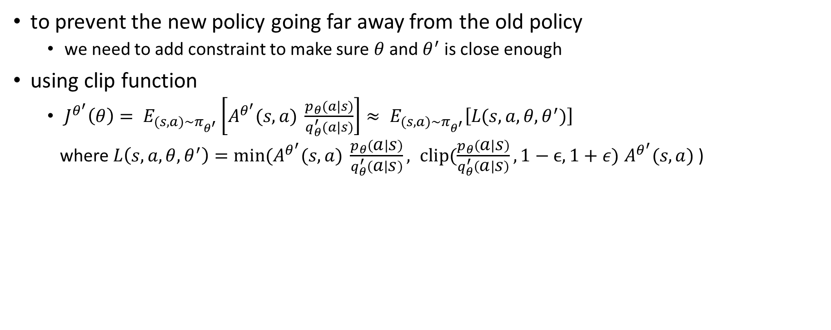
PPO
to prevent the new policy going far away from the old policy
we need to add constraint to make sure $θ$ and $θ^{′}$ is close enough
using clip function
${{J^{θ^{′}}\left(θ\right)= E}_{(s,a)\sim π_{θ^{′}}}\left[A^{θ^{′}}(s,a) \frac{p_{θ}(a|s)}{q_{θ}^{′}(a|s)}\right]≈ E}_{(s,a)\sim π_{θ^{′}}}\left[L(s,a, θ, θ^{′})\right]$
where $L\left(s,a, θ, θ^{′}\right)=min(A^{θ^{′}}(s,a) \frac{p_{θ}\left(a | s\right)}{q_{θ}^{′}\left(a | s\right)}, clip(\frac{p_{θ}\left(a | s\right)}{q_{θ}^{′}\left(a | s\right)},1−ϵ, 1+ε)$ $A^{θ^{′}}(s,a)$)

Slide 16
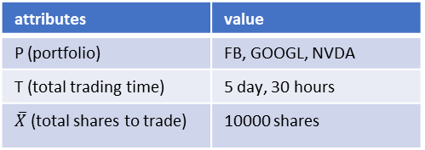
States
discard inefficient and time-consuming states in real-world applications
divide the states into 2 parts : public state / private state
Public State
LOB data (market data)
top 5 bid/ask prices
associated volumes
Private State
info of investor itself
remaining inventory
elapsed time
+
attributes | value
P (portfolio) | FB, GOOGL, NVDA
T (total trading time) | 5 day, 30 hours
$\overline{X}$ (total shares to trade) | 10000 shares

Slide 17

Actions
$TWAP=\frac{Total \# of shares to trade}{Total \# of periods}$
action space = {0, 2 TWAP}
assume we want to buy FB 300 shares in 10 periods
action range : 0(conservative) $\sim$ 60(aggressive)

Slide 18
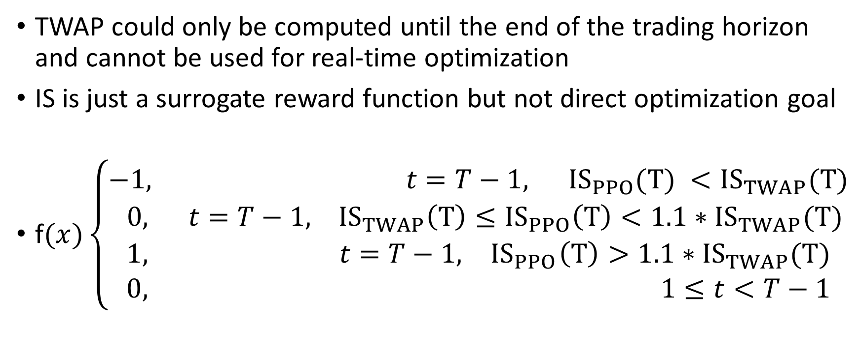
Rewards
TWAP could only be computed until the end of the trading horizon and cannot be used for real-time optimization
IS is just a surrogate reward function but not direct optimization goal
f$(x)\left\{\begin{aligned}\begin{aligned}−1, t=T−1, {IS}_{PPO}(T) <{IS}_{TWAP}(T) \\ 0, t=T−1, {IS}_{TWAP}\left(T\right)≤{IS}_{PPO}\left(T\right)<1.1∗{IS}_{TWAP}(T) \\ 1, t=T−1, { IS}_{PPO}\left(T\right)>1.1∗{IS}_{TWAP}(T)\end{aligned} \\ 0, 1≤t<T−1\end{aligned}\right.$

Slide 19
Assumptions
takes only a temporary impact, and the market is completely resilient
ignore commissions and exchange fees
apply quadratic penalty when our trading volume exceeds top 5 bids
remaining unexecuted volumes will be liquidated all at once at the last time step
assume direct and fast access to exchanges with no order arrival delays

Slide 20
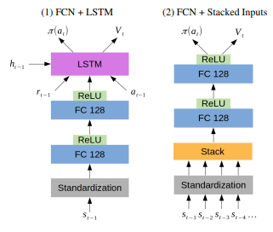
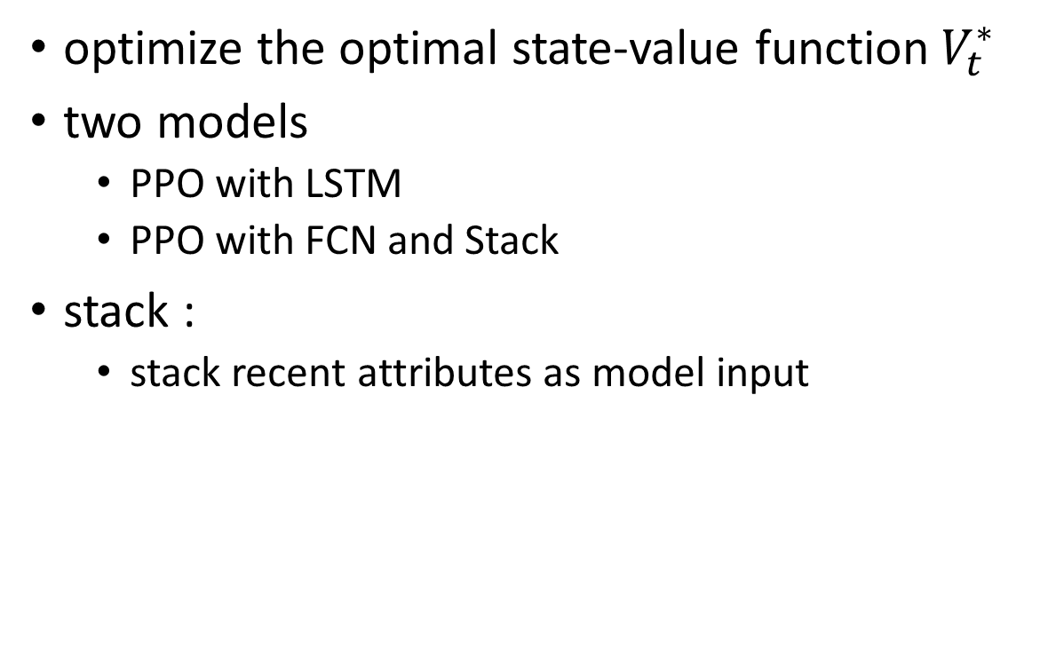
The PPO architecture
optimize the optimal state-value function${ V}_{t}^{∗}$
two models
PPO with LSTM
PPO with FCN and Stack
stack :
stack recent attributes as model input

Slide 21
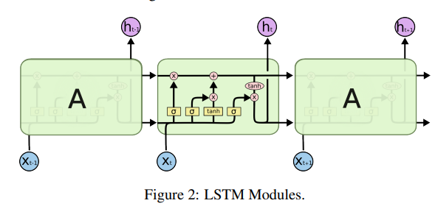
The PPO architecture
Why LSTM?
allow to store past information and identify temporal patterns
suitable for sequential data
resolve the problem of gradient vanishing / exploding from RNN

Slide 22
Experiment

Slide 23
Experimental methodology
apply the proposed PPO algorithms on 14 stocks
FB, GOOG, TSLA, MCD, WMT…
tune the hyperparameters on FB data only and apply the same neural network to the remaining stocks due to limited computing resources
obtain one-year millisecond LOB data of 14 stocks
split the data into training (9 months) and testing (3 months)
execution horizon: 1 minute
compare the results with : TWAP, VWAP, AC models, several DRL models, and our baseline model is TWAP

Slide 24
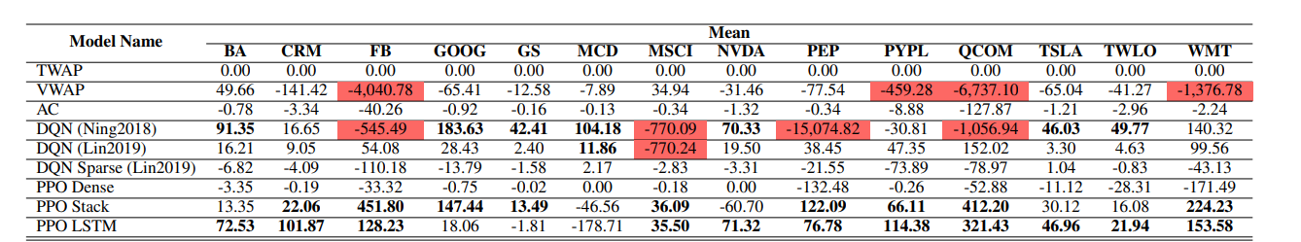

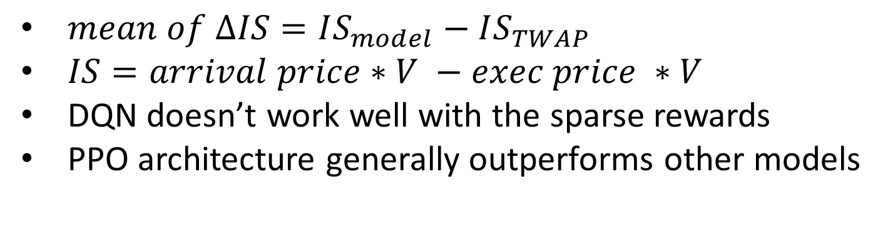
Results
$mean of ∆IS=IS_{model}−IS_{TWAP}$
$IS=arrival price∗V −exec price ∗V$
DQN doesn’t work well with the sparse rewards
PPO architecture generally outperforms other models

Slide 25
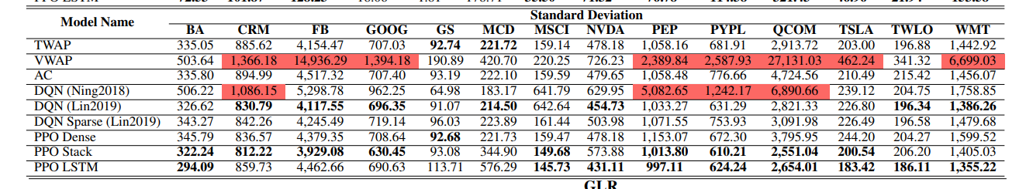
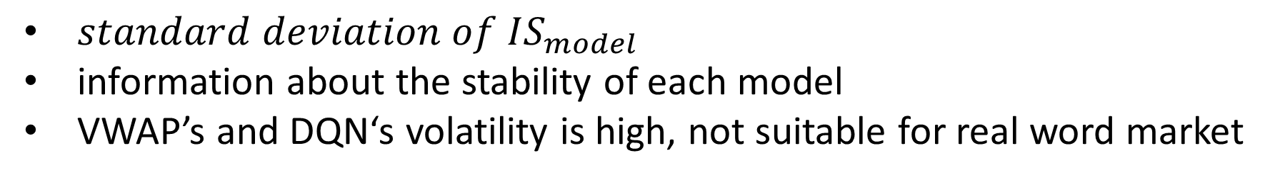
Results
$standard deviation of IS_{model}$
information about the stability of each model
VWAP’s and DQN‘s volatility is high, not suitable for real word market

Slide 26
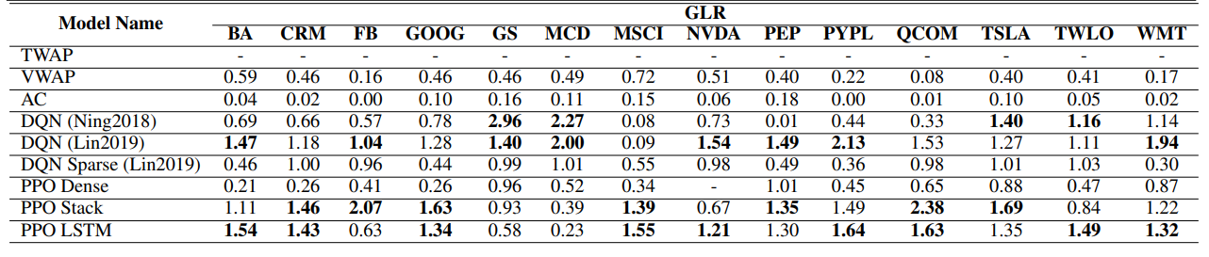
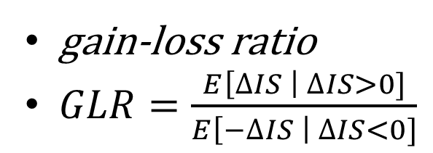
Results
gain-loss ratio
$GLR=\frac{E\left[∆IS \right| ∆IS>0]}{E\left[−∆IS \right| ∆IS<0]}$

Slide 27
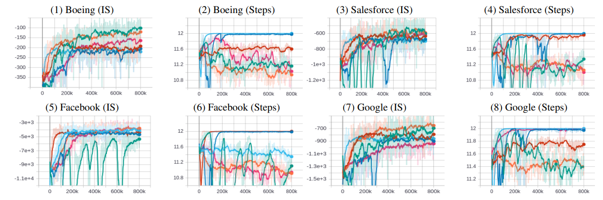

Slide 28
Conclusion
an end-to-end optimal trade execution framework based on PPO
able to outperform traditional strategies and several DRL methods
prove the strategy works even with sparse rewards and data without feature engineering

Slide 29
Future work
relax some of the assumptions
model the interactions of multiple DRL agents and their collective decisions in the market
only fine-tuned the parameters on FB only
finding a more general way to define these parameters

Slide 30
Q&A

