Slide 1
Optimal Trading Strategy and Supply/Demand Dynamics
Obizhaeva & Wang (2005)
郭盈均

Slide 2
Outline
Introduction
Statement of problem
Limit Order Book and Supply/Demand Dynamics
Discrete-Time Solution — fixed trading times
Implementation

Slide 3
Statement of the problem
How a trader optimally executes a large order?
We assume that the trader chooses his execution strategy to minimize the expected total cost of his purchase.
Notes:
本篇文章一直圍繞著一個核心問題，也就是trader要怎麼去執行一個大單交易，並且希望可以找到一個執行策略是在最小化它的購買成本下，完成購買大單交易。

Slide 4
The solution to the trader’s optimal execution strategy
The solution to the trader’s optimal execution strategy crucially depends on how his trades impact the prices.
It changes the security’s current supply/demand
A change in current supply/demand can lead to evolutions in futures supply/demand, which will affect the costs of supply/demand in response to a trade.
本篇考慮交易對於股票供需的動態變化
Notes:
最佳交易的策略取決於trader如何進行交易，甚麼時間點買多少的量，因為交易行為會影響供需的變化以及價格的變化
1.它會影響目前的供需變化
2.目前供需的變化也可能會改變未來的供需，進而影響到我們的total cost
本篇paper跟前面幾篇最大的不同，就是它有考慮交易對於供需的動態變化

Slide 5

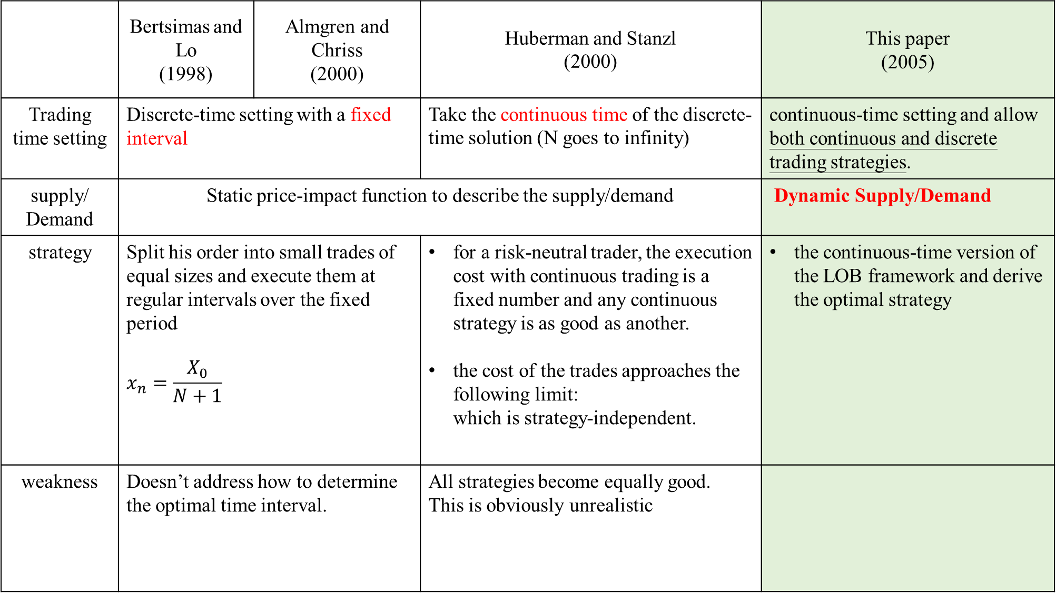
 | Bertsimas and Lo (1998) | Almgren and Chriss (2000) | Huberman and Stanzl (2000) | This paper (2005)
Trading time setting | Discrete-time setting with a fixed interval |  | Take the continuous time of the discrete-time solution (N goes to infinity) | continuous-time setting and allow both continuous and discrete trading strategies.
supply/ Demand | Static price-impact function to describe the supply/demand |  |  | Dynamic Supply/Demand
strategy | Split his order into small trades of equal sizes and execute them at regular intervals over the fixed period $$x_{n}=\frac{X_{0}}{N+1}$$ |  | for a risk-neutral trader, the execution cost with continuous trading is a fixed number and any continuous strategy is as good as another. the cost of the trades approaches the following limit: which is strategy-independent. | the continuous-time version of the LOB framework and derive the optimal strategy
weakness | Doesn’t address how to determine the optimal time interval. |  | All strategies become equally good. This is obviously unrealistic
Notes:
在本篇paper文獻回顧的部分，我們在這邊利用表格的方式，簡單回顧一下過去paper的做法，並且看一下這篇paper的觀點
前兩篇是固定的時間interval進行交易，所以在指定時間內交易次數是固定的。
那第三第四篇，就是在指定期間內有無限的交易次數，他想去模擬連續時間不斷交易的情況
施加固定交易成本以排除任何連續交易策略

Slide 6
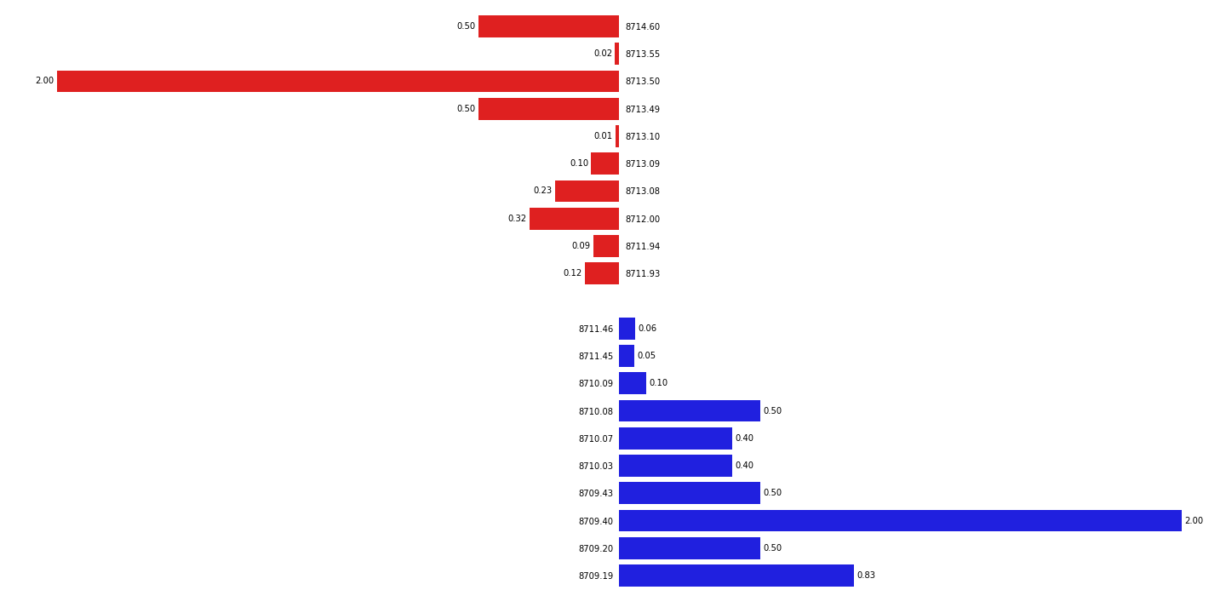



Limit Order Book and Supply/Demand Dynamics
Limit Order Book(限價委託簿)
The collection of all limit orders posted can be viewed as the total demand and supply in the market, and the order book consists of a price and a quantity
best ask : A
mid price : V = (best ask price + best bid price)/2
best bid : B
$$A=V+\frac{s}{2}$$
B$=V−\frac{s}{2}$
Notes:
為了瞭解交易對股票的供需造成甚麼影響，這篇paper利用LOB和一張價格的動態變化圖解釋，首先是LOB的部分

Slide 7

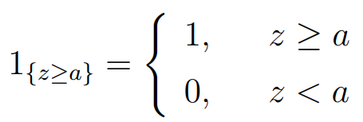
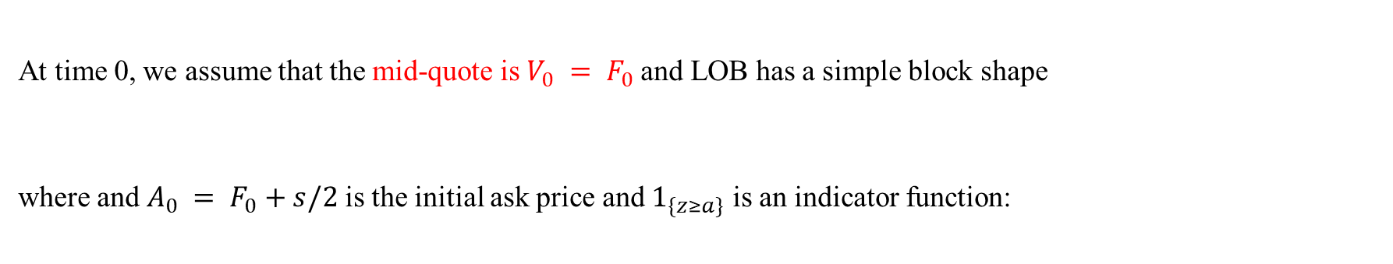
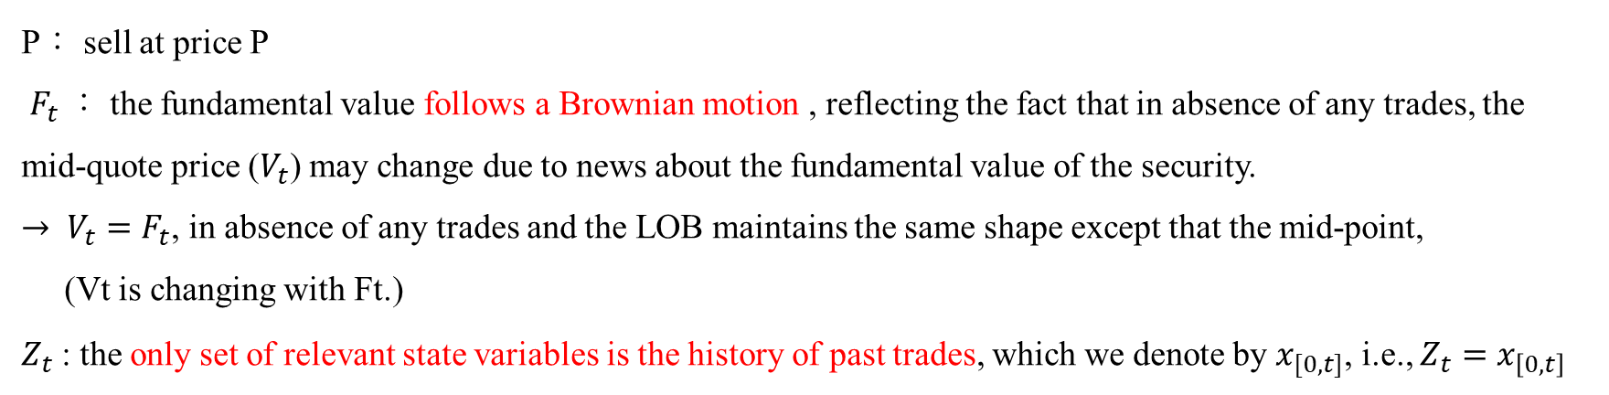
Because we are considering the execution of a large buy order, we will focus on the upper half of the LOB.
Let the LOB (the upper half of it) at time t be $q_{A}(P;F_{t};Z_{t};t)$
Let q_{A}(P) be the density of limit orders to sell at price P
Some assumptions
P： sell at price P
$F_{t}$： the fundamental value follows a Brownian motion , reflecting the fact that in absence of any trades, the mid-quote price ($V_{t}$) may change due to news about the fundamental value of the security.
$→ V_{t}=$ $F_{t}$, in absence of any trades and the LOB maintains the same shape except that the mid-point,
(Vt is changing with Ft.)
$Z_{t}$: the only set of relevant state variables is the history of past trades, which we denote by $x_{[0,t]}$, i.e., $Z_{t}=x_{\left[0,t\right]}$
At time 0, we assume that the mid-quote is $V_{0} = F_{0}$and LOB has a simple block shape
where and $A_{0} = F_{0}+s/2$is the initial ask price and $1_{\{z≥a\}}$ is an indicator function:
Notes:
Ft -> fundamental value是真實價格，跟隨著隨機運動，而且如果在現在要探討的這筆交易前面都沒有發生任何交易，則mid quote price會等於fundemental value，
Vt：若有發生交易，每一筆交易帶來的market impact，市場價格會偏離真實價格
Zt 則提到會影響到目前LOB變數組合只有過去發生的交易，
LOB的呈現方式，在這邊我們都假設在T=0，也就是還沒有發生任何一筆交易，則V0會等於F0，也就是MID QUOTE PRICE會等於FUNDEMENTAL VALUE，然後委託部的呈現方式則是由q乘上一個指標函數，這邊的意思是，只要這個P大於the best ask price A，這個指標函數就會是1，會出現在委託簿上面，量則會是Q乘上1，相反來說，如果我們現在要討論的價格，是小於目前的THE BEST ASK PRICE A的話，就會乘上指標函數0，代表這個價格，對於我們只討論的委託簿的上半部來說，是不存在的

Slide 8
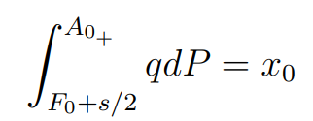
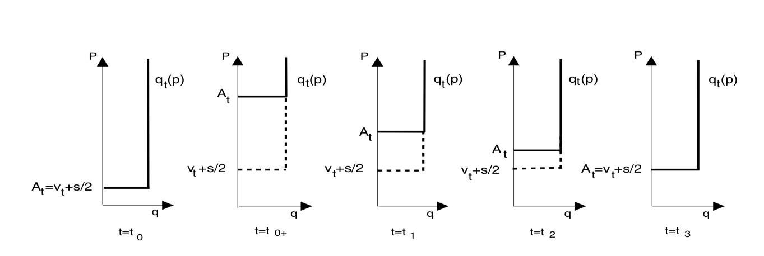
The shape of the limit order book and its dynamics
During the following periods, new orders will arrive at the ask price At, which will fill up the book and lower the ask price, until it converges to its new steady state
A₀₊ =( F₀+s/2)+ x₀/q
x₀
A₀ = F₀+s/2=V₀+s/2
A trade of size x₀ at t = 0. The trade will “eat off” all the sell orders with prices from F₀+s/2 up to A₀₊

Slide 9
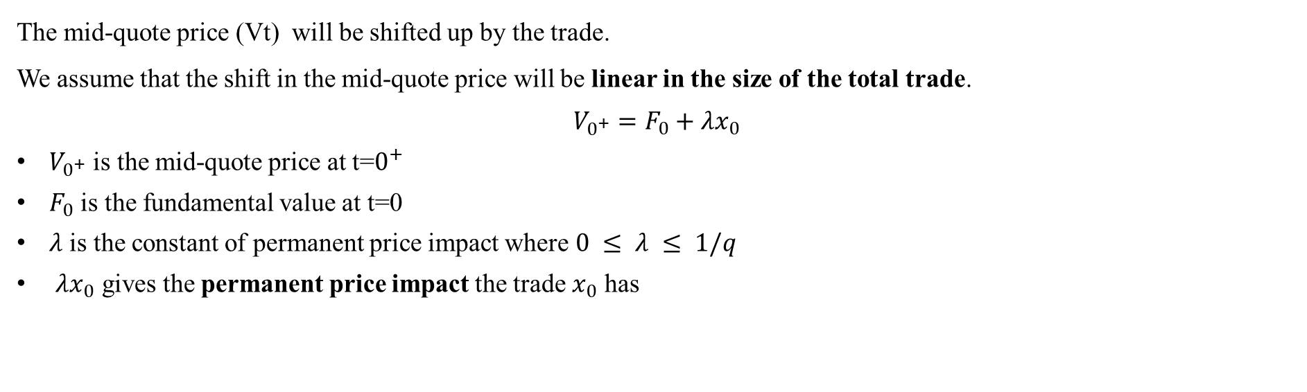
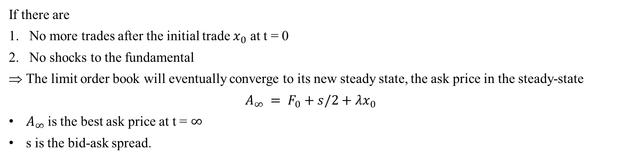
Limit Order Book Dynamics
How the LOB evolves over time after being hit by a trade
First , we need to specify the impact of the trade on the mid-quote price.
The mid-quote price (Vt) will be shifted up by the trade.
We assume that the shift in the mid-quote price will be linear in the size of the total trade.
$$V_{0^{+}}=F_{0}+λx_{0}$$
$V_{0^{+}}$ is the mid-quote price at t=$0^{+}$
$F_{0}$ is the fundamental value at t=0
$λ$ is the constant of permanent price impact where $0 ≤ λ ≤ 1/q$
$λx_{0}$ gives the permanent price impact the trade $x_{0}$ has
If there are
No more trades after the initial trade $x_{0}$ at t = 0
No shocks to the fundamental
The limit order book will eventually converge to its new steady state, the ask price in the steady-state
$$A_{∞} = F_{0}+s/2+λx_{0}$$
$A_{∞}$is the best ask price at t = $∞$
s is the bid-ask spread.
Notes:
v會隨著交易而上漲，在這邊我們先假設上漲的量與交易的量會呈現線性關係
在這邊我們另外做假設，如果只有一筆交易發生在t=0，而且基本面沒有什麼會造成劇烈波動的消息，則LOB會回歸到一個穩定的狀態，也就是一開始的A0加上這筆交易造成的永恆性影響

Slide 10
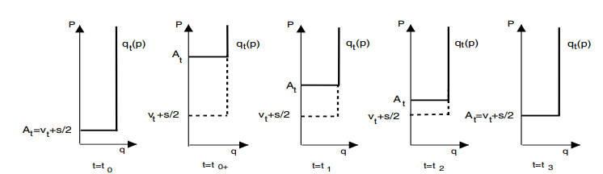

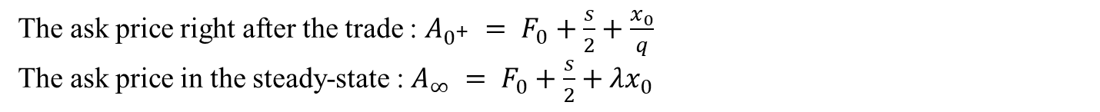
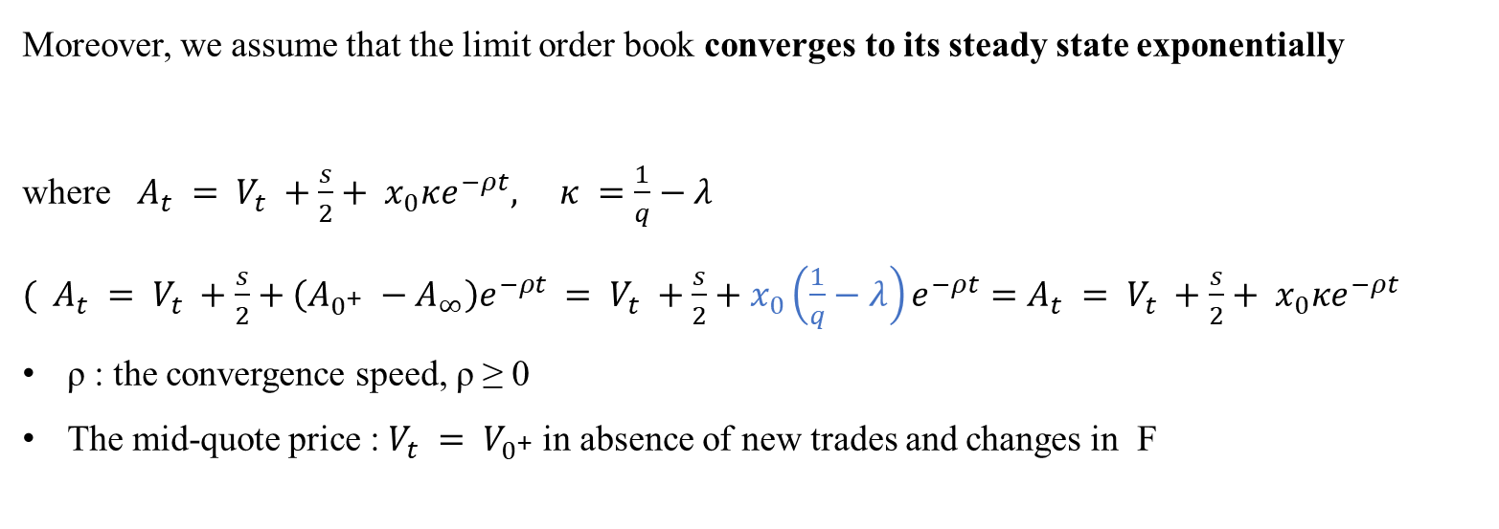
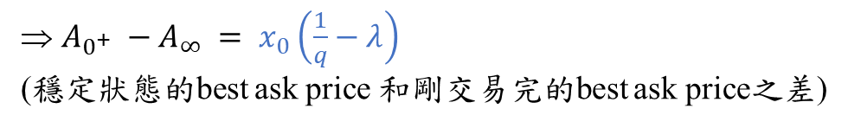
For a single trade
The ask price right after the trade : $A_{0^{+}} = F_{0}+\frac{s}{2}+\frac{x_{0}}{q}$
The ask price in the steady-state : $A_{∞} = F_{0}+\frac{s}{2}+λx_{0}$
$A_{0^{+}} −A_{∞} = x_{0}\left(\frac{1}{q}−λ\right)$
(穩定狀態的best ask price 和剛交易完的best ask price之差)
Moreover, we assume that the limit order book converges to its steady state exponentially
where $A_{t} = V_{t} +\frac{s}{2}+ x_{0}κe^{−ρt}, κ =\frac{1}{q}−λ$
$( A_{t} = V_{t} +\frac{s}{2}+\left(A_{0^{+}} −A_{∞}\right)e^{−ρt}$ $= V_{t} +\frac{s}{2}+x_{0}\left(\frac{1}{q}−λ\right)e^{−ρt}=$ $A_{t} = V_{t} +\frac{s}{2}+ x_{0}κe^{−ρt}$
ρ : the convergence speed, ρ ≥ 0
The mid-quote price : $V_{t} = V_{0^{+}}$in absence of new trades and changes in F
After trading $x_{0}$, the new sell orders will start coming in at the new ask price A_{t}
For convenience , we define $D_{t} = A_{t} −V_{t}−\frac{s}{2}$ (deviation of current ask price At from its steady state level Vt +s/2.)
Notes:
中間At那條，後面那項可以看成在t=0完成的這筆交易，在經過t單位之後，會對the best ask price造成的影響有多大，當t越大，後面那項會變成0，代表在經過x0這筆交易之後，新的賣單會慢慢地掛在price At上

Slide 11

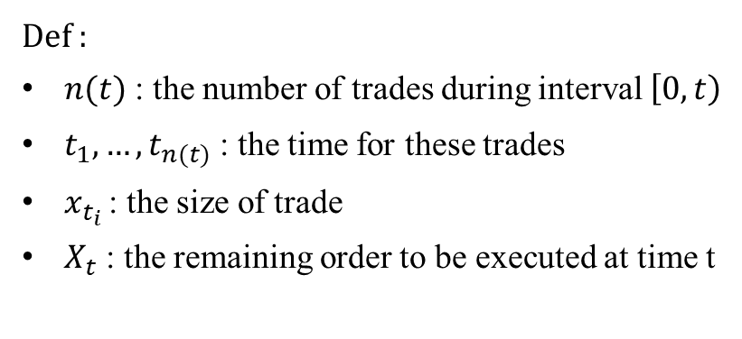

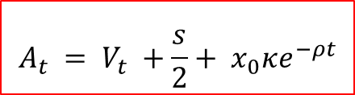
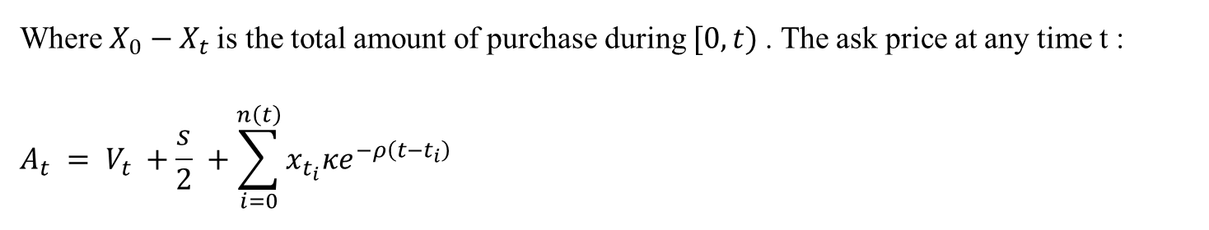
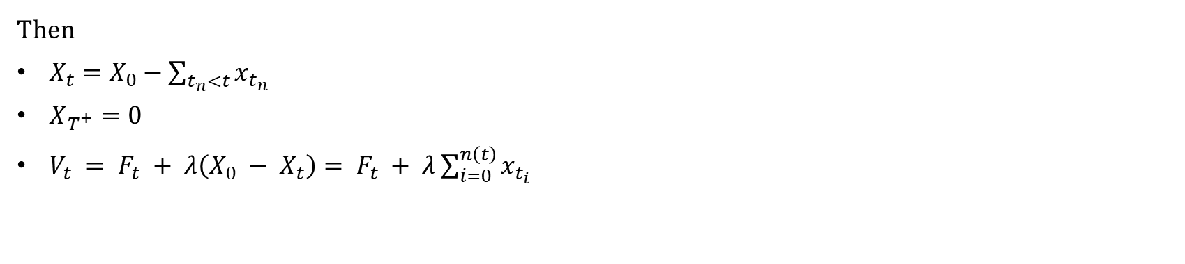
For multiple trades
Def :
$n(t)$ : the number of trades during interval $\left[0, t\right)$
${t_{1},…,t}_{n(t)}$ : the time for these trades
$x_{t_{i} }$: the size of trade
$X_{t}$ : the remaining order to be executed at time t
Then
$X_{t}=X_{0}−\sum_{t_{n}<t}{x_{t_{n}}}$
$X_{T^{+}}=0$
$V_{t} = F_{t} + λ\left(X_{0} − X_{t}\right)= F_{t} + λ\sum_{i=0}^{n\left(t\right)}{x_{t_{i}}}$
$$x_{n}=X_{n}−X_{n+1}$$
$$V_{0^{+}}=F_{0}+λx_{0}$$
Where $X_{0}−X_{t}$is the total amount of purchase during $[0, t)$. The ask price at any time t :
$$A_{t} = V_{t} +\frac{s}{2} +\sum_{i=0}^{n\left(t\right)}{x_{t_{i}}κe^{−ρ\left(t−t_{i}\right)}}$$
$$A_{t} = V_{t} +\frac{s}{2}+ x_{0}κe^{−ρt}$$

Slide 12
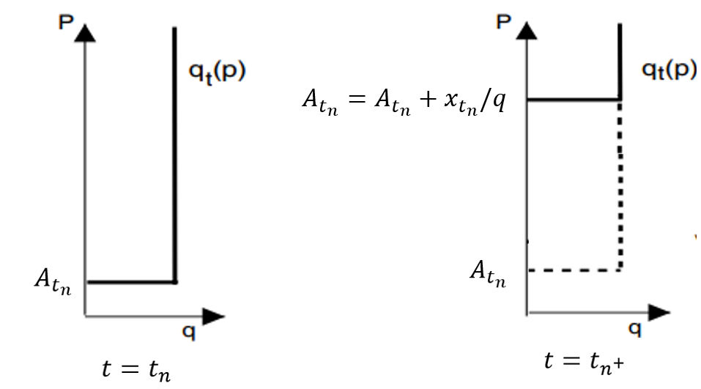
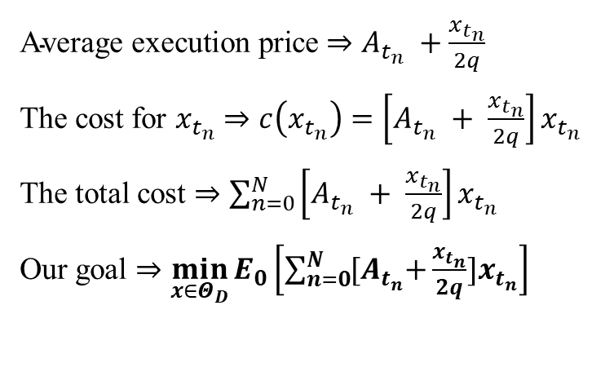

Execution Cost
$\text{Average} \text{execution} \text{price}$ $⇒A_{t_{n}} +\frac{x_{t_{n}}}{2q}$
The cost for $x_{t_{n}}$ $⇒c\left(x_{t_{n}}\right)=\left[A_{t_{n}} + \frac{x_{t_{n}}}{2q}\right]x_{t_{n}}$
The total cost $⇒\sum_{n=0}^{N}{\left[A_{t_{n}} + \frac{x_{t_{n}}}{2q}\right]x_{t_{n}}}$
Our goal $⇒\min_{x∈Θ_{D}}{E_{0}\left[\sum_{n=0}^{N}{{[A}_{t_{n}}+\frac{x_{t_{n}}}{2q}}]x_{t_{n}}\right]}$
$$A_{t_{n^{+} }}=A_{t_{n}} +\frac{x_{t_{n}}}{q}$$

Slide 13
Model 1
Discrete-Time Solution — fixed trading times
給定固定的交易次數，以時間離散式的模型討論最佳策略

Slide 14

模型介紹
$τ$ : 表示一個interval的時間長度 ($τ$ =$\frac{T}{N}$ )
trade times are fixed at t_{n} = nτ , where τ = T/N and n = 0, 1,...,N
$x_{t_{i} }$: the size of trade at t_{i}
$X_{t}$ : the remaining order to be executed at time t

Slide 15
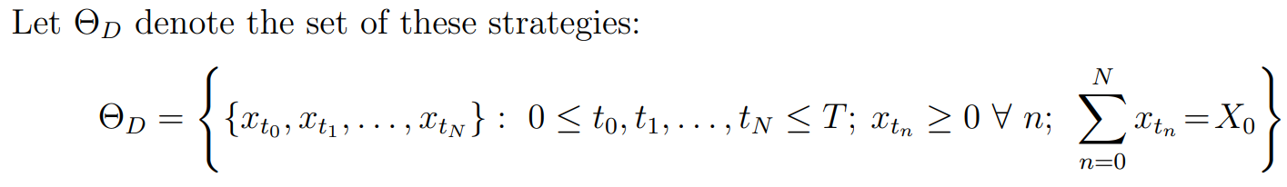
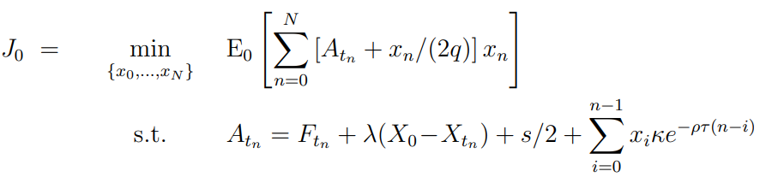
The strategy set
The optimal execution problem — minimize the expected total cost of his purchase.

Slide 16
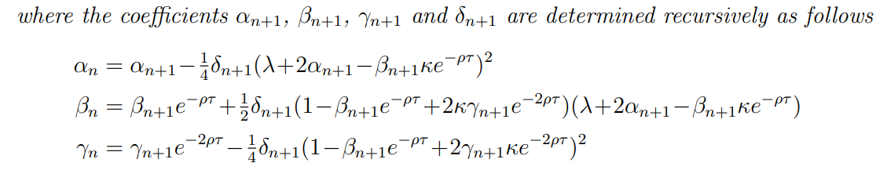
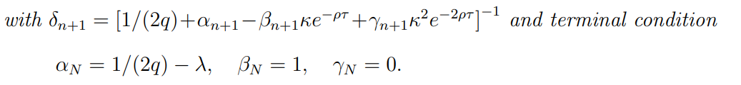

每一期的交易量($x_{n}$):
The expected cost for future trades under the optimal strategy is $J_{t_{n}}$:

Slide 17
Model 1_Implementation
T=1 , N=10, 25, 100
(觀察一天中交易次數大小對strategy的影響)

Slide 18
Model_ 實作
Japan Tobacco Inc.2914.T
T=1 (day) , 2021/08/2
N=10 , 25 , 100
Tau = T/N
X = 100,000 (交易總量)

Slide 19
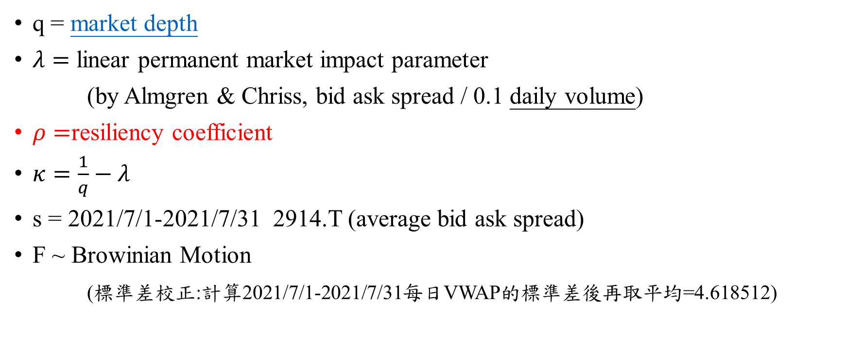
參數設定
q = market depth
$λ=$ linear permanent market impact parameter
(by Almgren & Chriss, bid ask spread / 0.1 daily volume)
$ρ=$resiliency coefficient
$κ=\frac{1}{q}−λ$
s = 2021/7/1-2021/7/31 2914.T (average bid ask spread)
F ~ Browinian Motion
(標準差校正:計算2021/7/1-2021/7/31每日VWAP的標準差後再取平均=4.618512)
Obizhaeva & Wang (2005) 給定𝜌= 2.231
Alfonsi, Fruth & Schied (2008, 2010) 給定𝜌= 20
目前還在找rho校準的方法，可能會在之後的paper提到，本篇實作先將𝜌= 2.231

Slide 20

參數設定
q = 8022
$λ=$ 1.737731597109334e-06 (bid-ask spread/0.1daily volume)
$ρ=2.231$
$κ=0.00012291946112291061$
s = 1.0680458688512746
F₀ = 2171.5 (2021/8/2 (一)的 open price)

Slide 21
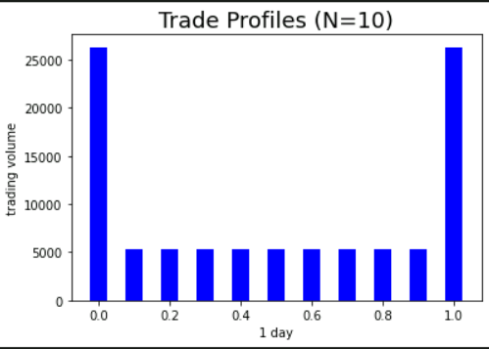
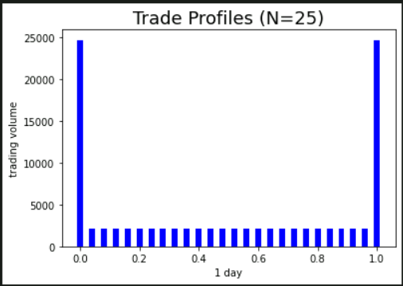
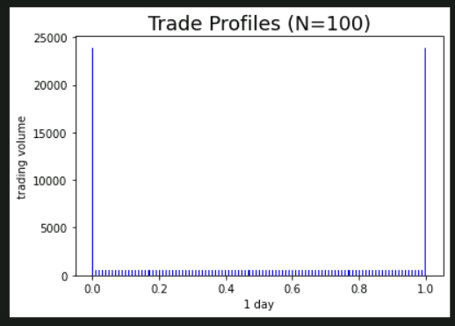
實作結果
 | N=10 | N=25 | N=100
trades at both ends of the horizon | 26318 | 24698 | 23899
Small trades in between | 5263 | 2109 | 527
J₀(The expected cost for future trades) | 2.17503246e+08 | 2.17502714e+08 | 2.17502618e+08
Realized cost on 2021/08/02 | 2.08398507e+08 | 2.12943894e+08 | 2.18494186e+08
As N becomes large, the strategy splits into two parts, large trades at both ends of the horizon (the beginning and the end) and small trades in between.

Slide 22
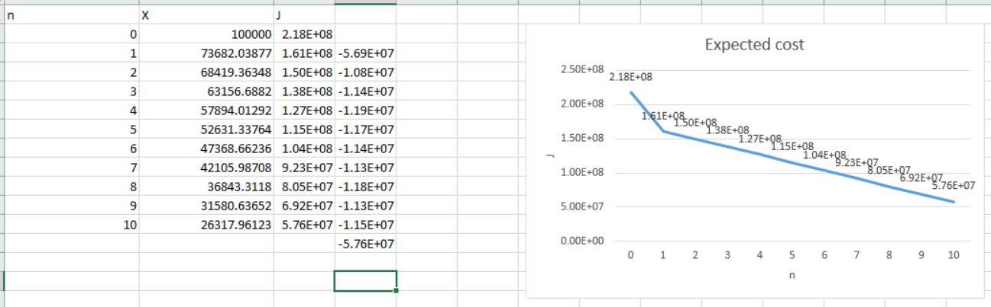
實作結果
N=10
X=100,000
J=Expected cost for future trades

Slide 23
Model 2
Continuous-Time Solution
允許連續和離散的交易，以時間連續型的模型討論最佳策略
We formulate the problem in continuous-time setting and allow both continuous and discrete trading strategies.

Slide 24


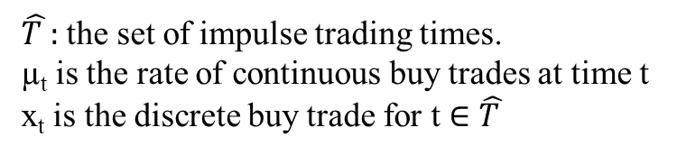
模型介紹
A general execution strategy can consist of two components, a set of discrete trades at certain times and a flow of continuous trades. A set of discrete trades is also called an “impulse” trading policy.
The strategy set
$\hat{T }:$ the set of impulse trading times.
µ_{t} is the rate of continuous buy trades at time t
x_{t} is the discrete buy trade for t ∈ $\hat{T }$
The dynamics of X_{t}, the number of shares to acquire at time t, is then given by the following equation:

Slide 25

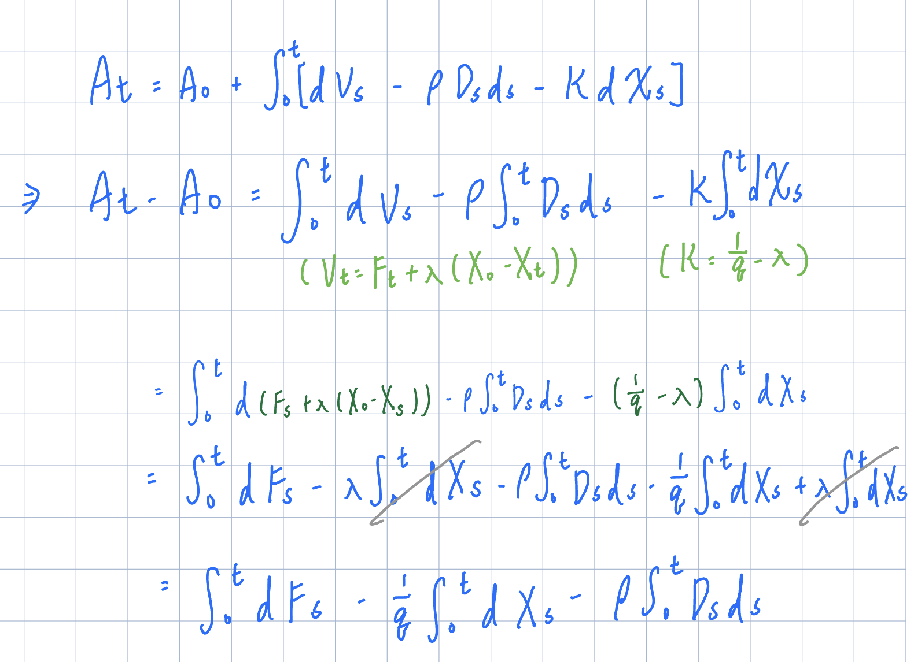

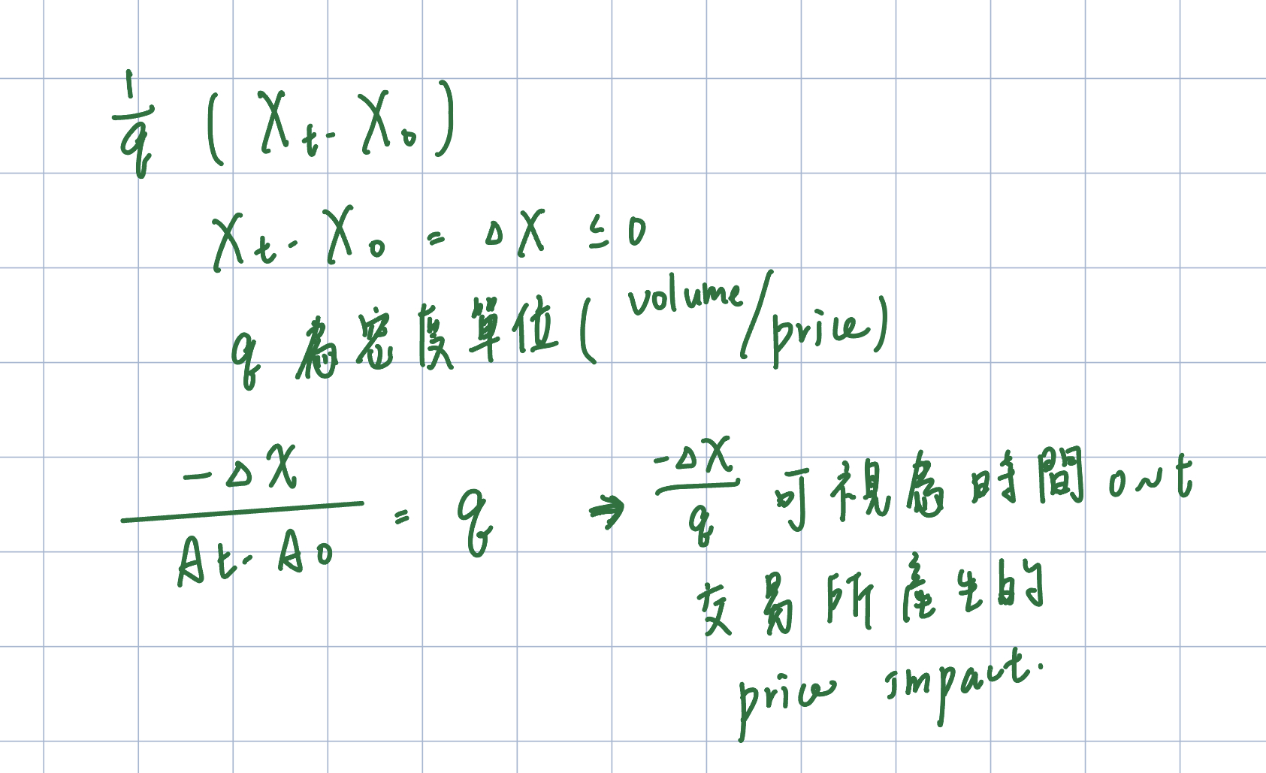


Let us specify the dynamics of ask price At. Similar to the discrete-time setting, we have A₀ = F₀+s/2
V_{t} = F_{t} + λ (X₀−X_{t})
$D_{t} = A_{t} −V_{t}−\frac{s}{2}$
The execution cost from t to T is
The optimal execution problem now becomes

Slide 26
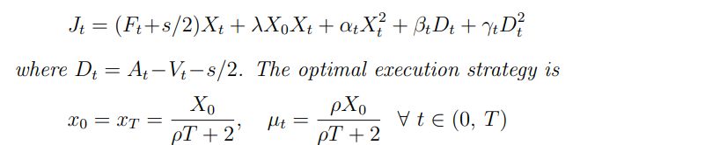
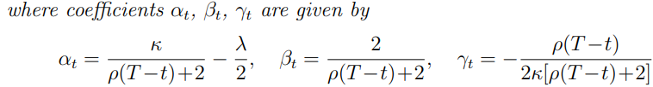
The value function for the optimization problem is

Slide 27
Properties of Optimal Execution Strategy
The optimal execution strategy depends on two parameters, the resilience of the limit order book ρ and the horizon for execution T. We consider these dependencies separately.

Slide 28
Model 2_Implementation
T=1,5,20
(拉長交易天數，固定time interval，觀察交易天數對strategy的影響)

Slide 29

Model_ 實作
Japan Tobacco Inc.2914.T
T=1 (2021/08/2) , 5 ,20
N=10000,50000,200000
Tau = T/N
X = 100,000 (交易總量)
$ρ=2.231$

Slide 30
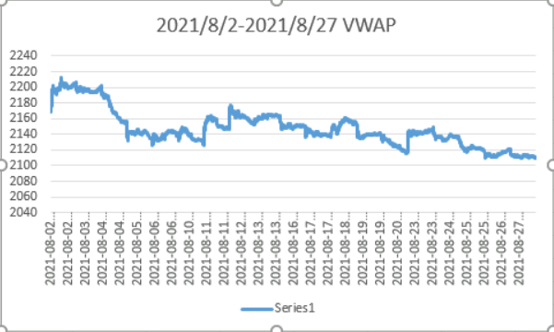
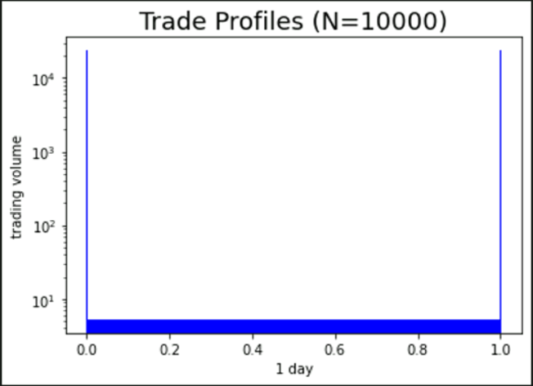
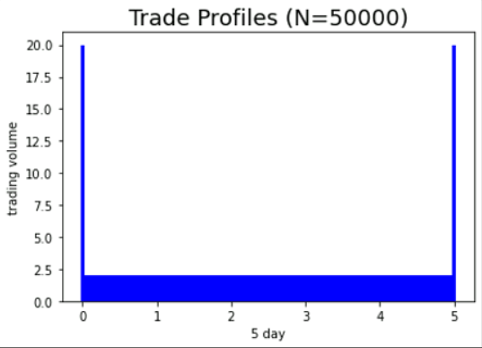
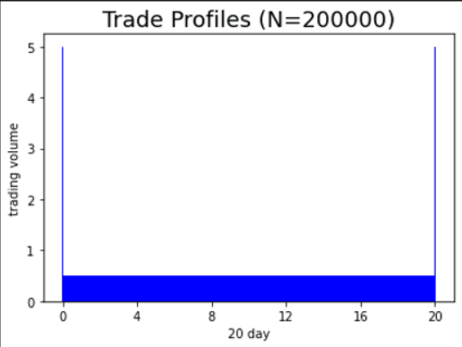
實作結果
 | T=1 | T=5 | T=20
trades at both ends of the horizon | 23635 | 20 | 5
Small trades in between | 5 | 2 | 0.5
J₀(The expected cost for future trades) | 2.17502612e+08 | 2.17212337e+08 | 2.17212152e+08
Realized cost | 2.19221811e+08 | 2.15419059e+08 | 2.14587998e+08
We see that as T increases, the size of the two discrete trades decreases.
The more time we have to execute the order, the more we can continuous trades to benefit from the inflow of new orders and to lower the total cost.

Slide 31
The resilience of the limit order book ρ
ρ is the key factor in determining optimal execution strategy
When ρ = 0, we have no recovery of the limit order book after a trade.
When ρ = ∞, the limit order book rebuilds itself immediately after a trade.
->the execution cost becomes strategy independent.
When 0 <ρ< ∞, the resiliency of the limit order book is finite, the optimal strategy is a mixture of discrete and continuous trades.
Notes:
代表彈性係數 rho 代表當供需失衡時，能後恢復均衡狀態的能力
Rho = 0,在這種情況下，執行成本將與策略無關，交易者何時以何種速度吃完限價訂單簿並不重要

Slide 32
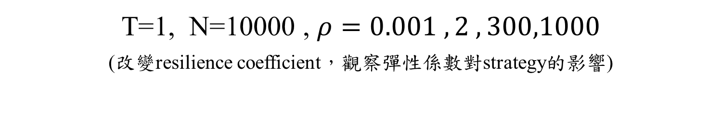
Model 2_Implementation
T=1, N=10000 , $ρ=0.001 ,2 , 300,1000$
(改變resilience coefficient，觀察彈性係數對strategy的影響)

Slide 33

Model_ 實作
Japan Tobacco Inc.2914.T
T=1
N=10000
Tau = T/N
X = 100,000 (交易總量)
$ρ=0.001,2, 300, 1000$

Slide 34
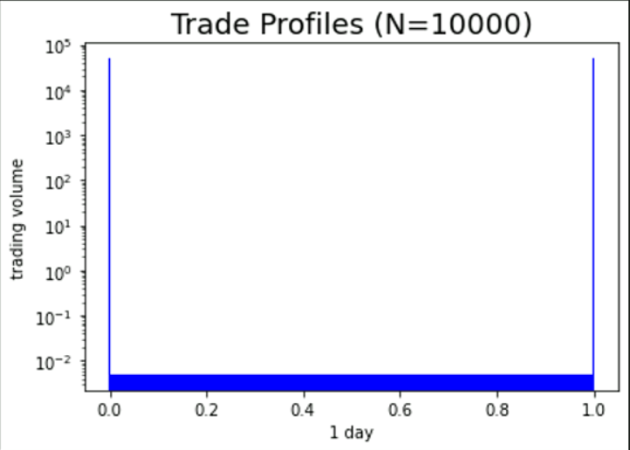
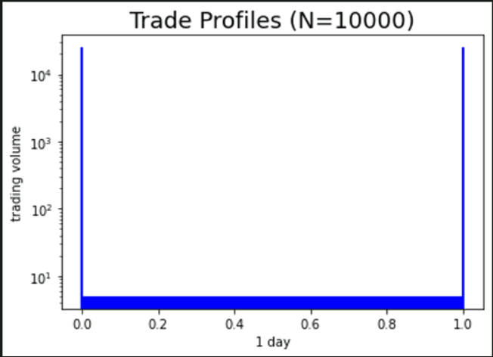
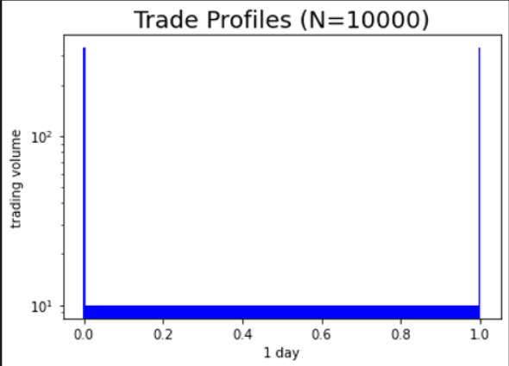
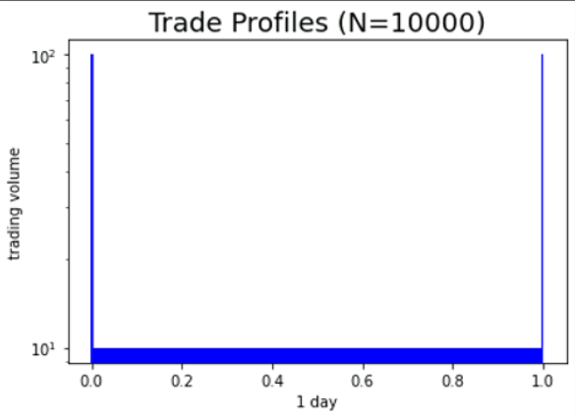


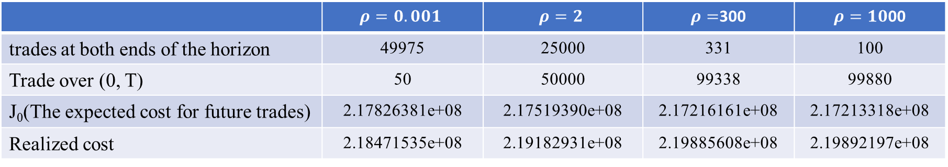


實作結果
$$ρ=0.001$$
$$ρ=2$$
$$ρ=300$$
$$ρ=1000$$
 | $$ρ=0.001$$ | $$ρ=2$$ | $ρ=$300 | $ρ=10$00
trades at both ends of the horizon | 49975 | 25000 | 331 | 100
Trade over (0, T) | 50 | 50000 | 99338 | 99880
J₀(The expected cost for future trades) | 2.17826381e+08 | 2.17519390e+08 | 2.17216161e+08 | 2.17213318e+08
Realized cost | 2.18471535e+08 | 2.19182931e+08 | 2.19885608e+08 | 2.19892197e+08
For small values of ρ, most of the order is executed through two discrete trades.
For large values of ρ, most of the order is executed through a flow of continuous trades.
It is more efficient to use small trades when the limit order book is more resilient.
This is intuitive because discrete trades do less in taking full advantage of new order flows than continuous trades.

Slide 35
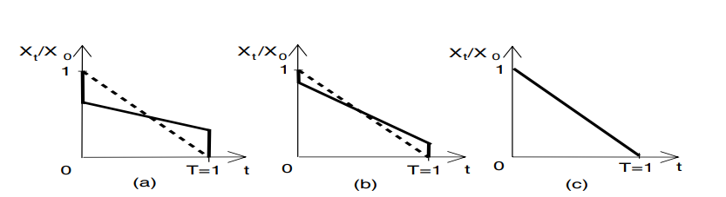



Optimal execution strategy versus simple execution strategy from the conventional models.
$$ρ=0.001$$
$$ρ=2$$
$$ρ=1000$$
The figure plots the time paths of remaining order to be executed for the optimal strategy (solid line) and the simple strategy obtained from the conventional models (dashed line), respectively.
q = 5, 000 units
λ = 1/(2q) = 10⁻⁴
T = 1 day
Panels (a), (b) and (c) plot the strategies for ρ = 0.001, 2 and 1,000, respectively

Slide 36
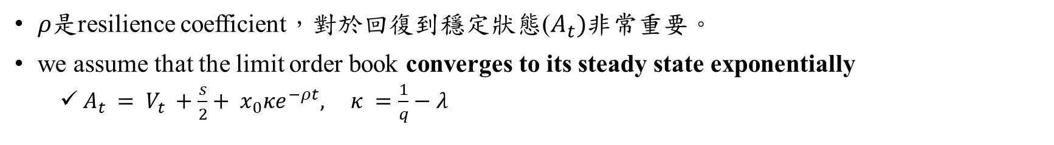
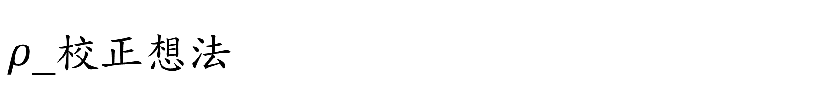
$ρ$_校正想法
$ρ$是resilience coefficient，對於回復到穩定狀態($A_{t})$非常重要。
we assume that the limit order book converges to its steady state exponentially
$A_{t} = V_{t} +\frac{s}{2}+ x_{0}κe^{−ρt}, κ =\frac{1}{q}−λ$

Slide 37
Extensions
Some simple characteristics of the model does not reflect the richness in the LOB dynamics we actually face in the market:
Time Varying LOB Resiliency
we can allow the resilience coefficient to be time dependent, ρ = ρ_{t} for t ∈ [0, T].
Different Shapes for LOB
We have considered a simple shape for the LOB. However, empirical literature has suggested that the shape of the LOB can be more complex (e.g., Hopman (2003)). We can allow more general shapes of the LOB in our framework.
Risk Aversion
We have to consider the optimal execution problem for a risk-averse trader.

Slide 38


Risk Aversion
X₀=100,000
q = 5, 000 units
λ = 0
T = 1 day
ρ = 1
coefficients of risk aversion a = 0 (risk neutral trader)
,0.05 ,0.5 ,1 ,respectively.
Profiles of the optimal execution strategies for different coefficients of risk aversion.
The more risk averse is the trader, the larger the initial trade more trades he shifts to the beginning.

Slide 39


q _校正
L. Boyde, Suechin Yang, T. Campbell (2018)

