Slide 1
Price Manipulation And Quasi-Arbitrage
By GUR HUBERMAN AND WERNER STANZL
郭盈均

Slide 2
Introduction
In any market, trades can affect prices.
Many traders want to generate infinite expected profits through price manipulation and quasi-arbitrage.
However , the absence of quasi-arbitrage is tantamount to market viability.

Slide 3
Problem Statement
If we want to rule out quasi-arbitrage and manipulation to support viable market prices,
What are the possible relations between price changes and trades that rule out quasi-arbitrage?
What are conditions that are implied by the absence of quasi-arbitrage or the absence of price manipulation?

Slide 4
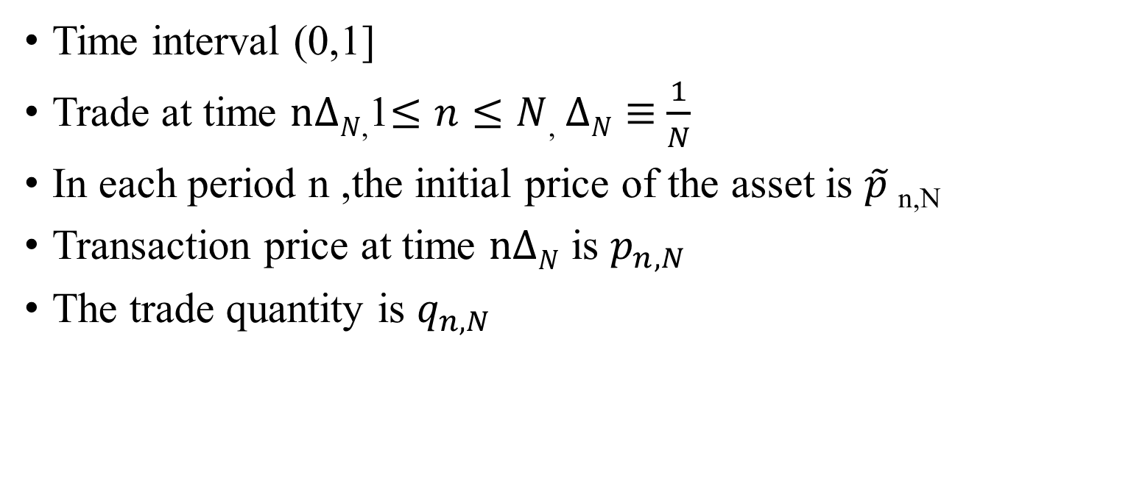
Trading Environment
Time interval (0,1]
Trade at time $n∆N$,1$≤n≤N$, $∆N≡$ $\frac{1}{N}$
In each period n ,the initial price of the asset is $\tilde{p}$_{n,N}
Transaction price at time $n∆N$ is $p_{n,N}$
The trade quantity is $q_{n,N}$

Slide 5

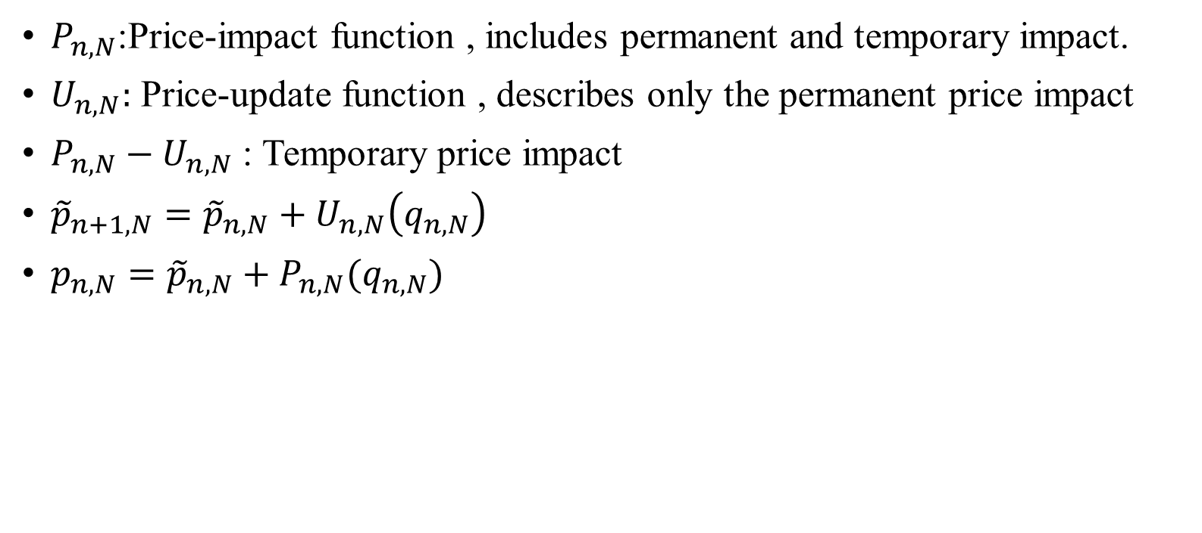
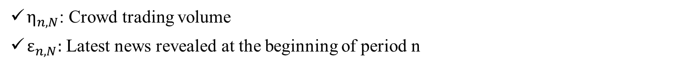
How trades affect price changes
$P_{n,N}$:Price-impact function , includes permanent and temporary impact.
$U_{n,N}:$ Price-update function , describes only the permanent price impact
${P_{n,N}−U}_{n,N}$ : Temporary price impact
${\tilde{p}}_{n+1,N}={\tilde{p}}_{n,N}+U_{n,N}\left(q_{n,N}\right)$
$p_{n,N}={\tilde{p}}_{n,N}+P_{n,N}(q_{n,N})$
$η_{n,N}$: Crowd trading volume
$ε_{n,N}:$ Latest news revealed at the beginning of period n

Slide 6
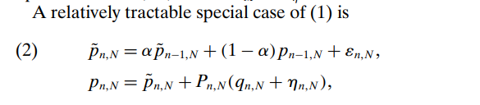
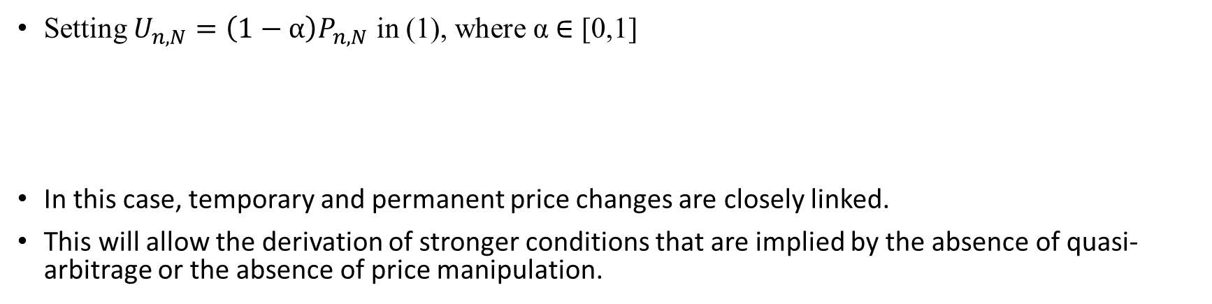
Setting $U_{n,N}=\left(1−α\right)P_{n,N}$ in (1), where α ∈ [0,1]
In this case, temporary and permanent price changes are closely linked.
This will allow the derivation of stronger conditions that are implied by the absence of quasi-arbitrage or the absence of price manipulation.

Slide 7

When α = 0, i.e., ${P_{n,N}=U}_{n,N}$
(2) Simplifies to
price change is a function of the current trades and randomness only
each trade has only a permanent impact on the security price

Slide 8
準套利與純套利之差異
 | 準套利 | 純套利
是否有現貨部位 | 有 | 無(原始投資額為0) 需同時買賣現貨及期貨
交易成本 | 低手續費 低模擬誤差成本 | 成本較高

Slide 9
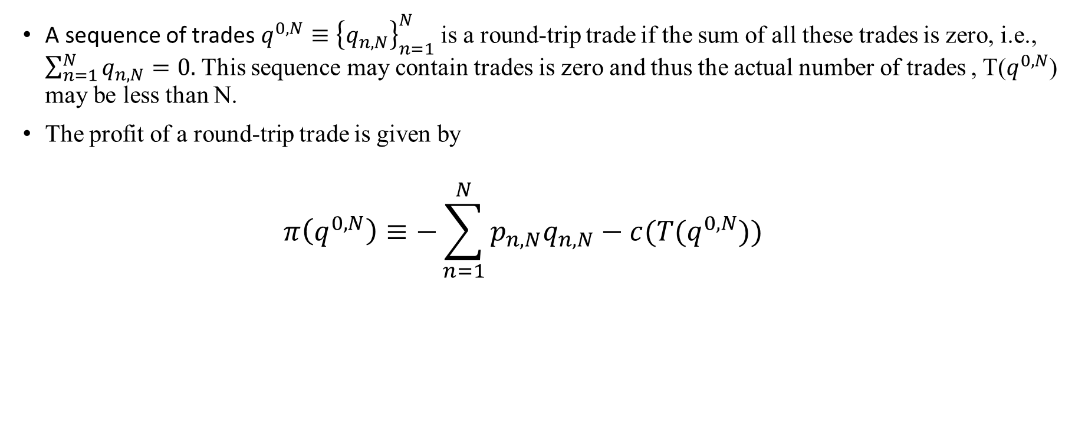
Definition of Price Manipulation and Quasi-Arbitrage
A sequence of trades $q^{0,N}≡{\left\{q_{n,N}\right\}}_{n=1}^{N}$ is a round-trip trade if the sum of all these trades is zero, i.e., $\sum_{n=1}^{N}{q_{n,N}=0. }$This sequence may contain trades is zero and thus the actual number of trades , T($q^{0,N}$) may be less than N.
The profit of a round-trip trade is given by
$$π\left(q^{0,N}\right)≡−\sum_{n=1}^{N}{p_{n,N}q_{n,N}}−c(T(q^{0,N}))$$

Slide 10
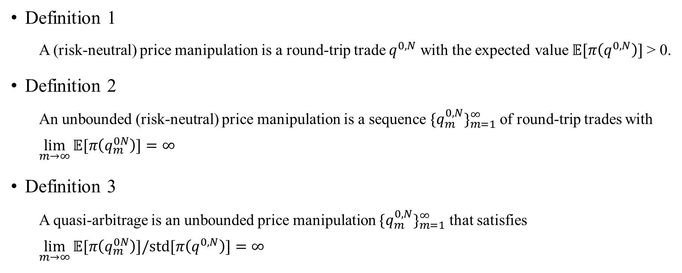
Definition 1
A (risk-neutral) price manipulation is a round-trip trade $q^{0,N}$ with the expected value$𝔼[π\left(q^{0,N}\right)]$ > 0.
Definition 2
An unbounded (risk-neutral) price manipulation is a sequence ${{\{q}_{m}^{0,N}\}}_{m=1}^{∞}$of round-trip trades with
$$\lim_{m→∞}{𝔼[π\left(q_{m}^{0N}\right)}]=∞$$
Definition 3
A quasi-arbitrage is an unbounded price manipulation ${{\{q}_{m}^{0,N}\}}_{m=1}^{∞}$ that satisfies
$$\lim_{m→∞}{𝔼[π\left(q_{m}^{0N}\right)}]/std[π\left(q^{0,N}\right)]=∞$$

Slide 11
Market Viability
Definition 4
A market is weakly viable if the optimal demand for the trader exists, and strongly viable if the trader’s optimal demand exists uniquely and is zero.
Limited price manipulation is feasible in weakly viable ones.
Weak viability rules out quasi-arbitrage. This follows immediately from the definition of quasi-arbitrage. We will identify conditions under which the absence of quasi-arbitrage implies either strong or weak viability.

Slide 12
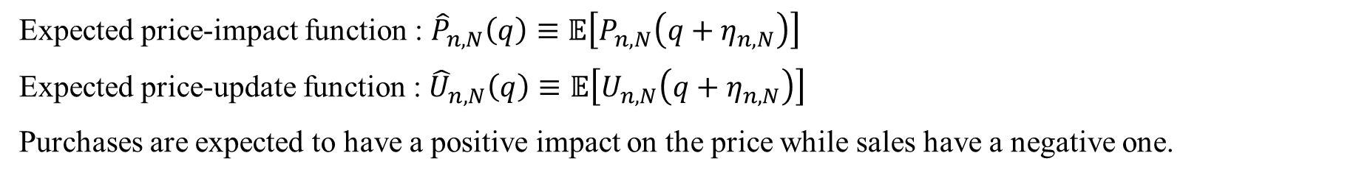
Market classification
Expected price-impact function : ${\hat{P}}_{n,N}\left(q\right)≡𝔼\left[P_{n,N}\left(q+η_{n,N}\right)\right]$
Expected price-update function : ${\hat{U}}_{n,N}\left(q\right)≡𝔼\left[U_{n,N}\left(q+η_{n,N}\right)\right]$
Purchases are expected to have a positive impact on the price while sales have a negative one.

Slide 13
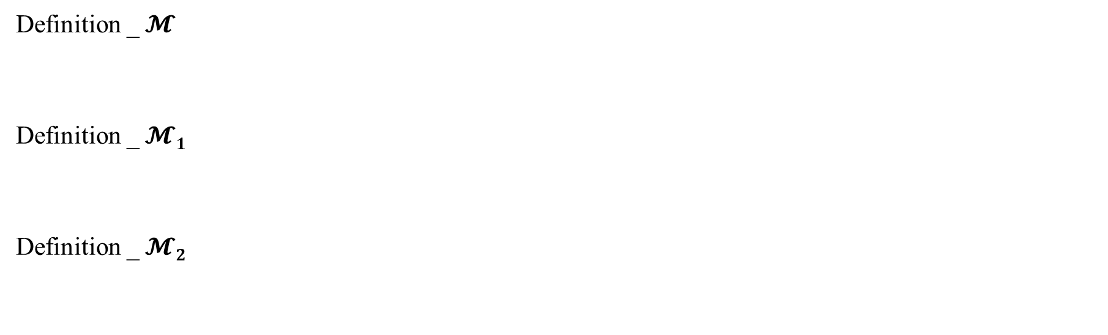

Market classification _ three markets
給定交易時間_
$∆N≡$ $\frac{1}{N}$
Definition _ $𝓜$
Definition _ $𝓜1$
Definition _ $𝓜2$
The market $𝓜$provides a minimal environment to study price manipulation.
放寬交易時間_在Time interval 隨時想做交易，交易筆數不限制
In market $𝓜1$we will examine unbounded price manipulation.
放寬交易時間_在Time interval 隨時想做交易，交易筆數不限制，Sharpe Ratio趨近無窮
In market $𝓜2$we will determine under which conditions quasi-arbitrage is absent.

Slide 14
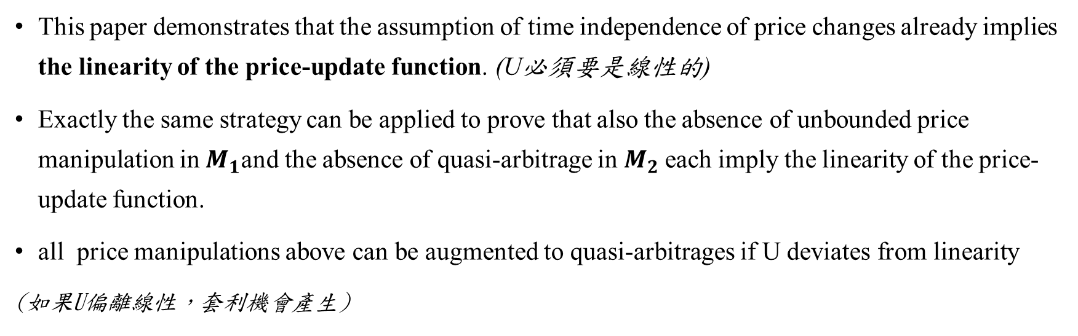
TIME-INDEPENDENT PRICE IMPACT
This paper demonstrates that the assumption of time independence of price changes already implies the linearity of the price-update function. (U必須要是線性的)
Exactly the same strategy can be applied to prove that also the absence of unbounded price manipulation in $Μ_{1}$and the absence of quasi-arbitrage in $Μ_{2}$each imply the linearity of the price-update function.
all price manipulations above can be augmented to quasi-arbitrages if U deviates from linearity
(如果U偏離線性，套利機會產生)

Slide 15

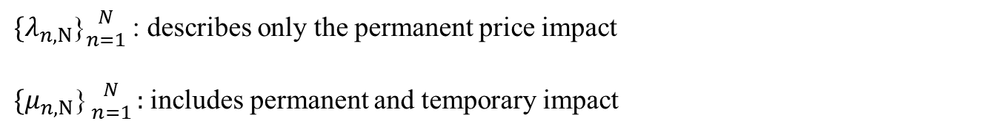
TIME-DEPENDENT PRICE IMPACT
$\{λ_{n,N}$}${N \atop n=1}$: describes only the permanent price impact
${\{μ}_{n,N}\text{\}}{N \atop n=1}:$ includes permanent and temporary impact

Slide 16
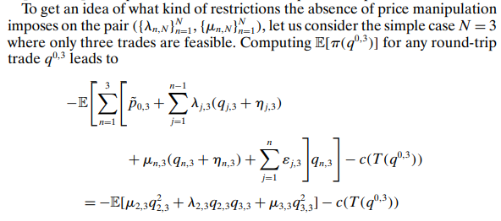
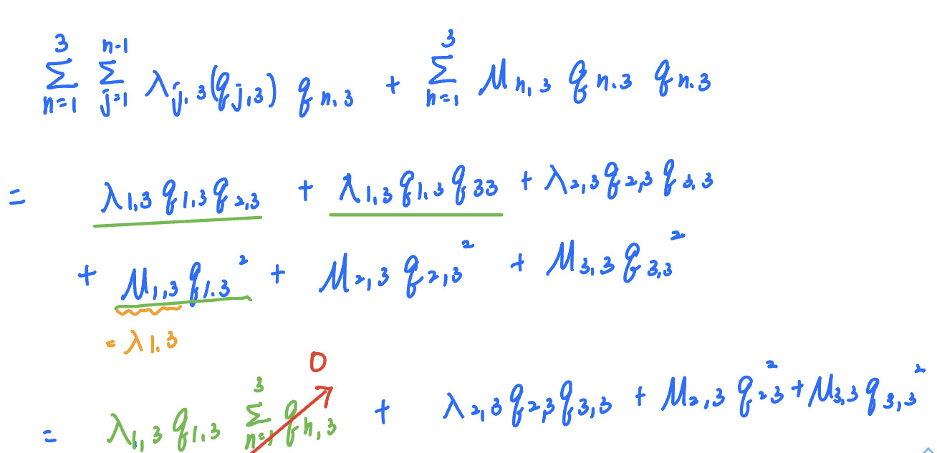
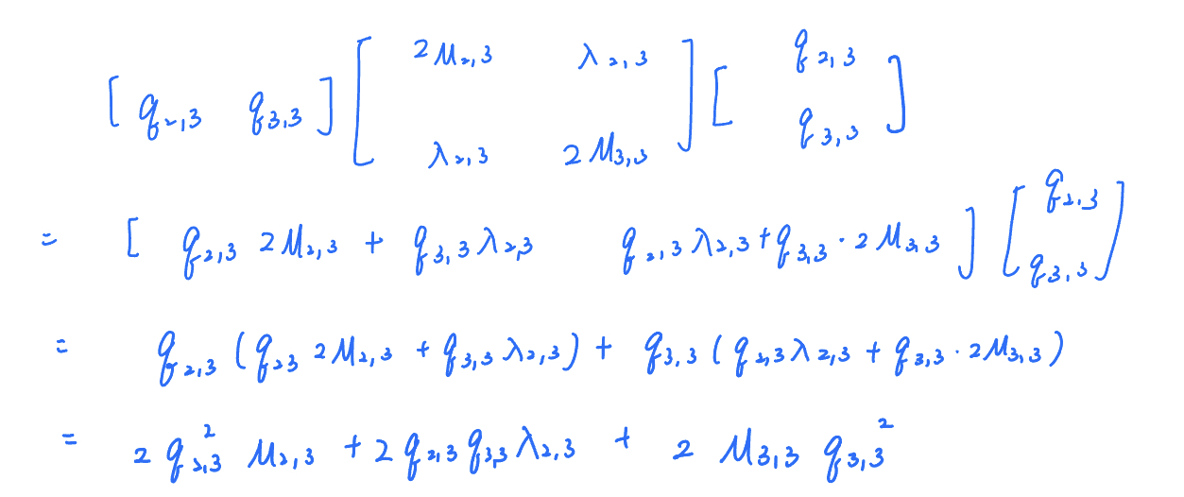


Slide 17

$Ε[π(q^{0, N})]$> 0 and there is price manipulation
當 expected profit >0， 會有價格操弄的機會
要如何確定沒有套利空間?
->
->
->
<= 0
>=0
x=[q_{2,3} q_{3,3}]為任意不為0的vector, 故要滿足(x^{T})Ax>=0, A為半正定
定義：對於任一 ，

