Slide 1
VWAP Trading Strategies
郭盈均

Slide 2
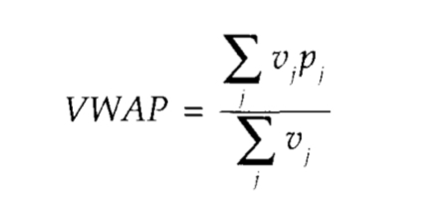
Intoduction
An implementation strategy where traders participate with market volume in the attempt to achieve an average execution price equal to the VWAP benchmark price.
Traders execute lists via a VWAP strategy to minimize market impact.
It’s a calculated value.

Slide 3
Achieving VWAP Price
Execute the order in proportion to the percentage of market volume that executes in specified trading periods.
Known as slicing strategy

Slide 4
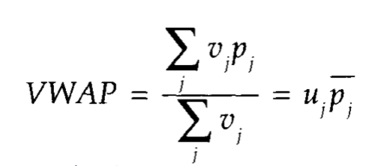
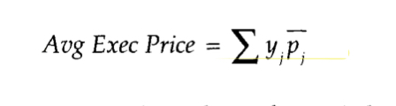
Derivation of VWAP Strategy
U_{j} is the percentage of day’s volume traded in the j^{th} period
P_{j} is the average price in the j^{th} period
If y is the specified slicing strategy, the average execution price of the order can be written as:

Slide 5
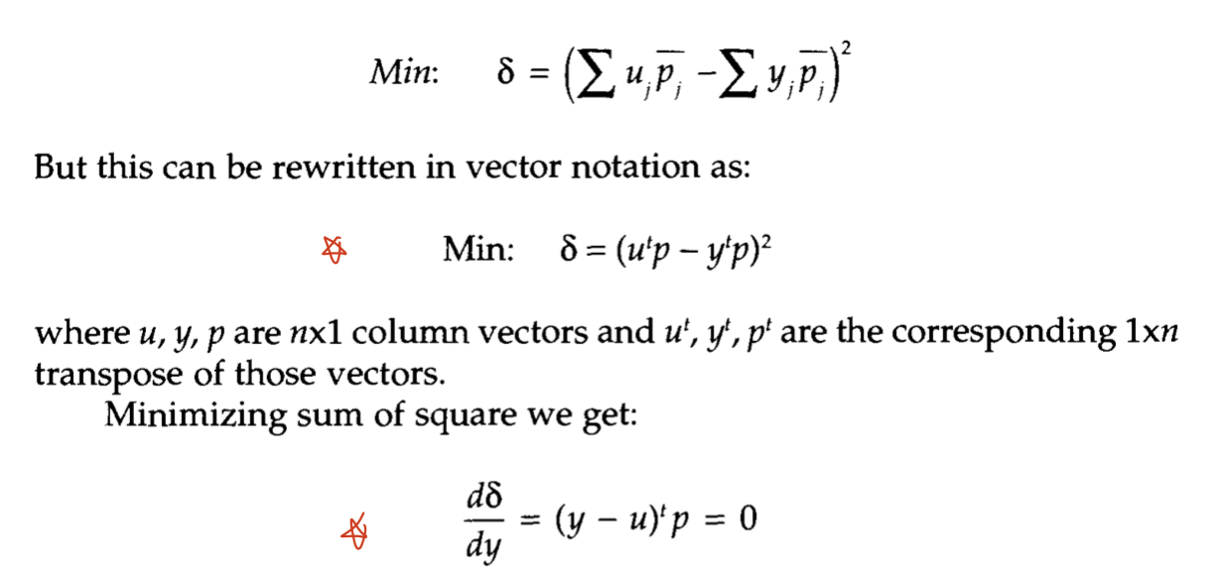
Determining the strategy that minimizes the mean square error of the difference between the two measures,that is,
The slicing strategy y=u is the strategy that minimizes variance between expected price and VWAP.
For traders to achieve VWAP, an appropriate slicing strategy is one where the order is sliced in accordance to the percentage of volume traded in the period.

Slide 6
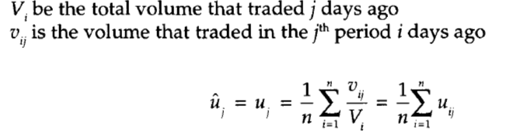
Estimating Volume Profiles
How to determine u_{j} :
historical moving average
The exact number of days is dependent upon the stability of volume profiles
U_{j} = the percentage of daily volume that typically trades in the jth period

Slide 7
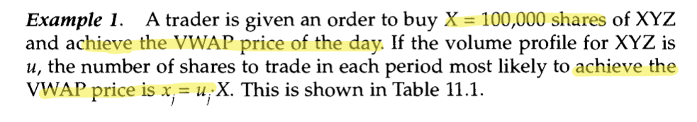
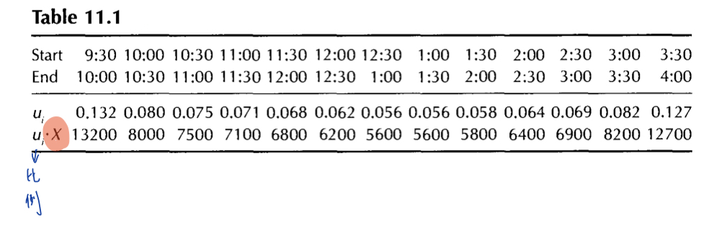

Slide 8
Why do traders select VWAP trading strategies?
Two Reasons:
Minimize market impact cost
For many traders their execution performance is measured against the VWAP benchmark.
However,
It may cause the fund to incur higher than necessary trading cost.

Slide 9
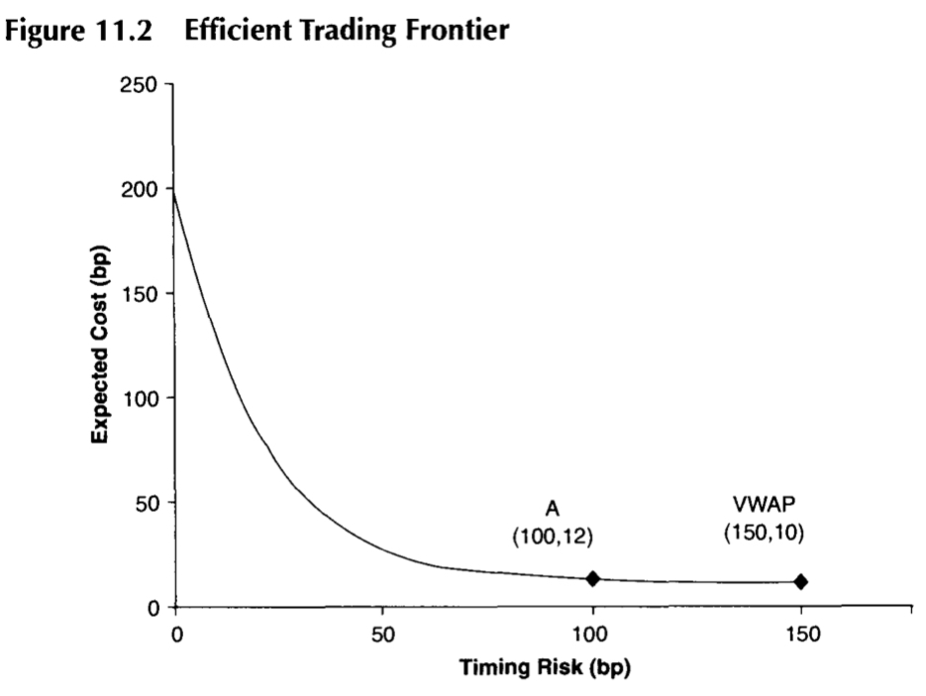
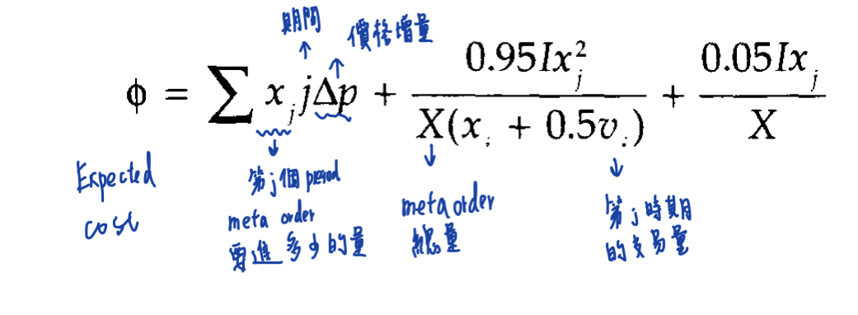
Strategy A as a VWAP-hedge strategy

Slide 10
VWAP-hedge strategy
A trading strategy that executes the order following the volume profile of the stock but does not necessarily execute the order over the entire day.
Smaller orders are executed over a smaller time
Does a better job at protecting the fund from incurring a high trading cost.

Slide 11
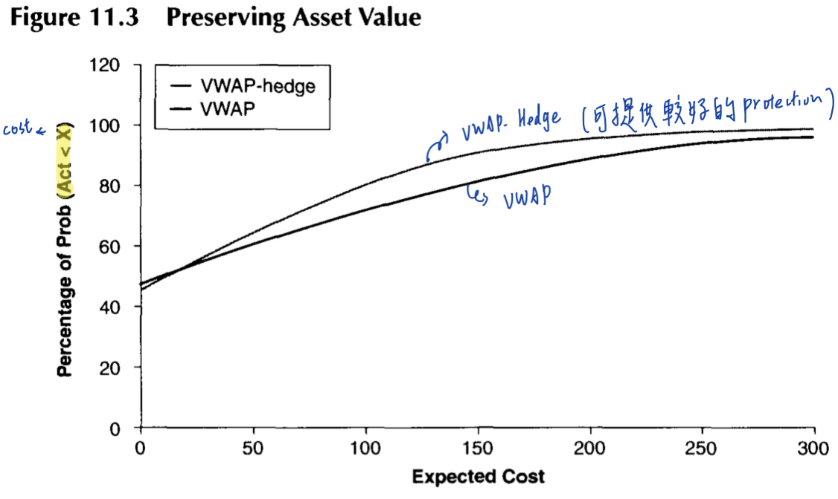

Slide 12
VWAP Strategy : The Good Side
Disguise the order size and their trading intentions by always being surrounded by other buyers and sellers.

